Slide 1

The Global Economy
Business Cycle Theory

Slide 2
Roadmap
News
Aggregate demand and supply: theory
Quantity theory
Hyperinflations

Slide 3
Mishkin: Inflation Targeting (FT 10-24-10)
Inflation objective guards against:
  Falling inflation expectations amid excess capacity
  Rising inflation expectations amid monetary expansion
Stable inflation expectations give Fed flexibility
How to Proceed:
  FOMC announces numerical target, subject to modification only for “sound economic reasons, such as improvements in the measurement of inflation or changes in the structure of the economy.”

Slide 4
Romer: Nominal GDP Targeting
NYTimes 10-29-11
Set NGDP goal (2% inflation + 2½% growth = 4½%)
Extend NGDP trend from 2007: 10% shortfall
Pursue expansionary target (“whatever it takes”) using various unconventional policies
Transmission mechanism: raise inflation expectations and lower ex ante real interest rate
Romer’s evidence: Exiting the Gold Standard

Slide 5
Next week
Put together money and business cycles
Monetary policy
  Quantity theory + AD/AS
  Interest rates and Taylor rules
  Unconventional monetary policy

Slide 6
Aggregate supply and demand
Adapt supply and demand to whole economy
Axes
  P is price level (could substitute π = inflation)
  Y is real GDP
Curves
  Supply focuses on production of goods
  Demand focuses on purchase of goods
Why do they look like this?

Slide 7
Aggregate supply and demand
P
AS
AD
Y

Slide 8
Aggregate supply I
Classical version [“long run”]
Production function
  Y = A K^{α} L^{1-α}
At any point in time
  A is given [but may change over time]
  K is given [but may change over time]
  L reflects “equilibrium” in labor market
  Y must therefore be “given” [and AS vertical]

Slide 9
Aggregate supply I
P
LRAS
Y*
Y

Slide 10
Aggregate supply II
Short run: sticky prices or wages
Production function
  Y = A K^{α} L^{1-α}
At any point in time
  A, K given
  Simple version: nominal wage “sticky”
  Increase in P reduces real wage, so firms hire more people
  More L implies more Y ⇨ AS curve slopes upward
  Alternative versions (other prices sticky)
Wage eventually adjusts, bringing us back to AS*

Slide 11
Aggregate supply II
P
LRAS
AS
Y*
Y

Slide 12
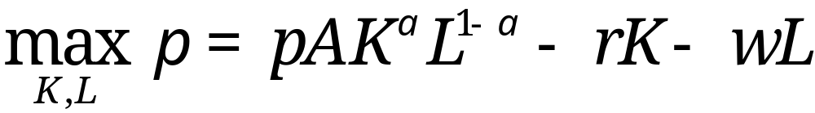
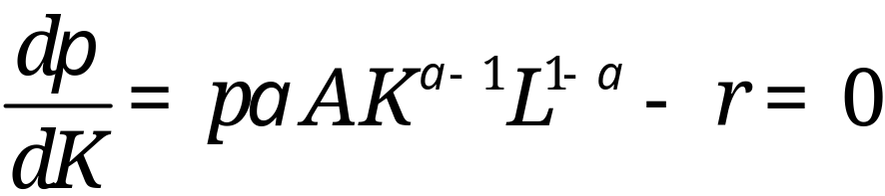
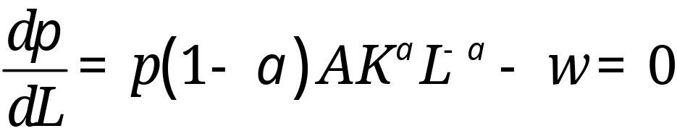
First Order Conditions Determine…
Profit maximization
First order conditions (marg. rev = marg. Cost)

Slide 13
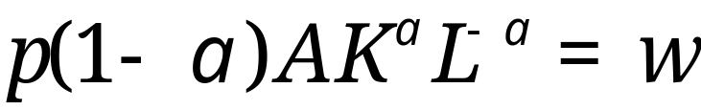
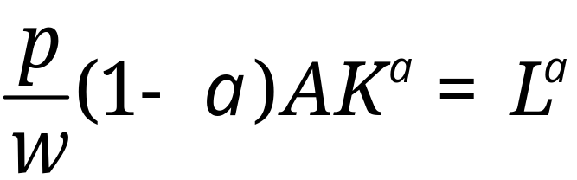
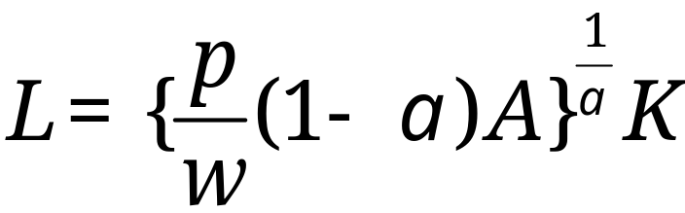
…the demand for inputs
To find labor demand, use the labor F.O.C
Solve for L to obtain labor demand:

Slide 14
Aggregate supply
What happens to aggregate supply if we
  Change A or K?
  Change price of oil?
Note: typically both AS and AS* shift

Slide 15

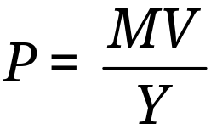
Aggregate demand
Basic version
  Quantity theory: inverse relation between P and Y
  Given M and V, an increase in Y results in lower P
  Note that V need not be fixed (when we study monetary policy next week, V rises with the interest rate, which serves as the policy instrument)

Slide 16
Aggregate demand
P
AD
Y

Slide 17
Aggregate demand
What happens to aggregate demand if we
  Change M?
  Change G?
  Change consumption or investment demand (“optimism”?)

Slide 18
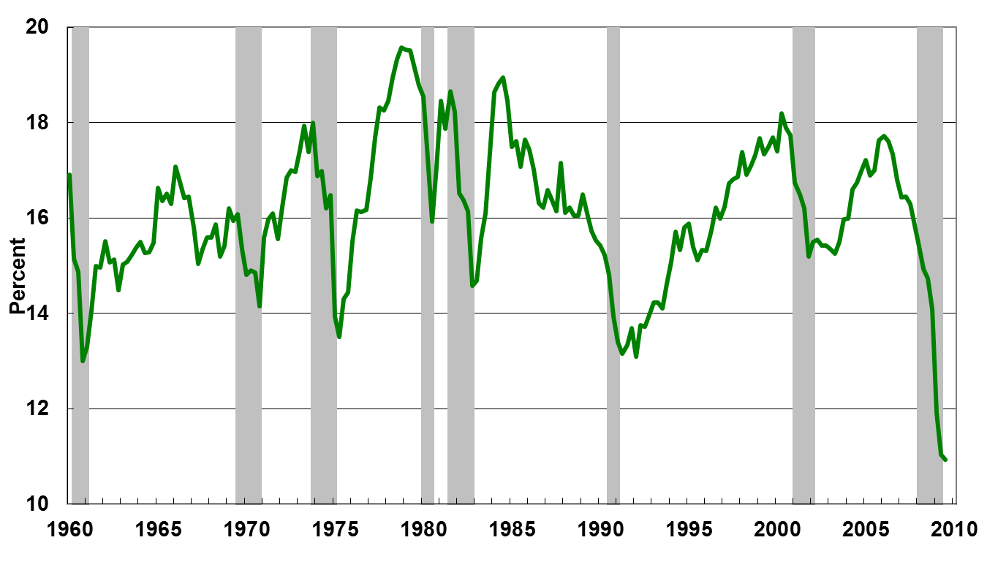
Investment and Business Cycles
Source: Cecchetti and Schoenholtz, 2010.

Slide 19
Equilibrium
P
LRAS
AS
AD
Y*
Y

Slide 20
Equilibrium ?
P
AS*
AS
A
B
AD
Y*
Y

Slide 21
Equilibrium
Start at A [“short-run equilibrium”]
  Where AS and AD cross
Move toward B [“long-run equilibrium”]
  Why? Because wages adjust, shifting AS down
  This goes on until AS crosses AS* at B
What is happening to output? Prices?

Slide 22
Overview
AS/AD is a tool for classic analysis
Goal: keep things simple
Sort issues into AS and AD bins

Slide 23
Fiscal Stimulus
Example: increase G
Does this shift AS or AD?
Does it raise or lower Y? P?

Slide 24
Fiscal stimulus
P
AS*
AS
AD
Y*
Y

Slide 25
Fiscal stimulus
Example: increase G
Does this raise or lower Y? P?
Impact of increase in “demand”
  AD shifts right/up
  Short-run impact: prices up, output up
  Long-run impact?

Slide 26
Increased productivity
Example: IT revolution
Does this shift AS or AD?
Does it raise or lower Y? P?

Slide 27
Increased productivity
P
AS*
AS
AD
Y*
Y

Slide 28
Increased productivity
Example: IT revolution
Does this raise or lower Y? P?
Impact of increase in “supply”
  AS and AS* shifts right/down
  Short-run impact: prices down, output up
  Long-run impact: ditto

Slide 29
More money
Example: central bank increases M
  Same as lowering interest rates
Does this shift AS or AD?
Does it raise or lower Y? P?

Slide 30
More money
P
AS*
AS
AD
Y*
Y

Slide 31
More money
Example: central bank increases M
Does this raise or lower Y? P?
Impact of increase in “demand”
  AD shifts right/up
  Short-run impact: prices up, output up
  Long-run impact? Prices up, output unchanged. [this should remind you of quantity theory]
This is where/how monetary policy works – more next week

Slide 32
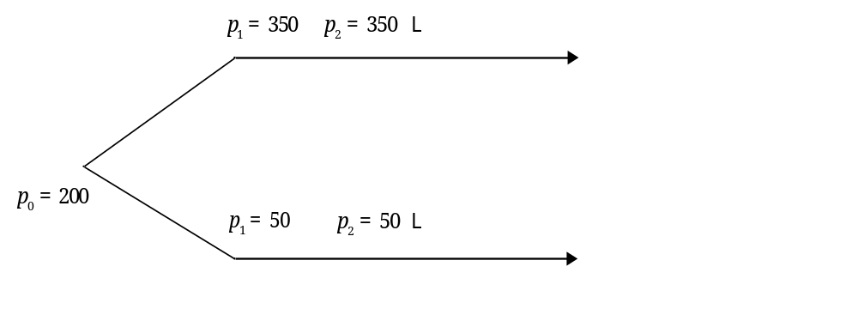
Investment under Uncertainty
Multi-period model
First period: Choice of investing or waiting
Diagram shows returns in good/bad scenarios
Let probability of good scenario (q_{H}) be 0.5,
so the probability of the bad scenario (q_{L}=1-q_{H}) is 0.5.

Slide 33
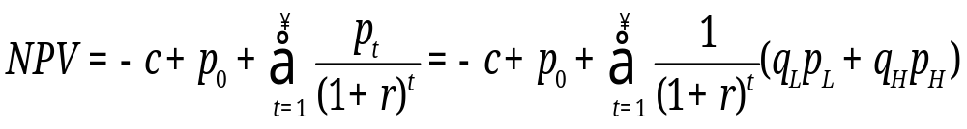
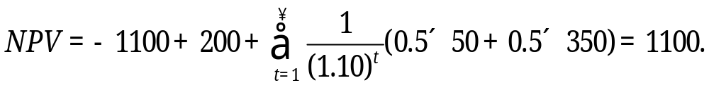
Valuing the Investment Today
Where : c = investment cost = 1100
p_{i} = return in period i
p_{L} = bad scenario return = 50
p_{H} = good scenario return = 350
r = discount rate = 0.1 (10%)

Slide 34
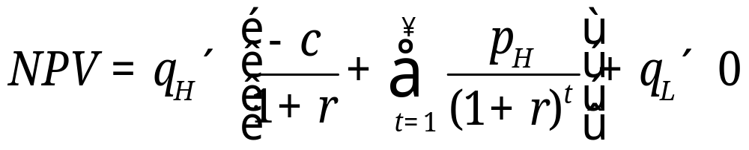
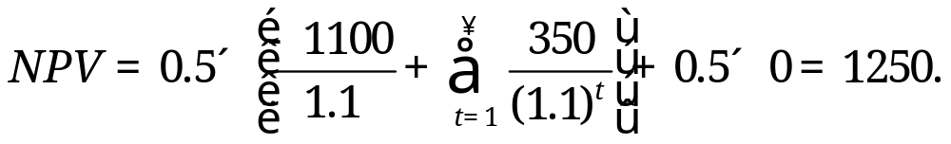
Value of Waiting
So:
So the value of waiting is 1250 – 1100 = 150.

Slide 35
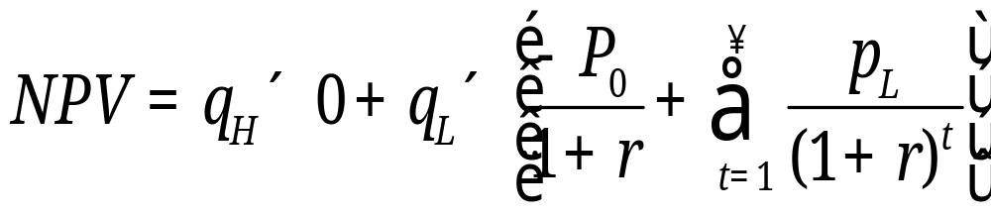
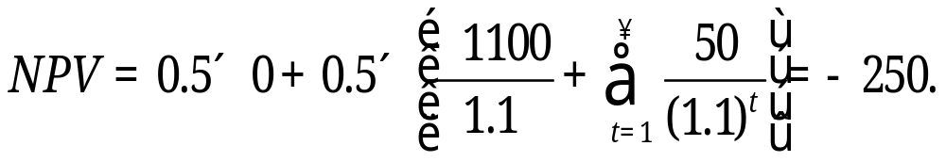
Waiting avoids the bad scenario!

Slide 36
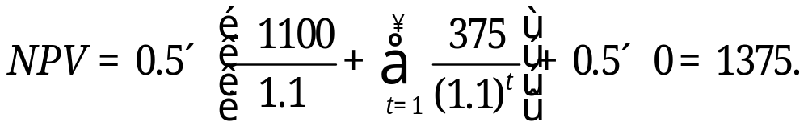
Suppose uncertainty rises…
Where : c = investment cost = 1100
p_{i} = return in period i
p_{L} = bad scenario return = 25
p_{H} = good scenario return = 375
r = discount rate = 0.1 (10%)
Note that the NPV rises to 1375 from 1250.
It pays more to wait!

Slide 37
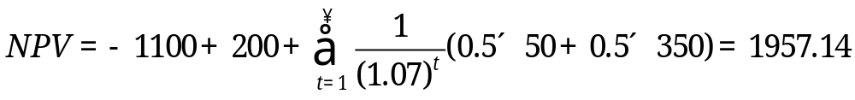
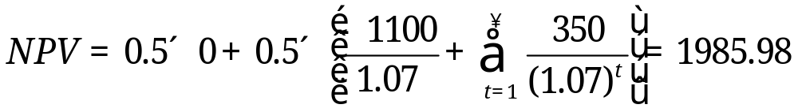
Suppose the discount rate falls…
Where : c = investment cost = 1100
p_{i} = return in period i
p_{L} = bad scenario return = 50
p_{H} = good scenario return = 350
r = discount rate = 0.07 (7%)
The value of waiting falls from 150 to 28.84
because the opportunity cost of investing falls.

Slide 38
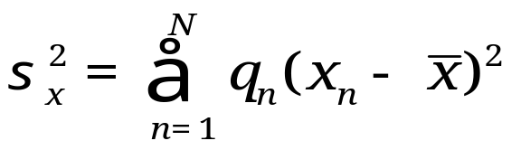
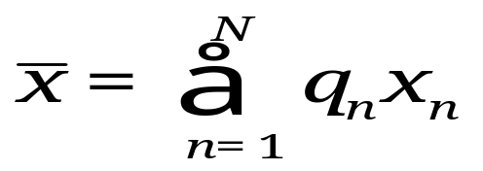
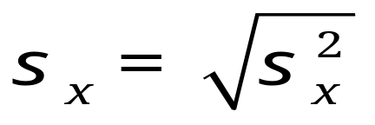
Measures of Dispersion:
Variance and Standard Deviation
Variance
Mean
Standard Deviation
A “mean-preserving increase of dispersion” raises the standard
deviation but leaves the mean unaltered. This can be viewed
as an increase of uncertainty.

Slide 39
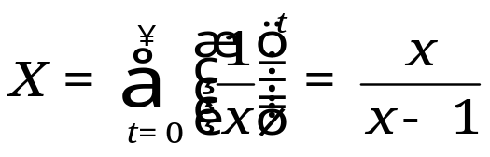
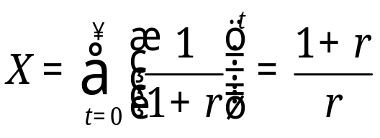
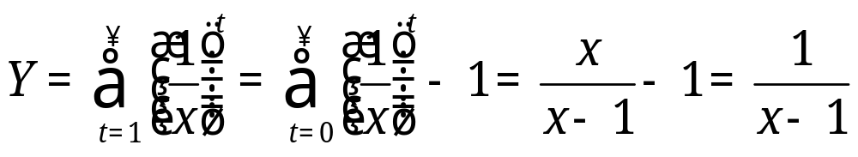
Summing Geometric Series
For x > 1
For discounting,
let x = 1+r, so…
Dropping
the first
term…

Slide 40
What causes recessions?
Supply vs Demand
Recession | Change of Inflation
1957 | 3.6 to 3.5 ⬇
1960 | 1.7 to 1.4 ⬇
1969 | 5.7 to 5.4 ⬇
1973 | 7.9 to 10.0 ⬆
1980 | 13.0 to 12.4 ⬇
1981 | 10.3 to 4.4 ⬇
1990 | 4.7 to 4.7 =
2001 | 2.9 to 1.8 ⬇
2007 | 4.2 to -1.2 ⬇
Note: Recessions are dated according to the prior cyclical peak.
Source: Cecchetti and Schoenholtz, 2010.

Slide 41
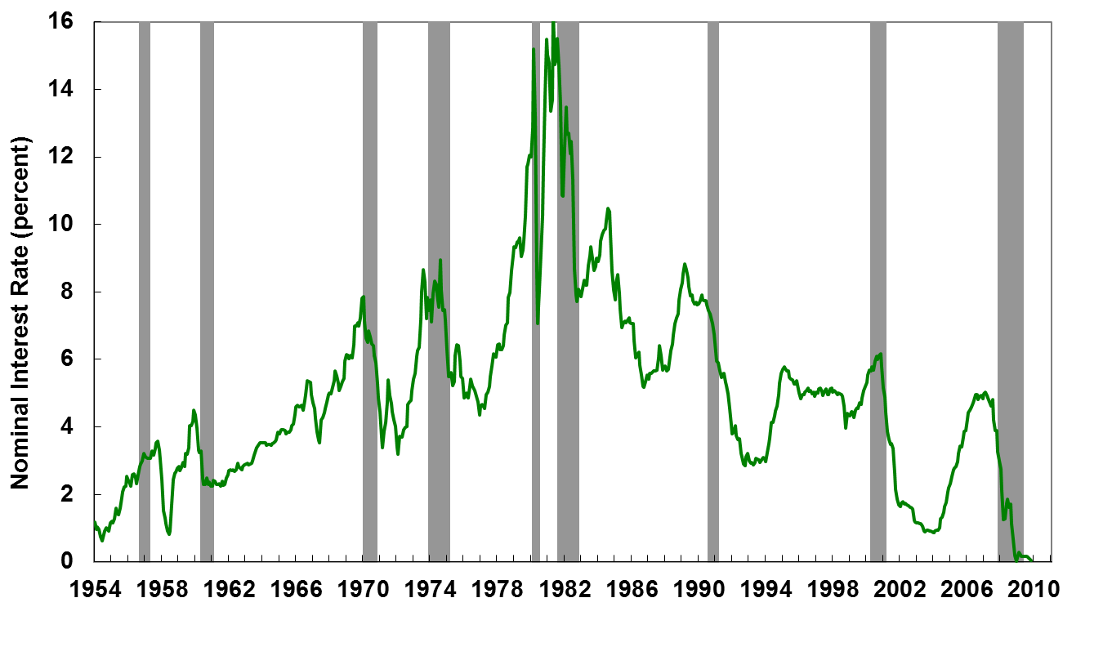
Interest Rates and Business Cycles
Note: The solid line is the three-month Treasury bill rate. Shaded areas denote NBER recessions.
Source: Cecchetti and Schoenholtz, 2010.

Slide 42
Inflation and growth
Would you expect to see high growth associated with high inflation? Why or why not?

Slide 43
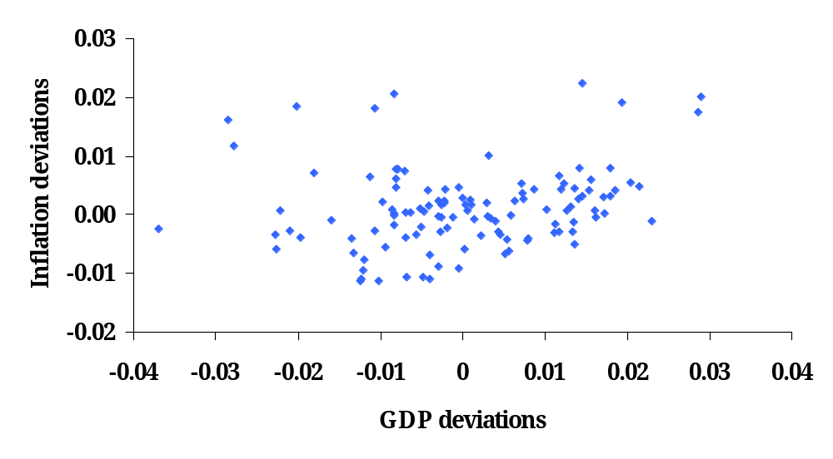
Inflation

Slide 44
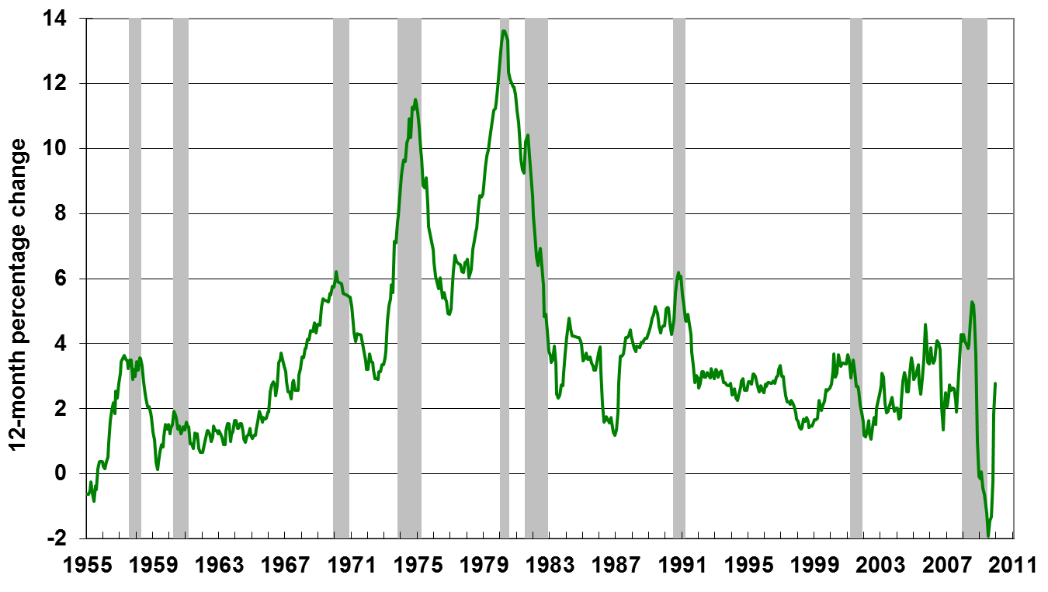
Inflation and Business Cycles
Note: Inflation measured as annual percent change of CPI. Shaded areas denote NBER recessions.
Source: Cecchetti and Schoenholtz, 2010.

Slide 45
AS/AD summary
Aggregate supply (producers/sellers) and demand (buyers) is the analytic standard
In practice, the challenge is to know whether conditions reflect supply or demand

Slide 46
The Global Economy
Quantity Theory of Money

Slide 47
Quantity theory
One equation (technology for transactions)
M V = P Y
  M = stock of money in circulation (currency)
  V = velocity (how often a unit of currency is used in a year)
In growth rates
γ_{M} + γ_{V} = γ_{P} + γ_{Y}
  γ_{M} = growth of money supply (think: currency in circulation)
  γ_{V} = growth of velocity
  γ_{P} = growth of price level (inflation rate)
  γ_{Y} = growth of real GDP

Slide 48

Quantity theory
Two assumptions
  V is constant
  Y not affected by changes in M
One conclusion:
  money growth causes inflation

Slide 49
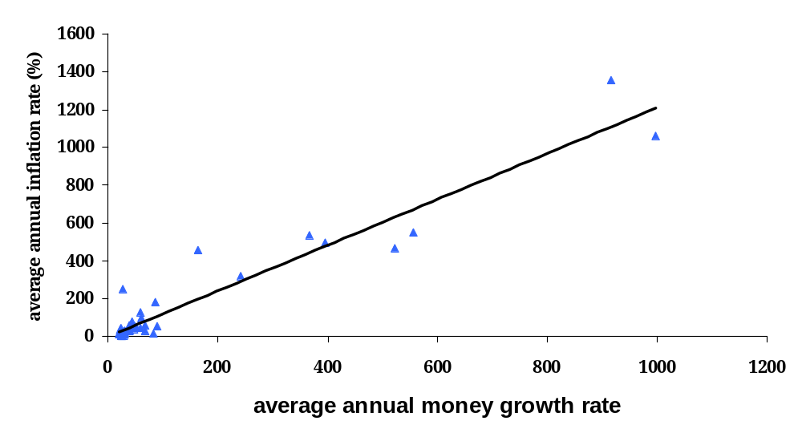
Rapid money growth
Nicaragua
Congo
Angola
Argentina
Brazil

Slide 50
Money supply mechanics
The treasury issues debt: bills, bonds, etc
Central bank manages the money supply
Balance sheets for
  Treasury
  Central bank
  Private agents: households and firms

Slide 51
Open market operations
Treasury
Assets |  | Liabilities
 |  | Bills | 200
Where does treasury debt come from?
How does the central bank increase money supply?
Central bank
Assets |  | Liabilities
Bills | 20 | Money | 20
Households and firms
Assets |  | Liabilities
Money | 20
Bonds | 180

Slide 52
Putting quantity theory to work
Hyperinflations

Slide 53
Selected Hyperinflations
Nation | Period | Cumulative Inflation Rate
USA | 1777-1780 | 2702
Germany | 1919-1923 | 0.5 x 10¹²
Greece | 1941-1944 | 1.6 x 10¹¹
Hungary | 1945-1946 | 1.3 x 10²⁴
Nicaragua | 1986-1991 | 1.2 x 10¹⁰
Yugoslavia | 1993-1994 | 1.6 x 10⁹
Zimbabwe | 2001-2008 | 8.53 x 10²³
Source: Cowen and Tabarrok, 2010.

Slide 54
German Hyperinflation
Germany paid for WWI by issuing debt and printing money. Rationing concealed the underlying inflation until after the war.
Postwar political instability
Versailles reparations impose a new burden of government spending (greater than 5% of GDP) with limited tax opportunities. Allies seek payment in kind (coal).
1923 occupation of Ruhr leads to “passive resistance” and government transfer payments

Slide 55
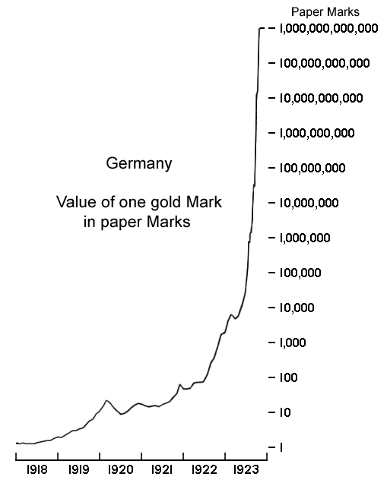
The Acceleration Phase

Slide 56
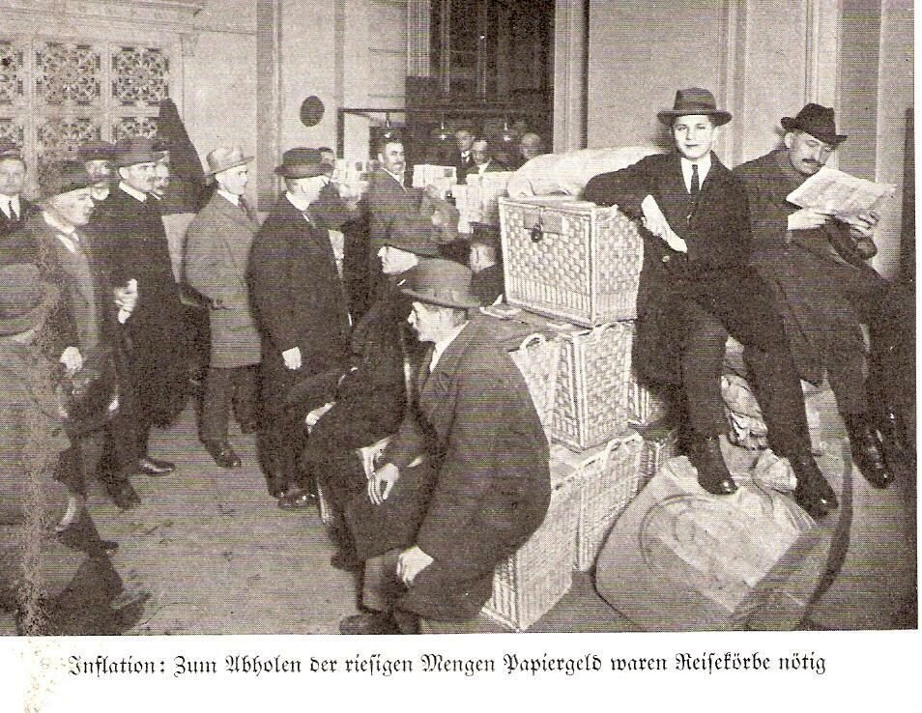
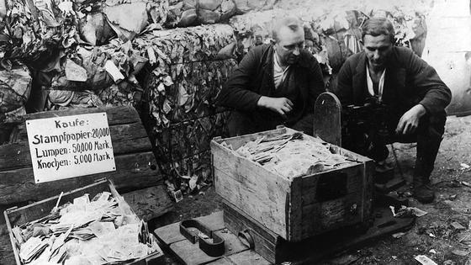
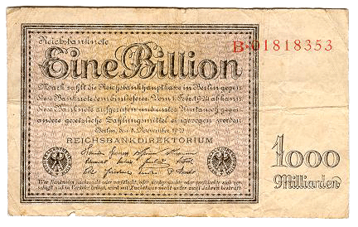
Life in a Hyperinflation

Slide 57
Why Hyperinflation in Zimbabwe?
“Governments and counterfeiters alone can pay their bills by printing money. […] Mugabe pushed the printing presses to breakneck speed. Whenever a bill came due or soldiers needed paying it was not problem – just print more money. In May 2006, for example, the government announced plans to print 60 trillion Zimbabwean dollars to finance a 300% pay increase for soldiers. Ironically, the payment was delayed because Zimbabwe didn’t have enough U.S. dollars to buy ink and paper.”
Cowen and Tabarrok, 2010.

Slide 58
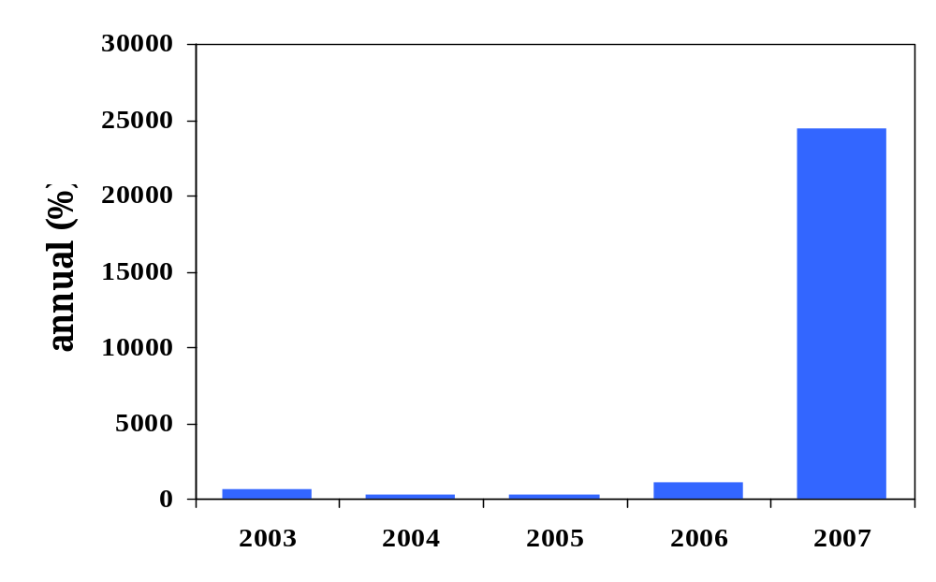
Inflation in Zimbabwe
Holding $100 for 1 month = $63!
Source: IFS.

Slide 59
Zimbabwe
Dec 06: inflation over 1000 percent
Feb 07: inflation ruled “illegal”
Oct 08: inflation over 200 million percent (!)
Jan 09: transactions allowed in foreign currencies
  Soldiers and teachers to be paid in USD
Feb 09: 12 zeros knocked off currency
April 09: currency is suspended all trades made in foreign currency

Slide 60
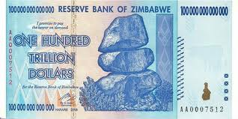
Endgame

Slide 61
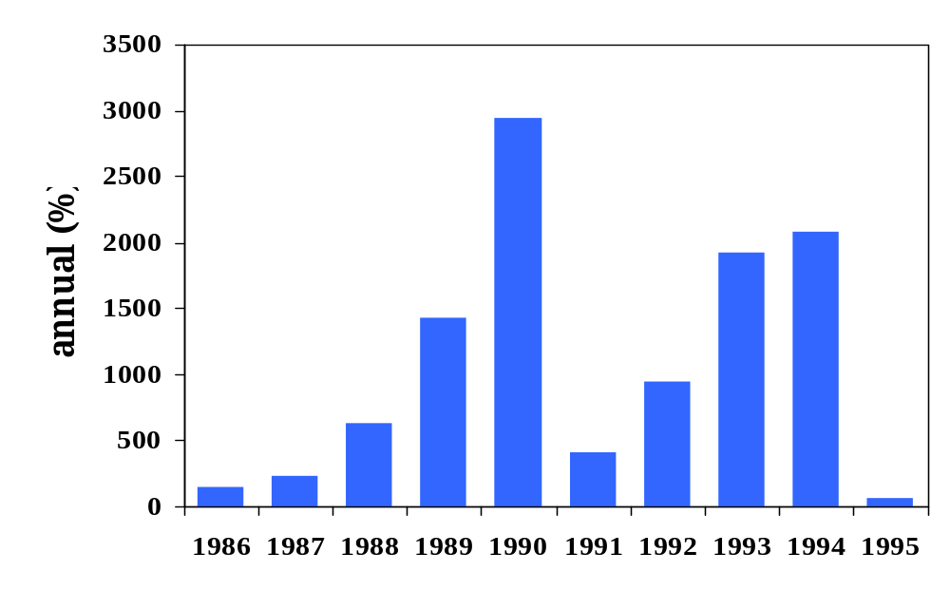
Inflation in Brazil
Source: EIU database.

Slide 62
Hyperinflation
Weak institutions
  Poor fiscal discipline
  Non-independent central bank
  Postwar stresses as a common factor
Government issues debt no one wants
Central bank monetizes debt
  Prints money, buys debt
Inflation makes government finances worse
  Expenses happen now, revenues come later
  Issue more debt, central bank monetizes it again, repeat

Slide 63
How do hyperinflations depress economies?
Velocity accelerates: “hot potato”
Households and firms waste resources economizing on money
Late stages of hyperinflations, the real value of money can plunge: insufficient liquidity!
Households and firms may be forced into inefficient modes of exchange (e.g. barter) or switch to foreign currency that is in inadequate supply

Slide 64
Quantity theory and hyperinflation
Political
Instability
Fiscal
Deficit
Money
Growth
Inflation

Slide 65
Ending hyperinflation
Ending a hyperinflation requires restoring confidence in the central bank
  Easier said than done
Fix the local currency to something
  Gold?
  Foreign currency (import credibility)

Slide 66
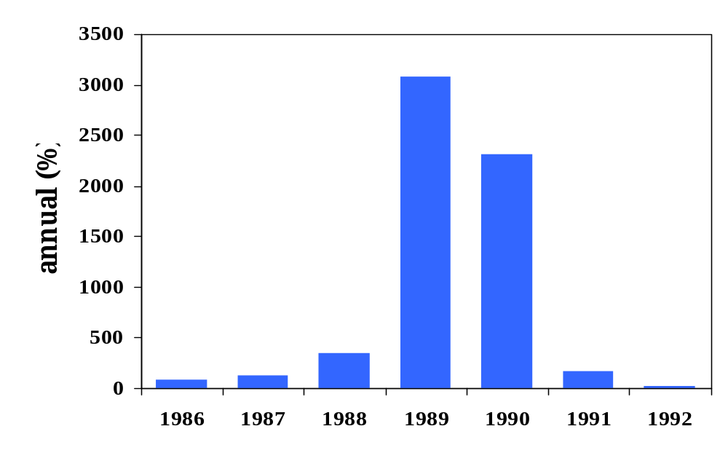
Inflation in Argentina
Source: EIU database.

Slide 67
Purchasing power during hyperinflation
Suppose annual inflation rate is 3000%, compounded daily (0.95% daily)
Start with 100 Pesos on January 1
100 Pesos is worth
  January 7: 95 Pesos
  January 30: 76 Pesos
  March 1: 57 Pesos
  June 1: 24 Pesos
  December 31: 3 Pesos

Slide 68
Ending inflation in Argentina
1975-1990: hyperinflation in Argentina
  Large fiscal deficits (central and local gov’t)
  Difficult to borrow externally
  Financed by central bank printing money

Slide 69
Convertibility plan
March 1991: Convertibility
  1 USD = 1 New Peso (or 10,000 Australes)
  Rate can only be changed by legislation
  Central bank holds 1 USD for every New Peso in circulation
  USD made legal tender in Argentina
  Other reforms include privatization of government owned enterprises

Slide 70
Post 1991
Hyperinflation ended
Central bank left to manage currency board
Government spending not tamed
  Privatization proceeds fund deficits
  Eventually run out
  Interest rates rising, difficult to increase the money supply
Crisis anew
  Central bank losing dollar reserves
  Convert dollar deposits into Pesos
  Abandon peg in January 2002

Slide 71
Inflation takeaways
In the long run, inflation comes from money growth
In big inflations, money growth typically comes from fiscal deficits …
… and fiscal deficits reflect political chaos
Solution
  central bank independence (a solution: peg to a better currency)
  fiscal discipline
  Less chaos (easier said than done)
Modest inflation is a different beast

