Slide 1

The Global Economy Business Cycle Theory

Slide 2
Roadmap
News
Aggregate demand and supply: theory
Uncertainty and real options
Quantity theory
Hyperinflations

Slide 3
Next week
Put together money and business cycles
Monetary policy
Quantity theory + AD/AS
Interest rates and Taylor rules
Unconventional monetary policy

Slide 4
Aggregate supply and demand
Adapt supply and demand to whole economy
Axes
P is price level – GDP deflator
Y is real GDP
Curves
Supply focuses on production of goods
Demand focuses on purchase of goods

Slide 5
Aggregate supply I
Long run: flexible prices
Production function
Y = A K^{α} L^{1-α}
At any point in time
A is given [but may change over time]
K is given [but may change over time]
L reflects equilibrium in labor market
Y must therefore be given: and AS vertical

Slide 6
Aggregate supply I
P
LRAS
Y

Slide 7
Aggregate supply II
Short run: prices can’t change
Production function
Y = A K^{α} L^{1-α}
At any point in time
A, K given
Nominal wage “sticky:” wages difficult to change
Increase in P reduces real wage, so firms hire more people
More L implies more Y ⇨ AS curve slopes upward
Wage eventually adjusts, bringing us back to LRAS

Slide 8
Aggregate supply II
P
LRAS
AS
Y

Slide 9
Aggregate supply
When we draw AS, we hold everything fixed but price and output
What happens to aggregate supply if we
Change A or K?
Change price of oil?
The wage
Typically both AS and LRAS shift
The change is permanent

Slide 10
Aggregate demand
Basic version
Quantity theory: inverse relation between P and Y
Given M and V, an increase in Y results in lower P

Slide 11
Aggregate demand
P
AD
Y

Slide 12
Aggregate demand
When we draw AS, we hold everything fixed but price and output
What happens to aggregate demand if we
Change M?
Change G?
Change consumption or investment demand (Optimism? Uncertainty?)

Slide 13
Equilibrium
P
AS*
AS
AD
Y

Slide 14
Equilibrium ?
P
AS*
AS
A
B
AD
Y

Slide 15
Equilibrium
Start at A [“short-run equilibrium”]
Where AS and AD cross
Move toward B [“long-run equilibrium”]
Why? Because wages adjust, shifting AS down
This goes on until AS crosses LRAS at B
What is happening to output? Prices?

Slide 16
Overview
AS/AD is a tool for classic analysis
Goal: keep things simple
Sort issues into AS and AD bins

Slide 17
Fiscal Stimulus
Example: increase G
Does this shift AS or AD?
Does it raise or lower Y? P?

Slide 18
Fiscal stimulus
P
LRAS
AS
AD
Y

Slide 19
Fiscal stimulus
Example: increase G
Does this raise or lower Y? P?
Impact of increase in “demand”
AD shifts right/up
Short-run impact: prices up, output up
Long-run impact?

Slide 20
Increased productivity
Example: IT revolution
Does this shift AS or AD?
Does it raise or lower Y? P?

Slide 21
Increased productivity
P
LRAS
AS
AD
Y

Slide 22
Increased productivity
Example: IT revolution
Does this raise or lower Y? P?
Impact of increase in “supply”
AS and LRAS shifts right/down
Short-run impact: prices down, output up
Long-run impact: prices down, output up

Slide 23
More money
Example: central bank increases M
Does this raise or lower Y? P?
Impact of increase in “demand”
AD shifts right/up
Short-run impact: prices up, output up
Long-run impact? Prices up, output unchanged. [this should remind you of quantity theory]
This is where/how monetary policy works – more next week

Slide 24
Pricing Uncertainty: VIX

Slide 25
Investment under Uncertainty
Multi-period model
First period: Choice of investing or waiting
Diagram shows returns in good/bad scenarios
Let probability of good scenario (q_{H}) be 0.5,
so the probability of the bad scenario (q_{L}=1-q_{H}) is 0.5.

Slide 26
Valuing the Investment Today
Where : c = investment cost = 1100
p_{i} = return in period i
p_{L} = bad scenario return = 50
p_{H} = good scenario return = 350
r = discount rate = 0.1 (10%)

Slide 27
Value of Waiting
So:

Slide 28
Waiting avoids the bad scenario

Slide 29
Suppose the return spread widens, but the mean is unchanged…
Where : c = investment cost = 1100
p_{i} = return in period i
p_{L} = bad scenario return = 25
p_{H} = good scenario return = 375
r = discount rate = 0.1 (10%)
Note that the NPV rises to 1375 from 1250.
It pays more to wait!

Slide 30
Suppose the discount rate falls…
Where : c = investment cost = 1100
p_{i} = return in period i
p_{L} = bad scenario return = 50
p_{H} = good scenario return = 350
r = discount rate = 0.07 (7%)
The value of waiting falls from 150 to 28.84 because the opportunity cost of investing falls.

Slide 31
Measures of Dispersion: Variance and Standard Deviation
Variance
Mean
Standard Deviation
A “mean-preserving increase of dispersion” raises the standard
deviation but leaves the mean unaltered. This can be viewed
as an increase of uncertainty.

Slide 32
AS/AD summary
Aggregate supply (producers/sellers) and demand (buyers) is the analytic standard
In practice, the challenge is to know whether conditions reflect supply or demand

Slide 33
The Global Economy Quantity Theory of Money

Slide 34
Quantity theory
One equation (technology for transactions)
M V = P Y
M = stock of money in circulation (currency)
V = velocity (how often a unit of currency is used in a year)
In growth rates
γ_{M} + γ_{V} = γ_{P} + γ_{Y}
γ_{M} = growth of money supply (think: currency in circulation)
γ_{V} = growth of velocity
γ_{P} = growth of price level (inflation rate)
γ_{Y} = growth of real GDP

Slide 35
Quantity theory
Two assumptions
V is constant
Y not affected by changes in M
One conclusion:
money growth causes inflation

Slide 36
Quantity theory: long-run

Slide 37
Open market operations
Treasury
Assets |  | Liabilities
 |  | Bonds | 200
How does the central bank increase money supply?
Central bank
Assets |  | Liabilities
Bonds | 20 | Money | 20
Households and firms
Assets |  | Liabilities
Money | 20
Bonds | 180

Slide 38
Putting quantity theory to work
Hyperinflations

Slide 39
Inflation in Argentina
Source: EIU database.
Notes:
39

Slide 40
Purchasing power during hyperinflation
Suppose annual inflation rate is 3000%, compounded daily (0.95% daily)
Start with 100 Pesos on January 1
100 Pesos is worth
January 7: 95 Pesos
January 30: 76 Pesos
March 1: 57 Pesos
June 1: 24 Pesos
December 31: 3 Pesos

Slide 41
Rapid money growth
Nicaragua
Congo
Angola
Argentina
Brazil

Slide 42
Inflation in Zimbabwe
Holding $100 for 1 month = $63!
Notes:
42

Slide 43
Zimbabwe
Dec 06: inflation over 1000 percent
Feb 07: inflation ruled “illegal”
Oct 08: inflation over 200 million percent (!)
Jan 09: transactions allowed in foreign currencies
Soldiers and teachers to be paid in USD
Feb 09: 12 zeros knocked off currency
April 09: currency is suspended all trades made in foreign currency

Slide 44
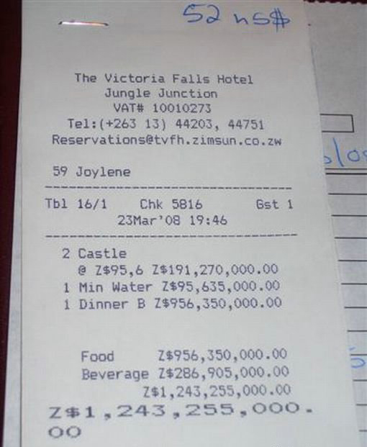

Buying lunch in Zimbabwe
Notes:
44

Slide 45
Hyperinflation
Weak institutions
Poor fiscal discipline
Non-independent central bank
Government issues debt no one wants
Central bank monetizes debt
Prints money, buys debt
Inflation makes gov’t finances worse
Expenses happen now, revenues come later
Issue more debt, c.b. monetizes it again, repeat

Slide 46
Ending hyperinflation
Ending a hyperinflation requires restoring confidence in the central bank
Easier said than done
Need to anchor long run inflation expectations
Fix the currency to something
Gold?
Foreign currency (import credibility)?

Slide 47
Ending inflation in Argentina
1975-1990: hyperinflation in Argentina
Large fiscal deficits (central and local gov’t)
Difficult to borrow externally
Financed by central bank printing money

Slide 48
Convertibility plan
March 1991: Convertibility
1 USD = 1 New Peso (or 10,000 Australes)
Rate can only be changed by legislation
Central bank holds 1 USD for every New Peso in circulation
USD made legal tender in Argentina
Other reforms include privatization of government owned enterprises

Slide 49
Inflation and exchange rates

Slide 50
Money growth

Slide 51
Inflation takeaways
Inflation comes from money growth
In big inflations, money growth typically comes from fiscal deficits …
… and fiscal deficits reflect political chaos
Solution
central bank independence (a solution: peg to a better currency)
fiscal discipline
Less chaos (easier said than done)
Modest inflation is a different beast

