Slide 1

The Global Economy
Monetary Policy

Slide 2
Advertisement
A lot more detail about today’s topic
Monetary policy, banks, and central banks
  Spring 2011, B30.2333
  Kim Schoenholtz
  Ex-Global Chief Economist at Citigroup
  Expert central bank researcher

Slide 3
News

Slide 4
Intro: big questions
What should central banks do?
  Control inflation?
  Control exchange rates?
  Control output?
What can central banks do?
  How does policy respond to demand shocks?
  How does policy respond to supply shocks?

Slide 5
Intro: tools
AS/AD
  Trace out impact of shocks to the economy
  Analyze the impact of policy
The reserve market
  How/where the Fed controls an interest rate
Taylor rule: a model of the central bank
  Connects output, inflation, and interest rates
  A model of “conventional” monetary policy

Slide 6
What should central banks do?
US Federal Reserve
Federal Reserve Act (1913)
  The Federal Reserve System and the Federal Open Market Committee should seek “to promote effectively the goals of maximum employment, stable prices, and moderate long-term interest rates.”

Slide 7
What should central banks do?
European Central Bank (ECB)
Treaty of Maastricht (1992) :
  The primary objective of [monetary policy] shall be to maintain price stability.
  Without prejudice to the objective of price stability, the ECB shall support the general economic policies in the Community with a view to contributing to the achievement of … a high level of employment and sustainable and non-inflationary growth.

Slide 8
Review: money supply mechanics
Increase the money supply
  Buy bonds for dollars
  Lower short term interest rates
  Expectations of future action influences long term interest rates
Decrease the money supply
  Sell bonds for dollars
  Increase short term interest rates
  Expectations of future action influences long term interest rates

Slide 9
How does monetary policy affect demand?
Higher real interest rates affect AD through
  Business investment
    Higher borrowing costs decrease investment
  Residential investment
    Higher mortgage rates decrease home building/buying
  Consumption
    Higher borrowing costs imply less borrowing for consumption
    Higher returns on savings imply more saving, less present consumption
    Lower returns on assets (discount at higher rate) implies a negative wealth effect; lowers consumption

Slide 10



Aside: the real interest rate
Nominal interest rate
  Yield measured in dollars
Real interest rate
  Yield measured in “goods”
The nominal rate, , is the real rate, , plus the expected rate of inflation,
Similar concept to the real wage: measure prices in terms of goods, not dollar bills
Real, not nominal, rates matter for decisions!

Slide 11
How does monetary policy affect demand?
We draw AD holding fixed everything but prices: including the real interest rate
When the real interest rate changes, AD shifts
A higher real interest rate shifts AD to the left
AD
P
AD’
Y

Slide 12
What should central banks do?
What are our goals?
  Low, predictable, inflation (stable prices)
  Output near “potential output” Y*
How should we respond to demand shocks?
How should we respond to supply shocks?
Tool: change interest rates (money supply) to move AD

Slide 13
Aggregate supply and demand
What’s an example of an adverse demand shock?
What is its impact?
How should we respond?

Slide 14
Adverse demand shock
P
AS*
AS
What should policy do?
AD'
AD
Y

Slide 15
Aggregate supply and demand
What’s an example of an adverse supply shock?
What is its impact?
How should we respond?

Slide 16
Adverse supply shock
AS*’
AS*
P
AS’
AS
What should policy do?
AD
Y

Slide 17
Summary: monetary policy + AS/AD
How should we respond to demand shocks?
  Resist demand shocks
How should we respond to supply shocks?
  Accommodate supply shocks
Or
  Do nothing: how do you know it is a supply shock? A demand shock?

Slide 18
The policy mechanism
In response to a shock:
  Change the supply of reserves to banks
  Which changes interest rates
  Which shifts AD
  Which impacts prices, output
Monetary policy works through interest rates. How does the central bank influence interest rates?

Slide 19
Central banking goals
Reminder: What are our goals?
  Low, predictable, inflation (stable prices)
  Output near “potential output” Y*
How does the Fed achieve these goals?
By managing interest rates
  Directly manages the overnight rate paid on reserves
  Indirectly manages longer term rates

Slide 20
Recap: the market for reserves
Fed buys and sells securities to provide reserves to the banking system
  Banks must hold some fraction of deposits as reserves with the Fed (the Fed is the bank for banks)
  At the end of the day, if a bank is low on reserves, it borrows from a bank with excess reserves.
  This market keeps banks from having to hold a lot of reserves to guard against a shortfall
  The rate at which these overnight loans are made is the federal funds rate
  Fed is monopoly supplier of aggregate reserves to banks

Slide 21
The market for reserves
Federal
Funds Rate
S₁
Demand for reserves
(from banks)
Quantity of Reserves

Slide 22
Managing the interest rate
The Federal Open Markets Committee sets a target for the federal funds rate
  FFR: rate charged on overnight loans between banks
The Domestic Trading Desk of the NY Fed engineers open market operations to push the rate as close as possible to the target
  Inject money: buy securities from banks for “money”
  Extract money: sell securities to banks for “money”

Slide 23
Policy tool target
FOMC chooses a federal funds rate
But, the federal funds rate is not perfectly implemented! It is a target.
Rather than “legislate” the federal funds rate, the Fed buys and sells bonds to try and hit the federal funds rate target
  Fed controls the supply of reserves
  Increase or decrease the supply to hit the target federal funds rate

Slide 24

Hitting target rate
Federal
Funds Rate
S₁
Target
Demand for reserves
(from banks)
Quantity of Reserves

Slide 25

Movements in reserve demand
Federal
Funds Rate
S₁
Off Target!
(FF rate too low)
Demand for reserves
(from banks)
Quantity of Reserves

Slide 26
Movements in reserve demand
Federal
Funds Rate
Sell bonds for reserves, shifting supply
S₂
S₁
Back to target!
Demand for reserves
(from banks)
Quantity of Reserves

Slide 27
Hitting the target federal funds rate
Open market operations change the supply of reserves to banks to keep the market federal funds rate close to the target
Decreasing the supply of reserves raises interest rates, lowers the money supply
Increasing the supply of reserves lowers interest rates, increases the money supply
Demand for reserves is constantly fluctuating
  How easy is it to hit the target?

Slide 28
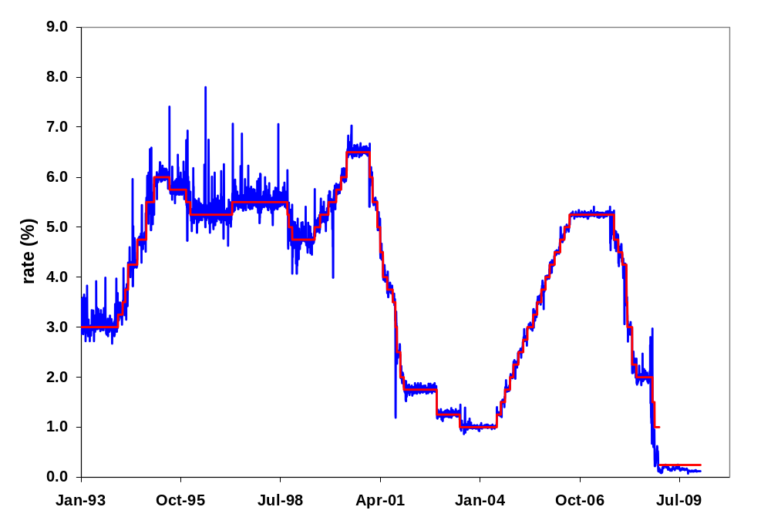
Hitting the target federal funds rate
Market federal funds rate

Slide 29
Long term interest rates: managing expectations
The Fed directly controls a very short term rate
  But, the overnight rate, per se, doesn’t shift AD
  Long rates matter more than short rates
How can the central bank affect long term rates?
  Long term rates reflect expectations about future short term rates
Correct expectation make policy more effective.

Slide 30
Long term interest rates: managing expectations
Old approach: “Never explain, never excuse”
  Fear of diminished “operational flexibility”
  Announcement requirement could impede policy
New approach: Talking about policy is part of making policy (guide expectations).
  Similar to a firm giving “guidance” to analysts and shareholders
Bernanke (2004):
“If effective communication can help financial markets develop more accurate expectations of the likely course of the funds rate, policy will be more effective.”

Slide 31
Why not use a rule?
If stable expectations are important
  Announce a rule the central bank will follow
  Used by some central banks (e.g. New Zealand)
  Predictable, stable, hard to secretly deviate
US Federal Reserve
  Rule doesn’t allow for necessary discretion
  Yet, Fed still acts much like it follows a rule

Slide 32






Modeling Ben Bernanke
Taylor Rule: relate prices and output to central bank policy
is the federal funds rate set by the Fed
is the real interest rate consistent with long run
is the current inflation rate
is the target inflation rate
is current output
is long run output

Slide 33
How much inflation is OK?
Either informally, or formally, central banks have values for growth and inflation that are “comfortable”
  Inflation rate: in the U.S., about 2%
  Output: close to long-run or “potential” output
These values differ across central banks
  Reflect different sensitivities to inflation and output deviations

Slide 34

Taylor rule
Use historical data to find with a regression
What does a bond trader expect if
    Inflation rises 1%, output unchanged?
    Growth rises 1%, inflation unchanged?

Slide 35
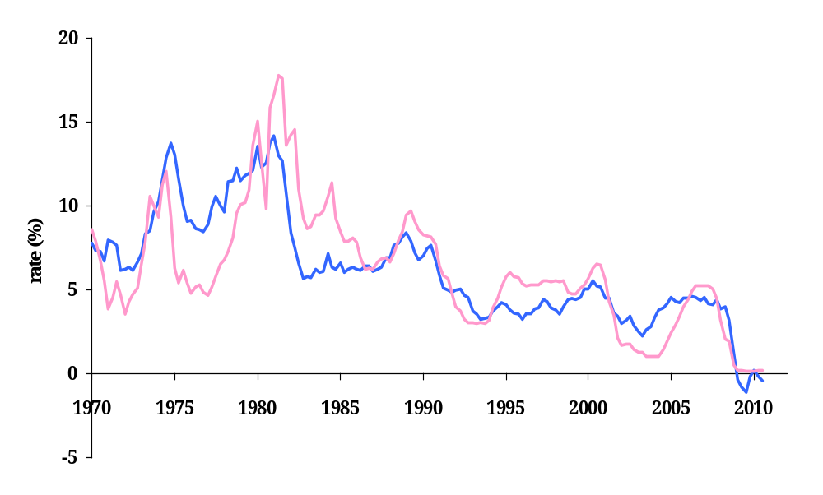
Taylor rule
Federal funds rate
Taylor rule

Slide 36
Taylor rule: 1970s
Federal funds rate
Taylor rule
What happened here?

Slide 37
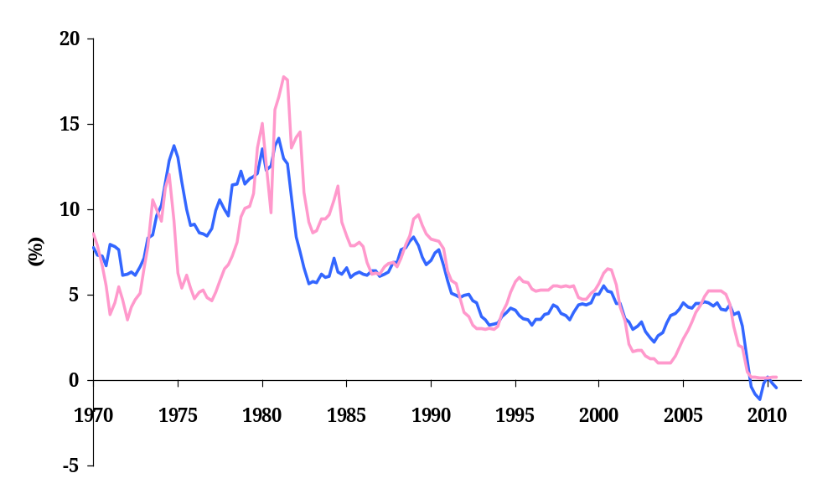
Taylor rule: 2002-05
Federal funds rate
Taylor rule
Greenspan’s mistake?

Slide 38
Taylor rule: interpreting the past
1970s
  Interest rate too low, try to end recessions
  Inflation exploded
2002-2005
  Interest rate too low, trying to avoid deflation after tech crash and 9/11
  Inflates the housing bubble?
2008-2010
  Interest rate should be negative!
  Need unconventional policy: more on that later

Slide 39
Putting it all together
How does the interest rate respond to a negative demand shock?
  Use the Taylor Rule
What does the Fed do to change interest rates?
  How is the market for reserve changed?
  What happens to the money supply?
What is the impact of the Fed’s actions on the economy?
  Use AS/AD analysis
What about a positive demand shock?

Slide 40
Negative demand shock: AS/AD
P
AS*
AS
AD'
AD
Y

Slide 41
Negative demand shock: Taylor rule

Slide 42
Negative demand shock: market for reserves
Federal
Funds Rate
S₁
Target
Demand for reserves
(from banks)
Quantity of Reserves

Slide 43
Negative demand shock: AS/AD
P
AS*
AS
AD'
Y

Slide 44
Summary: conventional policy
The Fed manages the interest rate that banks are charged for making overnight loans: the federal funds rate
  Open market operations consist of buying and selling treasury bills to increase or decrease the supply of reserves to this market
The Fed manages longer term rates through expectations
  Greater transparency in policy makes policy more effective
As the Fed has improved its ability to conduct policy, business cycle volatility has fallen
  Well, except recently…

Slide 45
Unconventional policy
What happens when the conventional policy instrument (i.e. the federal funds rate) can not be lowered further?
Interest rates cannot go below 0
  Banks would rather hold reserves than make loans at a negative interest rate
  Econ-speak: “the zero lower bound”

Slide 46
Unconventional policy
Federal funds rate
What can we do when interest rates are 0?
Taylor rule

Slide 47

The zero lower bound on interest rates
Federal
Funds Rate
Demand for reserves
(from banks)
S₁
S₂
Quantity of Reserves

Slide 48
The zero lower bound on interest rates
Interest rates cannot go below 0
  Banks, firms, people, would rather hold cash
There is a level of reserve supply for which the federal funds rate is 0
The Fed can increase reserves to banks past this level without having any impact on the federal funds rate
  This is Quantitative Easing
  The difference between A and B on the following graph is the amount of quantitative easing.

Slide 49
Quantitative easing
Federal
Funds Rate
Demand for reserves
(from banks)
S₁
S₂
A
B
Quantity of Reserves

Slide 50
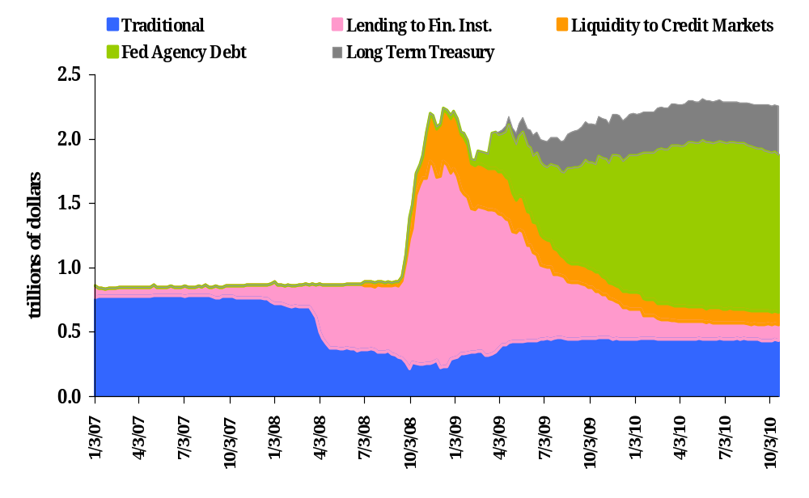
Unconventional monetary policy

Slide 51
Exiting QE
Suppose
  Output starts growing
  Inflation starts rising
How do we exit QE?
  Need to start increasing FF target rate
Sell all of the assets acquired during QE?
  All at once? What happens to asset prices?
Use another unconventional policy
  Pay interest on reserves

Slide 52
Exiting quantitative easing
Federal
Funds Rate
Demand for reserves
(from banks)
S₁
S₂
New target
A
B
Quantity of Reserves

Slide 53
Exiting QE
Another unconventional policy
  Pay interest on reserves
  New Fed policy tool (part of TARP)
Demand for reserves becomes kinked at the deposit rate
  Banks will not make a loan at less than the riskless reserve deposit rate
Partly disconnects reserves and federal funds rate
  Interest rates increase, even though quantities have not decreased
  Give Fed time to slowly unwind balance sheet

Slide 54

Exiting quantitative easing
Federal
Funds Rate
Demand for reserves
(from banks)
S₂
New target
Deposit rate
B
Quantity of Reserves

Slide 55
Monetary policy summary
Monetary policy affects
  Inflation
  Output in the short run
Central banks change the money supply with purchases and sales of government bonds
In theory, central banks should resist demand shocks and accommodate supply shocks
  If you can tell them apart!

Slide 56
Conventional monetary policy summary
Monetary policy has
  Long-run impact on prices/inflation
Most central banks focus on short-term interest rates
  Increase in rate implies fall in money
Taylor rule ties interest rate to inflation and output
  Policy is predictable
  Strong output growth and high inflation trigger increases in interest rates
  Long-term rates depend on expectations of future inflation and output

Slide 57
Unconventional monetary policy summary
At the “zero lower bound” managing the federal funds rate isn’t an option
  Interest rates can’t go below 0
Quantitative easing is increasing the quantity of reserves past the amount that results in a federal funds rate of 0
Exiting quantitative easing
  Sell all the assets accumulated: probably a bad idea
  Pay interest on reserves

