Slide 1

The Global Economy
Monetary Policy

Slide 2
Advertisement
Monetary policy, banks, and central banks
  Spring 2012, ECON-GB.2333.20
  MW 10:30am-11:50am

Slide 3
Intro: big questions
What should central banks do?
  Control inflation?
  Control exchange rates?
  Control output?
What can central banks do?
  How does policy respond to demand shocks?
  How does policy respond to supply shocks?

Slide 4
Intro: tools
AS/AD
  Trace out impact of shocks to the economy
  Analyze the impact of policy
The reserve market
  How/where the Fed controls an interest rate
Taylor rule: a model of the central bank
  Connects output, inflation, and interest rates
  A model of “conventional” monetary policy

Slide 5
What should central banks do?
US Federal Reserve
Federal Reserve Act (1913)
  The Federal Reserve System and the Federal Open Market Committee should seek “to promote effectively the goals of maximum employment, stable prices, and moderate long-term interest rates.”
  Usually described as Fed’s “dual mandate”

Slide 6
What should central banks do?
European Central Bank (ECB)
Treaty of Maastricht (1992) :
  “The primary objective of [monetary policy] shall be to maintain price stability. “
  “Without prejudice to the objective of price stability, the ECB shall support the general economic policies in the Community with a view to contributing to the achievement of … a high level of employment and sustainable and non-inflationary growth.”
  Usually described as ECB’s “hierarchical mandate”

Slide 7
Review: money supply mechanics
Increase the money supply
  Buy Treasury bills for dollars
  Lower short-term interest rates
  Expectations of future action influences long-term interest rates
Decrease the money supply
  Sell Treasury bills for dollars
  Increase short-term interest rates
  Expectations of future action influences long-term interest rates

Slide 8
How does monetary policy affect demand?
Higher real interest rates affect AD through
  Business investment
    Higher borrowing costs decrease investment
  Residential investment
    Higher mortgage rates decrease home building/buying
  Consumption
    Higher borrowing costs imply less borrowing for consumption
    Higher returns on savings imply more saving, less present consumption
    Lower returns on assets (discount at higher rate) implies a negative wealth effect; lowers consumption
    Lower asset values decrease value of collateral; lowers borrowing capacity

Slide 9
How does monetary policy affect demand?
Transmission through asset prices
  Equity prices and credit spreads
  House prices
  Exchange rate
  Collateral value (borrowing capacity)

Slide 10
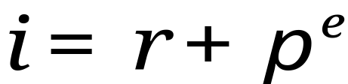



Aside: the real interest rate
Nominal interest rate
  Yield measured in dollars
Real interest rate
  Yield measured in “goods”
The nominal rate, , is the real rate, , plus the expected rate of inflation,
Similar concept to the real wage: measure prices in terms of goods, not dollar bills
Key role of expectations!
Real, not nominal, rates matter for spending decisions!

Slide 11
How does monetary policy affect demand?
We draw AD holding fixed everything (including the real interest rate) but prices
When the real interest rate changes, AD shifts
A higher real interest rate shifts AD to the left
AD
P
AD'
Y

Slide 12
What should central banks do?
What are our goals?
  Low, predictable, inflation (stable prices)
  Output near “potential output” Y*
How should we respond to demand shocks?
How should we respond to supply shocks?
Tool: change interest rates (money supply) to move AD

Slide 13
Aggregate supply and demand
What’s an example of an adverse demand shock?
What is its impact?
How should we respond?

Slide 14
Adverse demand shock
P
LRAS
AS
What should policy do?
P*
P'
AD'
AD
Y'
Y*
Y

Slide 15
Aggregate supply and demand
What’s an example of an adverse supply shock?
What is its impact?
How should we respond?

Slide 16
Adverse supply shock
P
LRAS'
LRAS
AS'
AS
P*'
What should policy do?
P'
P*
AD
Y*'
Y*
Y
Y'

Slide 17
Summary: monetary policy + AS/AD
How should we respond to demand shocks?
  Resist demand shocks
How should we respond to supply shocks?
  Accommodate supply shocks
Or
  Do nothing: how do you know it is a supply shock? A demand shock?

Slide 18
The policy mechanism
In response to a shock:
  Change the supply of reserves to banks
  Which changes interest rates
  Which shifts AD
  Which impacts prices, output
Conventional monetary policy works through interest rates. How does the central bank influence interest rates?

Slide 19
Central banking goals
Reminder: What are our goals?
  Low, predictable, inflation (stable prices)
  Output near “potential output” Y*
How does the Fed try to achieve these goals?
By managing interest rates
  Directly manages the overnight rate paid on reserves
  Indirectly manages longer term rates

Slide 20
Recap: the market for reserves
Fed buys and sells securities to provide reserves to the banking system
  Fed is monopoly supplier of aggregate reserves to banks
  Banks hold a portion of deposits as reserves with the Fed (the Fed is the bank for banks)
  At the end of the day, if a bank is low on reserves, it borrows from a bank with excess reserves.
  This interbank lending market keeps banks from having collectively to hold a lot of reserves to guard against a shortfall
  The rate at which these overnight loans are made is the federal funds rate

Slide 21
The market for reserves
Federal
Funds Rate
S₁
Demand for reserves
(from banks)
Quantity of Reserves

Slide 22
Managing the interest rate
The Federal Open Market Committee sets a target for the federal funds rate
  FFR: rate charged on overnight loans between banks
The trading desk of the NY Fed uses open market operations to nudge the rate close to the target
  Inject money: buy securities from banks for “money”
  Extract money: sell securities to banks for “money”

Slide 23
Policy tool vs target
FOMC chooses a federal funds rate
But, the federal funds rate is not perfectly implemented! It is a target.
Rather than “legislate” the federal funds rate, the Fed buys and sells securities in the open market to try and hit its federal funds rate target
  Fed controls the supply of reserves
  Increase or decrease the supply to hit the target federal funds rate

Slide 24

Hitting target rate
Federal
Funds Rate
S₁
Target
Demand for reserves
(from banks)
Quantity of Reserves

Slide 25

Movements in reserve demand
Federal
Funds Rate
S₁
D₂
D₁
Off Target!
(FF rate too low)
Demand for reserves
(from banks)
Quantity of Reserves

Slide 26
Movements in reserve demand
Federal
Funds Rate
Sell bonds for reserves, shifting supply
S₂
S₁
D₂
Back to target!
D₁
Demand for reserves
(from banks)
Quantity of Reserves

Slide 27


Raising the Federal Funds Rate
Federal
Funds Rate
Sell bonds for reserves, shifting supply left, raises funds rate target
S₂
S₁
D
Demand for reserves
(from banks)
Quantity of Reserves

Slide 28
Hitting the target federal funds rate
Open market operations change the supply of reserves to banks to keep the market federal funds rate close to the target
Decreasing the supply of reserves raises interest rates, lowers the money supply
Increasing the supply of reserves lowers interest rates, increases the money supply
Demand for reserves is constantly fluctuating
  How easy is it to hit the target?

Slide 29
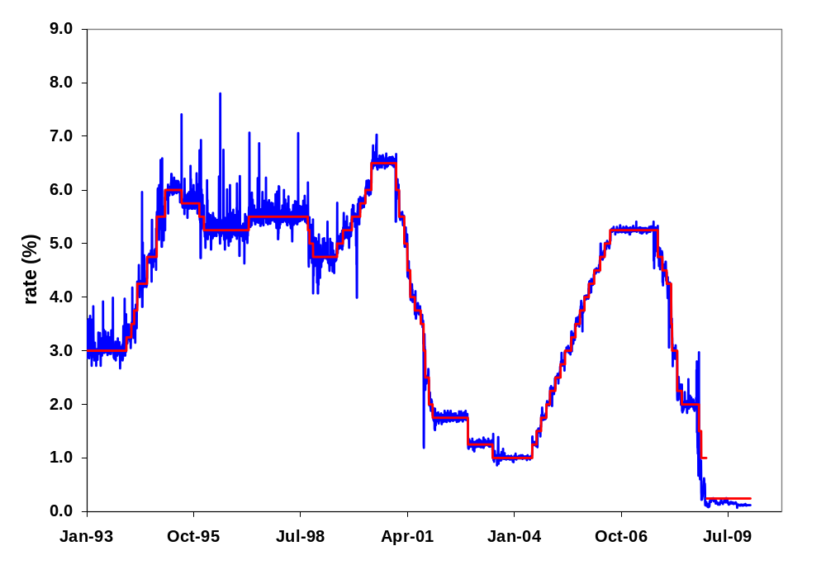
Hitting the target federal funds rate
Market federal funds rate

Slide 30
Long term interest rates: managing expectations
The Fed directly controls a very short term rate
  But, the overnight rate, per se, doesn’t shift AD
  Long rates and other asset prices matter more than short rates
How can the central bank affect long term rates?
  Long term rates (and long-term assets generally) reflect expectations about future short term rates
Correct market expectations make policy more effective.

Slide 31
Long term interest rates: managing expectations
Old CB approach: “Never explain, never excuse”
  Fear of diminished “operational flexibility”
  Announcement requirement could impede policy
New approach: Talking about policy is part of making policy (guide expectations).
  Similar to a firm giving “guidance” to analysts and shareholders
Bernanke (2004):
“If effective communication can help financial markets develop more accurate expectations of the likely course of the funds rate, policy will be more effective.”

Slide 32
Why not use a rule?
If stable expectations are important
  Announce a rule the central bank will follow
  Predictable, stable, hard to secretly deviate
US Federal Reserve
  Rule doesn’t allow for necessary discretion
  Yet, Fed still acts much like it follows a rule
  Call it “rule-like” behavior

Slide 33






Modeling Ben Bernanke
Taylor Rule: relate prices and output to central bank policy
is the federal funds rate set by the Fed
is the real interest rate consistent with long run
is the current inflation rate
is the target inflation rate
is current output
is long-run output

Slide 34
How much inflation is OK?
Either informally, or formally, central banks have values for growth and inflation that are “comfortable”
  US “mandate-consistent inflation rate”: about 2%
  Output: close to long-run or “potential” output
These values differ across central banks
Central banks also differ on how much they are willing to deviate from inflation or output goals in the short run

Slide 35

Taylor rule
Use historical data to find with a regression
What does a bond trader expect if
    Inflation is 1%, output at potential?
    Growth accelerates by 1%, inflation at target?

Slide 36
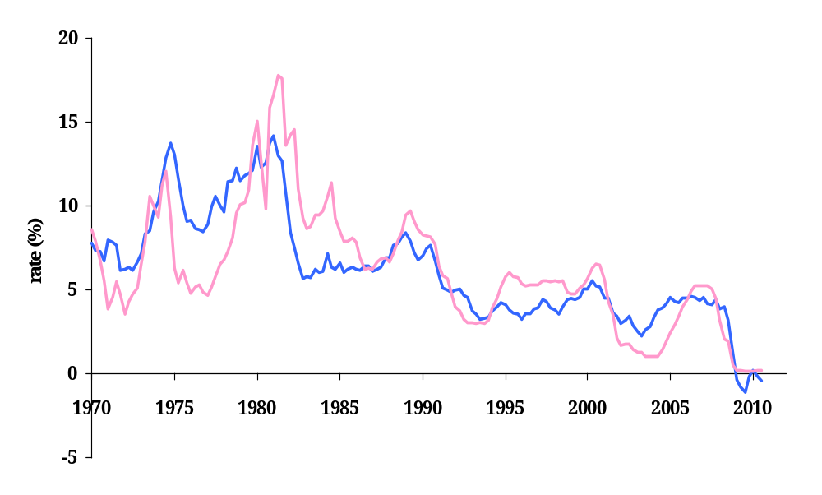
Taylor rule
Taylor rule
Federal funds rate

Slide 37
Taylor rule: 1970s
Taylor rule
Federal funds rate
What happened here?

Slide 38
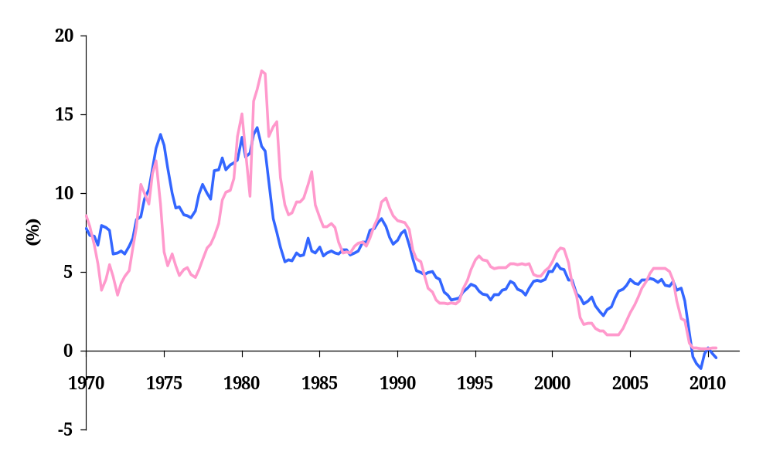
Taylor rule: 2002-05
Taylor rule
Federal funds rate
Greenspan’s conundrum

Slide 39
Taylor rule: interpreting the past
1970s
  Interest rate too low, try to end recessions
  Inflation trended higher
1985-2006
  Great Moderation
2002-2005
  Low rate: avoid deflation after tech crash and 9/11
  Aggravates the housing bubble?
2008-2010
  Nominal interest rate should be negative!
  Need unconventional policy: more on that later

Slide 40
Putting it all together
How does the interest rate respond to an adverse demand shock?
  Use the Taylor Rule
What does the Fed do to change interest rates?
  How is the market for reserves changed?
  What happens to the money supply?
What is the impact of the Fed’s actions on the economy?
  Use AS/AD analysis
What about a positive demand shock?

Slide 41
Adverse demand shock: AS/AD
P
LRAS
AS
P*
P'
AD'
AD
Y'
Y*
Y

Slide 42
Adverse demand shock: Taylor rule

Slide 43
Adverse demand shock: market for reserves
Federal
Funds Rate
S₁
Target
Demand for reserves
(from banks)
Quantity of Reserves

Slide 44
Adverse demand shock: AS/AD
P
LRAS
AS
P*
P'
AD'
AD
Y'
Y*
Y

Slide 45
Summary: conventional policy
The Fed manages the interest rate that banks charge for overnight loans: the federal funds rate
  Open market operations consist of buying and selling treasury bills to increase or decrease the supply of reserves to this market
The Fed manages longer term rates through expectations
  Greater transparency in policy makes policy more effective
As the Fed has improved its ability to conduct policy, business cycle volatility has fallen
  Well, except recently…

Slide 46
Unconventional policy
What happens when the conventional policy instrument (i.e. the federal funds rate) can not be lowered further?
Interest rates cannot go below 0
  Banks would rather hold reserves than make loans at a negative interest rate
  Econ-speak: “the zero lower bound”

Slide 47
Unconventional policy
Taylor rule
What can we do when interest rates are 0?
Federal funds rate

Slide 48

The zero lower bound on interest rates
Market Federal
Funds Rate
Demand for reserves
(from banks)
S₁
S₂
Quantity of Reserves

Slide 49
Zero lower bound on nominal interest rates
Nominal interest rates cannot go below zero
  Banks, firms, people, would rather hold cash.
There is a level of reserve supply for which the federal funds rate is zero
The Fed can increase reserves to banks past this level without having any impact on the federal funds rate
  This is Quantitative Easing
  The difference between A and B on the following graph is the amount of quantitative easing.

Slide 50
Quantitative easing
Market Federal
Funds Rate
Demand for reserves
(from banks)
S₁
S₂
A
B
Quantity of Reserves

Slide 51
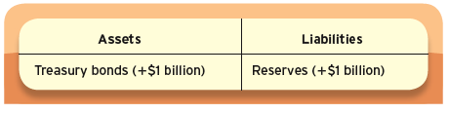
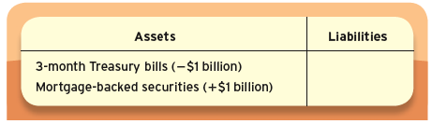
QE vs CE
Impact on the Fed’s Balance Sheet
Quantitative Easing
Credit Easing

Slide 52
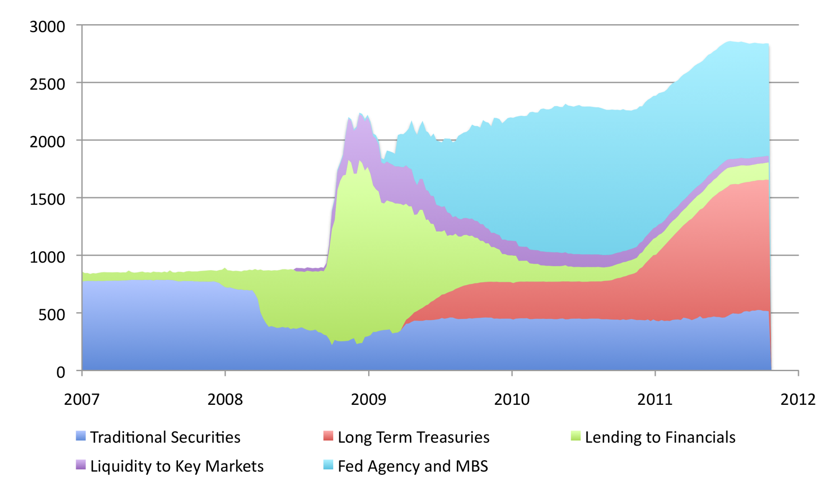
Unconventional Monetary Policy
Billions of Dollars
Source: FRB Cleveland.
Notes:
10/14/10

Slide 53
Exiting QE
Suppose
  Output starts growing
  Inflation starts rising
How do we exit QE?
  Need to start increasing FF target rate
Sell all of the assets acquired during QE?
  All at once? What happens to asset prices?
Use another unconventional policy
  Pay interest on reserves

Slide 54
Exiting quantitative easing
Federal
Funds Rate
Demand for reserves
(from banks)
S₁
S₂
New target
Old target = 0
A
B
Quantity of Reserves

Slide 55
Exiting QE
Another unconventional policy
  Pay interest on reserves
  New Fed policy tool (part of TARP: Oct 2008)
Demand for reserves becomes kinked at the deposit rate
  Banks will not make a loan at less than the riskless reserve deposit rate (imagine paying interest on cash)
Disconnects reserves and federal funds rate
  Interest rates increase, even though quantities have not decreased
  Give Fed time to slowly unwind balance sheet

Slide 56
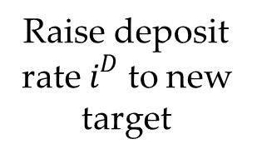


Exiting quantitative easing
Market Federal
Funds Rate
Demand for reserves
(from banks)
S₂
B
Deposit rate
A
Quantity of Reserves

Slide 57
Monetary policy summary
Monetary policy affects
  Inflation
  Output in the short run
Central banks change the money supply with purchases and sales of government bonds
In theory, central banks should resist demand shocks and accommodate supply shocks
  If you can tell them apart!

Slide 58
Conventional monetary policy summary
Monetary policy has
  Long-run impact on prices/inflation
Most central banks focus on short-term interest rates
  Increase in rate implies fall in money
Taylor rule ties interest rate to inflation and output
  Policy is predictable
  Strong output growth and high inflation trigger increases in interest rates
  Long-term rates depend on expectations of future inflation and output

Slide 59
Unconventional monetary policy summary
At the “zero lower bound” managing the federal funds rate isn’t an option
  Nominal interest rates can’t go significantly below 0
Quantitative easing is increasing the quantity of reserves past the amount necessary to hit the target federal funds rate (usually zero when QE is used)
Credit easing alters the mix of the Fed’s balance sheet toward riskier, less liquid assets
Mechanisms to exit quantitative easing
  Sell all the assets accumulated: may not be feasible
  Pay interest on reserves

