Slide 1

The Global Economy
Fiscal Policy + Balance of Payments

Slide 2
Agenda
Review Session: Dec 10: 12pm-12:45pm
  Email questions by Thursday, Dec 8
  Do not include questions from practice final
Tax and Fiscal Policy
Balance of Payments (introduction)

Slide 3
Using and Interpreting Regressions
R² – “goodness of fit” measure
  Share of variance of dependent variable explained by regression
Standard error of regression
  If errors are normally distributed, provides a confidence interval around fitted or forecast value (one-SD bandwidth = 68%; two-SD bandwidth = 95%)
Coefficients
  Sensitivity of dependent variable to independent variables; used in calculating forecast based on observed independent variables
Standard error of coefficient
  If errors are normally distributed, provides a confidence interval around coefficient (one-SD bandwidth = 68%; two-SD bandwidth = 95%)
t-statistic
  Measures ratio of coefficient to its standard error; tests hypothesis that coefficient is different from zero (95% confidence interval when t>1.96)

Slide 4
Fiscal Policy Roadmap
What should governments do?
Theory of taxation
Theory of debts and deficits
Issues in the U.S.
  Social Security
  Medicare/Medicaid

Slide 5
What should governments do? I
Provide public goods
Public goods are hard for markets to supply
  Non excludable: hard to keep people from consuming it
    Fish in the ocean, radio/tv/comms spectrum, fireworks
  Non rival: my consumption does not affect your consumption
    T.V. (cable and broadcast), fresh air, NY skyline
Hard for a private firm to capture all the benefits of these goods, so market would provide too little
Public goods governments may provide
  National defense, environmental protection, police, fire

Slide 6
What should governments do? I
Most goods are not completely public and society has to make choices about what to provide and what not to.
People have different opinions on this.
  Sports stadiums?
  Mass transit?
  Subsidies to home ownership?
  Economic data?

Slide 7
What should governments do? II
Provide insurance and redistribution
Protect the unfortunate
  Disability insurance, medical programs
  People who save too little: social security
Theory
  Rawls’ “Veil of Ignorance”
  Market failure: adverse selection, moral hazard
These are large programs in many countries

Slide 8
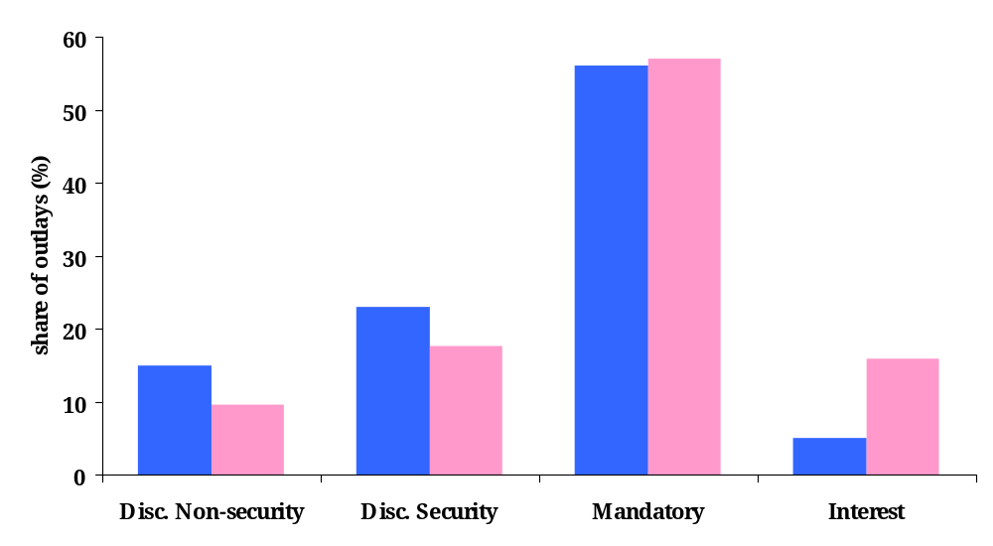
U.S. Budget Outlays
Medicare, Medicaid, Social Security
2010
2020
Where the “pork” lives
!!

Slide 9
What should governments do?
Insurance concerns make up large shares of government budgets
How much insurance?
  A lot of variation across countries
  Economists don’t have great answers to this question (see Glaeser blog in NYT)
In general, larger insurance programs have to be paid for by higher taxes (more on this later)
  Economists do have something to say here

Slide 10
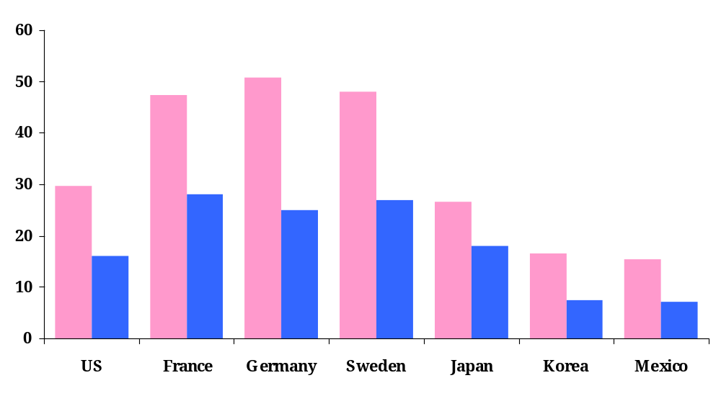
Social insurance and taxes across countries
Personal tax rates (at average wage)
Social expenditure
(% GDP)

Slide 11
Taxes: theory
Societies choose different levels of spending on goods, services, and insurance
But all countries have to pay for these expenditures, usually through taxation
Taxes differ across countries
  High tax rates reflect high gov’t spending
What does “good” tax policy look like?
  Keep distortions low
  Try not to ruin incentives

Slide 12
Taxes
Distortionary taxes: common
  Proportional to value (ad valorem tax)
  Per-unit tax (specific tax)
  Income tax, sales tax, sin tax

Slide 13
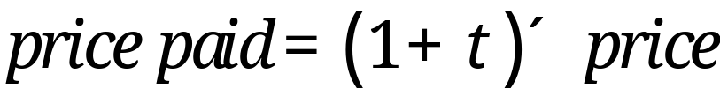
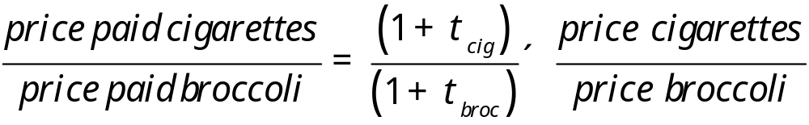
Distortionary taxes
Creates a wedge (distortion) between real price and the price paid
If tax rates differ across goods, distorts relative prices (sometimes on purpose)

Slide 14
Distortionary taxation
Taxes create distortions
  Break the link between producer costs and consumer willingness to pay
  Diminishes the efficiency of the market
To minimize distortions
  Tax a broad base at a low rate

Slide 15
Measuring welfare
P
consumer
surplus
S
P*
producer surplus
D
Q*
Q

Slide 16


A distortionary tax
Charge a per unit tax of dollars
Does it matter who “pays” the tax?

Slide 17


A distortionary tax
Charge a per unit tax of dollars
Price received by producer plus tax is price paid by consumer
Deadweight loss = loss of surplus not made up for by tax revenue
  Sales that would have created surplus, but are not transacted at the new, higher, price

Slide 18
Taxes destroy surplus
P
Deadweight loss
consumer
surplus
P_{c}’
S
t
P*
tax revenue
P_{f}’
producer surplus
D
Q’
Q*
Q

Slide 19
Larger taxes destroy more surplus!
P
Doubling the tax quadruples the deadweight loss!
S
2t
t
D
Q

Slide 20
The deadweight loss
What determines the size of the deadweight loss?
Slope of supply and demand curves
  Economists refer to price elasticity of demand and supply
  High elasticity = flatter slope
  Low elasticity = steep slope
  Cigarettes? Potatoes? Gasoline? Pepsi?
What kind of goods should be taxed?

Slide 21
Inelasticity reduces deadweight loss
Deadweight loss is smaller due to inelastic demand
P
consumer
surplus
P_{c}’
S
t
tax revenue
P*
P_{f}’
producer surplus
D
Q’
Q*
Q

Slide 22
Distortionary taxes summary
Distortions grow faster than the tax rate
  Decrease the efficiency of markets
To minimize distortions
  Small taxes
  Large base
  Low elasticity goods: smaller deadweight losses, but low elasticity goods tend to be necessities (fuel, food, etc) so these taxes may be regressive

Slide 23
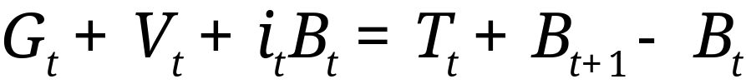
Debt and deficits: theory
Government budget constraint:
Ingredients:
  G = government purchases of goods and services
  V = transfer payments from government to households
  G + V = government spending
  T = tax revenue
  D = G + V – T = primary deficit (excl interest)
  B = government debt (“bonds”)
  i = (nominal) interest rate paid on debt
  iB = interest payments

Slide 24




How should a deficit be financed?
Government budget constraint:
If
  Raise taxes: increase
  Issue debt: increase
Is there a difference?

Slide 25


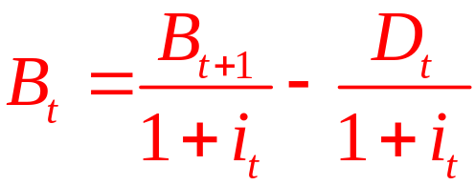
How should a deficit be financed?
Government budget constraint:
Rewrite as
Debt today is PV of tomorrow’s debt + tomorrow’s primary surplus

Slide 26
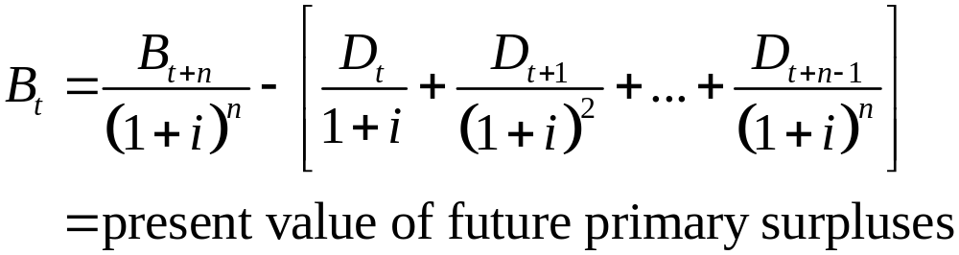
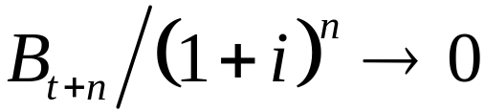

Taxes and debt: present value
Repeated substitution gives us
Debt is financed by future surpluses
  Assumes
  Don’t need

Slide 27
Pay me now, or pay me later
Spending must be financed by tax revenues
  Tax revenues now
  Or tax revenues later (with interest!)
Debt allows governments to
  Keep tax rates from fluctuating
  Transfer today’s spending to tomorrow’s taxpayers

Slide 28
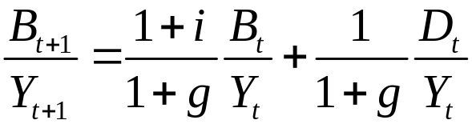
Sustainability analysis
Issue:
  What happens to ratio of debt to GDP if policy doesn’t change?
  If it decreases/constant, it is sustainable. If not, unsustainable.
  Both measured at current prices (“nominal”)
Growth of (nominal) debt
[1] B_{t+1} = (1+i)B_{t} + D_{t}
Growth of (nominal) GDP
[2] Y_{t+1} = (1+g)Y_{t}
Growth of debt to GDP ratio (divide [1] by [2])
[3]

Slide 29
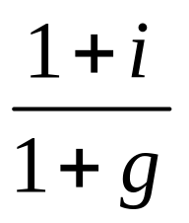
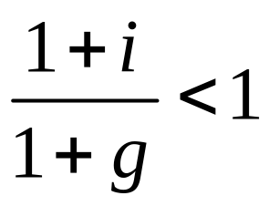
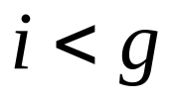
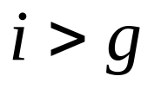
Sustainability analysis
With a balanced budget …
  Ratio of debt to GDP grows at:
… sustainability requires
or
Typically, however,
  Even with a balanced budget, debt load is too big
  Therefore something must change – but what?

Slide 30
Sustainability analysis
“Unsustainable” means something must change
  Start running surpluses: more tax revenue and/or less spending
  Faster GDP growth: real – not a policy choice
  Faster GDP growth: nominal – inflate your problems away!
  Default on debt

Slide 31
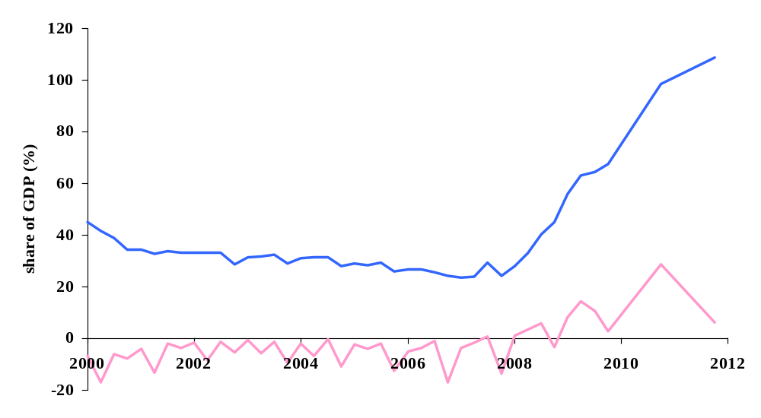
Debt and deficits in Ireland
Debt
Primary Deficit

Slide 32
Fiscal policy in Ireland 2011
Primary deficit (% GDP) | 6.2
Interest on debt (%) | 5.4
Inflation rate (%) | -0.7
Real GDP growth rate (%) | 1.2
Public debt (% GDP, end of 2010) | 98.5
Is debt increasing or decreasing?

Slide 33
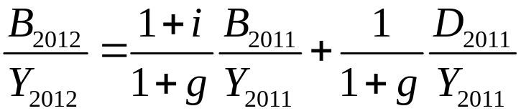
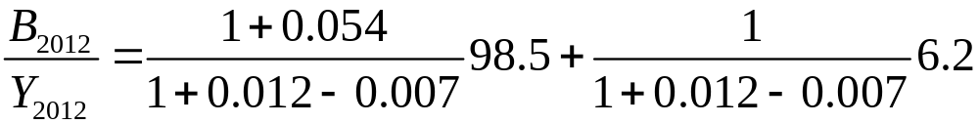
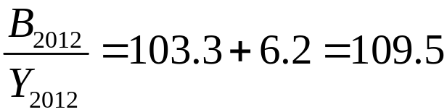
Ireland 2011
Note: Debt is reported at the end of year t, but is identical at the start of year t+1. The debt numbers in the equations above are at the start of the year.
Check at home: what is debt at the end of 2012 if the primary deficit, nominal GDP growth rate, and interest rate stay constant?

Slide 34
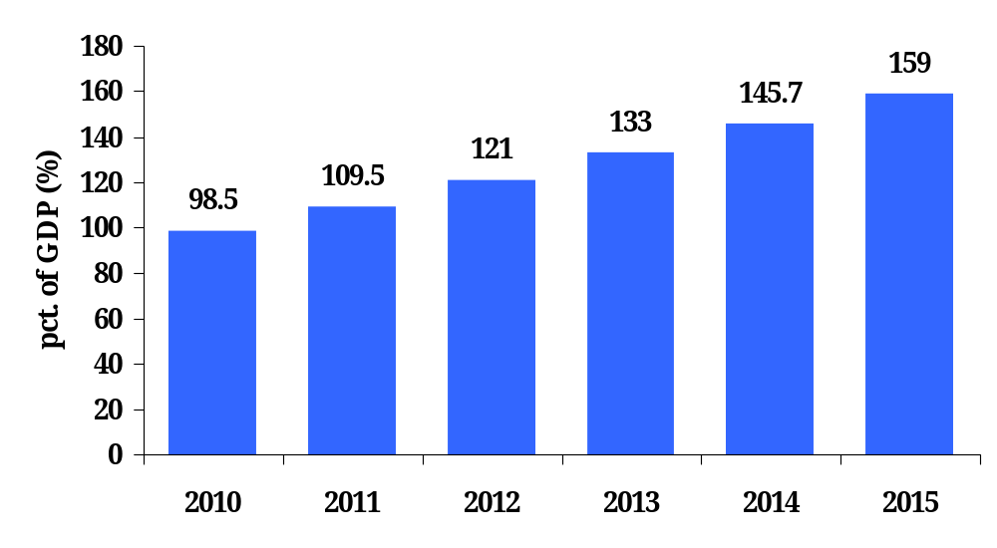
Ireland Debt Simulation
Constant Policy, Growth, Interest Rate

Slide 35
Choices: Ireland
“Unsustainable” means something must change
  Start running surpluses: more tax revenue and/or less spending
  Faster GDP growth: nominal – inflate your problems away!
  Default on debt
Painful!
Euro eliminates this choice!
Will other euro countries let this happen?

Slide 36
Fiscal policy in US
What are the long-term budget issues?
Explicit debt: contracts with others
  Legal liability, pay or default
  Bonds, bills, etc
Implicit debt: legislation that mandates future payments,
  Government can change these payments “at will”
  Social Security, Medicare, Medicaid

Slide 37
How big are US debts?
2010 U.S. debt held by the public
  Bonds, bills = $9 trillion
2010 unfunded liabilities (present value)
  Social Security (OASDI) = $16 trillion
  Medicare = $36 trillion
Nominal GDP in 2010 about $15 trillion
Debt-to-GDP ratio
  Explicit = 9/15 =60%
  Implicit = (16+36)/15=350%

Slide 38
Social Security
Old Age and Survivors Insurance (OASI) and Disability Insurance (DI)
Funded by 12.4% payroll tax
  The employer “pays” half the tax
  But we know it doesn’t matter who “pays!”
System is “pay as you go”
  Current workers finance current retirees
Initial level of benefits + cost of living adjustments

Slide 39
Social Security problems
Pay-as-you-go meets the baby boomers
  Ageing population means fewer workers paying taxes to support each retiree
  1983 reform: changed system to accumulate surplus to cover baby boomers retiring.
  Surpluses accumulated in the social security trust fund
  Trust fund, however, is not large enough to keep the system funded

Slide 40
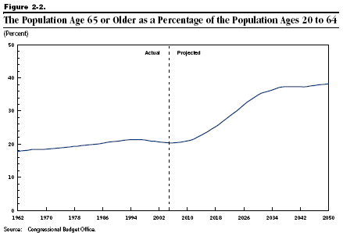
Demographics

Slide 41
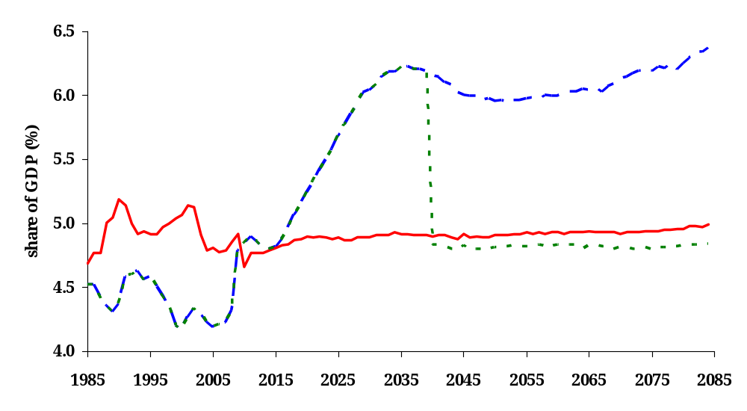
Social Security outlays and receipts
Scheduled Outlays
Scheduled Receipts
Feasible Outlays
Trust Fund Growing
Trust Fund Shrinking

Slide 42
Social Security fixes
Economist: solutions are “simple”
  Increase the payroll tax (need about 2% more)
  Reduce initial level of benefits
  Increase retirement age
  Reduce cost-of-living adjustments
Society/politicians: no, they are not!
Congressional Budget Office analysis (2010)
  http://www.cbo.gov/doc.cfm?index=11580

Slide 43
Medicare and Medicaid
Medicare: age 65 and older
  When enacted: 50% of elderly had insurance
  Parts A&B cover hospital and physician care
  Part D (2006) covers drugs
  Funded by payroll tax and general revenues
Medicaid: poor (joint state-federal program)
  Federal government share about 57%
  States set rules, but generally low income-low wealth populations
  Many enrollees are children

Slide 44
Medicare and Medicaid problems
Medi-spending is growing much faster than GDP
Why?
  Increase in covered population (baby boomers, again!)
  Increase in spending per enrollee
Which is more important?

Slide 45
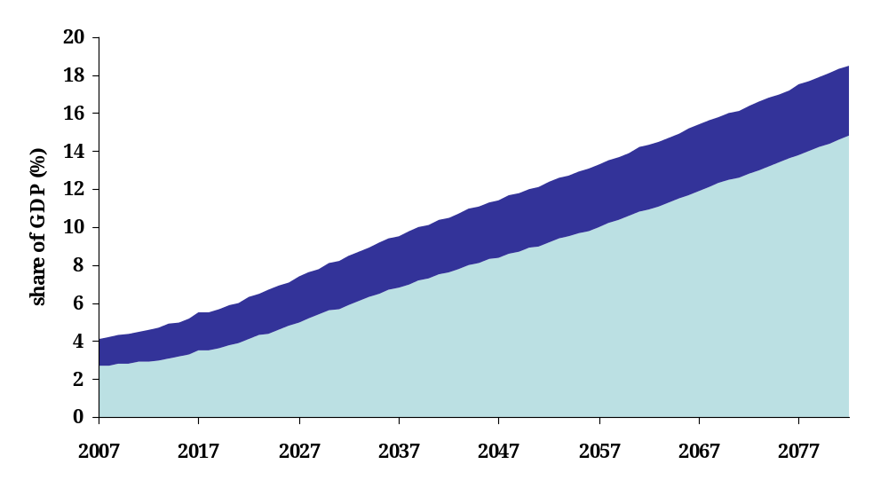
Projected expenditure
Medicaid
Medicare
source: http://www.cbo.gov/ftpdocs/87xx/doc8758/11-13-LT-Health.pdf

Slide 46
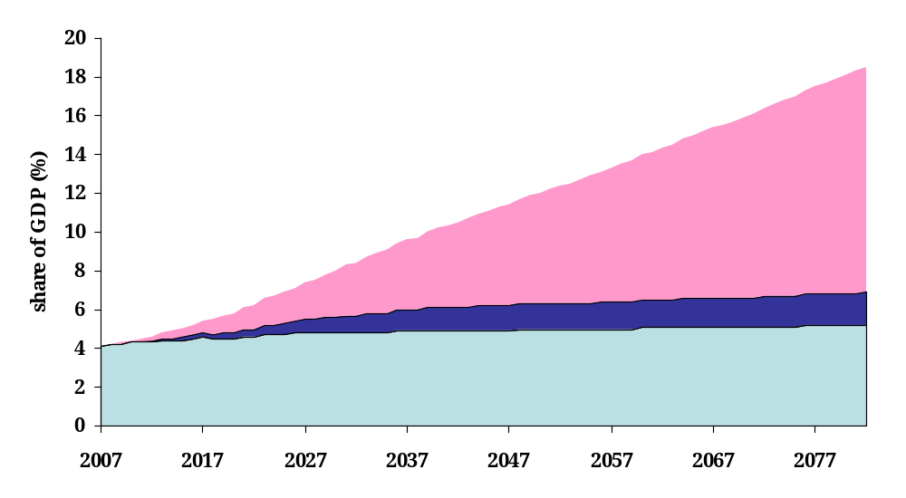
Why is spending growing?
Ageing population
Healthcare spending per insured rising faster than GDP
Holding fixed demographics and spending
source: http://www.cbo.gov/ftpdocs/87xx/doc8758/11-13-LT-Health.pdf

Slide 47
Medicare and Medicaid
What can be done?
  Reduce people receiving benefits
    Small effect
  Reduce payments to providers
  Encourage efficiency in health care
    Economists: benefits vs. costs of treatments
    Most everyone else: incredibly sensitive subject
    Pass costs of more expensive treatments onto patients
    Managing chronic conditions: 85% of medicare expenditures are spent on 25% of beneficiaries

Slide 48
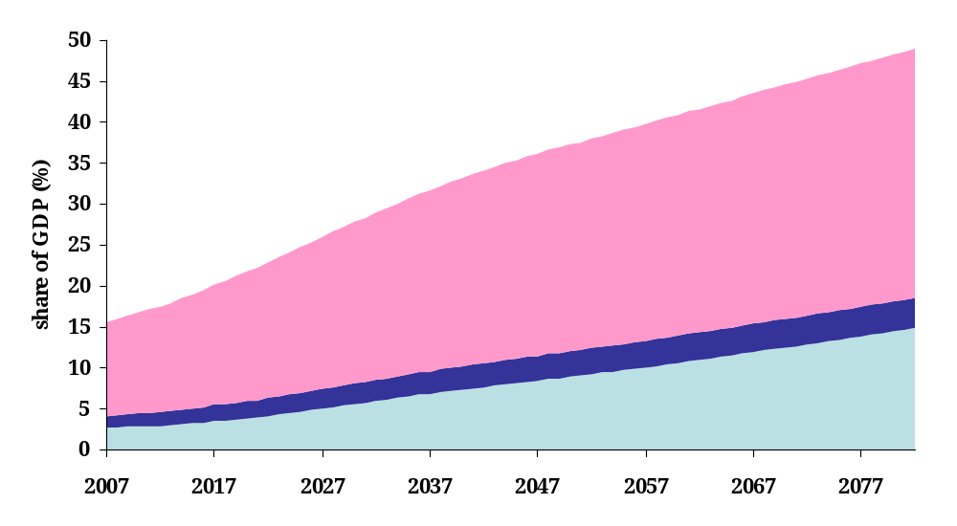
Not only a government issue!
All other medical spending
Medicaid
Medicare
source: http://www.cbo.gov/ftpdocs/87xx/doc8758/11-13-LT-Health.pdf

Slide 49
Long term expenditure summary
U.S. Social Security System
  “Pay-as-you-go” meets “Baby Boomers”
  PDV of unfunded liabilities about 100% of GDP
Medicare and Medicaid
  Expenditures to reach 15% of GDP by 2050
  Culprit: health care spending growing faster than GDP
  PDV of unfunded liabilities about 240% of GDP
Will need to cut benefits and/or increase taxes

Slide 50
Taxes and debt summary
Deficits must be financed
  By issuing debt today
  And by running (primary) surpluses in the future
Sustainability analysis
  Debt tends to grow unless you run surpluses
US deficits
  The biggest issues are not the current deficit, but projected future deficits implied by social security and Medicare-Medicaid payments

Slide 51
Fiscal Policy: For the ride home
The US (and many other countries) have a progressive income tax: tax rates are larger for people with larger incomes
Given our analysis of taxes, how are we distorting the labor supply choices of different groups of people?
Some issues
  Are income and ability related?
  Are labor supply/demand elasticities different for different income levels? Who might be more elastic?
This is a matter of incentives vs. insurance
  To provide insurance, we distort the incentives of people to supply labor (and capital) to earn income

Slide 52
Balance of Payments Roadmap
Balance of payments accounting
Foreign debt
  sustainability
U.S. current account
Surplus countries

Slide 53
Warren Buffett
Annual letter to shareholders, 2006:
  As time passes, and as claims against us grow, we own less and less of what we produce. ... Should we continue to run current account deficits comparable to those now prevailing, ... our US ‘family’ will be delivering [a substantial fraction of] its annual output to the rest of the world simply as tribute for the overindulgences of the past.

Slide 54
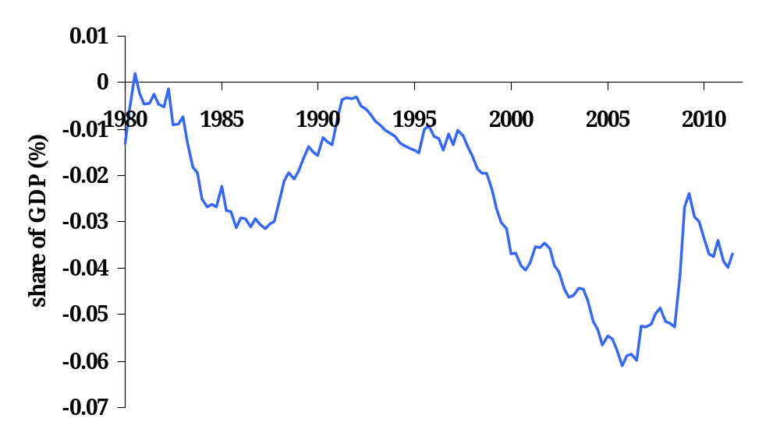
U.S. net exports

Slide 55
Largest deficits 2008
 | Billion USD | % GDP
United States | –788 | -4.3
Spain | –155 | -10.5
United Kingdom | –105 | -4.9
Australia | –53 | -6.3
France | –49 | -2.4
Italy | –49 | -2.4
Greece | –37 | -13.9
Turkey | –36 | -6.7
India | –32 | -3.1
Romania | –25 | -14.5
Source: IMF, WEO; current account.

Slide 56
Largest surpluses 2008
 | Billion USD | % GDP
China | 453 | 9.8
Japan | 195 | 4.0
Germany | 174 | 5.2
Saudi Arabia | 82 | 31.3
Switzerland | 64 | 15.4
Norway | 59 | 20.0
Netherlands | 54 | 5.9
United Arab Emirates | 50 | 27.5
Russia | 49 | 5.8
Singapore | 42 | 20.6

Slide 57
Capital flows
Countries
  When might capital flow from one country to another?

Slide 58
The balance of payments
Importing more than exporting
  Trade deficit (or current account deficit)
How is a current account deficit financed?
  “Inflow” of capital from abroad
  Equivalently: sell assets to rest-of-world
  We say the current account is mirrored by an equal and opposite “capital and financial account”
  That’s why we say balance of payments

Slide 59


Balance of payments
Current account: net exports plus net foreign income
  NFI usually small, we will mostly ignore it
Financial account: trade in assets
Balance of payments
Note: these are all net concepts

Slide 60
Balance of payments
BOP = CA + Capital/Financial Account = 0
Goods
Country 1
Country 2
IOUs
(Cash, bonds, equity)
If Country 1 runs a current account surplus:
There is a capital “outflow” for Country 1, “inflow” for Country 2.
Notes:
Say: NX = CA
Plus: focus on goods

Slide 61
Balance of payments
What do capital flows finance?
Accumulating current account deficits and surplus (flows) gives us the stock of foreign assets (assuming no changes in valuation, including exchange rates)

Slide 62
Net foreign assets
International capital markets
  Countries own claims on each other
  Net position (net foreign assets or NFA):
  NFA = Claims on Foreign Countries – Foreign Claims on Us
Borrowers and lenders
  If NFA>0, country is net creditor (lender)
  If NFA<0, country is net debtor (borrower)
Two terms for the same thing
  Net foreign assets (NFA)
  Net international investment position (Net IIP)

Slide 63
US international investment position
Billions of Dollars, end-2010
Category | Assets | Liabilities
Direct investment (cost) | 4,429 | 2,659
Portfolio investment & Other | 15,397 | 20,127
Reserves | 489 | –
Total | 20,315 | 22,786
Net IIP (=NFA) | –2,471
GDP (2010) = $14,527 bn IIP/GDP=-17.0%
Source: US Treasury.

Slide 64
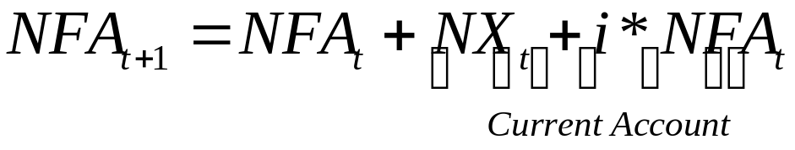
Debt
Net Foreign Assets (NFA) are the total amount owed by the rest of the world to a country
NFA is a stock
  Claims on Foreign Countries – Foreign Claims on us
Current and financial accounts are flows; they measure the changes in the stock of assets
  We are ignoring net asset revaluations

Slide 65
U.S. current account
The likely outcome, absent any major policy changes: current account deficits of 7% of GDP in 2006, and of more than 8% of GDP in 2008.
Roubini and Setser 2004
Where do statements like this come from?

Slide 66
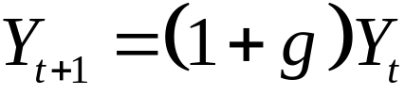
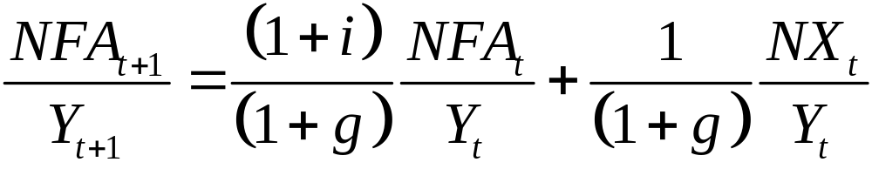
Evolution of debt
Simplified version of Roubini and Setser
Balanced growth path
Nominal interest rate on assets,
Evolution of net foreign debt-gdp ratio

Slide 67



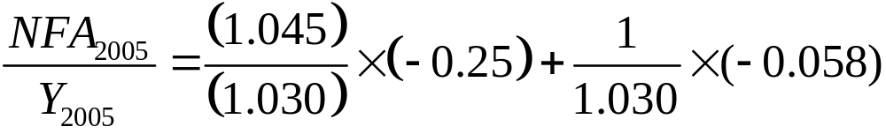
Evolution of debt
,
Assuming the trade deficit is still 5.8% of GDP…
…then the debt-to-GDP ratio evolves as
By 2008: NFA/Y = -0.54 and CA/Y = -0.083
Interest payments would be 2.5% of GDP

Slide 68
Current account deficits
Current account deficits reflect
  Low savings
  High investment
  Both
Are current account deficits “bad?”
  Are we borrowing to finance good investments? Are savings are too low for the long run?
  Is it “bad” when a firm issues bonds?

Slide 69
Is the U.S. in trouble?
Pessimistic view
  Deficits are financing consumption and government deficits
  Debt is accumulating – and so is interest
  We’ll have to pay it off some day
Optimistic view
  Capital inflow shows US is an attractive place to invest
  Interest burden remains small

Slide 70
What about the surplus countries?
Countries with low rates of return seek investments abroad
  Switzerland, Germany, Japan have all had lower growth rates of GDP compared to the U.S.
Oil producing countries
  High oil prices bring income, but not necessarily domestic investment opportunity
High savings countries

Slide 71
Why does China save so much?
Households
  Inadequate financial markets (financial repression)
  Limited social programs (precautionary savings)
  Demographics
Corporations
  Low dividends (SOEs)
  Receive capital transfers from government

Slide 72
BOP Takeaways
BOP accounting keeps track of goods, services, and asset trades
Current account measures changes in the stock of net foreign assets (absent valuation shifts).
Current account reflects net borrowing/lending
  To explain current accounts, explain savings and investment

Slide 73
BOP Deficit takeaways
U.S. current account deficit is large
  Why are foreigners accumulating U.S. assets?
  Are Americans saving sufficiently?
Are current account deficits bad?
  Depends on what is being done with borrowed funds.
  Deficits can not go on forever.

