Slide 1

The Global Economy
Foreign Exchange

Slide 2
Exam 2
Exam: Saturday, December 17, 9am
  Calculator
  1 page of notes
  No books, cell phones, etc.
  Focus study on post-midterm material
How I would study
  Problem sets and practice problems
  Slides
  Notes
  Try the practice exam, timed
Second half summary on Bb
Drinks around 3:30pm: Amity Hall (3rd/Sullivan)

Slide 3
Today’s Roadmap
European Monetary Union (continued)
Exchange Rates
  Exchange rates and prices
  Exchange rates and interest rates
  Exchange rate regimes
Review Session

Slide 4
European Union
Emerged from post-WWII Europe
  ECSC to foster peace between France and Germany
Evolved into the EU and eventually the monetary union, the EMU (a subset of the EU)
  1 currency; 1 central bank; 1 monetary policy
  “one market, one law, one money” (maybe?)
EMU challenge:
  1 monetary policy, 17 heterogeneous countries

Slide 5
Economic benefits and costs
Benefits
  Wide euro acceptance is a public good
  Promotes international trade and finance
    Lowers transaction costs
    Makes pricing transparent
    Expands size of market
  Eliminates exchange rate risk within EMU
Costs
  Sacrifice local monetary policy and lender of last resort
  Can’t inflate away debt; increase risk of government default; diminish ability to recapitalize banks

Slide 6
Two monetary unions
 | US States | EMU Countries
Common monetary policy | Yes | Yes
Common fiscal policy | Yes | No
Fiscal burden sharing | Yes | No
Labor market mobility | High | Low
Official languages | 1 | 23
Unemployment rate, average | 9 | 10
Unemployment rate, high/low | NV=13.4, ND=3.5 | ESP=22.6, NLD=4.5
Prices and wages | Flexible | Less flexible
Richest/Poorest | CT/MS=1.8 | LUX/EST=7.2
Common: deposit insurance, bank regulator and backstop | Yes | No

Slide 7
Rules and time consistency
Secure price stability
  Independent ECB
  “No bailout” clause
Fiscal entry conditions in Treaty
  Seek to contain fiscal moral hazard
  Pressure to comply weakens after entry
  Applied very flexibly even at start
Stability and Growth Pact
  Supplement to the Treaty
  Excessive deficit procedure
  Violated early by Germany, France and others

Slide 8
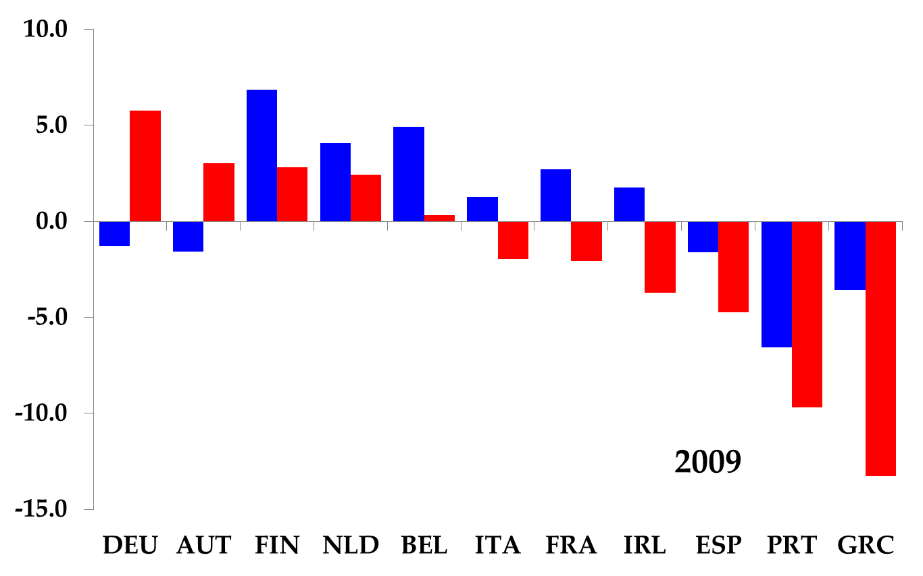
Current accounts percent GDP
1999

Slide 9
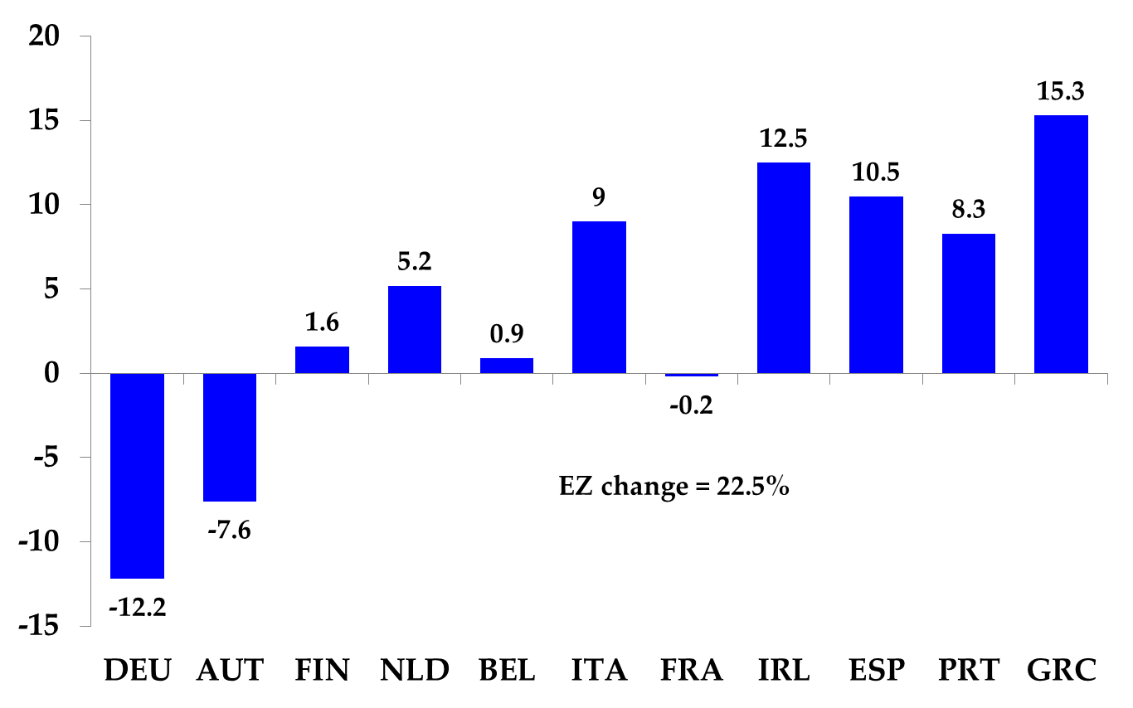
Unit labor costs percent change 1999-2009, relative to EZ change

Slide 10
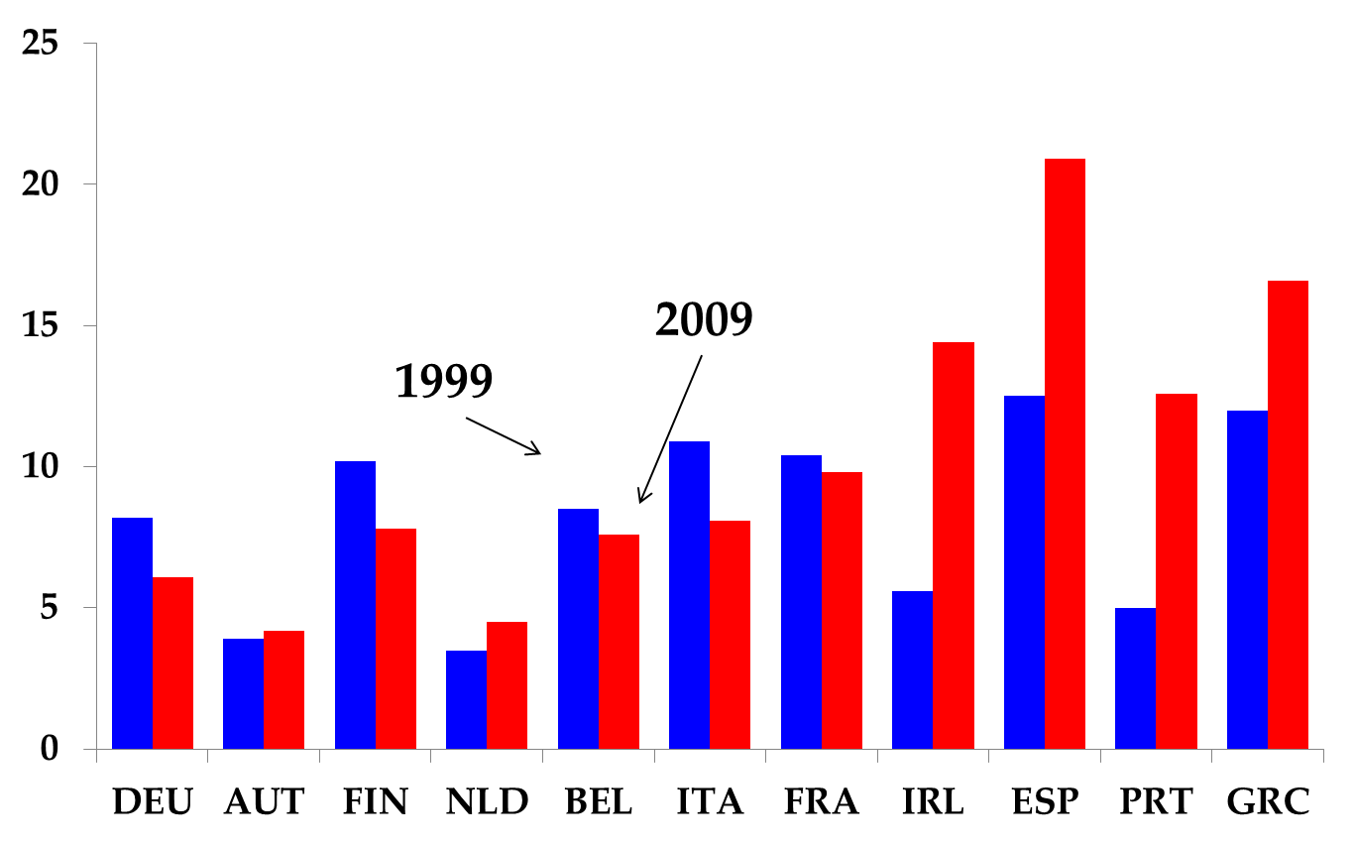
Unemployment rate

Slide 11
Spain, Greece, Ireland, Portugal, Italy
Borrowing costs fall on joining EMU
  “Inherit” central bank discipline
  Can no longer inflate away debt (i vs. g)
Portugal and Greece
  Government debt grows: increase net spending
Ireland and Spain
  Private sector debt grows: housing, consumption
  Private debt becomes public after bank bailouts
Italy
  Already had large debts, but runs primary surplus
  Problem is slow growth (i vs. g, again!)
  GDP/capita 1999-2011: avg 11.5%, Italy 1.8%

Slide 12
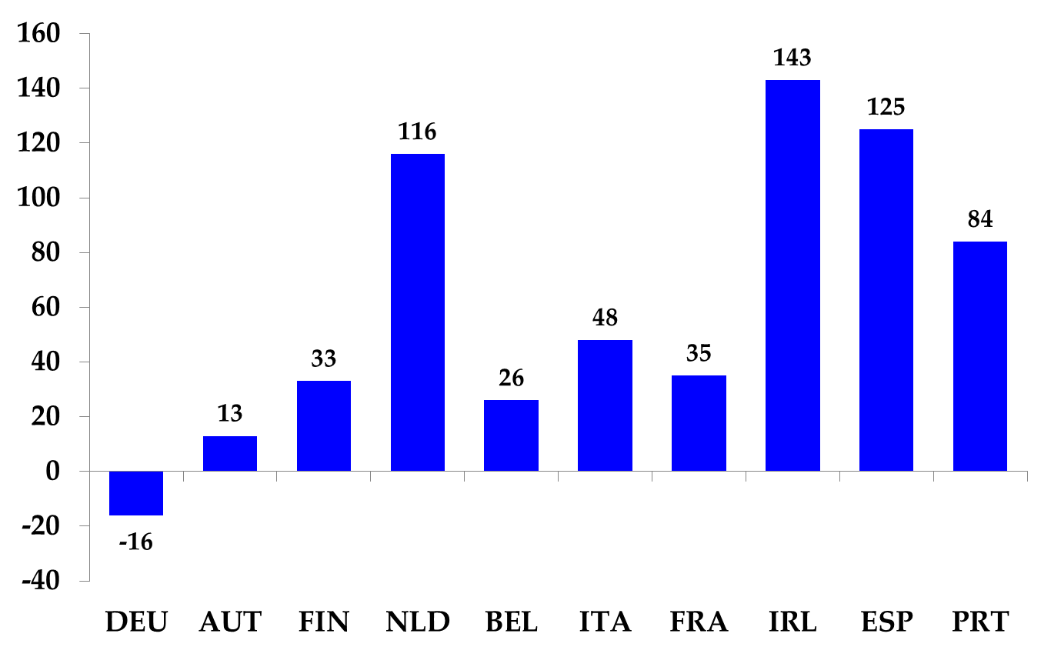
Private credit change from 1999-2009, percent GDP

Slide 13
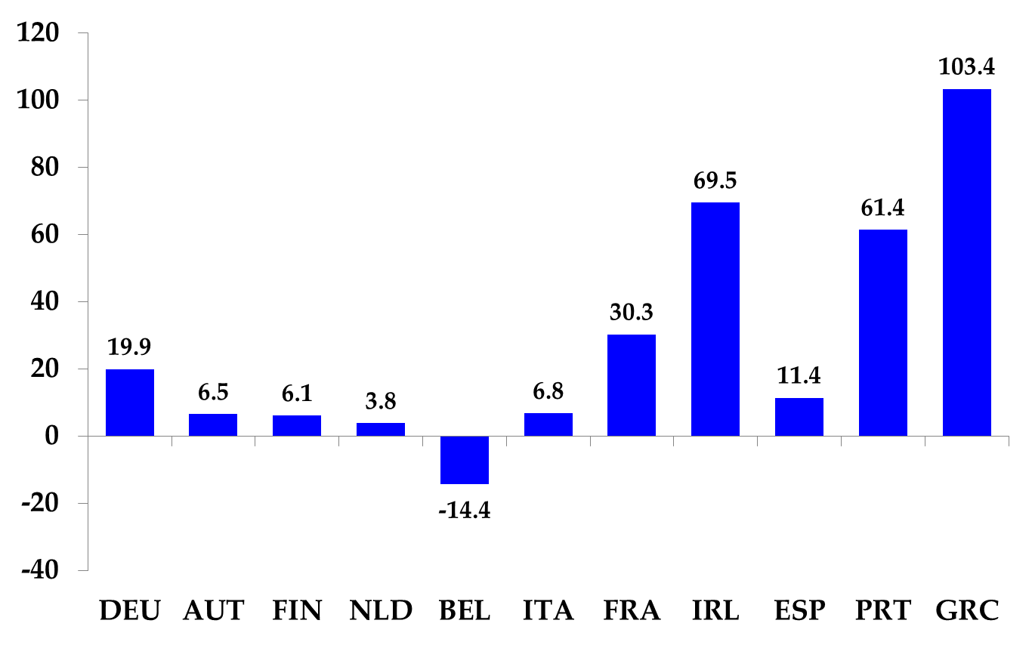
General government debt percent GDP, change 1999-2012

Slide 14
What would happen with no EMU?
Fixed exchange rate system (ERM in 1990s)
  Capital flight out of Greece, etc
  Fixed exchange rates are adjusted/abandoned
  More on this next week
Flexible exchange rate
  Peripheral currencies would depreciate
  Early adjustment likely
  Capital inflows to the peripheral economies would have been smaller, less debt would have been possible

Slide 15
What are the options? I
Abandon EMU?
  Not an economic decision, a political one
    Threatens the entire EU
  The whole thing?
    Germany leaves? Left with a “weak” EMU.
    Greece, Italy leave? Left with a “Northern” EMU.
      Need recapitalization of banks
      Would France be next?
  What happens during transition?
    Cataclysm: banks runs, capital flight, sovereign default
  Eventually settle on a system of fixed exchange rates?

Slide 16
What are the options? II
Fiscal compact?
  Anchor credible fiscal rules in new Treaty and/or state constitutions; require debt paydown over time
  Transition: creditworthiness of Germany used to lower Italy’s borrowing costs (reduce “i – g”)?
Inflate away debt?
  Sacrifices credibility of ECB, perhaps irreversibly
  Unacceptable in Germany

Slide 17
Today’s Roadmap
European Monetary Union (continued)
Exchange Rates
  Exchange rates and prices
  Exchange rates and interest rates
  Exchange rate regimes
Review Session
  Note handout on dating conventions for debt

Slide 18
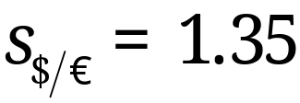
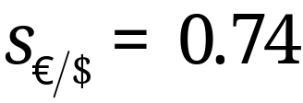
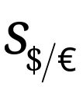
Bilateral exchange rate
Price of one currency in terms of another
  price of a Euro in terms of dollars:
  Careful when reading data
Decrease in is a depreciation of the Euro against the Dollar and an appreciation of the Dollar against the Euro.

Slide 19
Bilateral exchange rates
How are exchange rates determined?
Currencies are like any other good
  A demand and supply for currencies
Let supply and demand determine prices
  Floating exchange rate
Governments can fix a price
  Fixed or pegged exchange rate (more on this later)

Slide 20
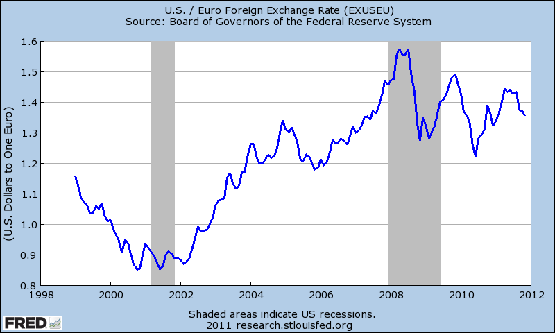
Floating exchange rates

Slide 21
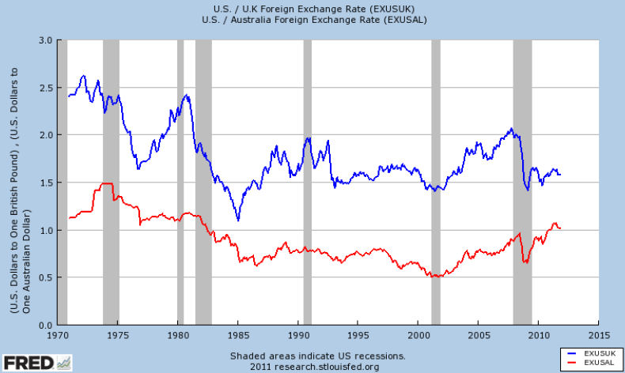
Floating exchange rates

Slide 22
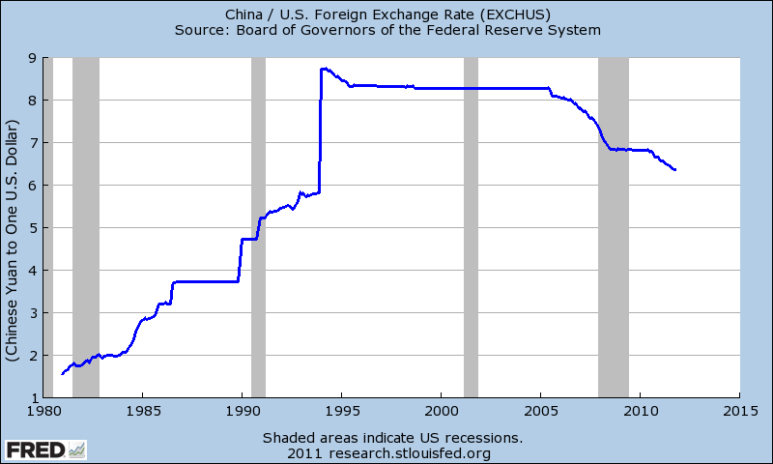
Fixed exchange rates

Slide 23
Explaining exchange rates
What drives the demand and supply of a currency?
Goods trade
  Purchasing power parity
  Exchange rate determined by cross-country goods prices
Asset trade
  Covered interest parity
  Uncovered interest parity
  Exchange rate determined by cross-country interest rates

Slide 24


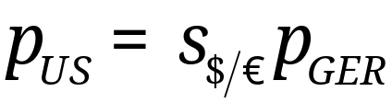
The ‘law’ of one price
The Dollar price of a good in the U.S.,
The Euro price of the same good in Germany,
Law of one price
What if this doesn’t hold?
What if there are transportation costs?
Should this hold for haircuts?

Slide 25

The Big Mac index
 | Local Currency Price | Exchange rate Dec-06-2011 (foreign cur/$) | Dollar price | Implied exchange rate (foreign cur/$) | Over/under valuation (%)
United States | 4.07 | 1.00 | 4.07
Argentina | 20 | 4.29 | 4.66 | 4.66 | 15
China | 14.7 | 6.36 | 2.31 | 3.60 | -43
Norway | 45 | 5.77 | 7.80 | 11.1 | +92
Canada | 4.73 | 1.02 | 4.65 | 1.16 | 14
Japan | 320 | 77.95 | 4.11 | 78.7 | 1
Euro Area | 3.44 | 0.74 | 4.62 | 1.18 | +58
Source: The Economist July 28, 2011
Notes:
Over/under val = implied rate/actual rate -1

Slide 26


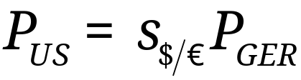
Absolute purchasing power parity
Generalize the law of one price
The Dollar price of a basket of goods in the U.S., such as the CPI,
The Euro price of the same basket of goods in Germany, such as the CPI,
Absolute purchasing power parity

Slide 27
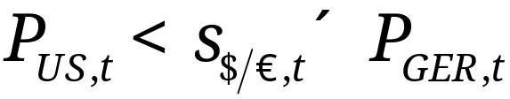
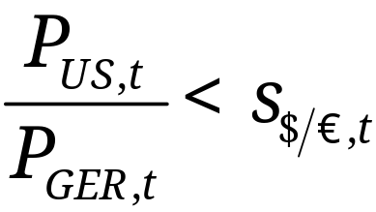
Absolute purchasing power parity
What happens if the price level in Germany is greater than that in the US?
The Euro is too expensive (overvalued) when
The Euro should depreciate relative to the Dollar, or the USD should appreciate relative to the Euro
Works in growth rates, too

Slide 28
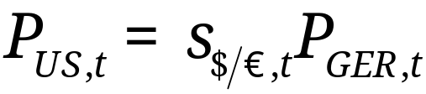
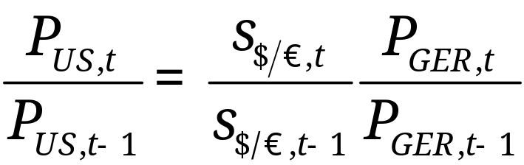
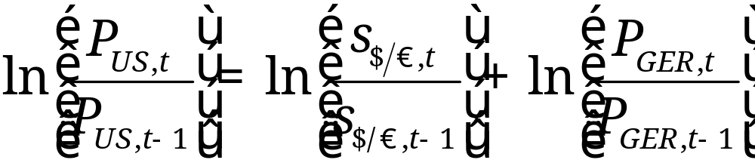
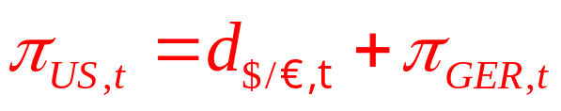
PPP in Growth Rates
PPP says

Slide 29
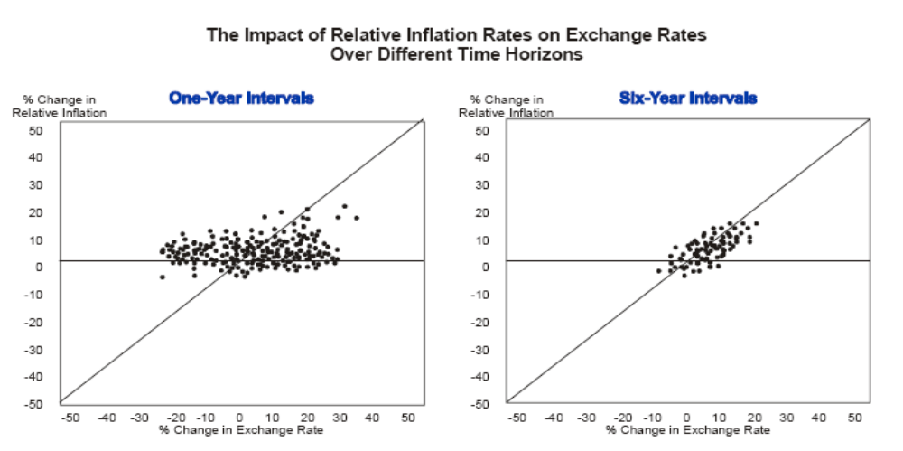
PPP: evidence
Source: Deutsche Bank FX Guide 2002

Slide 30
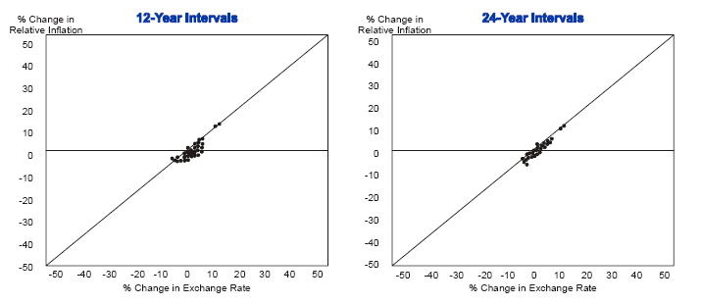
Relative PPP: evidence

Slide 31
Summary: goods trade
Law of one price
  Works well for some goods, not for others
  Depends on how “tradable” the good
Purchasing power parity
  Works well over long time horizons
  Adjustment is slow
    Takes about 5 years to close the gap half way
  Does not work well over short horizons

Slide 32
Explaining exchange rates
What drives the demand and supply of a currency?
Goods trade
  Law of one price 
  Purchasing power parity 
Asset trade
  Covered interest parity
  Uncovered interest parity

Slide 33



Covered interest parity
Want to save 1 dollar for 1 year: where to save?
Asset returns quoted in domestic currency
  U.S. T-bill pays in dollars:
  U.K. T-bill pays in pounds:
Forward contracts are possible
  Contract today for a pound to be delivered in 1 year
  Forward price: price today of a forward contract:

Slide 34
Covered interest parity
Two ways to earn dollars
  Invest abroad and buy a forward contract
    Exchange 1 dollar for pounds
    Invest in pound assets AND contract to sell pounds in the forward market
    One year later: receive returns in pounds, sell pounds according to forward contract
  Invest domestically
    No foreign exchange needed
No arbitrage implies an investor should be indifferent between the two options

Slide 35
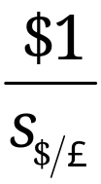
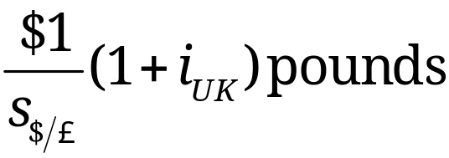
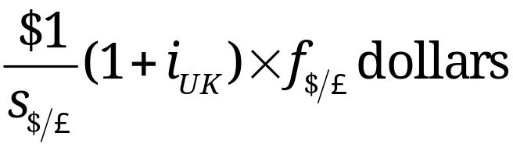
Return from investing abroad (covered)
Buy pounds in the spot market, get pounds
Invest pounds, at the end of the year have
Sell the pounds according to the forward contract

Slide 36

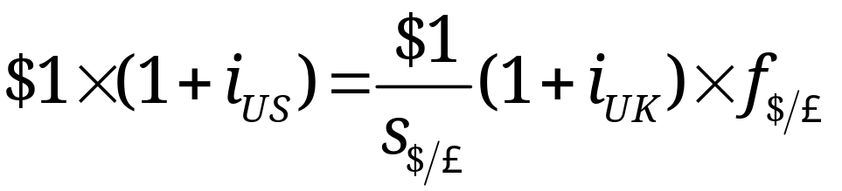
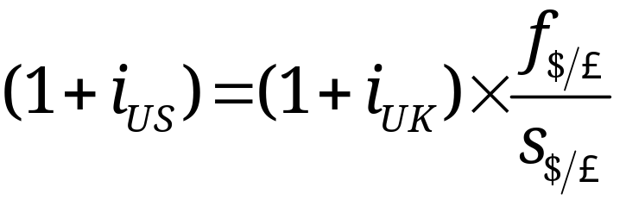
Covered interest parity
Return on one dollar invested in US
To eliminate arbitrage, we must have

Slide 37


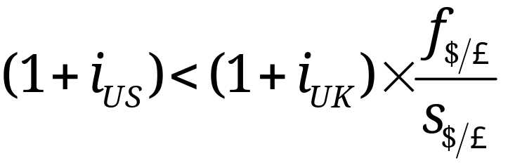
Covered interest parity
Suppose decreases (relative to )
Investors would want fewer US assets
  Need fewer dollars today, depreciate dollar in spot market
  Need more dollars in forward market: appreciate dollar in forward market
CIP generally confirmed in the data

Slide 38
Explaining exchange rates
What drives the demand and supply of a currency?
Goods trade
  Law of one price 
  Purchasing power parity 
Asset trade
  Covered interest parity 
  Uncovered interest parity

Slide 39
Uncovered interest parity
Similar to covered interest parity, but without the forward contract.
Invest abroad
  Exchange 1 dollar for pounds
  Invest in pound assets (no forward contract)
  One year later: receive returns in pounds, sell pounds in spot market for dollars
Invest domestically
Note: this is not an arbitrage.

Slide 40
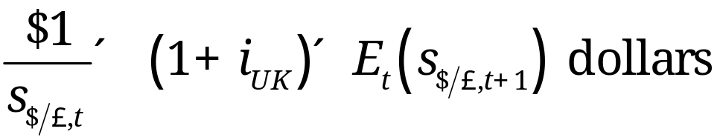
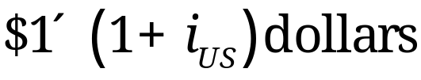
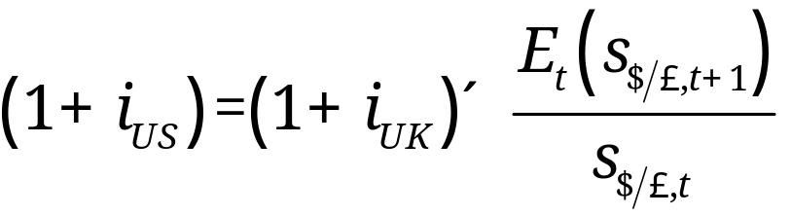
Uncovered interest parity
Expected return on 1 dollar invested in UK
Return on dollar invest in US
Equating the returns

Slide 41
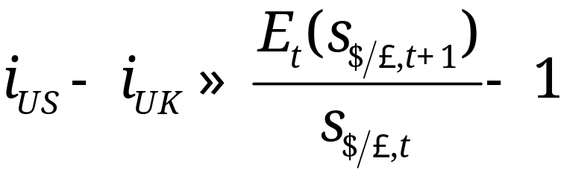

Uncovered interest parity
Taking LN
What happens if (all else constant)
  decreases?
Investors would want fewer US assets
  Need fewer dollars today, depreciate dollar in spot market
  Need more dollars in a year: expected appreciation of dollar
Bottom line: UIP says expect low interest rate currencies to appreciate and high interest rate currencies to depreciate
Expected depreciation rate of the dollar

Slide 42
UIP and the carry trade
UIP does not have to hold in the data
  Not an arbitrage
UIP doesn’t hold in the data, especially for currencies of developed countries
Opposite is often true: high interest rate countries often have appreciating currencies!!

Slide 43
Carry trade
Borrow money in low interest currency (USD)
Invest it in a high interest currency (Aust. $)
If UIP held, dollar would appreciate in future to shrink gain
Since UIP does not always hold, these trades can be profitable
But risky!

Slide 44
Asset trade summary
Covered interest parity
  Strong empirical support
Uncovered interest parity
  High interest rate currencies should depreciate
  Tends to work in the opposite direction in the data for developed countries

Slide 45
Exchange rate regimes
Floating
  Many countries with a float still intervene, (sometimes called “managed” or “dirty” floats)
Fixed or pegged rate
  Intervene to keep the exchange rate fixed in terms of another currency or basket of currencies
  Variations on this allow the rate to float in a band
  The peg may shift over time

Slide 46
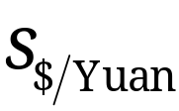
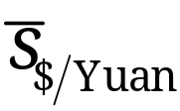


How do you fix an exchange rate?
S
D
Yuan

Slide 47






Fixed exchange rate mechanics
S
S
D
D
Yuan
Pounds
Assets
Liabilities
Assets
Liabilities
(+) dollars
(+) Yuan
(-) marks
(-) pounds

Slide 48
Why a fixed exchange rate?
Pro: provides a nominal anchor
  Helpful when monetary policy has lost credibility
  Argentina 1991
Pro: facilitates trade and investment
  Lowers costs of doing business (think Euro)
  Decreases uncertainty in foreign pricing

Slide 49
Why not a fixed exchange rate?
The ‘trilemma:’ three options, pick only two
  Fixed exchange rates
  Free movement of international capital
  Independent monetary policy
Examples
  U.K.(1992): fixed rate/free capital: no monetary policy discretion
  China: fixed rate/independent monetary policy: no free movement of capital
  U.S.: Free movement of capital/independent MP: no fixed exchange rate

Slide 50
United Kingdom, 1992
Fixed rate and free movement of capital
No monetary policy discretion
U.K. and Germany had a fixed exchange rate as part of a system of European fixed exchange rates: the ERM
High interest rates in Germany compel U.K. to adopt high interest rates to keep the exchange rate fixed
  If not, free movement capital means demand for Pounds shifts left
Weak U.K. economy means high interest rates are not desirable
Lack of policy credibility invites speculation

Slide 51
Monetary policy is not independent!
S
S
D
D
Pounds
Pounds
Higher interest rates in Germany + free movement of capital. Capital flees U.K., decreasing demand for Pounds. Losing reserves.
Must increase interest rates to increase demand for Pounds. Unwanted contractionary monetary policy!

Slide 52
The end of UK fixed exchange rates
Bank of England can
  Keep interest rates high
  Run down stock of reserves (can’t do this for long)
  Devalue the currency
Investors speculate that BoE would rather devalue than keep interest rates high during a recession: policy commitment not credible
  Borrow in Pounds, sell Pounds for Marks
  BoE must raise interest rates or allow reserves to drain
  Becomes a game of chicken

Slide 53
“Black Wednesday”
On September 16, 1992
U.K. raises interest rates from 10% to 12%
  Promise to raise rate to 15% later that day
Doesn’t stop speculators from selling Pounds
  Government abandons fixed rate regime
  Soros reportedly makes about $1 billion
Self-fulfilling prophecy
  Fixed rate may have held if not attacked
  Fixed rate failed when attacked

Slide 54
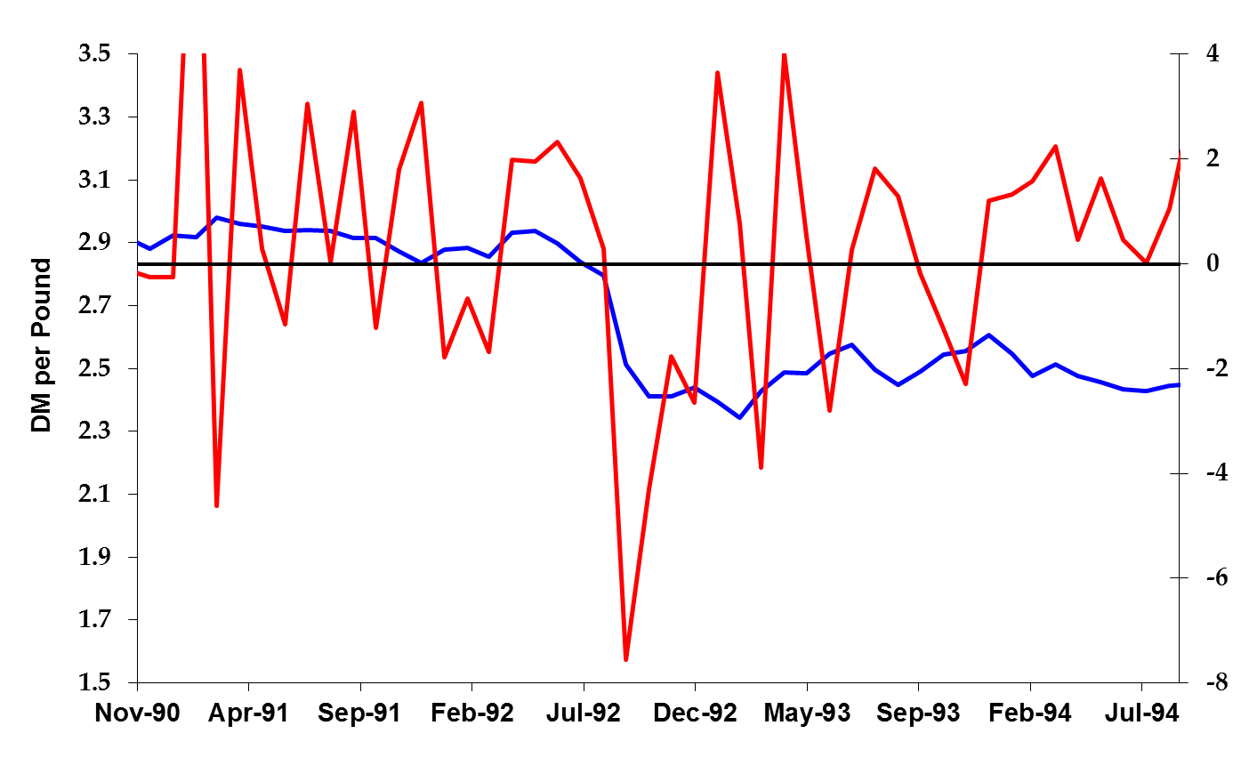
Deutschmark-Pound exchange rates
Growth rate of reserve assets (right axis)
Exchange rate (left axis)

Slide 55
China, present
Fixed rate and flexibility of monetary policy:
  No free movement of capital (lack of convertibility)
China fixes exchange rate against dollar
  Yuan appears undervalued relative to dollar
People’s Bank can alter monetary policy to some extent
  Raising interest rates to battle inflation shifts yuan demand right…
  …but capital controls partly mitigate this shift
  Like “throwing a wrench in the gears”
Costs of capital controls?
  Hinders efficient use of capital and limits financial development
  Overvaluation can lead to black market for currency
  Can discourage foreign investment
Works … for now

Slide 56
Fixed exchange rates

Slide 57
How do you fix an exchange rate?
S
D
Yuan

Slide 58
How do you fix an exchange rate?
The government buys and sells the domestic currency
People’s Bank of China balance sheet
Assets Liabilities
International Reserve Assets
Dollars
Domestic Currency
Dollar Assets
Yuan Assets

Slide 59
How do you fix an exchange rate?
People’s bank must supply the excess Yuan
  Buy Dollars with Yuan: “print money”
People’s Bank of China balance sheet
Accumulate foreign reserves
Capital controls (lack of convertibility) limit flows
Assets Liabilities
(+) Dollars
Domestic Currency (+)
Dollar Assets
Yuan Assets

Slide 60
How do you fix an exchange rate?
The people’s bank accumulates Dollars
Dollars have poor rates of return
Buy dollar assets, leaving the money supply unchanged
Dollars go back to the U.S.
Assets Liabilities
(-) Dollars
Domestic Currency
(+) Dollar Assets
Yuan Assets

Slide 61
“Sterilized” Intervention
Can the PBoC buy dollar assets without expanding its balance sheet (or the supply of money)? Answer: If it has yuan assets to sell.
  Method: Sell yuan assets to “sterilize” the $ purchase
Assets Liabilities
Dollars
Domestic Currency
(+) Dollar Assets
(–) Yuan Assets

Slide 62
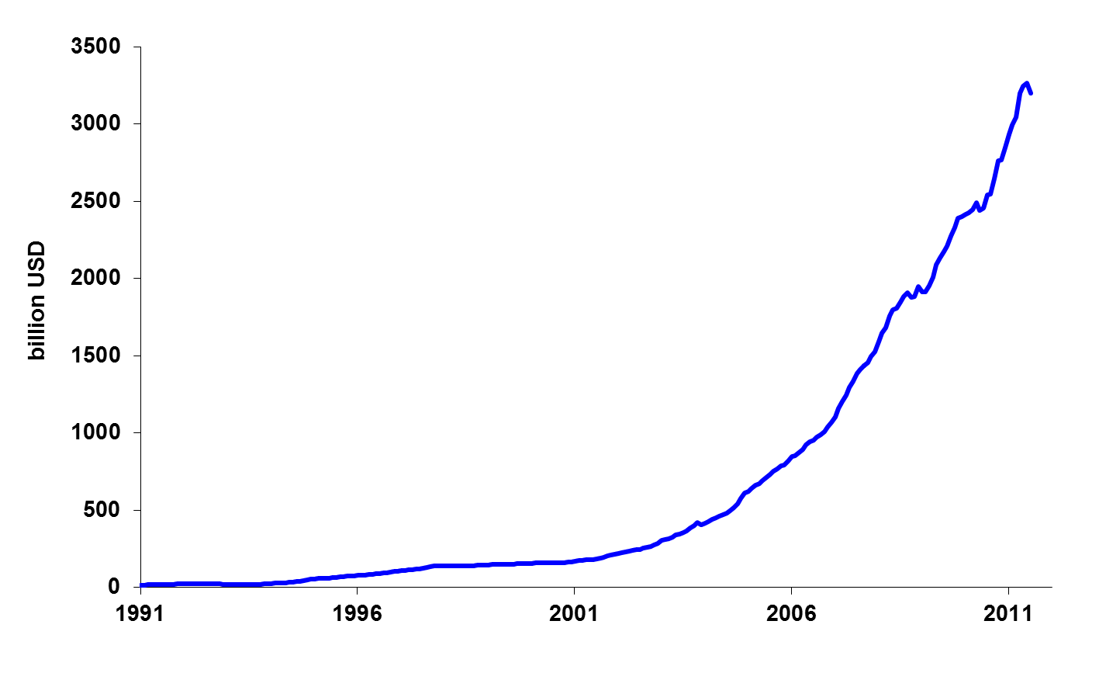
Foreign reserve assets, China

Slide 63
Foreign holdings of U.S. securities
Billions of US$, as of 6-30-2010
(Billions of dollars) | Total debt | Long term Treas. debt | Long term agency debt | Short term debt | Equity
China | 1484 | 1108 | 360 | 5 | 127
Japan | 1169 | 737 | 234 | 69 | 224
United Kingdom | 474 | 72 | 10 | 22 | 324
Cayman Is. | 453 | 36 | 32 | 82 | 290
Middle East oil-exporter | 222 | 107 | 16 | 73 | 128
Total | 7877 | 3343 | 1085 | 956 | 2814
Of which: held by foreign official institutions | 3920 | 2617 | 721 | 484 | 426
Source: US Treasury.

Slide 64
US, present
Free movement of capital and ind. monetary policy:
  No fixed exchange rate
Federal Reserve’s mandate
  Low and stable inflation
  Maximum sustainable employment
  Nothing about exchange rates
Monetary policy based on domestic conditions
Free movement of capital into/out of country
  Changes in interest rates shift demand for currency, and change the exchange rate
  Changes in expected inflation do, too

Slide 65
Exchange rate variation (1999-Nov 2011)
 | Floating exchange rate |  |  |  | Fixed exchange rate
 | Euro-USD | Yen-USD | Pound- USD |  | Yuan-USD | HKD-USD | D.Krone-Euro
Mean | 0.85 | 107.97 | 0.60 |  | 7.74 | 7.78 | 7.45
Std | 0.15 | 13.43 | 0.06 |  | 0.68 | 0.02 | 0.01
Std/mean | 0.18 | 0.12 | 0.11 |  | 0.09 | 0.003 | 0.001
Far more variation in floating exchange rates
Foreign trade pricing decision more difficult
  Argument for the Euro area (Euro area std=0)
Variation in Yuan-USD relatively “forecastable”

Slide 66
Why a fixed exchange rate?
Pro: provides a nominal anchor
  Helpful when monetary policy has lost credibility
Pro: facilitates trade and investment
  Lowers costs of doing business (think Euro)
Con: lose control of monetary policy or lose capital mobility
  Cannot respond to domestic conditions: Greece, Ireland, etc
  Capital flows restricted: China
Con: Subject to speculative attacks
Bottom line: most exchange rates were fixed after WWII, most no longer are.
  Evidence that the cons outweigh the pros in most cases.

Slide 67
Exchange rate regime summary
Variety of exchange rate regimes: most variations on floating or fixed rates
A fixed rate (almost) always has to be defended
  Sell domestic currency if rate is too “low”
  Buy domestic currency if rate is too “high”
Fixed rates have pros…
  Nominal anchor, increase trade
…and significant cons
  Speculative attacks, loss of monetary policy

Slide 68
Today’s Roadmap
European Monetary Union (continued)
Exchange Rates
  Exchange rates and prices
  Exchange rates and interest rates
  Exchange rate regimes
Review Session

