Slide 1

The Global Economy BoP & Foreign Exchange

Slide 2
Exam
Exam: Saturday, December 17, 9am
Calculator
1 page of notes
No books, cell phones, etc.
Focus study on post-midterm material

Slide 3
Today’s Roadmap
European Monetary Union (continued)
Exchange Rates
Exchange rates and prices
Exchange rates and interest rates
Exchange rate regimes
Review Session
Note handout on dating conventions for debt

Slide 4
European Union
Emerged from post-WWII Europe
ECSC to foster peace between France and Germany
Evolved into the EU and eventually the monetary union, the EMU (a subset of the EU)
1 currency; 1 central bank; 1 monetary policy
“one market, one law, one money” (maybe?)
EMU challenge:
1 monetary policy, 17 heterogeneous countries

Slide 5
Economic benefits and costs
Benefits
Wide euro acceptance is a public good
Promotes international trade and finance
Lowers transaction costs
Makes pricing transparent
Expands size of market
Eliminates exchange rate risk within EMU
Costs
Sacrifice local monetary policy and lender of last resort
Can’t inflate away debt; increase risk of government default; diminish ability to recapitalize banks

Slide 6
Two monetary unions
 | US States | EMU Countries
Common monetary policy | Yes | Yes
Common fiscal policy | Yes | No
Fiscal burden sharing | Yes | No
Labor market mobility | High | Low
Official languages | 1 | 23
Unemployment rate, average | 9 | 10
Unemployment rate, high/low | NV=13.4, ND=3.5 | ESP=22.6, NLD=4.5
Prices and wages | Flexible | Less flexible
Richest/Poorest | CT/MS=1.8 | LUX/EST=7.2
Common: deposit insurance, bank regulator and backstop | Yes | No

Slide 7
Rules and time consistency
Secure price stability
Independent ECB
“No bailout” clause
Fiscal entry conditions in Treaty
Seek to contain fiscal moral hazard
Pressure to comply weakens after entry
Applied very flexibly even at start
Stability and Growth Pact
Supplement to the Treaty
Excessive deficit procedure
Violated early by Germany, France and others

Slide 8
Current accounts percent GDP
1999

Slide 9
Unit labor costs percent change 1999-2009, relative to EZ change

Slide 10
Unemployment rate

Slide 11
Spain, Greece, Ireland, Portugal, Italy
Borrowing costs fall on joining EMU
“Inherit” central bank discipline
Can no longer inflate away debt (i vs. g)
Portugal and Greece
Government debt grows: increase net spending
Ireland and Spain
Private sector debt grows: housing, consumption
Private debt becomes public after bank bailouts
Italy
Already had large debts, but runs primary surplus
Problem is slow growth (i vs. g, again!)
GDP/capita 1999-2011: avg 11.5%, Italy 1.8%

Slide 12
Private credit change from 1999-2009, percent GDP

Slide 13
General government debt percent GDP, change 1999-2012

Slide 14
What would happen with no EMU?
Fixed exchange rate system (ERM in 1990s)
Capital flight out of Greece, etc
Fixed exchange rates are adjusted/abandoned
More on this next week
Flexible exchange rate
Peripheral currencies would depreciate
Early adjustment likely
Capital inflows to the peripheral economies would have been smaller, less debt would have been possible

Slide 15
What are the options? I
Abandon EMU?
Not an economic decision, a political one
Threatens the entire EU
The whole thing?
Germany leaves? Left with a “weak” EMU.
Greece, Italy leave? Left with a “Northern” EMU.
Need recapitalization of banks
Would France be next?
What happens during transition?
Cataclysm: banks runs, capital flight, sovereign default
Eventually settle on a system of fixed exchange rates?

Slide 16
What are the options? II
Fiscal compact?
Anchor credible fiscal rules in new Treaty and/or state constitutions; require debt paydown over time
Transition: creditworthiness of Germany used to lower Italy’s borrowing costs (reduce “i – g”)?
Inflate away debt?
Sacrifices credibility of ECB, perhaps irreversibly
Unacceptable in Germany

Slide 17
Today’s Roadmap
European Monetary Union (continued)
Exchange Rates
Exchange rates and prices
Exchange rates and interest rates
Exchange rate regimes
Review Session
Note handout on dating conventions for debt

Slide 18
Exchange Rates
Exchange rates and prices
Exchange rates and interest rates
Exchange rate regimes

Slide 19
Bilateral exchange rate
Price of one currency in terms of another
price of a Euro in terms of dollars:
Careful when reading data
Decrease in is a depreciation of the Euro against the Dollar and an appreciation of the Dollar against the Euro.

Slide 20
Bilateral exchange rates
How are exchange rates determined?
Currencies are like any other good
A demand and supply for currencies
Let supply and demand determine prices
Floating exchange rate
Governments can fix a price
Fixed or pegged exchange rate (more on this later)

Slide 21
Floating exchange rates
U.K.
Australia

Slide 22
Fixed exchange rates
China

Slide 23
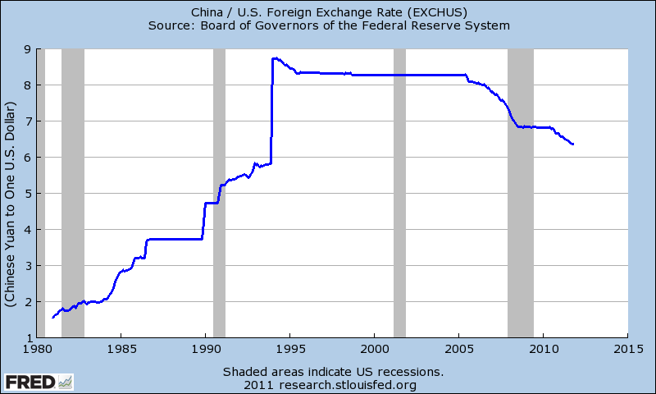

Slide 24
Explaining exchange rates
What drives the demand and supply of a currency?
Goods trade
Purchasing power parity
Asset trade
Covered interest parity
Uncovered interest parity

Slide 25
The ‘law’ of one price
The Dollar price of a good in the U.S.,
The Euro price of the same good in Germany,
Law of one price
What if this doesn’t hold?
What if there are transportation costs?
Should this hold for haircuts?

Slide 26

The Big Mac index
 | Local Currency Price | Exchange rate July 22 (foreign cur/$) | Dollar price | Implied exchange rate (foreign cur/$) | Over/under valuation (%)
United States | 3.73 | 1.00 | 3.73
Argentina | 14 | 3.94 | 3.52 | 3.75 | -4.8
China | 13.2 | 6.78 | 1.98 | 3.54 | -48
Norway | 45 | 6.26 | 7.52 | 12.1 | +93
Canada | 4.17 | 1.04 | 4.15 | 1.12 | 8
Japan | 320 | 87.12 | 3.87 | 85.7 | -2
Euro Area | 3.38 | 0.78 | 4.51 | 0.91 | +17
Source: The Economist July 22, 2010
Notes:
Over/under val = implied rate/actual rate -1

Slide 27
Absolute purchasing power parity
Generalize the law of one price
The Dollar price of a basket of goods in the U.S., such as the CPI,
The Euro price of the same basket of goods in Germany, such as the CPI,
Absolute purchasing power parity

Slide 28
Absolute purchasing power parity
What happens if the price level in Germany is greater than that in the US?
The Euro is too expensive
The Euro should depreciate relative to the Dollar, or the USD should appreciate relative to the Euro

Slide 29
Purchasing power parity
PPP says
The Euro is too expensive (overvalued) when
The Euro should depreciate relative to the Dollar, or the USD should appreciate relative to the Euro
Can express this in growth rates, too (see notes)

Slide 30
PPP: evidence
Source: Deutsche Bank FX Guide 2002

Slide 31
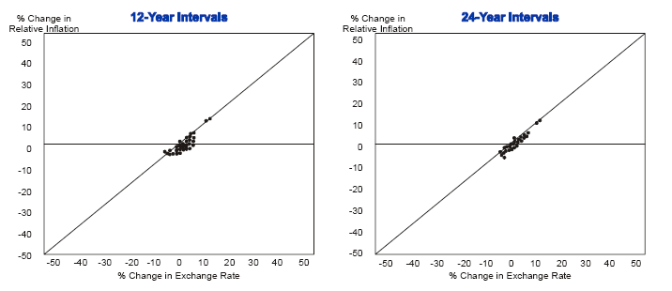
Relative PPP: evidence

Slide 32
Summary: goods trade
Law of one price
Works well for some goods, not for others
Depends on how “tradable” the good
Purchasing power parity
Works well over long time horizons
Adjustment is slow
Takes about 5 years to close the gap half way
Does not work well over short horizons

Slide 33
Explaining exchange rates
What drives the demand and supply of a currency?
Goods trade
Law of one price 
Purchasing power parity 
Asset trade
Covered interest parity
Uncovered interest parity

Slide 34
Covered interest parity
Want to save 1 dollar for 1 year: where to save?
Asset returns quoted in domestic currency
U.S. T-bill pays in dollars:
U.K. T-bill pays in pounds:
Forward contracts are possible
Contract today for a pound to be delivered in 1 year
Forward price: price today of a forward contract:

Slide 35
Covered interest parity
Two ways to earn dollars
Invest abroad and buy a forward contract
Exchange 1 dollar for pounds
Invest in pound assets AND contract to sell pounds in the forward market
One year later: receive returns in pounds, sell pounds according to forward contract
Invest domestically
No foreign exchange needed

Slide 36
Return from investing abroad (covered)
Buy pounds in the spot market, get pounds
Invest pounds, at the end of the year have
Sell the pounds according to the forward contract

Slide 37
Covered interest parity
Return on one dollar invested in US
To eliminate arbitrage, we must have

Slide 38
Covered interest parity
Suppose decreases (relative to )
Investors would want fewer US assets
Need fewer dollars today, depreciate dollar in spot market
Need more dollars in forward market: appreciate dollar in forward market
CIP generally confirmed in the data

Slide 39
Explaining exchange rates
What drives the demand and supply of a currency?
Goods trade
Law of one price 
Purchasing power parity 
Asset trade
Covered interest parity 
Uncovered interest parity

Slide 40
Uncovered interest parity
Similar to covered interest parity, but without the forward contract.
Invest abroad
Exchange 1 dollar for pounds
Invest in pound assets (no forward contract)
One year later: receive returns in pounds, sell pounds in spot market for dollars
Invest domestically

Slide 41
Uncovered interest parity
Expected return on 1 dollar invested in UK
Return on dollar invest in US
Equating the returns

Slide 42
Uncovered interest parity
Taking LN
What happens if (all else constant)
decreases?
Investors would want fewer US assets
Need fewer dollars today, depreciate dollar in spot market
Need more dollars in a year: expected appreciation of dollar
Bottom line: expect low interest rate currencies to appreciate and high interest rate currencies to depreciate
Expected depreciation rate of the dollar

Slide 43
UIP and the carry trade
UIP does not have to hold in the data
Not an arbitrage
UIP doesn’t hold in the data, especially for currencies of developed countries
Opposite is often true: high interest rate countries often have appreciating currencies!!

Slide 44
Carry trade
Borrow money in low interest currency (USD)
Invest it in a high interest currency (Aust. $)
If UIP held, dollar would appreciate in future to shrink gain
Since UIP does not always hold, these trades can be profitable
But risky!

Slide 45
Asset trade summary
Covered interest parity
Strong empirical support
Uncovered interest parity
High interest rate currencies should depreciate
Tends to work in the opposite direction in the data for developed countries

Slide 46
Exchange rate regimes
Floating
Many countries with a float still intervene, (sometimes called “managed” or “dirty” floats)
Fixed or pegged rate
Intervene to keep the exchange rate fixed in terms of another currency or basket of currencies
Variations on this allow the rate to float in a band
The peg may shift over time

Slide 47
How do you fix an exchange rate?
S
D
Yuan

Slide 48
How do you fix an exchange rate?
S
D
Argentine Peso

Slide 49
Why a fixed exchange rate?
Pro: provides a nominal anchor
Helpful when monetary policy has lost credibility
Argentina 1991
Pro: facilitates trade and investment
Lowers costs of doing business (think Euro)
Decreases uncertainty in foreign pricing

Slide 50
Why not a fixed exchange rate?
The ‘trilemma:’ three options, pick only two
Fixed exchange rates
Free movement of international capital
Independent monetary policy
Examples
U.K.(1992): fixed rate/free capital: no monetary policy discretion
China: fixed rate/independent monetary policy: no free movement of capital
U.S.: Free movement of capital/independent MP: no fixed exchange rate

Slide 51
United Kingdom, 1992
Fixed rate and free movement of capital No monetary policy discretion
U.K. and Germany had a fixed exchange rate as part of a system of European fixed exchange rates: the ERM
High interest rates in Germany compel U.K. to adopt high interest rates to keep the exchange rate fixed
If not, free movement capital means demand for Pounds shifts left
Weak U.K. economy means high interest rates are not desirable
Lack of policy credibility invites speculation

Slide 52
Monetary policy is not independent!
S
S
D
D
Pounds
Pounds
Higher interest rates in Germany + free movement of capital. Capital flees U.K., decreasing demand for Pounds. Losing reserves.
Must increase interest rates to increase demand for Pounds. Unwanted contractionary monetary policy!

Slide 53
The end of UK fixed exchange rates
Bank of England can
Keep interest rates high
Run down stock of reserves (can’t do this for long)
Devalue the currency
Investors speculate that BoE would rather devalue than keep interest rates high during a recession: policy commitment not credible
Borrow in Pounds, sell Pounds for Marks
BoE must raise interest rates or allow reserves to drain
Becomes a game of chicken

Slide 54
“Black Wednesday”
On September 16, 1992
U.K. raises interest rates from 10% to 12%
Promise to raise rate to 15% later that day
Doesn’t stop speculators from selling Pounds
Government abandons fixed rate regime
Soros reportedly makes about $1 billion
Self-fulfilling prophecy
Fixed rate may have held if not attacked
Fixed rate failed when attacked

Slide 55
Deutschmark-Pound exchange rates
Growth rate of reserve assets (right axis)
Exchange rate (left axis)

Slide 56
China, present
Fixed rate and flexibility of monetary policy:
No free movement of capital (lack of convertibility)
China fixes exchange rate against dollar
Yuan appears undervalued relative to dollar
People’s Bank can alter monetary policy to some extent
Raising interest rates to battle inflation shifts yuan demand right…
…but capital controls partly mitigate this shift
Like “throwing a wrench in the gears”
Costs of capital controls?
Hinders efficient use of capital and limits financial development
Overvaluation can lead to black market for currency
Can discourage foreign investment
Works … for now

Slide 57
Fixed exchange rates
China

Slide 58
How do you fix an exchange rate?
S
D
Yuan

Slide 59
How do you fix an exchange rate?
The government buys and sells the domestic currency
People’s Bank of China balance sheet
Assets Liabilities
International Reserve Assets
Dollars
Domestic Currency
Dollar Assets
Yuan Assets

Slide 60
How do you fix an exchange rate?
People’s bank must supply the excess Yuan
Buy Dollars with Yuan: “print money”
People’s Bank of China balance sheet
Accumulate foreign reserves
Capital controls (lack of convertibility) limit flows
Assets Liabilities
(+) Dollars
Domestic Currency (+)
Dollar Assets
Yuan Assets

Slide 61
How do you fix an exchange rate?
The people’s bank accumulates Dollars
Dollars have poor rates of return
Buy dollar assets, leaving the money supply unchanged
Dollars go back to the U.S.
Assets Liabilities
(-) Dollars
Domestic Currency
(+) Dollar Assets
Yuan Assets

Slide 62
“Sterilized” Intervention
Can the PBoC buy dollar assets without expanding its balance sheet (or the supply of money)? Answer: If it has yuan assets to sell.
Method: Sell yuan assets to “sterilize” the $ purchase
Assets Liabilities
Dollars
Domestic Currency
(+) Dollar Assets
(–) Yuan Assets

Slide 63
Foreign reserve assets, China

Slide 64
Foreign holdings of U.S. securities
(Billions of dollars) | Total debt | Long term Treas. debt | Long term agency debt | Short term debt | Equity
China | 1371 | 757 | 454 | 160 | 78
Japan | 934 | 646 | 219 | 69 | 182
United Kingdom | 94 | 56 | 15 | 23 | 279
Cayman Is. | 134 | 19 | 42 | 73 | 227
Middle East oil-exporter | 213 | 123 | 22 | 68 | 110
Total | 4949 | 2604 | 1196 | 1149 | 2252
Of which: held by foreign official institutions | 3463 | 2054 | 795 | 614 | 311
Source: http://www.treasury.gov/resource-center/data-chart-center/tic/Documents/shl2009r.pdf

Slide 65
US, present
Free movement of capital and ind. monetary policy:
No fixed exchange rate
Federal Reserve’s mandate
Low and stable inflation
Maximum sustainable employment
Nothing about exchange rates
Monetary policy based on domestic conditions
Free movement of capital into/out of country
Changes in interest rates shift demand for currency, and change the exchange rate
Changes in expected inflation do, too

Slide 66
Exchange rate variation (1999-2009)
 | Floating exchange rate |  |  |  | Fixed exchange rate
 | Euro-USD | Yen-USD | Pound- USD |  | Yuan-USD | HKD-USD | D.Krone-Euro
Mean | 0.87 | 111.94 | 0.60 |  | 7.91 | 7.78 | 7.45
Std | 0.16 | 9.74 | 0.067 |  | 0.55 | 0.021 | 0.021
Std/mean | 0.18 | 0.087 | 0.11 |  | 0.069 | 0.003 | 0.003
Far more variation in floating exchange rates
Foreign trade pricing decision more difficult
Argument for the Euro area (Euro area std=0)
Variation in Yuan-USD relatively “forecastable”

Slide 67
Why a fixed exchange rate?
Pro: provides a nominal anchor
Helpful when monetary policy has lost credibility
Pro: facilitates trade and investment
Lowers costs of doing business (think Euro)
Con: lose control of monetary policy or lose capital mobility
Cannot respond to domestic conditions: Greece, Ireland, etc
Capital flows restricted: China
Con: Subject to speculative attacks
Bottom line: most exchange rates were fixed after WWII, most no longer are.
Evidence that the cons outweigh the pros in most cases.

Slide 68
Exchange rate regime summary
Variety of exchange rate regimes: most variations on floating or fixed rates
A fixed rate (almost) always has to be defended
Sell domestic currency if rate is too “low”
Buy domestic currency if rate is too “high”
Fixed rates have pros…
Nominal anchor, increase trade
…and significant cons
Speculative attacks, loss of monetary policy

Slide 69
Thank you!

Slide 70
Today’s Roadmap
European Monetary Union (continued)
Exchange Rates
Exchange rates and prices
Exchange rates and interest rates
Exchange rate regimes
Review Session

