Slide 1

The Global Economy
Emerging Market Crises
© NYU Stern School of Business

Slide 2
Today’s plan of attack
Where we’re headed
Turkey
Damocles
Crises and volatility
Argentina
Classical analysis of crises
Korea
Are the rich different?

Slide 3
Executive summary
Fiscal policy is typically the central issue

Slide 4
Where we’re headed
Long-Run Performance
Saving and Investment, Productivity, Institutions, Labor Markets, International Trade, Taxes
First half:
Short-Run Performance
Inflation, Interest Rates, Exchange Rates, Indicators, Monetary Policy, Govt Deficits, Capital Flows, Emerging Market Crises
Second half:

Slide 5
Where we’re headed
Next three classes
  Group Presentations
Last class, Thursday April 26
  9am class: review
  3pm class: Bill Lewis, former McKinsey partner, on productivity differences around the world
  Both will be taped (as usual)
Final exam
  May 3, 9-11am

Slide 6
Turkey
Would you invest there?
Would you buy government debt? Private debt?
How would you decide?

Slide 7
Damocles
Lehman crisis index
Reserve indicators
  Reserves/imports
  Reserves/short-term debt
  Broad money/reserves
Macro indicators
  Current account/GDP
  Real short-term interest rate
  Real trade-weighted exchange rate (relative to 3-year avg)
Debt indicators
  External debt/GDP
  Short-term debt/exports

Slide 8
Damocles
Details at end of slides
Why no fiscal indicators?

Slide 9
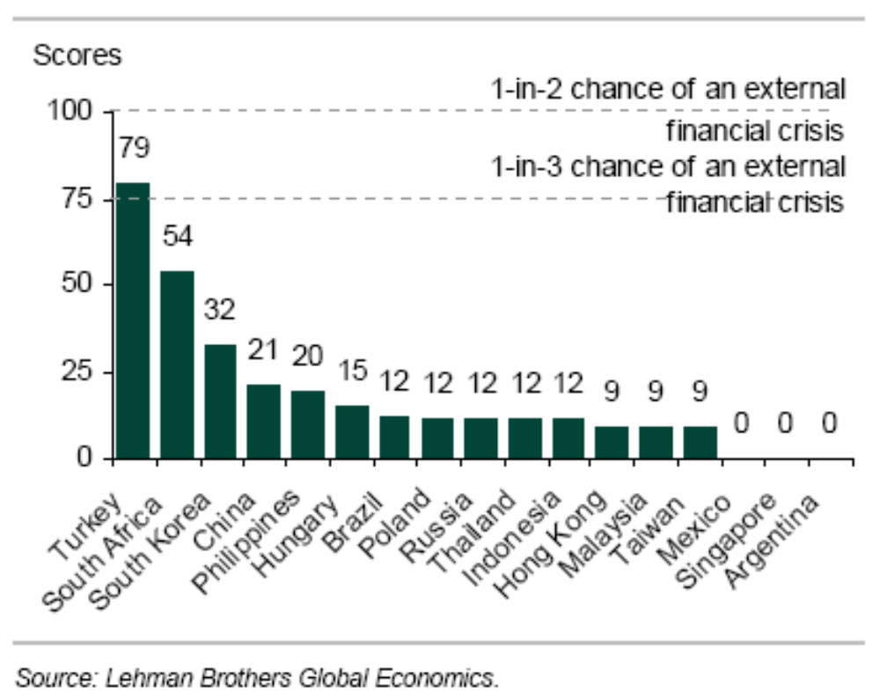
Turkey
Source: Lehman Brothers, Damocles, December 2006.

Slide 10
Turkey
Lehman report, December 2006:
  The crux of the problem is Turkey’s current account deficit, which is in turn driven by a collapse in the private savings rate. … In addition, we worry about the rising indebtedness of the corporate sector. Indeed, the rise in short-term external debt is one of the factors that pushed the score higher this time around. So, although we would not look for a financial crisis in Turkey, we have little doubt that the economy will remain vulnerable.

Slide 11
Crises
Australia 1891-93 (“Barings crisis”)
  GDP fell 18%
United States 1907-08
  GDP fell 10%
Mexico 1994-95:
  GDP fell 9%, peso fell almost 50%
Korea 1997-98
  GDP fell 9%, won fell 30%
Argentina 1999-2002
  GDP fell 20%, peso fell 65%

Slide 12
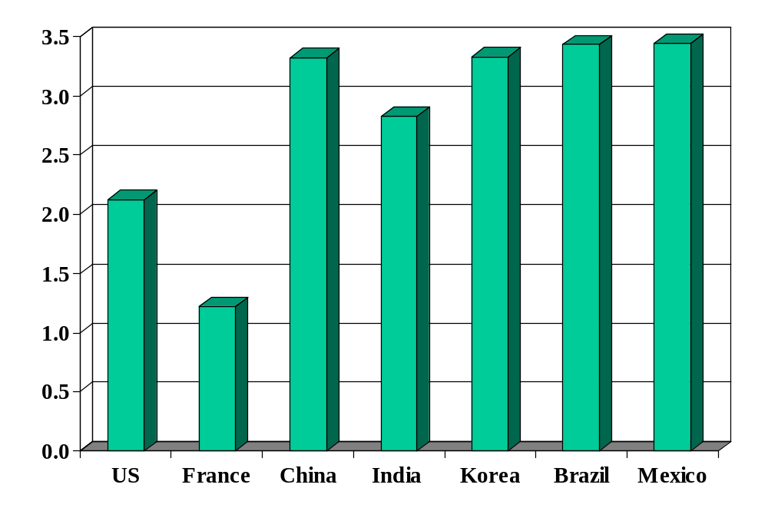
Volatility (std dev of annual growth rate %)
Source: World Bank, World Development Indicators, GDP per capita, 1975-2005.

Slide 13
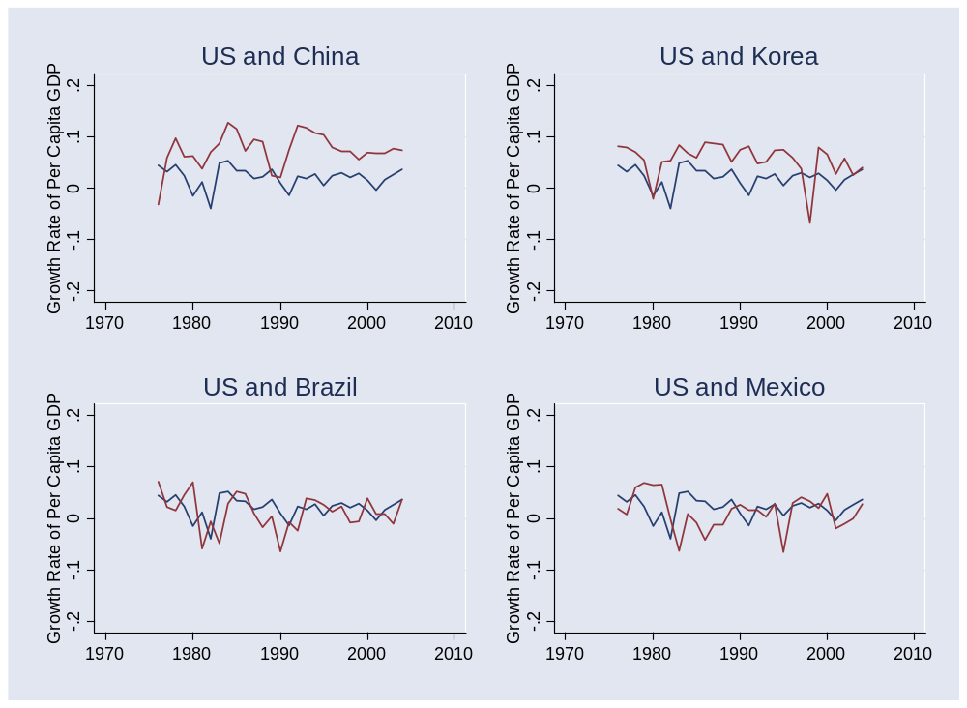
Volatility
Source: World Bank, World Development Indicators, GDP per capita, 1975-2005. Blue=US.

Slide 14
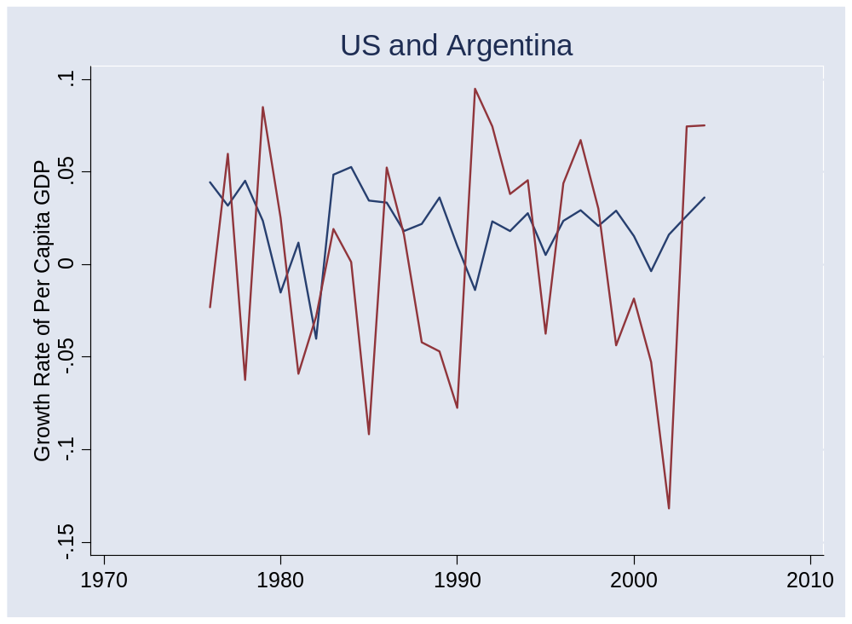
Argentina
Source: World Bank, World Development Indicators, GDP per capita, 1975-2005.

Slide 15
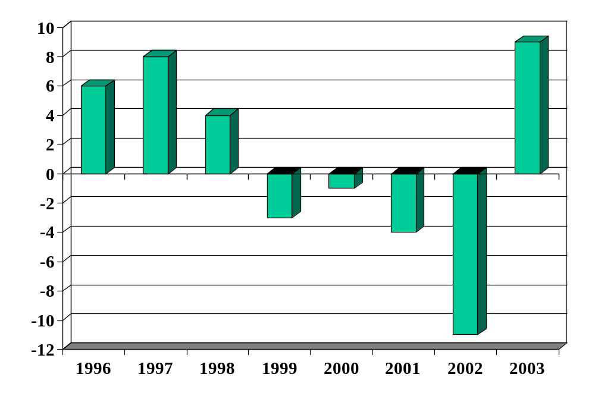
Argentina (GDP growth, %)
Source: EIU.

Slide 16
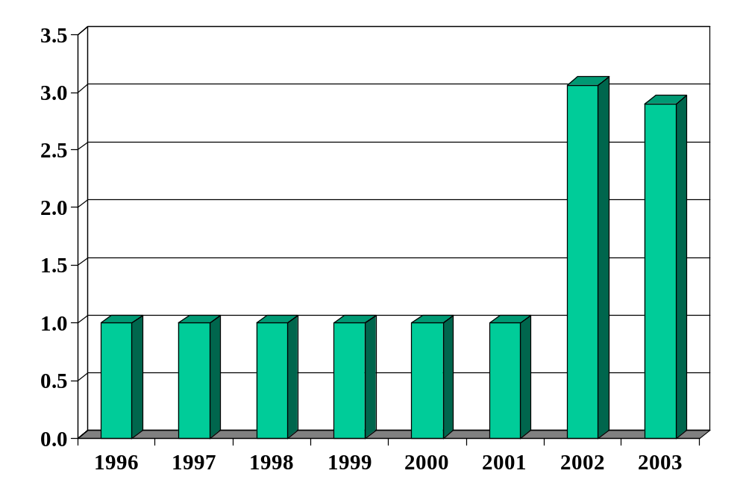
Argentina (pesos per USD)
Source: EIU.

Slide 17
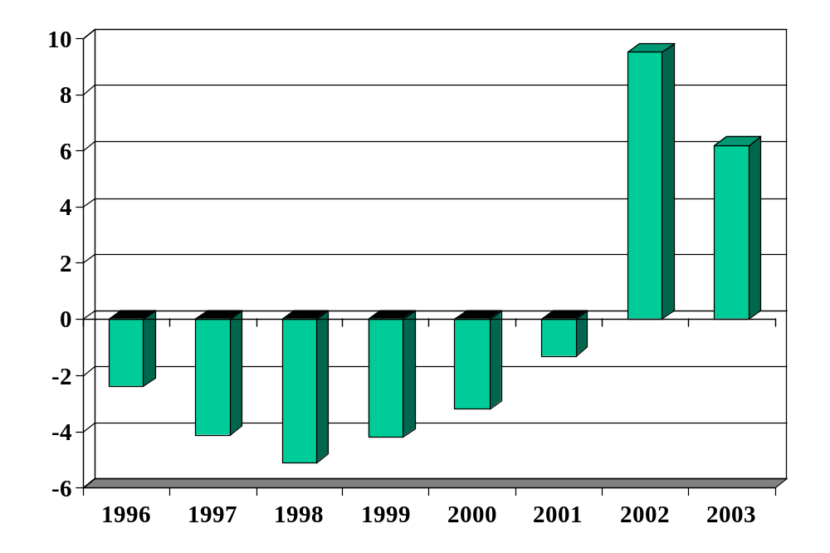
Argentina (current account, % of GDP)
Source: EIU.

Slide 18
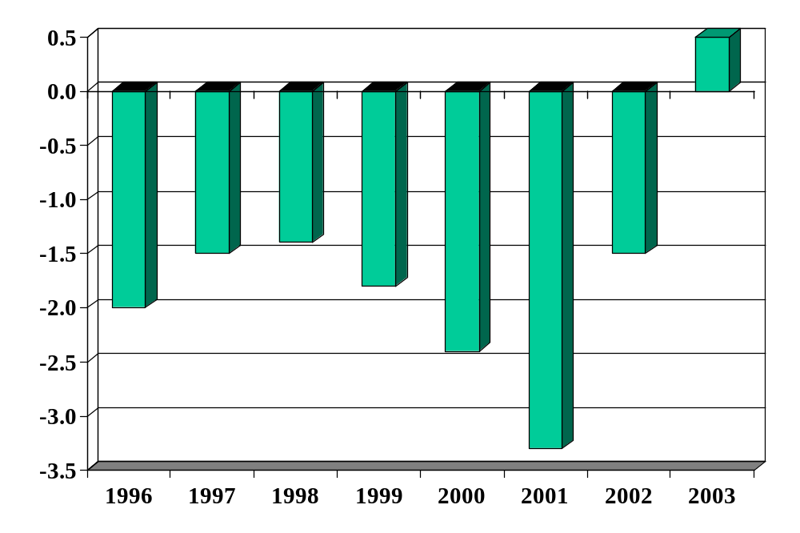
Argentina (govt budget, % of GDP)
Source: EIU.

Slide 19
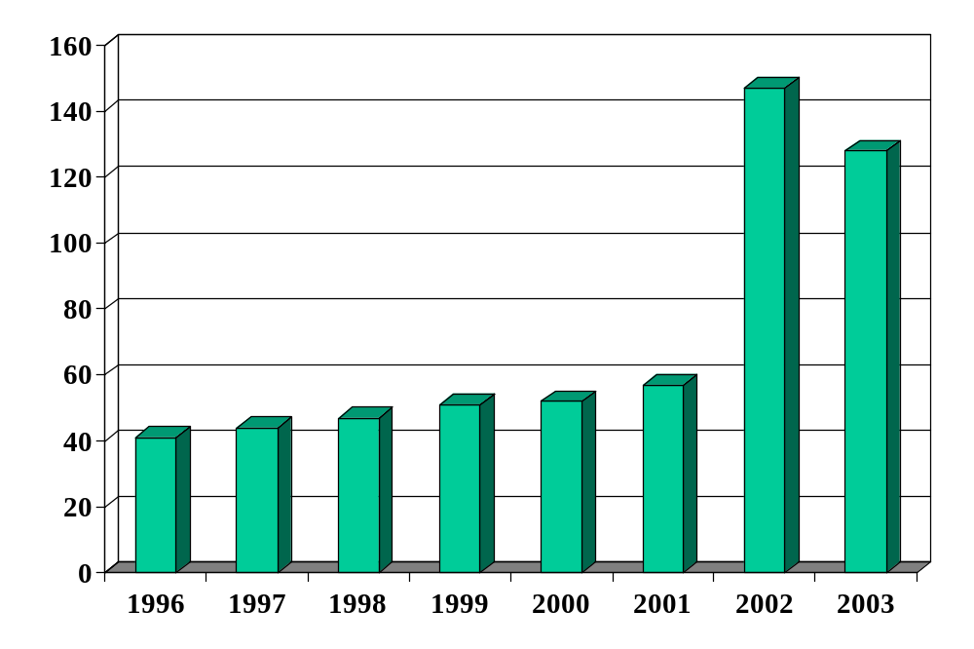
Argentina (govt debt, % of GDP)
Source: EIU.

Slide 20
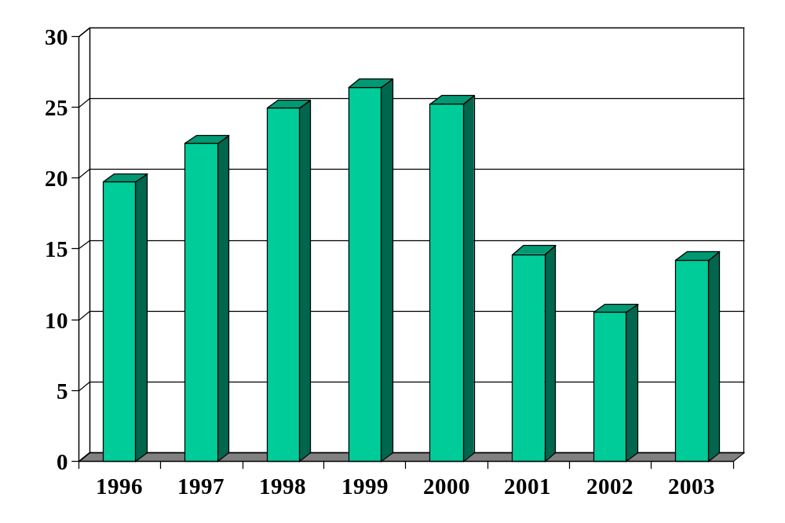
Argentina (fx reserves, USD billions)
Source: EIU.

Slide 21
Argentina
What happened?

Slide 22
Argentina
Fixed exchange rate (currency board)
Current and government deficits in late 1990s
  Foreign-denominated, increasingly onerous terms
Credit spread rose, increasing debt service
IMF supplied loans – twice
Debt put reserves at risk
Banks driven to insolvency
Defaulted on debt
Currency and economy collapsed

Slide 23
Classical theory of crises
Fixed exchange rate
Government deficit leads to current account deficit
  Financed in part by issuing foreign debt
Investors question repayment
  When do you hit this point?
Investors stop buying debt (current account reverses!)
Central bank unable to support exchange rate
  FX reserves run out, currency collapses

Slide 24
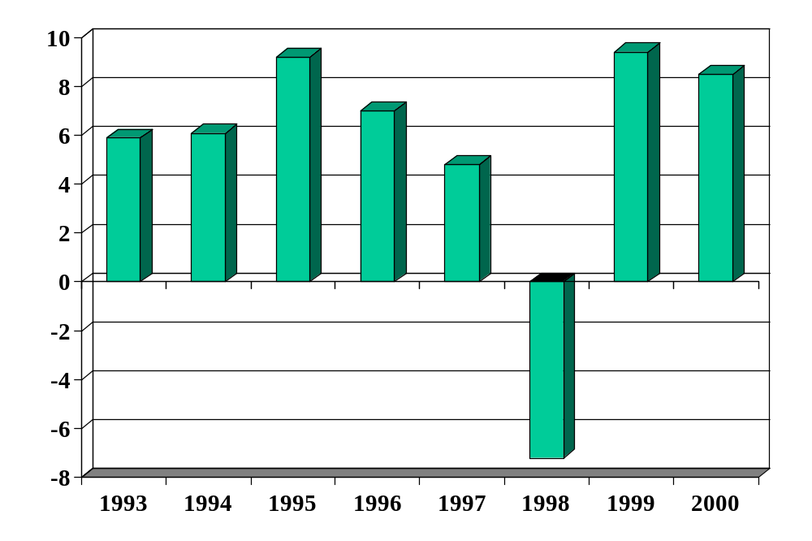
Korea (GDP growth, %)
Source: EIU.

Slide 25
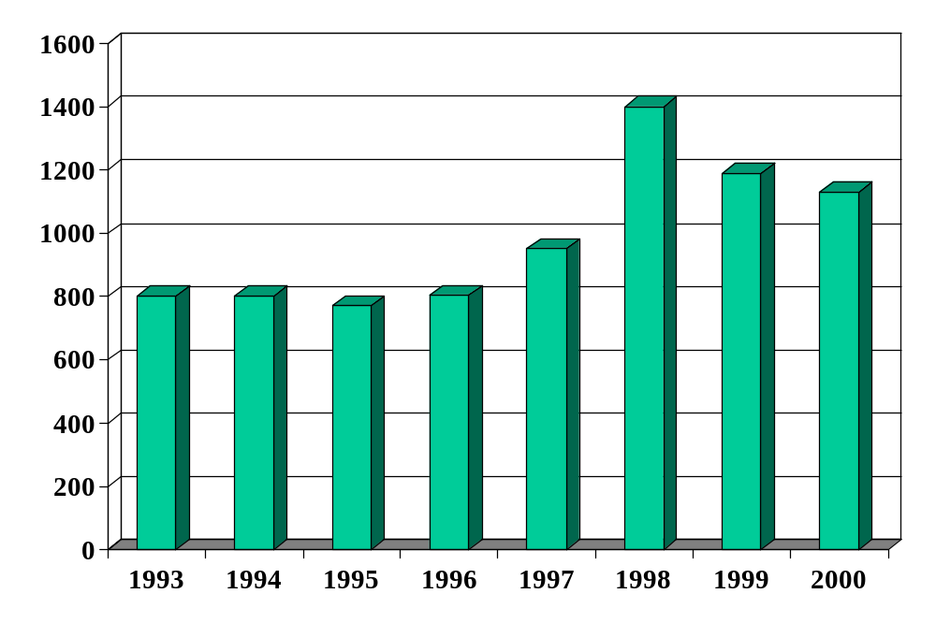
Korea (won per USD)
Source: EIU.

Slide 26
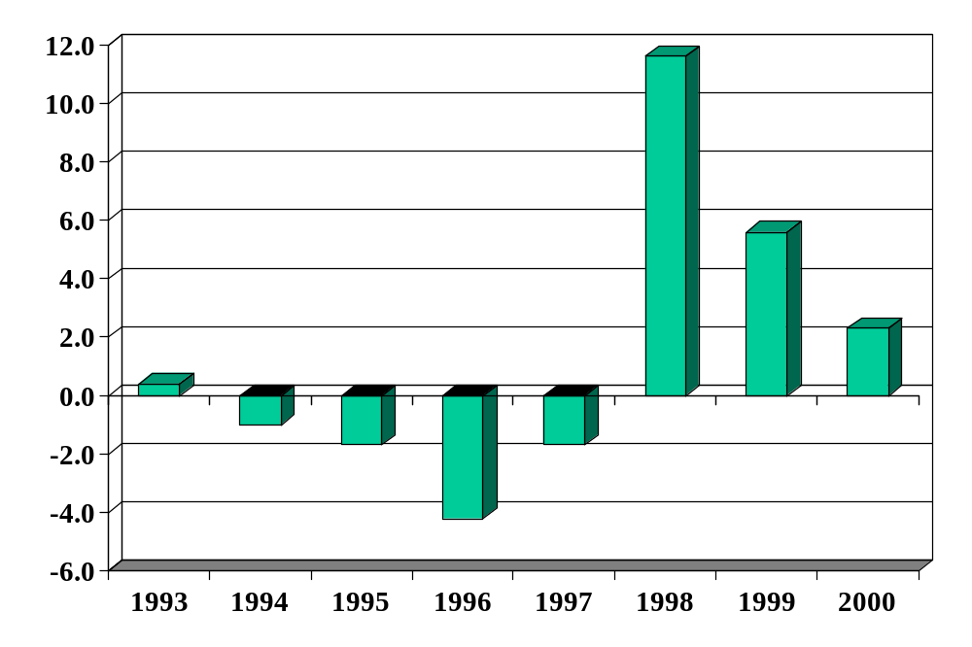
Korea (current account, % of GDP)
Source: EIU.

Slide 27
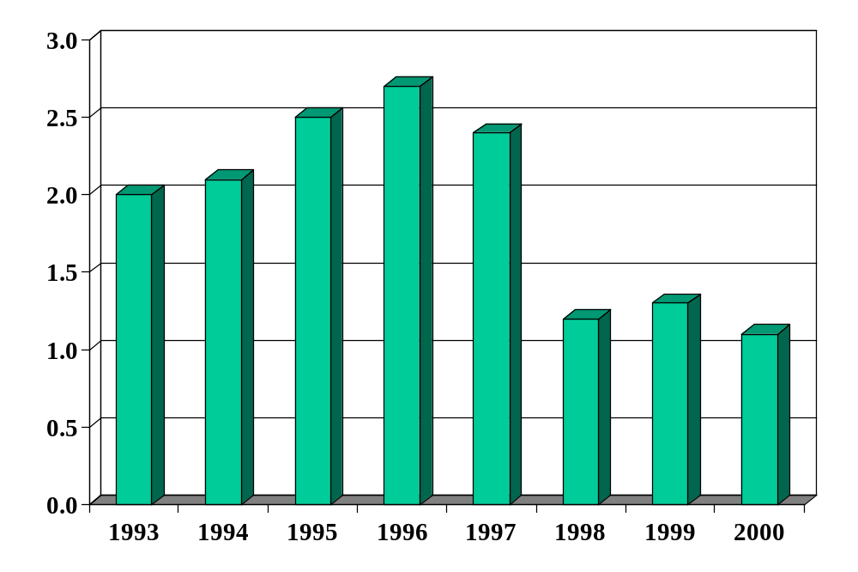
Korea (govt budget, % of GDP)
Source: EIU.

Slide 28
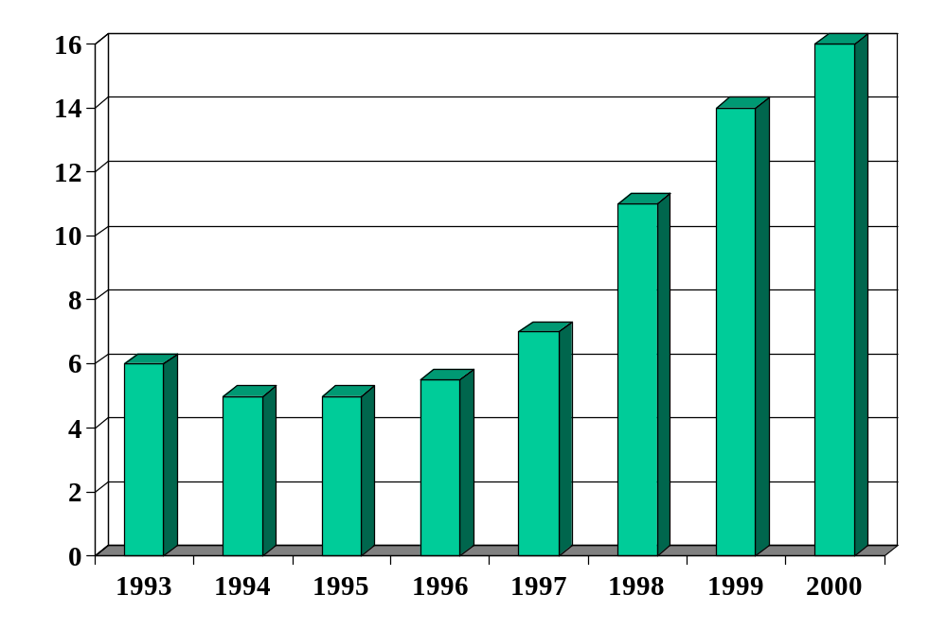
Korea (govt debt, % of GDP)
Source: EIU.

Slide 29
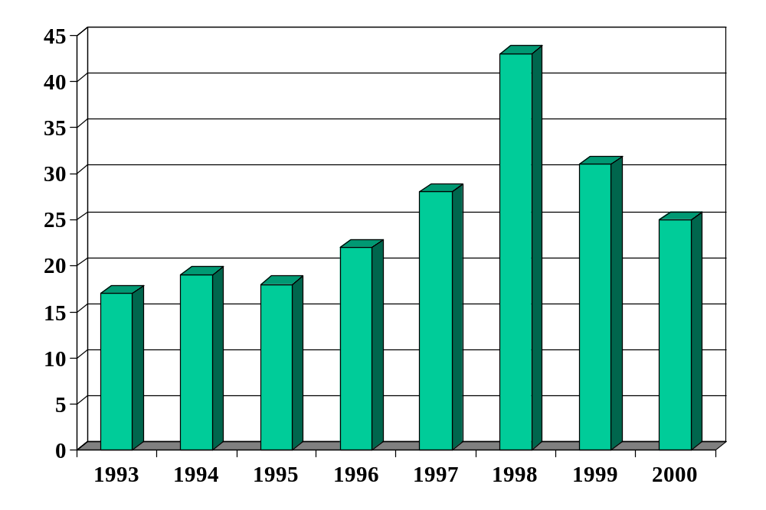
Korea (foreign debt, % of GDP)
Source: EIU.

Slide 30
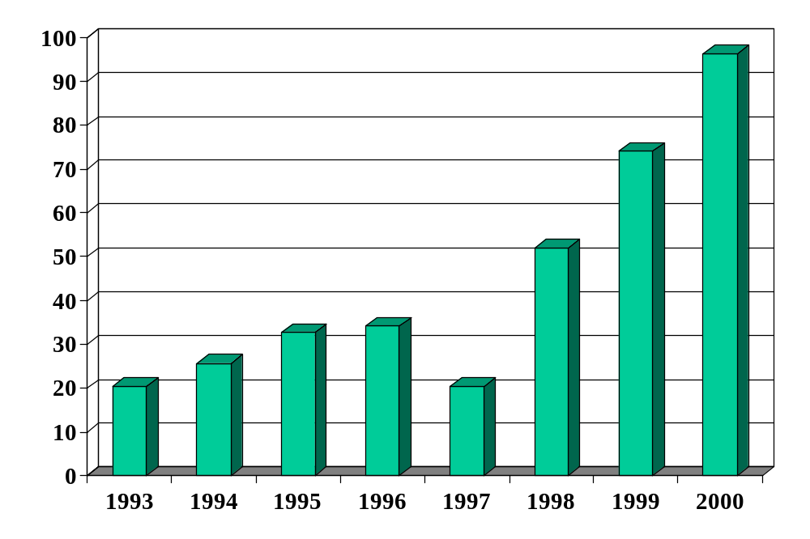
Korea (fx reserves, USD billions)
Source: EIU.

Slide 31
Korea
Signs of weakness
  Nonperforming loans at banks
  Suggestions that some chaebols were insolvent

Slide 32
Korea
What happened?

Slide 33
Korea
Modest current account deficits in mid 1990s
  After years of limited international capital flows
Fiscal surplus!
Financial panic throughout Asia in 1997-98
Current account reversed
Economy rebounded
Current account remains in surplus

Slide 34
Asian crisis explanation 1
Foreign investors panicked for no reason

Slide 35
Asian crisis explanation 2
Courtesy of Professor Roubini and friends
  Take his course if you want to know more
Financial institutions financed bad private investments
Left them unofficially insolvent
Investors expected governments to bail banks out, which would lead to massive government deficits
Massive expected government deficits led to crisis through the traditional fiscal route

Slide 36
Are the rich different?
Famous exchange:
  F. Scott Fitzgerald: “The rich are different from you and me.”
  Ernest Hemingway: “Yes, they have more money.”
Would you apply this kind of analysis to the US? Germany? Japan?
Why or why not?
  Better protection of investors
  Better capital structure (more equity, less debt)

Slide 37
Takeaways
Developing countries are volatile
  Many experience periodic crises
Fundamental factor in a crisis
  Investor concern over repayment
  This is a subjective judgment
  Fiscal discipline often critical
Maybe rich countries are different

Slide 38
Reading recommendation
Paul Blustein, And the money kept rolling in (and out); readable book on Argentina’s 2001 collapse.

Slide 39
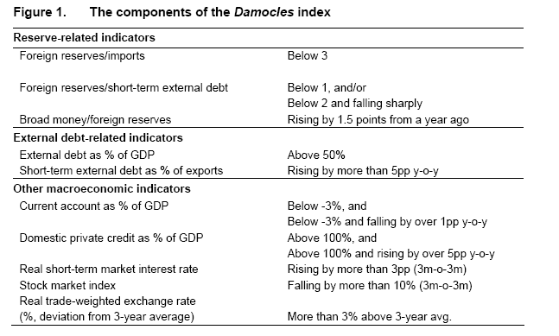
Damocles
Source: Lehman Brothers, Damocles, December 2006.

