Slide 1

The Global Economy
Business Cycles
© NYU Stern School of Business

Slide 2
The Global Economy
Business Cycle Indicators
© NYU Stern School of Business
Notes:
What’s happening to US growth over rest of year? (Hand out reports?)
Start with Bloomberg calendar
What are best indicators?

Slide 3
Today’s plan of attack
The US economy right now
Good indicators of future business conditions
Patterns in the data
Aggregation

Slide 4
Reminder
An indicator is procyclical if it moves up and down with GDP, countercyclical if it moves in the opposite direction
An indicator leads GDP if its ups and downs precede those in GDP, lags if its movements come after

Slide 5
The US economy
What are the prospects for 2007?
Why?

Slide 6
What’s a good indicator?
First we need to decide: Indicator of what?
Correlated with variable we’re interested in
Leads variable
Timely: available quickly
Stable: not subject to significant revision that would make in-sample assessment unrealistic

Slide 7
Good indicators?

Slide 8
Our problem
Forecast economy over next 12 months
Focus on growth rate of industrial production (“IP”)
γ_{t,t+k} = k-period growth rate in IP
Our plan
  Identify good indicators
  Use a regression to relate them to IP growth
  Use the regression to form a forecast

Slide 9
Identifying good indicators
Suggestions?
For each one:
  Why might it work?

Slide 10
Good indicators ??
Scatterplots with lags…

Slide 11
Identifying good indicators
Autocorrelation function
  Correlations of an indicator with its own past values (“auto” = “own”)
acf(k) = Corr(x_{t},x_{t-k})
Cross-correlation function
  Correlations between two variables at different times
ccf(k) = Corr(x_{t},y_{t-k})
  If k>0: x lags y [or y leads x]
  If k>0: x leads y [or y leads x]

Slide 12
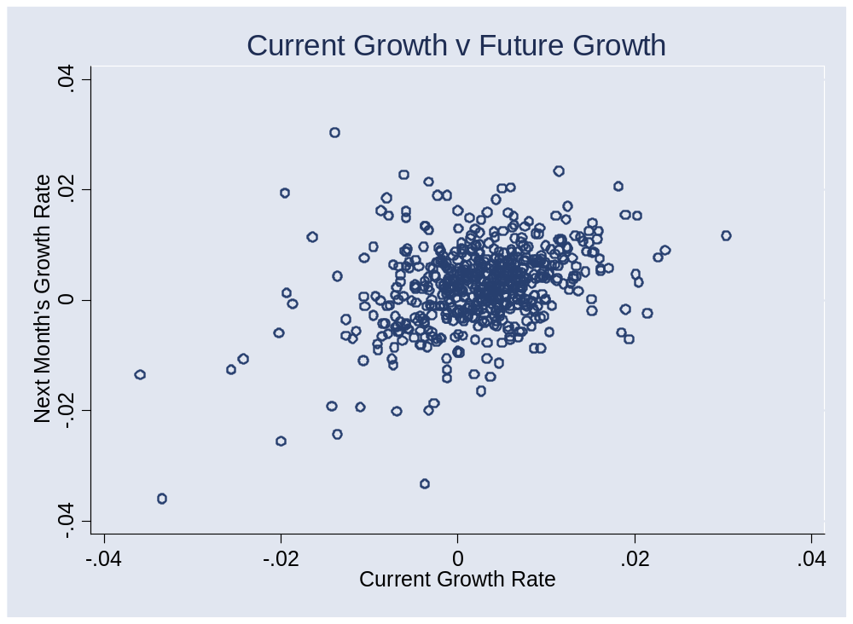
Past IP growth?

Slide 13
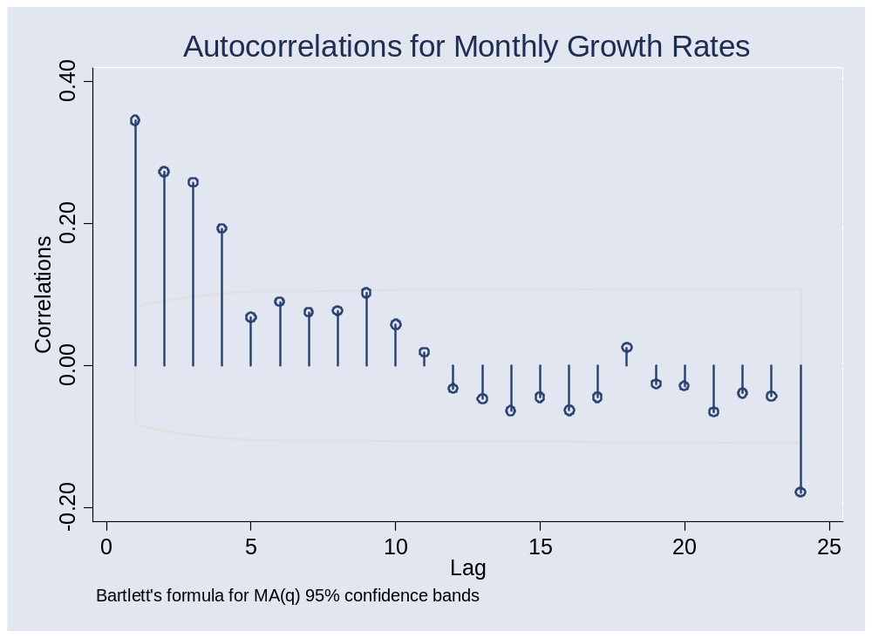
Past IP growth?

Slide 14
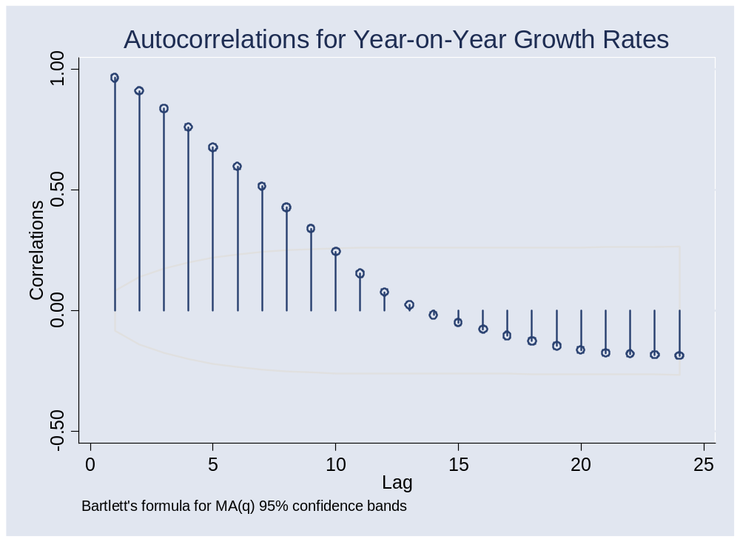
Past IP growth?

Slide 15
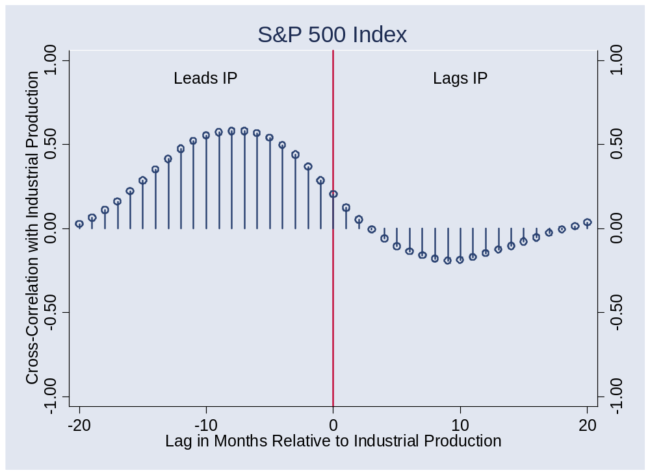
Stock market?

Slide 16
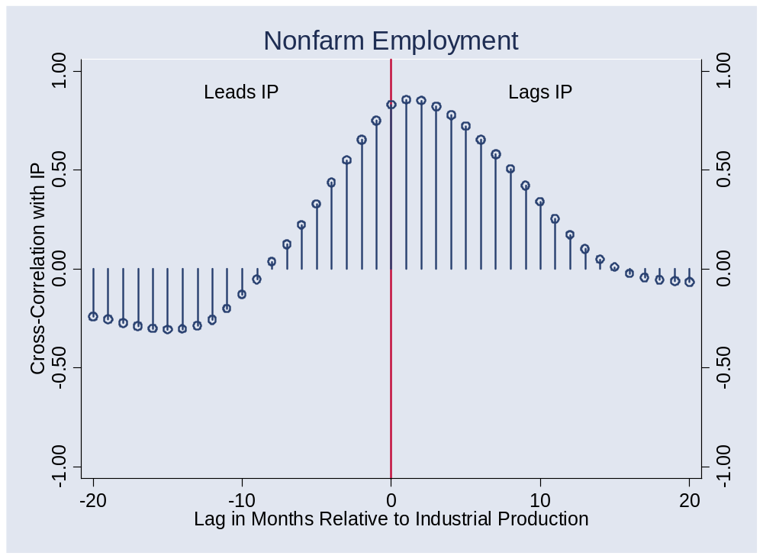
Employment?

Slide 17
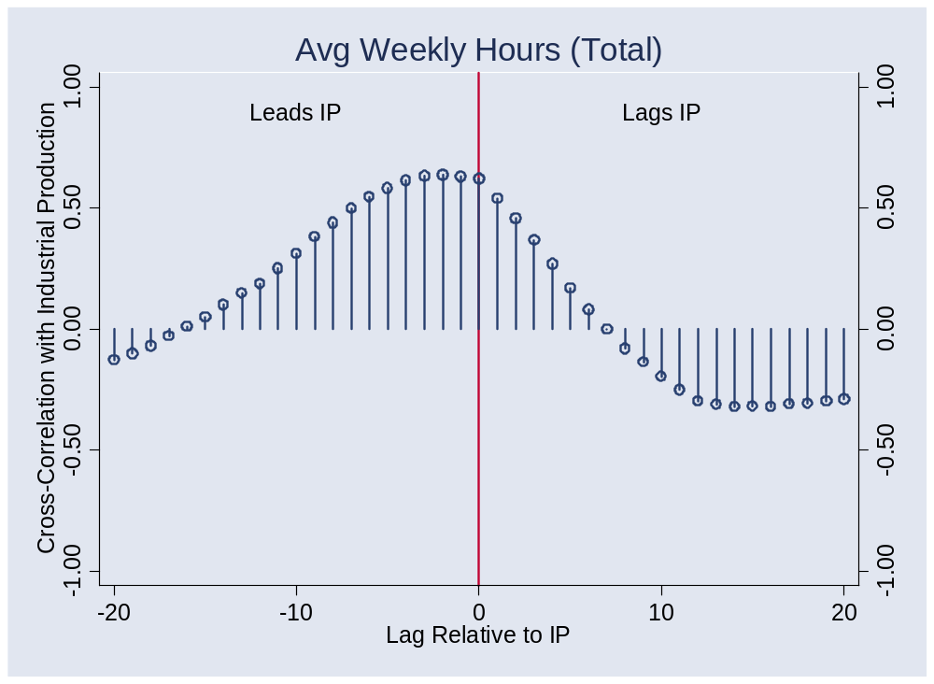
Average weekly hours?

Slide 18
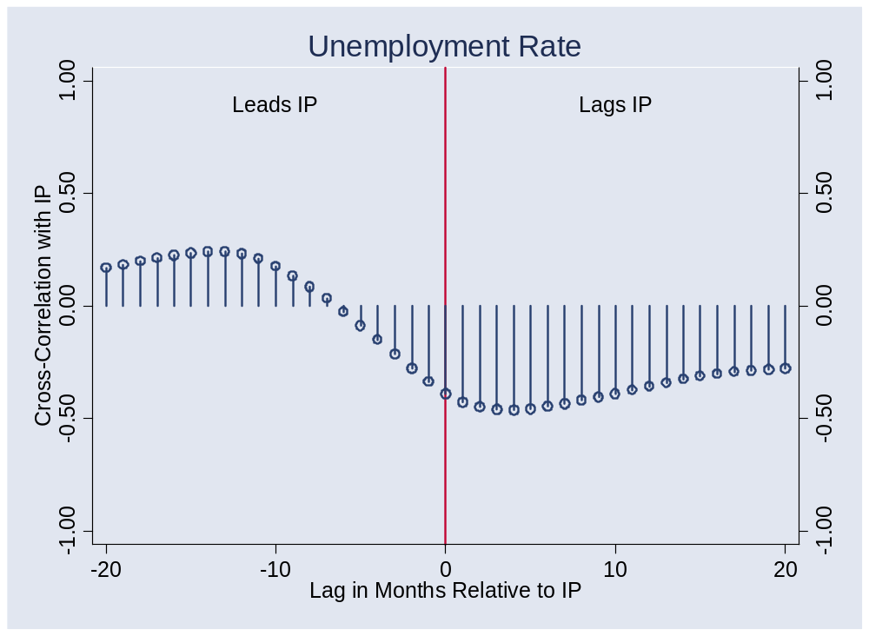
Unemployment?

Slide 19
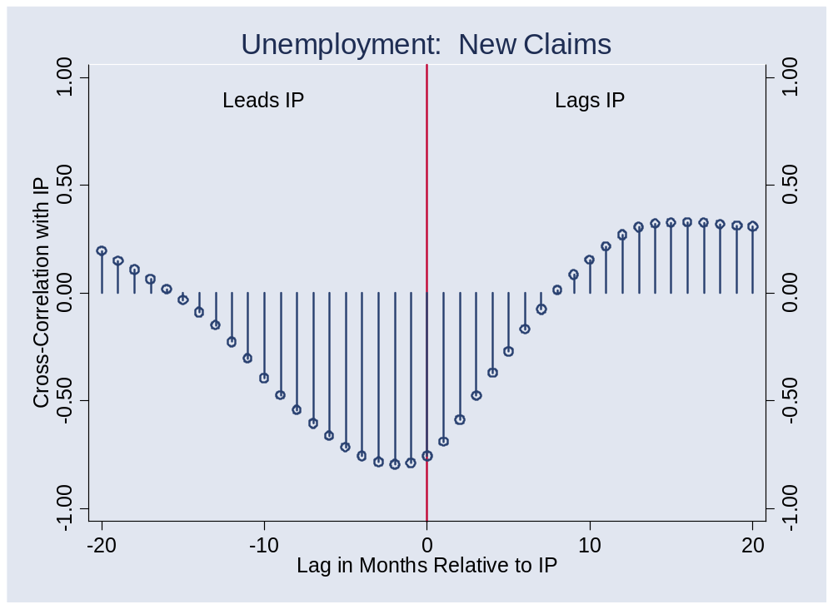
New claims?

Slide 20
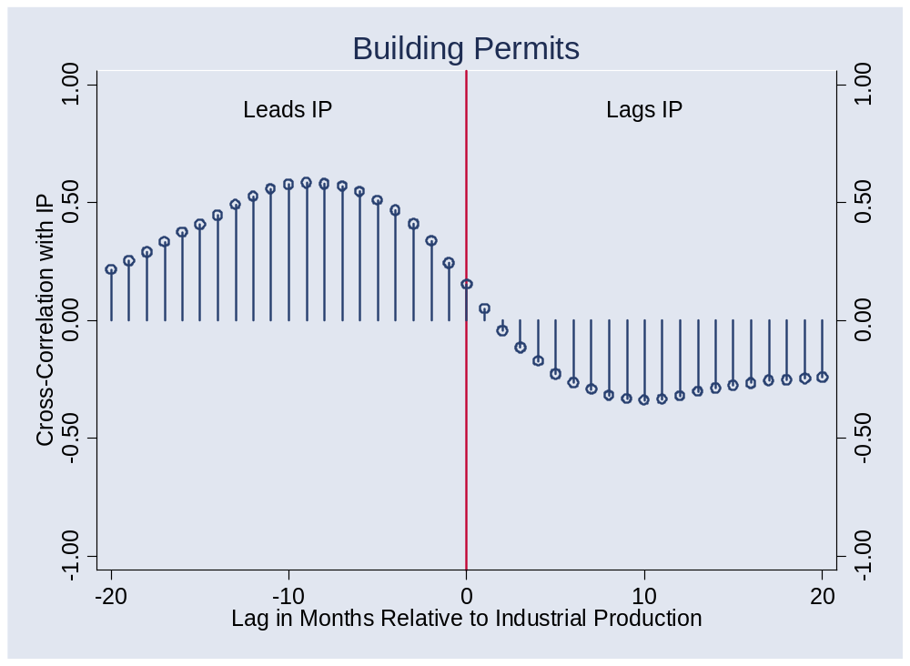
Building permits?

Slide 21
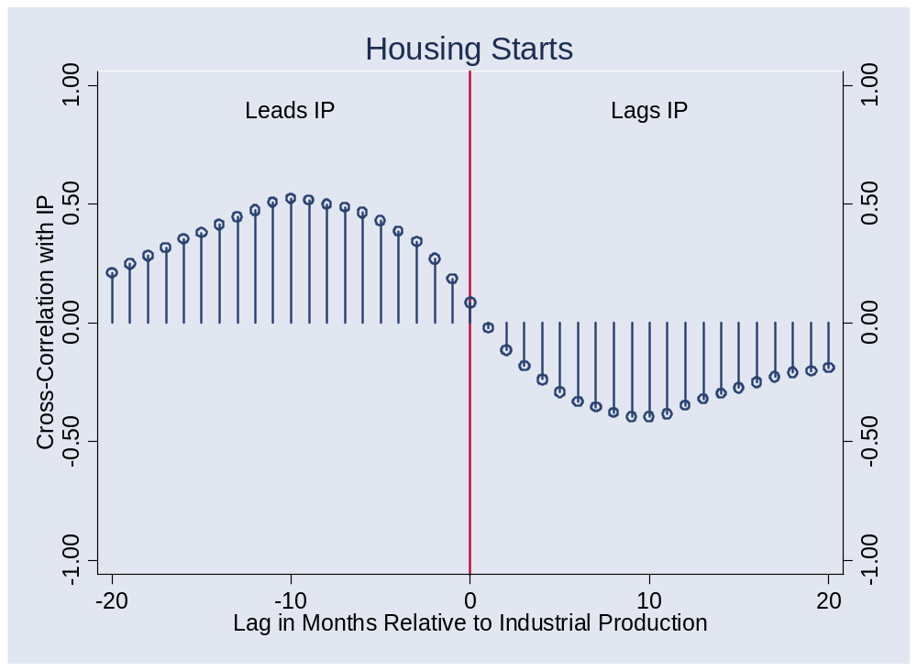
Housing starts?

Slide 22
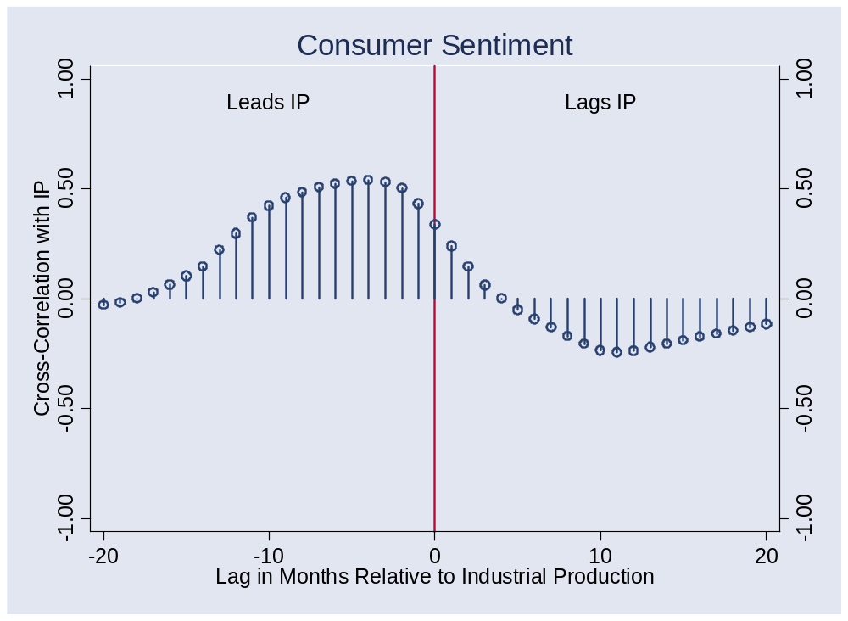
Consumer sentiment?

Slide 23
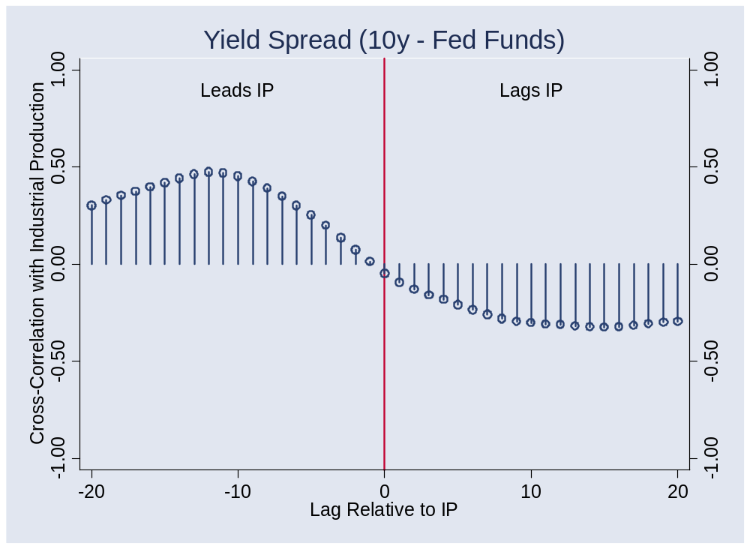
Yield spread?

Slide 24
More…
Retail sales, IP diffusion indexes

Slide 25
Regression
Recall: we’re forecasting
γ_{t,t+k} = k-period growth rate in IP
Estimate the regression
γ_{t,t+k} = a + b x_{t} + residual
x_{t} is an “indicator” of your choice
Note timing!!
Variations
  Add lags of x
  Add lags of γ
  Use more than one x

Slide 26
Forecasting
Use estimated regression line
Plug in current indicator x
Calculate predicted future growth rate
γ_{t,t+k} = a + b x_{t}

Slide 27
Forecasting
Sources of forecast error?
How well can we do?
  R² = 0.25 is reasonably good [what does this mean?]

Slide 28
Aggregation
What if we have multiple forecasts?
  Combine them
  Invariably does better
Could we do this ourselves?
  Of course!
Can we use markets?
  They’re natural information “aggregators”
  Risk adjustment?

Slide 29
Prediction markets
Intrade.com
Academy Awards Best Picture: futures prices
Picture | Price
Departed | 46
Letters from Iwo Jima | 6
The Queen | 4
Babel | 22
Little Miss Sunshine | 22

Slide 30
Prediction markets
Intrade.com
Year-end fed funds
Fed funds | Price
>4.00 | 91
>4.25 | 86
>4.50 | 82
>5.00 | 65
>5.25 | 50

Slide 31
Macroeconomic markets
Consider futures price of x
Futures price = Market forecast of x + Risk Premium
Do we need the risk premium?
  Generally yes
Examples
  Fed funds, CPI, yield curve, …

Slide 32
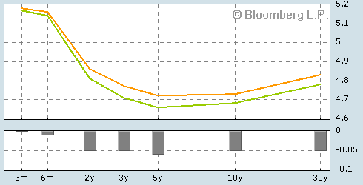
Current yield curve
Source: Bloomberg.com. Green line is current, orange line yesterday.

Slide 33
Forecasting flow chart
Identify good indicators
  Use cross-correlation function, ask friends, whatever works
Transform them
  Do you use the level? Growth rate? Change?
Put them in a regression
  Tells you relation between indicator and variable being forecast
Use the regression coefficients and current value of indicator to construct forecast

Slide 34
Takeaways
Good indicators: available, lead variable of interest
Some of the best indicators
  Tied to durable goods (greater sensitivity to cycle)
  Linked to future production
Best forecasts far from perfect
Aggregation often helpful
  Markets do this automatically

Slide 35
Current situation
What are our favorite indicators?
What do they indicate?

Slide 36
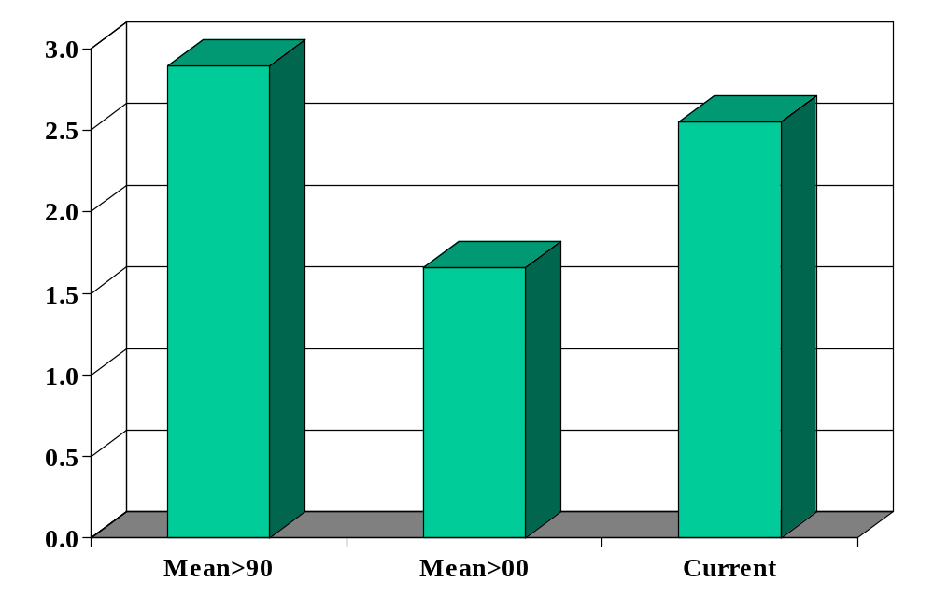
IP growth (YOY, %)

Slide 37
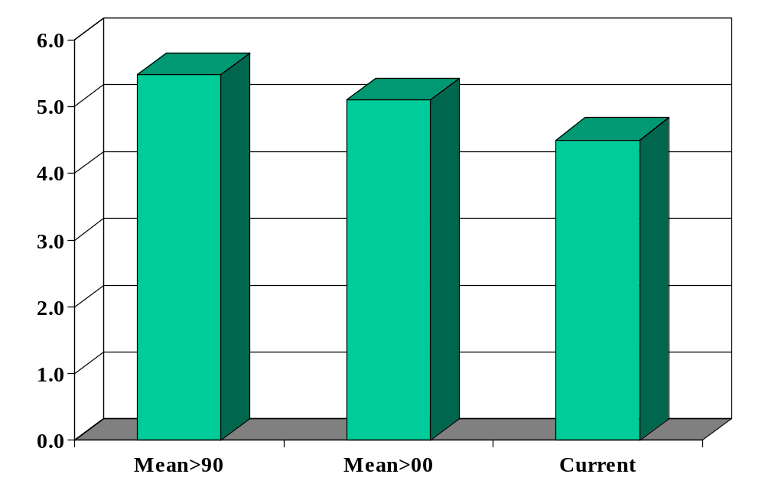
Unemployment rate

Slide 38
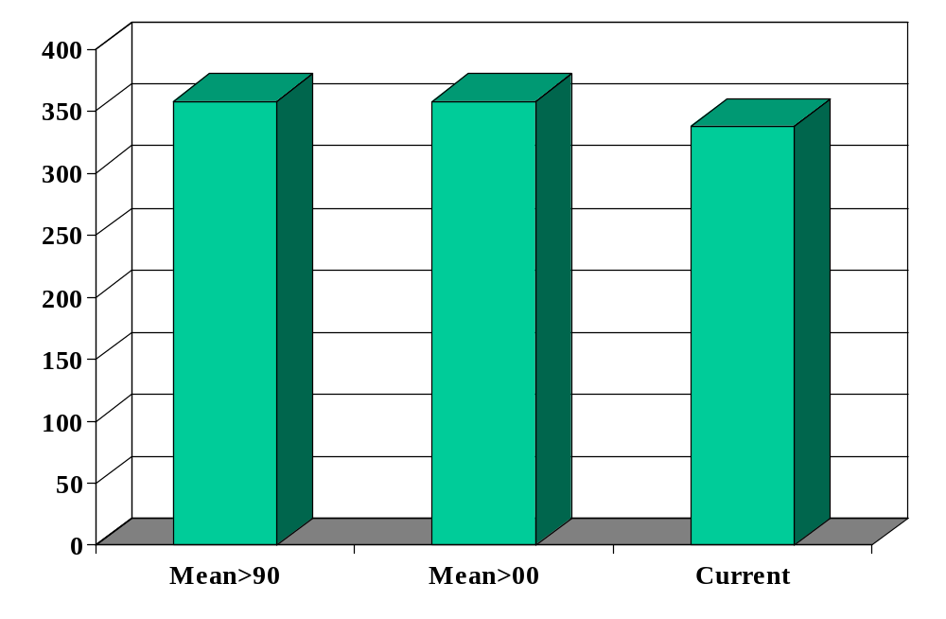
New claims for UI (thousands)

Slide 39
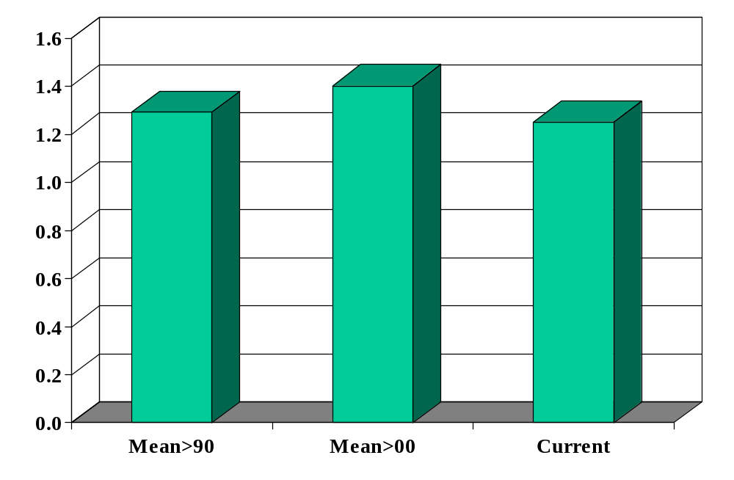
New car sales (millions)

Slide 40
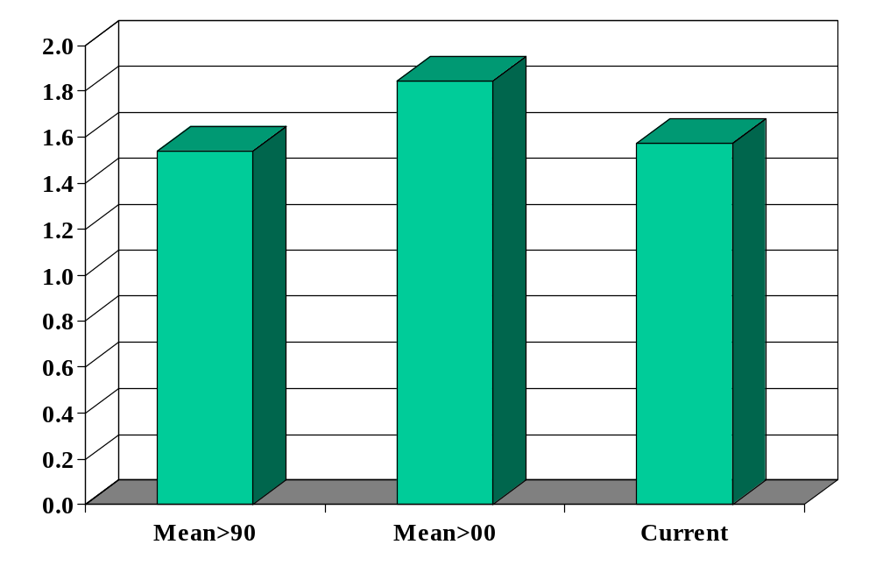
Building permits (millions)

Slide 41
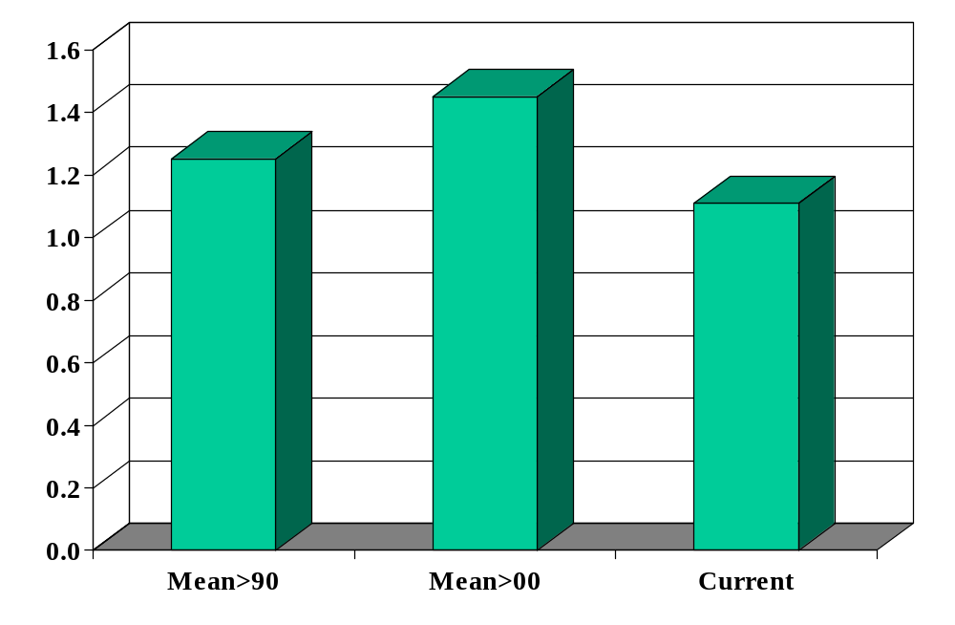
Housing starts (millions)

Slide 42
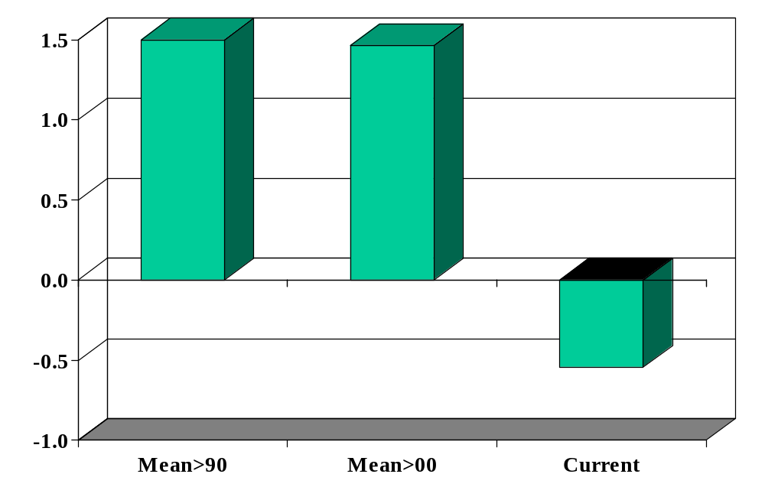
Term spread (%)

Slide 43
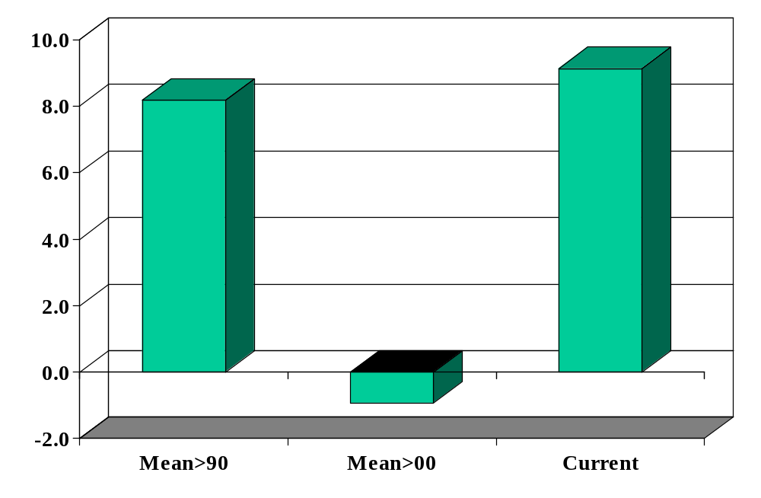
S&P 500 growth (YOY, %)

Slide 44
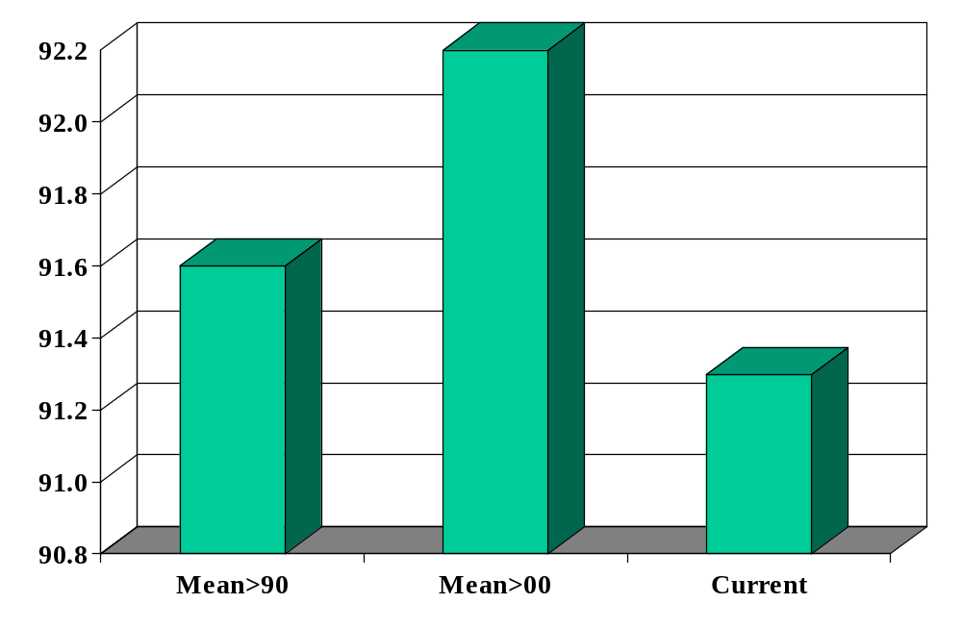
Consumer sentiment

Slide 45
Citigroup Global Markets
Brian M Jones
  Stern MBA 1989
  Previously: Lloyds Bank, Salomon Brothers
  Currently: Director, Citigroup Global Markets
    Briefs traders, investment bankers, and customers on domestic economic developments and their impact on markets
Ish McLaughlin
  Stern MBA 1995
  Previously: Salomon Brothers
  Currently: Managing Director, Citigroup Global Markets
    Investment grade syndicate desk

Slide 46
Questions
How did you get to your current position? What advice would you give us?
How do economic fluctuations affect your business?
How do you see the US economy over the next 3-12 months? Are there any trouble spots on the horizon?
What indicators do you find to be most reliable?
What indicators do you see as positive right now? Negative?
Do you have a theoretical perspective on the current situation?

