Slide 1

The Global Economy
Business Cycle Indicators
© NYU Stern School of Business
Notes:
What’s happening to US growth over rest of year? (Hand out reports?)
Start with Bloomberg calendar
What are best indicators?
Stages of grief: denial, anger, acceptance…

Slide 2
Second-half plan of attack
The US economy right now
Good indicators of future business conditions
Patterns in the data
Aggregation

Slide 3
Reminder
An indicator is procyclical if it moves up and down with GDP, countercyclical if it moves in the opposite direction, acylical if neither of the above
An indicator leads GDP if its ups and downs precede those in GDP, lags if its movements come after, coincident if its movements are simultaneous

Slide 4
The US economy
What are the prospects for 2007?
Why?

Slide 5
What’s a good indicator?
First we need to decide: Indicator of what?
Correlated with variable we’re interested in
Leads variable
Timely: available quickly
Stable: not subject to significant revision that would make in-sample assessment unrealistic

Slide 6
Good indicators?

Slide 7
Our problem
Forecast economy over next 12 months
Focus on growth rate of industrial production (“IP”)
γ_{t,t+k} = k-period growth rate in IP
Our plan
  Identify good indicators
  Use a regression to relate them to IP growth
  Use the regression to form a forecast

Slide 8
Identifying good indicators
Suggestions?
For each one:
  Why might it work?

Slide 9
Identifying good indicators
Autocorrelation function
  Correlations of an indicator with its own past values (“auto” = “own”)
acf(k) = Corr(x_{t},x_{t-k})
Cross-correlation function
  Correlations between two variables at different times
ccf(k) = Corr(x_{t},y_{t-k})
  If k>0: x lags y [or y leads x]
  If k>0: x leads y [or y leads x]

Slide 10
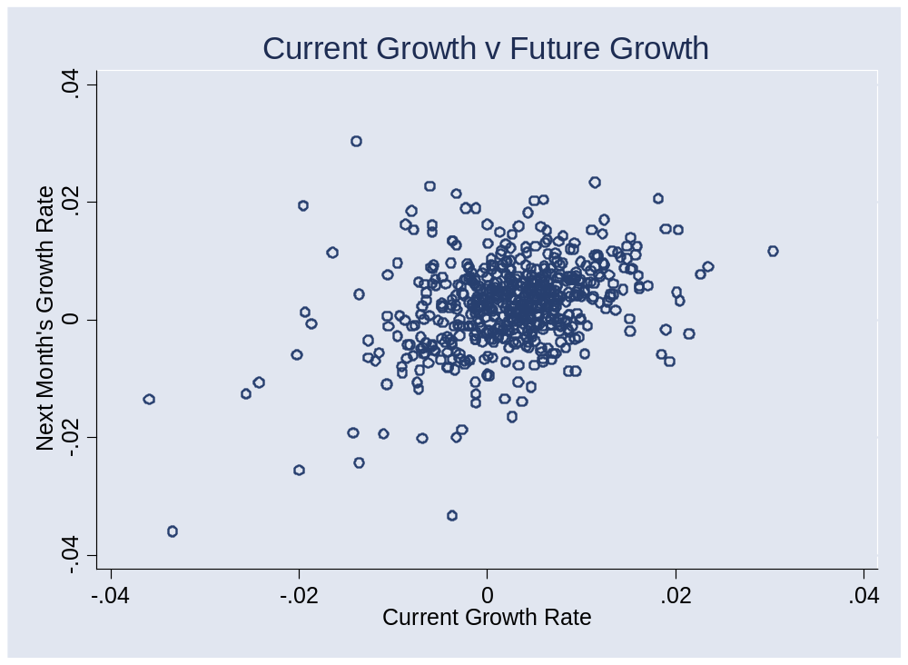
Past IP growth?

Slide 11
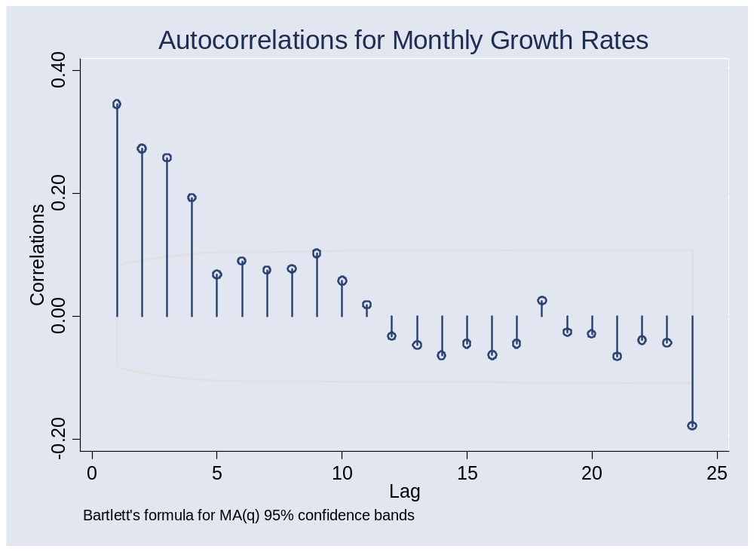
Past IP growth?

Slide 12
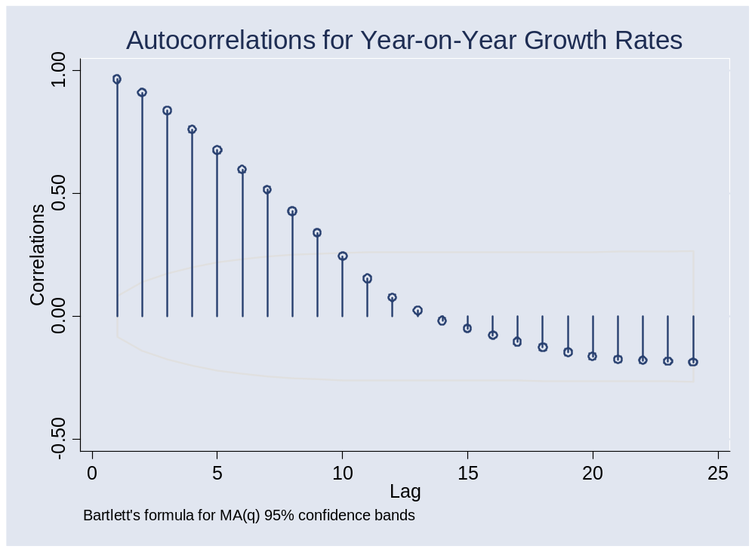
Past IP growth?

Slide 13
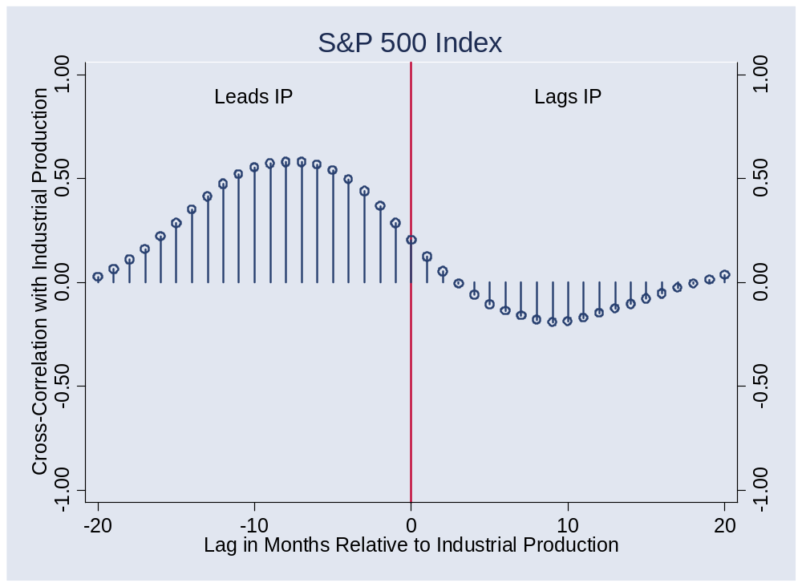
Stock market?

Slide 14
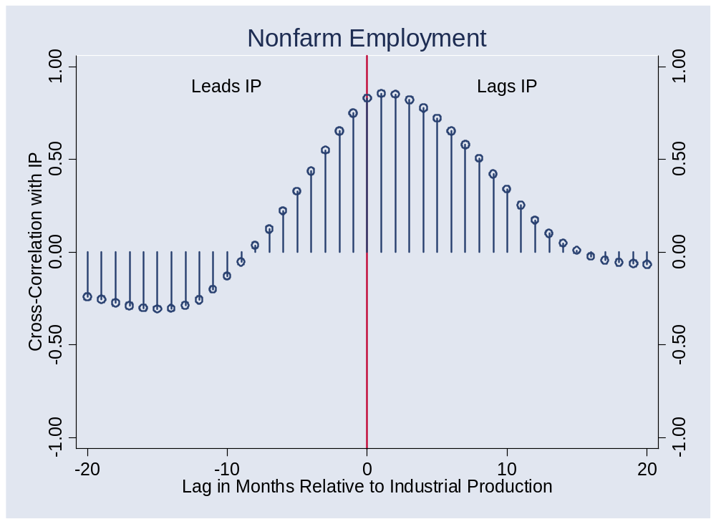
Employment?

Slide 15
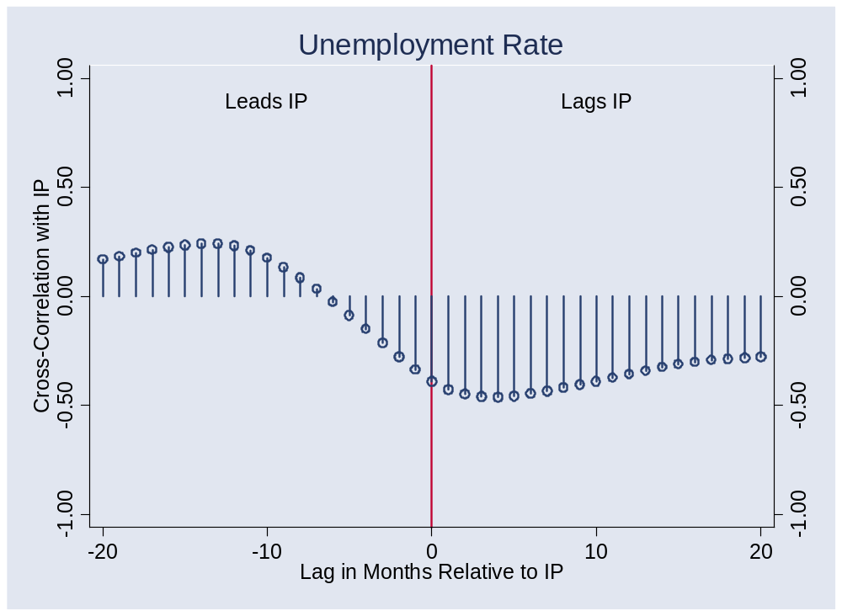
Unemployment?

Slide 16
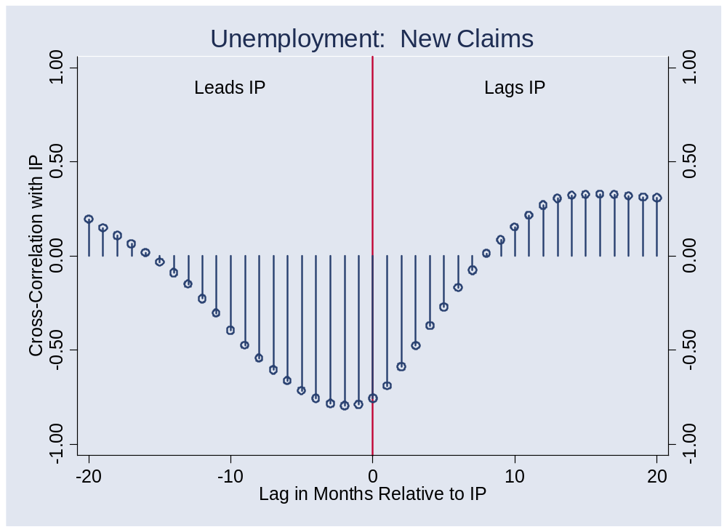
New claims?

Slide 17
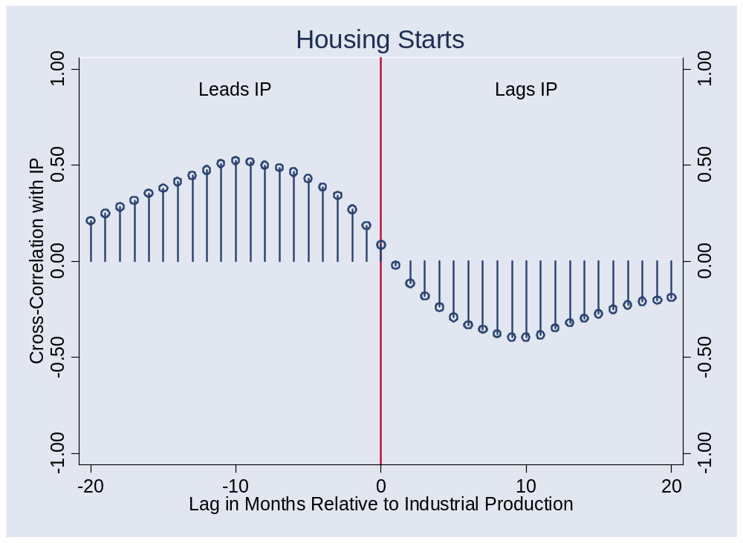
Housing starts?

Slide 18
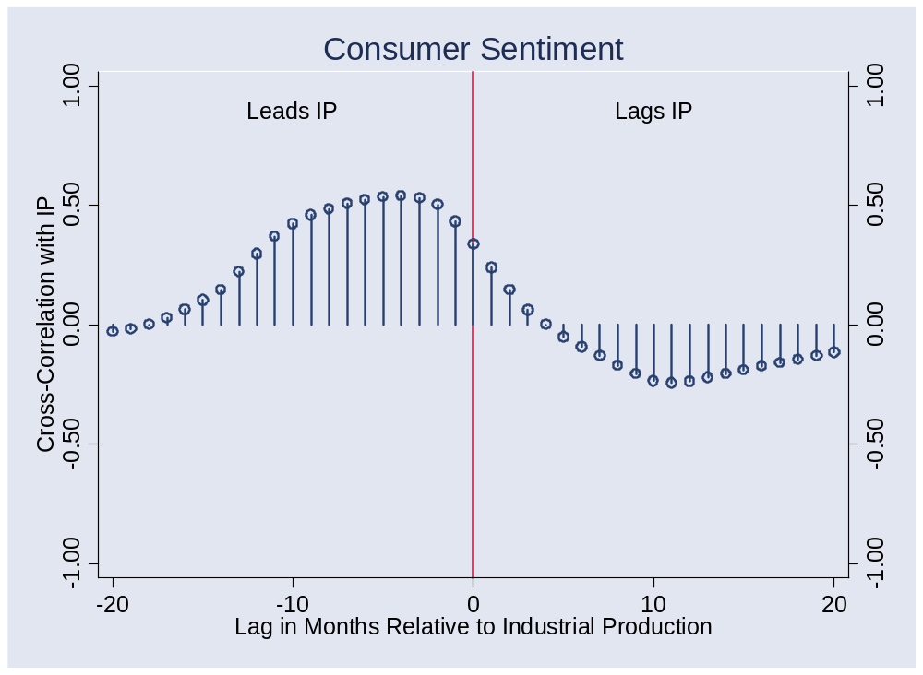
Consumer sentiment?

Slide 19
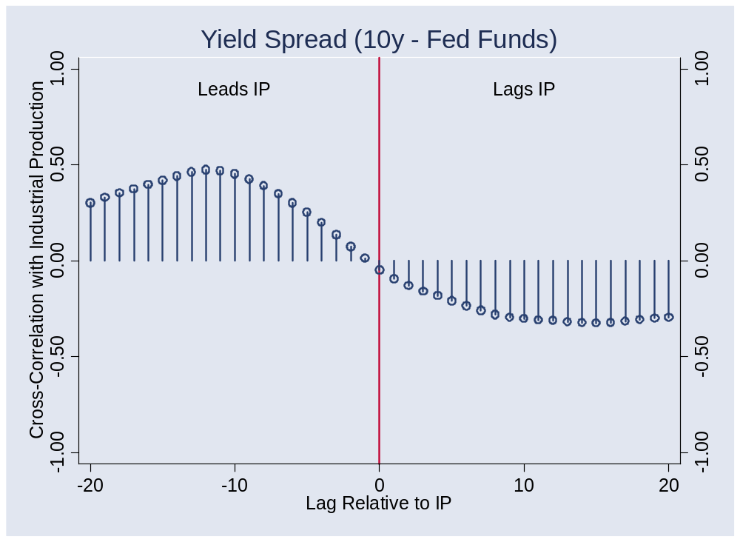
Yield spread?

Slide 20
Regression
Recall: we’re forecasting
γ_{t,t+k} = k-period growth rate in IP
Estimate the regression
γ_{t,t+k} = a + b x_{t} + residual
x_{t} is an “indicator” of your choice
Note timing!!
Variations
  Add lags of x
  Add lags of γ
  Use more than one x

Slide 21
Forecasting
Use estimated regression line
Plug in current indicator x
Calculate predicted future growth rate
γ_{t,t+k} = a + b x_{t}

Slide 22
Forecasting
Sources of forecast error?
How well can we do?
  R² = 0.25 is reasonably good [what does this mean?]

Slide 23
Current situation
Various indicators, where they stand now vs mean…. ???

Slide 24
Aggregation
What if we have multiple forecasts?
  Combine them
  Invariably does better
Could we do this ourselves?
  Of course!
Can we use markets?
  They’re natural information “aggregators”
  Risk adjustment?

Slide 25
Current situation
Bernanke, March 20, 2006:
  [By looking at many] indicators, we sacrifice some degree of simplicity, but we are less likely to be misled when a favored indicator behaves in an unusual manner.
Notes:
Last par of: http://www.federalreserve.gov/boarddocs/speeches/2006/20060320/default.htm

Slide 26
Prediction markets
Intrade.com
Futures contract pays 100 if statement is true
Contract | Price
Libby pardoned by end of 2007 | 22.5
Libby pardoned by end of Bush’s term | 65
Medvedev next Russian president | 20
Dow > 12,000 at end of 2007 | 60
Fed funds target > 5% at end of 2007 | 45

Slide 27
Macroeconomic markets
Consider futures price of x
Futures price = Market forecast of x + Risk Premium
Do we need the risk premium?
  Generally yes
Examples
  Fed funds, CPI, yield curve, …

Slide 28
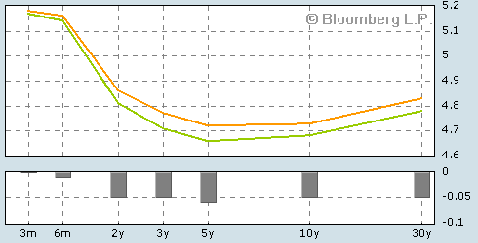
Current yield curve
Source: Bloomberg.com. Green line is current, orange line yesterday.

Slide 29
Takeaways
Good indicators: available, lead variable of interest
Some of the best indicators
  Tied to durable goods (greater sensitivity to cycle)
  Linked to future production
Best forecasts far from perfect
Aggregation is helpful
  Markets do this automatically

