Slide 1

The Global Economy
Business Cycle Indicators II
© NYU Stern School of Business

Slide 2
Citigroup Global Markets
Brian M Jones
  Stern MBA 1989
  Previously: Lloyds Bank, Salomon Brothers
  Currently: Director, Citigroup Global Markets
    Briefs traders, investment bankers, and customers on domestic economic developments and their impact on markets
Ish McLaughlin
  Stern MBA 1995
  Previously: Salomon Brothers
  Currently: Managing Director, Citigroup Global Markets
    Investment grade syndicate desk

Slide 3
Today’s plan of attack
The US economy
Good indicators of future business conditions
Brian Jones and Ish McLaughlin

Slide 4
Current situation
What are our favorite indicators?
What do they indicate?

Slide 5
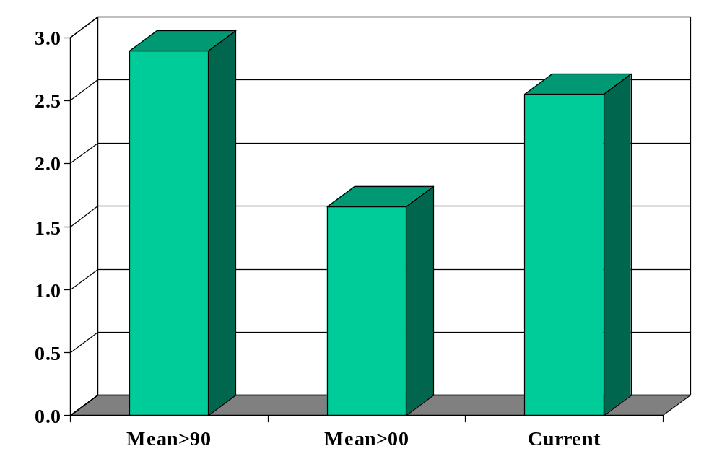
IP growth (YOY, %)

Slide 6
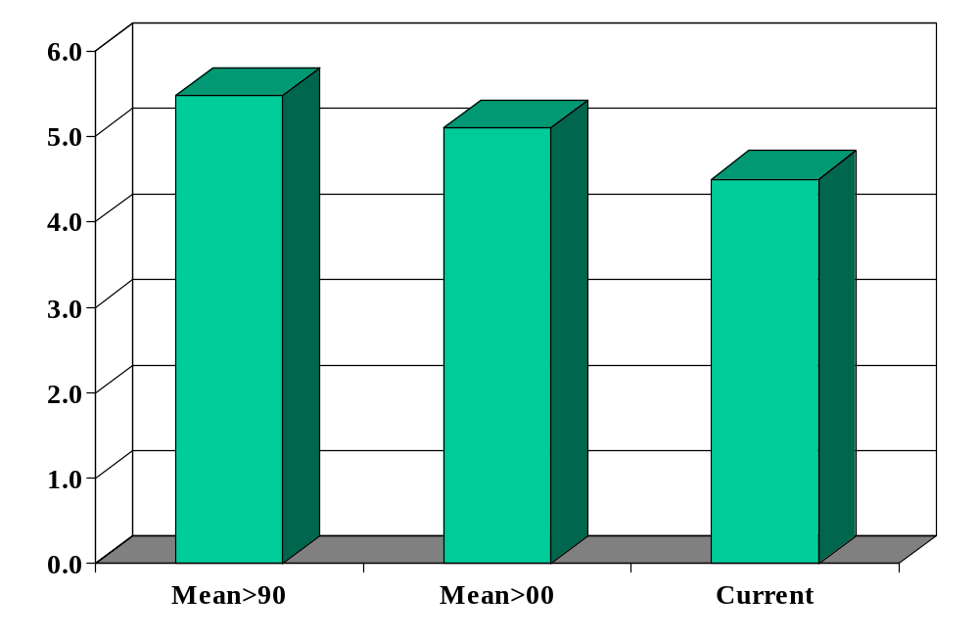
Unemployment rate

Slide 7
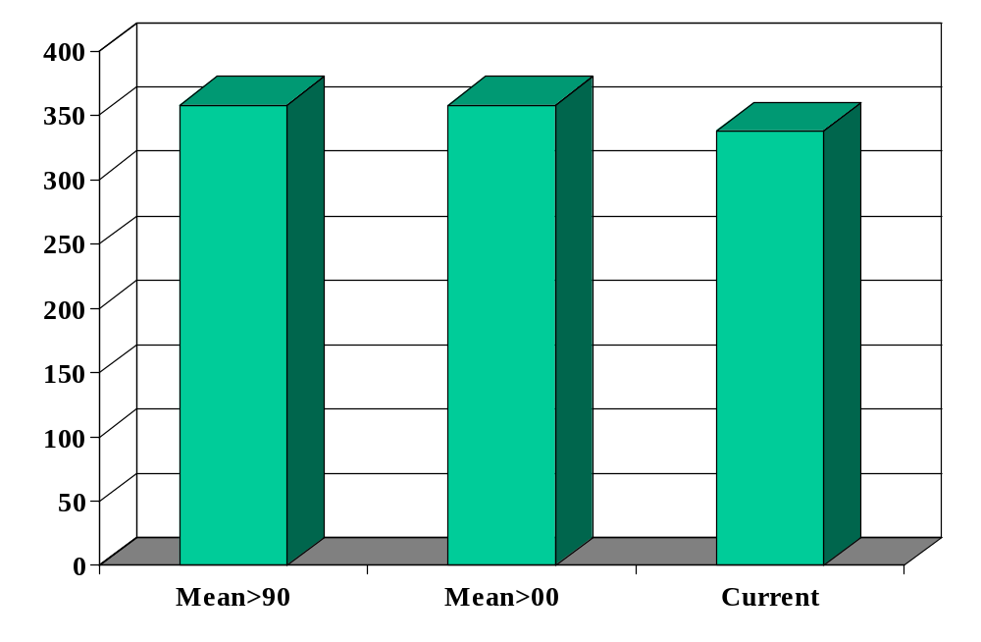
New claims for UI (thousands)

Slide 8
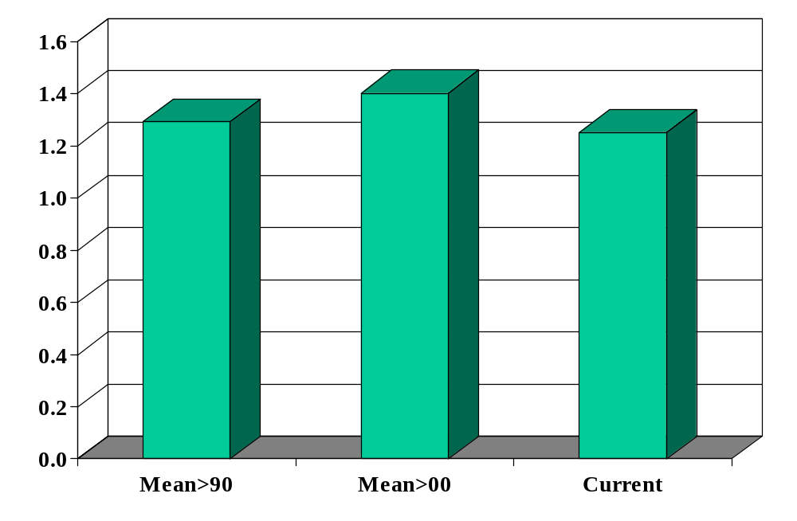
New car sales (millions)

Slide 9
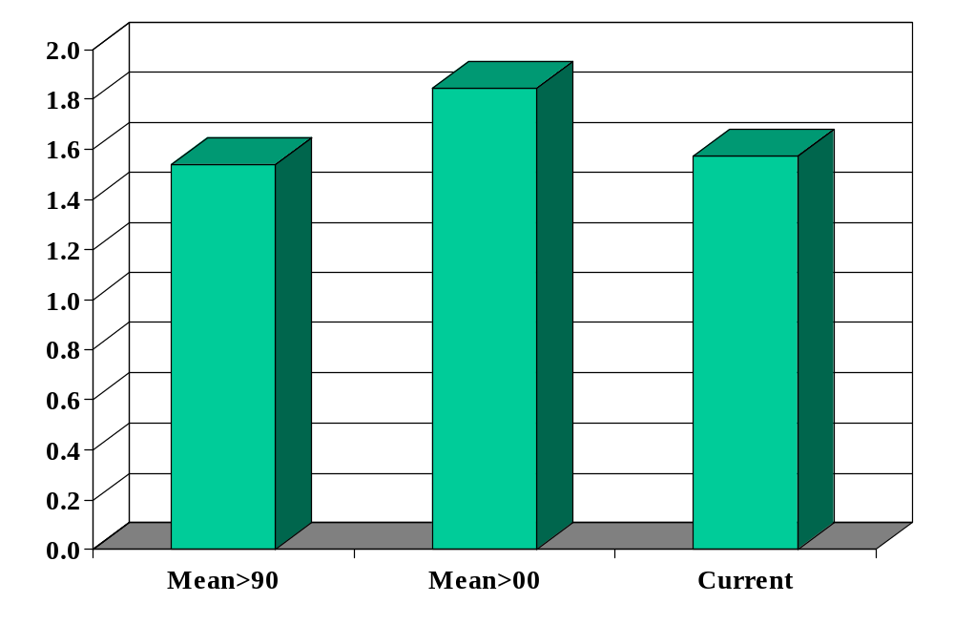
Building permits (millions)

Slide 10
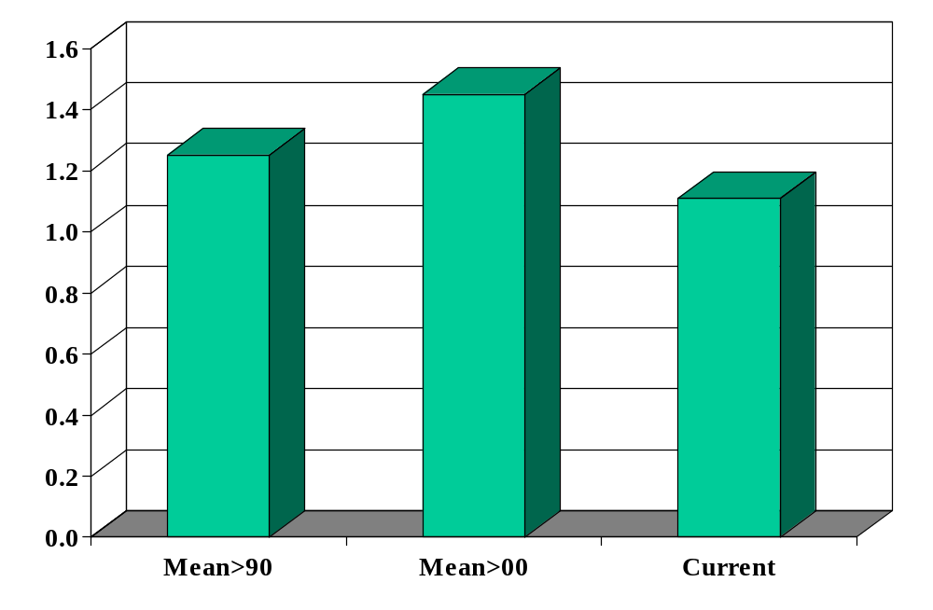
Housing starts (millions)

Slide 11
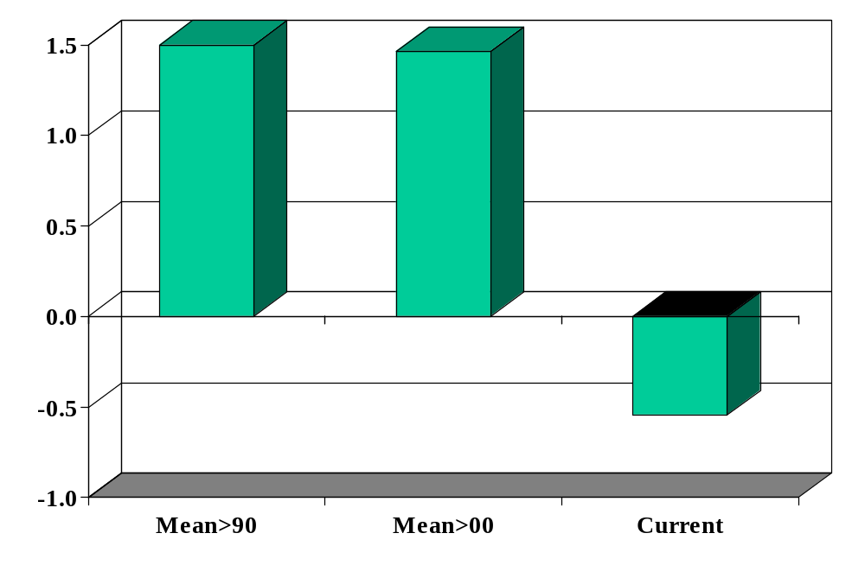
Term spread (%)

Slide 12
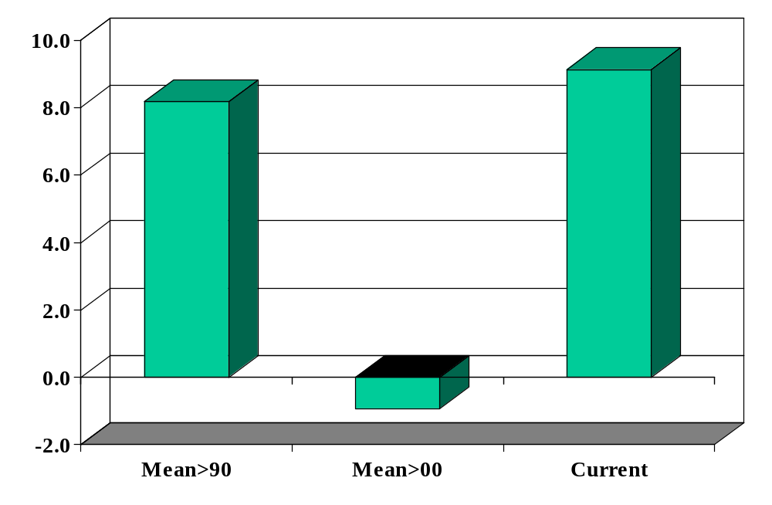
S&P 500 growth (YOY, %)

Slide 13
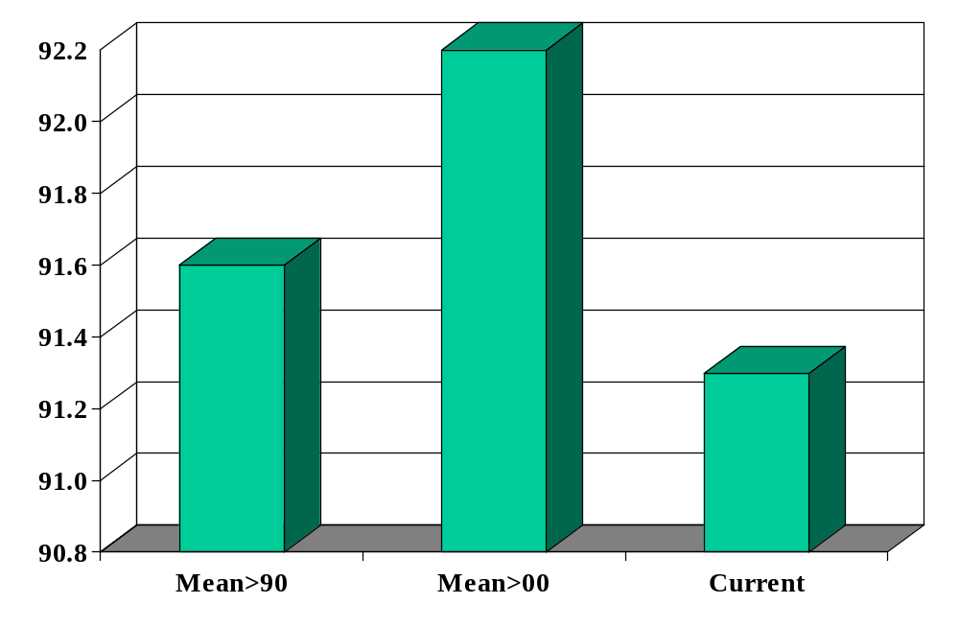
Consumer sentiment

Slide 14
Citigroup Global Markets
Brian M Jones
  Stern MBA 1989
  Previously: Lloyds Bank, Salomon Brothers
  Currently: Director, Citigroup Global Markets
    Briefs traders, investment bankers, and customers on domestic economic developments and their impact on markets
Ish McLaughlin
  Stern MBA 1995
  Previously: Salomon Brothers
  Currently: Managing Director, Citigroup Global Markets
    Investment grade syndicate desk

Slide 15
Questions
How did you get to your current position? What advice would you give us?
How do economic fluctuations affect your business?
How do you see the US economy over the next 3-12 months? Are there any trouble spots on the horizon?
What indicators do you find to be most reliable?
What indicators do you see as positive right now? Negative?
Do you have a theoretical perspective on the current situation?

Slide 16
Richard Berner
PhD in economics, University of Pennsylvania
Currently
  Morgan Stanley, Chief Economist and Managing Director
Past positions
  Federal Reserve, Economist
  Salomon Brothers, Chief US Economist
  Mellon Bank, Chief Economist and Executive Vice President

