Slide 1

The Global Economy
Business Cycle Theory
© NYU Stern School of Business

Slide 2
Changes
Add lots of applications of AS/AD
  Bernanke: is AS flatter due to cheap imports?
  ??

Slide 3
Today’s plan of attack
Group Project #6
Current economic and business issues
Albert Einstein
Basic model: aggregate supply and demand
Why dynamics are tricky
Radical model: productivity-based fluctuations
A step forward or back?

Slide 4
Group Project #6
Data sources
  Spreadsheet: see Blackboard link for indicators class
  St Louis Fed’s “FRED” database

Slide 5
Current issues

Slide 6
Current issues
Richard Berner, Morgan Stanley, March 19:
  Stagflation fears may start to haunt investors again. Among the ingredient: a deepening housing recession, slower productivity growth, and surging food and energy prices. … In my view [however], declining inflation expectations and increased economic slack will bring inflation down.

Slide 7
Albert Einstein
He may have said:
  Make things as simple as possible – but not simpler.

Slide 8
Aggregate supply and demand
P
AS
AD
Y

Slide 9
Aggregate supply and demand
Adapt supply and demand to whole economy
Axes:
  P is price level
  Y is real GDP
Curves
  Supply focuses on production of goods
  Demand focuses on purchases of goods
But why do they look like the picture?
What factors cause them to shift?

Slide 10
Aggregate supply 1
Classical version
Production function
  Y = A K^{α} L^{1-α}
At any point in time
  A is given [but may change over time]
  K is given [but may change over time in response to investment]
  L reflects “equilibrium” in labor market
  Y must therefore be “given” [and AS vertical]

Slide 11
Aggregate supply 1
P
AS*
Y

Slide 12
Aggregate supply 2
Keynesian version
Production function
  Y = A K^{α} L^{1-α}
At any point in time
  A, K given
  Nominal wage “sticky”
  Increase in P reduces real wage, leads firms to hire more people
  AS curve slopes upward (more L implies more Y)
Wage eventually adjusts, bringing us back to AS*

Slide 13
Aggregate supply 2
P
AS*
AS
Y

Slide 14
Aggregate demand
Basic version
  Quantity theory generates inverse relation betw P and Y
  M V = P Y
  M/P = Y/V
  Given M, an increase in P results in lower Y
Sophisticated version
  Demand for money declines with nominal interest i
  M/P = L(i,Y)
  Increase in P can decrease Y directly, or indirectly through an increase in i, which lowers demand for interest-sensitive products

Slide 15
Aggregate supply and demand
P
AD
Y

Slide 16
Aggregate supply and demand
What causes AS to shift? AS*?
  Change in A, K
  Change in price of oil
  Change in “sticky” wage
What causes AD to shift?
  Change in G
  Change in consumption or investment demand (“optimism”)
  Change in M

Slide 17
Aggregate supply and demand
P
AS*
AS
AD
Y

Slide 18
Aggregate supply and demand
Impact of increase in “demand”
  Example: “animal spirits” that move investment demand
  AD shifts right/up
  Short-run impact: prices up, output up
  Long-run impact?
  What is correlation between P and Y?
  What do we conclude from the evidence?

Slide 19
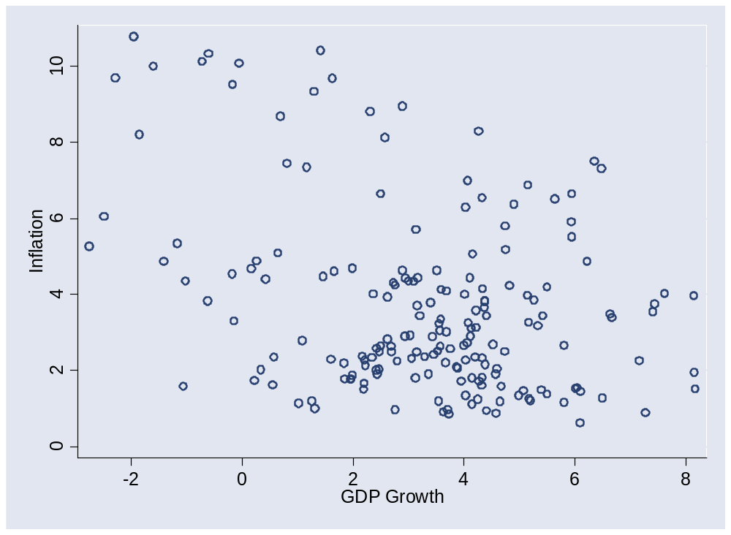
Aggregate supply and demand

Slide 20
Aggregate supply and demand
Impact of decrease in TFP
  AS shifts left [AS*?]
  Short-run impact: prices up, output down [“stagflation”]
  Long-run impact?
  What is correlation between P and Y?

Slide 21
Aggregate supply and demand
Fed stance puzzles economists (FT, Feb 26 07):
  Has the Fed changed its thinking about the relation between unemployment and inflation? Can the US economy operate with unemployment at 4.5% without generating inflation? This puzzle has preoccupied economists since Bernanke testified before Congress earlier this month. He mentioned that Fed policymakers think unemployment will be between 4.5 and 4.75% this year, while inflation will decline to between 1.75 and 2.00% in 2008.

Slide 22
Why dynamics can be tricky
Suppose Fed increases M, shifting AD right
  This increases output, because real wage falls
Why do workers tolerate this?
  If they see it coming, should they build the increase into current wages?
  If so, what happens to the AS curve?

Slide 23
Why dynamics can be tricky
Stagflation revisited
  Contrast impact of higher M and higher inflation expectations
  Why is it important to keep expectations under control?
  Like self-administered drugs?

Slide 24
Why dynamics can be tricky
Suppose we see increases in stock prices, consumption, and output
What caused what?
  Demand theory: increase in stock prices raised consumer demand, which then raised output
  Dynamic supply theory: people expect high future productivity. Consumers and stock traders both see this coming, raise consumption and equity valuations.
How can we tell the difference?
Can future productivity “cause” current consumption to rise?

Slide 25
Productivity-based theory
The radical alternative [aka “real business cycles”]
Everything follows from productivity fluctuations
  Consumers and firms understand productivity dynamics
  Model mimics business cycle properties reasonably well
  Market responses are optimal for the usual reasons
  No need for countercyclical policy: downturns are bad luck, just as a drought is bad luck for farmers
  Interest rates fluctuate, too, even though there’s no monetary policy
Progress or madness?

Slide 26
Productivity-based theory
2004 Nobel prize statement:
  Research by Finn Kydland and Edward Prescott transformed the theory of business cycles by integrating it with the theory of economic growth. Whereas earlier research emphasized macroeconomic shocks on the demand side of the economy, they demonstrated that shocks on the supply side may have far-reaching effects. Their methods have been widely adopted.

Slide 27
Productivity-based theory
Are productivity shocks unreasonable?
  Too much volatility
  Sometimes productivity declines
But that’s what they look like!?

Slide 28
Productivity-based theory
Robert Gordon, Northwestern University:
  I’m not alone in thinking this is a significant step backwards.

Slide 29
Productivity-based theory
Greg Mankiw’s “joke”:
  A group of macroeconomists are talking over coffee. In a heated exchange, the New Keynesian says to the Real Business Cycle theorist: “You guys have set macroeconomics back twenty years with this nonsense!”
  The Real Business Cyclist smiles and says: “So you DO believe in negative productivity shocks after all.”
Comment by PhD student:
  I don’t know what bothers me more: that I understand the joke or that I find it really funny.
Notes:
http://gregmankiw.blogspot.com/2006/08/joke-for-econ-grad-students.html

Slide 30
Productivity-based theory
New Keynesian models
  Most central banks now use models that integrate sticky prices and wages with the dynamic structure of Kydland and Prescottt’s model, referring to the hybrid as “New Keynesian.”

Slide 31
Takeaways
Aggregate supply and demand model is the analyst standard
Dynamics are tricky: hard to separate present and future
Productivity-based theory turns many things on their head
  Food for thought, not a tool for everyday use
There’s a fair amount of uncertainty about exactly how the economy works in the short run

