Slide 1

The Global Economy
Principles of Fiscal Policy
© NYU Stern School of Business

Slide 2
Group Project #7
Notes:
March 23 2005 p 15

Slide 3
Slovakia
Ivan Miklos, Deputy Prime Minister, Financial Times:
  I am convinced that the reforms of new EU member states could serve as inspiration for the older member states as well. One such reform is the flat tax. Pioneered in the 1990s by Estonia, it was implemented with great success in Slovakia last year. We now have one of the simplest, most transparent tax systems in the world, and one that is more conducive to economic activity, as work and investment are taxed more lightly than in most countries. And our tax revenues have not decreased at all, partly because the reform eliminated most of the incentives and opportunities for tax avoidance. The new system has been particularly popular with German companies.
What do we mean by a flat tax?
Is it a good idea?
Notes:
March 23 2005 p 15

Slide 4
Germany
From The Economist (May 6, 2004):
  Mr Schröder reportedly argued that cutting the budget will merely fuel the anxieties of German consumers, and so weaken the economy further. Instead, he wants to make a “strategic reply,” which could include spending some real money on his so-called “innovation offensive.” To finance this, the government could sell more assets, such as stakes in companies and parts of the country's gold reserves – and borrow more, like George Bush in America.
  In contemplating a Keynesian shift, Mr Schröder may be taking a lead from Peter Bofinger, an economist at Würzburg University. The government has focused too much on structural reform and not enough on sustaining demand, argues Mr Bofinger, who was recently appointed to the German council of economic experts.
Is Schröder right?
Notes:
March 23 2005 p 15

Slide 5
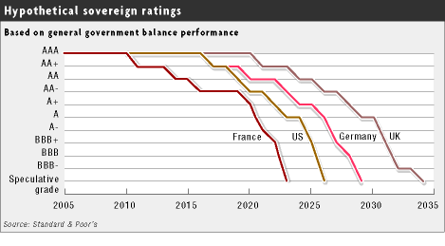
Are we in trouble?
Source: FT, March 21, 2005

Slide 6
Agenda
Ingredients of fiscal policy
Good tax policy
Is government spending good?
  Are wars good for the economy?
Are deficits bad?
  Do they raise interest rates?
  Do they reduce saving and investment?
Measurement issues of social security

Slide 7
Fiscal policy
Government budget:
G_{t} + V_{t} + i_{t} B_{t} = T_{t} + B_{t+1} – B_{t}
Ingredients:
  G = government purchases of goods and services
  V = transfer payments from government to households
  G + V = government spending
  T = tax revenue
  G + V – T = primary deficit (excl interest)
  B = government debt (“bonds” – ignore money)
  i = (nominal) interest rate on debt
  iB = interest payments

Slide 8
Fiscal indicators
Country | Taxes/GDP | Capital | Labor +Cons’n | Def/GDP | Debt/GDP
Canada | 41 | 88 | 38 | (1) | 71
Czech | 42 | 64 | 51 | 4 | 39
France | 51 | 41 | 51 | 4 | 74
Germany | 44 | 36 | 46 | 4 | 67
Japan | 30 | 84 | 29 | 6 | 163
Korea | 31 | 49 | 23 | (3) | 19
Sweden | 58 | 64 | 58 | (1) | 61
UK | 41 | 69 | 34 | 3 | 43
US | 31 | 51 | 27 | 4 | 64
OECD | 37 | 52 | 43 | 3 | 77
Sources: OECD Economic Outlook 2005; Carey and Tchilinguirian, “Tax rates,” OECD, 2000.

Slide 9
Taxes
Are they bad?

Slide 10
Government purchases
Evidence on long-run impact
  Countries with governments that provide basic services and infrastructure grow faster
  Countries with governments that spend a lot on other things grow more slowly
Why?
  Best guess: institutions (rule of law, property rights, competition) and incentives (high spending and taxes reduce incentives to work and save)

Slide 11
Government purchases
Experiment
  Increase government purchases temporarily
  Purchases not substitutes for private consumption
  Raise lump-sum taxes by same amount to balance budget
  What is impact on economy?
Analysis
  Does TFP rise?
  What about K and L?
  Conjecture: L rises (income effect), Y up by less than G, C falls, r rises

Slide 12
War and the US economy
 | WWI (1915) | WWII (1947) | Korea (1950)
Excess military spending ($ billions) | 81.4 | 645.3 | 146.3
Excess as % of trend real GNP | 16.8 | 66.2 | 11.4
Excess of real GNP | 13.7 | 405.7 | 101.9
Excess as % of trend real GNP | 2.8 | 41.6 | 8.0
Ratio to excess military spending of:
Real GNP | 0.17 | 0.63 | 0.70
Personal Consumption | -0.45 | -0.08 | -0.05
Gross Private Investment | -0.19 | -0.16 | -0.26
Excess of employment (millions)
Total | 2.1 | 8.4 | 1.5
Military Personnel | 2.7 | 9.9 | 1.9
Civilian Employment | -0.6 | -1.5 | -0.4
Excess of total employment as % of trend value | 5.3 | 14.8 | 2.4
Notes:
Barro page 451

Slide 13
Government deficits
Debt dynamics
  B_{t+1} = (T_{t}–G_{t}–V_{t}) + (1+r_{t})B_{t}
  (unstable?)
Debt to GDP ratio (B/Y):
  Grows naturally if B and r are positive
  And r > growth rate of GDP
To stabilize the ratio:
  Budget balance isn’t enough (T_{t}–G_{t}–V_{t}=0)
  Need primary surplus: T_{t}–G_{t}–V_{t} > 0
Otherwise:
  Eventually: interest on debt > GDP!

Slide 14
Government deficits
Government budget (fixed r)
  (1+r)B_{t} = (T_{t}–G_{t}–V_{t}) + B_{t+1}
  B_{t} = (T_{t}–G_{t}–V_{t})/(1+r) + B_{t+1}/(1+r)
Now substitute repeatedly:
B_{t} = (T_{t}–G_{t}–V_{t})/(1+r) + (T_{t+1}–G_{t+1}–V_{t+1})/(1+r)² + B_{t+2}/(1+r)²
If the last term goes away:
B_{t} = present value of future primary surpluses
Bottom line:
  Cut in tax now must be balance by increase later [why taxes?]
  Debt is a future promise to make future payments

Slide 15
Government deficits
Experiment
  Increase current government deficit by cutting current taxes
  No change in spending
  What is impact on economy?
Analysis
  Are resources used?
  What’s the impact on households? If PV of taxes hasn’t changed, why should they change consumption?

Slide 16
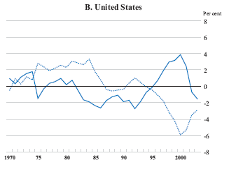
Public and private saving
Solid: govt
Dashed: pvt
Devs from trend
Source: OECD Economic Outlook.

Slide 17
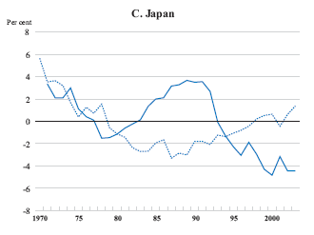
Public and private saving
Solid: govt
Dashed: pvt
Devs from trend
Source: OECD Economic Outlook.

Slide 18
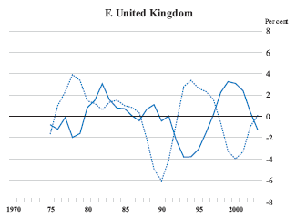
Public and private saving
Solid: govt
Dashed: pvt
Devs from trend
Source: OECD Economic Outlook.

Slide 19
Government deficits
Summary:
  A current deficit is a promise to run a surplus later
  If spending is fixed: current tax cut is financed by future tax increase with same present value
  If household decisions depend only on the present value of taxes, the impact on private consumption and saving nil
  Evidence suggests that this isn’t a bad approximation
  Consequence: tax cuts don’t stimulate consumption – at least not very much
  Schröder is wrong: deficits don’t eliminate “anxieties”
  And: the longer the deficit continues, the larger the tax burden on future taxpayers
  What about the US?

Slide 20
Social security
Why are these payments transfers?
A promise to pay in the future
  Should current payments in be counted as government revenue?
  If debt is a commitment to make future payments, are future social security commitments debt?

Slide 21
Takeaways
Taxes discourage work and saving/investment
  Good systems have low rates on large base
Government purchases use resources
  Needed to provide institutions conducive to growth (rule of law, property rights, competition)
  Infrastructure investments typically foster growth, too
  They’re not a free lunch: higher G leads to smaller C
  Wars are bad for the economy
Debt and deficits are promises to pay in the future
  Impact on consumption and interest rates is small
Unfunded pensions: a difficult measurement issue

Slide 22
Midterm review
Notes:
March 23 2005 p 15

