Slide 1

The Global Economy
Government Deficits
© NYU Stern School of Business

Slide 2
Today’s plan of attack
Current economic and business issues
The government’s budget
Questions
Pictures and quotes
Government budget mechanics
Do we care about deficits?
Sustainability analysis
US fiscal policy: Are we in trouble?

Slide 3
Today’s plan of attack
Current economic and business issues
The government’s budget
Questions
Pictures and quotes
Government budget mechanics
Do we care about deficits?
Sustainability analysis
US fiscal policy: Are we in trouble?

Slide 4
Government’s budget constraint
Government budget:
G_{t} + V_{t} + i_{t} B_{t} = T_{t} + B_{t+1} – B_{t}
Ingredients:
  G = government purchases of goods and services
  V = transfer payments from government to households
  G + V = government spending
  T = tax revenue
  D = G + V – T = primary deficit (excl interest) “EBITDA”
  B = government debt (“bonds” – ignore money)
  i = (nominal) interest rate on debt
  iB = interest payments

Slide 5
Questions
Are government deficits bad?
Is debt bad?
Why or why not?

Slide 6
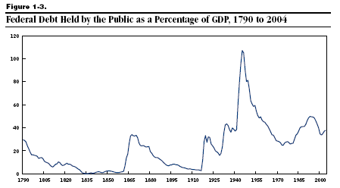
US debt (% of GDP)

Slide 7
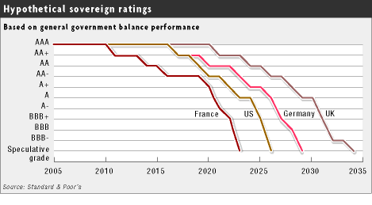
Government debt ratings?
Source: FT, March 21, 2005

Slide 8
Alexander Hamilton
Second Report on Public Credit, 1795:
  Every system of Public Credit must assume as a fundamental principle that it will possess ability to pay the debt which it contracts. … With the creation of debt should be incorporated the means of extinguishment, which means are twofold: the establishing at the time of contracting a fund for the reimbursement of principal, as well as for the payment of interest.

Slide 9
Larry Summers
Remarks to IMF:
  The US government deficit, and the associated low saving rate, are the most serious problem to face the US economy in the last 50 years. [paraphrase]

Slide 10
Government budget: summary
Analogy: credit cards
  Allow you to shift payments in time, not avoid them
  Higher debt leads to higher interest payments, which requires higher cash flow to finance
Government deficits and debt
  Deficits concern timing, not whether we pay for government spending
  Eventually accumulated debt must be repaid [sort of]
  Therefore: not only must deficits not last forever, you must run future (primary) surpluses to balance today’s deficit.

Slide 11
Government budget: variations
Three versions of the same equation
D_{t} + iB_{t} = B_{t+1} – B_{t} finance deficit with debt
B_{t+1} = (1+i)B_{t} + D_{t} debt dynamics (backwards)
B_{t} = B_{t+1}/(1+i) – D_{t}/(1+i) debt dynamics (forwards)
Bottom line
  Deficits must be financed

Slide 12
Government budget: present value
Current debt equals
B_{t} = B_{t+1}/(1+i) – D_{t}/(1+i)
= B_{t+2}/(1+i)² – [D_{t}/(1+i) + D_{t+1}/(1+i)²]
= …
= B_{t+n}/(1+i)^{n} – [D_{t}/(1+i) + D_{t+1}/(1+i)² + … + D_{t+n-1}/(1+i)^{n}]
= present value of future primary surpluses
Comments
  Debt must be financed by future (primary) surpluses
  Assumes: B_{t+n}/(1+i)^{n} → 0 [weaker condition than B_{t+n} → 0]
  Or we could default!

Slide 13
Should we care about deficits?
Deficits concern timing of taxes and revenues
Reasons we don’t care
  Present value doesn’t change [Analogy: Modigliani-Miller on dividends]
Reasons we might care
  Smooth tax rates?
  Redistribution across generations?

Slide 14
Sustainability analysis
Issue:
  Will ratio of debt to GDP settle down if policy doesn’t change?
  If yes: sustainable. If not, unsustainable.
  Both measured at current prices
Growth of (nominal) debt
B_{t+1} = (1+i)B_{t} + D_{t}
Growth of (nominal) GDP
Y_{t+1} = (1+g)Y_{t}
Growth of debt to GDP ratio
B_{t+1}/Y_{t+1} = [(1+i)/(1+g)] (B_{t}/Y_{t}) + (1+g)⁻¹ D_{t}/Y_{t}

Slide 15
Sustainability analysis
“Natural” growth rates
  Debt: (1+i)
  GDP: (1+g)
  Ratio of debt to GDP: (1+i)/(1+g)
Sustainability requires
(1+i)/(1+g) < 1
i < g
Typically i>g
  Therefore something must change – but what?

Slide 16
Sustainability analysis
“Unsustainable” means something must change
  Raise taxes
  Lower spending
  Default on debt

Slide 17
Brazil: sustainability analysis
Brazil today
  B/Y = 50%
  D/Y = –4.8% (surplus!)
  i = 16%
  g = 7% (2+5)
Is fiscal policy sustainable?
  Compare “natural growth” of B/Y with current surplus

Slide 18
Is the US in trouble?
Why or why not?

Slide 19
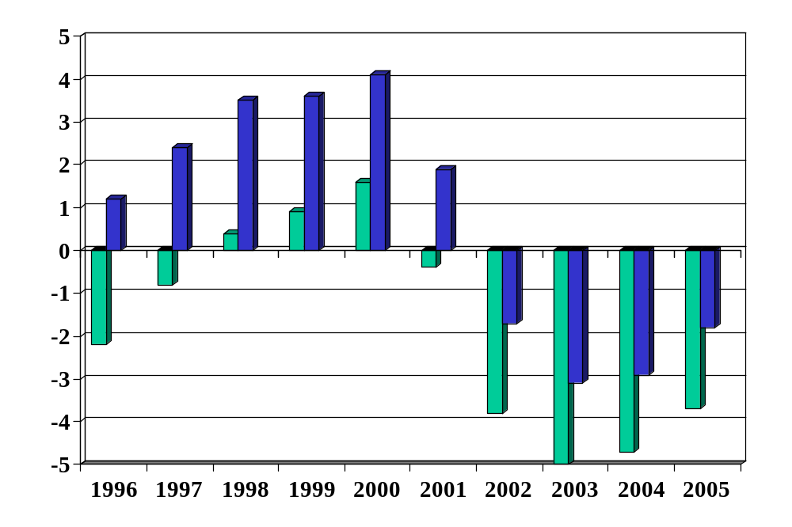
US: budget balance (% of GDP)
Source: OECD Economic Outlook, Annex Tables 27 and 29. Green=total, Blue=primary.

Slide 20
US: debt (% of GDP)
Notes:
http://www.cbo.gov/showdoc.cfm?index=6982&sequence=0

Slide 21
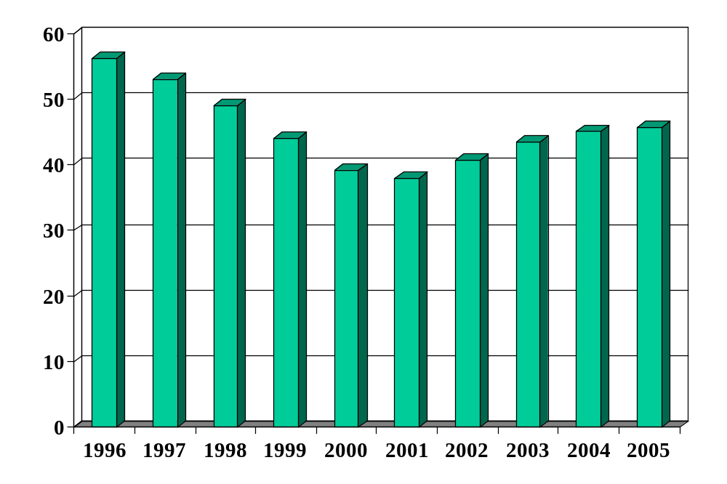
US: debt (% of GDP)
Source: OECD Economic Outlook, Annex Table 33.

Slide 22
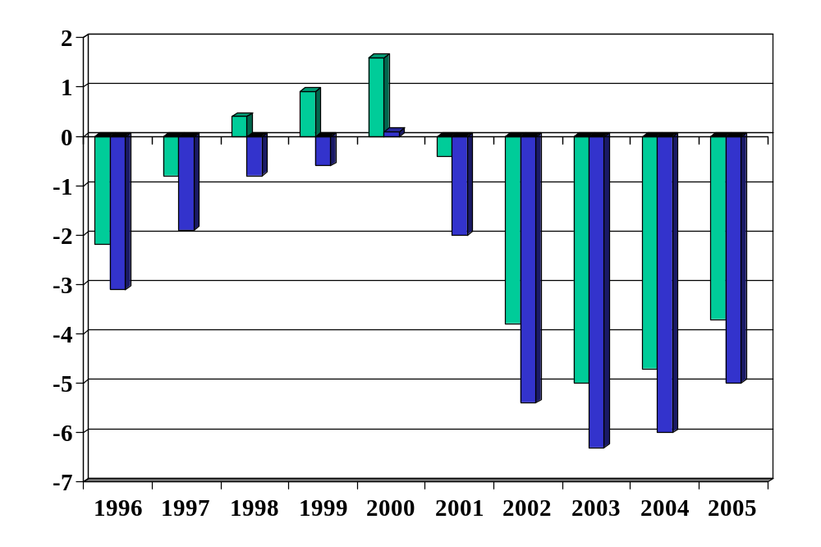
US: impact of soc sec (% of GDP)
Source: OECD Economic Outlook, Annex Tables 27 and 29. Green=total, Blue=excl soc sec.

Slide 23
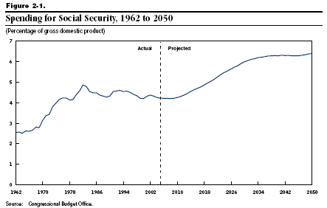
US: social security (% of GDP)

Slide 24
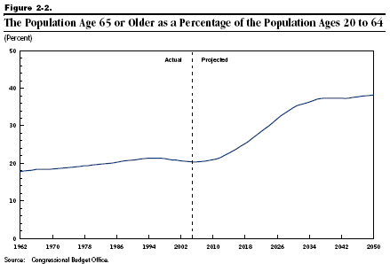
US: age distribution

Slide 25
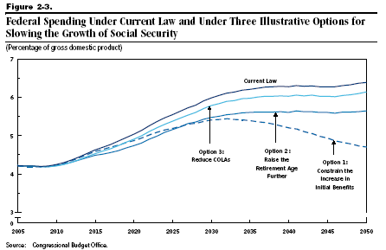
US: social security (% of GDP)

Slide 26
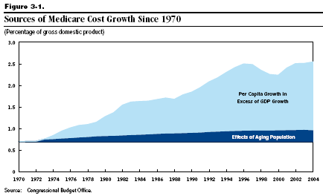
US: medicare (% of GDP)

Slide 27
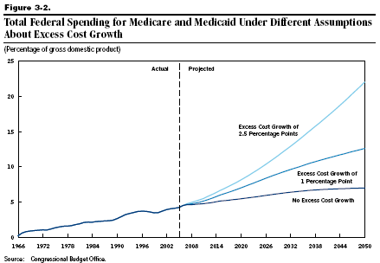
US: medicare/medicaid (% of GDP)
Historical avg: 2.9%

Slide 28
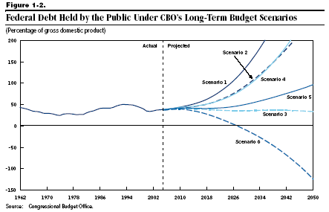
US debt (% of GDP)

Slide 29
Takeaways
Government deficits must be financed
  By issuing debt today
  And by running (primary) surpluses in the future
Sustainability analysis
  Based on dynamics of debt to GDP ratio
Why we might care about deficits
  Uneven tax rates and redistribution
US deficits
  The biggest issues are not the current deficit, but projected future deficits implied by social security and medicare-medicaid payments

Slide 30
Germany: sustainability analysis
Germany today
  B/Y = 70%
  D/Y = 4%
  i = 2%
  g = 4%
Is fiscal policy sustainable?

Slide 31
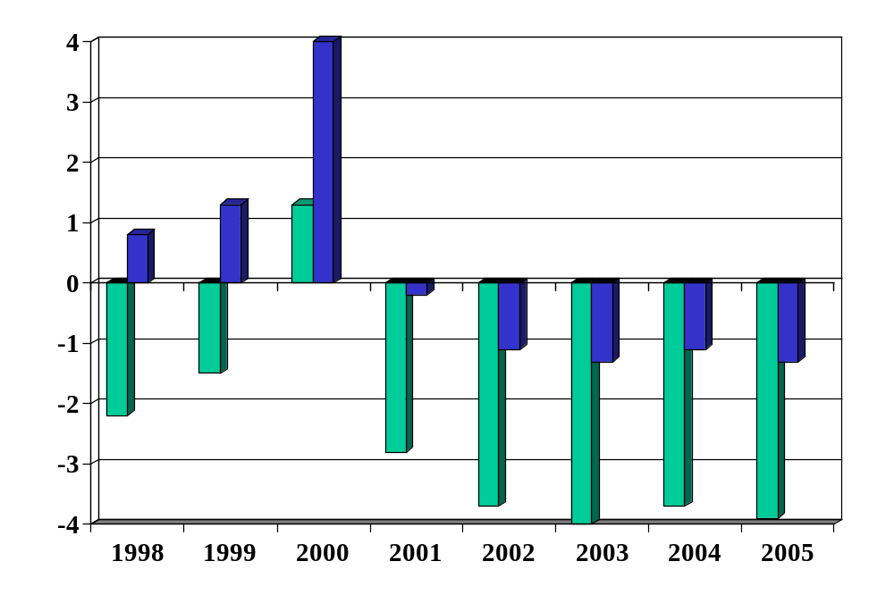
Germany: budget balance (% of GDP)
Source: OECD Economic Outlook, Annex Tables 27 and 29. Green=total, Blue=primary.

Slide 32
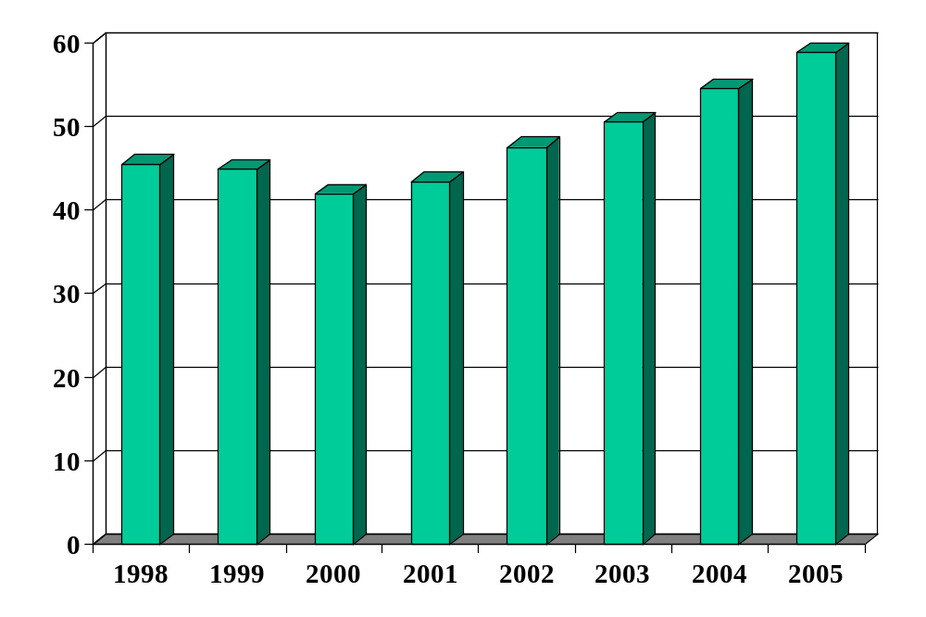
Germany: debt (% of GDP)
Source: OECD Economic Outlook, Annex Table 33.

