Slide 1

The Global Economy
Exchange Rates
© NYU Stern School of Business
Notes:
ERs central to international transactions
Why do they move?

Slide 2
Today’s plan of attack
Group Project #5
Current economic and business issues
Quotes
Exchange rates and prices: the “anchor”
Chinese renminbi
The carry trade
Exchange rates and “X”
Heineken USA

Slide 3
Executive summary
Short-run movements in exchange rates are large … but (mostly) inexplicable, at least for developed countries

Slide 4
Group Project #5
Questions? Comments?

Slide 5
Current issues

Slide 6
Current issues
From Antonio:
  I wanted to consider a parallel issue [to international trade]: cross border takeovers. Should governments try to protect national companies or, at least, try to in strategic industries?

Slide 7
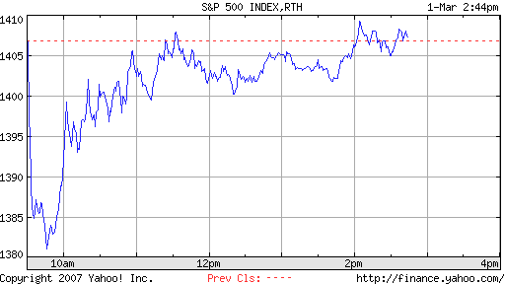
Current issues
Notes:
What is this telling us?

Slide 8
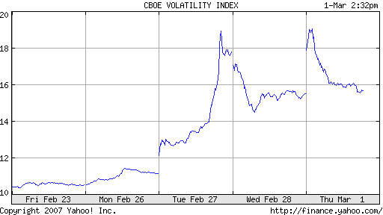
Current issues
Notes:
What is this telling us?

Slide 9
Quotes
Alan Greenspan:
  Having endeavored to forecast exchange rates for more than half a century, I have understandably developed significant humility about my ability in this area, a sentiment that I suspect many in this room share.

Slide 10
Quotes
Bill Gross, PIMCO, 2004:
  If you think writing about the fortunes of the stock market is tricky, try getting your arms around currencies.

Slide 11
Quotes
Warren Buffett, Letter to Shareholders, 2005:
  Berkshire owned about $21.4 billion of foreign exchange contracts at yearend, spread among 12 currencies. As I mentioned last year, holdings of this kind are a decided change for us. But the evidence grows that our trade [deficit] will put unremitting pressure on the dollar for many years to come.
Two years later, he closed out the positions

Slide 12
Exchange rates and prices
Define
  P = domestic price (measured in domestic currency)
  P* = foreign price (measured in foreign currency)
  s = spot exchange rate (domestic currency price of one unit of foreign currency)
  NB: rise in s = fall in value of domestic currency
Comparing prices
  Expressed in the same units, the prices are P and sP*

Slide 13
Exchange rates and prices
Classical theory
  Changes in M lead to changes in P (ditto M* and P*)
  Trade in goods equates prices: P = sP*
  Exchange rate reflects differences in prices: s = P/P*
Assessment
  Works reasonably well in high-inflation countries: rapid increase in P leads to similar increase in s
  Horrible in low-inflation countries, but nevertheless used as an “anchor” for long-run changes

Slide 14
Exchange rates and prices
Region | USD Price of Big Mac (Feb 1 07)
US | 3.22
Euro Zone | 3.82
Japan | 2.31
China | 1.41
Brazil | 3.01
Argentina | 2.65
Mexico | 2.66
Is dollar weak or strong? Expected to rise or fall?

Slide 15
Exchange rates and prices
Look at “average” prices
  P = domestic price index (measured in domestic currency)
  P* = foreign price index (measured in foreign currency)
  s = spot exchange rate (domestic currency price of one unit of foreign currency)
Real exchange rate
RER = s P*/P
Purchasing power parity (PPP): RER = 1
  Obviously wrong!
But: If RER >1, will s fall?
  Yes, on average, but slowly (half-way in 5 years)

Slide 16
Exchange rates and prices
Same thing in growth rates
Δ log RER = Δ log s – [Δ log P – Δ log P*]
Do exchange rate changes reflect inflation differences?
  Yes if RER = 1 (PPP)

Slide 17
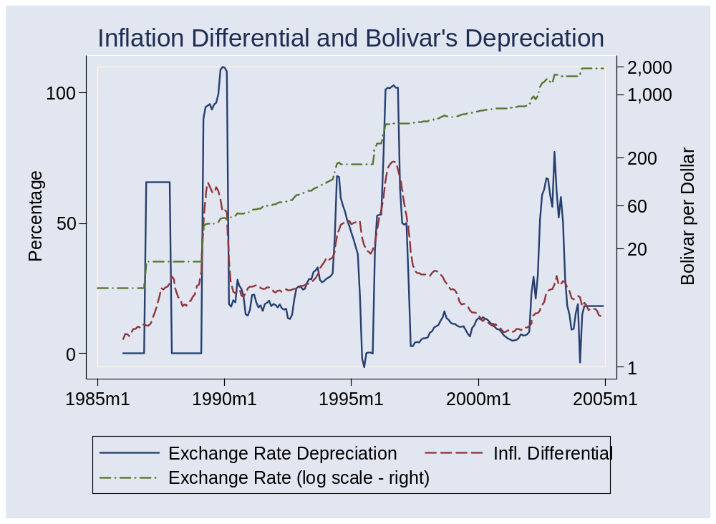
Exchange rates and prices

Slide 18
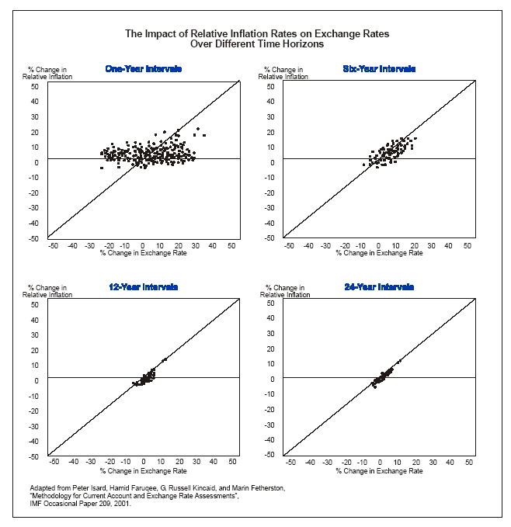
Exchange rates and prices
Source: Deutsche Bank guide.

Slide 19
Exchange rates and prices
Bottom line for PPP
  OK for high inflation countries
  OK over low inflation countries over long periods of time (>5 years)
  Useless for low inflation countries over short periods of time

Slide 20
Chinese renminbi
Is it “undervalued”?
  What does this mean?
  How would we tell?
Notes:
IMF paper: http://www.imf.org/external/pubs/ft/wp/2006/wp06220.pdf
PBOC balance sheet: http://www.pbc.gov.cn/diaochatongji/tongjishuju/gofile.asp?file=2004S2.htm

Slide 21
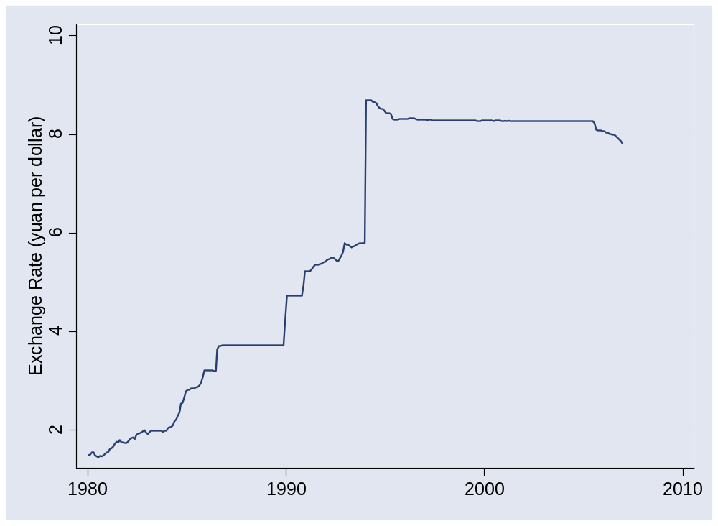
Chinese renminbi
Source: IMF, International Financial Statistics.

Slide 22
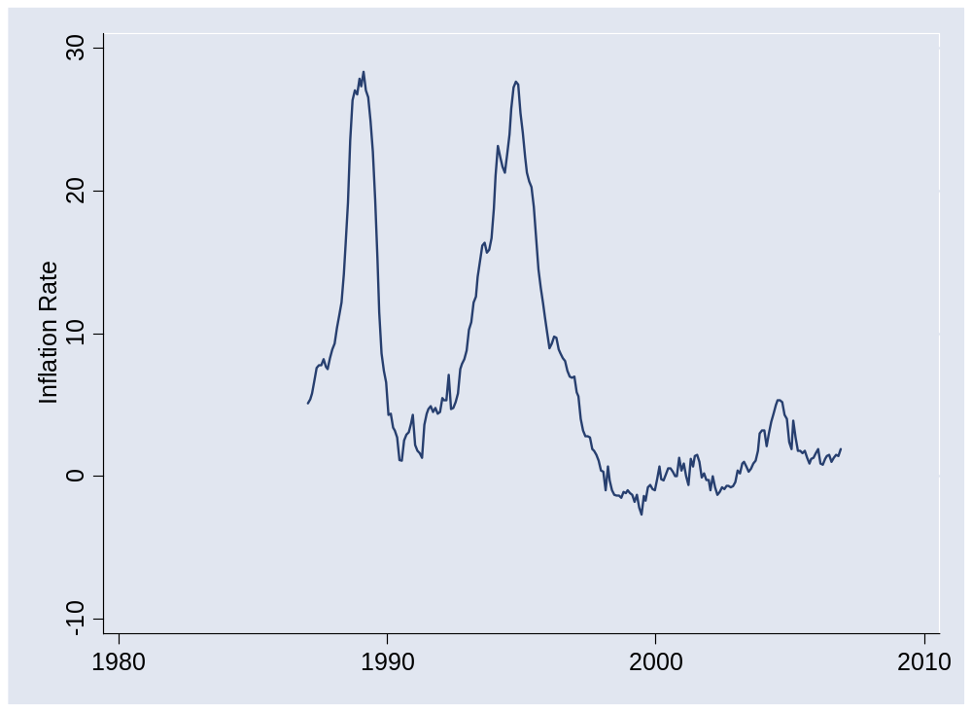
Chinese renminbi
Source: IMF, International Financial Statistics.

Slide 23
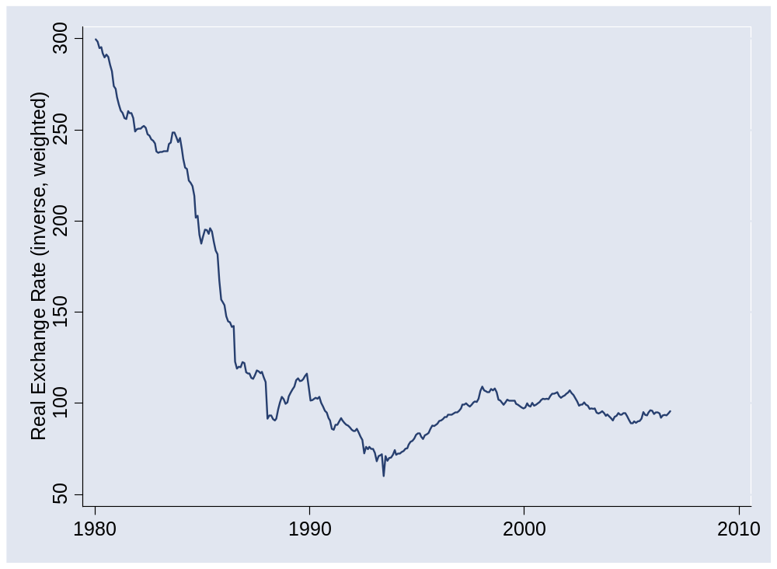
Chinese renminbi
Source: IMF, International Financial Statistics.

Slide 24
PBOC balance sheet
Source: PBOC website.

Slide 25
Exchange rates and interest rates
Region | Money market rate
US | 5.17
Euro Zone | 3.84
Japan | 0.45
China | 3.60
Brazil | 12.94
Argentina | 9.50
Mexico | 7.03
Why are rates different? Where would you invest?
Source: The Economist.

Slide 26
Exchange rates and interest rates
Define
  i = money market interest rate on domestic currency
  i* = money market interest rate on foreign currency
  s = spot exchange rate (domestic currency price of one unit of foreign currency)
Comparing returns
  We need to adjust the foreign return for capital gain or loss on currency
(s_{t+1}– s_{t})/s_{t}

Slide 27
Exchange rates and interest rates
Do global capital markets equalize returns?
Return on a foreign-currency-denominated asset:
  Return in domestic currency = return in foreign currency + rate of change in exchange rate (depreciation rate):
  Return = i* + (s_{t+1}– s_{t})/s_{t}
  Excess Return = [i* + (s_{t+1}– s_{t})/s_{t}] – i
Do markets equalize expected returns? [We call this conjecture “uncovered interest parity”]
  If so: currency depreciation would offset interest rate
  No: high interest rate currencies do better, on average [On average they appreciate, not depreciate]
  Evidence coming

Slide 28
Exchange rates and interest rates
The “carry trade”
  Long position in high interest rate currency
  Short position in low interest rate currency
  Carry: positive net interest rate
  Risk: that currency will depreciate
Question: is risk worth it, on average?

Slide 29
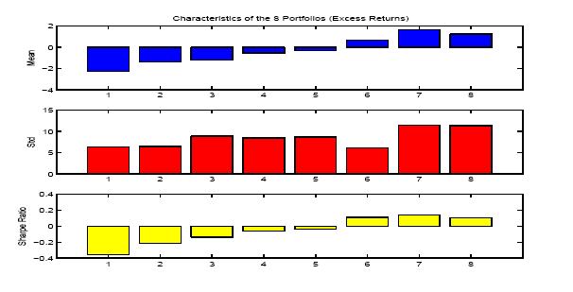
Exchange rates and interest rates
Portfolio strategy
  Rank currencies by short-term interest rate
  Sort into eight portfolios (low to high by rate)
  Compare excess returns in dollars
Source: Lustig and Verdelhan, NBER wp 11104.

Slide 30
Exchange rates and interest rates
Bottom line
  Currency changes do not compensate (on average) for interest differentials
  On average, high interest rate currencies appreciate
  Low R² (0.05 or so)
  Nevertheless: investments in high interest rate currencies have higher average returns (and some risk of currency fluctuations)

Slide 31
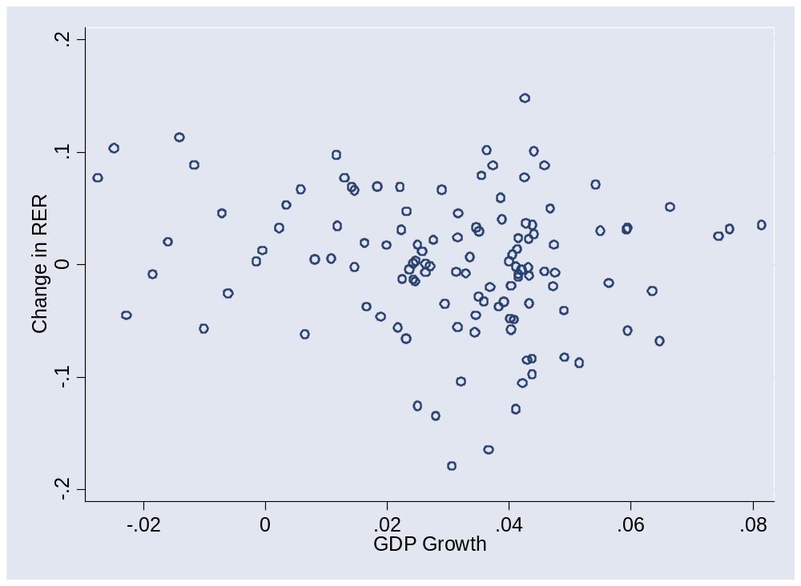
Exchange rates and output growth
Data for the US, 1975-present.

Slide 32
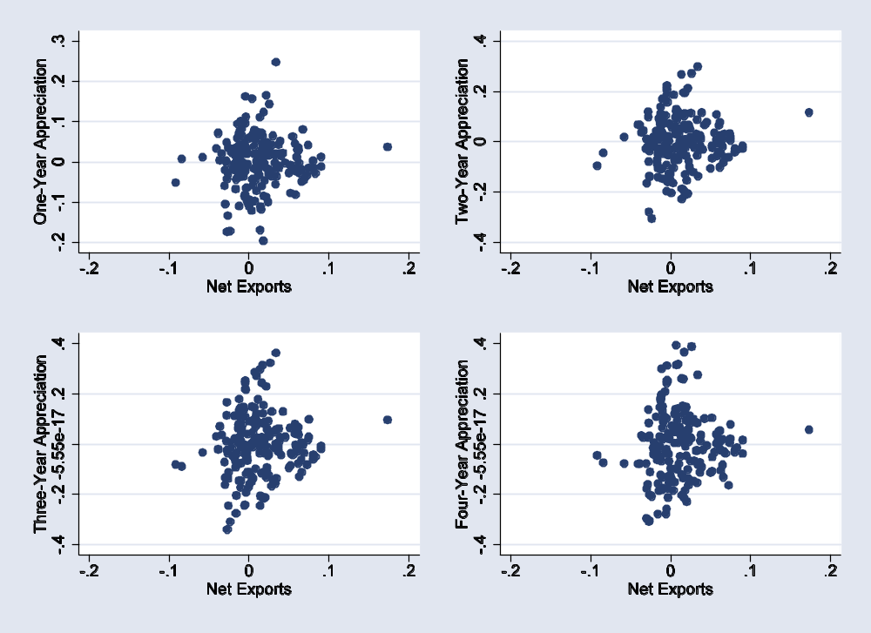
Exchange rates and trade balance
Data for lots of developed countries.

Slide 33
Exchange rate summary
People have tried everything
  Almost nothing gives you a more reliable short-run prediction than a random walk (no change)
  Really

Slide 34
Heineken USA
Heineken’s US import business
  Monthly volume: 14m units (6-pack)
  Production cost: 1.96 euros
  US distribution and marketing expenses: 1.75 dollars
  Elasticity of demand: –3
  Current price of one euro: 1.30 dollars
Questions
  How likely is it that the euro rises by 10% v the dollar?
  If it rises 10%, how would you change your US price?
  If the Mexican peso fell, how would that affect your pricing?

Slide 35
Takeaways
Exchange rates are central to international transactions
They remain largely inexplicable in the short run
Nevertheless
  PPP is a long-term anchor
  The carry trade works – on average
FX volatility is a fact of life

Slide 36
Extra slides

Slide 37
Current issues
Wall Street Journal, Feb 27 07, via Neely:
  Despite India's strong economy, there are growing concerns that government spending has increased debt to dangerous levels. In a November report, the International Monetary Fund warned that government debt stood at 80% of gross domestic product, and suggested measures to shrink it. The immediate impact is to squeeze spending. Health and education experts contend that funding shortages -- and poor monitoring of how funds are disbursed -- have sharpened inequalities between urban and rural areas. In rural schools, poorly paid teachers often fail to appear for class.

Slide 38
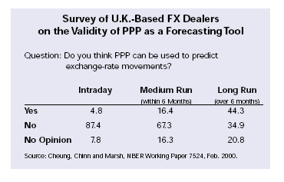
Exchange rates and prices
Source: DB guide.

