Slide 1

The Global Economy
Growth and Institutions
© NYU Stern School of Business
Notes:
Overview:
GP #3
Spiel:
Modern society is a miracle – that hundreds of millions of people could interact and have things (more or less) work
All of this shows up in TFP
Where does it come from?
Not just math/science/tech: iron, porcelin, algebra
Fibonacci and PV: math taken from India and Islamic world
Bigger issue: Why aren’t people stealing from each other?
Some examples: Pirates (North), borrowing/lending game….
What do we need?
Security
Property rights
Competition

Slide 2
Samuel Villegas
From: Mexico
Stern MBA 1998
Goldman Sachs
  Sales and trading, Latin America
  Credit risk management, Latin America

Slide 3
Today’s plan of attack
Group Project #3
Where we’re headed
Institutions and productivity (TFP)
Samuel Villegas

Slide 4
Group Project #3

Slide 5
Where we’re headed
GDP
Capital & Labor
Productivity
Political Process
“Institutions”

Slide 6
Where does TFP come from?

Slide 7
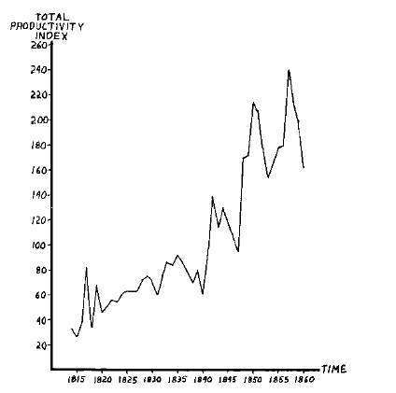
TFP in ocean shipping, 1600-1850
Source: Douglas North, 1993 Nobel prize
Why?

Slide 8
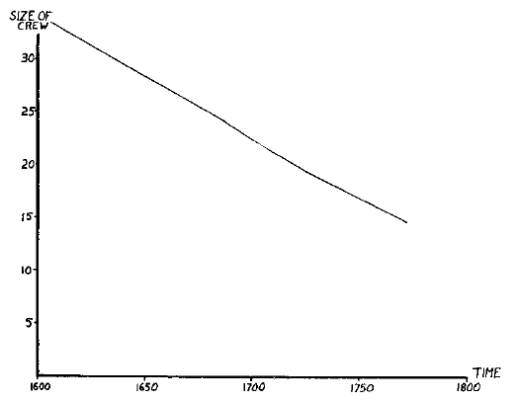
TFP in ocean shipping, 1600-1850
Notes:
Comment: TFP is a social phenomenon

Slide 9
The lending game
Parameters:
  Lender offers 100 to borrower for one year
  Lender’s cost of funds is 5%, charges 10%, the competitive risk-adjusted rate
  Borrower has project that generates 100 + 15
  If you default, you use up 25 (lawyers etc)
  Note: the deal generates value (115 – 105 = 10)
  What happens?

Slide 10
The lending game
Don’t lend
Payoffs = (0,0)
L
(+5,+5)
Repay
Lend
B
0
X
Default
(-105,+90)
What’s the outcome? What do we do about it?
Notes:
Note: economic activity creates value

Slide 11
Lending reconsidered
Note: creditor rights help borrowers!
  Making it easy to default simply kills off loan market, which hurts borrowers as well as lenders
  Result: positive NPV projects not funded, TFP lower than it could be
Evidence:
  States/countries with stronger creditor rights have more lending, lower rates
  Countries with strong creditor rights have higher GDP per capita

Slide 12
Madison’s “difficulty”
James Madison, Federalist Papers 51 (1788):
  If men were angels, no government would be necessary. If angels were to govern men, neither external nor internal controls on government would be necessary. In framing a government which is to be administered by men over men, the great difficulty lies in this: you must first enable the government to control the governed; and in the next place oblige it to control itself.

Slide 13
We started with
GDP
Capital & Labor
Productivity

Slide 14
Now we have
GDP
Capital & Labor
Productivity
“Institutions”

Slide 15
Takeaways
Productivity (TFP) reflects in large part social institutions that facilitate economic activity
Many of these institutions are reflected in the issues you raised in Group Project #3
Measures of institutional quality are attempts to quantify important but inherently subjective features of the economic and business environment

Slide 16
Samuel Villegas
From: Mexico
Stern MBA 1998
Goldman Sachs
  Sales and trading, Latin America
  Credit risk management, Latin America

Slide 17
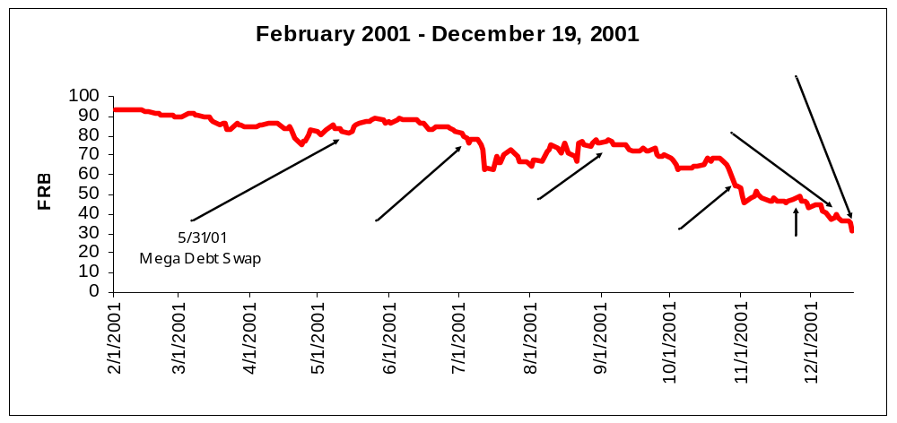
Argentina (Before)

Slide 18
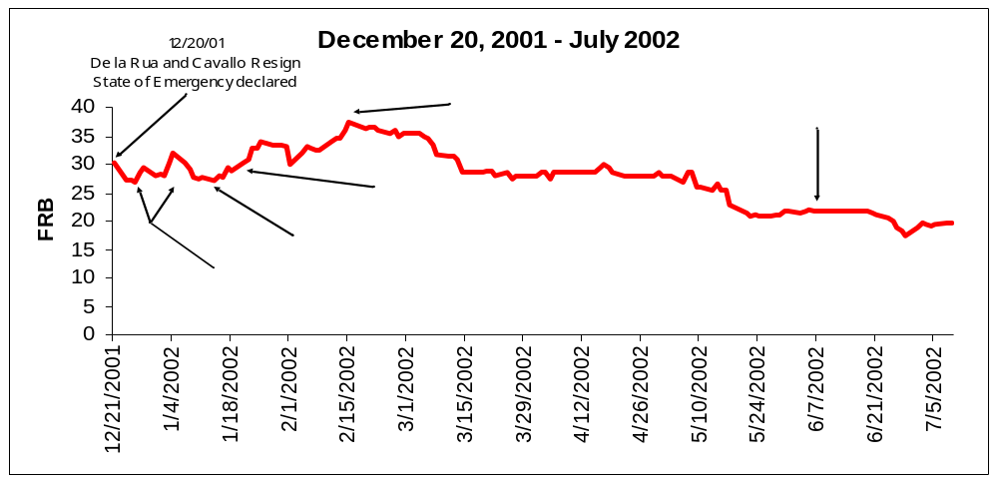
Argentina (After)

Slide 19
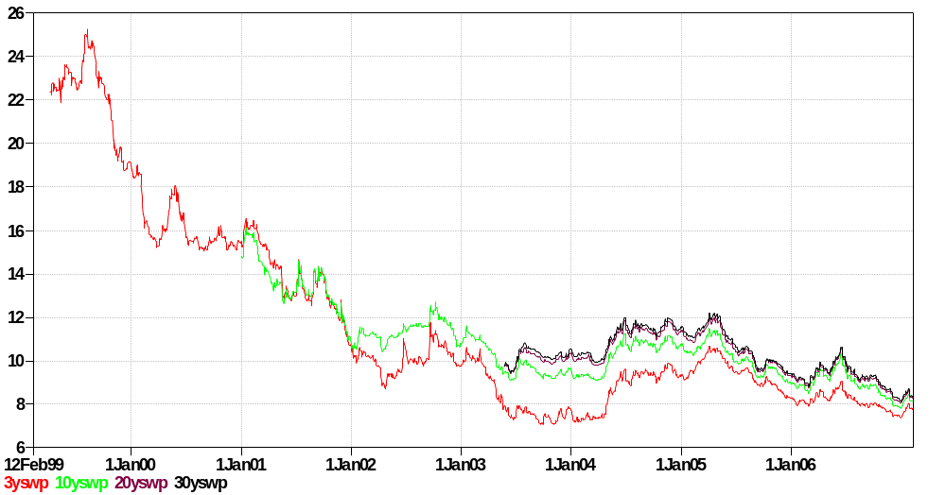
Mexican Capital Markets

Slide 20
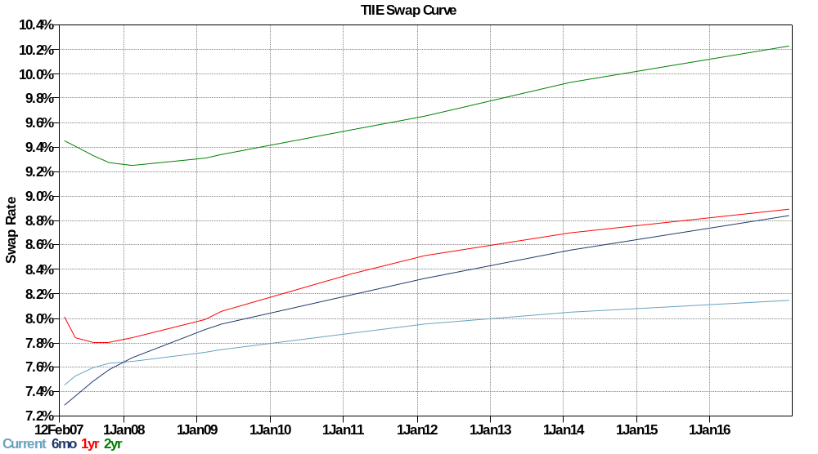
Mexican Swap Curve

Slide 21
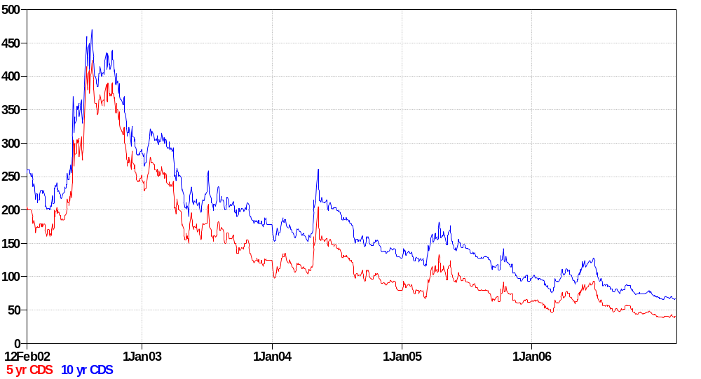
Mexican CDS

Slide 22
Extra slides
We don’t have time for these slides, but I don’t have the heart to delete them. If you find any of them interesting, feel free to ask questions next class.

Slide 23
“Washington consensus”
Fiscal discipline
Direct public spending toward pro-growth, pro-poor services such as education, health, and infrastructure investment
Broad tax base, low tax rates
Market-determined interest rates
Competitive exchange rates
Open trade in goods
Open trade in assets, incl inward direct investment
Privatize state enterprises
Abolish regulations that restrict competition
Legal security for property rights
Source: Wikipedia, http://en.wikipedia.org/wiki/Washington_Consensus

Slide 24
Property rights
Darren Richman, DiMaio Ahmad Capital, MBA 2000
  Involved in restructuring Telecom Argentina (TEO)
  Rights of debtors poorly defined (solvent firm simply refused to pay debtors)
  Result: harder to issue debt, terms typically worse

Slide 25
Property rights
Hernando de Soto, Mystery of Capital:
  My summary: the absence of clear property rights is a major problem in many developing countries. This hits small businesses hardest, since lack of clear claim to (say) real estate makes it difficult for them to finance new or expanding businesses. An earlier book emphasized red tape: it would take a small business months to get the approvals needed to operate legally in Peru.

Slide 26
Competition
McKinsey study of auto industry in India:
  1982: incumbents (PAL, HM) protected from foreign competition
  1983: government allowed Suzuki to set up joint venture: Suzuki-Maruti
  1992: PAL produced 15,000 cars with 10,000 employees; SM produced 122,000 cars with 4,000 employees
  PAL exits industry
  Output per worker up by factor of 3.5
  Cars cheaper and better, market tripled in size

Slide 27
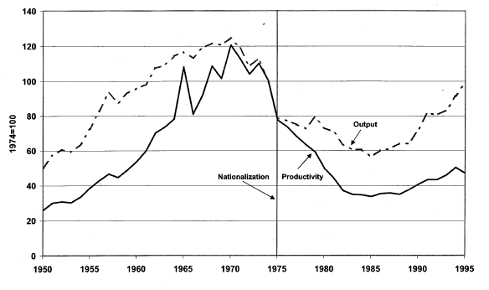
Competition
Petroleum productivity in Venezuela
Light line is production, solid line is TFP.
Source: Schmitz and others.

Slide 28
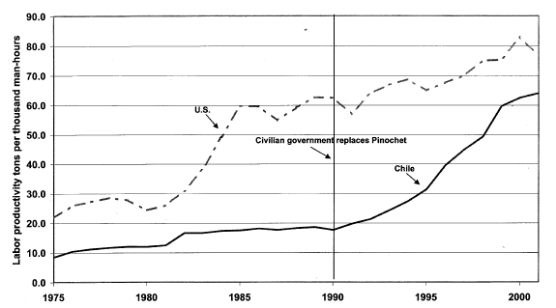
Competition
Copper productivity in US and Chile
Light line is production, solid line is TFP.
Source: Schmitz and others.

Slide 29
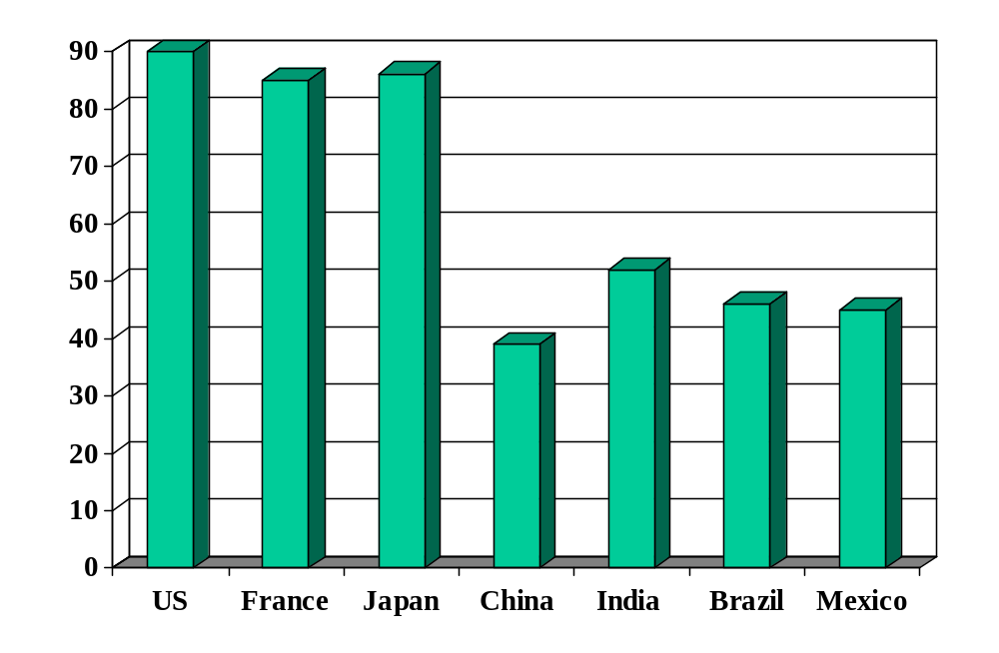
Rule of law (index)
Source: World Bank, Governance Indicators.

Slide 30
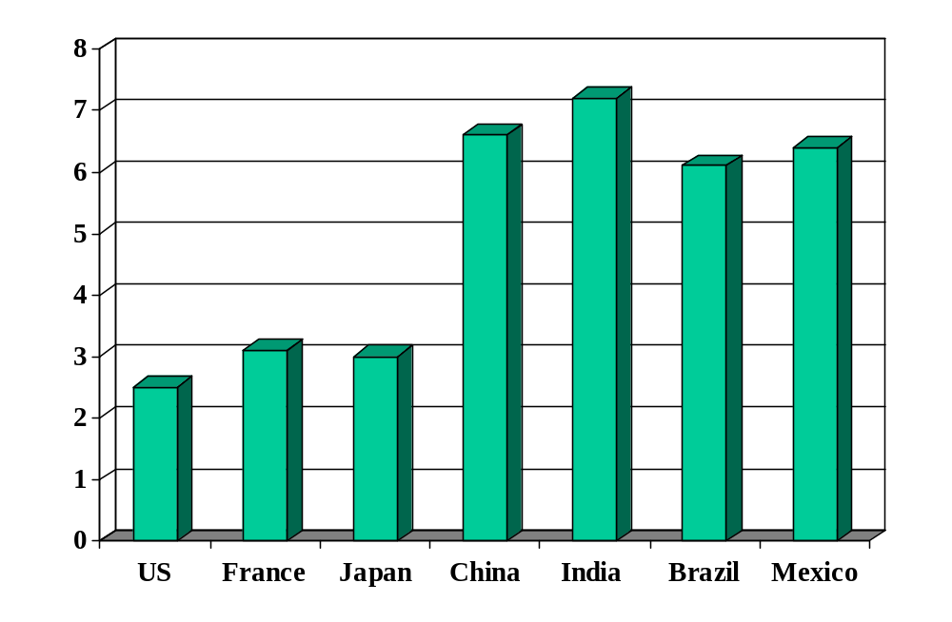
Government corruption (index)
Source: Transparency International.

Slide 31
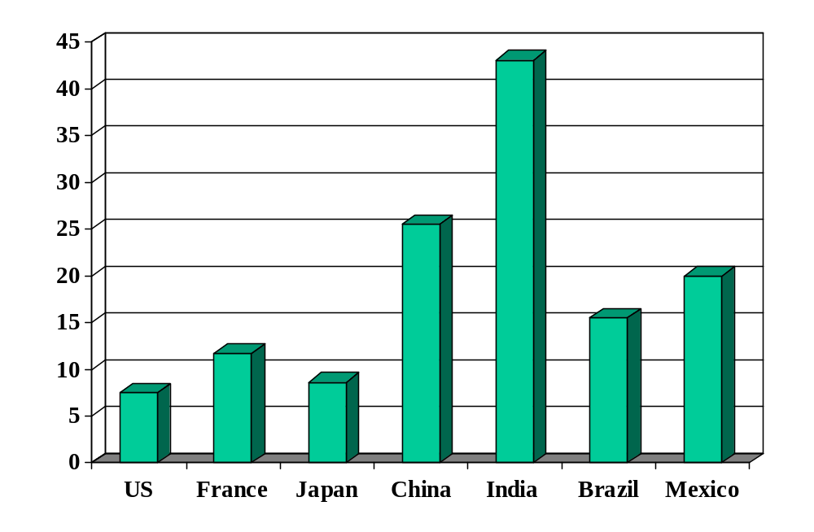
Cost of enforcing contracts (%)
Source: World Bank, Doing Business.

Slide 32
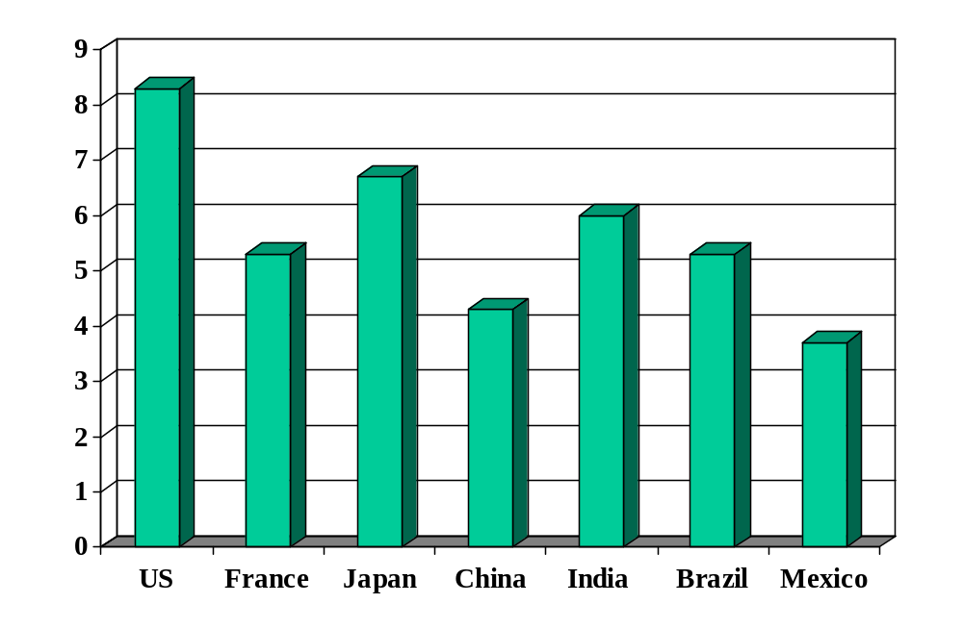
Investor protection (index)
Source: World Bank, Doing Business.

Slide 33
Evidence
Good economic performance is associated with good institutions
How do we know this?
  Regressions: relate performance (growth and level of GDP per capita) to measures of institutional quality
  Micro studies
Causality?

Slide 34
Property rights
The Economist, January 29, 2005:
  When Argentine President Kirchner visited Paris, French President Chirac referred to “a little stone in the shoe” – Argentina’s stalled negotiations with Aguas Argentinas, a water provider serving 6.5m people that is 40%-owned by French conglomerate Suez. Aquas Argentinas saw its dollar fees converted to devalued pesos and frozen by a government emergency law during the crisis of 2001-02.
  The state and Aguas remain far apart. After fining Aguas $680,000 for cuts in water, the government called for $136m in new investment. But Aguas, whose debts total $700m, is loath to comply. It is demanding a 60% rate increase; the government is offering 16%. With elections looming, the government is reluctant to offer more.

Slide 35
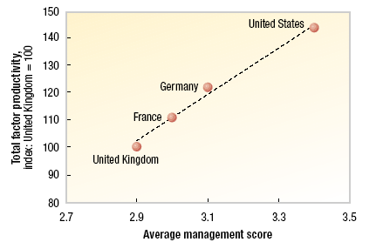
Good management
McKinsey study:
Notes:
Good mgt = lean manuf, hire the best, reward performance

Slide 36
Opportunities in emerging markets
A former student in private client services writes:
  I frequently come in contact with quantitative and qualitative assessments of country risk like Group Project #3. They arise in my world in three ways:
  Firm expansion strategy: to enter (say) Latin America, we need to decide which countries, when, and how (use local distribution arrangements, acquisition, joint venture, etc).
  Client qualification and identification: assess risk of individuals and their assets, often closely tied to local economies and governments.
  Investment strategy: give significant clients insight into where to invest and what we forecast for the performance of (esp) sovereign debt.
  These assessments are often qualitative.

Slide 37
Voice of reason?
Professor Dani Rodrik, globalization skeptic:
  Experience with economic growth over the last few decades has taught us a number of important lessons. One is the importance of private initiative and incentives. [Others are] social and political institutions that mitigate risk and manage social conflicts, the rule of law, and clean government.
  Nevertheless, local experience varies widely. Countries with only moderately good institutions often grow rapidly, and well-intentioned attempts to foster private initiative sometimes lead to disaster.
  (This is my paraphrase, not a direct quotation.)

Slide 38
Dr Otmar Thoemmes
Deloitte & Touche
  Global Managing Partner of Clients & Markets
  20+ years experience in tax law
  Expert on European business
Education and experience
  Masters in law, University of Munich
  JD, University of Bielefeld
  Managing partner of Wollert-Elmendorff Detsche Industrie-Treuhand GmbH, Munich, now Deloitte & Touche GmbH
  Served European Commission as expert on tax issues
  Professor of Intl Bus and Tax Law, Univ of Augsburg

