Slide 1

The Global Economy
Inflation
© NYU Stern School of Business
Notes:
Indicators
Arg note
High inflation: has anyone lived through one? What was it like?

Slide 2
Today’s plan of attack
Current economic and business issues
Where we’re headed
Pictures
Zimbabwe
Quantity theory of money
Real and nominal interest rates
Hyperinflations
What’s missing?

Slide 3
Current issues

Slide 4
Current issues
Washington Post, Feb 23, 2007, via David:
  Venezuelan President Hugo Chavez promises to “liberate” Latin America from the “imperialist North American plot” to enslave the region. The goal is to kill the so-called Washington Consensus, championed by the IMF and the US Treasury, pressing governments to open their economies to foreign trade and investment.
  “All of this IMF [activity] has benefited a very small sector of our economies,” said Hernando de Soto, a Peruvian economist who champions free markets. “Chavez and company pick up on the resentment.”

Slide 5
Current issues
Wall Street Journal, Feb 24, 2007, via Whitney:
  Following a decade of dispute, the U.S. will open its highways to Mexican cargo trucks, in a move that could alter the economics of the domestic trucking industry and is already uniting some American lawmakers, unions and trucking companies to oppose the change. The Transportation Department on Friday said it is starting a pilot program that could begin as soon as April. If the trial succeeds, the U.S. trucking industry could change drastically. Mexican drivers are paid one-third to 40% less than their U.S. counterparts.

Slide 6
Current issues
Cheap stocks blog via Kyle:
  $39.5 Billion. That’s what Exxon Mobil bottom lined in 2006. Many call it obscene. Others shake their fist in disgust. Politicos in Washington use this in order to win votes. USA Today, “McPaper,” put it this way: “Consumers who wondered where some of the $3 a gallon they paid for gasoline this summer ended up might want to take a look at ExxonMobil’s bottom line.” The talk in Washington has started already. One Senator from New York suggested in the fall that big oil should be forced to pay a portion of their profits into a fund that would seek renewable sources of energy. Wow, what a great idea.

Slide 7
Where we’re headed
Theme: economic performance of countries
First half: long-run performance
  Why is GDP per capita lower in India than France?
  Why are China and India growing so rapidly?
  What are the business opportunities and challenges?
Second half: short-run performance
  How does [country name] look over the next year?
  What are the business opportunities and challenges?

Slide 8
Where we’re headed
Long-Run Performance
Saving and Investment, Productivity, Institutions, Labor Markets, International Trade
First half:
Short-Run Performance
Inflation, Interest Rates, Exchange Rates, Indicators, Monetary Policy, Govt Finance, Capital Flows, Emerging Market Crises
Second half:

Slide 9
Where we’re headed
Goal: coherent view of near-term future
  Identify key indicators
  Likely outcomes and alternative scenarios

Slide 10
Indicators of short-run performance
What indicators would you look at?
What do they tell us?

Slide 11
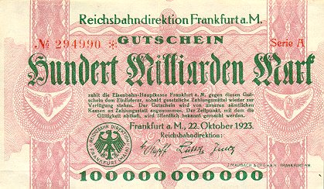
German currency
October 1923: 20 USD = 1 billion DM
Notes:
http://www.zum.de/whkmla/region/germany/turm2023.html

Slide 12
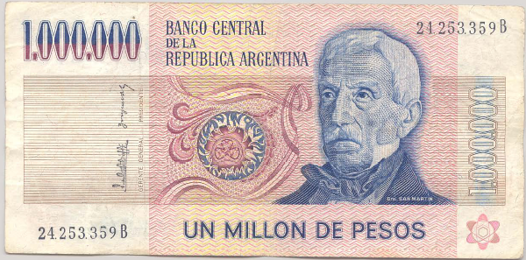
Argentine currency
This note dates from 1980s. What’s it worth now? Why?

Slide 13
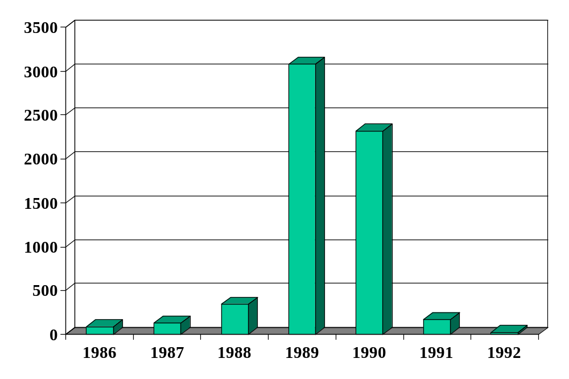
Inflation in Argentina (annual %)
Source: EIU database.

Slide 14
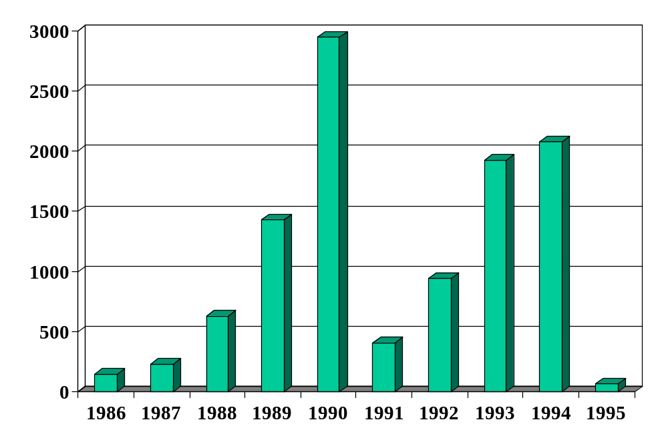
Inflation in Brazil (annual %)
Source: EIU database.

Slide 15
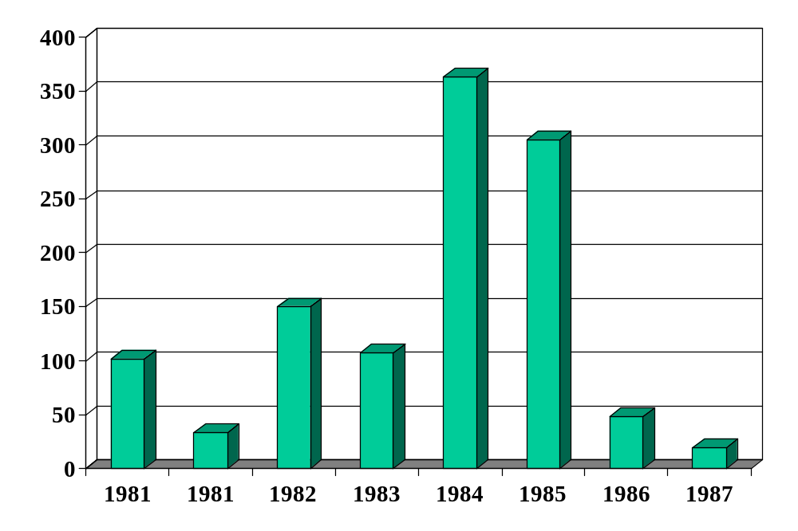
Inflation in Israel (annual %)
Source: EIU database.

Slide 16
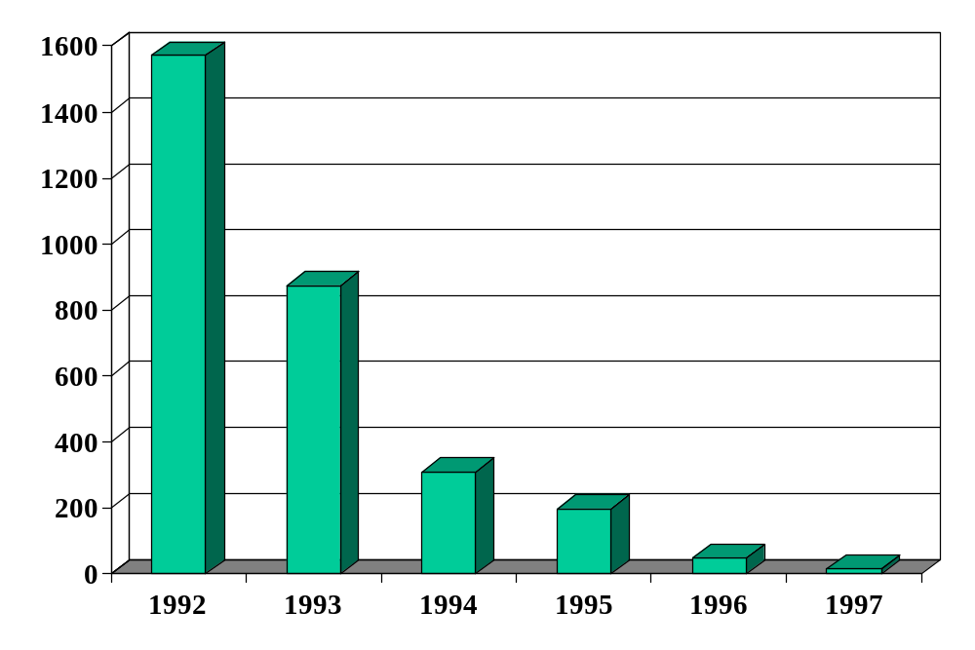
Inflation in Russia (annual %)
Source: EIU database.

Slide 17
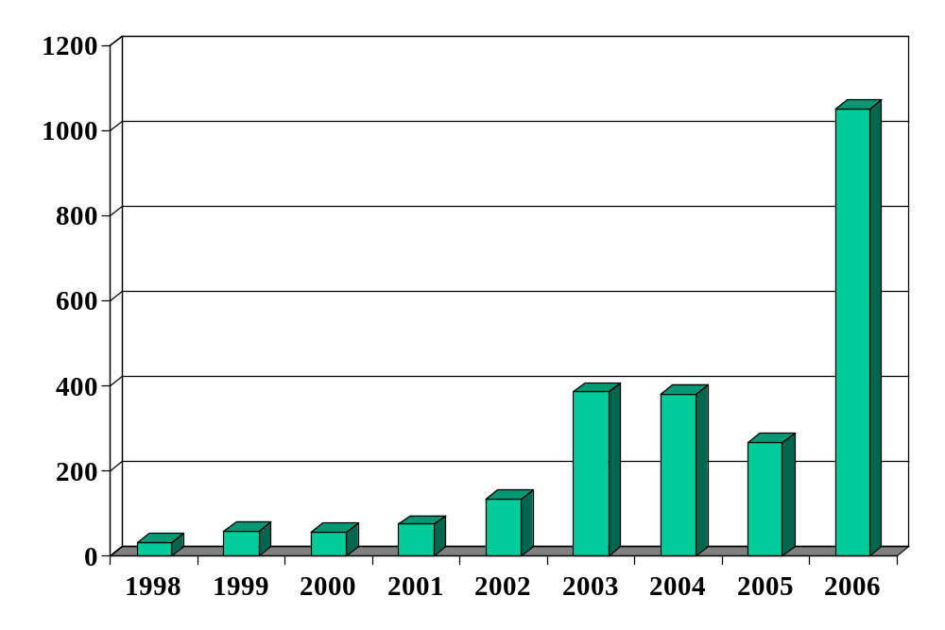
Inflation in Zimbabwe (annual %)
Source: EIU database.

Slide 18
Zimbabwe
What’s going on? Outline a chain of connections that generates inflation as the outcome.

Slide 19
Quantity theory
Milton Friedman, 1976 Nobel Laureate:
  Inflation is always and everywhere a monetary phenomenon. To control inflation, you need to control the money supply.

Slide 20
Quantity theory
Money
Growth
Inflation

Slide 21
Quantity theory
One equation (representing technology for transactions)
M V = P Y
  M = stock of money in circulation (currency)
  V = velocity (how often a unit of currency is used in a year)
Two hypotheses
  V is constant
  Y not affected by changes in M [we’ll use this later]
One conclusion
  Money growth causes inflation
P = V (M/Y)
γ_{P} = γ_{M} – γ_{Y}

Slide 22
Money supply mechanics
How the central bank manages the money supply
Look at balance sheets for
  Treasury
  Central bank
  Private agents
Show
  Open market purchase of bonds increases money supply
  Behind the scenes: interest rate adjusted to make people content to hold more money
  Zimbabwe revisited

Slide 23
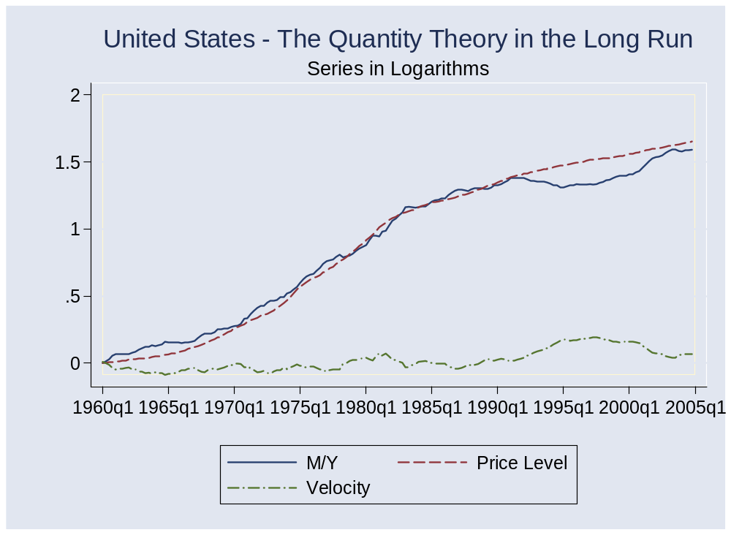
Evidence: long run

Slide 24
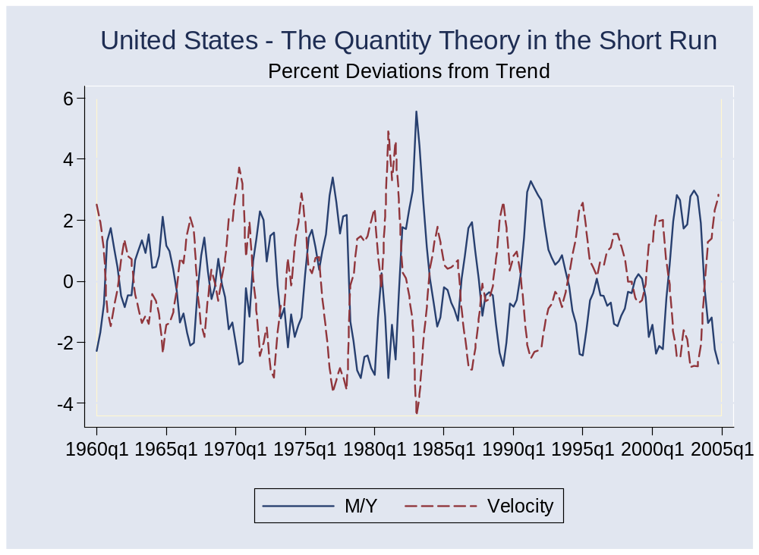
Evidence: short run

Slide 25
Real and nominal interest rates
Connection:
i = r + π
  i = nominal interest rate (what we usually see quoted)
  r = real interest rate (rate on basket of goods)
  π = expected inflation [why “expected”?]
Comment
  Movements in i reflect both r and π
  Which is more important? [It depends!]

Slide 26
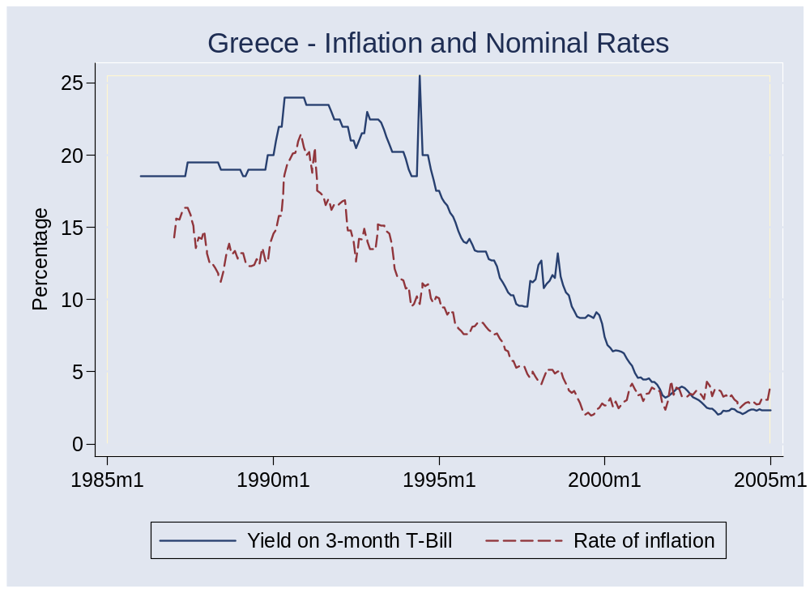
Interest rates and inflation

Slide 27
Hyperinflations
What are they like?
Why don’t we simply stop money growth?

Slide 28
Quantity theory amended
Political
Instability
Fiscal
Deficit
Money
Growth
Inflation

Slide 29
Hyperinflation summary
Inflation comes from money growth
Money growth typically comes from fiscal deficits
Economic costs
  Time spent getting rid of cash
  Associated with poor economic performance (cause or effect?)
Orthodox solution
  Fiscal discipline
  Separate central bank from government
  Order it to focus on price stability

Slide 30
What’s missing?
In moderate inflations
  Connection to money growth low in short run
  Inflation can have momentum
  May require a recession to reverse
  Lesson: stop inflation before it starts
  More on this later

Slide 31
Takeaways
Inflation is related to money growth – in long run
Nominal interest rates move with inflation
Big inflations: money growth typically stems from money-financed deficits
Solution: fiscal discipline, independent central bank, …and a stable political situation

Slide 32
Extra slides

Slide 33
Israel in the 1980s
American Rabbi visiting Israel:
  During Israel’s hyperinflation of the early 1980s, the name of the game was to part with currency as quickly as possible. I invested some money with an Israeli mortgage bank, which gave me the option of receiving at a later date a secondary mortgage at a 5% fixed annual interest rate. When my wife and I purchased a condominium in 1981, interest rates on mortgages were 39%, a very high rate one might think. We took the secondary mortgage. Fixed rate mortgage payments became laughably easy to make as inflation shot up to 800% a year, because salaries more or less kept pace with inflation, a typical phenomenon in high inflation economies. The coup de grace came when I received a notice canceling my mortgage, because the cost of record-keeping had become more costly than the value of our monthly payment.
Link

Slide 34
Euro Zone’s stability pact
Maastricht treaty limits fiscal deficits in Euro Zone to 3% of GDP
Financial penalties for violations
Why?
  Avoid pressure to bail out high-debt countries
  Avoid pressure on monetary authority to inflate

Slide 35
EU’s stability pact
From The Economist (March 23, 2005):
  For eight years finance ministers have steadfastly insisted that the stability and growth pact is essential to the health of their single currency. … But now the rules have been so loosened that they have been rendered almost entirely meaningless. … The European Central Bank clearly does not believe the reassuring spin emanating from Brussels. Shortly after the new deal was announced, it issued a statement that it was “seriously concerned.”

