Slide 1

The Global Economy
Labor market institutions
© NYU Stern School of Business
Notes:
People are the core of any business
Hire great people and you’re halfway there
But: laws very different around the world.
Ask for personal experiences

Slide 2
Group Project #4
Exercise applying tools of growth accounting
Think of it as practice for the midterm
Go easy on last part of each question

Slide 3
Today’s plan of attack
Current economic and business issues
Stories and pictures
Labor market indicators/outcomes
France and US
Institutions: employment protection laws etc
Institutions and outcomes

Slide 4
Executive summary
Fact: Employment is lower, and unemployment higher, in France than the US
Fact: French laws make hiring workers less attractive to firms
Question: Are the two connected?

Slide 5
Current issues

Slide 6
“Gestalt” of the class
Your role
  Pitch in, feel free to argue
  Tell us what labor markets are like in your country
  Make up your own mind
My confession
  I’m an economist (incentives matter, markets usually work)
  I have tenure
  Experience with unions at NYU
The US
  A model for the world?
  Or just the flavor of the month?
Notes:
Entering the religious part of the course!
Grew up in Pitt, Homestead, etc

Slide 7
Labor markets in France
Christopher Caldwell, Financial Times, Feb 2005:
  In early 2000, when the French unemployment rate was 9.6%, Martine Aubry, the Socialist labour minister, shepherded into law a bill that capped the work-week of most employees at 35 hours. She called it “a necessity for job creation.” Today, the unemployment rate stands at 9.9% … and French labour participation is rock-bottom among developed countries.

Slide 8
Labor markets in France
The Economist, Feb 1 07:
  These days a new hazard is blocking the French capital's pavements: smokers fleeing the country's new anti-tobacco law. The country's strict working-time rules, though, add a particular French twist: should smoking breaks be counted as part of the 35-hour week?
  France's legendary 35-hour regulations, introduced in 2000-02, prompt a constant stream of labour-court rulings. Late last year, for instance, the Paris Court of Appeal ruled against Euro Disney, upholding a claim by employees that the time they spent in full costume travelling between the dressing room and their spot inside the theme park should count as part of their working hours. Every minute counts—and is counted. …

Slide 9
Labor markets in Germany
Financial Times, February 2005:
  After announcing 6,400 job cuts globally as part of a cost-saving program, Deutsche Bank last week sought the necessary go-ahead from its works council. But the works council refused to negotiate, demanding instead a meeting with the board and the withdrawal of all cost-cutting measures in their current form. Under German law, an employer cannot implement job cuts without the cooperation of its works council.

Slide 10
Labor markets in Germany
Financial Times, February 13, 3006:
  Diether Klingelnberg knows what’s holding the German economy back: there is no incentive for (mid-sized) firms like his to hire new workers. Demand is good, we have more than enough orders, but without greater labor flexibility and predictability of social security and healthcare costs, companies are increasingly likely to move production abroad.

Slide 11
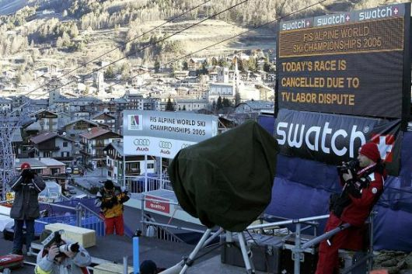
Labor markets in Italy

Slide 12
Labor markets in Hong Kong
Financial Times, February 2005:
  People routinely work Saturday mornings, have long work weeks (50-55 hours)
  Pressure on unskilled workers as jobs move to China
  Proposal: minimum wage, cap on hours
  Advocates: min wage would reduce unemployment by making work more attractive

Slide 13
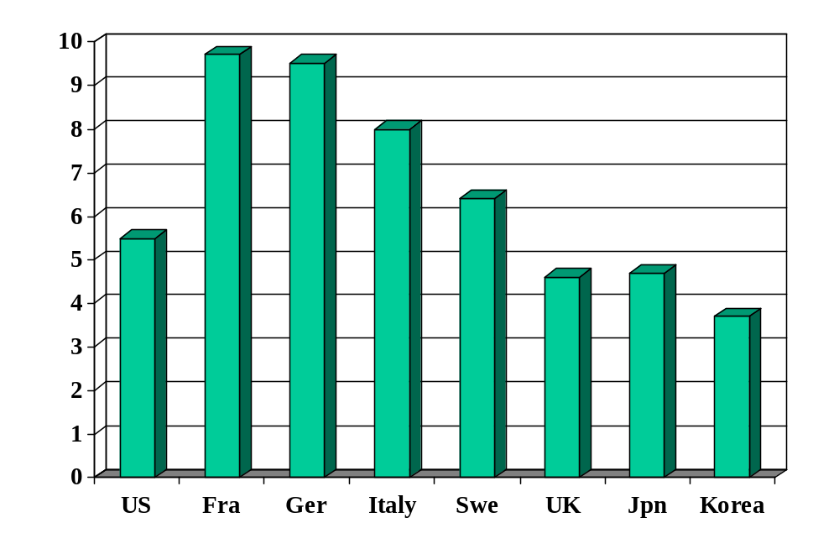
Unemployment rate (% of labor force)
Source: OECD, Employment Outlook; standardized rates intended to be comparable across countries.

Slide 14
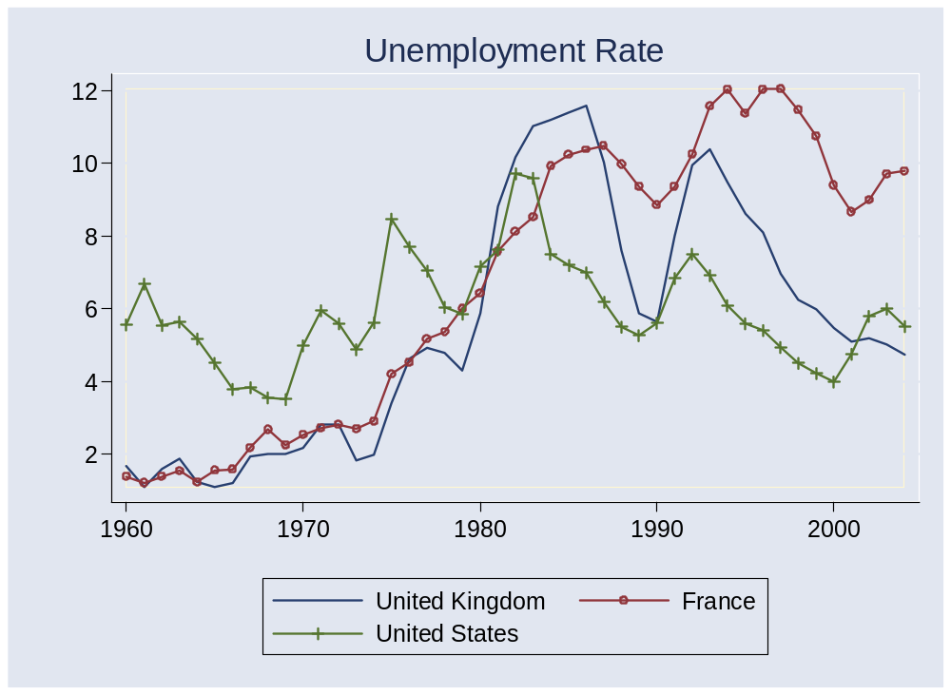
Unemployment rates

Slide 15
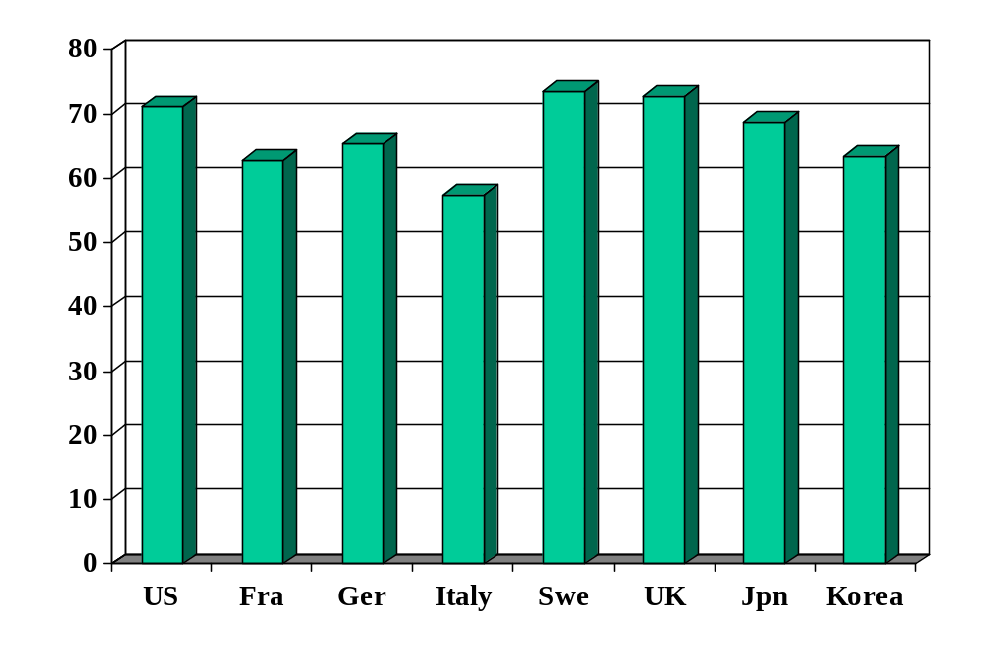
Employment rate (% of 15-64)
Source: OECD, Employment Outlook.

Slide 16
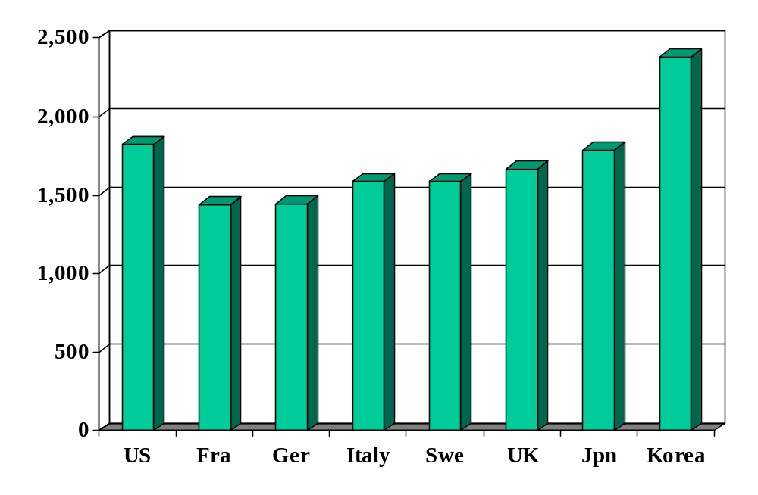
Hours worked (per person per year)
Source: OECD, Employment Outlook.

Slide 17
Labor market indicators (“outcomes”)
Employment rate = employed/(working-age) population
Labor force = employed + unemployed
Unemployment rate = unemployed/labor force
Participation rate = labor force/working-age population
Inactivity rate = out of labor force/working-age population
Hours worked = average hours worked of employed people

Slide 18
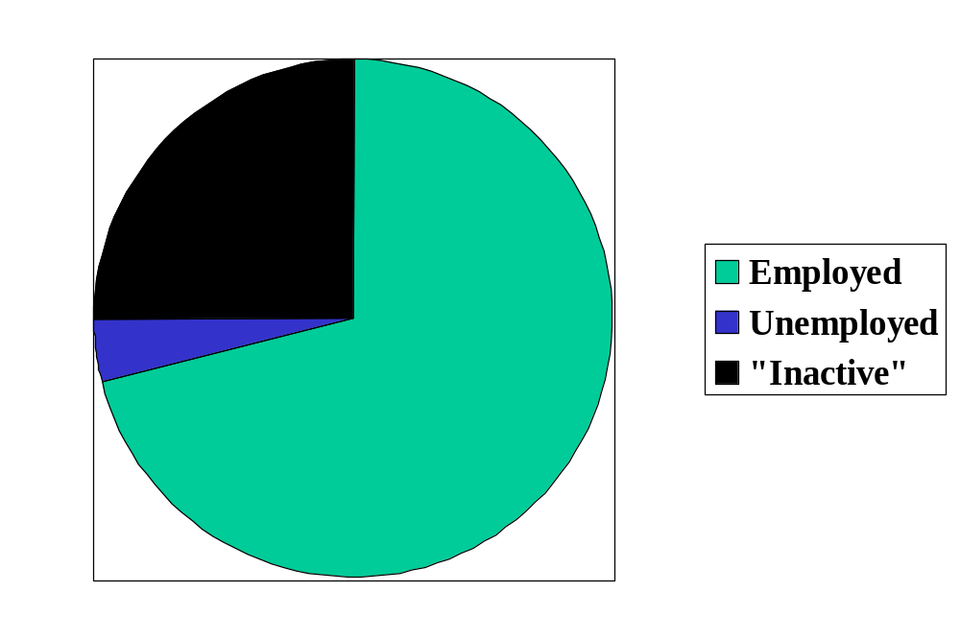
Labor market status in the US
Source: OECD, Employment Outlook, 2006. Numbers are percentages of the population 15-64.
Notes:
Draw this on board, show what universe and pieces are

Slide 19
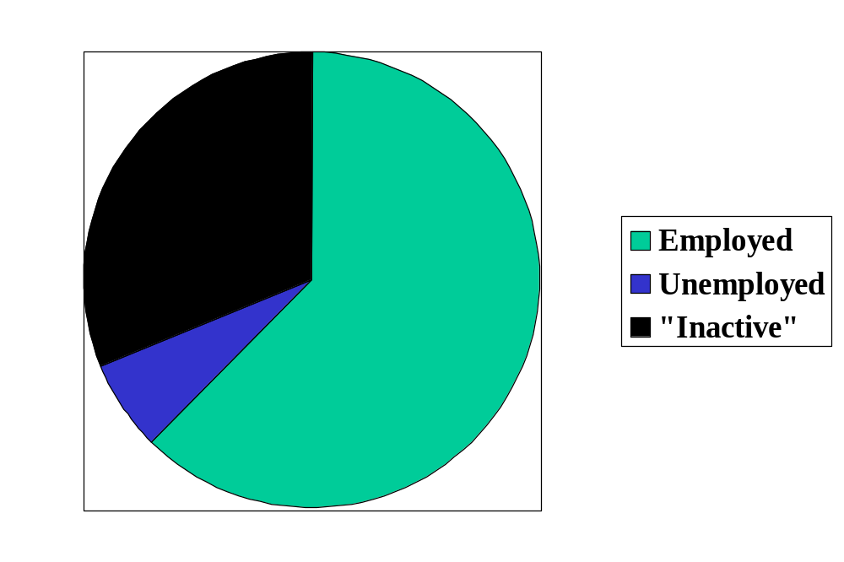
Labor market status in France
Source: OECD, Employment Outlook, 2006. Numbers are percentages of the population 15-64.

Slide 20
France and US
Output per capita:
Y/POP = (Y/L) (L/POP)
 | Y/POP | Y/L | L/POP | h
US | 34,875 | 67,865 | 0.514 | 1806
France | 25,664 | 56,909 | 0.451 | 1532
Ratio | 1.36 | 1.19 | 1.14 | 1.18
Log of ratio (%) | 30.7 | 17.6 | 13.1 | 16.5
Source: Penn World Tables, version 6.2, numbers for 2003.

Slide 21
France and US
Output per hour:
Y = A K^{α} (hL)^{1-α}
Y/hL = A (K/hL)^{α}
 | Y/hL | K/hL | A
US | 37.58 | 98.01 | 8.15
France | 37.12 | 108.77 | 7.78
Ratio | 1.012 | 0.901 | 1.047
Ratio adjusted for α | 1.012 | 0.966 | 1.047
Log of ratio (%) | 1.1 | (3.5) | 4.6
Source: Penn World Tables, version 6.2, numbers for 2003.

Slide 22
France and US
What’s the difference?
Why?
What about TFP?

Slide 23
Institutions

Slide 24
Employment protection laws (EPL)
What are they?
  Laws that govern employment contracts
Examples
  Duration of contract
  Overtime compensation
  Layoffs
  Dismissals
  Related issues: minimum wage, government employment

Slide 25
Portugal v New Zealand
Fixed-term contracts
PRT Fixed term contracts allowed only in special situations (such as seasonal activity)
NZL Fixed term contracts are unrestricted, with no maximum duration period

Slide 26
Portugal v New Zealand
Overtime
PRT Mandatory premium for overtime work ranges from 50% to 75%, additional restrictions on night work, and there are 24 days of paid leave per year
NZL No required premium for overtime work, no restrictions on night work, and the minimum paid leave is 15 days per year

Slide 27
Portugal v New Zealand
Dismissal
PRT Has a list of fair grounds for termination and stringent procedural limitations on dismissals, such as mandatory notification of the government and priority rules for re-employment of redundant workers.
NZL Allows “contracts at will,” which can be terminated with notice without cause
Source: Botero, Djankov, La Porta, Lopez-de-Silanes, Shleifer, 2003

Slide 28
Industrial relations laws
What are they?
  Laws that govern collective bargaining, enforcement of collective agreements, and the organization of trade unions
Examples:
  Employers’ duty to bargain with unions
  Extension of collective contracts to third parties
  Right to strike
  Right of unions to appoint company directors

Slide 29
Portugal v New Zealand
Collective bargaining
PRT Employers have a legal duty to bargain with unions, collective agreements are extended to third parties by law, workers councils are mandatory, and employer lockouts are prohibited.
NZL Employers have no legal obligation to bargain with unions, collective agreements are not legally extended, labor participation in management is not required by law, and employer lockouts are allowed.
Source: Botero, Djankov, La Porta, Lopez-de-Silanes, Shleifer, 2003

Slide 30
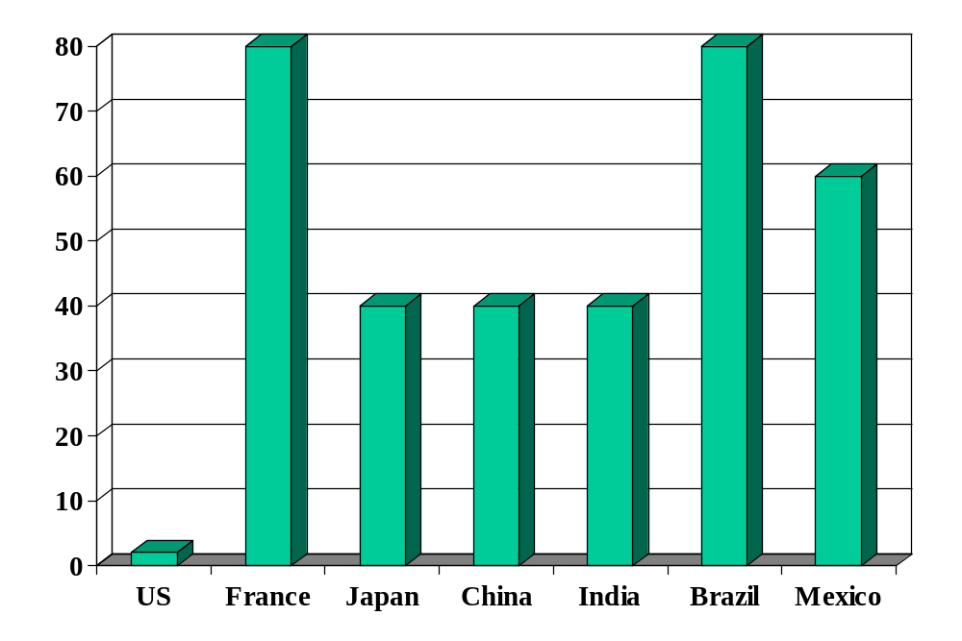
Rigidity of hours (index)
Source: World Bank, Doing Business.

Slide 31
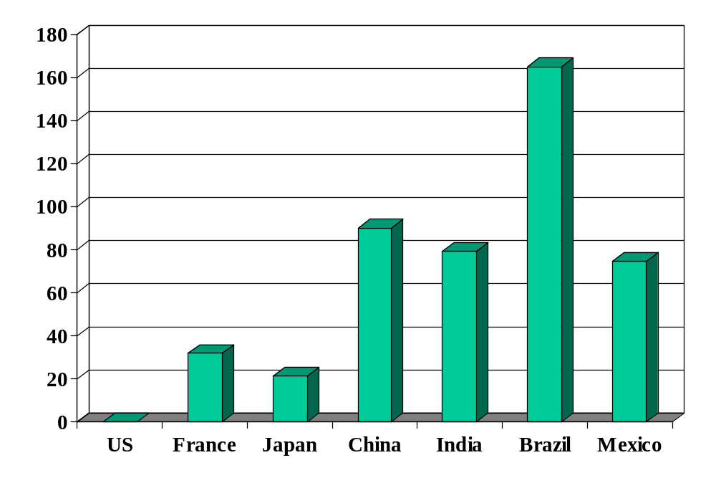
Cost of firing workers (weeks of wages)
Source: World Bank, Doing Business.

Slide 32
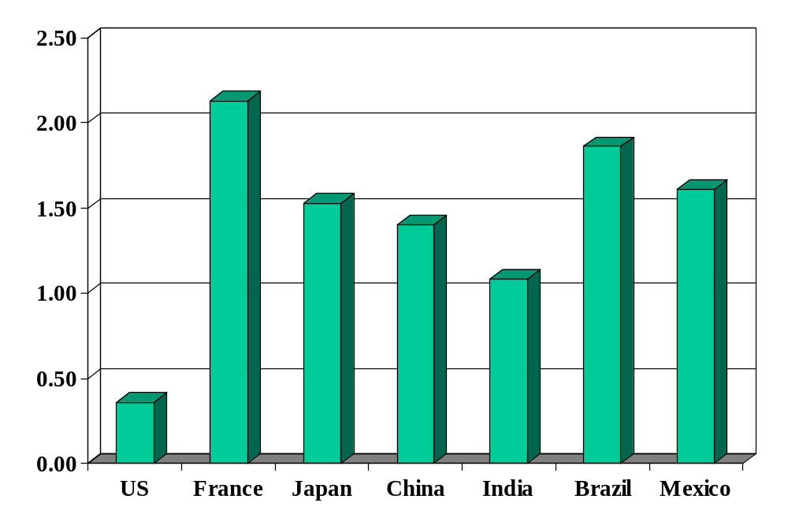
Union rights (index)
Source: Botero, Djankov, La Porta, Lopez-de-Silanes, Shleifer, Regulation of Labor.

Slide 33
Employment protection laws
Are these laws a hindrance to economic activity or reasonable protection of workers?
Do they affect economic performance?
Bottom line: they’re a fact of life in many countries

Slide 34
Unemployment: why?
“Frictions” that make labor different
  It takes time to match workers and jobs – more so at higher levels of skill and specialization (more on this next class)
  Government policy (!?)

Slide 35
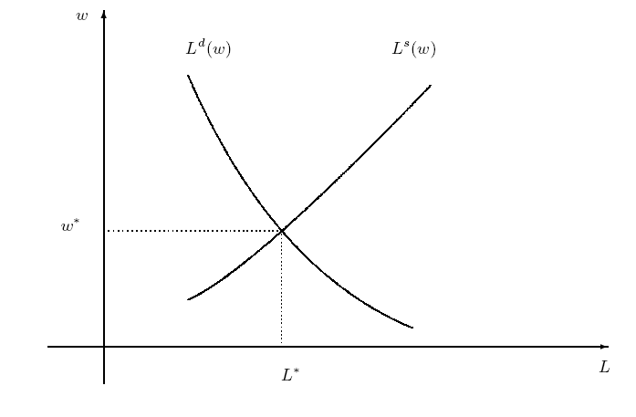
A frictionless model

Slide 36
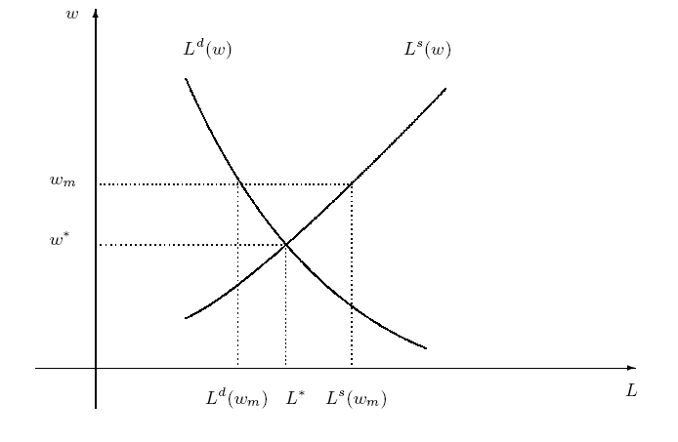
Policy friction: minimum wage
Are we better off?
Who’s “we”?
Notes:
Is this a big deal in the US? Elsewhere?

Slide 37
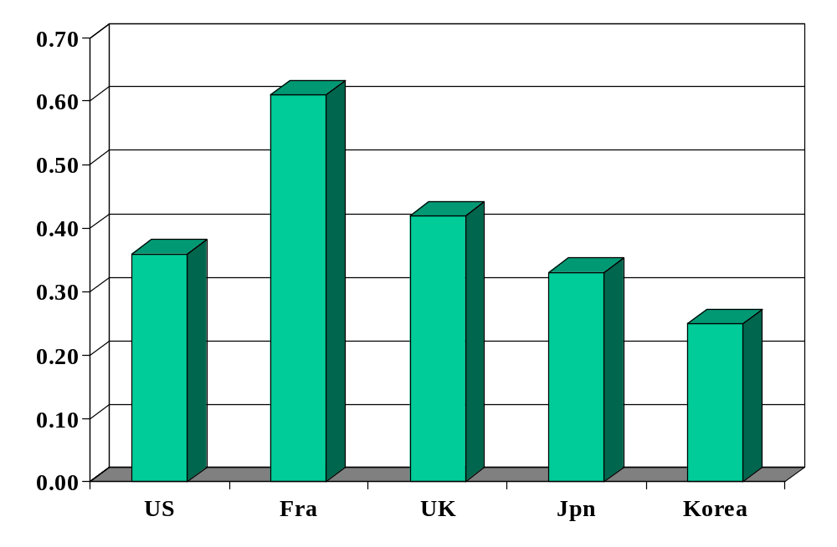
Minimum wage (ratio to median wage)
Source: OECD, employment database.

Slide 38
Other policies
What is the impact on employment and unemployment:
  Strong unions
  Shorter work week
  Works councils
  Large severance payments for layoffs
  Generous unemployment insurance benefits
  High tax rates on labor income
  Large social insurance payments supported by taxes on firms
  Other?

Slide 39
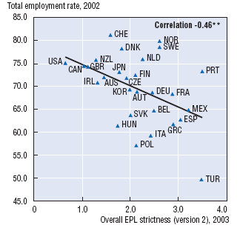
Protection and employment
Source: OECD, Employment Outlook, 2004.

Slide 40
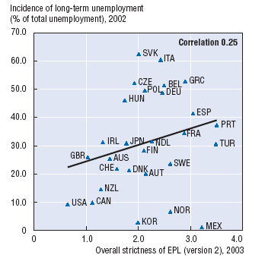
Protection and unemployment
Source: OECD, Employment Outlook, 2004.

Slide 41
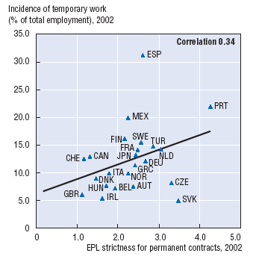
Protection and temporary work
Source: OECD, Employment Outlook, 2004.

Slide 42
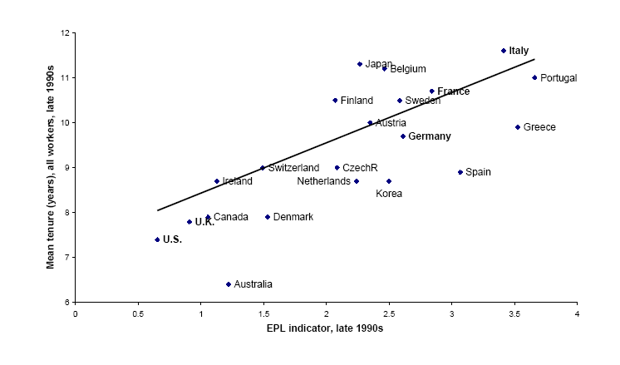
Employment protection and tenure
Source: Bertola, 2001.

Slide 43
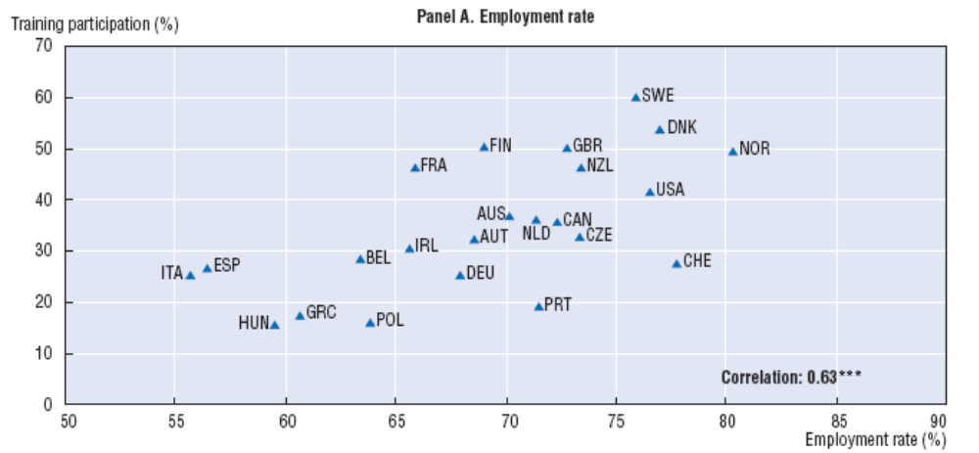
Training and employment
Source: OECD, Employment Outlook, 2004.

Slide 44
Takeaways
Fact: Countries differ widely in labor market institutions (laws and regulations)
Fact: Labor market indicators/outcomes also differ
  Employment rate, unemployment rate, hours worked
There’s probably a connection between institutions and outcomes
  And between institutions and the cost and difficulty of operating a business
  Roughly speaking, it seems that “employment protection” = “management challenge” = “job killer”

Slide 45
France today
Financial Times, Feb 12 07:
  Presidential candidate Segolene Royal laid out her economic vision, which includes: increase the minimum wage, merge state-owned electricity and gas utilities, scrap laws that make it easier for small companies to hire and fire employees; demand that the European Central Bank focus on economic growth.

Slide 46
Extra slides

Slide 47
Labor markets in India
The Economist, February 3, 2007:
  Some very poor men, perhaps 18,000 of them, went on strike in Kolkata on January 24th to protest against a ban… The Communist government of West Bengal has long wanted to outlaw rickshaws. Last December it did so, on the grounds that man-powered transport was inhuman. But what else are the thousands of rickshaw-wallahs, in one of the world's poorest cities, to do? Earning around 150 rupees ($3.50) a day, with an average fare of 20 cents, they are not flush. But with an annual income of a little over $1,000, after paying rent on their rickshaws, they make roughly double West Bengal's average.

Slide 48
The Global Economy
Labor market dynamics
© NYU Stern School of Business

Slide 49
Today’s plan of attack
Group Project #4
Current economic and business issues
Quotations
Volatility
Labor market “flows”
US and Europe revisited
Innovation

Slide 50
Group Project #4

Slide 51
Current issues

Slide 52
Current issues
Financial Times, Feb 12 07:
  Presidential candidate Segolene Royal laid out her economic vision, which includes: increase the minimum wage, merge state-owned electricity and gas utilities, scrap laws that make it easier for small companies to hire and fire employees; demand that the European Central Bank focus on economic growth.

Slide 53
Current issues
The Economist, Feb 1 07:
  France’s centre-right presidential candidate Nicolas Sarkozy took his campaign to London, calling it “one of the biggest French cities.” London is thought to have at least 300,000 French citizens – and voters – some of whom left “in desperation,” said Sarkozy. He called on them to help revive France’s “blocked society.” Journalists noted that France’s unemployment rate is 8.6%, compared with 5.5% in Britain, and has not dipped below 8% for nearly 25 years.

Slide 54
Current issues
The Economist, Jan 18 07:
  NESTLED among the wooded Blue Ridge mountains in Virginia's far south-west, Galax is a town of bluegrass music, barbecue and hardscrabble living. It is home to an annual fiddlers’ convention and, less happily, a huddle of textile and furniture factories. Over the past few years, globalisation has hit hard. Last year … three big factories closed their doors within months. More than 1,000 people, around one-sixth of the town’s workforce, lost their jobs.
  For some, particularly those in their 50s, the future looks bleak. At 59, Paul Rotan sees little chance of finding another job with health insurance, but he is still six years away from qualifying for Medicare. But other, mainly younger, workers are already better off.

Slide 55
Marx and Engels
Communist Manifesto (1848):
  Everlasting uncertainty and agitation distinguish the bourgeois epoch from all earlier ones. All fixed, fast frozen relations, with their train of ancient and venerable prejudices and opinions, are swept away, all new-formed ones become antiquated before they can ossify. All that is solid melts into air, all that is holy is profaned, and man is at last compelled to face with sober senses his real condition of life and his relations with his kind.
  All old-established national industries have been destroyed or are daily being destroyed. They are dislodged by new industries, whose introduction becomes a life and death question for all civilized nations.
Notes:
http://www.marxist.net/marx/index.html

Slide 56
Joseph Schumpeter
Capitalism, Socialism and Democracy (1942):
  The fundamental impulse that sets and keeps the capitalist engine in motion comes from the new consumers, goods, the new methods of production or transportation, the new markets, the new forms of industrial organization that capitalist enterprise creates. This process of Creative Destruction is the essential fact about capitalism.
  In capitalist reality, competition [comes] from the new commodity, the new technology, the new source of supply, the new type of organization – competition which … strikes not at the margins of the profits and the outputs of the existing firms but at their foundations and their very lives.

Slide 57
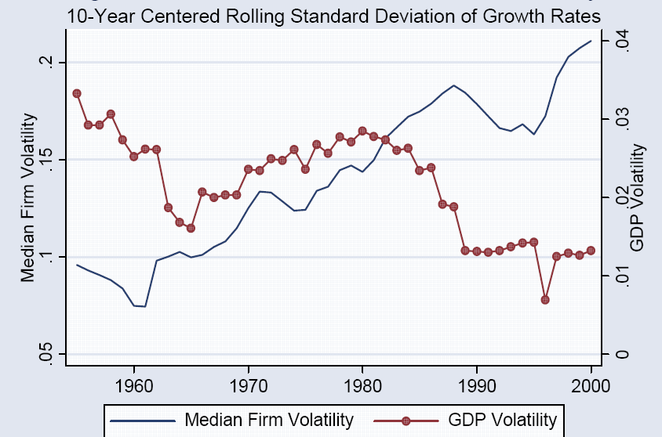
Micro and macro volatility
Source: Comin and Philippon, NBER Macro Annual, 2006.

Slide 58
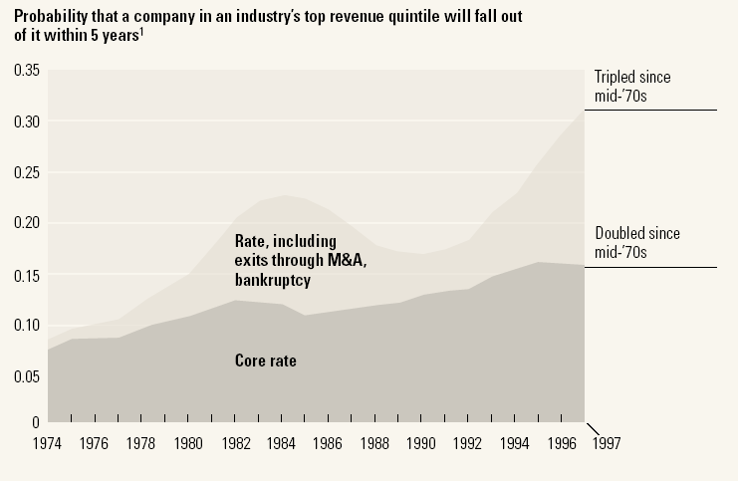
Industry leadership
Source: McKinsey Quarterly, “Extreme competition,” 2005.

Slide 59
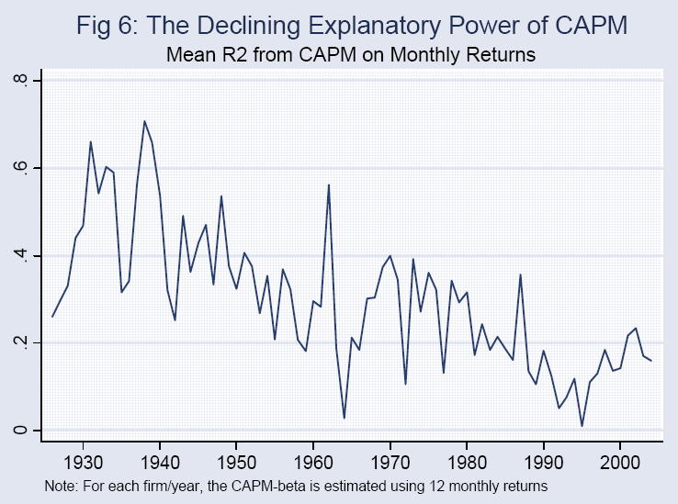
The fall of the CAPM
Source: Comin and Philippon; see also Morck, Yeung, Yu, JFE, 2000.

Slide 60
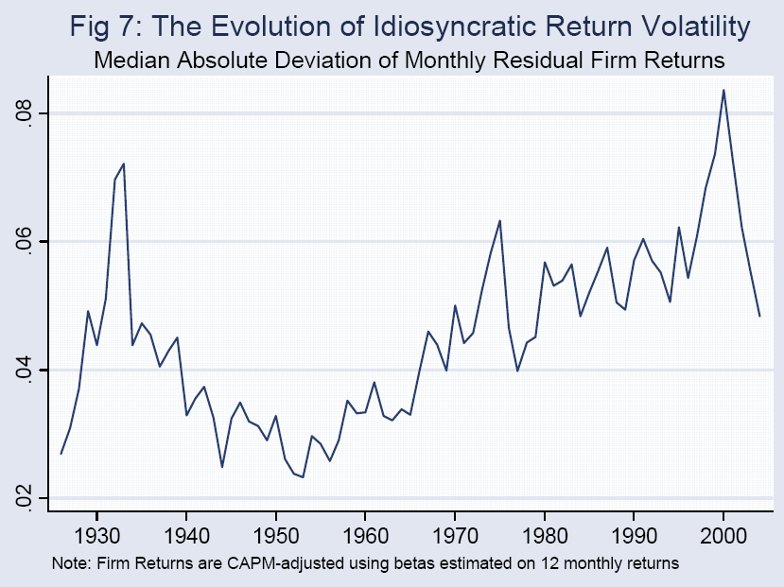
The rise of idiosyncratic risk
Source: Comin and Philippon; see also Morck, Yeung, Yu, JFE, 2000.

Slide 61
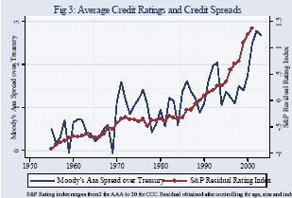
Credit ratings and spreads
Source: Comin and Philippon.

Slide 62
Why?
Why more micro volatility?
Good or bad?

Slide 63

Reminder: labor market status
Source: OECD, Employment Outlook, 2006. Numbers are percentages of the population 15-64.
Notes:
Draw this on board, show what universe and pieces are

Slide 64
Labor market “flows” (“transitions”)
Transitions
  How many people change “status” from month to month?
Aggregate measures of turnover
  Accessions: number of workers taking new jobs, whether their previous status was employed, unemployed, or not in labor force
  Separations: number of workers leaving current jobs, whether they become employed, unemployed, or leave labor force
Bottom line: enormous turnover

Slide 65
Labor market flows (avg, 1993-2005)
Monthly!
2.6% “job-to-job”
Employment
122.0m
1.3%
4.8%
28.3%
2.7%
2.4%
Unemployment
6.2m
Out of labor force
59.3m
23.3%
Source: US data, monthly, reported in Davis, Faberman, and Haltiwanger, “Flow approach,” 2005.

Slide 66
Flows in US and EU
 |  | Workers and Jobs
Country | EPL | Accessions | Separations | Reallocation
Denmark | 1.8 | 29.0 | 29.0 | 58.0
France | 2.8 | 28.9 | 30.7 | 59.6
Germany | 2.5 | 31.6 | 30.4 | 62.0
Italy | 2.5 | 34.5 | 33.6 | 68.1
Sweden | 2.6 | 16.8 | 17.8 | 34.6
UK | 1.2 | 37.2 | 37.6 | 74.8
USA | 0.7 | 45.2 | 46.0 | 91.2
Source: OECD, Employment Report, 1994; numbers are annual percentages of labor force.

Slide 67
Employment protection and tenure
Source: Bertola, 2001.

Slide 68
US and Europe revisited
Evidence on unemployment
  1960s: unemployment lower in Europe
  Now: unemployment lower in US
Why?
  What changed?
Notes:
Three things: policy, globalization/Berlin Wall, volatility.

Slide 69
Unemployment rates

Slide 70
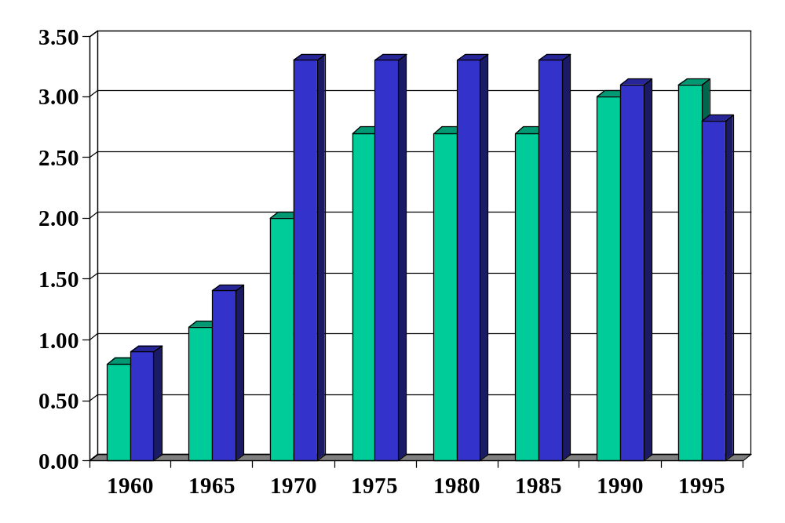
Employment protection in Europe
Green = FRA
Blue = DEU
Source: Blanchard and Wolfers.
Notes:
http://bpp.wharton.upenn.edu/jwolfers/research.shtml

Slide 71
Innovation
A source of prosperity
Also a source of volatility and turbulance
Example:
  Two sectors, agriculture and manufacturing
  Consume equal quantities of each
  Suppose: large increase in TFP in agriculture
  Impact on: employment, GDP, aggregate TFP?
What policies would you recommend?
  What are the costs and benefits of employment protection?
  Were the Luddites right?

Slide 72
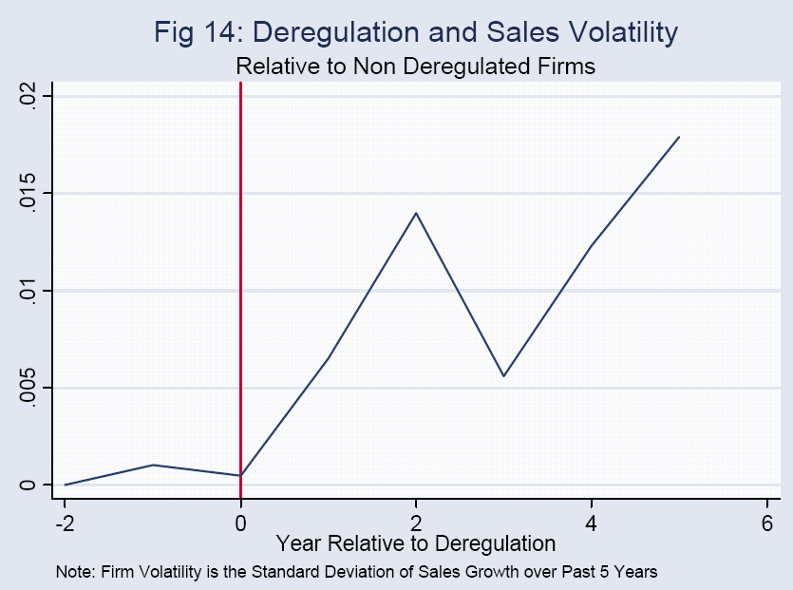
Deregulation in US
Source: Comin and Philippon.

Slide 73
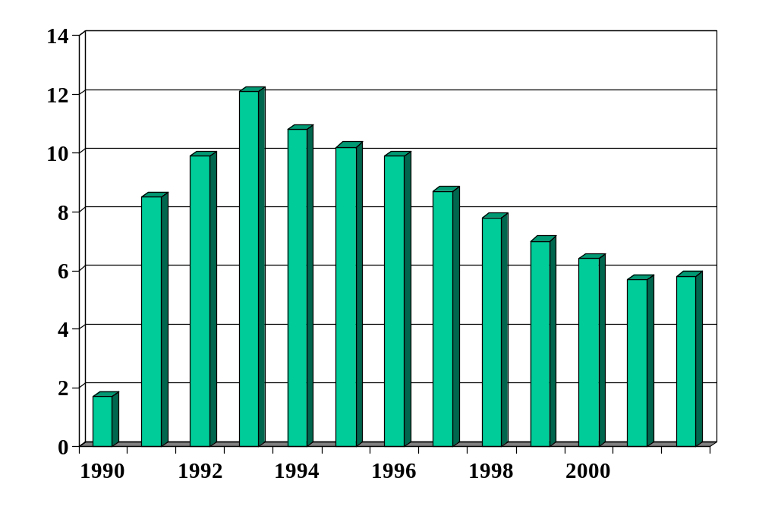
Unemployment in Hungary (%)
Source: World Bank, World Development Indicators.

Slide 74

Ljunqvist and Sargent
Volatile Economy
+
Inflexible Labor Market

Slide 75
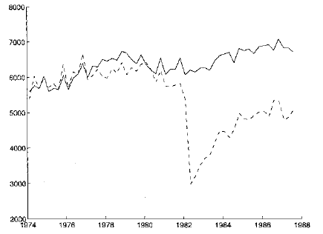
Displaced workers
Average quarterly earnings of “stayers” and “separators”
“stayers”
“separators”
Source: Ljungqvist and Sargent, JPE, 1999; adapted from Jacobson et al, AER, 1993.

Slide 76
Takeaways
Modern economies are volatile
  Affects businesses, employees, investors, etc
  Capital and labor are constantly “reallocated” to growing businesses from shrinking ones
Countries with stronger employment protection
  Have lower turnover
  Harder to lose a job, also harder to get one
  Probably reduces employment, output, and TFP
Competition is good for consumers, stressful for managers and workers
  Investors?

