Slide 1

The Global Economy
Macroeconomic Measurement
© NYU Stern School of Business
Notes:
Set up Gapminder, use for indicators
Set fast pace: lots to do

Slide 2
Today’s plan of attack
Group Project #1
Reminders
Current economic and business issues
Measuring country performance:
  GDP
  Prices and quantities
  Flow identities
Do Americans save too little?
What countries have you lived or worked in?

Slide 3
Group Project #1
Notes:
Questions?

Slide 4
Reminder: course overview
First half: long-run economic performance
Second half: short-run economic performance
Today: measuring performance

Slide 5
Reminder: course overview
Long-Run Performance
Saving and Investment, Productivity, Institutions, Labor Markets, International Trade, Taxes
First Half:
Short-Run Performance
Inflation, Interest Rates, Indicators, Monetary Policy, Govt Deficits, Exchange Rates, Capital Flows, Emerging Market Crises
Second Half:

Slide 6
Reminder: emails
If you haven’t gotten them, check your email address in Blackboard

Slide 7
Current issues
Notes:
Questions?

Slide 8
Measuring economic performance

Slide 9
GDP
GDP = Gross Domestic Product
Total value of production in an economy
  Sum value-added by all production units
  Equals: sales minus material costs
  Equals: payments to labor and capital (owners)
  Equals: sales of final goods
  Equals (almost): income

Slide 10
GDP and income
Recall: GDP = payments to labor and capital (“income”)
Income that’s not in GDP
  Capital gains
  Interest on government debt
  Income on domestically-owned capital and labor used abroad
In GDP but not in income
  Depreciation

Slide 11
GDP and income
?? Show income components

Slide 12
GDP
Some questions to reinforce the point
Impact of ?? On GDP etc ??

Slide 13
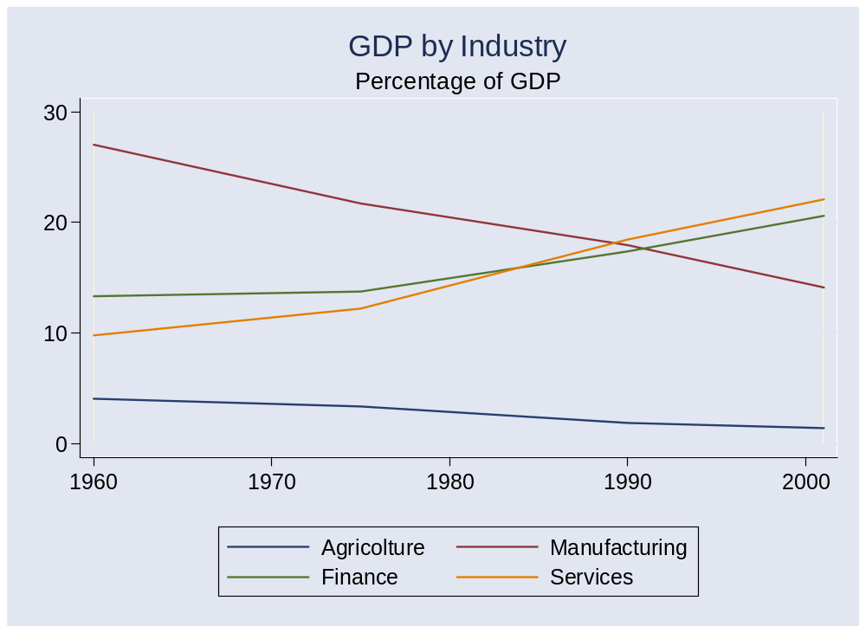
GDP by industry/sector

Slide 14
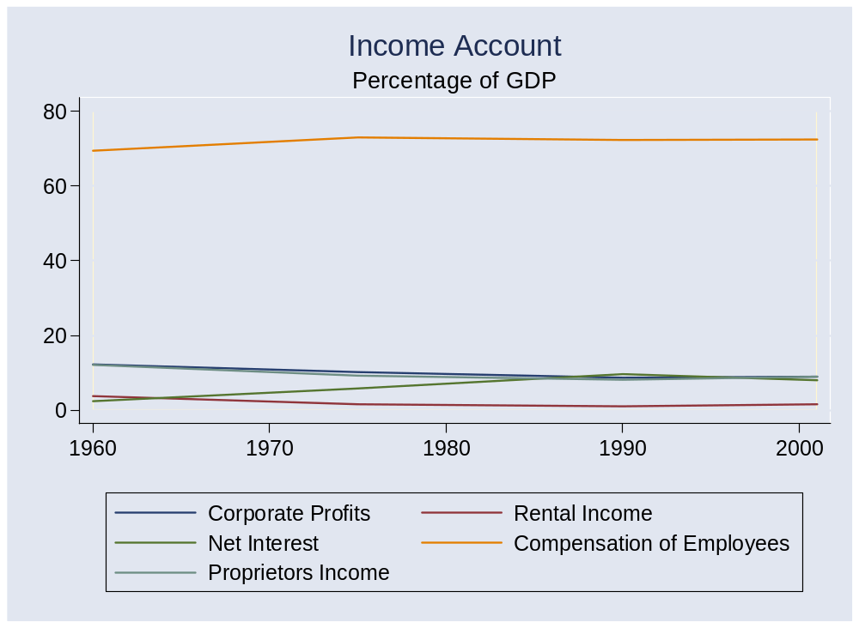
GDP by income category

Slide 15

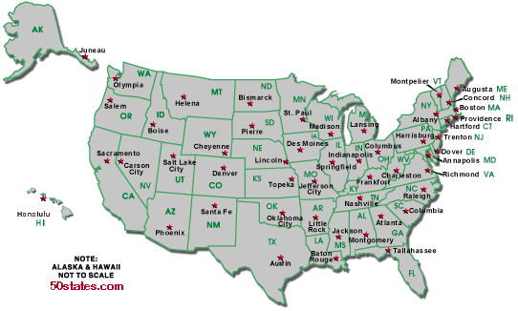
GDP and quality of life
Per capita GDP: $40k
Per capita GDP: $29k
Avg weekly hours: 35
Avg weekly hours: 29

Slide 16
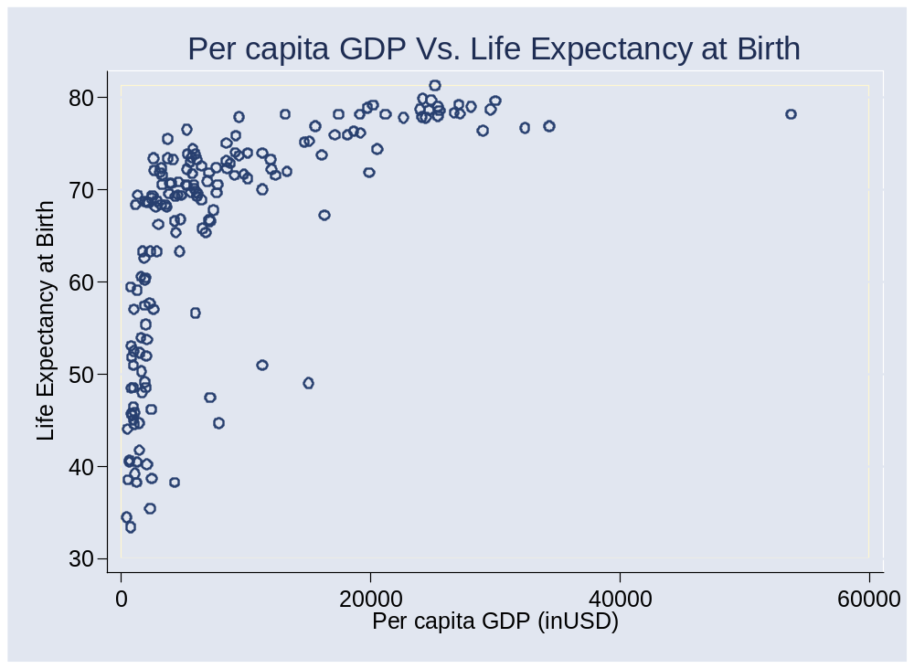
GDP and life expectancy

Slide 17
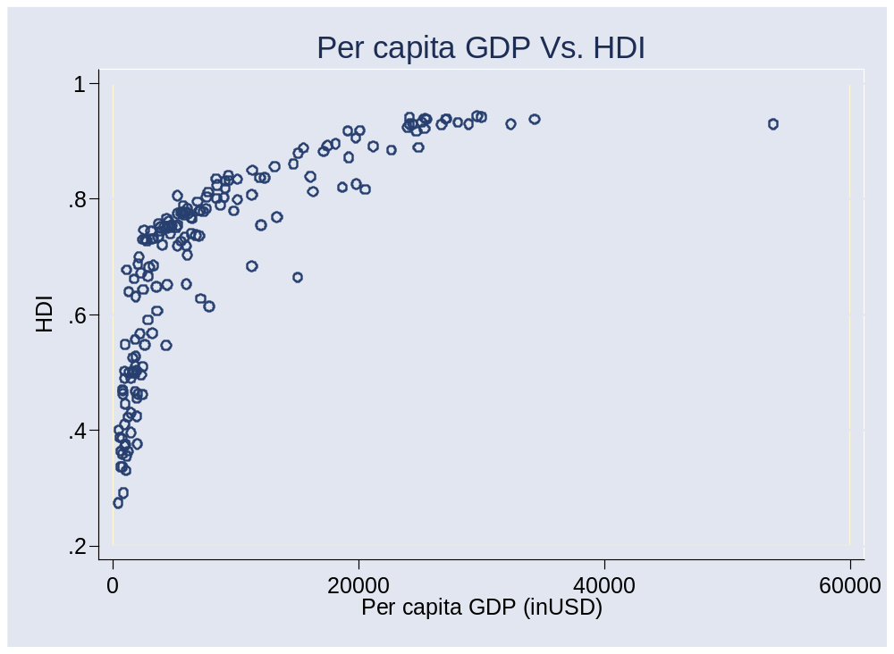
GDP and “human development”

Slide 18
Prices and quantities
Why do we want to separate prices and quantities?

Slide 19
Prices and quantities
Do Wal-Mart example – revenue up do to prices or quantities? ???

Slide 20
Prices and quantities
GDP measures output at market prices
What if prices change?
  If GDP rises, how much is higher quantity, how much higher prices?
Two measures (we’ll use both)
  GDP at current prices (“nominal GDP”)
  GDP at constant prices (eg, 1990 prices) (“real GDP”)
  Price deflator = ratio of first to second

Slide 21
Prices and quantities
Measurement issues
  Quality adjustment. Adjust price increases for changes in quality. We do this using a product’s characteristics, and call it a “hedonic adjustment.”
  Substitution bias. As some products get cheaper relative to others, people naturally buy more of them, less of the others. This substitution into cheaper products is ignored in fixed-weight indexes like the CPI but built into expenditure deflators like the PCE deflator (“personal consumption expenditures”).
  Impact. Both adjustments tend to reduce our estimate of inflation and increase our estimate of real growth.

Slide 22
Prices and quantities
Bill Gross, PIMCO’s Investment Outlook, Oct 04:
  [Let’s talk about] the con job foisted on the American public about the low level of inflation. My quarrel is with hedonic adjustments. The government says that if the quality of a product goes up, then its price really didn’t go up and may actually have gone down. Today, no less than 46% of the weight in the US CPI comes from products subject to hedonic adjustments. No wonder core inflation is under 2%. Why does the US government continue to foist this hedonic/substitution mantra on a gullible public when they should know better? They do a disservice to those grounded in the reality of trying to stretch a paycheck.

Slide 23
Flow identities
What are we talking about? Why?
Notes:
Expenditures: who we sell to
Financing: how are expenditures financed?

Slide 24
Show me the goods
Allocate GDP among purchasers of final goods:
Y = C + I + G + NX
  Y = GDP (“output”)
  C = sales to households (“consumption”)
  I = sales of capital goods to firms (“investment”)
  G = purchases of goods and services by government
  NX = net exports (net sales to other countries)
  We call these: “expenditure components”

Slide 25
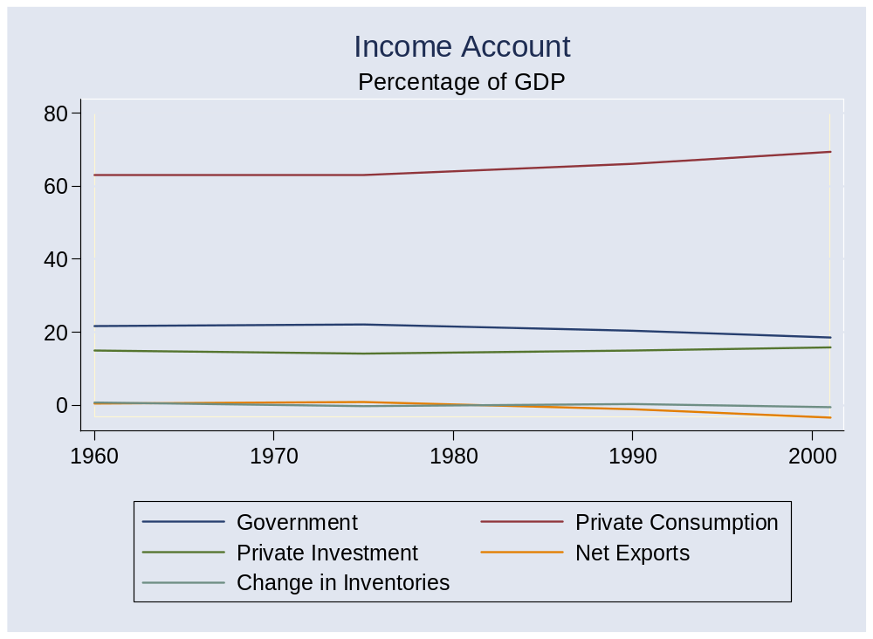
Show me the goods
Expenditure Components

Slide 26
Show me the money (streamlined version)
Allocate flows of assets:
Y – C – G = I + NX
S = I + NX
  I = (gross) investment (new plant and equipment)
  S = (gross) national saving (purchases of assets)
  NX = net purchases of foreign assets
Why are these “flows of assets”?

Slide 27
Show me the money
Allocate flows of assets:
(Y–C–T) + (T– G) = I + NX
S_{p} + S_{g} = I + NX
  T = taxes net of transfers paid by households to govt
Beware: many measures of saving
  Sometimes we subtract depreciation from both S and I (“net”)
  Useful for confusing amateurs
Later in the course
  We’ll include income and transfers with foreign countries and replace NX with the “current account”

Slide 28
Show me the money (financial flows)
Households
S_{p}
S
Financial Markets
Households+ Govt
S_{g}
NX
Government
Rest-of-World

Slide 29
Show me the money (financial flows)
Households+ Govt
S
Financial Markets
I
Firms
NX
Rest-of-World

Slide 30
Do Americans save too little?
Notes:
Write down the list

Slide 31
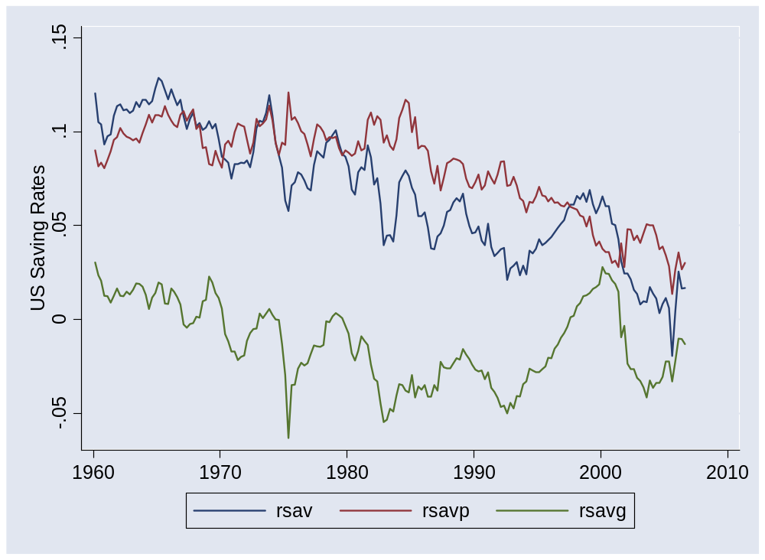
US saving rates
Source: US NIPA.
Notes:
Capital flowing “into” US

Slide 32
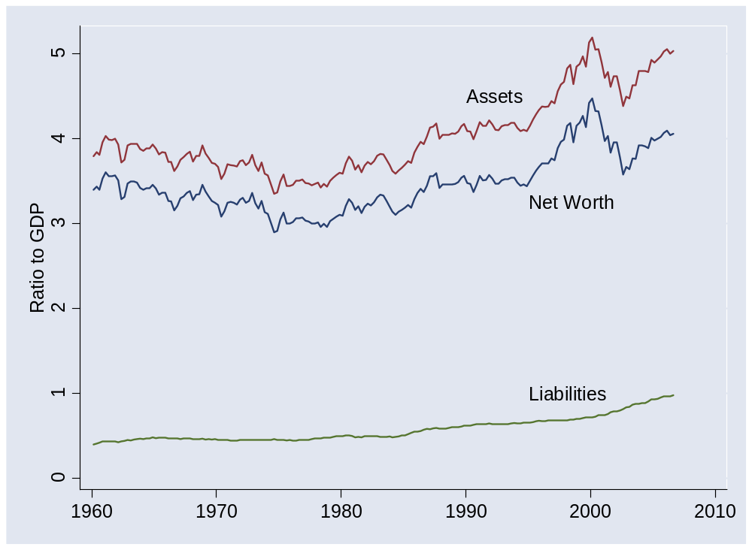
US net worth
Source: US, Federal Reserve, Flow of Funds Accounts.
Notes:
Capital flowing “into” US

Slide 33
Saving and net worth
How can net worth be high if saving is low?
Notes:
Write down the list

Slide 34
Countries
What countries have you lived or worked in?
Notes:
Write down the list

Slide 35
Takeaways
Economic data are like sausages
GDP: output, income, economic performance
Separating prices and quantities is hard: we do our best
Flow identities:
  Goods: Y = C + I + G + NX
  Assets: S = I + NX

Slide 36
International students
Please come to the next class ready to speak briefly about your country [aim for 1 minute or less]
  What has it done to encourage economic growth?
  What else could it do?
  Thank you!

Slide 37
Upcoming events (Wed Jan 31)
GDP release
  Fourth quarter advanced estimate
  Released at 8:30 am
  What do we expect?
  Impact on interest rates and equity prices?
  http://bea.gov/bea/newsrel/gdpnewsrelease.htm
FOMC meeting
  Statement released at 2:15 pm
  What do we expect?
  http://www.federalreserve.gov/FOMC/

Slide 38
Extra slides

Slide 39
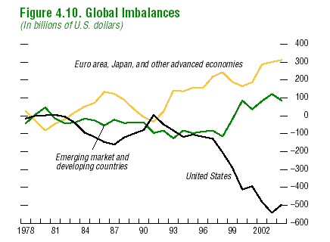
Global current accounts
Source: IMF, Global Financial Stability Report, 2004.
Notes:
Capital flowing “into” US

Slide 40
Prices and quantities
Example:
 | Fish |  | Chips
Date | Price | Quantity | Price | Quantity
2004 | 0.50 | 10 | 0.25 | 10
2005 | 0.75 | 12 | 0.50 | 8
What’s “real” output growth? What’s the inflation rate?

Slide 41
Prices and quantities
Fixed weight method (“GDP deflator”):
Date | Nominal GDP | Real GDP | Price Deflator
2004 | 7.50 | 7.50 | 1.000
2005 | 13.00 | 8.00 | 1.625
Growth rate | 73.3% | 6.7% | 62.5%
Base year: 2004.
Notes:
Where does this [pick one] number come from?

Slide 42
Prices and quantities
Fixed weight method (“GDP deflator”):
Date | Nominal GDP | Real GDP | Price Deflator
2004 | 7.50 | 12.50 | 0.600
2005 | 13.00 | 13.00 | 1.000
Growth rate | 73.3% | 4.0% | 66.7%
Base year: 2005.

Slide 43
Prices and quantities
Fixed basket method (“CPI”):
Date | Price Index (2004 Basket) | Price Index (2005 Basket)
2004 | 7.50 | 8.00
2005 | 12.50 | 13.00
Growth rate | 66.7% | 62.5%

Slide 44
Current issues
From Morgan Stanley’s Stephen Roach:
  There is a striking asymmetry to globalization’s macro impacts: (1) With China leading the way, living standards have improved dramatically in the developing world; benefits have been shared both by workers and by the owners of capital. (2) Benefits in the developed world have been skewed away from labor. (3) The pro-capital bias of globalization’s impact on rich countries could sow the seeds of a pro-labor political backlash in the US, France, Germany, Spain, Italy, Japan, and Australia.
Link

