Slide 1

The Global Economy
(The Art of) Monetary Policy
© NYU Stern School of Business

Slide 2
Global economy panel today
With
  Edward Prescott, 2004 Nobel Laureate in economics
  Thomas Cooley, Dean
When and where
  Today, Tuesday March 28, 4:30-5:45, KMC 5-50
  Reservations: check your old emails (or just barge in)

Slide 3
Presentation ideas
China: what’s ahead?
Brazil: solutions to low TFP growth
Malaysia: investor relations after the Asian crisis
South Africa: opportunities and challenges for foreign businesses after apartheid
Czech Republic, Poland, Hungary: post-Soviet hangover or tigers in the making?
Korea: has it recovered from the Asian crisis?
Vietnam: the next (mini)-China?
Ireland: sources of success, prospects for the future

Slide 4
Agenda
Markets and monetary policy
Overview
What should central banks do?
Inflation and output
Money and interest rates
Taylor rule
Markets revisited

Slide 5
Overview
Monetary policy works through short-term interest rate
  High rate associated with less money
Interest rate typically responds to
  High inflation: raise rate
  High output: raise rate

Slide 6
Markets and policy
Bond markets
  Monetary policy is a key ingredient
How do bond yields respond to news about
  Inflation? Why?
  Output or employment? Why?
  Central bank announcements? Why?

Slide 7
Markets and policy
Lehman (March 24, 2006):
  We expect the FOMC will announce that they have raised the Fed funds target rate by 25 basis points to 4.75%.
  The bigger issue is whether the Fed signals an imminent end to the tightening cycle. In the 8 March Bloomberg survey, one forecaster thought the Fed was finished, 21 thought it was “one and done”, the median forecast was for a peak of 5%, and only 9 forecasters share our view the Fed goes to 5.5%. This divergence in views makes the wording of the directive particularly important.
How would you expect the statement’s wording to affect long-term interest rates?

Slide 8
What should central banks do?

Slide 9
France today
Financial Times, Feb 12 07:
  Presidential candidate Segolene Royal laid out her economic vision, which includes: increase the minimum wage, merge state-owned electricity and gas utilities, scrap laws that make it easier for small companies to hire and fire employees; demand that the European Central Bank focus on economic growth.

Slide 10
Federal Reserve
Federal Reserve Act
  The Federal Reserve System and the Federal Open Market Committee should seek “to promote effectively the goals of maximum employment, stable prices, and moderate long-term interest rates.”
Do you agree? Are these goals in consistent?

Slide 11
ECB
Treaty establishing the European Community:
  The primary objective of [monetary policy] shall be to maintain price stability.
  Without prejudice to the objective of price stability, the ECB shall support the general economic policies in the Community with a view to contributing to the achievement of … a high level of employment and sustainable and non-inflationary growth.
Is this different?

Slide 12
Banco Central de Argentina
BCRA Act (2003):
  The Argentine Central Bank is a National State self-governed institution, whose primary and fundamental mission is to preserve the value of the Argentine currency.

Slide 13
Inflation and output
Bernanke (November 2005):
  Middle-income living standards, and poverty for that matter, are best addressed through employment growth. By maintaining low inflation and low expectations of inflation, you can create new employment.

Slide 14
Inflation and output: classical view
P
AS
AD
Y
Notes:
Notes:
AD depends on: interest rate, growth expectations, monetary policy
AS depends on: price stickiness, supply shocks (TFP)

Slide 15
Inflation and output: classical view
Inflation and output not connected
  Output determined by supply
  Inflation by monetary policy
Policy
  Use monetary policy for price stability

Slide 16
Inflation and output: modern view
P
AS
AD
Y
Notes:
Notes:
AD depends on: interest rate, growth expectations, monetary policy
AS depends on: price stickiness, supply shocks (TFP)

Slide 17
Inflation and output: modern view
Correlation depends on source of “shocks”
  Demand shocks lead to positive correlation of output and prices [Phillips curve tradeoff]
  Supply shocks lead to inverse corrrelation
Lucas and Sargent
  Phillips curve tradeoff is temporary at best
Kydland and Prescott
  Supply shocks are paramount (TFP)
  Critic: “I’m not alone in thinking this is a major step backwards”
Bottom line: there’s some question about how monetary policy works

Slide 18
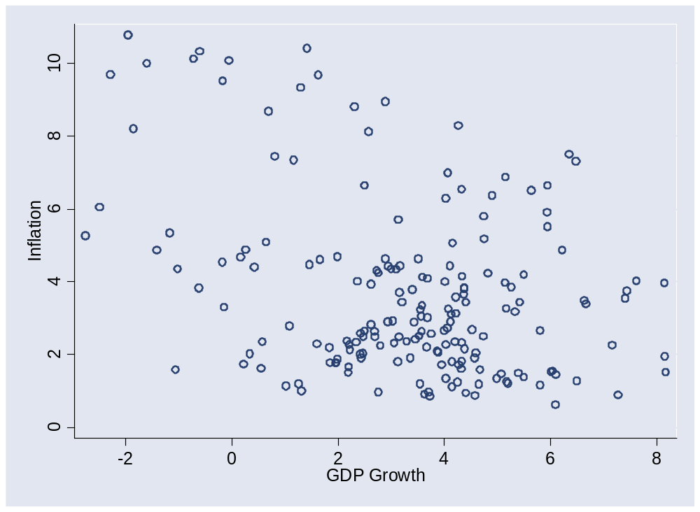
Inflation and output: evidence

Slide 19
Money and interest
The Economist (March 2006):
  A quarter of a century ago, control of the money supply was seen as both necessary and sufficient to curb inflation – so most central banks set monetary targets. Financial deregulation and innovation have made the money supply harder to interpret, let alone control. As the link between money and prices broke down, central banks focused on inflation directly.
Result: most central banks “manage” interest rates rather than the money supply

Slide 20
Money and interest
i
MS/P
MD
M/P
Notes:
Notes: relate to quantity theory

Slide 21
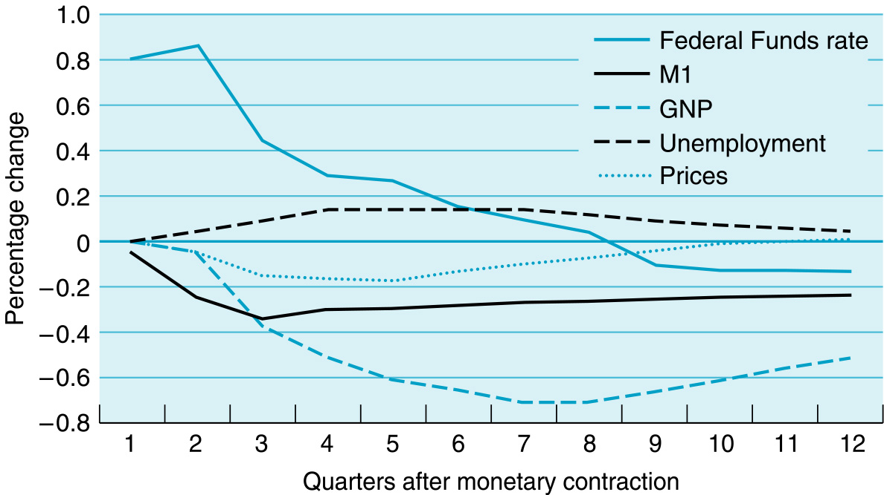
Money, interest, and the economy
Source: Miles and Scott, from Christiano, Eichenbaum, and Evans

Slide 22
Taylor rule
Rule for setting short-term interest rate
i = r* + π + a₁(π –π*) + a₂(y–y*)
  i = short term interest rate (fed funds rate)
  r* = target real interest rate
  π = inflation rate
  π* = target inflation
  y = log of real GDP
  y* = log of trend real GDP
  a₁, a₂ = (positive) parameters
What do (a₁,a₂) mean?
Rule of thumb for thinking about policy

Slide 23
Taylor rule
Why a rule?
What should r* and π* be?
What should the coefficients (a₁,a₂) be?

Slide 24
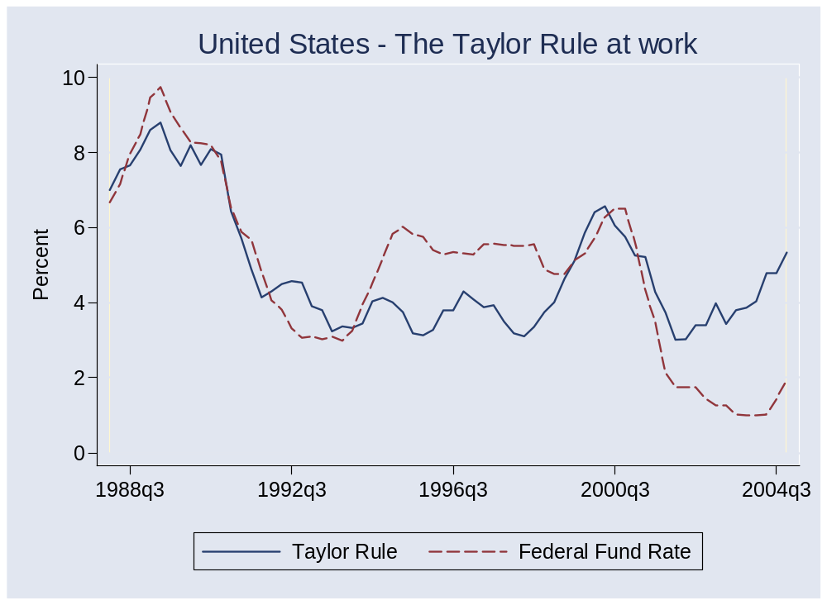
Taylor rule

Slide 25
Money and the economy
MonetaryPolicy
Output & Inflation

Slide 26
FOMC statement
Previous (January 2006):
  Although recent economic data have been uneven, the expansion in economic activity appears solid. Core inflation has stayed relatively low in recent months and longer-term inflation expectations remain contained. The Committee judges that some further policy firming may be needed to keep the risks to the attainment of both sustainable economic growth and price stability roughly in balance. In any event, the Committee will respond to changes in economic prospects as needed to foster these objectives.
Link (click on date)

Slide 27
FOMC statement
Today (March 28, 2006):
  Due about 2:15
  Link:

Slide 28
Markets revisited
How do short rates respond to news about
  Inflation?
  Output or employment?
  Central bank announcements?
Long rates?

Slide 29
Takeaways
Monetary policy has
  Long-run impact on prices/inflation
  Uncertain impact on output
Most central banks focus on short-term interest rates
  Increase in rate implies fall in money
Taylor rule ties interest rate to inflation and output
  Policy is predictable
  Strong output growth and high inflation trigger increases in interest rates
  Long-term rates depend on expectations of future inflation and output

