Slide 1

The Global Economy
Trade Reality
© NYU Stern School of Business

Slide 2
Today’s plan of attack
Current economic and business issues
Ricardo revisited
Pictures
Mini-cases: “UPS” and “Dumping”
Questions
First-half summary

Slide 3
Current issues

Slide 4
Current issues
Bloomberg, February 20, 2007:
  Kasongo Ilunga, the Democratic Republic of Congo’s newly appointed Commerce Minister, may not exist, a government spokesman said. Ilunga has failed to attend any cabinet meetings since being appointed to the post on Feb. 5, Godefroid Mayobo, spokesman for Prime Minister Antoine Gizenga, said in an interview today in the capital, Kinshasa. “I don’t know whether he exists or not,” Mayobo said in an interview today in the capital, Kinshasa.

Slide 5
Current issues
Fiat, Italy (Bloomberg, Italian press):
  Fiat SpA agreed with unions to cut its Italian staff by 2,000 workers by granting them early retirement. The agreement was signed yesterday in Rome by chief executive officer Sergio Marchionne and union representatives, said a spokesman for the company, who asked not to be named. Observers suggested that most of the cost of early retirement, for workers as young as 47, would be paid for by government programs.

Slide 6
Ricardo revisited
Two countries (US, Mexico), two goods (apples, bananas), one input (labor)
  Our production function: Y = AL (no K)
Productivities A (output from one unit of labor):
 | Apples | Bananas | Labor
US (country 1) | α₁ = 20 | β₁ = 10 | 100
Mexico (country 2) | α₂ = 5 | β₂ = 5 | 100

Slide 7
Wages in Ricardo’s model
Questions about “free trade” equilibrium
  Why are Mexican wages lower?
  How are prices and wages related?
  What if Mexican wages increased?
US wage (w₁) | 1
Mexican wage (w₂) | 1/3
Apple price (p_{a}) | 0.05
Banana price (p_{b}) | 0.0667

Slide 8
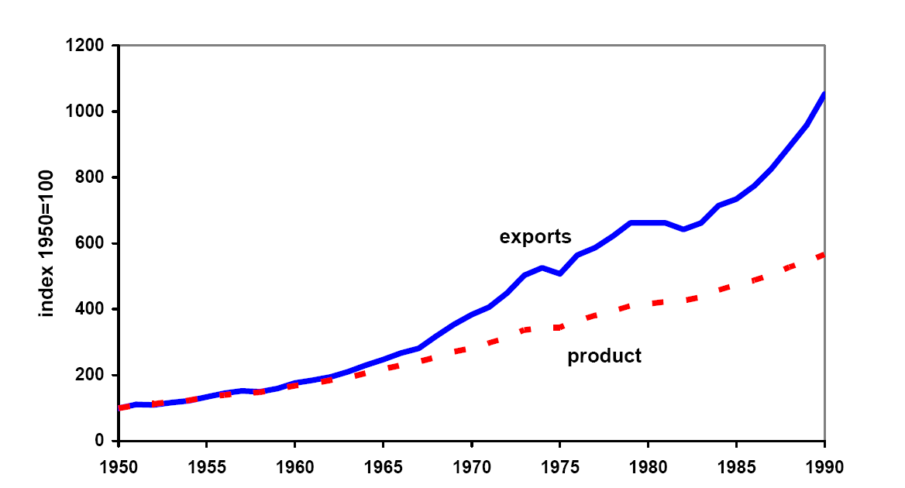
World trade and output since 1950
Source: Kehoe and Boergoing.
Notes:
Trade growing twice as fast as output

Slide 9
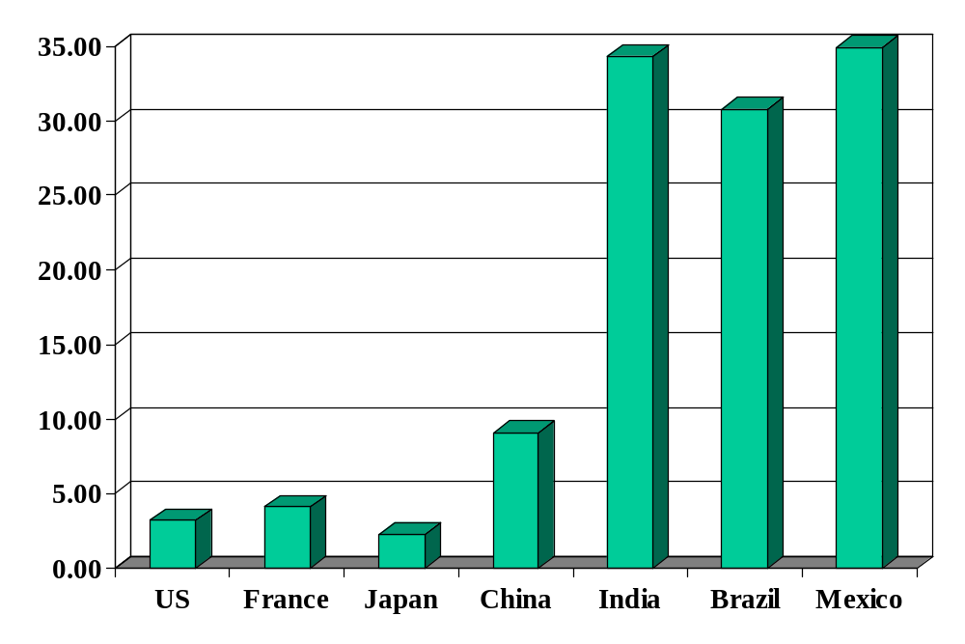
Average tariffs (non-agriculture)
Source: World Trade Organization, World Trade Report, 2004.

Slide 10
UPS in Mexico
UPS enters Mexico to take part in NAFTA boom
Mexicans protect local truckers
UPS asks US government for help
US drags feet when Teamsters protest Mexican truckers entering US
Mexico drags own feet in return
10+ years later nothing has changed

Slide 11
Chinese furniture
US firms file dumping suit against Chinese manufacturers
  Legitimate complaint or strategic attack on competitors?
US industry divided
  Retailers fight suit, favor low prices
Chinese firms hire US lawyers
  They’re the winners! (the lawyers, that is)
Some producers head elsewhere
  Vietnam, Brazil, etc

Slide 12
Questions
Would you
  Hire workers for $2/day in Cambodia?
  Pollute third world country while obeying their environmental laws?
  Outsource to a foreign company that uses prison labor?
  Bribe local officials to counter bribes made by competitors?
Notes:
Who’s laws, norms do you follow?

Slide 13
Political context
High-performance “institutions” include
  Security and rule of law
  Property rights
  Competitive markets – for capital, labor, and products
What political process leads to good institutions?
  Democratic leaders often protect supporters from competition
  Dictators often protect friends
Trade adds:
  Protect us from “unfair” foreign competition (remember: foreigners don’t vote)

Slide 14
The challenge of good government
Madison again (Federalist Papers 51):
  The great difficulty [of good government] lies in this: you must first enable the government to control the governed; and in the next place oblige it to control itself.
Czech joke (circa 1968):
  The difference between capitalism and socialism? Under capitalism, Man oppresses Man. Under socialism it’s exactly the opposite.

Slide 15
Summary of first half
GDP
Capital & Labor
Productivity
Political Process
“Institutions”

Slide 16
Takeaways
Globalization is a fact
The argument for free trade is compelling
  Consumers everywhere benefit
  Production more efficient
Political opposition also a fact
Trade reality
  International business remains a challenge

Slide 17
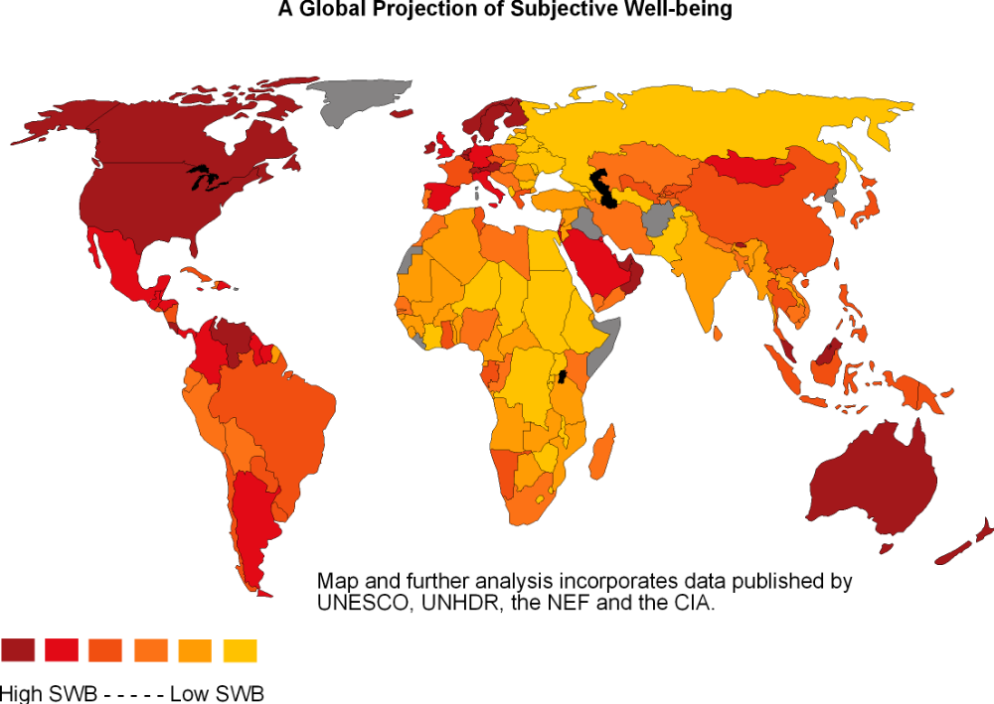
Current issues
Subjective well-being:
Source: http://www.le.ac.uk/pc/aw57/world/sample.html

