Slide 1

The Global Economy
International Capital Flows
© NYU Stern School of Business
Notes:
Open spreadsheet
History of international capital flows
25 years ago lots of flows, but
From Rich to poor
mostly debt
Some to govts
Our concern was would they pay us back
Compare:
Mexico open to equity claims
China too
Governments less involved
Our concern is that they’re buying us!
Two issues today
US borrowing: why? Is it bad?
SWFs: why? Are they bad?

Slide 2
Warren Buffett
Annual letter to shareholders, 2006:
  As time passes, and as claims against us grow, we own less and less of what we produce. ... Should we continue to run current account deficits comparable to those now prevailing, ... our US ‘family’ will be delivering [a substantial fraction of] its annual output to the rest of the world simply as tribute for the overindulgences of the past.

Slide 3
Stephen Roach
Morgan Stanley Global Economic Forum:
  Lacking in domestic saving, America must import foreign saving ... to keep growing at acceptable rates. And so America must then run massive and ever-widening current account deficits to attract that foreign capital. ... America now requires an average of $2.9 billion of capital inflows each and every business day to keep the magic going.

Slide 4
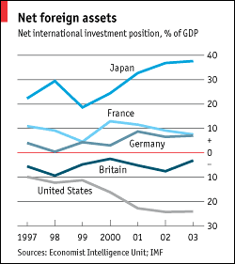
Net international investment position
Source: Economist, January 2005.
Notes:
table across countries

Slide 5
US IIP (2006, USD, billions)
Category | Assets | Liabilities
Direct investment | 2856 | 2099
Portfolio investment | 5838 | 8672
Other | 4841 | 5523
Reserves | 220 | –
Total | 13,755 | 16,295
Net IIP (=NFA) | –2,540
Source: IMF, International Financial Statistics.

Slide 6
Plan of attack
Quotes and numbers ✓
Final group projects
Where we’re headed
Capital flows
Balance of payments
NFA dynamics and sustainability
Is the US in trouble?

Slide 7
Final group projects
Good term sheets had
  Compelling business prospect
  Data on the business/industry as well as the country
  Addressed the obvious counterarguments
Aim for all the above on final product
Grades and comments on back of last page

Slide 8
Final group projects
Please submit the usual way through Blackboard
Also: post a copy on the discussion board

Slide 9
Where we’re headed
Long-Run Performance
Production, Saving & Investment, Productivity, Institutions, Capital & Labor Markets, International Trade
First half:
Short-Run Performance
Inflation, Economic Indicators, Aggregate Supply & Demand, Monetary Policy, Taxes & Deficits, Exchange Rates, Capital Flows, Emerging Market Crises
Second half:

Slide 10
Where we’re headed
Morning schedule
  April 29, first half: second-half review
  April 29, second half: emerging market crises
Afternoon schedule
  April 29, first half: second-half review
  April 29, second half: Bill Lewis, former McKinsey partner, “Productivity differences around the world”

Slide 11
Capital flows
What are they?
Where do they come from?
What do they tell us?

Slide 12
Capital flows
Industries
  Industry A (software): growing fast
  Industry B (steel): not growing
  Where will capital markets direct funds?
  Is that a good thing?

Slide 13
Capital flows
Individuals
  You have low income now (in school)
  Expect to have higher income later
  Would like to consume more than income now
  How do you accomplish that?
  Would capital markets support this?
  Is that a good thing?

Slide 14
Capital flows
Governments
  Chooses to spend more than current tax revenue
  Would capital markets support this?
  Is that a good thing?

Slide 15
Capital flows
Countries
  When might capital flow from one country to another?
  Would capital markets support this?
  Is that a good thing?

Slide 16
Balance of payments
We’ll treat these as synonyms:
  Trade balance
  Net exports
  Current account balance
Call me if you ever need to know the difference

Slide 17
Balance of payments
How is a current account deficit financed?
  “Inflow” of capital from abroad
  Equivalently: sell assets to rest-of-world
  We say the current account is mirrored by an equal and opposite “capital and financial account”
  That’s why we say balance of payments

Slide 18
Balance of payments
BOP = CA + Capital/Financial Flows = 0
Goods
Country 1
Country 2
Capital “outflow”
If Country 1 runs a current account surplus:
There is a capital “outflow” for Country 1, “inflow” for Country 2.
Notes:
Say: NX = CA
Plus: focus on goods

Slide 19
Balance of payments
What does a capital inflow finance?
Version 1: income and expenditures
Y = C + I + G + NX
Version 2: saving and investment
S = Y – C – G = I + NX
Does it matter?

Slide 20
Net foreign assets
Two terms for the same thing
  Net foreign assets (NFA)
  Net international investment position (Net IIP)
It reflects (mostly) cumulative current accounts

Slide 21
US IIP (2006, USD, billions)
Category | Assets | Liabilities
Direct investment | 2856 | 2099
Portfolio investment | 5838 | 8672
Other | 4841 | 5523
Reserves | 220 | –
Total | 13,755 | 16,295
Net IIP (=NFA) | –2,540
Source: IMF, International Financial Statistics.

Slide 22
NFA dynamics
International capital markets
  Countries own claims on each other
  Net position (net foreign assets or NFA):
  NFA = Claims on Foreign Countries – Foreign Claims on Us
Changes in NFA:
NFA_{t+1} = NFA_{t} + CA_{t} + Net Asset Revaluations
≈ (1+i)NFA_{t} + NX_{t}
Comments
  NX is like the primary deficit from fiscal policy

Slide 23
Sustainability analysis
Is a current account deficit bad?

Slide 24
Sustainability analysis
Current account deficits
  Increase our net foreign liabilities
  Raises our interest burden
  Do they affect our ability to pay?
Analogy with a firm
  Which firms raise the most money in capital markets?
  How do firms and countries differ?
Sustainability analysis
  Quick look at NFA/Y: how fast is it growing, and why?
  Missing: equity claims, asset revaluations…

Slide 25
Sustainability analysis
Sustainability analysis
  Quick look at NFA/Y: how fast is it growing, and why?

Slide 26
Sustainability analysis
Inputs
NFA_{t+1} = (1+i) NFA_{t} + NX_{t}
Y_{t+1} = (1+g) Y_{t}
Change in NFA/Y:
NFA_{t+1}/Y_{t+1} = [(1+i)/(1+g)] (NFA_{t}/Y_{t}) + (1+g)⁻¹ NX_{t}/Y_{t}
Typically i>g
  Negative NFA will tend to get worse on its own
  Eventually debt service overwhelms the economy [i NFA]
  Something must change – but what?

Slide 27
Sustainability analysis: US
Current numbers
  NFA/Y = –25%
  NX/Y = –6% (deficit)
  i = 3%
  g = 4% (4+0)
Is the current situation sustainable?
  Where are changes in NFA/Y coming from?
  Are you worried?

Slide 28
Is the US in trouble?
Choose one:
  This US current account deficit is a sign of trouble
  The US is fine
  Both of the above

Slide 29
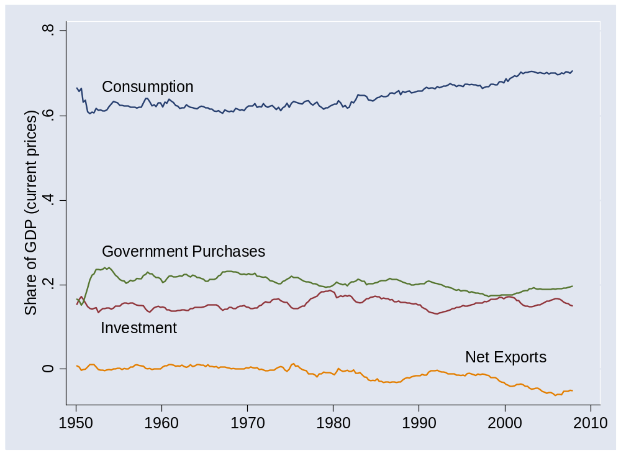
US flows

Slide 30
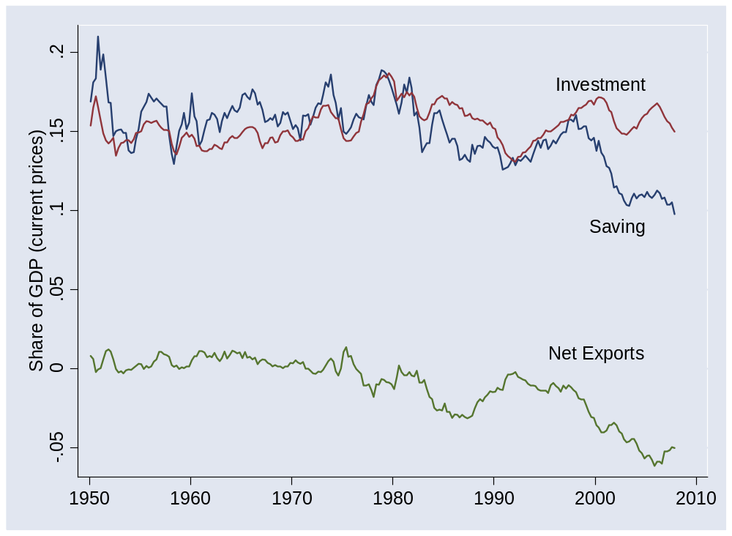
US flows

Slide 31
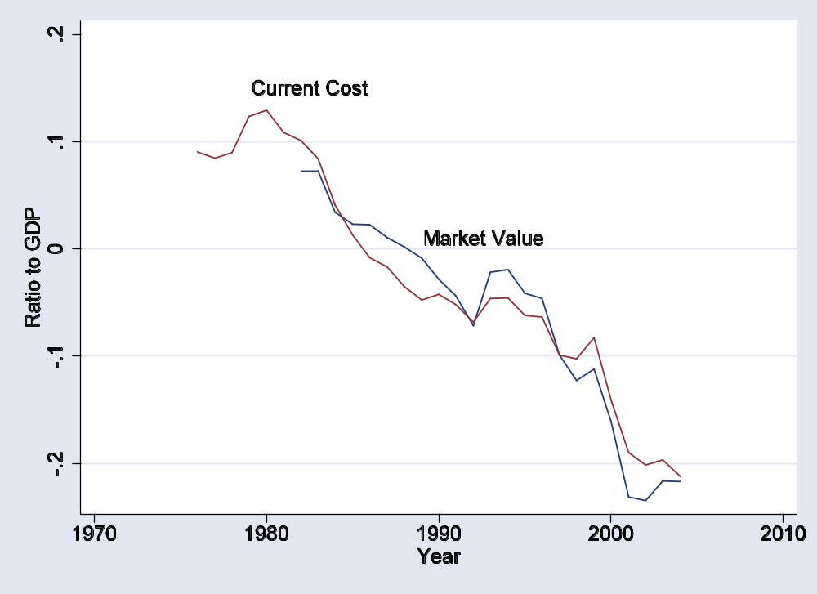
US net foreign assets

Slide 32
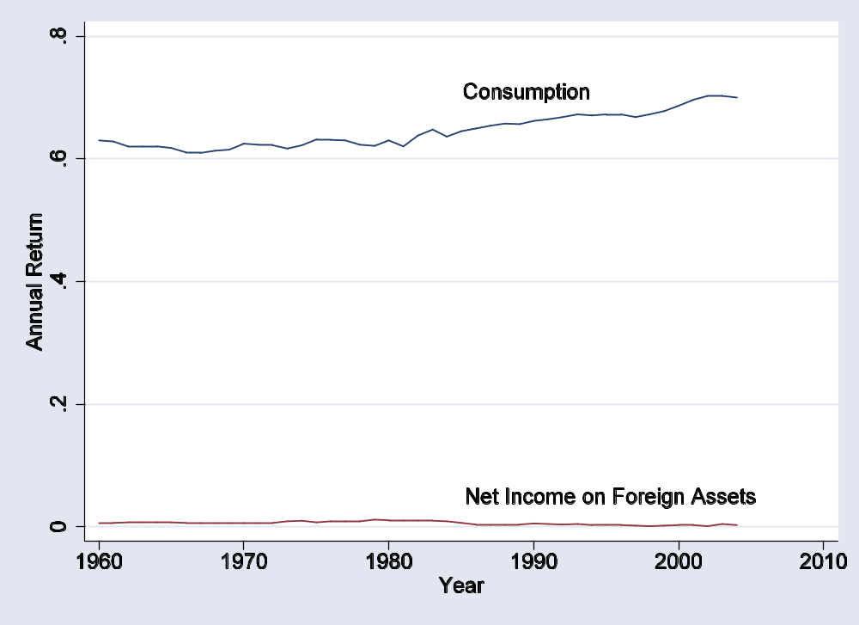
US foreign interest burden

Slide 33
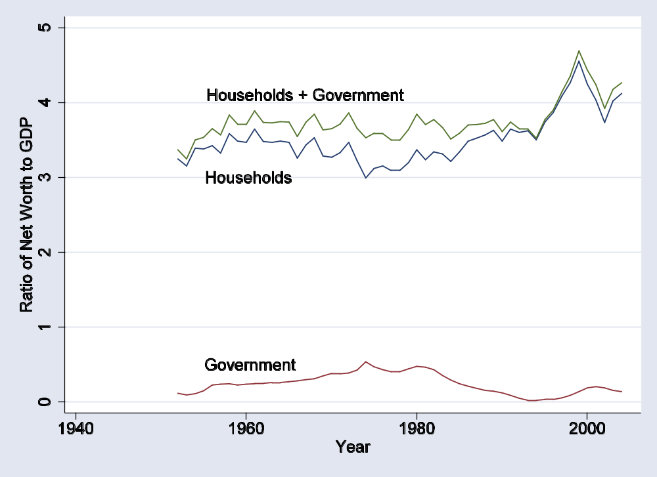
US net worth 1

Slide 34
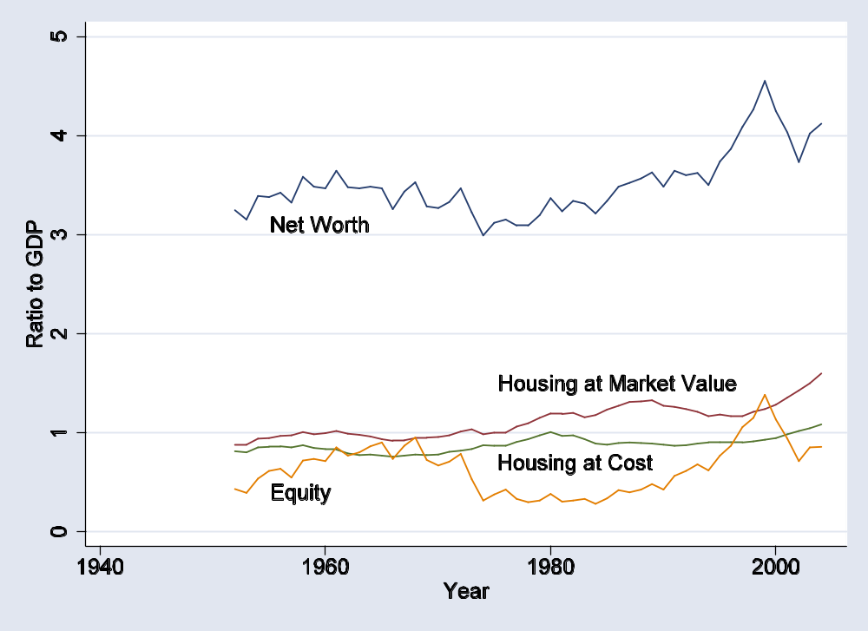
US net worth 2

Slide 35
Is the US in trouble?
Choose one:
  We’re in trouble
  We’re fine
  Both of the above

Slide 36
Is the US in trouble?
Facts
  Consumption has risen as fraction of GDP
  Interest payments remain small
  Household net worth remains strong

Slide 37
Is the US in trouble?
Pessimistic view
  Deficits are financing consumption and government deficits
  Debt is accumulating – and so is interest
  We’ll have to pay it off some day
Optimistic view
  Capital inflow shows US is an attractive place to invest
  Net worth position remains strong despite low saving
  Interest burden remains small

Slide 38
Takeaways
Trade deficits are matched by capital inflows
  This is accounting, not theory
They reflect either high investment or low saving
  Saving includes government
Are deficit countries bad bets?
  It depends: on where the money goes, whether debtor might choose to default

Slide 39
After the break
Be prepared to talk about sovereign wealth funds

Slide 40
The Global Economy
Sovereign Wealth Funds
© NYU Stern School of Business
Notes:
Irony: we used to be worried that EMs wouldn’t pay us back, now we’re worried they’re giving us money
General concern about foreign ownership: Canadians nixed deal

Slide 41
Citigroup
From the Wall Street Journal, Nov 27 07:
  Citigroup announced last night that it was receiving a $7.5b infusion from the Abu Dhabi Investment Authority, the investment arm of the Abu Dhabi government.
  “This investment, from one of the world's leading and most sophisticated equity investors, provides further capital to allow Citi to pursue attractive opportunities to grow its business,” said Sir Win Bischoff, the bank's acting chief executive officer, in a statement.
Source: “Abu Dhabi to Bolster Citigroup With $7.5 Billion Capital Infusion.”

Slide 42
Related investments
Merrill Lynch
  Kuwait Investment Authority, Temasek Holdings (Sng), Korean Investment Authority
Morgan Stanley
  China Investment Corp
UBS
  Government Investment Corp (Sng)
Blackstone
  China Investment Corp

Slide 43
Bad idea?
“Citi of Arabia,” Wall Street Journal, Nov 29 07:
  It strikes us as unfortunate that America's largest bank had to go hat in hand to Arab sheiks. … No one should be under any illusions that Abu Dhabi's investment is a normal commercial transaction. It comes from a sovereign wealth fund controlled by a foreign government, which has political as much as business interests; from an Arab government that has a troubling history with American banking laws; and it offers a Middle Eastern entree into the US financial system that since 9/11 plays a pivotal role in the war on terror.

Slide 44
Plan of attack
Quotes ✓
Answer these questions
  Where do these “capital flows” come from?
  How big are they? Compared to what?
  Why are government funds involved?
  Should we be concerned? Do something? What?
What have we learned?

Slide 45
US current account
Estimated current account deficit in 2008: $788b
What does this mean?

Slide 46
Largest deficits (2008 est, USD billions)
United States | –788
Spain | –155
United Kingdom | –105
Australia | –53
France | –49
Italy | –49
Greece | –37
Turkey | –36
India | –32
Romania | –25
Source: IMF, WEO; current account.

Slide 47
Largest surpluses (2008 est, USD billions)
China | 453
Japan | 195
Germany | 174
Saudi Arabia | 82
Switzerland | 64
Norway | 59
Netherlands | 54
United Arab Emirates | 50
Russia | 49
Singapore | 42
Source: IMF, WEO, current account.

Slide 48
Singapore IIP (2006, USD, billions)
Category | Assets | Liabilities
Direct investment | 134 | 222
Portfolio investment | 156 | 130
Other | 290 | 235
Reserves | 136 | –
Total | 716 | 587
Net IIP | 129
Source: IMF, International Financial Statistics.

Slide 49
Norway IIP (2006, USD, billions)
Category | Assets | Liabilities
Direct investment | 120 | 100
Portfolio investment | 435 | 229
Other | 186 | 255
Reserves | 56 | –
Total | 797 | 584
Net IIP | 213
Source: IMF, International Financial Statistics.

Slide 50
China IIP (2006, USD, billions)
Category | Assets | Liabilities
Direct investment | 82 | 544
Portfolio investment | 229 | 121
Other | 242 | 300
Reserves | 1073 | –
Total | 1627 | 964
Net IIP | 671
Source: IMF, International Financial Statistics.

Slide 51
Question
Where do these capital flows come from?

Slide 52
Largest SWFs (2007 est, USD billions)
Abu Dhabi Inv Authority | 625
Norwegian Pension – Global | 322
Singapore GIC | 215
Kuwait Inv Authority | 213
China Investment Corp | 200
Russia Stabilization Fund | 128
Temasek Holdings (Singapore) |  | 159
Qatar Inv Authority | 60
Alaska Reserve Fund | 40
Brunei Inv Authority |  | 30
Source: Lyons, “State capitalism,” Standard Chartered, Oct 2007.

Slide 53
Largest asset mgrs (2007 est, USD billions)
UBS | 2,450
Barclays Global | 1,810
State Street Global | 1,750
AXA | 1,740
Allianz | 1,710
Fidelity | 1,640
Capital Group | 1,400
Deutsche Group | 1,270
Vanguard Group | 1,170
BlackRock Group | 1,120
Source: Watson-Wyatt.
Notes:
http://www.watsonwyatt.com/europe/pubs/globalinvestment/render2.asp?id=12170

Slide 54
Largest US ret funds (2007 est, USD billions)
Calpers | 129
Federal Retirement Thrift | 98
New York State | 95
California Teachers | 88
Florida State Board | 79
General Motors | 74
Texas Teachers | 67
New York Teachers | 66
New York City | 66
New Jersey | 58
Source: Watson-Wyatt.
Notes:
http://www.watsonwyatt.com/europe/pubs/globalinvestment/render2.asp?id=12170

Slide 55
SWFs overall
Current estimates: $2.2 trillion
In 10 years: $13 trillion?

Slide 56
Other big numbers (2007 est, USD billions)
Bill Gates’ net worth | 23
US treasury debt | 5,000
US GDP | 13,844
US housing | 14,242
US market cap | 17,544
US claims on ROW | 13,800
ROW claims on US | 16,300
Global market cap | 43,000
US household net worth | 58,000
Global financial assets | 167,000
Source: various.

Slide 57
Question
How big are SWFs? Compared to what?

Slide 58
China Investment Corp
Source of funds: part of fx reserves
Purpose: higher returns, incl “social and political”
Guidelines
  Very broad
  Limited reports, some information from public stakes
Source: Lyons, “State capitalism,” Standard Chartered, Oct 2007.

Slide 59
GIC (Singapore)
Source of funds: fx reserves
Purpose: higher returns
Guidelines
  Investments in market instruments, real estate, and venture capital/private equity
  Describes structure and investments on website, but no detailed financial reports
Source: Lyons, “State capitalism,” Standard Chartered, Oct 2007.

Slide 60
ADIA
Source of funds: government oil revenues
Purpose: diversify beyond commodities
Description
  No investments in commodities
  Stakes in many financial institutions worldwide
  Opaque: even the value of the fund’s assets is unknown
Source: Lyons, “State capitalism,” Standard Chartered, Oct 2007.

Slide 61
Norwegian Pension Fund – Global
Source of funds: government oil revenues
Purpose: invest for future generations
Guidelines
  Investments must be outside Norway
  Stakes limited to 5%
  Ethical investing (no weapons, tobacco, etc)
  Audited, public statements
Source: Lyons, “State capitalism,” Standard Chartered, Oct 2007.

Slide 62
Temasek
Source of funds: government saving programs
Purpose: high returns
Guidelines
  Broad diversification
  Focus on Asia said to be for strategic reasons
  Audited, public reports of “highlights”
Source: Lyons, “State capitalism,” Standard Chartered, Oct 2007.

Slide 63
Question
Why are governments involved? Should that worry us?

Slide 64
Code of conduct
Ted Truman, Peterson Institute:
  Management of official holdings of foreign assets, in particular in sovereign wealth funds, has become a major focus of national and international economic and financial policy. These investment activities of governments have become sufficiently significant that an internationally agreed standard should be established to guide these activities.

Slide 65
Code of conduct
What should a code of conduct look like?

Slide 66
Transparency?
“Watching sovereign wealth,” WSJ, Feb 28 08:
  Increased disclosure and transparency may actually be a win-win. … Perhaps most important, citizens of the countries whose funds are being invested would gain a tool to hold their leaders accountable. … Soon after CIC invested in Blackstone, the holding lost nearly $1 billion in less than a month. Chinese citizens immediately let their political leaders know how they felt about their country's savings being squandered by flooding the Internet and other media outlets with angry criticism.

Slide 67
Transparency?
From Hsing Hsing Li, Barrons, Jan 14 08:
  The hub of Asian wealth management, Singapore can scarcely find enough private bankers these days. Already the world's second largest private-banking center, it is fast closing in on longtime leader Switzerland, as tough secrecy laws and favorable taxes attract big accounts from throughout Asia.

Slide 68
Norwegians?
From “Anne”
  Surely the problem is Norway. All that Norwegian oil money looking to slosh over Rupert Murdoch's Wall Street Journal looking to turn the Journal to nefarious Norwegian uses. (I am even now feeling an urge to buy a tin of sardines.) If you knew any Norwegians, you would be as worried as I am.

Slide 69
Question
Should we be concerned? Do something? What?

Slide 70
What have we learned?

Slide 71
Takeaways
Growth of SWF reflects growth in international capital flows
They’re large, but so are other funds
Government involvement reflects local institutions
Proposed code of conduct may be good, but also asks more of them than we ask of ourselves

Slide 72
Extra slides

Slide 73
India IIP (2006, USD, billions)
Category | Assets | Liabilities
Direct investment | 24 | 72
Portfolio investment | 1 | 80
Other | 20 | 136
Reserves | 200 | –
Total | 244 | 289
Net IIP | –45
Source: IMF, International Financial Statistics.

Slide 74
Mexico IIP (2006, USD, billions)
Category | Assets | Liabilities
Direct investment | 31 | 236
Portfolio investment | 7 | 254
Other | 51 | 80
Reserves | 76 | –
Total | 165 | 570
Net IIP | –405
Source: IMF, International Financial Statistics.

Slide 75
Japan IIP (2006, USD, billions)
Category | Assets | Liabilities
Direct investment | 450 | 108
Portfolio investment | 2343 | 1763
Other | 1004 | 1013
Reserves | 895 | –
Total | 4692 | 2884
Net IIP | 1808
Source: IMF, International Financial Statistics.

