Slide 1

The Global Economy
Business Cycle Indicators
© NYU Stern School of Business
Notes:
The “r” word
Intro: example, tools
Releases: emp last fri, hs next tue
Open spreadsheet, Bloomberg calendar

Slide 2
Mercedes USA
2008 forecasts for
  (real) GDP growth
  Inflation
  Interest rates
  Exchange rates (save for later)
Add
  Explanation: why this forecast?
  Implication: how does it affect Mercedes USA?

Slide 3
Mercedes USA

Slide 4
Plan of attack
Mercedes USA ✓
Where we’re headed
Pictures
Forecasting
Good indicators
Leads and lags: the “cross-correlation function”
What have we learned?

Slide 5
Where we’re headed
Long-Run Performance
Production, Saving & Investment, Productivity, Institutions, Capital & Labor Markets, International Trade
First half:
Short-Run Performance
Inflation, Business Cycle Indicators, Monetary Policy, Taxes & Deficits, Exchange Rates, Capital Flows, Emerging Market Crises
Second half:

Slide 6
Where we’re headed
Morning schedule:
  March 11, second half: Dick Berner, Morgan Stanley
  March 25, first half: business cycle indicators
  March 25, second half: aggregate supply and demand
Afternoon schedule:
  March 11, second half: business cycle indicators
  March 25, first half: aggregate supply and demand
  March 25, second half: Tobias Levkovich, Citigroup

Slide 7
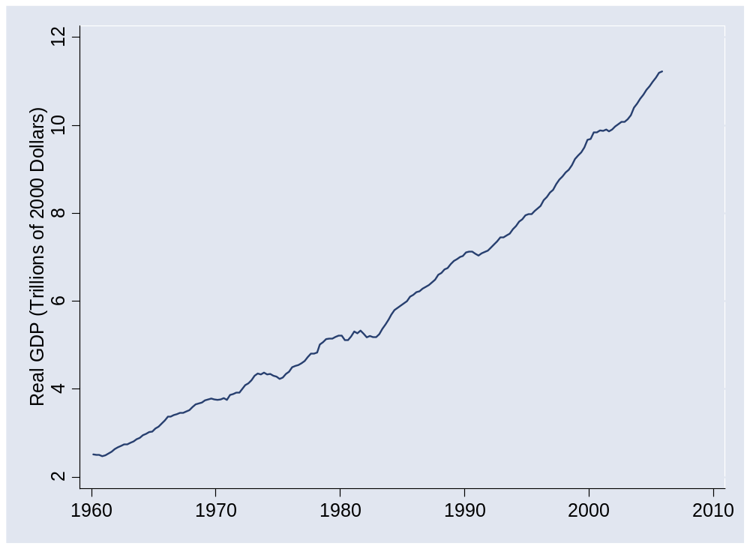
US GDP

Slide 8
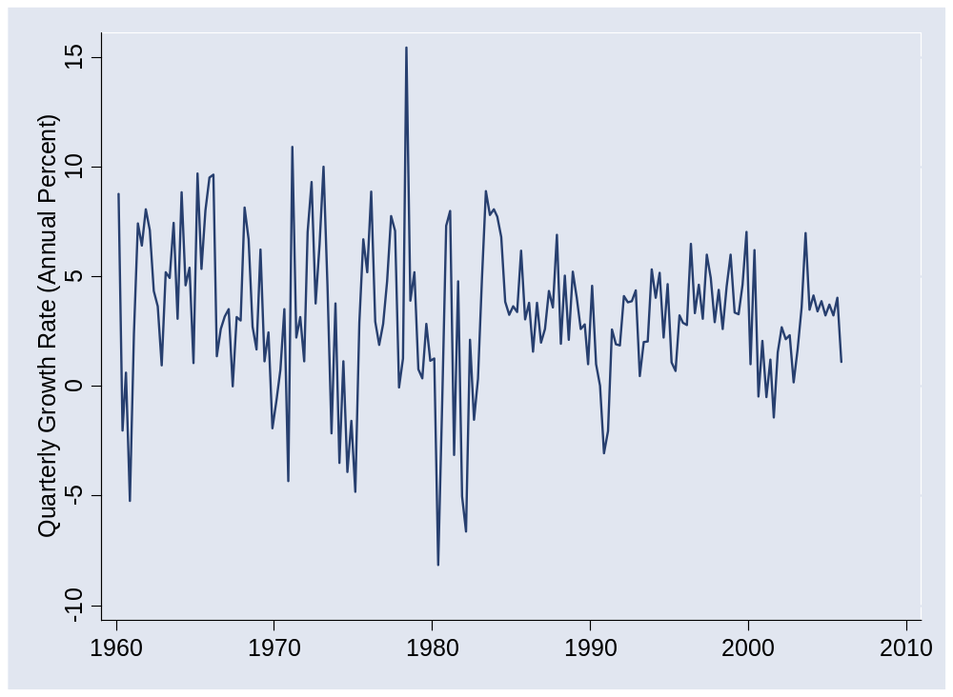
US GDP growth (quarterly, annual rate)

Slide 9
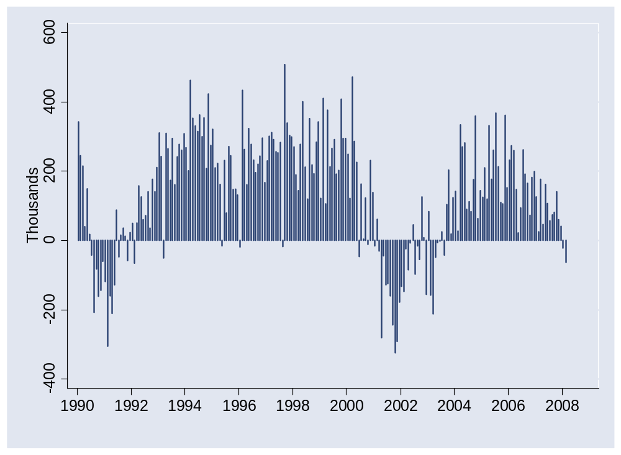
Employment (month-to-month change)
Notes:
Does it tell us there’s a recession? Will be?

Slide 10
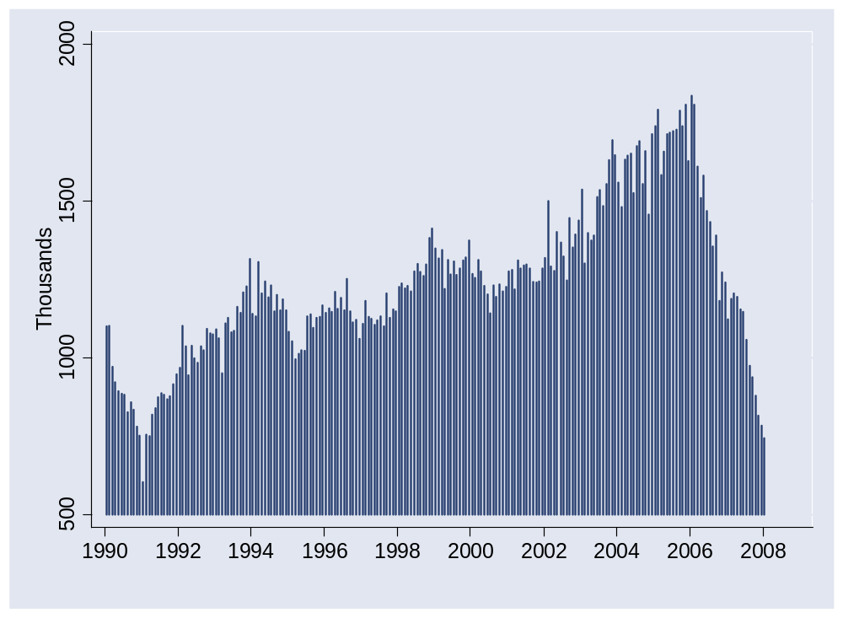
Housing starts

Slide 11
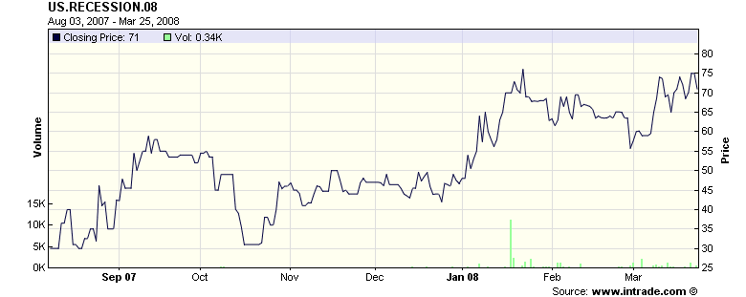
Recession futures
Probability of recession in 2008 (2 q neg growth, final)
Source: Intrade.com.

Slide 12
Forecasting
Can we forecast future economic conditions?

Slide 13
Forecasting: objective
How will economic conditions evolve over the next 0-24 months?
We call the answer “forecasting”
We can forecast lots of things
  GDP growth, inflation, car sales, oil prices, interest rates…
Example: growth in industrial production (“IP”)
γ_{t,t+k} = log(IP_{t+k}/IP_{t})/k = k-period growth rate in IP
Why? How? How well do we do?

Slide 14
Forecasting: regressions
Reminder: we’re forecasting
γ_{t,t+k} = log(IP_{t+k}/IP_{t})/k = k-period growth rate in IP
[set k=12 months?]
Estimate the regression
γ_{t,t+k} = a + b x_{t} + residual
x_{t} is an “indicator” of your choice
Note timing!!

Slide 15
Forecasting: fancy regressions
Reminder: we use the regression
γ_{t,t+k} = a + b x_{t} + residual
  γ_{t,t+k} is what we’re trying to forecast
  x_{t} is an “indicator” of your choice
Variations
  Use more than one x
  Add lags of x
  Add lags of γ

Slide 16
Forecasting: forecasts
Reminder: we use the regression
γ_{t,t+k} = a + b x_{t} + residual
Estimate coefficients a (“intercept”) and b (“slope”)
Calculate predicted future growth rate
γ_{t,t+k} = a + b x_{t}
  x_{t} = value now (t) of indicator x
  γ_{t,t+k} = predicted growth from now (t) to the future (t+k)
Make sure you understand the timing

Slide 17
Forecasting: assessment
How well can we do?
  R² = 0.25 is reasonably good for one-year forecasts [what does this mean?]

Slide 18
Identifying good indicators
What would you suggest?
Why do you think it might work?

Slide 19
Identifying good indicators
How do you find good indicators?
  Forecasting the future requires indicators that lead what you’re forecasting
  Ask friends, read reports, look at ccf (next!)
Cross-correlation function (“ccf”)
  Correlations between two variables at different times
ccf(k) = Corr(x_{t},y_{t-k})
[plot this against k]
  If k<0: x leads y [or y lags x]
  If k>0: x lags y [or y leads x]

Slide 20
Identifying good indicators
Pictures: plot ccf(k) v k
  y = IP growth
  x = indicator
  Does indicator lead or lag IP growth?

Slide 21
Computing cross-correlations
Mechanics: see spreadsheet

Slide 22
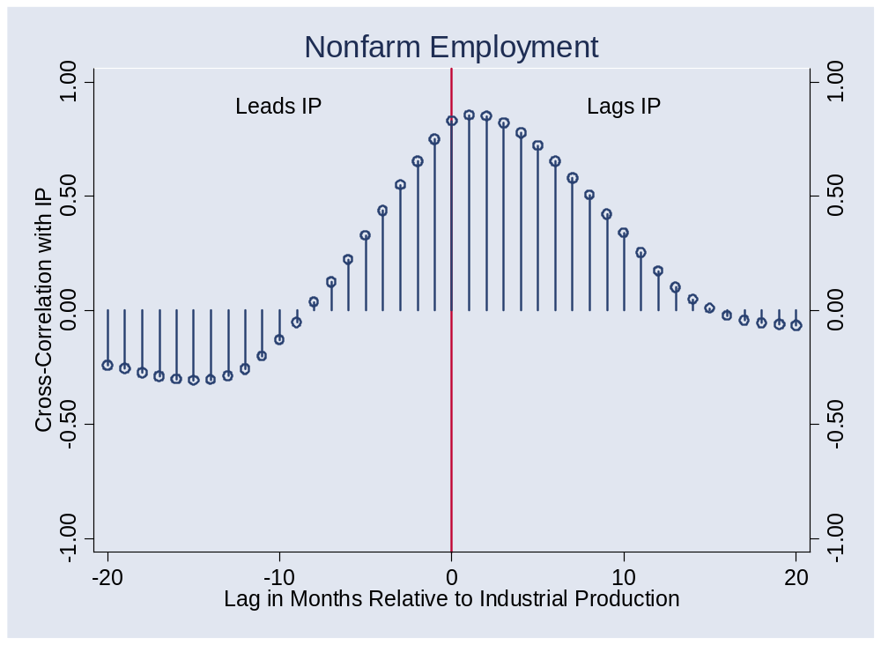
Does employment lead or lag?
What is this dot?

Slide 23
Computing cross-correlations
Date | x(t) | y(t)
1 | 2.43 | 8.47
2 | 1.19 | 2.29
3 | 0.13 | 7.36
4 | 0.56 | 6.39
5 | 0.38 | 6.02
6 | 0.96 | 0.22
7 | 1.87 | 3.60
Reminder:
ccf(k) = corr[x(t),y(t-k)]
For k = 0:
ccf(0) = corr[x(t),y(t)]
Use data marked
Red for x
Blue for y

Slide 24
Computing cross-correlations
Date | x(t) | y(t)
1 | 2.43 | 8.47
2 | 1.19 | 2.29
3 | 0.13 | 7.36
4 | 0.56 | 6.39
5 | 0.38 | 6.02
6 | 0.96 | 0.22
7 | 1.87 | 3.60
Reminder:
ccf(k) = corr[x(t),y(t-k)]
For k = +1:
ccf(1) = corr[x(t),y(t-1)]
Means: x lags y
Use data marked
Red for x
Blue for y

Slide 25
Computing cross-correlations
Date | x(t) | y(t)
1 | 2.43 | 8.47
2 | 1.19 | 2.29
3 | 0.13 | 7.36
4 | 0.56 | 6.39
5 | 0.38 | 6.02
6 | 0.96 | 0.22
7 | 1.87 | 3.60
Reminder:
ccf(k) = corr[x(t),y(t-k)]
For k = –1:
ccf(-1) = corr[x(t),y(t+1)]
Means: y lags x
Use data marked
Red for x
Blue for y

Slide 26
Does employment lead or lag?

Slide 27
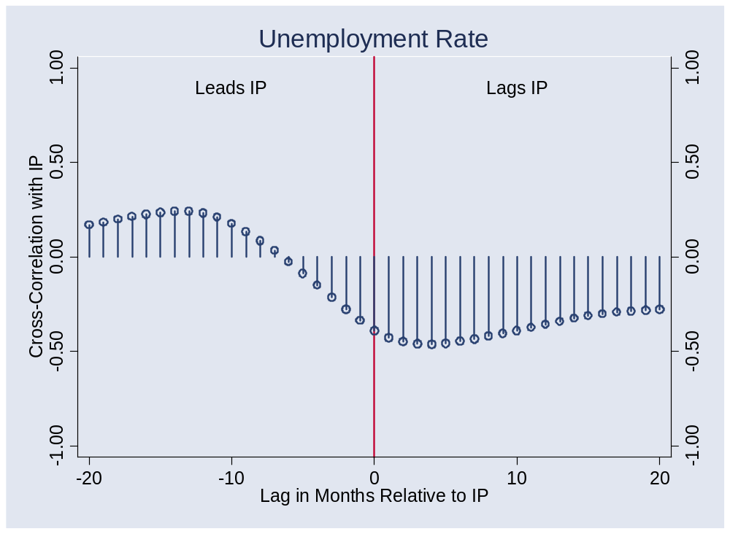
Unemployment?

Slide 28
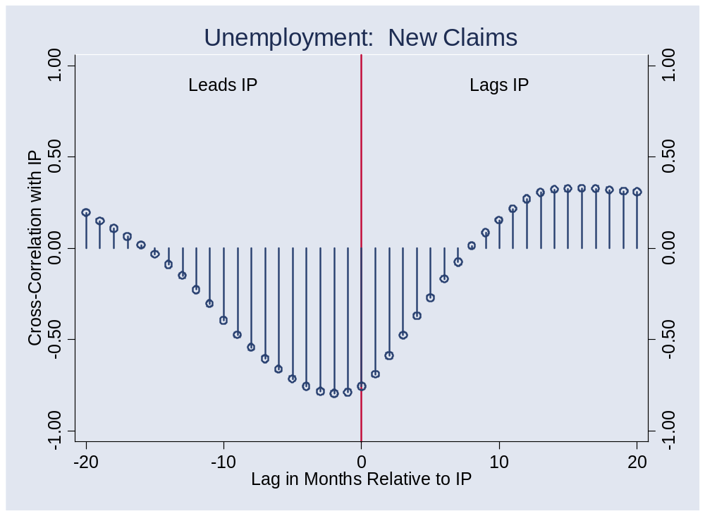
New claims for un ins?

Slide 29
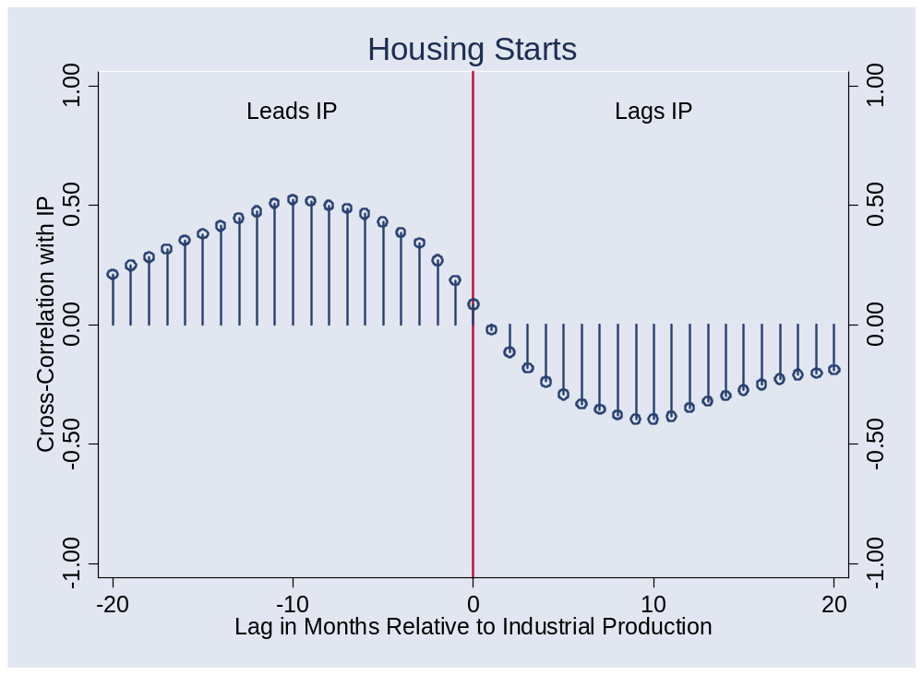
Housing starts?

Slide 30
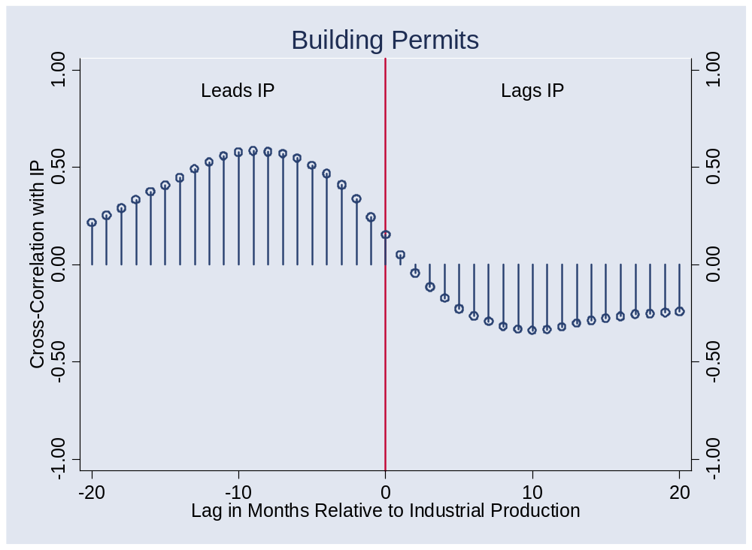
Building permits?

Slide 31
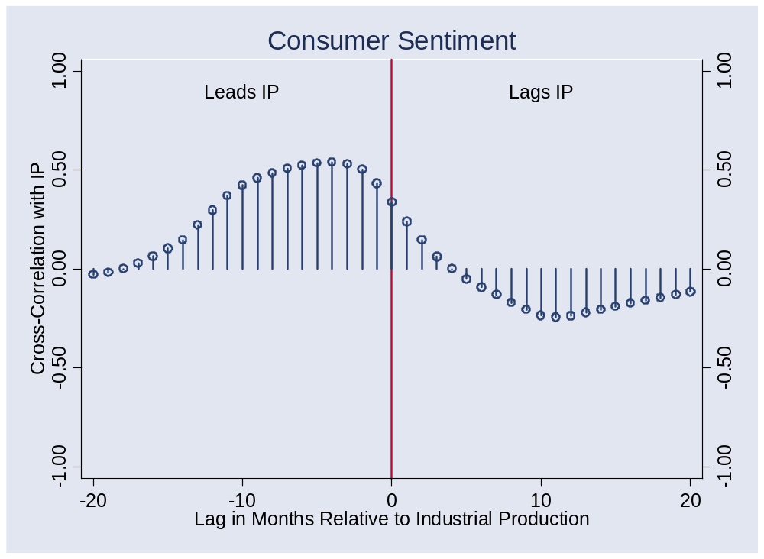
Consumer sentiment?

Slide 32
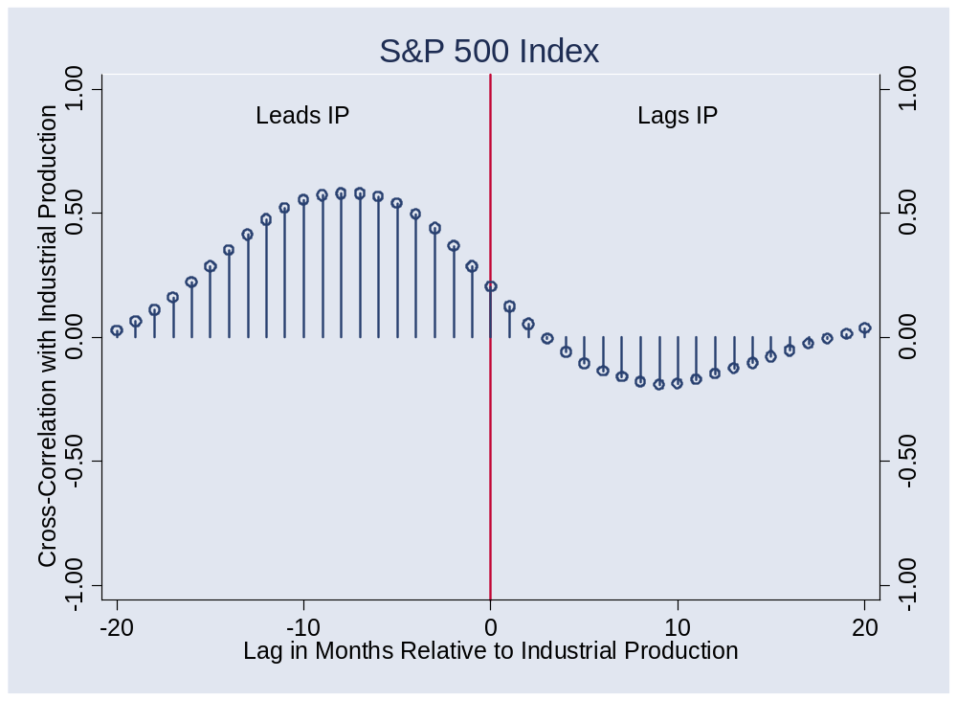
S&P 500 index?
Notes:
Pick a point: what is this?

Slide 33
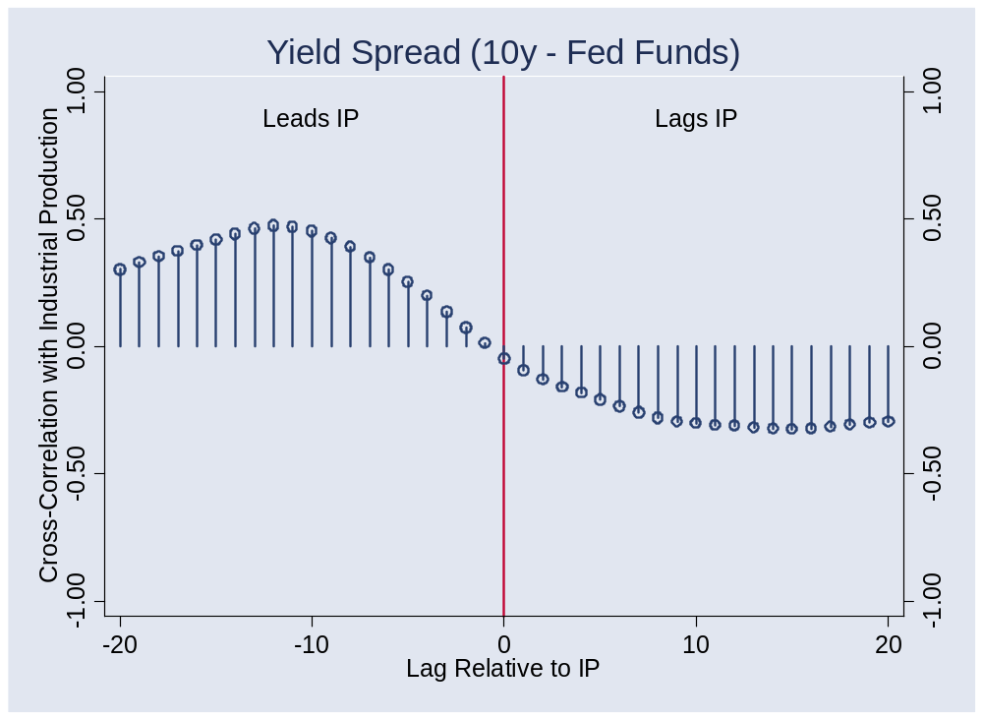
Yield spread?

Slide 34
Forecasting flow chart
Identify good indicators
  Use cross-correlation function, ask friends, whatever works
Transform them
  Do you use the level? Growth rate? Change?
Put them in a regression
  Tells you relation between indicator and variable being forecast
Use the regression coefficients and current value of indicator to construct forecast

Slide 35
What have we learned?

Slide 36
Takeaways
Good indicators tell us something about the future
  Readily available
  Lead the variable we want to forecast
Even the best forecasts leave lots of uncertainty
Useful tools:
  Regressions
  Cross-correlation function

Slide 37
The Global Economy
Aggregate Supply and Demand
© NYU Stern School of Business
Notes:
Open: Bloomberg calendar

Slide 38
Good indicators
Ideas?

Slide 39
Good indicators
Bloomberg calendar

Slide 40
Good indicators
What is this dot?

Slide 41
Questions
Does saving raise or lower GDP?
Why has inflation risen recently?
Is high growth associated with high inflation?
Should monetary policy focus on inflation or growth?

Slide 42
Plan of attack
Good indicators revisited ✓
Questions ✓
Aggregate supply and demand
Answers
What have we learned?
Group Project #5

Slide 43
Aggregate supply and demand
P
AS
AD
Y

Slide 44
Aggregate supply and demand
Adapt supply and demand to whole economy
Axes
  P is price level
  Y is real GDP
Curves
  Supply focuses on production of goods
  Demand focuses on purchase of goods
Why do they look like this?

Slide 45
Aggregate supply 1
Classical version [“long run”]
Production function
  Y = A K^{α} L^{1-α}
At any point in time
  A is given [but may change over time]
  K is given [but may change over time]
  L reflects “equilibrium” in labor market
  Y must therefore be “given” [and AS vertical]

Slide 46
Aggregate supply 1
P
AS*
Y

Slide 47
Aggregate supply 2
Keynesian version [“short run”]
Production function
  Y = A K^{α} L^{1-α}
At any point in time
  A, K given
  Nominal wage “sticky”
  Increase in P reduces real wage, so firms hire more people
  More L implies more Y ⇨ AS curve slopes upward
Wage eventually adjusts, bringing us back to AS*

Slide 48
Aggregate supply 2
P
AS*
AS
Y

Slide 49
Aggregate supply
What happens if we
  Change A or K?
  Change price of oil?
  Change “sticky” wage?
Note: typically both AS and AS* shift

Slide 50
Aggregate demand
Basic version
  Quantity theory generates inverse relation betw P and Y
  M V = P Y
  M/P = Y/V
  Given M, an increase in P results in lower Y
Sophisticated version
  Demand for money declines with nominal interest i
  M/P = L(i,Y)
  Increase in P can decrease Y directly, or indirectly through an increase in i, which lowers demand for interest-sensitive products (housing, durable goods)

Slide 51
Aggregate demand
P
AD
Y

Slide 52
Aggregate demand
What happens if we
  Change M?
  Change G?
  Change consumption or investment demand (“optimism”?)

Slide 53
Aggregate supply and demand
P
AS*
AS
AD
Y

Slide 54
Equilibrium
P
AS*
AS
A
B
AD
Y

Slide 55
Equilibrium
Start at A [“short-run equilibrium”]
  Where AS and AD cross
Move toward B [“long-run equilibrium”]
  Why? Because wages adjust, shifting AS down
  This goes on until AS crosses AS* at B

Slide 56
Higher saving
Example: consumer confidence falls
Does this raise or lower Y? P?

Slide 57
Higher saving
Example: consumer confidence falls
Does this raise or lower Y? P?
Impact of decrease in “demand”
  AD shifts left/down
  Short-run impact: prices down, output down
  Long-run impact? [this should remind you of quant theory]

Slide 58
Higher inflation
Where is this coming from? What is the impact?

Slide 59
Higher inflation
Where is this coming from? What is the impact?
Impact of higher energy prices
  Like a fall in A [why?]
  AS shifts left/up
  Short-run impact: prices up, output down
  Long-run impact?

Slide 60
Inflation and growth
Would you expect to see high growth associated with high inflation? Why or why not?

Slide 61
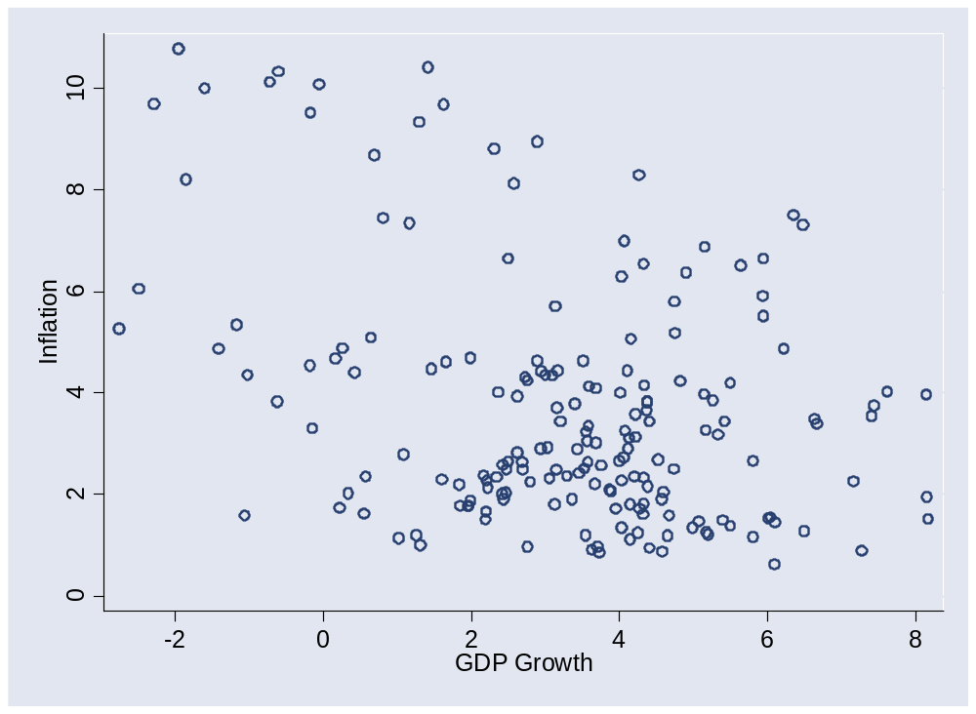
Inflation and growth

Slide 62
Monetary policy
Should it focus on inflation or growth?

Slide 63
What have we learned?

Slide 64
Takeaways
Aggregate supply and demand is the analyst standard
In practice, the challenge is to know whether high output reflects supply or demand factors

Slide 65
Group Project #5
Goal: forecast US employment growth
  Number 1 Wall Street indicator
Data sources
  Indicators spreadsheet: see Blackboard link
  St Louis Fed’s “FRED” database
Statistical work is tricky
  See “forecasting” sheet of indicators spreadsheet
  Or use Minitab template
  Get started soon
Come see me if you have questions

Slide 66
Group Project #5
The document should look professional
  Valuable skill, worth practicing now
  Guide included in updated version of project (Blackboard)
  Samples available here
  More practice coming (Group Project #6, Final Project)

Slide 67
Group Project #5
Reminder: we count the best 5 of 6
You can skip one if you want

Slide 68
Midterm
Guide to grades
  90 and up [35%]: A/A–
  65-89 [62%]: B+/B/B–
  Below 65 [3%]: think about what went wrong
  Come see me if you have questions
Statistics
  High: 100
  Median: 85
  Mean: 84

Slide 69
After the break
Tobias Levkovich
  Managing director and Chief U.S. Equity Strategist for Citi Investment Research and member of Citi’s Investment Strategy Committee. Prior to assuming his current role, Tobias spent 13 years analyzing the engineering, construction, and machinery industries and has been recognized repeatedly by Institutional Investor, The Wall Street Journal, and Reuters.
  Tobias began his career with L.F. Rothschild & Co. He holds a bachelor’s in commerce from Concordia University in Montreal and attended Boston University’s Graduate School of Management. He remains a huge fan of the Montreal Canadiens and Team Canada.

Slide 70
Extra slides

Slide 71
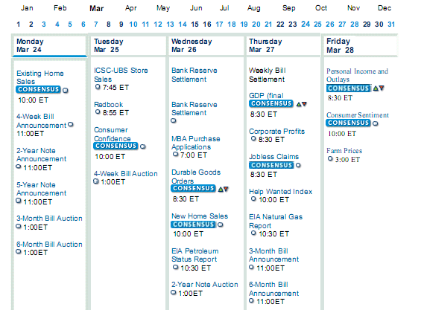
Identifying good indicators
Source: Bloomberg economic calendar.

Slide 72
Dynamics
Suppose Fed increases M, shifting AD right
  This increases output, because real wage falls
Why do workers tolerate this?
  If they see it coming, they should build the increase into current wages
  If so, what happens to the AS curve?

Slide 73
Dynamics
Stagflation revisited
  Contrast impact of higher M and higher inflation expectations
  Why is it important to keep expectations under control?
  Like self-administered drugs?

Slide 74
Dynamics
Suppose we see increases in stock prices, consumption, and output
What caused what?
  Demand theory: increase in stock prices raised consumer demand, which then raised output
  Dynamic supply theory: people expect high future productivity. Consumers and stock traders both see this coming, raise consumption and equity valuations.
How can we tell the difference?
Can future productivity “cause” current consumption to rise?

