Slide 1

The Global Economy
Principles of Tax Policy
© NYU Stern School of Business
Notes:
Many of the recent disasters/crises stemmed from fiscal policy mistakes

Slide 2
Announcements & reminders
Use your nameplates
  Affects our tracking of participation
Please do not sit in the back row or right section
Check discussion board: good stuff!
Group Project #5: good content, professional

Slide 3
Group Project #6
How do economic conditions differ between the US and the Euro Zone?
How does ECB policy differ from Fed policy?
How do you see Euro interest rates evolving?

Slide 4
Group Project #6

Slide 5
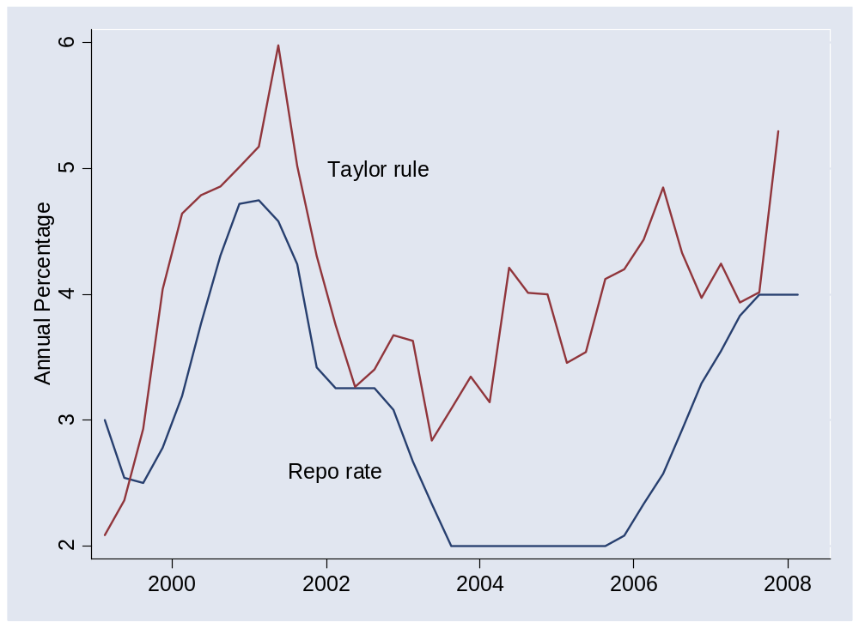
Group Project #6

Slide 6
Plan of attack
Group Project #6 ✓
Where we’re headed
Pictures and quotes
What should governments do?
Principles of tax policy
What have we learned?

Slide 7
Where we’re headed
Long-Run Performance
Production, Saving & Investment, Productivity, Institutions, Capital & Labor Markets, International Trade
First half:
Short-Run Performance
Inflation, Economic Indicators, Aggregate Supply & Demand, Monetary Policy, Taxes & Deficits, Exchange Rates, Capital Flows, Emerging Market Crises
Second half:

Slide 8
France
The Economist, Survey France, Oct 26 06:
  An employer who pays a worker twice the minimum wage, or €2,400 a month, has to shell out nearly half as much again to the state in social-security contributions; the employee, for his part, has to hand over 22% of his pay in social-security contributions, on top of income tax. A French pay slip typically runs to over 40 itemised lines. Deductions from the employee's gross pay include 6.65% to the pension fund; 2.4% to the unemployment fund; and 5.1% to the social-security fund. The employer gets stung for contributions of 1.25% to the work-accident fund; 0.4% to the work medicine fund; 2.6% to the transport fund; and so on.
Notes:
http://online.wsj.com/article/SB117500805386350446-email.html?

Slide 9
Slovakia
Ivan Miklos, Deputy Prime Minister of Slovakia, Financial Times:
  I am convinced that the reforms of new EU member states could serve as inspiration for the older member states as well. One such reform is the flat tax. … We now have one of the simplest, most transparent tax systems in the world. … And our tax revenues have not decreased at all, partly because the reform eliminated most of the incentives and opportunities for tax avoidance. The new system has been particularly popular with German companies.
Notes:
March 23 2005 p 15

Slide 10
Mihir Desai
“Taxing foreign profits,” from Jeannine Torres:
  The United States operates a mishmash of a [corporate tax] system that taxes worldwide income, provides partial relief for foreign taxes paid and imposes those taxes only upon repatriation. … The ability to defer US taxation until profits are repatriated is often framed as providing an incentive to ship jobs overseas [and] the current worldwide system is often derided as making American firms uncompetitive relative to their foreign competition. So, there are easy ways to take political potshots at the current system from both sides.
Link
Notes:
March 23 2005 p 15

Slide 11
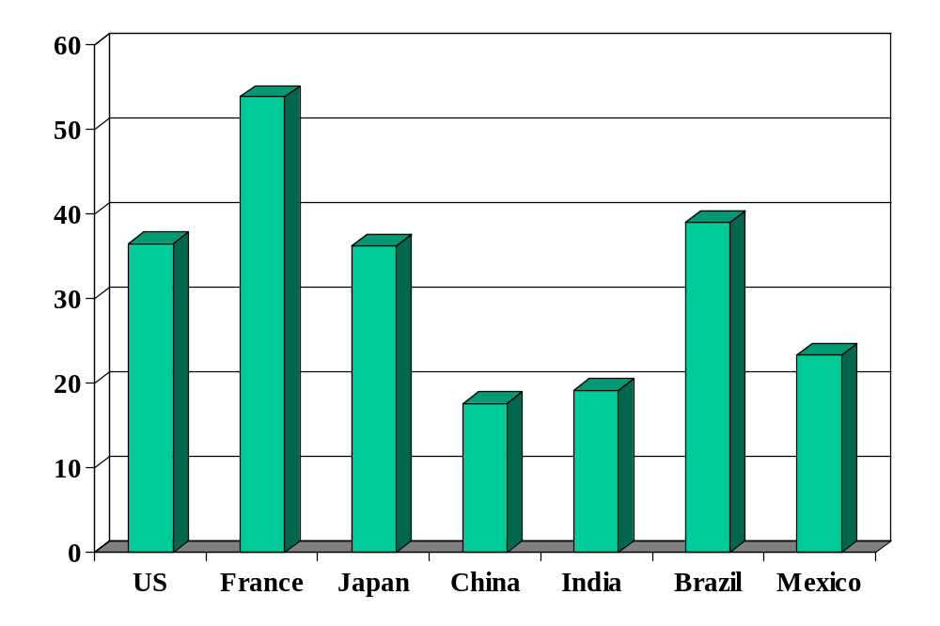
Government spending (% of GDP)
Source: OECD fiscal database, EIU country data.
Notes:
OECD countries: 2006 numbers, Economic Outlook, Annex Table 25.
China, India, Brazil, Mexico: EIU

Slide 12
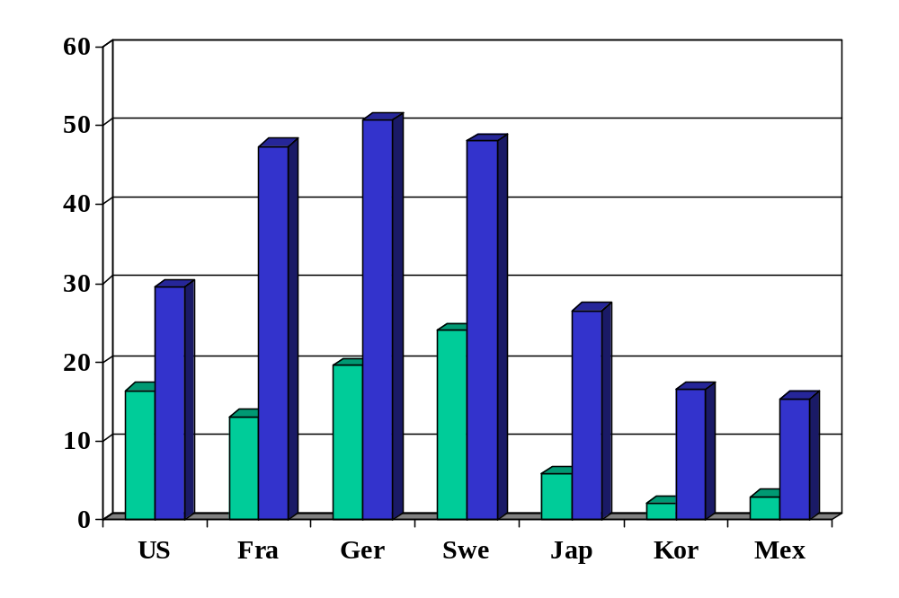
Personal tax rates (%, at average wage)
Source: OECD tax database. Green=direct tax. Blue=total incl soc ins payments by employee/er.

Slide 13
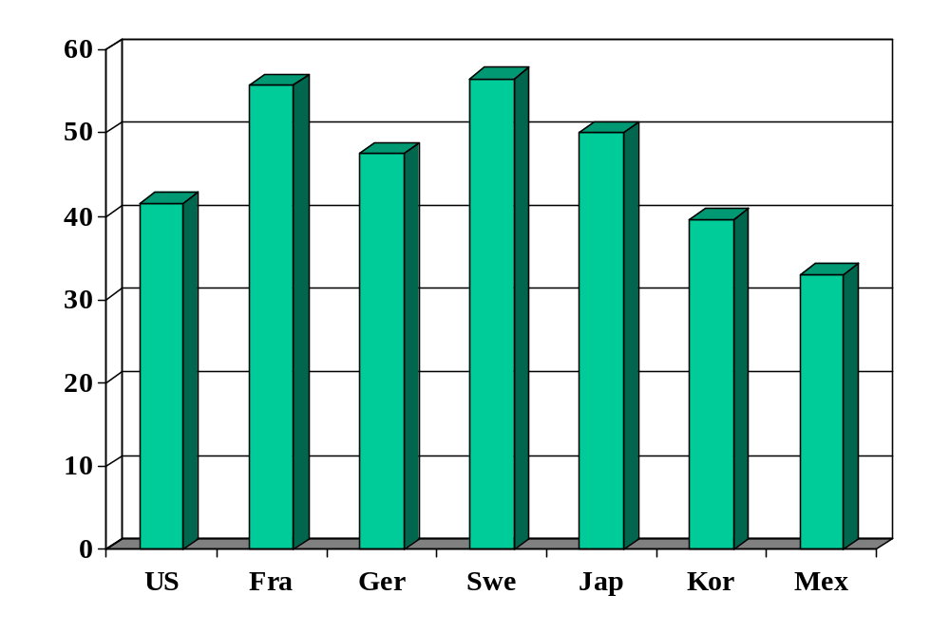
Top personal tax rates (%)
Source: OECD tax database.

Slide 14
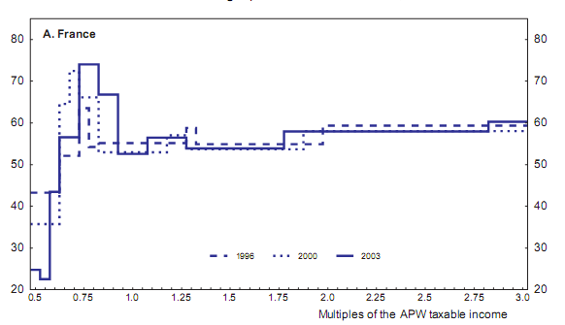
French marg tax rates by income
Source: OECD working paper 439, “The French tax system.”

Slide 15
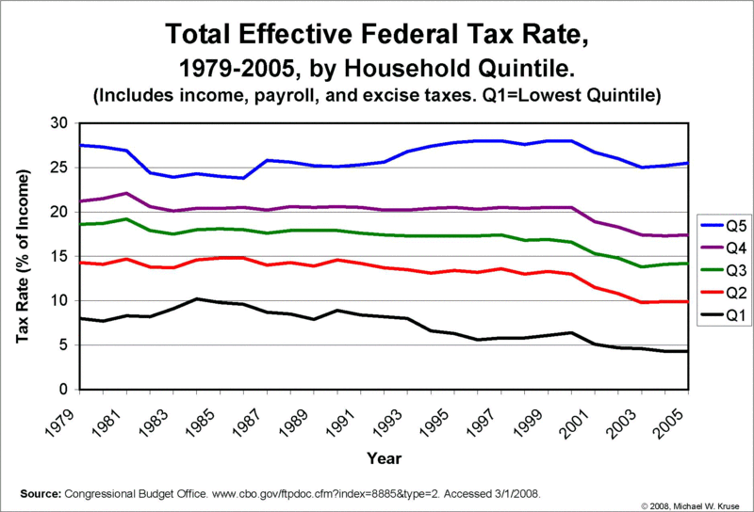
US avg tax rates by income
Source:http://krusekronicle.typepad.com/kruse_kronicle/2008/02/taxing-question.html

Slide 16
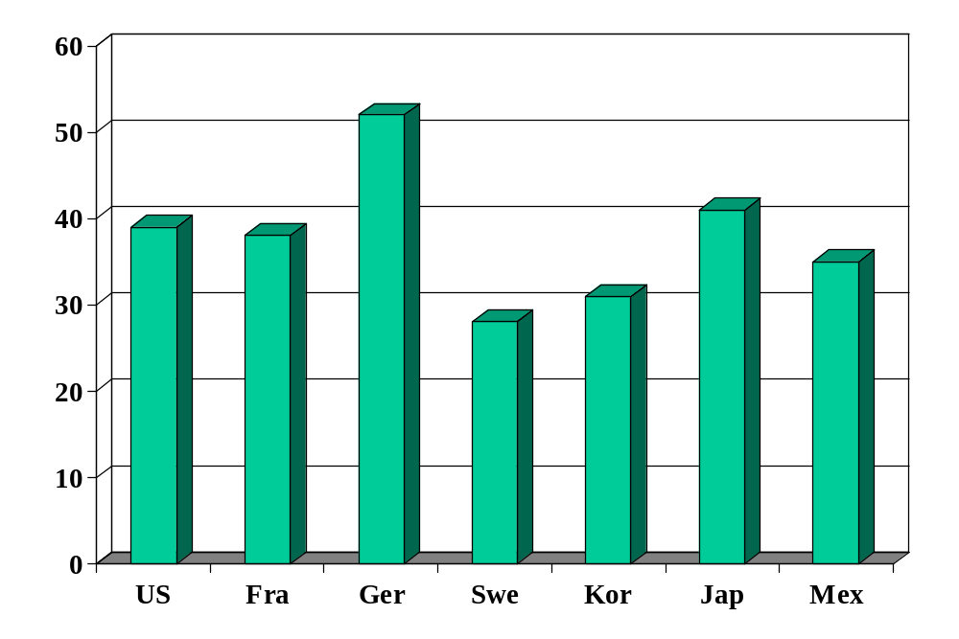
Corporate tax rates (%)
Source: KPMG Tax Survey.

Slide 17
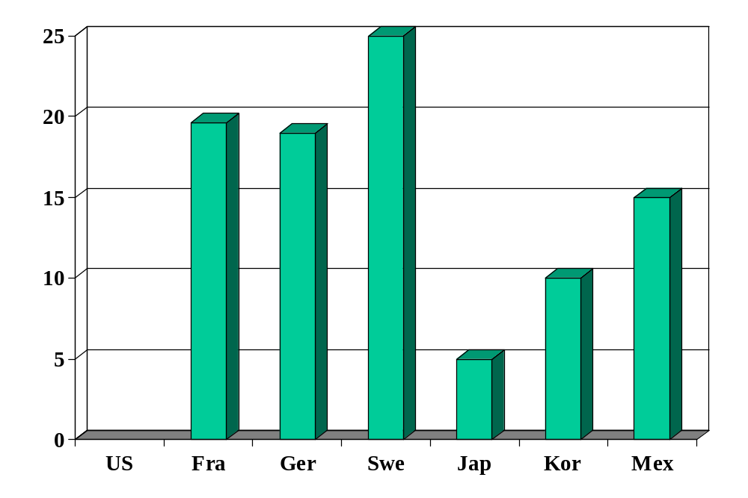
VAT rates (%)
Source: OECD tax database.
Notes:
For person with average wage

Slide 18
What should governments do?
Spending?
Taxes?

Slide 19
What should governments do?
Provide public goods
  Non-excludable: hard to keep people from consuming it
    National defense, clean air, fish in the ocean
  Non-rival: my consumption does not affect your consumption
    National defense, etc
Insurance and redistribution
  Protect the unfortunate and unlucky
    Disability, major medical issues, …
Hard to provide these services privately

Slide 20
What should governments do?
Many goods have both public and private aspects
Opinions differ on what government should provide

Slide 21

What should governments do?
Libertarian Reluctantly Calls Fire Department
April 21, 2004 | Issue 40•16
CHEYENNE, WY—After attempting to contain a living-room blaze started by a cigarette, card-carrying Libertarian Trent Jacobs reluctantly called the Cheyenne Fire Department Monday. “Although the community would do better to rely on an efficient, free-market fire-fighting service, the fact is that expensive, unnecessary public fire departments do exist,” Jacobs said. “Also, my house was burning down.” Jacobs did not offer to pay firefighters for their service.
© Copyright 2006, Onion, Inc. All rights reserved.
The Onion is not intended for readers under 18 years of age.

Slide 22
What should governments do?
How should they finance spending?

Slide 23
Tax principles
Principle #1: Taxes must finance spending
  High government spending requires high taxes
  More on this later
Principle #2: Apply low rates to a broad base
  Exceptions implicitly raise taxes for others

Slide 24
Tax principles
Principle #2: Apply low rates to a broad base
Why?
  Taxes “distort” economic decisions
  High taxes distort more
Contrast
  Tax two markets equally
  Tax one market twice as much

Slide 25
Taxes and loss of surplus
P
consumer
surplus
S
P*
producer surplus
D
Q*
Q

Slide 26
Taxes and loss of surplus
P
“Deadweight loss”
S'
consumer
surplus
S
P_{c}
t
P*
tax revenue
P_{f}
producer surplus
D
Q'
Q*
Q

Slide 27
Taxes and loss of surplus
P
S''
S'
S
2t
t
D
Q

Slide 28
Tax principles
Applications of Principle #2
Should we
  Make food and clothing exempt from tax?
  Internet sales?
  Medical care?
Optional issues
  What’s the logic for a value-added tax?
  Should we tax income or spending?

Slide 29
Tax principles
Where are the largest disincentives of US tax system?

Slide 30
What have we learned?

Slide 31
Takeaways
Countries differ in government spending and taxation
Taxes change incentives to work and save/invest
Good systems have low rates on large base

Slide 32
After the break
Be prepared to comment on India’s fiscal policy

Slide 33
The Global Economy
Government Deficits
© NYU Stern School of Business
Notes:
Open spreadsheet

Slide 34
Final Group Project
Not optional
Due dates:
  Term sheet: April 15
  Draft slides: April 29
How to think of a topic
  Pick a country that interests you
  Pick a business that interests you
  Think about what you’re doing this summer
  Think about what you’d like to do

Slide 35
Fiscal policy in India
What are the pressures on spending and revenue?
Projected deficit? Ratio of debt to GDP?
Concerns for
  Indian business leader
  Foreign investor
  Poor person?

Slide 36
Fiscal policy in India

Slide 37
Plan of attack
Final Group Project ✓
India ✓
Pictures and quotes
Ingredients of government budgets
Government debt dynamics
Sustainability
Fiscal policy in Germany/Brazil/Peru/US
What have we learned?

Slide 38
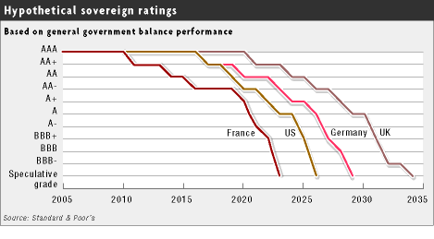
Government debt ratings
Source: FT, March 21, 2005

Slide 39
Government spending (% of GDP)
Source: OECD fiscal database, EIU country data.
Notes:
OECD countries: 2006 numbers, Economic Outlook, Annex Table 25.
China, India, Brazil, Mexico: EIU

Slide 40
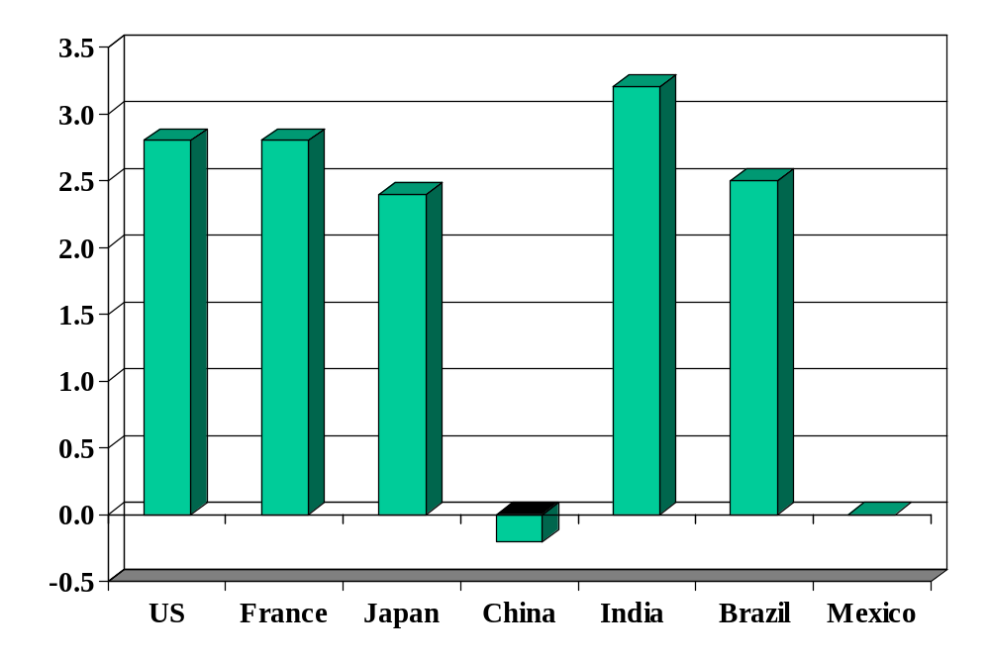
Government deficits (% of GDP)
Source: The Economist, 2008 estimates.

Slide 41
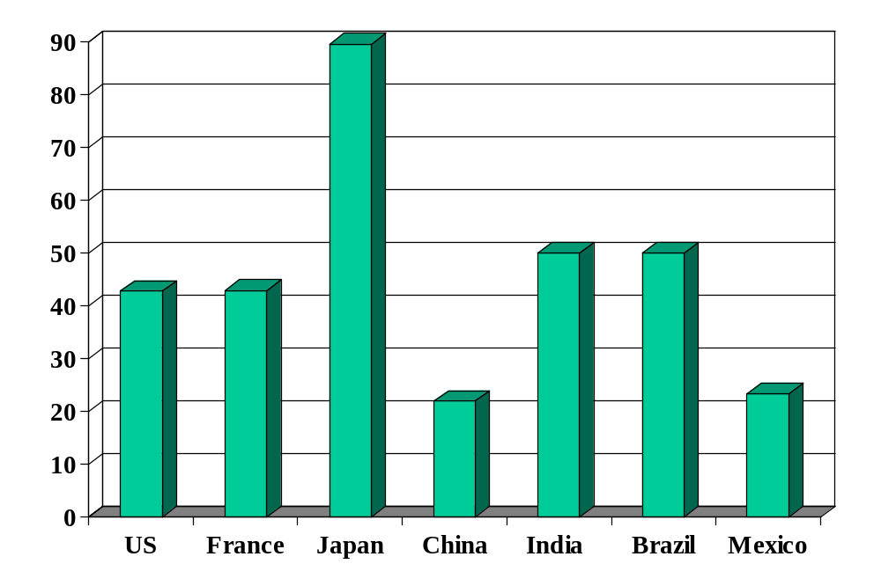
Government debt (% of GDP)
Source: Economist Intelligence Unit Country Data and OECD Economic Outlook.
Notes:
Net debt from OECD

Slide 42
Alexander Hamilton
Second Report on Public Credit, 1795:
  Every system of Public Credit must assume as a fundamental principle that it will possess ability to pay the debt which it contracts. … With the creation of debt should be incorporated the means of extinguishment, which means are twofold: the establishing at the time of contracting a fund for the reimbursement of principal, as well as for the payment of interest.

Slide 43
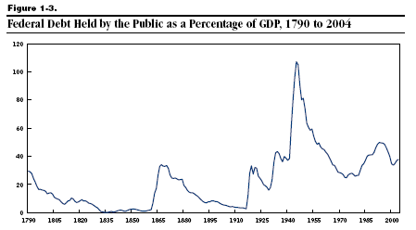
US debt (% of GDP)
Source: Congressional Budget Office.

Slide 44
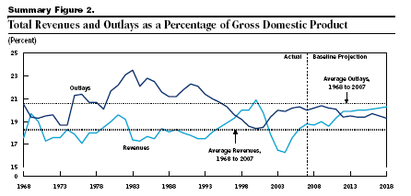
US revenues and expenses (% of GDP)
Source: Congressional Budget Office.

Slide 45
Ingredients of government budgets
Government budget:
G_{t} + V_{t} + i_{t} B_{t} = T_{t} + B_{t+1} – B_{t}
Ingredients:
  G = government purchases of goods and services
  V = transfer payments from government to households
  G + V = government spending
  T = tax revenue
  G + V – T = primary deficit (excl interest)
  B = government debt (“bonds” – includes currency)
  i = (nominal) interest rate paid on debt
  iB = interest payments

Slide 46
Ingredients in Germany (% of GDP)
2005!
Revenue |  | 43.4
 | Tax revenue | 22.1
 | Social security revenue | 17.7
Expenses |  | 46.8
 | Goods, services, and employee comp | 11.7
 | Social security | 26.6
 | Interest on debt | 2.8
Surplus |  | -3.3
Sources: EIU Country Profile. Numbers might not add: some small categories have been omitted.

Slide 47
Government debt dynamics
Principle #1: taxes must finance spending
  You need to pay for what you spend
Analogy: credit card
  Allows you to shift payments in time, not avoid them
  Higher debt leads to higher interest payments, which requires higher cash flow to finance
Government deficits and debt
  Deficits concern timing, not whether we pay for government spending
  Eventually accumulated debt must be repaid [sort of]
  Therefore: not only must deficits not last forever, you must run future (primary) surpluses to balance a deficit today.

Slide 48
Government debt dynamics
Government budget:
G_{t} + V_{t} + i_{t} B_{t} = T_{t} + B_{t+1} – B_{t}
Ingredients:
  G = government purchases of goods and services
  V = transfer payments from government to households
  G + V = government spending
  T = tax revenue
  D = G + V – T = primary deficit (excl interest)
  B = government debt (“bonds” – ignore money)
  i = (nominal) interest rate on debt
  iB = interest payments

Slide 49
Government debt dynamics
Three versions of the same equation
D_{t} + iB_{t} = B_{t+1} – B_{t} (1) finance deficit with debt
B_{t+1} = (1+i)B_{t} + D_{t} (2) debt dynamics (backwards)
B_{t} = B_{t+1}/(1+i) – D_{t}/(1+i) (3) debt dynamics (forwards)
Bottom line
  Deficits must be financed (Principle #1)

Slide 50
Government debt dynamics
Current debt equals
B_{t} = B_{t+1}/(1+i) – D_{t}/(1+i) [version (3)]
= B_{t+2}/(1+i)² – [D_{t}/(1+i) + D_{t+1}/(1+i)²]
= …
= B_{t+n}/(1+i)^{n} – [D_{t}/(1+i) + D_{t+1}/(1+i)² + … + D_{t+n-1}/(1+i)^{n}]
Debt = present value of future primary surpluses
Comments
  Debt must be financed by future (primary) surpluses
  Assumes: B_{t+n}/(1+i)^{n} → 0 [weaker condition than B_{t+n} → 0]
  Or we could default!

Slide 51
Fiscal policy in Germany (% of GDP)
2005!
Revenue |  | 43.4
 | Tax revenue | 22.1
 | Social security revenue | 17.7
Expenses |  | 46.8
 | Goods, services, and employee comp | 11.7
 | Social security | 26.6
 | Interest on debt | 2.8
Surplus |  | –3.3
Sources: EIU Country Profile. Numbers may not add: some small categories have been omitted.

Slide 52
Fiscal policy in Germany
High debt: ~68% of GDP
  Reflects, in part, high cost of reunification
High spending
  Large pension obligations, aging population
High taxes
  Labor: esp high taxes on singles (52%) and two-income families (45%)
  Corporations: highest rate in OECD (39%)
How would this affect you if you were a
  German manufacturer deciding where to locate factory?
  Internationally mobile German worker?
  US investor?
Sources: OECD report.

Slide 53
Fiscal policy in Germany
What would you recommend?
Sources: OECD report.

Slide 54
Fiscal policy in Germany
Update 2008
Budget balanced (primary surplus)
  Increased VAT from 16% to 19%
  Dropped corporate rate
  Capped some social programs
  Growth increased, generated more revenue
Sources: OECD report.

Slide 55
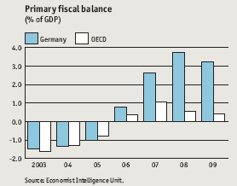
Fiscal policy in Germany
Sources: EIU Country Profile.

Slide 56
Sustainability analysis
Issue:
  Will ratio of debt to GDP settle down if policy doesn’t change?
  If yes: sustainable. If not, unsustainable.
  Both measured at current prices (“nominal”)
Growth of (nominal) debt [budget version (2)]
B_{t+1} = (1+i)B_{t} + D_{t}
Growth of (nominal) GDP
Y_{t+1} = (1+g)Y_{t}
Growth of debt to GDP ratio
B_{t+1}/Y_{t+1} = [(1+i)/(1+g)] (B_{t}/Y_{t}) + (1+g)⁻¹ D_{t}/Y_{t}

Slide 57
Sustainability analysis
“Natural” growth rates
  Debt: (1+i)
  GDP: (1+g)
  Ratio of debt to GDP: (1+i)/(1+g)
Sustainability requires
(1+i)/(1+g) < 1
i < g
Typically i>g
  Therefore something must change – but what?

Slide 58
Sustainability analysis
“Unsustainable” means something must change
  Higher tax revenue
  Lower spending
  Higher growth
  Lower interest rate
  Default on debt

Slide 59
Fiscal policy in Brazil
Bill Lewis, McKinsey (The Power of Prosperity):
  High government spending for developing country (~40%)
  Magnified by interest on past debt (at high rates)
  Requires high taxes
  Large underground economy survives by avoiding taxes
  Major impediment to TFP: official businesses more efficient, but higher tax burden limits their growth
  Therefore: fiscal discipline is a central issue for growth

Slide 60
Fiscal policy in Brazil
High debt for a developing country: >40% of GDP
  Debt service high because interest rate is high
Major spending issues
  High spending for a developing country
  Generous pensions to civil servants (spending ~8% of GDP)
  Similar obligations to private-sector pensions
How would this affect you if you were a
  European food retailer deciding where to expand?
  Brazilian worker about to retire?
  Young Brazilian worker?

Slide 61
Fiscal policy in Brazil
What would you do?

Slide 62
Fiscal policy in Brazil (% of GDP)
Primary balance (non-interest) | 3.2
Interest on debt | –5.1
Total budget balance | –1.9
Public debt | 41.7
Is debt increasing or decreasing?
Sources: EIU Country Report, 2008 estimates.

Slide 63
Fiscal policy in Brazil
Brazil today
  B/Y = 42%
  D/Y = –3.2% (surplus!)
  i = 11% [what is this rate?]
  g = 9% (4.5+4.5)
Is fiscal policy sustainable?
  Compare “natural growth” of B/Y with current surplus
  Note roles of: i, g, D/Y

Slide 64
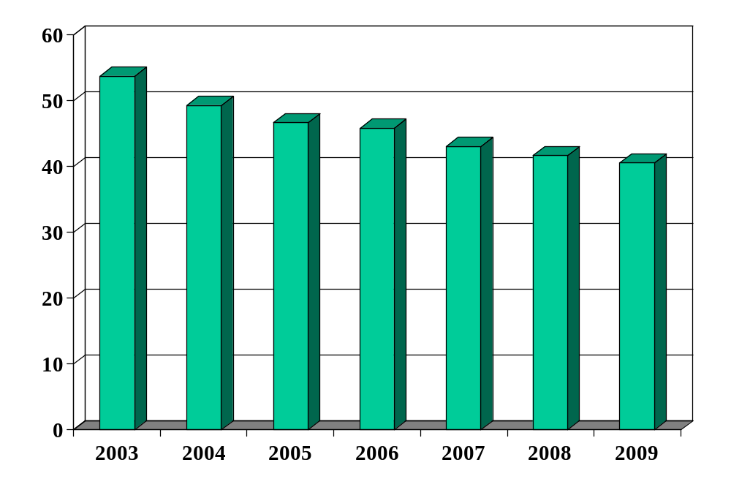
Brazilian debt (% of GDP)
Source: EIU Country Report.

Slide 65
Fiscal policy in Peru (% of GDP)
From Jaime Pease:
Primary balance (non-interest) | 1.4
Interest on debt | –2.0
Total budget balance | –0.6
Public debt | 27.3
Sources: Fitch report..

Slide 66
Fiscal policy in Peru
Peru today
  B/Y = 27%
  D/Y = –1.4%
  i = 7.5%
  g = 8.0% (5.6+2.4)
Is fiscal policy sustainable?

Slide 67
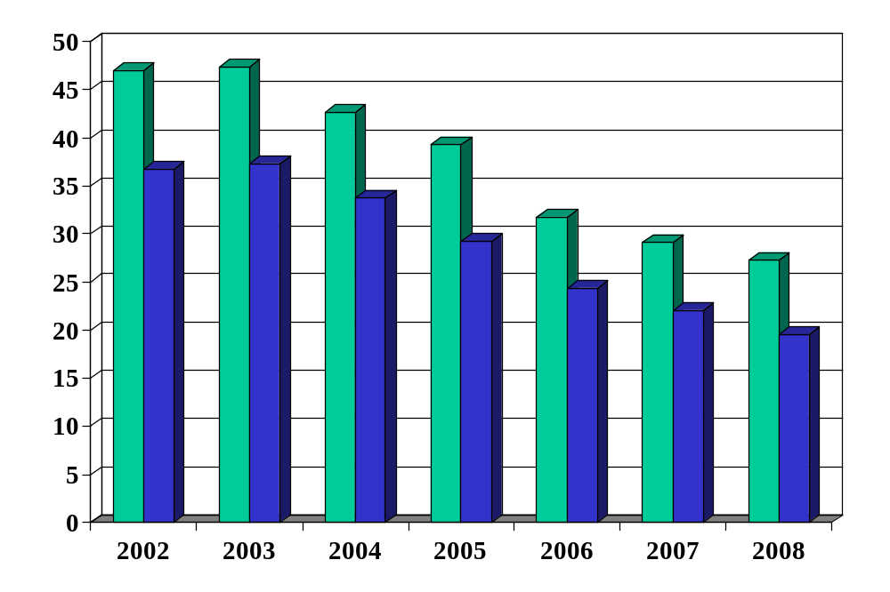
Peruvian debt (% of GDP)
Source: Fitch report. Green = total debt, Blue = foreign debt.

Slide 68
Fiscal policy in the US
Is the US in trouble? Why or why not?

Slide 69
Fiscal policy in the US
US today
  B/Y = 37%
  D/Y = 2.3%
  i = 3.0%
  g = 4.5% (1.6+2.9)
Is fiscal policy sustainable?

Slide 70
Fiscal policy in the US
What are the long-term budget issues?

Slide 71
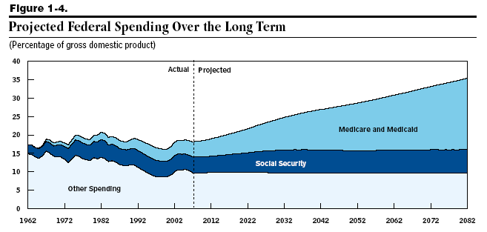
US: medicare/medicaid (% of GDP)
Source: Congressional Budget Office.

Slide 72
What have we learned?

Slide 73
Takeaways
Government deficits must be financed
  By issuing debt today
  And by running (primary) surpluses in the future
Sustainability analysis
  Debt tends to grow unless you run surpluses
US deficits
  The biggest issues are not the current deficit, but projected future deficits implied by social security and medicare-medicaid payments

Slide 74
Germany: sustainability analysis
Germany today
  B/Y = 70%
  D/Y = 4%
  i = 2%
  g = 4%
Is fiscal policy sustainable?

Slide 75
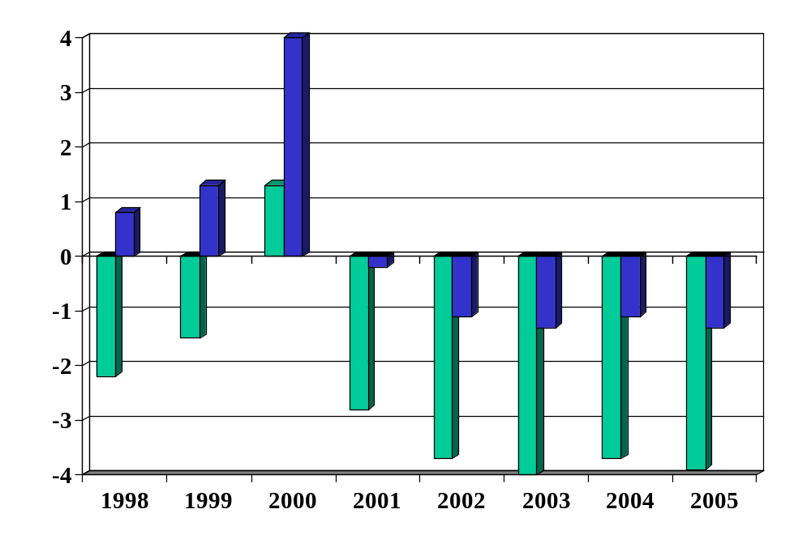
Germany: budget balance (% of GDP)
Source: OECD Economic Outlook, Annex Tables 27 and 29. Green=total, Blue=primary.

Slide 76
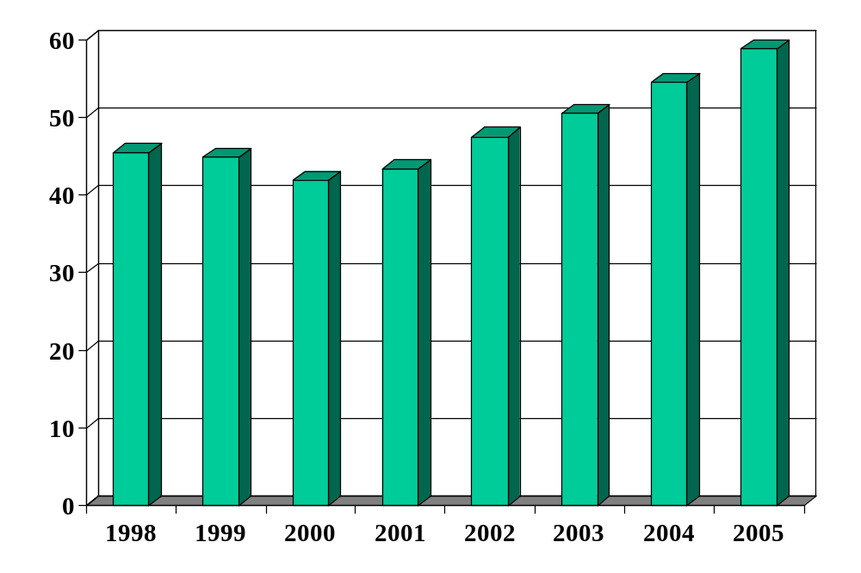
Germany: debt (% of GDP)
Source: OECD Economic Outlook, Annex Table 33.

Slide 77
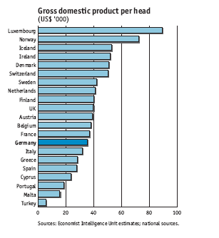
Fiscal policy in Germany

Slide 78
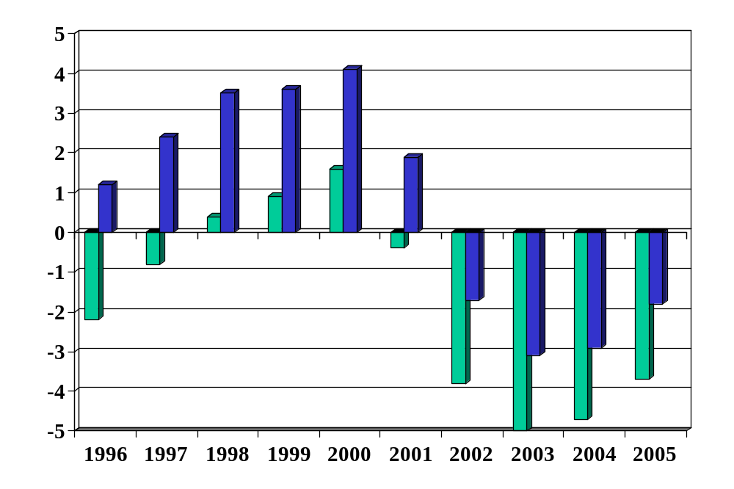
US: budget balance (% of GDP)
Source: OECD Economic Outlook, Annex Tables 27 and 29. Green=total, Blue=primary.

Slide 79
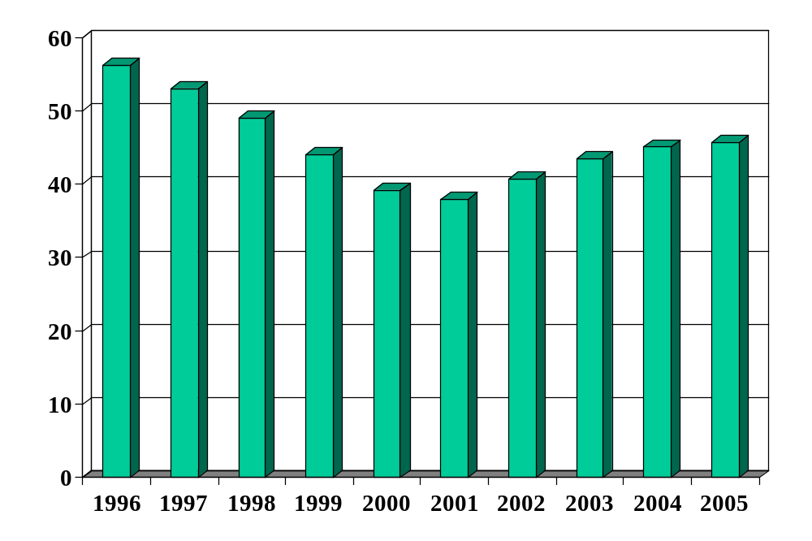
US: debt (% of GDP)
Source: OECD Economic Outlook, Annex Table 33.

Slide 80
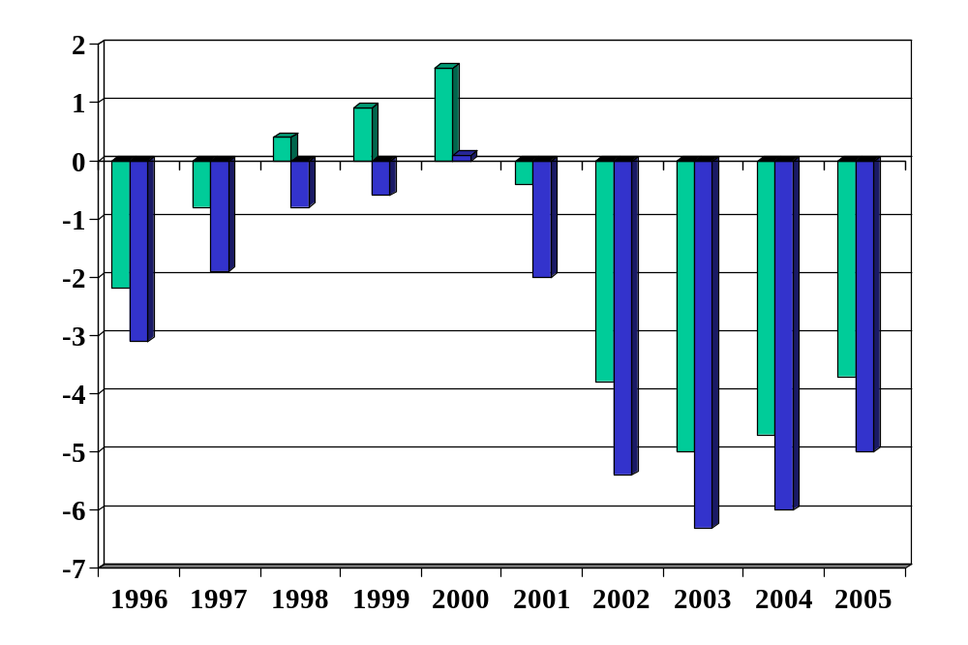
US: impact of soc sec (% of GDP)
Source: OECD Economic Outlook, Annex Tables 27 and 29. Green=total, Blue=excl soc sec.

Slide 81
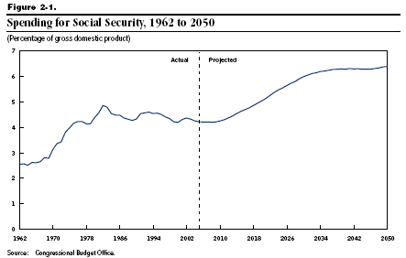
US: social security (% of GDP)

Slide 82
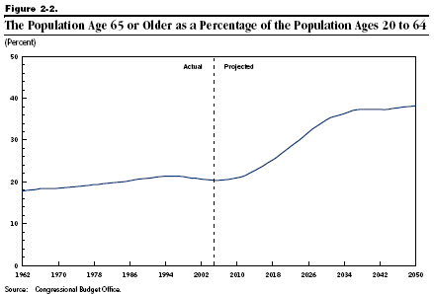
US: age distribution

Slide 83
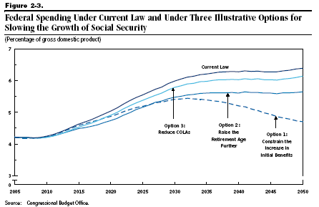
US: social security (% of GDP)

Slide 84
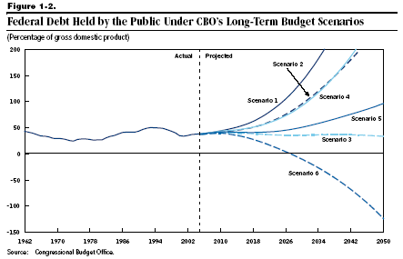
US debt (% of GDP)

