Slide 1

The Global Economy
Exchange Rates
© NYU Stern School of Business
Notes:
One of my favorite classes
ERs central to most international transactions – and a source of vol

Slide 2
Heineken USA
Prospects for dollar/euro rate
Possibility of 10% move
How should you respond to strong euro?
Overall currency strategy

Slide 3
Heineken USA

Slide 4
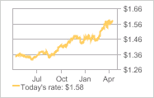
Heineken USA
Source: NY Fed.

Slide 5
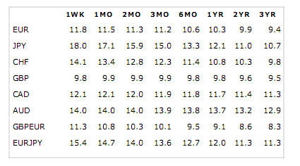
Heineken USA
Implied volatilities from currency options
Source: NY Fed.

Slide 6
Plan of attack
Heineken USA ✓
US economy
Where we’re headed
Pictures and quotations
Exchange rates and prices: the PPP “anchor”
Exchange rates and interest rates: the “carry trade”
What have we learned?

Slide 7
US economy
Due this month
  Wed April 16: housing starts, industrial production
  Thur April 17: jobless claims
  Wed April 23: existing home sales
  Thur April 24: jobless claims
  Fri April 25: consumer sentiment
  Wed April 30: GDP growth for Q1
  Fri May 2: employment situation

Slide 8
US economy
From Intrade.com [contracts pay 100 if statement is true]
Contract | Price
Recession in 2008 | 72.9
GDP growth positive in Q1 | 17.9
GDP growth positive in Q2 | 26.5
GDP growth positive in Q3 | 62.0
GDP growth positive in Q4 | 63.0

Slide 9
US economy
Clive Crook on US fiscal policy, FT, Apr 14 07:
  Bear in mind the wreckage the Bush administration has left of fiscal policy. It would be more accurate to talk of the fiscal footprint than to imply anything as deliberate as ‘policy’. All three contenders criticise the administration, but none is offering much improvement. … The biggest pressure comes from healthcare. If the US is incapable of changing its politics, the outlook is a gradual growth-sapping increase in taxes and spending.

Slide 10
Where we’re headed
Long-Run Performance
Production, Saving & Investment, Productivity, Institutions, Capital & Labor Markets, International Trade
First half:
Short-Run Performance
Inflation, Economic Indicators, Aggregate Supply & Demand, Monetary Policy, Taxes & Deficits, Exchange Rates, Capital Flows, Emerging Market Crises
Second half:

Slide 11
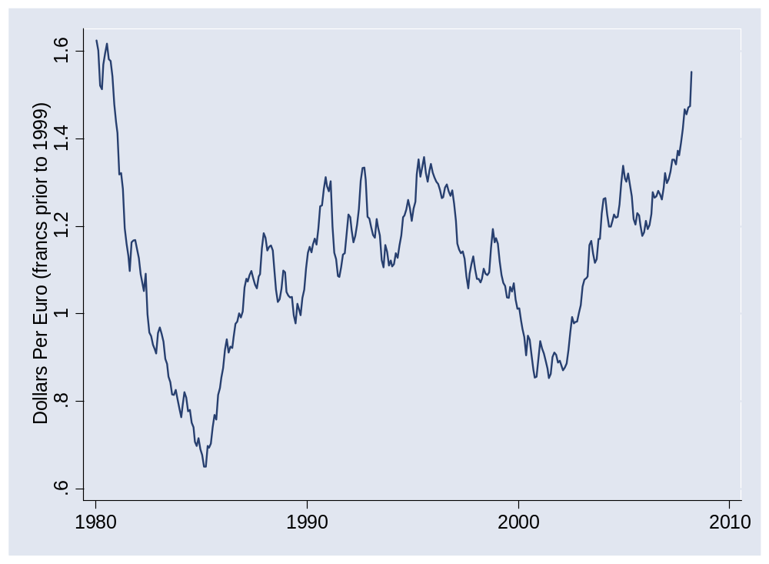
Dollars per euro

Slide 12
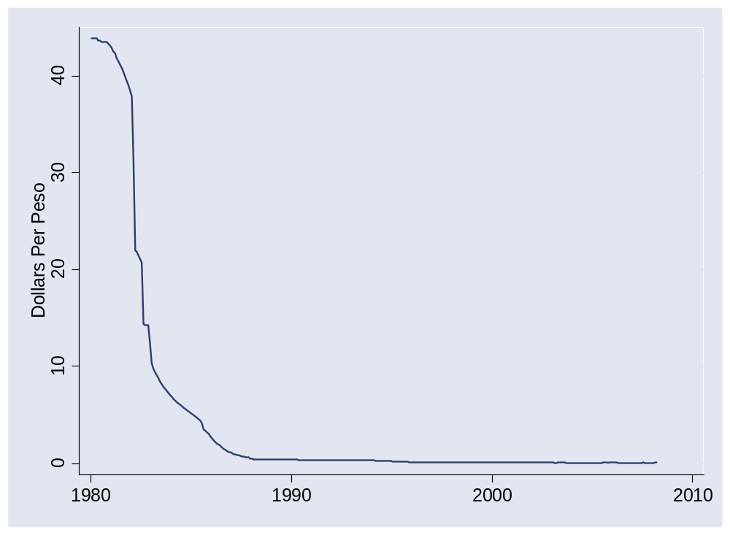
Dollars per peso

Slide 13
Quotes
Alan Greenspan:
  Having endeavored to forecast exchange rates for more than half a century, I have understandably developed significant humility about my ability in this area, a sentiment that I suspect many in this room share.
Link

Slide 14
Quotes
Bill Gross, PIMCO, 2004:
  If you think writing about the fortunes of the stock market is tricky, try getting your arms around currencies.
Link

Slide 15
Quotes
Warren Buffett, Letter to Shareholders, 2005:
  Berkshire owned about $21.4 billion of foreign exchange contracts at yearend, spread among 12 currencies. As I mentioned last year, holdings of this kind are a decided change for us. But the evidence grows that our trade [deficit] will put unremitting pressure on the dollar for many years to come.
Two years later, he closed out the positions. Shortly after that, the dollar fell against most currencies.

Slide 16
Quotes
Anonymous hedge fund manager:
  From time to time, the dollar's been very weak; from time to time, it's very strong. … Over the very very long term, currency processes tend to be fairly stable and mean-reverting. So the dollar's very weak today, but that's no reason to believe the dollar's going to be weak forever or that, because it's weak today, it's going to get dramatically weaker tomorrow. [But] it's amazing how many brilliant investors have gotten so much egg on their face trying to trade the G-7 crosses [currencies].
Link

Slide 17
Exchange rates and prices
Purchasing power parity
  If prices are lower in the country X than country Y, the value of X’ currency will fall to reduce the difference.
What we’ll find
  Poor short-term indicator, but common long-run “anchor”

Slide 18
Exchange rates and prices
Define
  P = domestic price (measured in domestic currency)
  P* = foreign price (measured in foreign currency)
  s = spot exchange rate (domestic currency price of one unit of foreign currency)
  NB: rise in s = fall in value of domestic currency
Comparing prices
  Expressed in the same units, the prices are P and sP*
  If they’re different, is there an arbitrage opportunity?

Slide 19
Exchange rates and prices
Region | USD Price of Big Mac (Jul 5 07)
US | 3.41
Euro Zone | 4.17
Japan | 2.29
China | 1.45
Brazil | 3.61
Argentina | 2.67
Mexico | 2.69
Is dollar weak or strong? Expected to rise or fall?
Source: The Economist.

Slide 20
Exchange rates and prices
Look at “average” prices
  P = domestic price index (measured in domestic currency)
  P* = foreign price index (measured in foreign currency)
  s = spot exchange rate (domestic currency price of one unit of foreign currency)
Comparing prices
  Expressed in the same units, the prices are P and sP*
  If they’re different, is there an arbitrage opportunity?
  If they’re different, should we expect s to adjust?

Slide 21
Exchange rates and prices
Nominal exchange rate: s
Real exchange rate
RER = s P*/P
Purchasing power parity (PPP):
RER = 1
sP* = P
If RER >1 [and sP* > P], will s fall?
  Yes, on average, but very slowly (half-way in 5+ years)

Slide 22
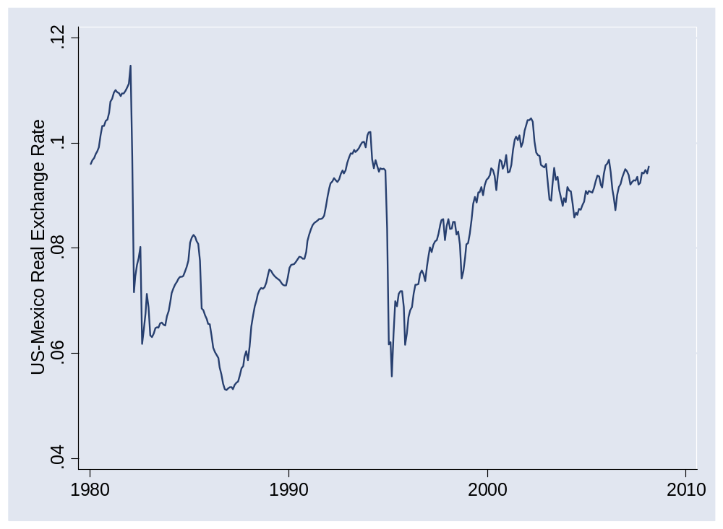
Exchange rates and prices

Slide 23
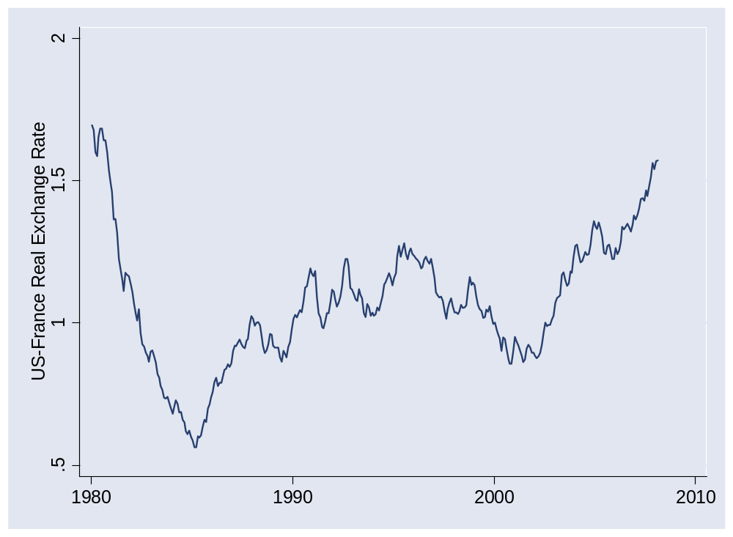
Exchange rates and prices

Slide 24
Dollars per euro

Slide 25
Exchange rates and prices
Summary
Dollar v euro/franc
  Little variation in P*/P
  Movements in s are therefore similar to those in sP*/P
Dollar v peso
  Large movements in P*/P reflected in opposite movements in s
  Still some movement in RER left

Slide 26
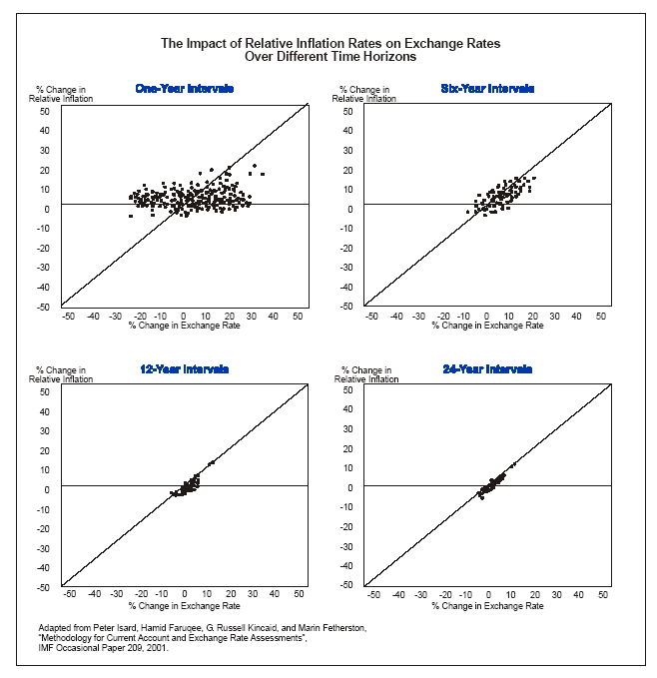
Exchange rates and prices
Source: Deutsche Bank guide.

Slide 27
Exchange rates and interest rates

Slide 28
Exchange rates and interest rates
Region | Money market rate
US | 2.08
Euro Zone | 4.74
Japan | 0.75
China | 4.50
India | 6.92
Brazil | 11.18
Mexico | 7.46
Why are rates different? Where would you invest?
Source: The Economist.

Slide 29
Exchange rates and interest rates
Define
  i = money market interest rate on domestic currency
  i* = money market interest rate on foreign currency
  s = spot exchange rate (domestic currency price of one unit of foreign currency)
Comparing returns
  We need to adjust the foreign return for capital gain or loss on currency
i* + (s_{t+1}– s_{t})/s_{t}

Slide 30
Exchange rates and interest rates
Do global capital markets equalize returns?
Return on a foreign-currency-denominated asset:
  Return in domestic currency = return in foreign currency + rate of change in exchange rate (depreciation rate):
  Return = i* + (s_{t+1}– s_{t})/s_{t}
  Excess Return = [i* + (s_{t+1}– s_{t})/s_{t}] – i
Do markets equalize expected returns? [We call this conjecture “uncovered interest parity”]
  If so: currency depreciation would offset interest rate
  No: high interest rate currencies do better, on average [On average they appreciate, not depreciate]
  Evidence coming

Slide 31
Exchange rates and interest rates
The “carry trade”
  Long position in high interest rate currency
  Short position in low interest rate currency
  Carry: positive net interest rate
  Risk: that currency will depreciate
Question: is risk worth it, on average?

Slide 32
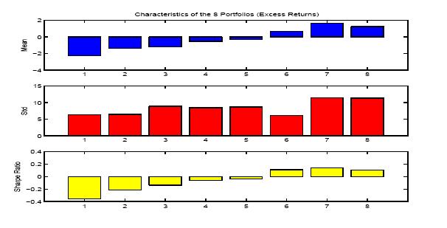
Exchange rates and interest rates
Portfolio strategy
  Rank currencies by short-term interest rate
  Sort into eight portfolios (low to high by rate)
  Compare excess returns in dollars
Source: Lustig and Verdelhan, NBER wp 11104.

Slide 33
Exchange rates and interest rates
Bottom line
  Currency changes do not compensate (on average) for interest differentials
  On average, high interest rate currencies appreciate
  Low R² (0.05 or so)
  Nevertheless: investments in high interest rate currencies have higher average returns (and some risk of currency fluctuations)

Slide 34
What have we learned?

Slide 35
Takeaways
Exchange rates remain largely inexplicable in short run
Nevertheless
  PPP is useful a long-term anchor
  The carry trade works – on average
FX volatility is a fact of life

Slide 36
After the break
Be prepared to discuss the Chinese renminbi
  Is it undervalued?
  How might we tell?

Slide 37
The Global Economy
Fixed Exchange Rates
© NYU Stern School of Business
Notes:
And how they come unfixed!

Slide 38
Chinese renminbi
Is it “undervalued”?
  What does this mean?
  How might we tell?
Notes:
IMF paper: http://www.imf.org/external/pubs/ft/wp/2006/wp06220.pdf
PBOC balance sheet: http://www.pbc.gov.cn/diaochatongji/tongjishuju/gofile.asp?file=2004S2.htm

Slide 39
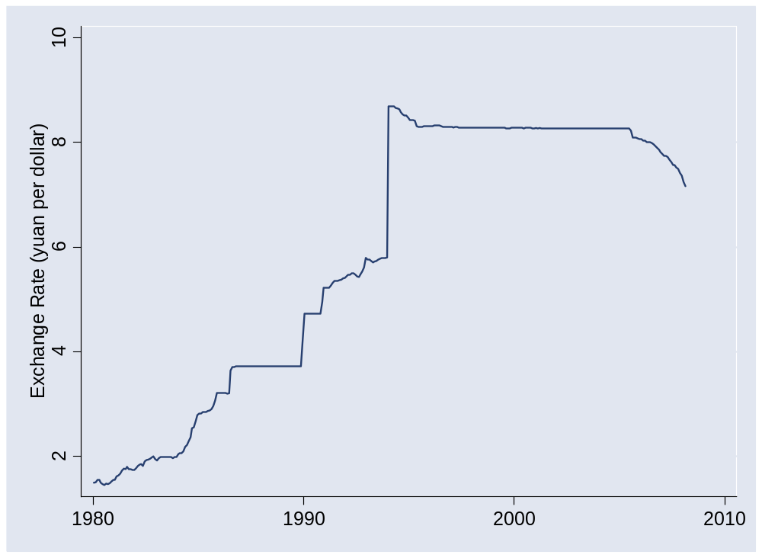
Chinese renminbi
Source: IMF, International Financial Statistics.

Slide 40
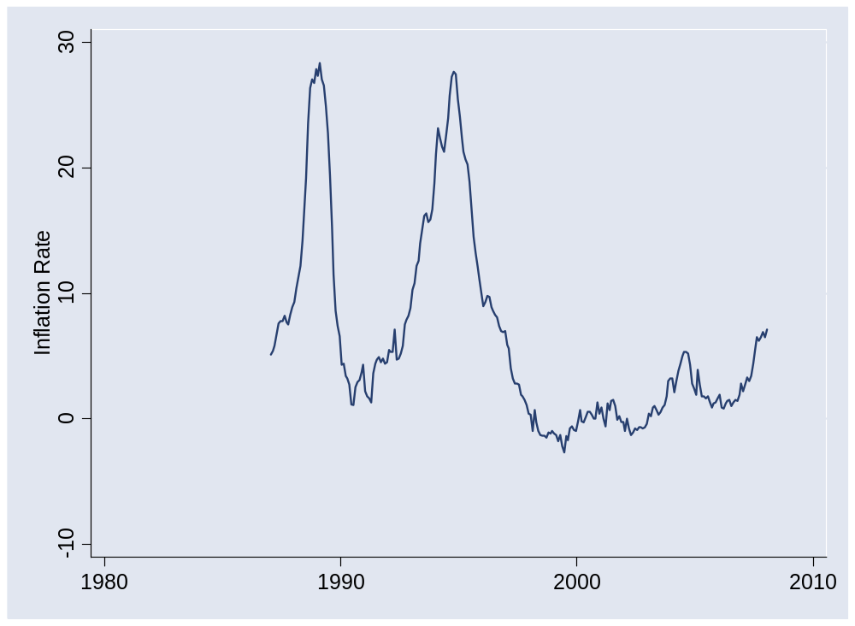
Chinese renminbi
Source: IMF, International Financial Statistics.

Slide 41
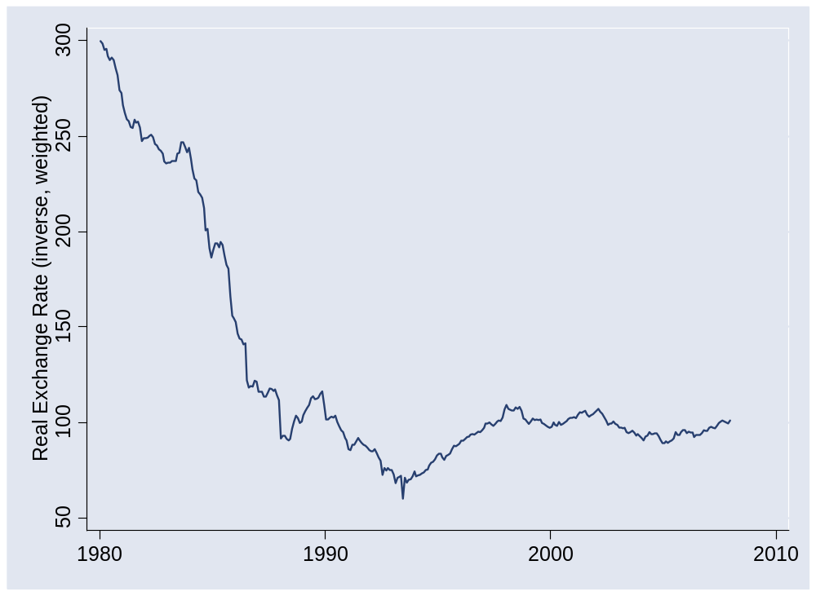
Chinese renminbi
Source: IMF, International Financial Statistics.

Slide 42
Chinese renminbi
Institutional issues
  Is currency “convertible”? [what does this mean?]
  Is PBOC “intervening”? [what does this mean?]
Notes:
IMF paper: http://www.imf.org/external/pubs/ft/wp/2006/wp06220.pdf
PBOC balance sheet: http://www.pbc.gov.cn/diaochatongji/tongjishuju/gofile.asp?file=2004S2.htm

Slide 43
Plan of attack
Is the renminbi undervalued? ✓
Convertibility in China and Mexico
Exchange rate systems
Reserve “mechanics”
Mexico and China again
What have we learned?

Slide 44
Convertibility
Convertibility
  We say a currency is convertible if people can trade it freely for foreign currency
Example: China
  Said to be convertible for current account transactions (imports and exports)
  Limited convertibility for capital/financial transactions (aka “capital controls”)
  Both require central bank approval

Slide 45
China: EIU reports
Financial inflows
  For direct investment, industries fall into four categories: prohibited, restricted, permitted, and encouraged. Extensive limitations remain on financial services, telecommunications, and many other sectors.
Financial outflows
  The government maintains relatively strict exchange controls. Convertibility on the capital account is not expected in the near future.

Slide 46
Mexico: EIU reports
Financial inflows
  Substantial liberalization since 1996. Investments still limited to 49% in ﬁshing, shipping, publishing, telecommunications, and some ﬁnance. Some exemptions for subsidiaries from countries with Mexican trade agreements. Constitutional restrictions on real estate.
Financial outflows
  Capital moves freely across Mexican borders. State retirement saving plan invests primarily in high-grade local debt, but up to 10% can be foreign.

Slide 47
Exchange rate systems
Common currency (EU, Panama)
Currency board (HK, Argentina < 00)
Fixed exchange rate (US < 71)
Crawling peg (Mexico < 95, China > 00)
Managed exchange rate (Brazil? Canada?)
Floating exchange rate (US?)
Increasing flexibility

Slide 48
Fixed exchange rates
How does central bank set the rate? [How is any price set? Think: EU’s CAP.]

Slide 49
Reserves
Holdings of foreign currency by central bank

Slide 50
Reminder: money supply mechanics
Treasury
Assets |  | Liabilities
 |  | Bonds | 200
How does central bank increase money supply?
Central bank
Assets |  | Liabilities
Bonds | 20 | Money | 20
Households & firms (everyone else)
Assets |  | Liabilities
Money | 20
Bonds | 180

Slide 51
Reserve mechanics
Treasury
Assets |  | Liabilities
 |  | Bonds | 200
What is FX?
How does bank maintain currency?
What if people sell foreign currency?
What if people buy foreign currency?
What if central bank runs out?
Central bank
Assets |  | Liabilities
Bonds | 10 | Money | 20
FX reserves | 10
Households & firms (everyone else)
Assets |  | Liabilities
Money | 20
FX | 50
Bonds | 190

Slide 52
Reserve mechanics
Treasury
Assets |  | Liabilities
 |  | Bonds | 200
How does selling FX affect money supply?
How can we offset this impact?
“Sterilization”
Central bank
Assets |  | Liabilities
Bonds | 10 | Money | 20
FX reserves | 10
Households & firms (everyone else)
Assets |  | Liabilities
Money | 20
FX | 50
Bonds | 180

Slide 53
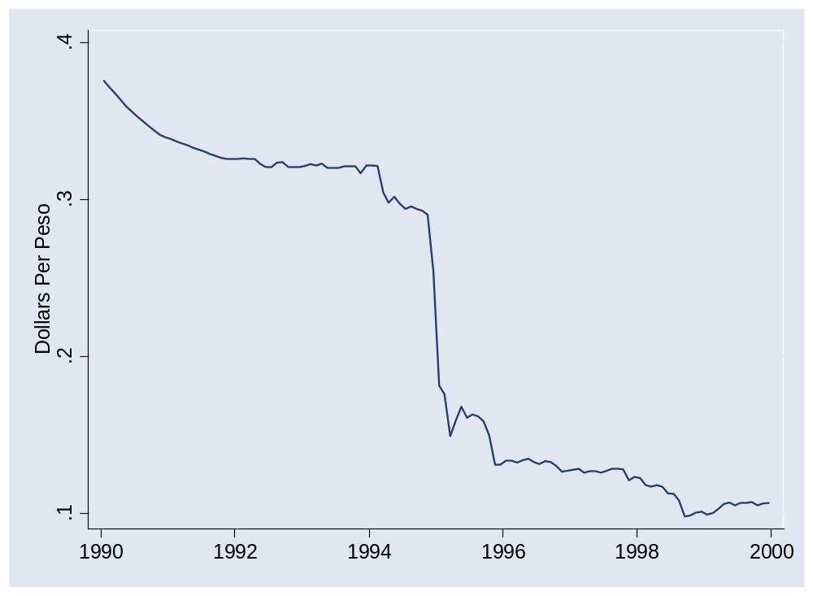
Mexico in 1994
What happened here?

Slide 54
China
Could it run out of reserves?
What’s happening there?

Slide 55
What have we learned?

Slide 56
Takeaways
Fixed exchange rates require “support”
  Buy and sell at official price
  Or limit “convertibility”
They also blow up on occasion

