Slide 1

The Global Economy
Production
© NYU Stern School of Business
Notes:
Intro
Start spreadsheet
Move around, ask new people
Open IE with Bb, Gapminder, CIA (just in case)
Ask students for comments on countries: why successes?
Hand signals
Two hands = important point
Point up = louder
Faster, Timeout
Two hands out = what on earth are you talking about?

Slide 2
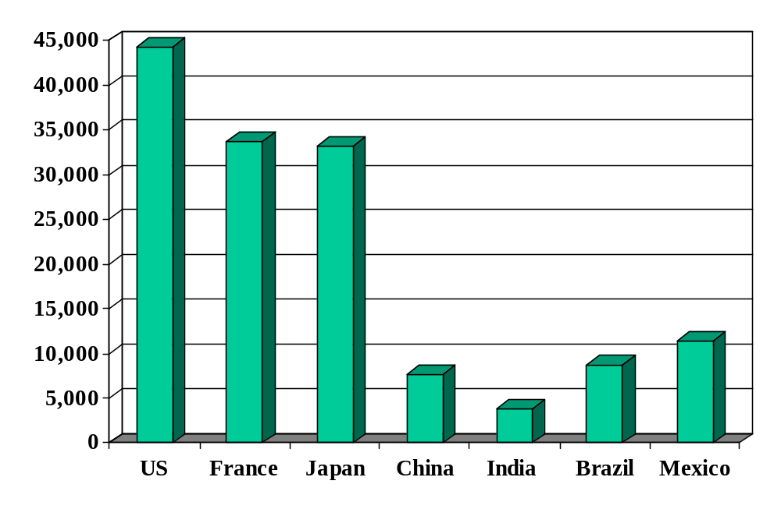
GDP per capita (2006, US dollars, PPP adj)
How did we get here?
Source: World Bank, World Development Indicators.
Notes:
Set up the class: why such large differences? Where did they come from?

Slide 3
About participation
Don’t panic – if you’re not comfortable, say so
Contributions to discussion board count
Be brief
If you’ve made a comment, others get priority
Use your nameplate
Hand signals
Notes:
Aim for 100% participation – 40% last week.

Slide 4
Country reports
International students (and others with extensive international experience)
  What has your country done to encourage economic growth?
  What else do you think it should do?
Notes:
15 minutes total
Consolidate at the end: what have we learned?

Slide 5
Plan of attack
Country reports ✓
About the course
GDP review
World history and pictures
Theory: the production function
  Capital and labor inputs
  Productivity (the infamous “TFP”)
High wages: good or bad?

Slide 6
About groups
Try to include someone you don’t know
Aim for 5, 6 doable
Divide and add?
Meet at break? After class? Use “personals”?
Notes:
Questions?

Slide 7
About the course
Theme: economic performance of countries
First half: long-run performance
  Why is GDP per capita lower in India than France?
  Why are China and India growing so rapidly?
  What are the business opportunities and challenges?
Second half: short-run performance
  How does [country name] look over the next year?
  What are the business opportunities and challenges?

Slide 8
About the course
Long-Run Performance
Production, Saving & Investment, Productivity, Institutions, Capital & Labor Markets, International Trade
First half:
Short-Run Performance
Inflation, Business Cycle Indicators, Monetary Policy, Taxes & Deficits, Exchange Rates, Capital Flows, Emerging Market Crises
Second half:

Slide 9
About today’s class
GDP
Capital & Labor
Productivity
Political Process
“Institutions”

Slide 10
About GDP
GDP: Gross Domestic Production
  Total value of production in a given geographic area
Nominal GDP
  GDP at current prices
  Changes over time from both quantities and prices
Real GDP (today’s focus)
  GDP at constant prices (eg, 2000 US dollars)
  Impact of price changes taken out
GDP price deflator
  = Nominal GDP / Real GDP

Slide 11
World history
Statistic | Year 0 | 1000 | 1820 | 1998
Population (millions) | 231 | 268 | 1,041 | 5,908
GDP Per Capita | 444 | 435 | 667 | 5,709
Life expectancy | 24 | 24 | 26 | 66
Source: Maddison, Millennial Perspective, OECD, 2001, Tables 1-2, 1-5a.
Notes:
Prior to 1500 or so: life was “poor, nasty, brutish, and short” (Thomas Hobbes, Leviathan, 1651)
Draw pix on board
Temporary ups and downs from natural disasters, war…

Slide 12
GDP per capita (1990 US$)
Region | Year 0 | 1000 | 1820 | 1998
Western Europe | 450 | 400 | 1,232 | 17,921
Western offshoots | 400 | 400 | 1,201 | 26,146
Japan | 400 | 425 | 669 | 20,413
Latin America | 400 | 400 | 665 | 5,795
E Europe + “USSR” | 400 | 400 | 667 | 4,354
Asia (excl Japan) | 450 | 450 | 575 | 2,936
Africa | 425 | 416 | 418 | 1,368
World Average | 444 | 435 | 667 | 5,709
Source: Maddison, Millennial Perspective, OECD, 2001, Table 1-2.
Notes:
Offshoots = US + Canada + Australia + NZ
Note: Some grew, others didn’t. But it’s not true that growth by some was associated with shrinkage by others.

Slide 13
Share of world GDP (%)
Region | 1000 | 1820 | 1950 | 1998
Western Europe | 8.7 | 23.6 | 26.3 | 20.6
Western offshoots | 0.7 | 1.9 | 30.6 | 25.1
Japan | 2.7 | 3.0 | 3.0 | 7.7
Latin America | 3.9 | 2.0 | 7.9 | 8.7
E Europe + “USSR” | 4.6 | 8.8 | 13.1 | 5.3
Asia (excl Japan) | 67.6 | 56.2 | 15.5 | 29.5
Africa | 11.8 | 4.5 | 3.6 | 3.1
World | 100.0 | 100.0 | 100.0 | 100.0
Source: Maddison, Millennial Perspective, OECD, 2001, Table 3-1c.
Notes:
Offshoots = US + Canada + Australia + NZ

Slide 14
World history
One-minute history of the world
Why Western Europe?
Why not China, India, Arab world?
What will the future bring?

Slide 15
Catch your breath
Can we make sense of large differences in GDP per capita?
What do they mean for someone running a business?
What do they mean for Bono or Bill Gates?
Notes:
Stretch….

Slide 16
Production
How are things produced?
What are the inputs? The outputs?
Production function
  A theoretical concept to organize our thoughts

Slide 17
Production function: picture
GDP
Capital & Labor
Productivity

Slide 18
Production function: math
Idea: relate output to inputs
Mathematical version:
Y = A F(K,L)
= A K^{α} L^{1-α} (“Cobb-Douglas”)
Definitions:
  K = quantity of physical capital used in production (plant and equipment)
  L = quantity of labor used in production
  A = total factor productivity (everything else)
  α = 1/3 (take my word for it)

Slide 19
Production function: properties
More inputs lead to more output
  Positive marginal products of capital and labor
Diminishing marginal products
  If we increase one input, each increase leads to less additional output
Constant returns to scale
  If we double both inputs, we double output
Notes:
Write out MPL …

Slide 20
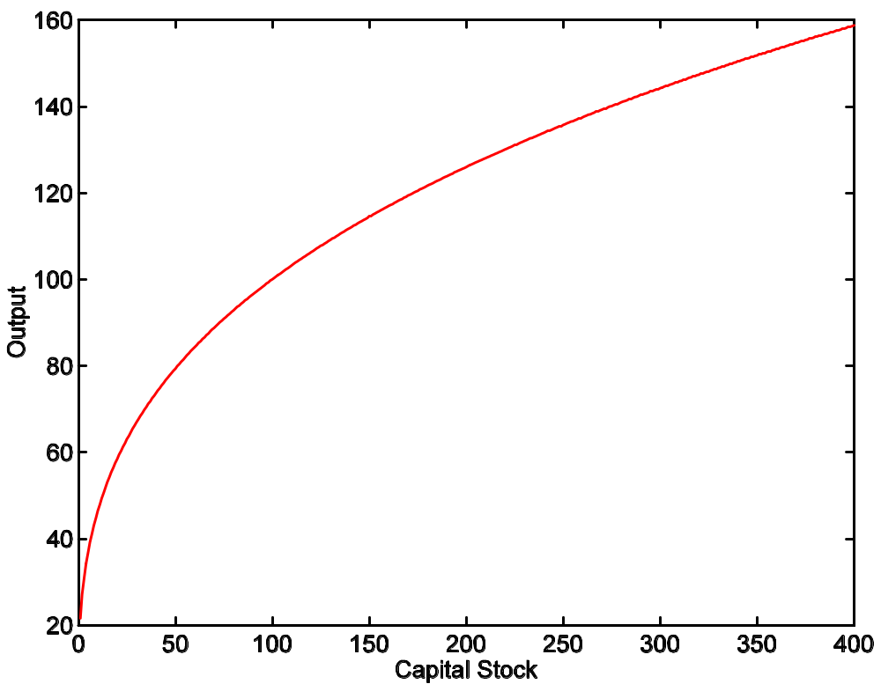
Production function: properties
A = 1
L = 100
α = 1/3

Slide 21
Capital
Meaning: physical capital used in production (capital input, plant and equipment)
Why does it change?
  Depreciation/destruction
  New investment (“capex”)
Mathematical version:
K_{t+1} = K_{t} – δ_{t}K_{t} + I_{t}
= (1 – δ_{t})K_{t} + I_{t}
Adjustments for quality?

Slide 22
Capital measurement
Option #1: direct surveys of plant and equipment
Option #2: perpetual inventory method
  Pick an initial value K₀ (survey?)
  Pick a depreciation rate (or measure depreciation directly)
  Measure K like this:
K_{t+1} = (1 – δ_{t})K_{t} + I_{t}
In practice, #2 is the norm:
  Get I from NIPA
  Set δ = 0.06 [ballpark number]
  Example: K₂₀₀₄ = 100, δ = 0.06, I = 12 → K₂₀₀₅ = 106

Slide 23
Labor
Meaning: units of labor used in production (labor input)
Why does it change?
  Population growth
  Fraction of population employed, hours worked, changes in skill
Basic measure: L = number of workers (employment)
Adjustments for quality? Quantity?
  Skill: education? other? [H = “human capital”]
  Hours: often not available [h = hours]
  Leads to an “augmented production function”:
Y = A F(K,hHL) = A K^{α} (hHL)^{1-α}

Slide 24
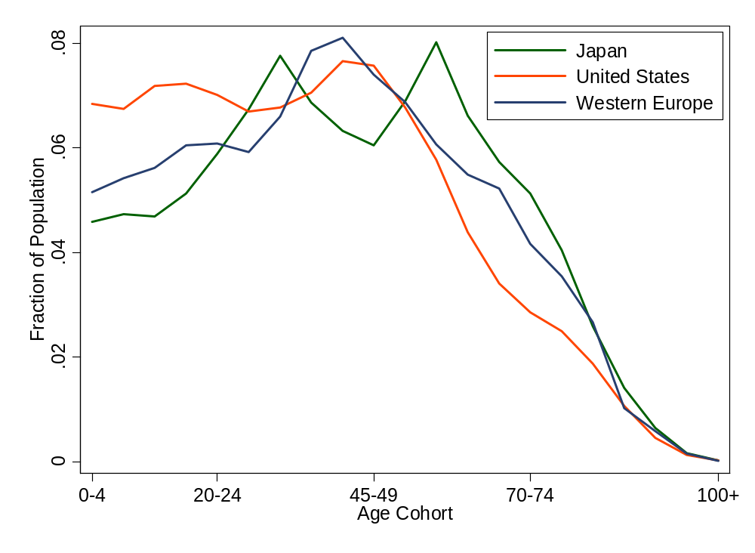
Age distribution
Source: UN Population Information Network.

Slide 25
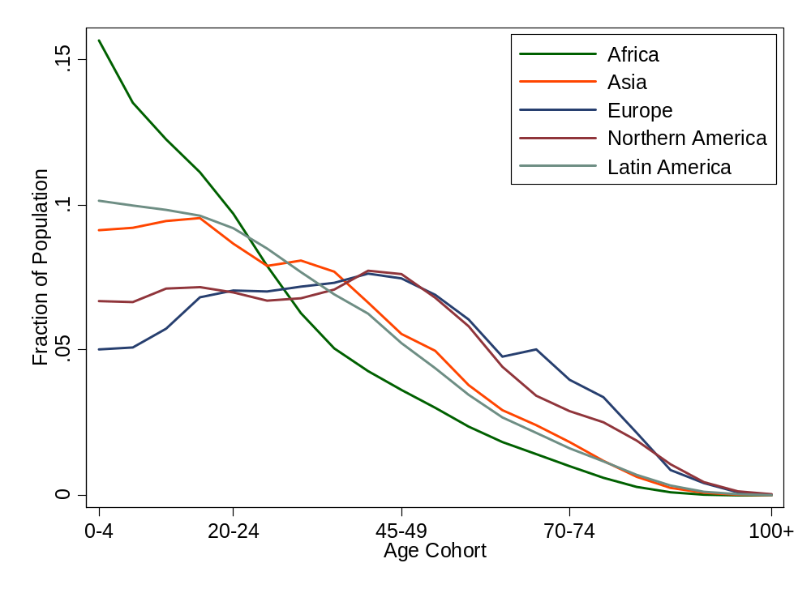
Age distribution
Source: UN Population Information Network.

Slide 26
Productivity and “TFP”
“Labor productivity”
  Average product of labor: Y/L = A (K/L)^{α}
Marginal product of labor
  Differentiate with respect to L:
  ∂Y/∂L = A K^{α} (1-α) L^{-α} = (1-α) A (K/L)^{α}
Our number:
  Total Factor Productivity: Y/F(K,L) = Y/[K^{α} L^{1-α}]

Slide 27
“Measuring” “TFP”
We “measure” it indirectly
Solve the production function for A:
  Y = A K^{α} L^{1-α}
  A = Y/[K^{α} L^{1-α}] = (Y/L)/(K/L)^{α}
Example (US): Y/L = 33, K/L = 65:
A = 33/65^{1/3} = 8.21
Comments
  Any mistakes will be absorbed in A
  Solow: “a measure of our ignorance”

Slide 28
Production function summary
Remember: Y = A F(K,L)
What changes in this equation if
  A firm builds a new factory?
  The US reinstitutes a mandatory retirement age of 65
  Nintendo designs and produces a superior Wii?
  Workers shift from agriculture to industry in Viet Nam?
  France makes employment more attractive to employers?
  Dubai makes a massive infrastructure investments?
  Venture capital fund identifies good unfunded projects?
  Alaska builds a bridge to nowhere?

Slide 29
High wages
Good or bad? (For whom?)

Slide 30
GDP per capita revisited
GDP per worker
    Y/L = A (K/L)^{α}
Where does GDP per capita come from?
    Y/POP = (L/POP) (Y/L)
    = (L/POP) A (K/L)^{α}
Reasons for high GDP per capita:
  More work: L/POP
  More productivity: A
  More capital: K/L
  Not present but could be added: skill H or hours worked h

Slide 31
What have we learned?

Slide 32
Takeaways
The production function links output to inputs and productivity:
Y = A K^{α} L^{1-α}
Capital input (K):
  Plant and equipment, a consequence of investment (I)
Labor input (L):
  Population growth, age distribution, participation
  Could add skill (H) or hours per person (h)
TFP (A) is everything else
  can be inferred from data on output and inputs

Slide 33
At the break
Meet up front if you are looking for a new group or new members of your current group

Slide 34
After the break
Be prepared to discuss
  Problem 3 of Group Project #1
  Yield curve: Why long rates rose recently
  World poverty: Why it has fallen sharply since 1990
  Immigration: Good or bad? Why does it happen?

Slide 35
The Global Economy
Capital Accumulation
© NYU Stern School of Business
Notes:
Start gapminder: growth v GDP per capita
Start spreadsheet (Solow)
Use China and India as the example. Is s a big deal?

Slide 36
Current issues
Yield curve in the recent past (Jan 17 to Jan 30):
  Fed funds target lowered 125 bps (“overnight”)
  1-month treasuries down 114 bps
  10-year treasuries UP 12 bps
  10-year TIPS flat
  See FRED: http://research.stlouisfed.org/fred2/
Comments from Jack Grady and Shun-ning (Shaun) Wong
What’s going on?

Slide 37
Current issues
From Manuel Navas: “The world’s silver lining,” The Economist, Jan 24 08:
  In China 25 years ago, over 600m people—two-thirds of the population—were living in extreme poverty (on $1 a day or less). Now, the number on $1 a day is below 180m. In the world as a whole, a stunning 135m people escaped dire poverty between 1999 and 2004.
Why did extreme poverty fall so dramatically?
Link

Slide 38
Current issues
From Lydia Midwood: “Bedsheets and vodka,” The Economist, Jan 3 08:
  FOR the past two decades, high rates of immigration into OECD countries have coincided with prolonged economic growth. Consider Cobh, a bustling tourist town in southern Ireland. … Now, like the rest of Ireland, Cobh heaves with foreign workers. There are Poles on building sites, Latvians who own a shop selling dumplings and sauerkraut, a South African in the tourist office, Chinese in restaurants, a Bangladeshi managing a fishing business, and so on.
Is this good or bad? What causes it?
Link

Slide 39
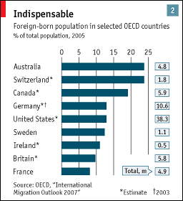
Current issues

Slide 40
Plan of attack
Current economic and business issues ✓
Group Projects
Where we’ve been, where we’re headed
The Solow model
  How important are saving and investment?
  India
Does China invest too much?
What’s coming up

Slide 41
Group Project #2
Treat as the business problem it claims to be
Make it look professional
Looks toward the next class
Does not use what we’ve done in class – but you’re still capable of doing good work
Use the materials suggested
See or email me if you have questions
Notes:
Questions?

Slide 42
Group Project #2
Builds a useful career skill: business judgment and communication
5-page limit intended to force you to prioritize
Projects 5, 6, and Final Project develop same skill
Notes:
Questions?

Slide 43
Group Project #1
Exercise designed to apply the concepts covered in “Notes on Measurement.”
Answers will be posted shortly
Notes:
Questions?

Slide 44
Group Project #1
Problem 3
  Why difference in saving/investment rates?
  Why difference in net exports?
Notes:
Foreshadows this class

Slide 45
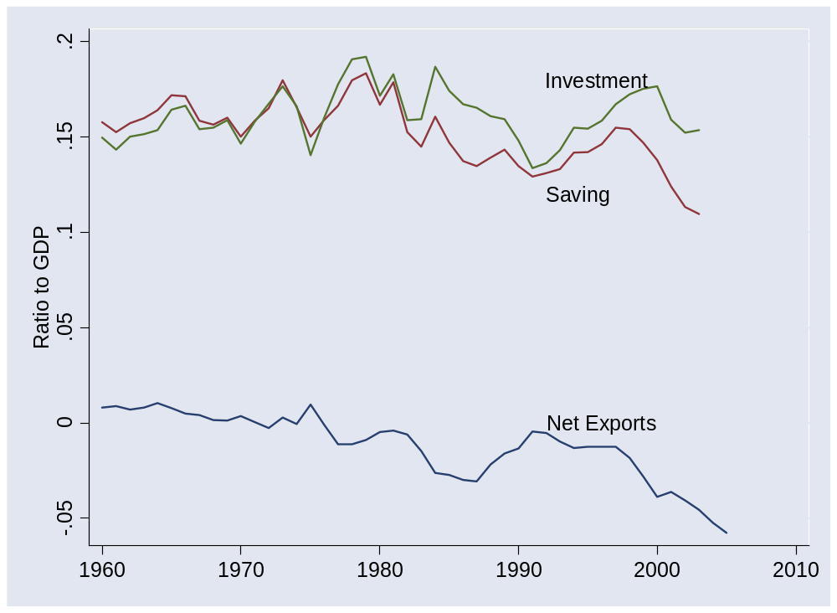
Group Project #1 (US)
Notes:
Foreshadows this class

Slide 46
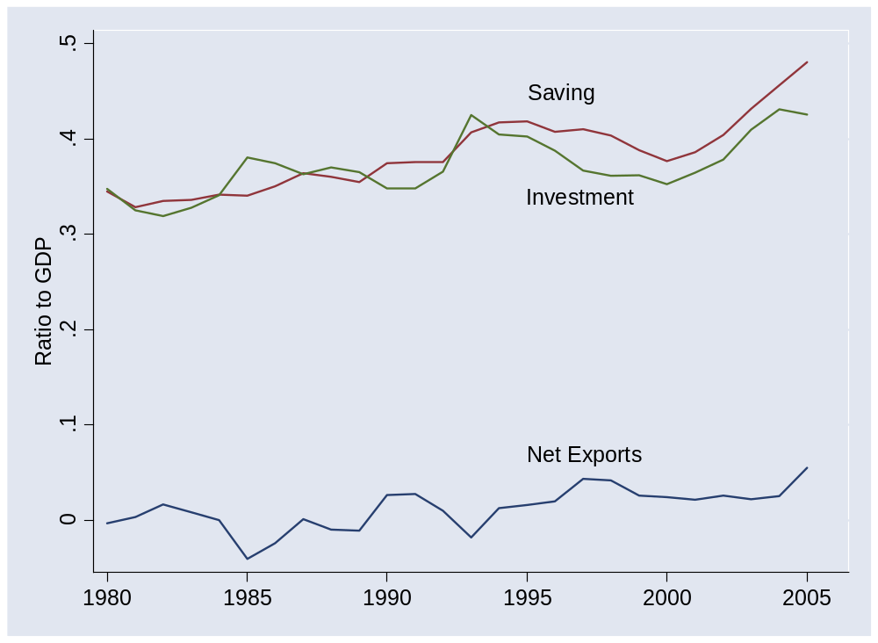
Group Project #1 (China)
Notes:
Foreshadows this class

Slide 47
Where we’ve been
Production function
Y = A K^{α} L^{1-α}
  Y is GDP
  A is “total factor productivity” or TFP
  K is capital (plant and equipment)
  L is number of workers (or perhaps a more refined measure of the “labor input”)
All measurable, either directly (Y,K,L) or indirectly (A)

Slide 48
Where we’re headed
Long-Run Performance
Production, Saving & Investment, Productivity, Institutions, Capital & Labor Markets, International Trade
First half:
Short-Run Performance
Inflation, Business Cycle Indicators, Monetary Policy, Taxes & Deficits, Exchange Rates, Capital Flows, Emerging Market Crises
Second half:

Slide 49
Where we’re headed
GDP
Capital & Labor
Productivity
Political Process
“Institutions”

Slide 50
Where we’re headed
How important are saving and investment to growth?
Notes:
Solow stories

Slide 51
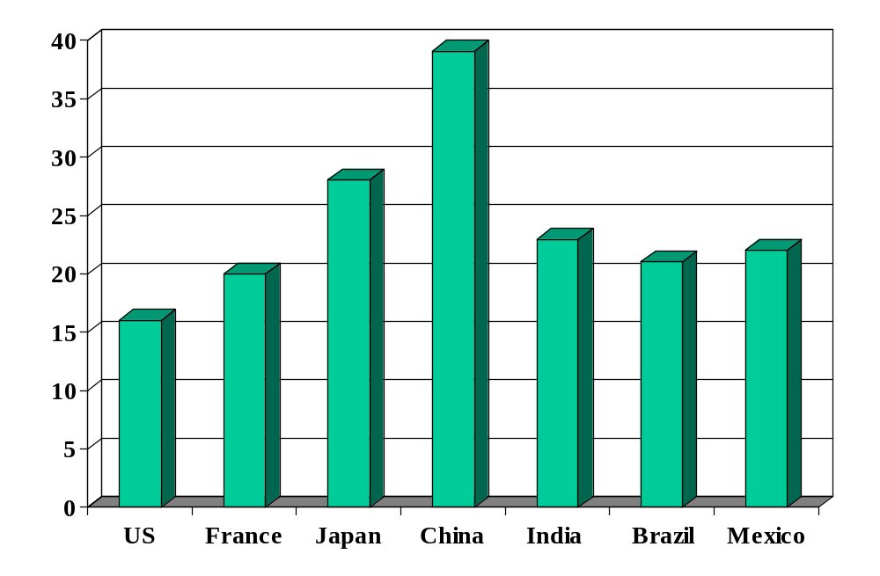
Investment rates (% of GDP)
Source: International Financial Statistics, averages for 1990-present.

Slide 52
Solow model
Quantitative tool for thinking about growth
Used to extrapolate current trends in a sensible way
  How large will China and India be in 2050?
Focus on saving and investment
Conclusion: adding capital can’t produce high growth on its own
  Diminishing returns to capital in production function
Don’t sweat the details

Slide 53
Solow model: overview
Production function:
Y = A K^{α} L^{1-α}
Flow identity:
I = S
Saving:
S = sY
Capital stock:
ΔK = I – δK
Notes:
Write on board, look at spreadsheet

Slide 54
Solow model: India
Inputs:
  GDP in 2003: 3139b (2000 USD)
  Capital: 3683b
  Labor force: 467m
  TFP: compute from above
  Saving and investment rate: 0.20
  Depreciation rate: 0.06
  Labor force growth: 0.00 (for comparison purposes)
  TFP growth: 0.05

Slide 55
Solow model: India
Comparisons
  No labor or TFP growth
  Higher saving/investment rate [how large an impact?]
  Higher TFP growth [how large an impact?]

Slide 56
Solow model: India
Estimated GDP | GDP
2003 | 3,139
2050: no-growth benchmark | 5,030
2050: higher saving (+5%) | 5,591
2050: TFP growth (2%) | 17,188
2050: TFP growth (+1%) | 31,851
Notes:
US in 2050: 27 trillion (ballpark)

Slide 57
India
Is relative shortage of capital important?

Slide 58
Does China save/invest too much?
How would we judge that?
What investment rate is needed to maintain K/Y?
  K and Y grow at rate g
  Given depreciation, how must investment rate vary with g?
Numbers
  Target: K/Y = 2 (typical number)
  Set δ = 0.06 (ditto)
  Compare: g = 0.03 and g = 0.08
In words: a fast-growing country needs a high investment rate just to keep up

Slide 59
What have we learned?

Slide 60
Takeaways
Solow model
  Growth comes from saving-financed increases in capital
  Conclusion: capital can’t be the key to growth
  Value: tool for exploring future growth of emerging economies
What are we missing?
  TFP growth

Slide 61
What’s coming up
Read notes before next class
  Content is both important and demanding
  Important input to midterm exam
  You’ll be lost if you don’t

Slide 62
What’s coming up
Ben Druskin, Citigroup, 10:30-12 next Tuesday
  Ben is a Managing Director and Head of Global Services and East Coast Technology Investment Banking at Citigroup. He joined Citigroup in 1993 and has been a member of the Technology Investment Banking Group since 1996. Ben received an MBA from the Stern School of Business at New York University and a BA from Rutgers College.
Harish Hulyarkar, ditto
  Harish joined Citi’s Investment Banking team in Mumbai in 2002. He helped set up Citi’s captive offshore analytics unit supporting offices in New York, London, and Hong Kong. In New York, he has focused on the offshore IT services/BPO space. Harish has an undergraduate degree in Commerce from the University of Mumbai and an MBA from the ISB.

