Slide 1

The Global Economy
Sources of Growth
© NYU Stern School of Business
Notes:
Open spreadsheet for calculations
Why are some countries richer than others? Why do some grow faster than others?
How do the business conditions vary?
US, Africa, China…

Slide 2
Easterly on Africa
Bill Easterly, “Bill Gates hates my book,” WSJ, Feb 7 08:
  The parts of the world that are still poor are suffering from too little capitalism. The environment for private business in Africa is still hostile. There are some industry and country success stories in Africa, but not enough.
Fact or propaganda? Do you agree or disagree?
Notes:
Cold calls: share, pair?

Slide 3
Easterly on Africa
Gaurav Mehta comments:
  A related article cites the “2008 Index of Economic Freedom” in which India and China’s respective positions are 115 and 126, while Ghana is 94.
  The Index also reports that the freest 20% of the world's economies have twice the per capita income of those in the second quintile and five times that of the least-free 20%. In other words, freedom and prosperity are highly correlated.
On the first: what do we make of it?
On the second: ditto.
Notes:
Cold calls: share, pair?

Slide 4
Plan of attack
Easterly on Africa ✓
Where we’re headed
Pictures
Growth accounting:
  A tool for quantifying sources of growth
  Applications to many countries
What have we learned?

Slide 5
Where we’re headed
Long-Run Performance
Production, Saving & Investment, Productivity, Institutions, Capital & Labor Markets, International Trade
First half:
Short-Run Performance
Inflation, Business Cycle Indicators, Monetary Policy, Taxes & Deficits, Exchange Rates, Capital Flows, Emerging Market Crises
Second half:

Slide 6
Where we’re headed
GDP
Capital & Labor
Productivity
Political Process
“Institutions”

Slide 7
Pictures
100+ year perspective
What’s going on?

Slide 8
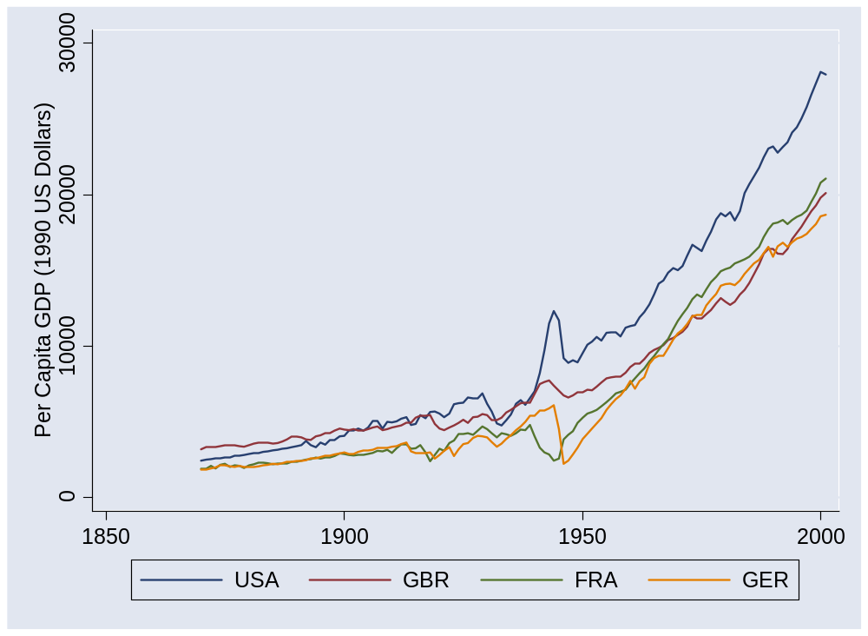
US and Europe
Source: Maddison, Historical Statistics, OECD.

Slide 9
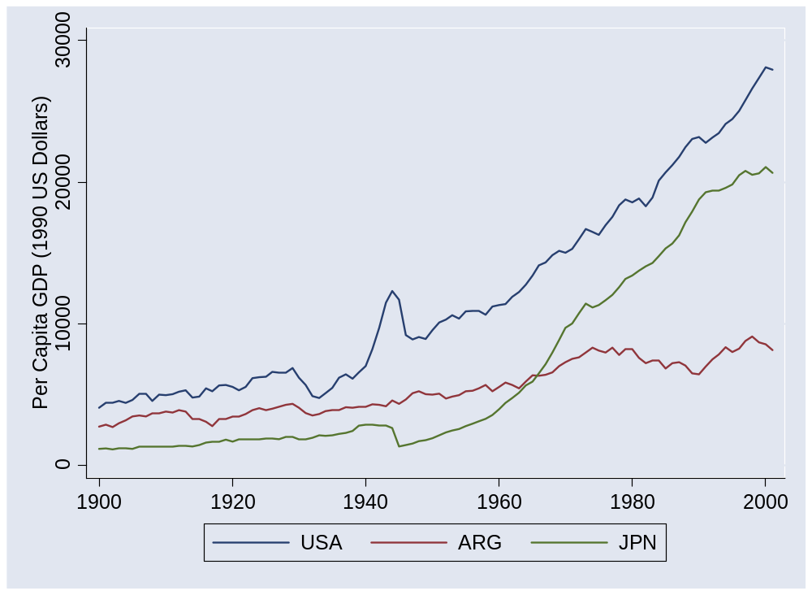
Argentina and Japan
Source: Maddison, Historical Statistics, OECD.

Slide 10
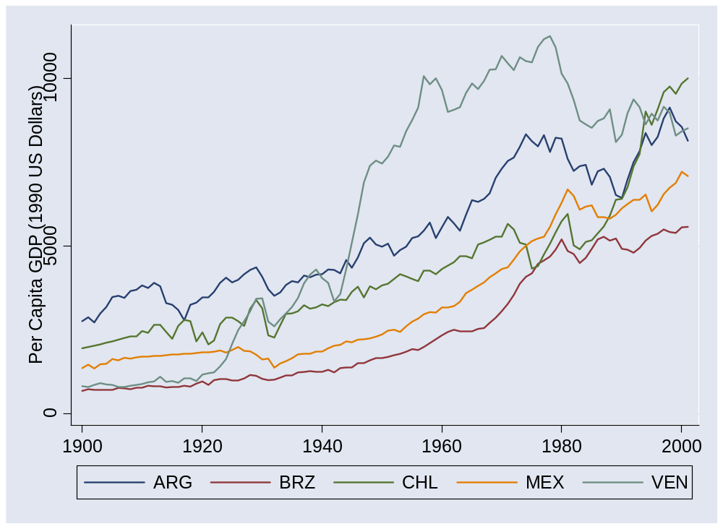
Latin America
Source: Maddison, Historical Statistics, OECD.

Slide 11
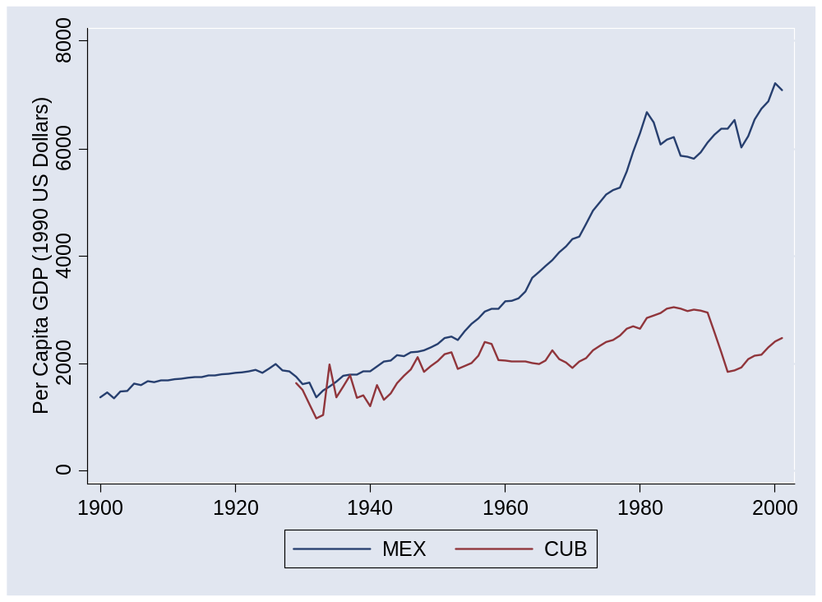
Mexico and Cuba
Source: Maddison, Historical Statistics, OECD.

Slide 12
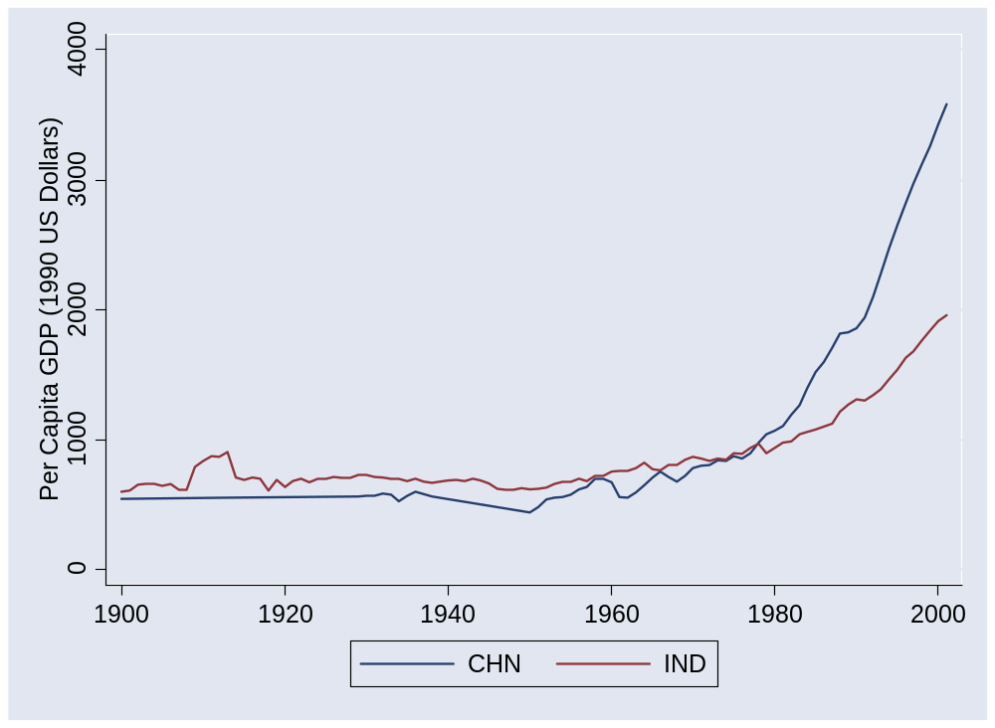
China and India
Source: Maddison, Historical Statistics, OECD.

Slide 13
Pictures
50+ year perspective
What’s going on?

Slide 14
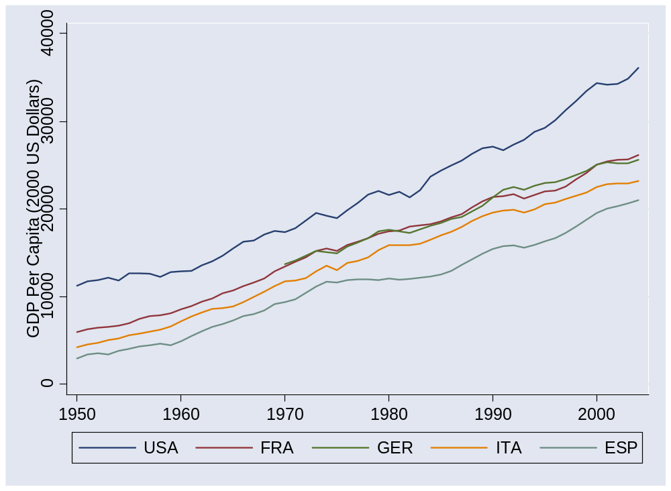
Europe (post 1950)
Source: Penn World Tables, version 6.2.

Slide 15
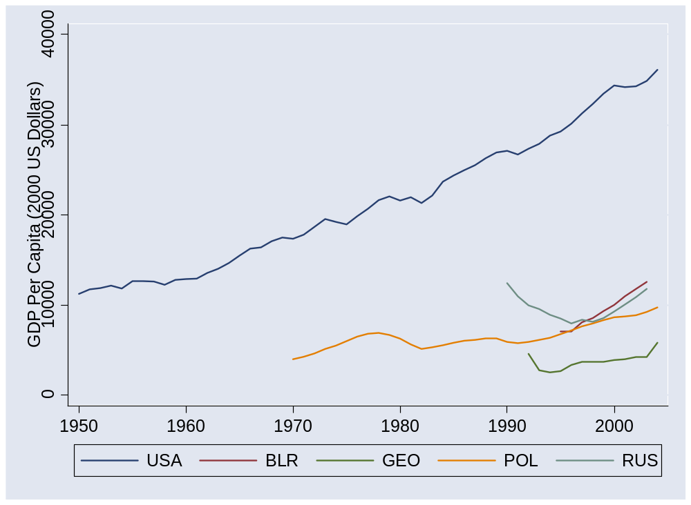
Former Soviet bloc
Source: Penn World Tables, version 6.2.

Slide 16
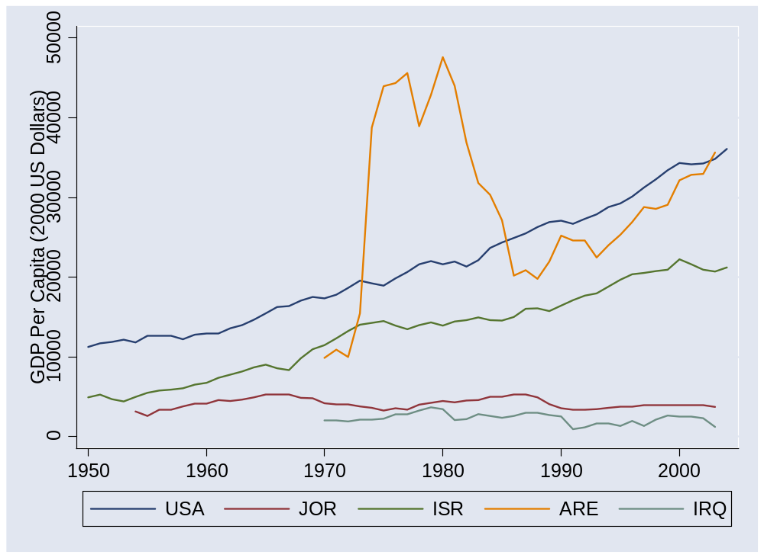
Middle East
Source: Penn World Tables, version 6.2.

Slide 17
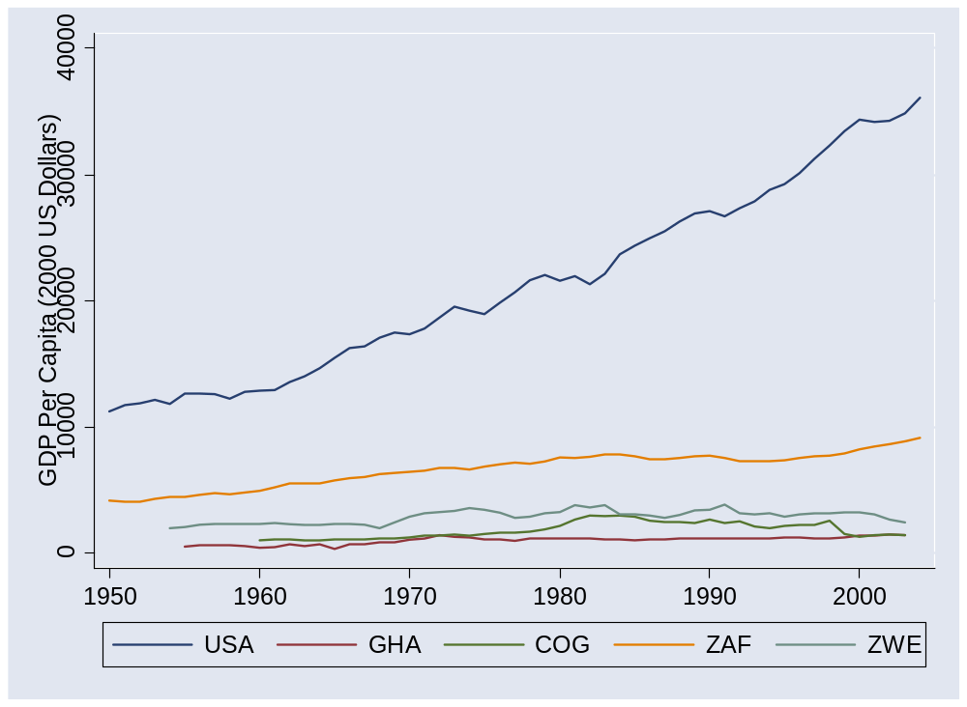
Africa 1
Source: Penn World Tables, version 6.2.

Slide 18
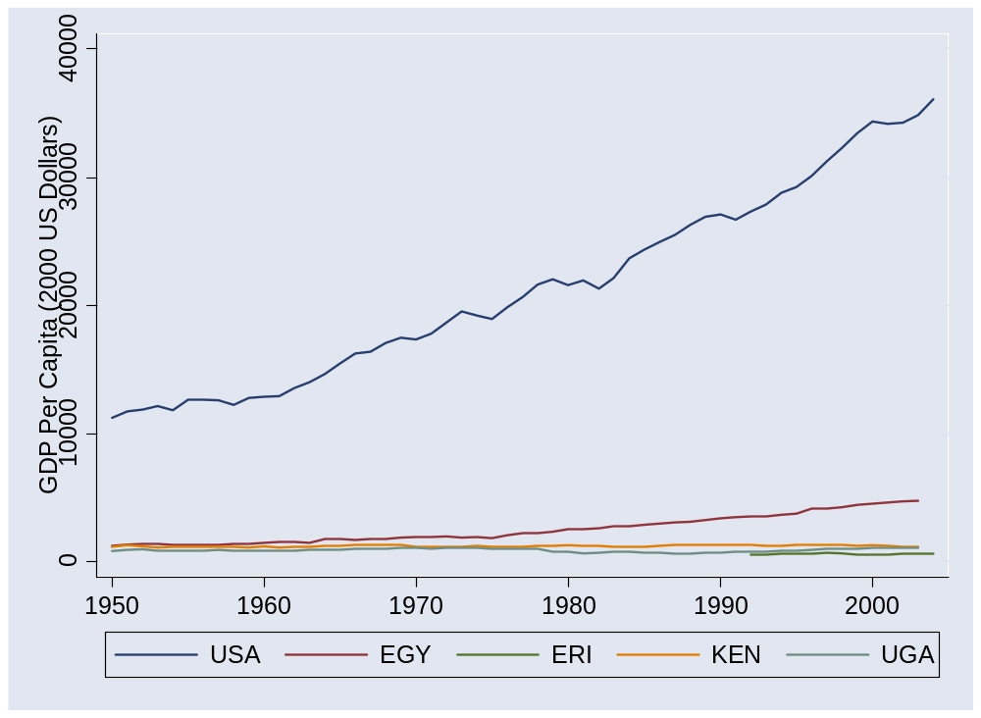
Africa 2
Source: Penn World Tables, version 6.2.

Slide 19
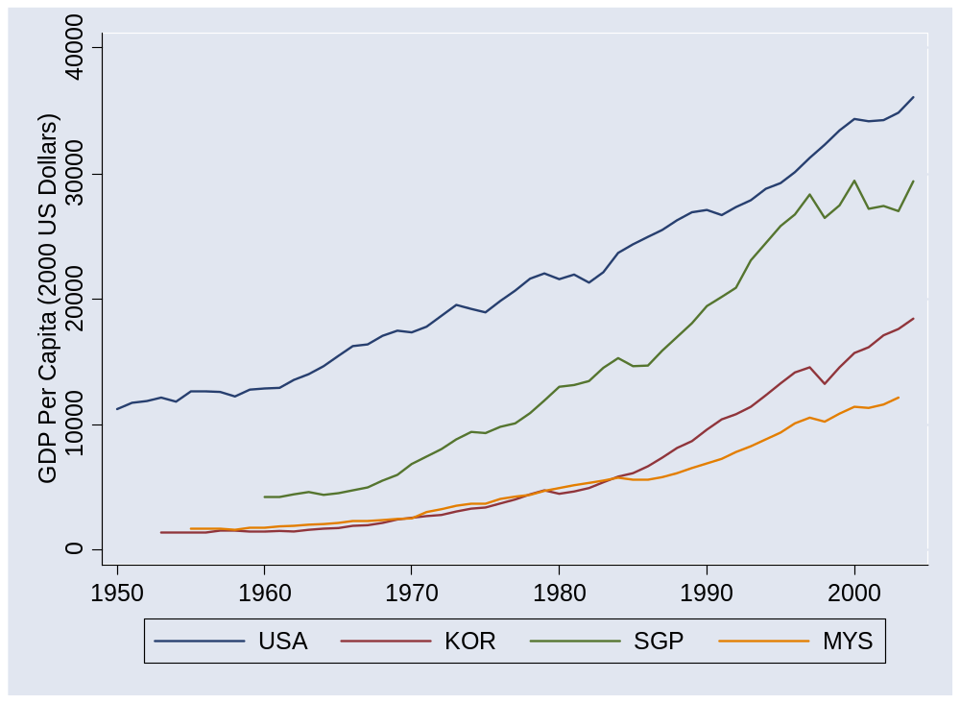
Asia 1
Source: Penn World Tables, version 6.2.

Slide 20
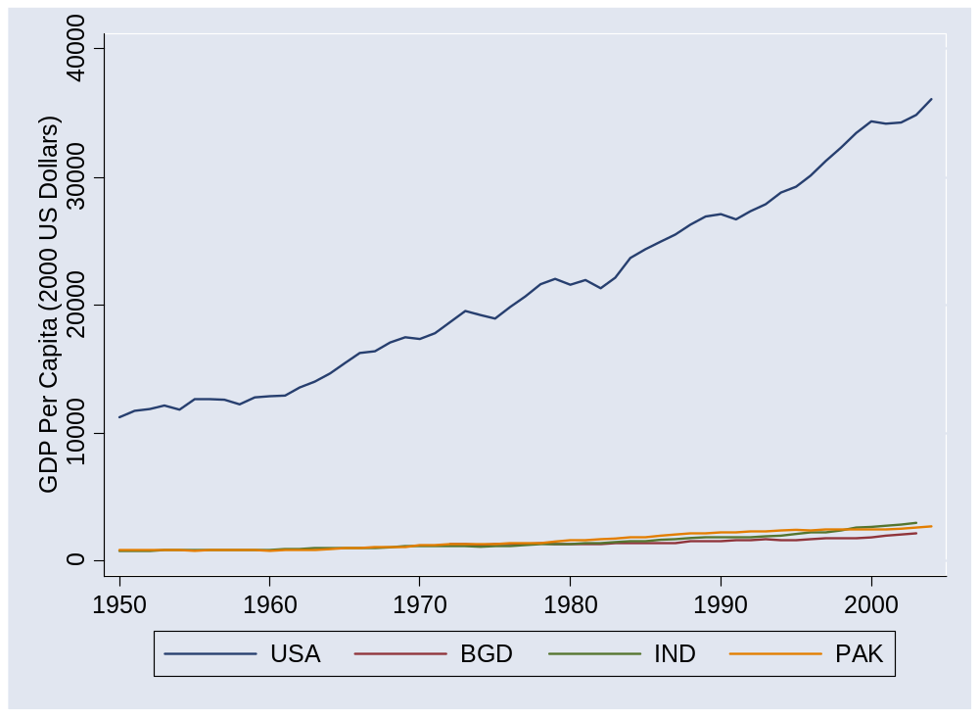
Asia 2
Source: Penn World Tables, version 6.2.

Slide 21
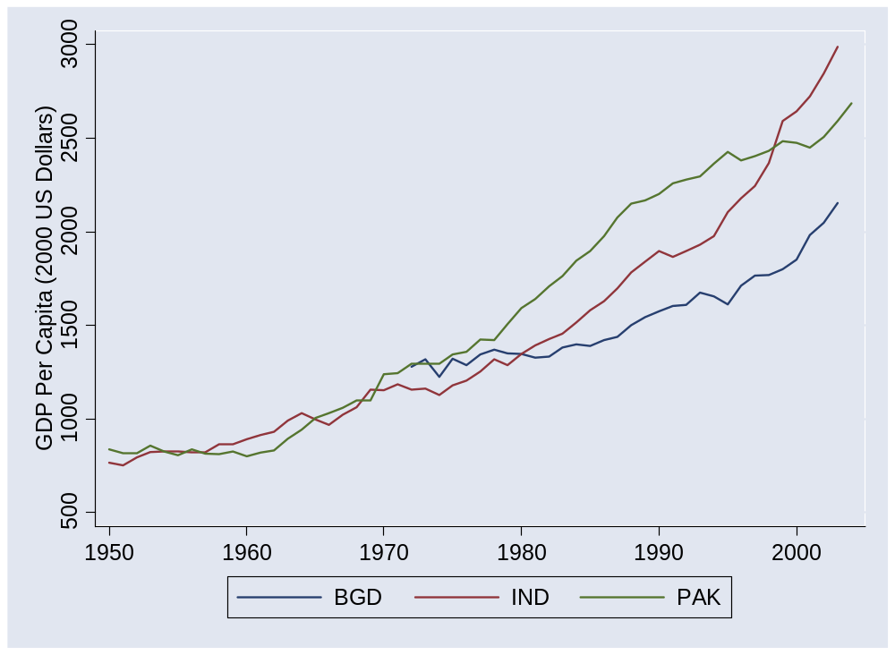
Asia 2 (without USA)
Source: Penn World Tables, version 6.2.

Slide 22
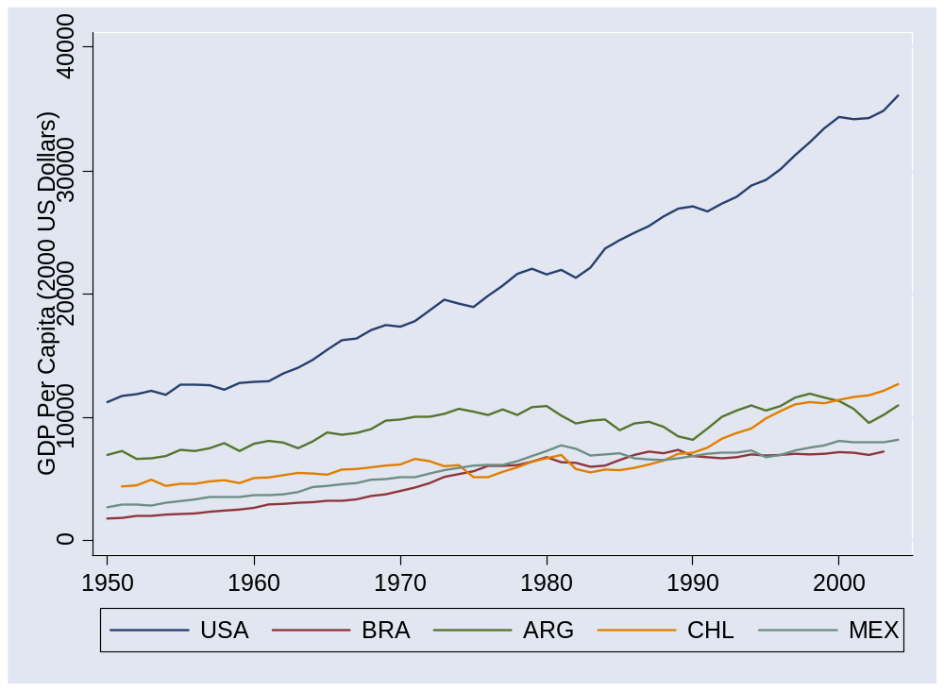
Latin America
Source: Penn World Tables, version 6.2.

Slide 23
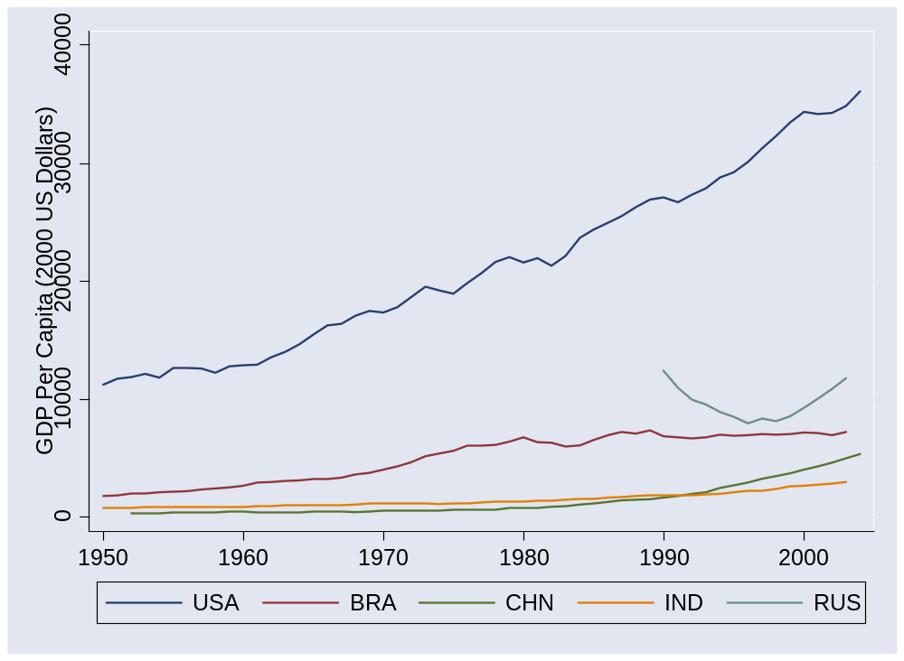
BRICs
Source: Penn World Tables, version 6.2.

Slide 24
Catch your breath
Where do these differences come from?
What do they say about the business environment?

Slide 25
Accounting for GDP
Where does output per worker come from?
Production function
Y = A K^{α} L^{1-α}
Y/L = A (K/L)^{α}
Comparison of two countries
(Y/L)₁/(Y/L)₂ = (A₁/A₂) [(K/L)₁/(K/L)₂]^{α}
Bottom line: a clue to economic performance

Slide 26
Computing growth rates
Traditional growth rate
(1+g)^{n} = x_{t+n}/x_{t}
Continuously-compounded growth rate
e^{nγ} = x_{t+n}/x_{t}
Computing the growth rate
γ = log(x_{t+n}/x_{t})/n
See:
  “Math review”
  “Sources of growth”
My advice:
Just memorize this.

Slide 27
Accounting for growth
Where does growth in output per worker come from?
Production function
Y = A K^{α} L^{1-α}
Y/L = A (K/L)^{α}
In terms of growth rates
γ_{Y/L} = γ_{A} + α γ_{K/L}
[γ_{x} means “growth rate of X”]
Bottom line: a clue to where growth comes from

Slide 28
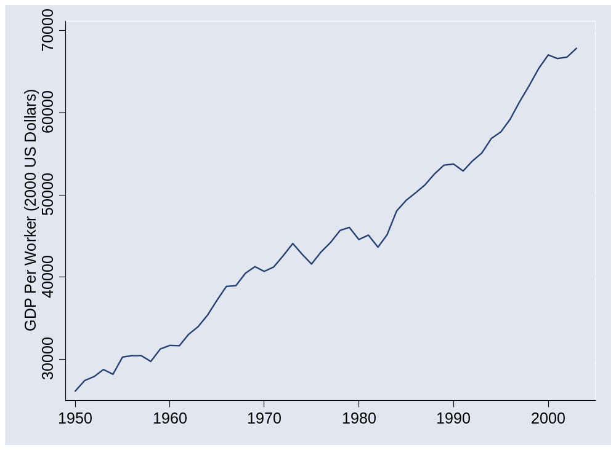
What happened in the US?
Source: Penn World Tables, version 6.2.

Slide 29
What happened in the US?
 | Y/L | K/L | A
1950 | 26,130 | 57,394 | 677
2003 | 67,865 | 177,008 | 1209
Growth rate (annual %) | 1.80 | 2.13 | 1.09
Contribution to growth | 1.80 | 0.71 | 1.09

Slide 30
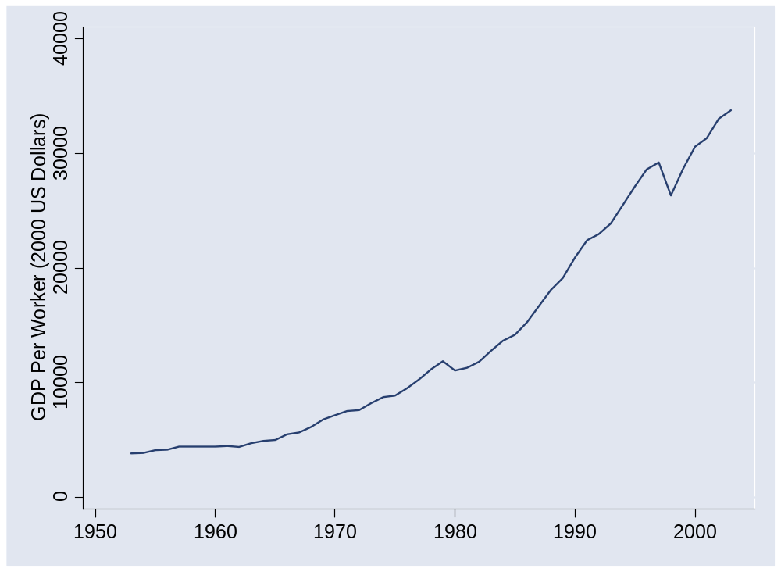
What happened in Korea?
Source: Penn World Tables, version 6.2.

Slide 31
What happened in Korea?
 | Y/L | K/L | A
1953 | 3,817 | 4,289 | 235
2003 | 33,784 | 113,720 | 697
Growth rate (annual %) | 4.36 | 6.56 | 2.18
Contribution to growth | 4.36 | 2.19 | 2.18

Slide 32
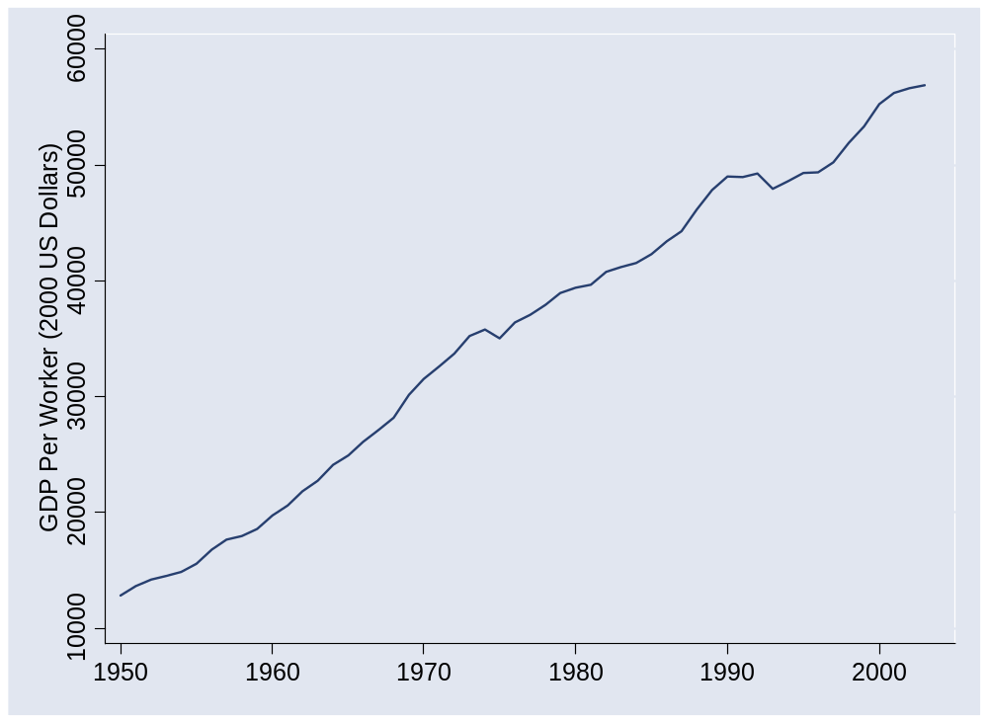
What happened in France?
Source: Penn World Tables, version 6.2.

Slide 33
What happened in France?
 | Y/L | K/L | A
1950 | 12,838 | 24,009 | 445
1973 | 35,236 | 82,298 | 810
2003 | 56,909 | 166,636 | 1,034
Contribution 1950-73 | 4.39 | 1.79 | 2.60
Contribution 1973-2003 | 1.60 | 0.79 | 0.81

Slide 34
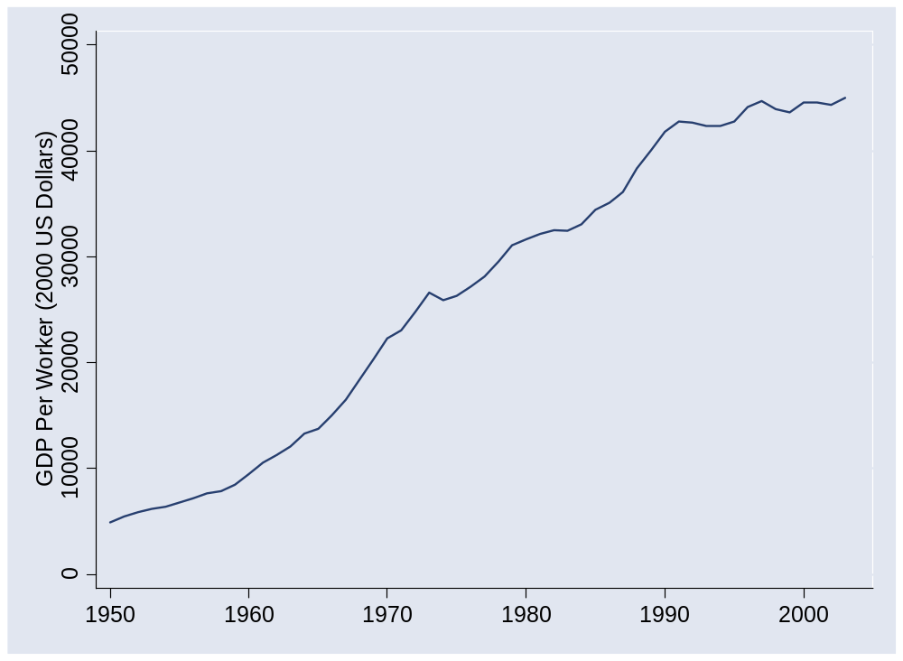
What happened in Japan?
Source: Penn World Tables, version 6.2.

Slide 35
What happened in Japan?
 | Y/L | K/L | A
1950 | 4,936 | 5,104 | 287
1973 | 26,642 | 61,119 | 676
1990 | 41,810 | 133,656 | 818
2003 | 45,030 | 180,284 | 797
Contribution 1950-73 | 7.33 | 3.60 | 3.73
Contribution 1973-90 | 2.65 | 1.53 | 1.12
Contribution 1990-2003 | 0.57 | 0.77 | (0.20)

Slide 36
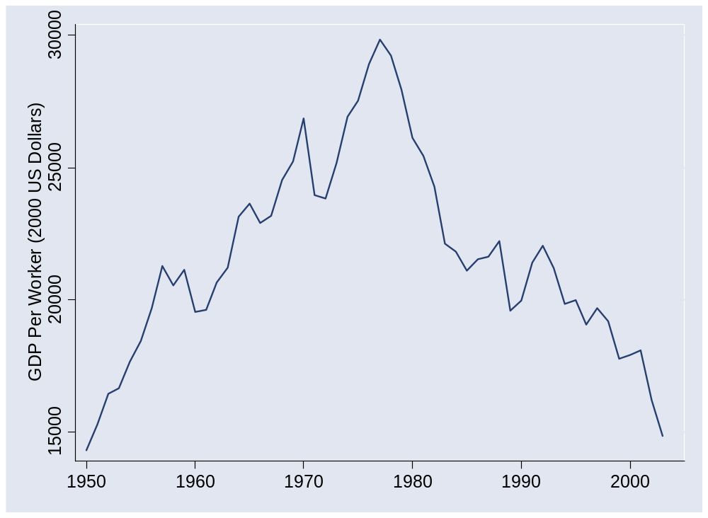
What happened in Venezuela?
Source: Penn World Tables, version 6.2.

Slide 37
What happened in Venezuela?
 | Y/L | K/L | A
1950 | 14,311 | 34,658 | 439
1977 | 29,853 | 81,303 | 689
2003 | 14,848 | 44,990 | 418
Contribution 1950-77 | 2.72 | 1.05 | 1.67
Contribution 1977-2003 | (2.69) | (0.76) | (1.92)

Slide 38
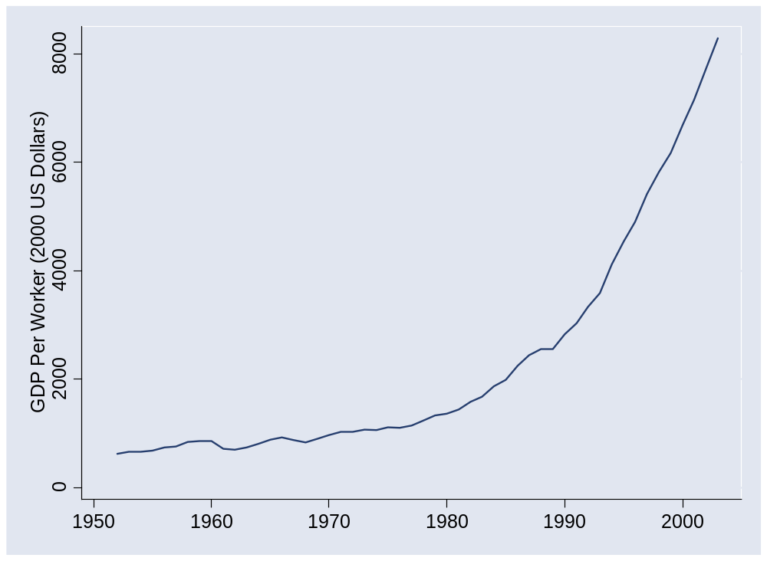
What happened in China?
Source: Penn World Tables, version 6.2.

Slide 39
What happened in China?
 | Y/L | K/L | A
1952 | 620 | 942 | 63
1978 | 1,234 | 3,070 | 85
2003 | 8,284 | 18,015 | 316
Contribution 1952-78 | 2.64 | 1.52 | 1.13
Contribution 1978-2003 | 7.62 | 2.36 | 5.26

Slide 40
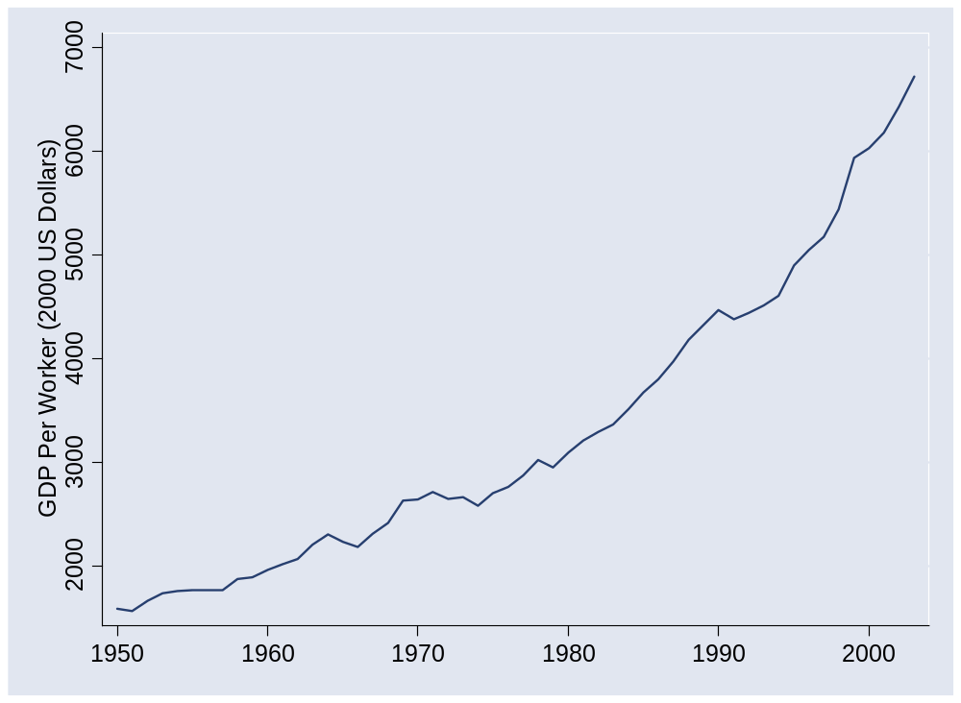
What happened in India?
Source: Penn World Tables, version 6.2.

Slide 41
What happened in India?
 | Y/L | K/L | A
1950 | 1,585 | 990 | 159
1980 | 3,094 | 3,714 | 200
2003 | 6,725 | 7,892 | 338
Contribution 1950-80 | 2.23 | 1.47 | 0.76
Contribution 1980-2003 | 3.38 | 1.09 | 2.28

Slide 42
What happened in India?
1980s
  Import delicensing
  Industrial controls relaxed (“license raj”)
  Administered prices de-controlled
1990s
  Further relaxation of industrial controls
  Foreign investment permitted (with limits)
  Trade: import licenses dropped, tariffs slashed
  Financial deregulation: banks, stock exchange
Source: Lehman report.

Slide 43
What happened in India?
EIU, Country Finance Report, 2007:
  India is a difficult operating environment for foreign companies. Most economic activities are girded with restrictions, public services and infrastructure are poor, and the government continues to impede the free flow of capital across its borders. Tax rates are relatively high and the tax system is complicated.
Source: EIU Country Report.

Slide 44
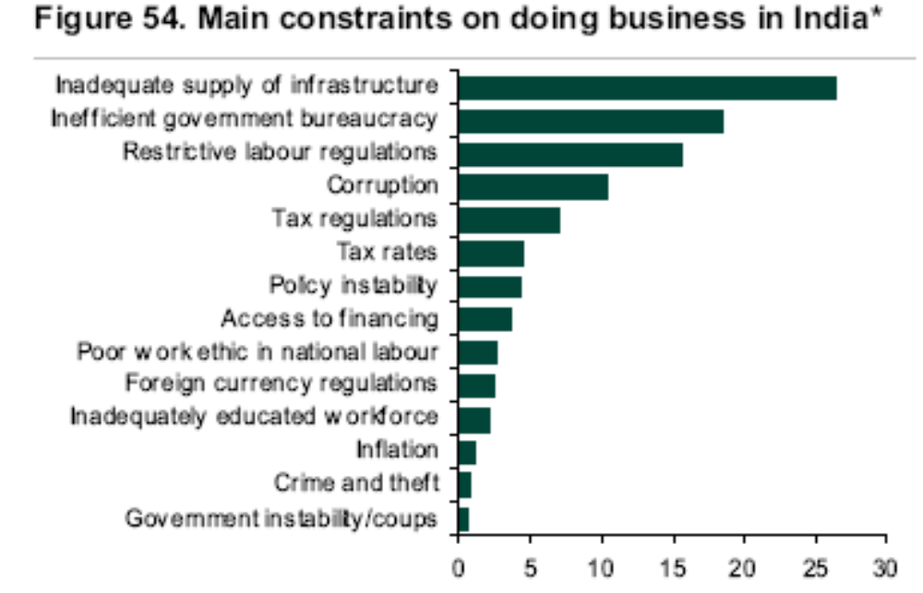
What happened in India?
Source: Lehman report, using data from World Economic Forum.

Slide 45
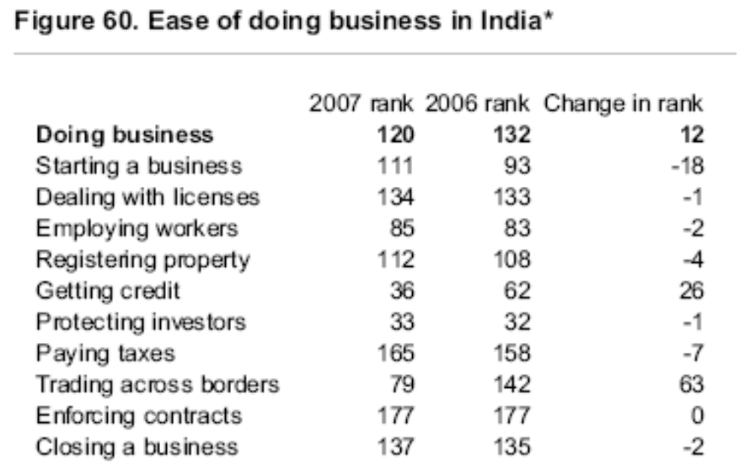
What happened in India?
Source: Lehman report, using data from the World Bank’s Doing Business.

Slide 46
What happened in [country]?
Do your own calculations for any country you like
  Data online (link)
  Or through Blackboard (linked to this class)

Slide 47
What have we learned?

Slide 48
Takeaways
Growth accounting quantifies sources of GDP growth
TFP important role in many cases
But… where does TFP come from? [more on this soon]

Slide 49
After the break
Be prepared to speak about Group Project #2

Slide 50
The Global Economy
“Institutions”
© NYU Stern School of Business
Notes:
Business (+ life) is a combination of quant and qualitative – the trick is to integrate them.
Overview:
GP #3
Spiel:
Modern society is a miracle – that hundreds of millions of people could interact and have things (more or less) work
All of this shows up in TFP
Where does it come from?
Not just math/science/tech: iron, porcelin, algebra
Fibonacci and PV: math taken from India and Islamic world
Bigger issue: Why aren’t people stealing from each other?
Some examples: Pirates (North), borrowing/lending game….
What do we need?
Security
Property rights
Competition

Slide 51
Institutions – what are they?
Environmental factors that facilitate economic activity
And lead to higher productivity
Like what?

Slide 52
Group Project #2

Slide 53
Plan of attack
Institutions: like what? ✓
Group Project #2 ✓
Current economic and business issues
Where we’re headed
Ocean shipping and capital markets
Institutions and productivity
What have we learned?

Slide 54
Where we’re headed
GDP
Capital & Labor
Productivity
Political Process
“Institutions”

Slide 55
Where does TFP come from?

Slide 56
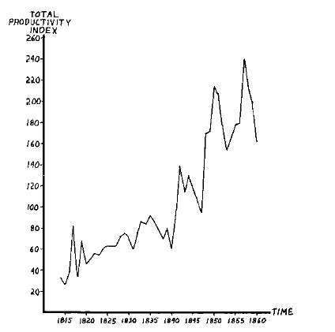
TFP in ocean shipping, 1600-1850
Source: Douglas North, 1993 Nobel prize
Why?

Slide 57
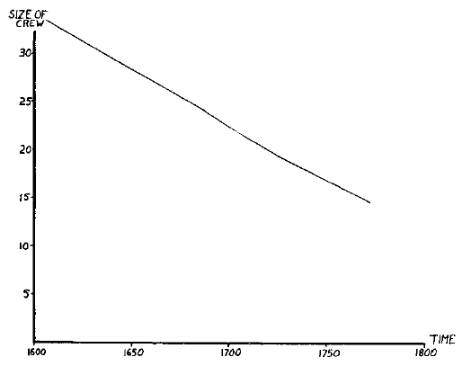
TFP in ocean shipping
Notes:
Comment: TFP is a social phenomenon

Slide 58
TFP in ocean shipping
What does this suggest about TFP in general?

Slide 59
Productivity in the British navy
From Parkinson’s Law, published 1957, p 8:
Year | Ships | Men in Navy | Dock-workers | Dock officials | Naval Admin
1914 | 62 | 146,000 | 57,000 | 3249 | 2000
1928 | 20 | 100,000 | 62,439 | 4558 | 3569
What happened to productivity? Why?

Slide 60
The capital markets game
Parameters:
  Lender offers 100 to borrower for one year
  Lender’s cost of funds is 5%, charges 10%, the competitive risk-adjusted rate
  Borrower has project that generates 100 + 15
  If you default, you use up 50 (lawyers etc)
  Note: the deal generates value (115 – 105 = 10)
  What happens?

Slide 61
The capital markets game
Don’t lend
Payoffs = (0,0)
L
(+5,+5)
Repay
Lend
B
0
X
Default
(–105,+65)
What’s the outcome? What do we do about it?
Notes:
Note: economic activity creates value

Slide 62
Capital markets reconsidered
Note: creditor rights help borrowers!
  Making it easy to default simply kills off loan market, which hurts borrowers as well as lenders
  Result: positive NPV projects not funded, TFP lower than it could be
Evidence:
  States/countries with stronger creditor rights have more lending, lower rates
  Countries with strong creditor rights have higher GDP per capita

Slide 63
The capital markets game
What does this suggest about institutions in general?

Slide 64
Institutions: categories
Rule of law
Property rights
Open competitive markets

Slide 65
What is this?
Personal security?

Slide 66
What is this?
Ability to start a business?

Slide 67
What is this?
Ability to collect a debt?

Slide 68
What is this?
Ability to fire a worker?

Slide 69
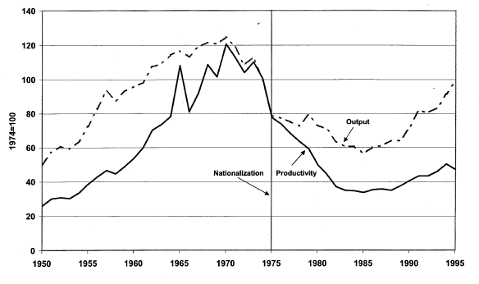
What is this?
Petroleum productivity in Venezuela
Light line is production, solid line is TFP.
Source: Schmitz and others.

Slide 70
What is this?
The Economist, Jan 29 05:
  When Argentine President Kirchner visited Paris, French President Chirac referred to “a little stone in the shoe” – Argentina’s Aguas Argentinas, a water provider serving 6.5m people that is 40%-owned by French conglomerate Suez. Aquas Argentinas saw its dollar fees converted to devalued pesos and frozen by a government emergency law during the crisis of 2001-02.
  The state and Aguas remain far apart. After fining Aguas $680,000 for cuts in water, the government called for $136m in new investment. But Aguas, whose debts total $700m, is loath to comply. It is demanding a 60% rate increase; the government is offering 16%. With elections looming, the government is reluctant to offer more.

Slide 71
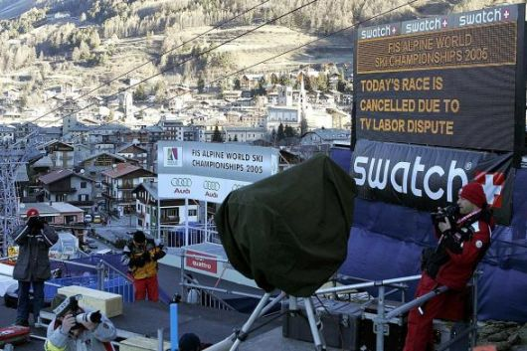
What is this?

Slide 72
What is this?
Indicator | US | France | Ratio
GDP | 6,297b | 1,296b | 5:1
Biomedical researchers | 77,000 | 12,000 | 6:1
Public research funding | 15.8b | 1.8b | 9:1
Industry research funding | 18.6b | 2.8b | 7:1
Biotech patents | 13,982 | 1051 | 13:1
Biotech startups | 1,100 | 40 | 27:1
Publicly-traded biotechs | 315 | 5 | 63:1
Recombinant proteins | 97 | 0 | ∞:1
Source: Gittelman.

Slide 73
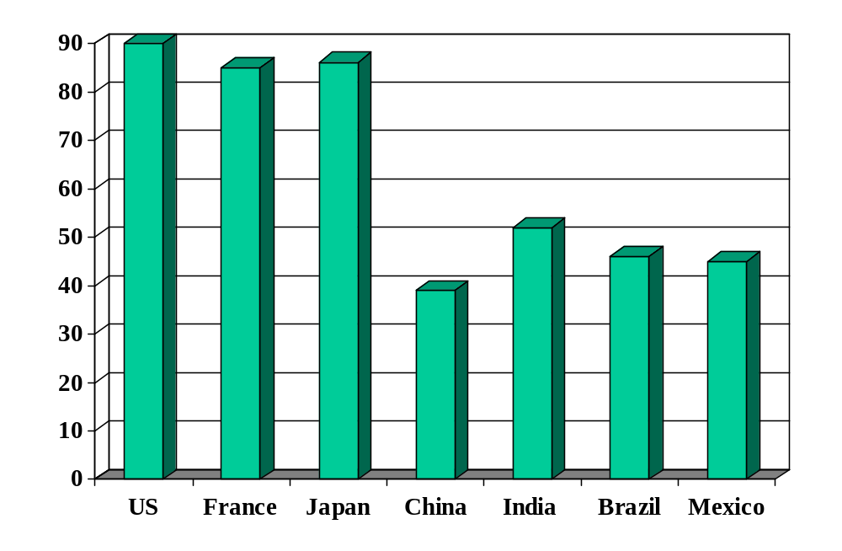
Rule of law (index)
Source: World Bank, Governance Indicators.

Slide 74
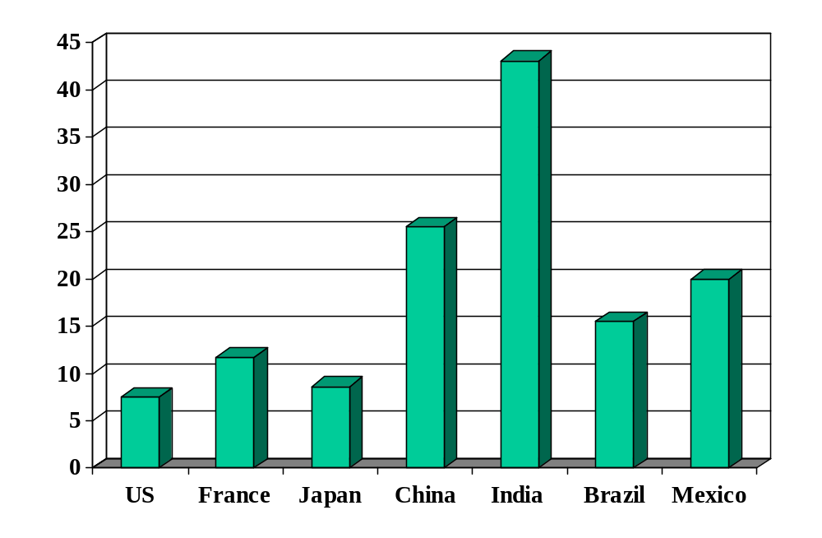
Cost of enforcing contracts (% of debt)
Source: World Bank, Doing Business.

Slide 75
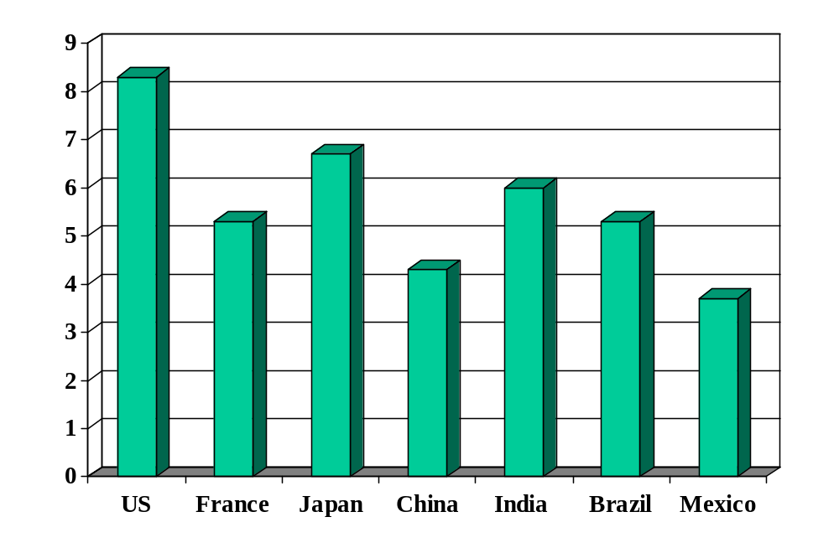
Investor protection (index)
Source: World Bank, Doing Business.

Slide 76
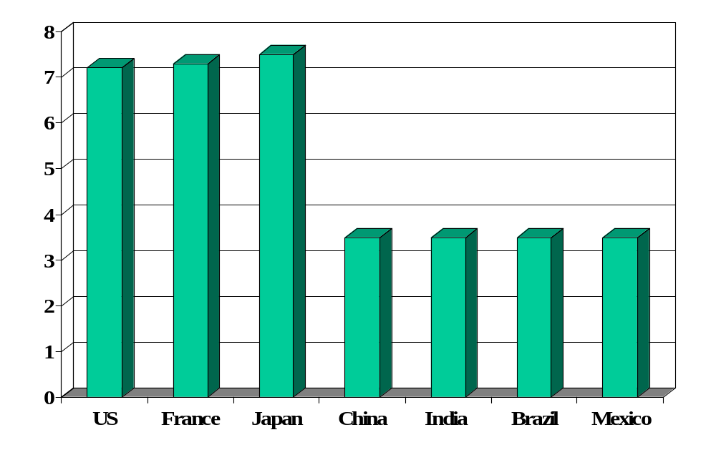
Absence of corruption (perceptions index)
Source: Transparency International.

Slide 77
What have we learned?

Slide 78
We started with
GDP
Capital & Labor
Productivity

Slide 79
Now we have
GDP
Capital & Labor
Productivity
“Institutions”

Slide 80
Madison’s “difficulty”
James Madison, Federalist Papers 51 (1788):
  If men were angels, no government would be necessary. If angels were to govern men, neither external nor internal controls on government would be necessary. In framing a government which is to be administered by men over men, the great difficulty lies in this: you must first enable the government to control the governed; and in the next place oblige it to control itself.

Slide 81
And finally
GDP
Capital & Labor
Productivity
Political Process
“Institutions”

Slide 82
The challenge of good government
Madison again (Federalist Papers 51):
  The great difficulty [of good government] lies in this: you must first enable the government to control the governed; and in the next place oblige it to control itself.
Czech joke (circa 1968):
  The difference between capitalism and socialism? Under capitalism, Man oppresses Man. Under socialism it’s exactly the opposite.

Slide 83
Takeaways
Productivity (TFP) reflects “institutions” that facilitate economic activity
Many are reflected in Group Project #2
Measures of institutional quality are attempts to quantify important but inherently subjective features of the economic and business environment
Governments must be powerful enough to establish good institutions, but so powerful as to run the system for narrow interests

Slide 84
What’s coming up
Group Project #3
  Application of the tools developed earlier today
  Good practice for the midterm
  Read notes: “Sources of Economic Growth”

Slide 85
Extra slides
We don’t have time for these slides, but I don’t have the heart to delete them. If you find any of them interesting, feel free to ask questions next class.

Slide 86
“Washington consensus”
Fiscal discipline
Direct public spending toward pro-growth, pro-poor services such as education, health, and infrastructure investment
Broad tax base, low tax rates
Market-determined interest rates
Competitive exchange rates
Open trade in goods
Open trade in assets, incl inward direct investment
Privatize state enterprises
Abolish regulations that restrict competition
Legal security for property rights
Source: Wikipedia, http://en.wikipedia.org/wiki/Washington_Consensus

Slide 87
Property rights
Hernando de Soto, Mystery of Capital:
  My summary: the absence of clear property rights is a major problem in many developing countries. This hits small businesses hardest, since lack of clear claim to (say) real estate makes it difficult for them to finance new or expanding businesses. An earlier book emphasized red tape: it would take a small business months to get the approvals needed to operate legally in Peru.

Slide 88
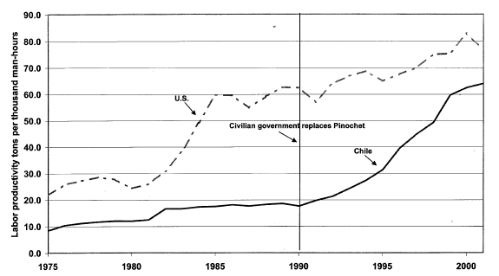
What is this?
Copper productivity in US and Chile
Light line is production, solid line is TFP.
Source: Schmitz and others.

Slide 89
Evidence
Good economic performance is associated with good institutions
How do we know this?
  Regressions: relate performance (growth and level of GDP per capita) to measures of institutional quality
  Micro studies
Causality?

Slide 90
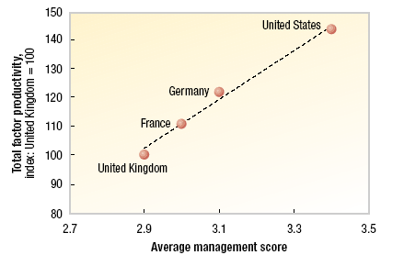
What is this?
McKinsey study:
Notes:
Good mgt = lean manuf, hire the best, reward performance

Slide 91
After the break
Ben Druskin
  Ben is a Managing Director and Head of Global Services and East Coast Technology Investment Banking at Citigroup. He joined Citigroup in 1993 and has been a member of the Technology Investment Banking Group since 1996. Ben received an MBA from the Stern School of Business at New York University and a BA from Rutgers College.
Harish Hulyarkar
  Harish joined Citi’s Investment Banking team in Mumbai in 2002. He helped set up Citi’s captive offshore analytics unit supporting offices in New York, London, and Hong Kong. In New York, he has focused on the offshore IT services/BPO space. Harish has an undergraduate degree in Commerce from the University of Mumbai and an MBA from the ISB.

