Slide 1

The Global Economy
Midterm Review
© NYU Stern School of Business
Notes:
Start xls
Intro
Review to consolidate learning
Long-term bus relationship: what do you look for?
Big picture “checklist,” but we’ll work through the components
Your job: ask a question if there’s anything you don’t follow

Slide 2
Plan of attack
About the course
About the midterm
Review of topics

Slide 3
About the course
Long-Run Performance
Production, Saving & Investment, Productivity, Institutions, Capital & Labor Markets, International Trade
First half:
Short-Run Performance
Inflation, Business Cycle Indicators, Monetary Policy, Taxes & Deficits, Exchange Rates, Capital Flows, Emerging Market Crises
Second half:

Slide 4
About the midterm
Same format and content as practice exam
You can use one page of notes: std size, both sides
Bring a calculator that does “logs” and “exponents”
Wireless devices prohibited
Covers long-run performance only
Some questions will be quantitative
Anything from the notes, slides, or projects is fair game, but the exam is not an attempt to stump you with obscure issues

Slide 5
About the midterm
Recommended study plan
  Skim “checklist” to get big picture
  Review course materials slides, notes, projects
  Draft summary page
  Work through practice exam
  Review topics you have difficulty with
  Come see me if you have questions

Slide 6
About the “cheat sheet”
For each topic, I suggest you ask:
  What are the quantitative tools?
  What are the takeaways?

Slide 7
Measuring performance
Big picture
  Q: Why do we care about National Income and Product Accounts? A: They’re the basic data on country performance.
  Q: Does GDP measure performance? A: There are other things we might care about, but most of them are closely related to GDP.
Tools:
  Price indexes and price deflators are used to measure inflation and to separate real quantities from changes in average prices.
  Identities connect expenditure components and financial flows
Relevance
  Common indicators of performance and market size

Slide 8
Measuring performance
GDP
  Gross domestic product
  Gross of depreciation [ie, includes depreciation]
  Equals: sum of value-added for all production units
  Equals: payments to capital and labor by the same units
  Almost equals: income

Slide 9
Measuring performance
Production
GDP
Income
Labor, Capital
Expenditures
C,I,G,NX
Financial Flows
S = I + NX

Slide 10
Measuring performance
Real and nominal
  Not so easy to separate changes in nominal GDP into price and quantity components: we do our best.
  GDP and components measured at current market prices and constant prices: What’s the difference?
  Cross-country comparisons often done at constant international prices: Why do we call this PPP adjusted?
Real GDP is typically the sum of expenditure components at constant prices, not outputs produced
  Should be called: real GDE (E for expenditure)
  Why does this matter?

Slide 11
Measuring performance
Recall:
Y = C + I + G + NX
What does this mean?
We commonly take ratios to Y
  Often express everything at current prices [why?]
  Eg, NX/Y
Saving
  Has many definitions [be forewarned!]
  We use: S = Y – C – G [“gross” “national” saving]
  And sometimes: S = S_{p} + S_{g} [S_{p} = Y – C – T, S_{g} = T – G]

Slide 12
Measuring performance
Recall:
S = I + NX
What does this mean?
If S (domestic source of new funds) ≠ I (domestic use of new funds), where does the difference go?
  In the US?
  In Singapore?
  In Norway?
It is better to give or receive?

Slide 13
Production function
Big picture
  Q: Where does GDP come from? A: Inputs of capital and labor, total factor productivity
Tools
  The production function:
  Y = A K^{α} (hHL)^{1-α}
  Y/L = A (K/L)^{α} (hH)^{1-α}
  Y/POP = (L/POP) A (K/L)^{α} (hH)^{1-α}
Relevance
  Fundamental to country analysis. (Why is per capita GDP higher in the US than Argentina?)

Slide 14
Production function
Function
  Y/L = A (K/L)^{α} [for example]
India, 2000
  Y/L = 6216
  K/L = 6413
What is A?
  A = (Y/L)/(K/L)^{α} = ??
  “Whatever’s left”

Slide 15
Production function
What changes if
  A firm builds a new factory?
  Students learn a lot in their Global Economy course?
  China builds unnecessary infrastructure?
  The US imports more cotton from Brazil and Africa?
  The government buys or bails out unprofitable industries or businesses?
  [put your own example here]?

Slide 16
Solow model
Big picture
  Q: Can saving and capital formation lead to continuing growth? A: No, diminishing returns to capital limits the impact, so saving-based growth will eventually stop
Tools
  Dynamics: connects “t” to “t+1”
Relevance
  Basic tool for studying economic dynamics. (How large will India’s economy be in 20 years?)
  Superior to extrapolating trends: builds in information on the economy, clarifies assumptions.

Slide 17
Solow model
How important is a high saving rate to India’s economic growth?
Is low saving a central issue for the US economy?

Slide 18
Growth accounting
Big picture
  Q: Why do some countries grow faster than others? A: It depends, but often the most important factor is TFP.
Tools
  Continuously-compounded growth rates:
  γ_{x} = log(x_{t+n}/x_{t})/n [“log” = “LN”]
  Growth accounting
  γ_{Y/L} = γ_{A} + α γ_{K/L} + (1–α) (γ_{H} +γ_{h})
Relevance
  Basic tool for country analysis. (Why have China and India grown so fast? Why has growth slowed in Japan?)

Slide 19
Growth accounting for China
 | Y/L | K/L | A
1952 | 620 | 942 | 63
1978 | 1,234 | 3,070 | 85
2003 | 8,284 | 18,015 | 316
Contribution 1952-78 | 2.64 | 1.52 | 1.13
Contribution 1978-2003 | 7.62 | 2.36 | 5.26
You should be able to compute all the numbers in italics

Slide 20
Growth accounting
How does a high saving rate show up?
Why is TFP so important?
  Would its absence worry you?
Where does TFP come from?

Slide 21
Institutions
Big picture
  Q: Where does TFP come from? A: Much of it is tied to “institutions”
Tools
  Measures of institutional quality
Relevance
  The institutional environment is probably the most important factor in decisions to produce or invest in a country. (Is an Argentine winery a good bet?)

Slide 22
Institutions
High-performance institutions
  Rule of law
  Property rights
  Competitive markets for products, capital, and labor

Slide 23
Institutions
The infamous “Washington consensus”: Good for business? Good for growth?
  Fiscal discipline
  Direct public spending toward pro-growth, pro-poor services such as education, health, and infrastructure investment
  Broad tax base, low tax rates
  Market-determined interest rates
  Competitive exchange rates
  Open trade in goods
  Open trade in assets, incl inward direct investment
  Privatize state enterprises
  Abolish regulations that restrict competition
  Legal security for property rights
Source: Wikipedia, http://en.wikipedia.org/wiki/Washington_Consensus

Slide 24
Labor markets
Big picture
  Q: Why do unemployment and participation rates differ so much across countries? A: Largely because local labor laws differ.
Tools
  Participation, employment, unemployment rates
  Measures of employment “protection” and flexibility
Relevance
  Labor laws can be a major source of difficulty when doing business abroad. If you’re American, you’d make a big mistake thinking other countries are like the US. (Should Toyota open a plant in France?)

Slide 25
International trade
Big picture
  Q: Who are the winners and losers from trade? A: On average, people in all countries gain, but it is nevertheless politically appealing to protect local workers and businesses from foreign competition.
Tools
  Ricardo’s model of trade is based on comparative advantage: consumers get products from cheapest source, production is more efficient.
Relevance
  If you’re operating in a foreign country, you can expect local competitors to use the political process against you. (UPS in Mexico, Chinese furniture makers in the US)

Slide 26
International trade
Trade is like TFP
Who wins from trade? Who loses?
Wages
  Why do wages differ across countries?
  Would you expect trade to increase or reduce differences?
What is dumping? Why is it illegal?

Slide 27
Long-run “big picture”
GDP
Capital & Labor
Productivity
Political Process
“Institutions”

Slide 28
The challenge of good government
Madison (Federalist Papers 51):
  The great difficulty [of good government] lies in this: you must first enable the government to control the governed; and in the next place oblige it to control itself.
Czech joke (circa 1968):
  The difference between capitalism and socialism? Under capitalism, Man oppresses Man. Under socialism it’s exactly the opposite.

Slide 29
Practice midterm
Questions and answers posted
Come see me if you have questions

Slide 30
Beach and airplane reading
Andrea Camilleri, The terra-cotta dog. Delightful series about a Sicilian detective.
Alan Furst, Dark star. Great spy novel about Europe prior to World War II.
Carl Hiaasen, Tourist season. Florida-based mystery, loaded with dark humor.
Carol O'Connell, Dead famous. Her Mallory series has a really intriguing amoral antagonist.
Richard Russo, Straight man. If you're not laughing out loud in 5 pages, I'll buy the book from you.

Slide 31
Global economy nonfiction
Paul Blustein, And the money kept rolling in. Argentina’s boom and bust, misbehavior all around, good read.
Norman Cantor, In the wake of the plague. How the black plague killed one-third of the people in Europe, but led to huge improvements in property rights.
Tim Clissold, Mr China. Big money from the US hits China in the 1990s. Great story, great read.
William Easterly, The elusive quest for growth. Great stories about the developing world from the director of NYU’s Africana Center.

Slide 32
The Global Economy
Inflation
© NYU Stern School of Business
Notes:
Indicators
Arg note
High inflation: has anyone lived through one? What was it like?

Slide 33
Zimbabwe
What’s going on? Outline a chain of connections that generates inflation as the outcome.

Slide 34
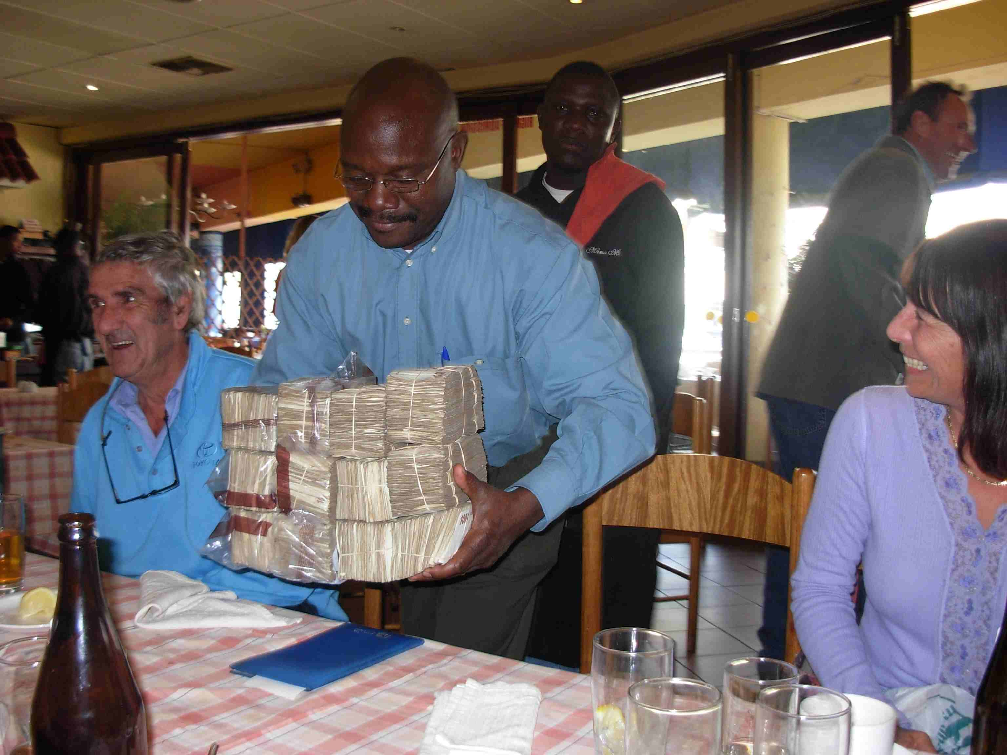
Zimbabwe: buying lunch

Slide 35
Zimbabwe: land of opportunity?
“Funds pour money into Zimbabwe,” WSJ, Nov 17 07
  Zimbabwe is an economic nightmare. The annual inflation rate is 8,000% and rising. People don't have food to eat. Yet investors have started pouring millions of dollars into the country.
  Joberg-based Imara Asset Management launched a Zimbabwean-focused investment fund in March.
  Lonrho last month snapped up Blueberry International Services Ltd., a company with interests in two Zimbabwean companies – telecom firm Celsys Ltd. and chemical-maker Gardoserve.

Slide 36
Group Project #4
Question 2: Would you locate a plant in Brazil, Czech Republic, or Hong Kong?
Question 3: Who might the winners be? What’s your sales pitch to them?

Slide 37
Plan of attack
Zimbabwe ✓
Group Project #4 ✓
Where we’re headed
Pictures
Quantity theory of money
Money supply mechanics
What have we learned?
What’s coming up

Slide 38
Where we’re headed
Theme: economic performance of countries
First half: long-run performance
  Why is GDP per capita lower in India than France?
  Why are China and India growing so rapidly?
  What are the business opportunities and challenges?
Second half: short-run performance
  How does [country name] look over the next year?
  What are the business opportunities and challenges?

Slide 39
Where we’re headed
Long-Run Performance
Production, Saving & Investment, Productivity, Institutions, Capital & Labor Markets, International Trade
First half:
Short-Run Performance
Inflation, Business Cycle Indicators, Monetary Policy, Taxes & Deficits, Exchange Rates, Capital Flows, Emerging Market Crises
Second half:

Slide 40
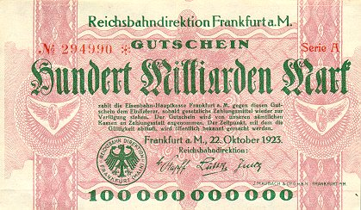
German currency
October 1923: 20 USD = 1 billion DM
Notes:
http://www.zum.de/whkmla/region/germany/turm2023.html

Slide 41
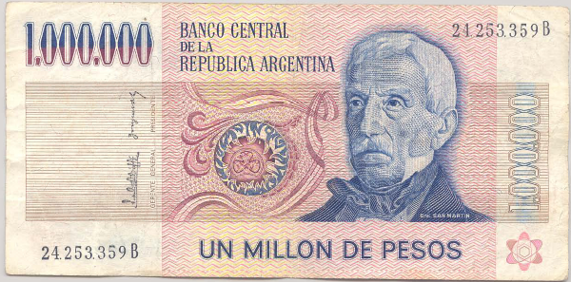
Argentine currency
This note dates from 1980s. What’s it worth now? Why?

Slide 42
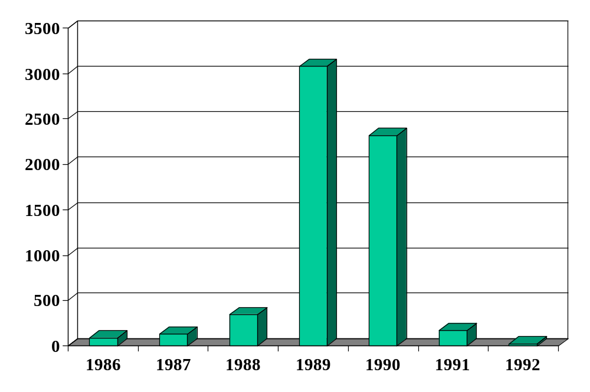
Inflation in Argentina (annual %)
Source: EIU database.

Slide 43
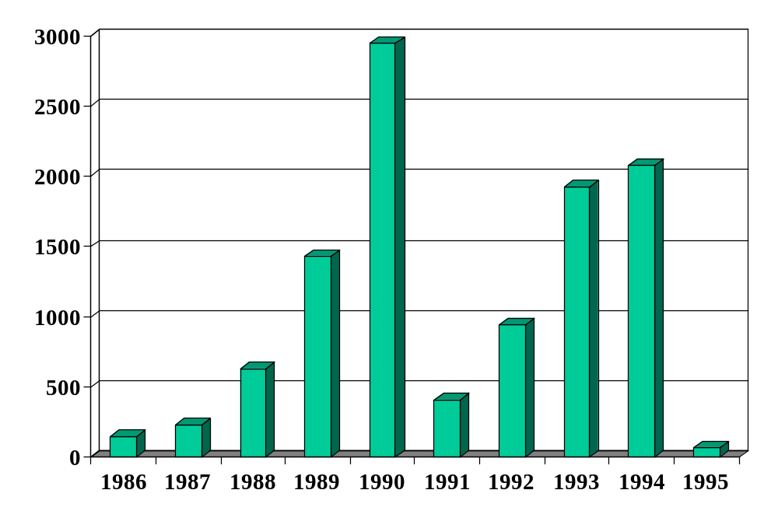
Inflation in Brazil (annual %)
Source: EIU database.

Slide 44
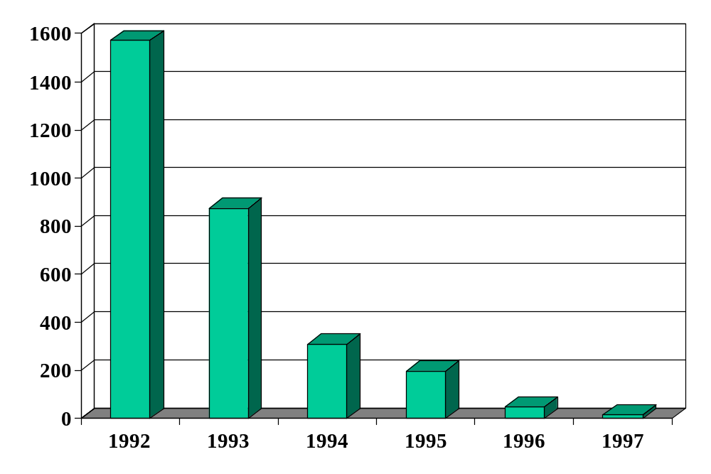
Inflation in Russia (annual %)
Source: EIU database.

Slide 45
Inflation in Yugo/Serbia??(annual %)
Source: EIU database.

Slide 46
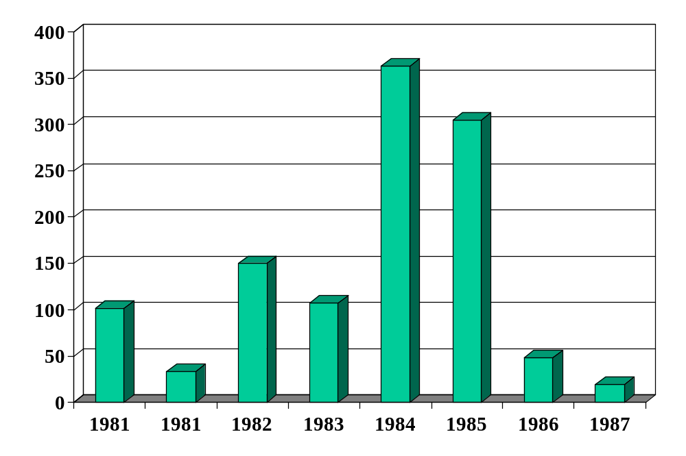
Inflation in Israel (annual %)
Source: EIU database.

Slide 47
Israel in the 1980s
American Rabbi visiting Israel:
  During Israel’s hyperinflation, the name of the game was to part with currency as quickly as possible. I invested some money with an Israeli mortgage bank, which gave me the option of receiving a secondary mortgage at a 5% fixed annual interest rate. When my wife and I purchased a condominium in 1981, interest rates on mortgages were 39%, a very high rate one might think. We took the secondary mortgage. Fixed rate mortgage payments became laughably easy to make as inflation shot up to 800% a year, because salaries more or less kept pace with inflation, a typical phenomenon in high inflation economies. The coup de grace came when I received a notice canceling my mortgage, because the cost of record-keeping had become more than the value of our monthly payment.
Link

Slide 48
Quantity theory
Milton Friedman, 1976 Nobel Laureate:
  “Inflation is always and everywhere a monetary phenomenon. To control inflation, you need to control the money supply.”
Is he right?

Slide 49
Quantity theory
Money
Growth
Inflation

Slide 50
Quantity theory
One equation (technology for transactions)
M V = P Y
  M = stock of money in circulation (currency)
  V = velocity (how often a unit of currency is used in a year)
In growth rates
γ_{M} + γ_{V} = γ_{P} + γ_{Y}
  γ_{M} = growth of money supply (think: currency in circulation)
  γ_{V} = growth of velocity
  γ_{P} = growth of price level (inflation rate)
  γ_{Y} = growth of real GDP

Slide 51
Quantity theory
Two hypotheses
  V is constant (γ_{V} = 0)
  Y not affected by changes in M [we’ll use this later]
One conclusion
  Money growth causes inflation
γ_{P} = γ_{M} – γ_{Y}

Slide 52
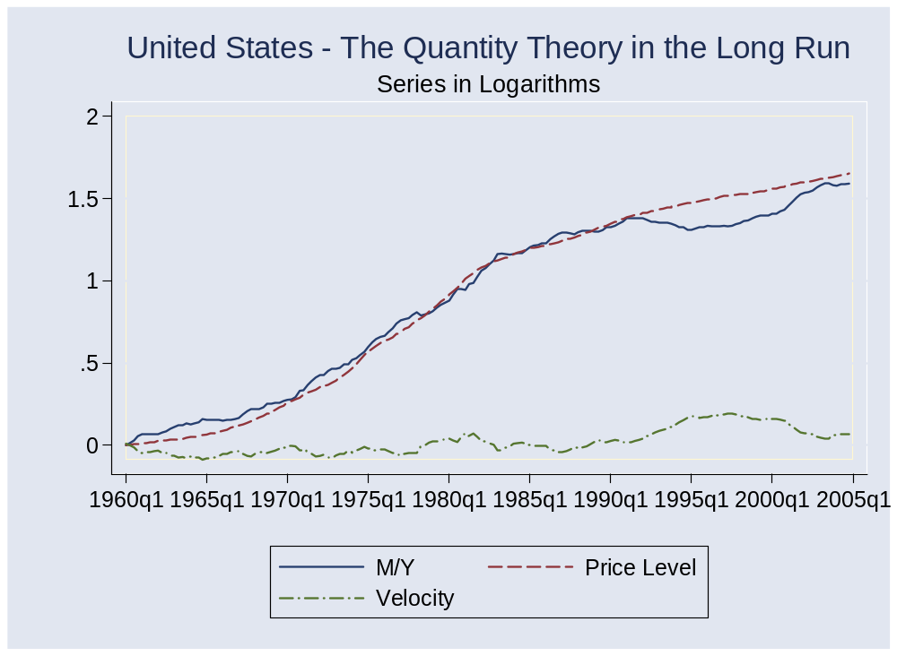
Quantity theory: long-run evidence

Slide 53
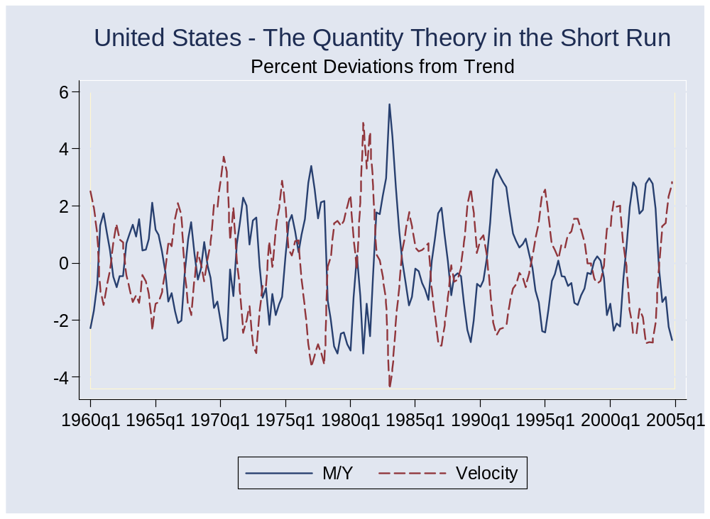
Quantity theory: short-run evidence

Slide 54
Money supply mechanics
How the central bank manages the money supply
Look at balance sheets for
  Treasury
  Central bank
  Private agents (households and firms)
Discuss
  Open market purchase of bonds
  Why do private agents accept the money?
  Zimbabwe revisited

Slide 55
Money supply mechanics
Treasury
Assets |  | Liabilities
 |  | Bonds | 200
Where does treasury debt come from?
How does central bank increase money supply?
Why do households go along?
What happened in Zimbabwe?
Central bank
Assets |  | Liabilities
Bonds | 20 | Money | 20
Households and firms
Assets |  | Liabilities
Money | 20
Bonds | 180

Slide 56
Transition?
Add something here to come back to Zimbabwe

Slide 57
Quantity theory amended
Political
Instability
Fiscal
Deficit
Money
Growth
Inflation

Slide 58
What have we learned?

Slide 59
Takeaways
Inflation comes from money growth
In big inflations, money growth typically comes from fiscal deficits …
… and fiscal deficits reflect political chaos
But: modest inflation is another story – more later

Slide 60
What’s coming up
First half of next week’s class: midterm
Second half: start “business cycles”
  Morning: Dick Berner, Chief US Economist at Morgan Stanley
  Afternoon: Mercedes mini-case, visitor March 25
  Detailed email about this after the midterm

Slide 61
Extra slides

Slide 62
Real and nominal interest rates
Connection:
i = r + π
  i = nominal interest rate (what we usually see quoted)
  r = real interest rate (rate on basket of goods)
  π = expected inflation [why “expected”?]
Comment
  Movements in i reflect both r and π
  Which is more important? [It depends!]

Slide 63
Long-run performance
Big picture
  Why does GDP per capita differ so much across countries?
  Why do growth rates differ?
  How do legal and political institutions affect business around the world?
Relevance
  What is it like running a business in country X?
  See “Global Economy Long-Run Checklist”

Slide 64
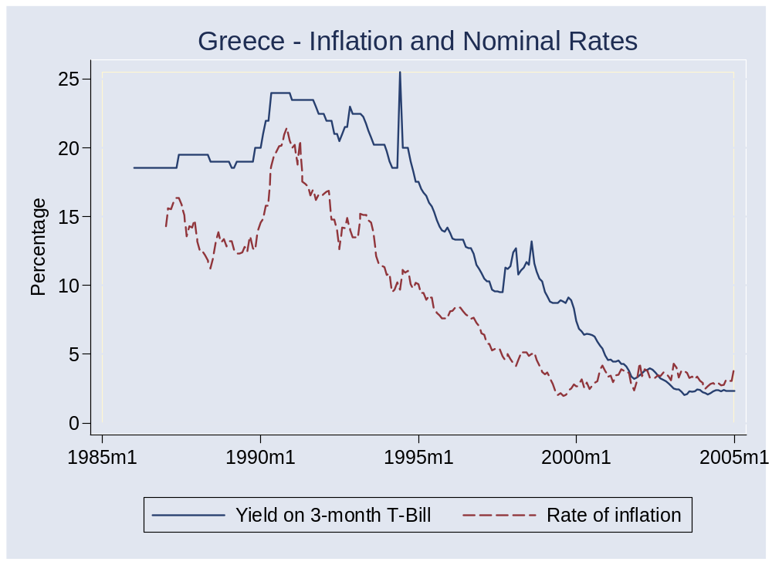
Interest rates and inflation

