Slide 1

The Global Economy
© NYU Stern School of Business
Notes:
Bring to class: Economist
Start Blackboard
Ditto GapMinder
On board: pickup binder, start at 8:35, do not sit on side or back, two names for cold calls
Conventions:
Point up = louder
Welcome to Global Economy
Goal: learn about the world, using economics as our tool
Gapminder: share-pair
US economy: share-pair-square

Slide 2
The Global Economy
© NYU Stern School of Business

Slide 3
The Global Economy
© NYU Stern School of Business

Slide 4
Gapminder
  http://www.gapminder.org/world/
Notes:
Growth vs GDP per capita
What do you see?
Cold calls

Slide 5
About participation
Broad-based participation part of class design
“Volunteers” intended to keep you involved
  Don’t panic
  Ask for help if you need it

Slide 6
About participation
Class should be used to think
  Share your thoughts
  I’ll share mine
  Extra points if you prove me wrong

Slide 7
About participation
If you’re an economics aficionado
  Share your insights
  But leave time for others
If you’re not
  Please ask questions… others will thank you!

Slide 8
About participation
If you’re stuck, here are two foolproof comments:
  It depends
  Fact of life
  [Of course, each is better if you explain why]

Slide 9
Plan of attack
Gapminder ✓
Prospects for the US economy
About the course

Slide 10
Prospects for the US economy
What growth do you expect over the next 12 months?
  [above/at/below] average?
Evidence for your opinion?
Where are the risks? opportunities?
How does US compare to other countries?

Slide 11
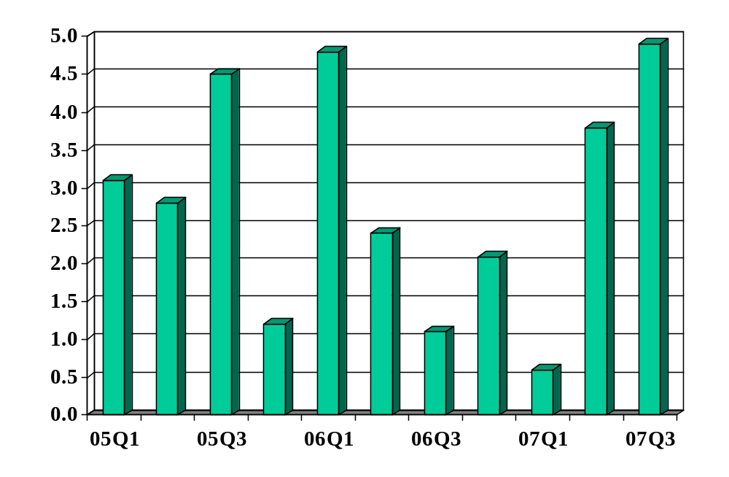
US GDP growth (annual rate, %)
Source: US Bureau of Economic Analysis.

Slide 12
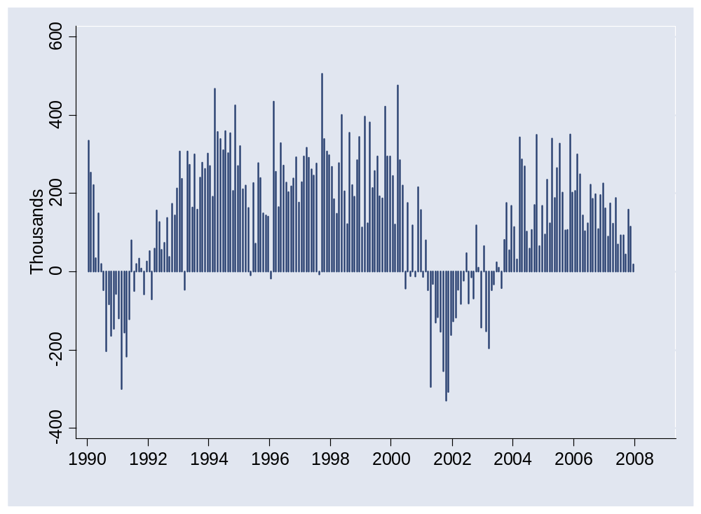
US prospects: new jobs
Source: BLS via FRED.

Slide 13
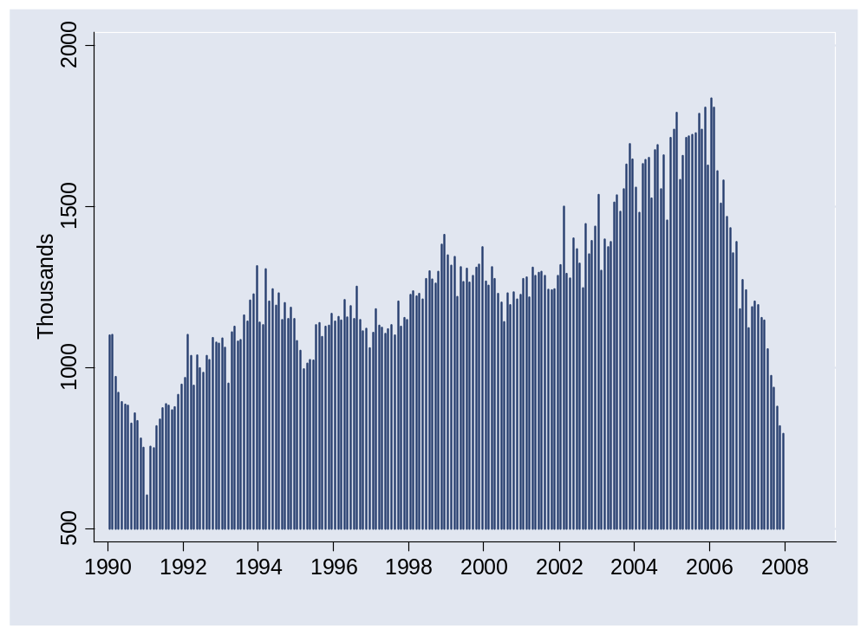
US prospects: housing starts
Source: Commerce via FRED.

Slide 14
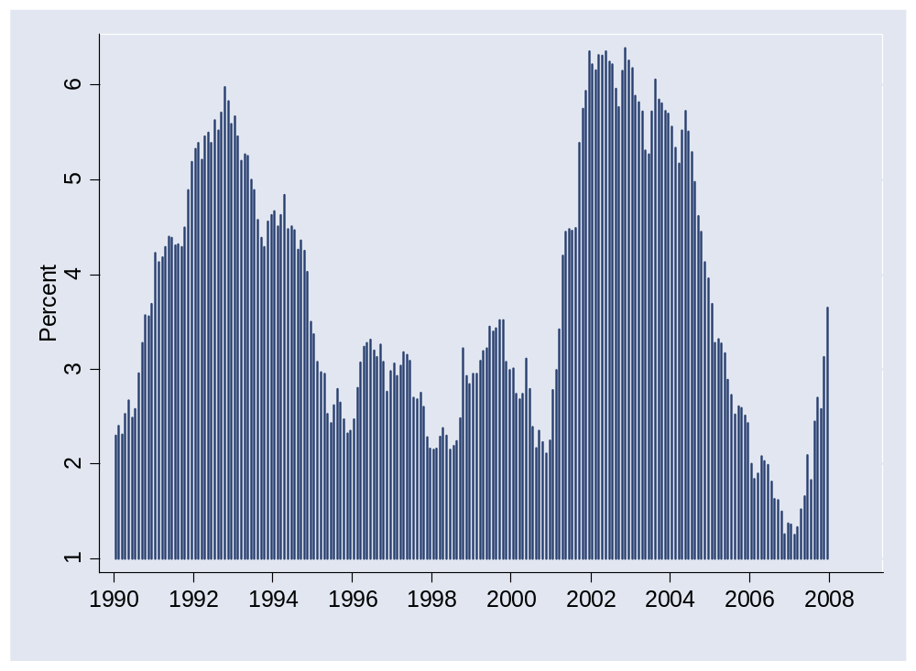
US prospects: corp bond spread
Source: Federal Reserve via FRED.

Slide 15
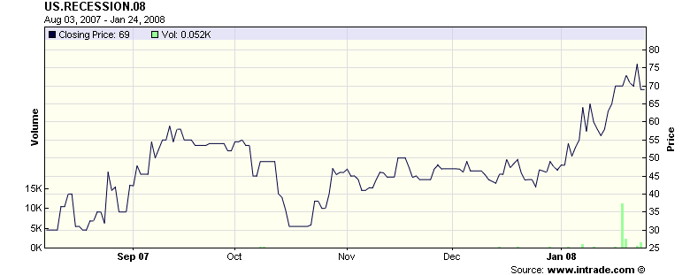
US prospects
Probability of recession in 2008 (2 q neg growth, final)
Source: Intrade.com.

Slide 16
US prospects
Bruce Kasman, JP Morgan Chase, Jan 18 08:
  US asset prices moved to the dark side this week, reaching levels consistent with an economy in recession. Investment grade credit spreads now stand wider than they did during 2001, while forward rates are pricing in a move toward a zero real fed funds rate. … While markets have voted on recession, the message from the data is not yet on board. As was the case with the December payroll report, the latest indicators highlight weakness concentrated in goods-producing sectors. Both housing starts and manufacturing output declined in 4Q07. Labor market indicators point to moderating growth. … We have revised down our estimate for 4Q07 GDP to 1%.

Slide 17
US prospects
Richard Berner, Morgan Stanley, Jan 23 08:
  The Fed's inter-meeting cut in the funds rate to 3.5% is a first big step towards what we called “The Great Monetary Easing of 2008.” With the neutral Fed funds rate around 4% on our estimates, US monetary policy has thus entered expansionary territory. Moreover, our US economists expect another 25 bp cut at [tomorrow's] FOMC meeting, and even a 50 bp move gets relatively high odds. … The Fed's move has increased the odds for an easier global monetary policy stance than previously thought, according to our central bank watchers around the globe. One reason is that lower Fed rates make it more difficult for central banks in EM countries that peg to the dollar to raise rates.

Slide 18
US prospects
Ethan Harris, Lehman Brothers, Jan 25 08:
  The market is pricing in a high chance of a 50bp or greater rate cut at next week’s FOMC meeting. We believe the Fed’s inter-meeting move was largely pre-emptive and, in combination with the favorable reaction to the cut, expect a follow-up 25bp ease.

Slide 19
About the course
Read the syllabus – please!

Slide 20
About the course
Theme: economic performance of countries
Introduction: measurement (later today)
First half: long-run performance
  Why is GDP per capita lower in Brazil than Japan?
  Why are China and India growing so rapidly?
  What are the business opportunities and challenges?
Second half: short-run performance
  How does the US look over the next year?
  The Euro Zone?
  What are the business opportunities and challenges?

Slide 21
About the course
Long-Run Performance
Production, Saving & Investment, Productivity, Institutions, Capital & Labor Markets, International Trade
First half:
Short-Run Performance
Inflation, Economic Indicators, Aggregate Supply & Demand, Monetary Policy, Taxes & Deficits, Exchange Rates, Capital Flows, Emerging Market Crises
Second half:

Slide 22
About class notes
Theoretical background to class discussion
Executive summaries: more concise than a textbook
Custom designed for this course
Read them – preferably before class
Notes:
Questions?

Slide 23
About the textbook
Optional
Most students prefer not to use one
But if you have little or no background in economics, you might buy
  Mankiw, Macroeconomics [concise, well-written]
Blackboard lists chapters for current edition, but older editions are similar and much cheaper (Amazon, eBay)
  If you buy an old edition, let me know and I’ll post the appropriate chapters
Order now so you’ll have it
Notes:
Questions?

Slide 24
About slides
Catalyst for class discussion
Not intended to be readable on their own
Available by noon the day before class
Subject to modification without notice

Slide 25
About your grade
Participation | 10%
Group Projects (best 5 of 6) | 25%
Final Group Project | 15%
Midterm | 25%
Final | 25%

Slide 26
About participation
On-time attendance is 50%
  Experiment with RFID
  Check in with TF is you don’t have your id with you
The other 50%
  Comments in class
  Emails to me about interesting articles for class
Use your name plate so I know who you are

Slide 27
About group projects
Essential part of the class experience
I’ll tell you what’s coming the week before
Some are demanding, so plan ahead
Notes:
Questions?

Slide 28
About groups
Up to 5 members, unlimited marriage and divorce
Can contain members from both sections
Make sure all names are listed

Slide 29
About laptops
At the request of other students
  Only for class use
  And only if you sit in the back

Slide 30
About the room
Please don’t sit
  In the far right section (from my perspective)
  In the last two rows

Slide 31
About me
Grew up in Pittsburgh
PhD in Economics, Yale, 1981
Research interests:
  International capital markets
  Fixed income and currency derivatives
  Emerging markets
Other interests:
  Paul (16) and Melanie (13)
  Basketball, biking, books, beer
Notes:
Questions?

Slide 32
About the TFs
Kerla Moore
  From: New York
  Concentrations: strategy and marketing
  Career plans: American Express, global marketing and strategy for corporate services
  Personal interests: cooking, wine, horseback riding, skiing
Neely Pielet
  From: Israel
  Concentrations: finance and accounting
  Career plans: Lehman Brothers, equity research
  Personal interests: running, traveling, financial markets, cooking
Notes:
Questions?

Slide 33
About help
If you get stuck, come see me
Or email me – I check email frequently
Notes:
Questions?

Slide 34
About Blackboard
Notes:
Show all pages
Overview
* Link to resources
* Link to feedback

Slide 35
About feedback
If you have ideas, comments, questions, whatever:
  Come see me
  Send an email
  Speak to one of the TFs
  Speak to a Block Leader
  Send an anonymous email to me
  … whatever you like

Slide 36
About 9:00 am
Pain for all of us
Suggestion: aim for 8:50, bring coffee and paper, look for an interesting article for us to discuss

Slide 37
Takeaways
Read the syllabus
Come to class
Expect to participate
Have some fun

Slide 38
The Global Economy
Macroeconomic Measurement
© NYU Stern School of Business
Notes:
Set fast pace: lots to do
Notes + this session + GP1
Open spreadsheet for price indexes

Slide 39
Plan of attack
Pictures
Measuring country performance:
  GDP
  Prices and quantities
  Flow identities
Do Americans save too little?
What’s coming up

Slide 40
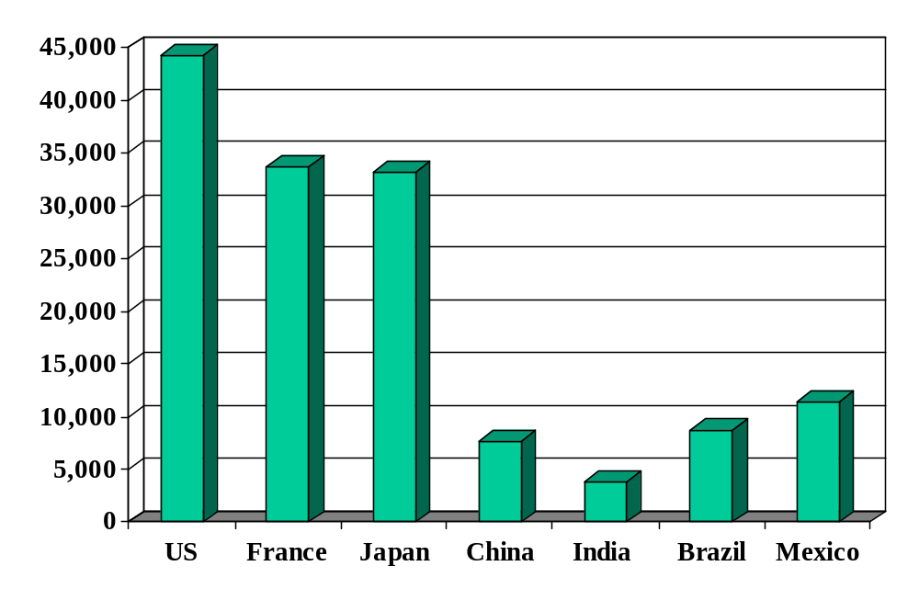
GDP per capita (2006, US dollars, PPP adj)
Source: World Bank, World Development Indicators.
Notes:
What are we talking about?

Slide 41
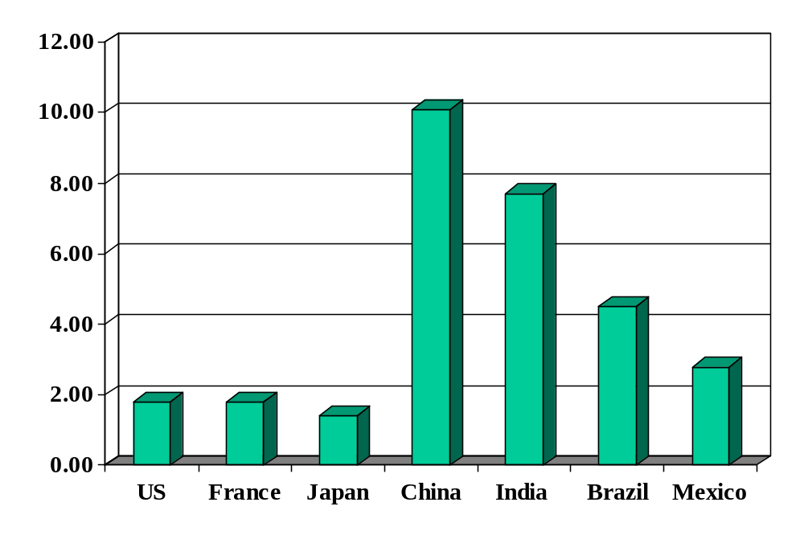
GDP growth (real, forecast for 2008, %)
Source: The Economist.

Slide 42
GDP
GDP = Gross Domestic Product
Total value of production in an economy
  Sum value-added by all production units
  Equals: sales minus material costs
  Equals: payments to labor and capital (owners)
  Equals: sales of final goods (the end of the value chain)
  Equals (almost): income

Slide 43
GDP
Example:
  Farmer produces wheat, sells it for 100
  Miller buys wheat, produces flour, sells it for 175
  Baker buys flour, makes bread, sells it for 300
What is value added for each producer?
What is GDP?
Who eats the wheat?

Slide 44
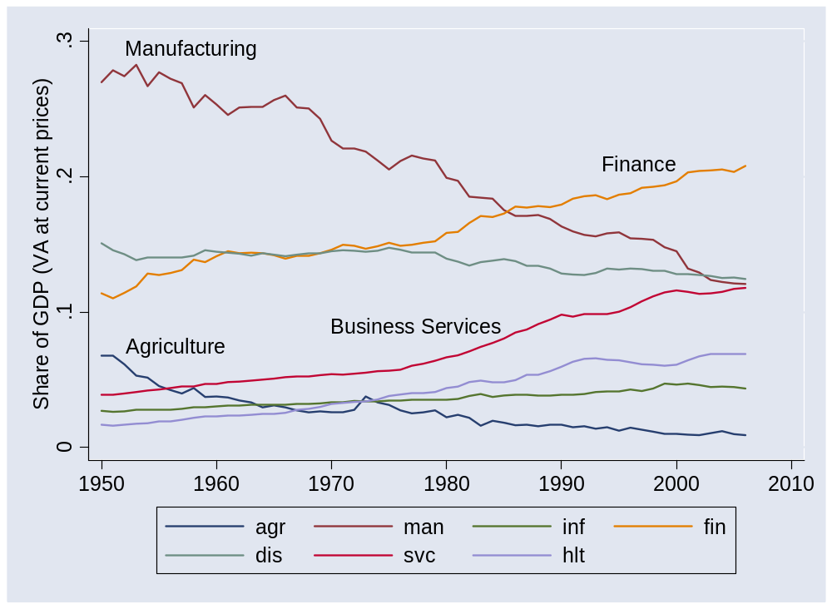
GDP by industry
Notes:
What does this mean? What does it tell us?

Slide 45
GDP
GDP = Gross Domestic Product
Total value of production in an economy (“output”)
  Sum value-added by all production units
  Equals: sales minus material costs
  Equals: payments to labor and capital (owners)
  Equals (almost): income
Why gross?
  All of these numbers include depreciation

Slide 46
GDP and income
Recall: GDP = payments to labor and capital (“almost income”)
In income but not in GDP
  Capital gains
  Interest on government debt
  Net foreign income
In GDP but not in income
  Depreciation
Bottom line
  GDP ≈ income [“≈” means “almost equals”]

Slide 47
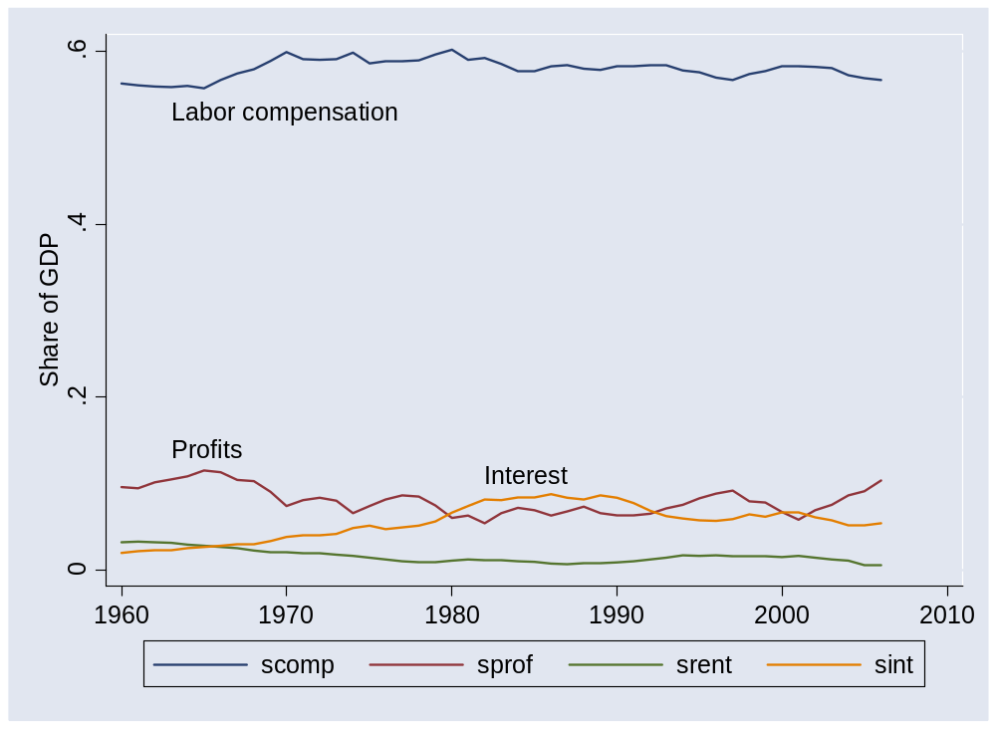
GDP by income component

Slide 48
GDP: real and nominal
GDP measured at market prices
  At current prices: “nominal”
  At base-year prices: “real”
What is
  GDP at 2000 prices?
  GDP in 2005 US dollars?
  GDP in 2000 international prices?
  GDP in 2000 USD PPP adjusted?
More on this shortly

Slide 49

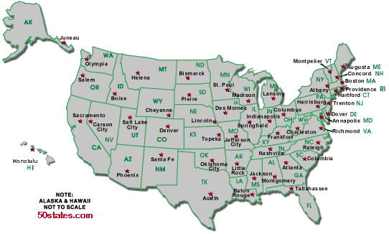
GDP and quality of life
Per capita GDP: $40k
Per capita GDP: $29k
Avg weekly hours: 35
Avg weekly hours: 29

Slide 50
Prices and quantities
Intel (say)
  Sales up 25% year-on-year
  How much is higher prices, how much greater quantities?
US economy: ditto
  GDP up 5% year-on-year
  How much is higher prices, how much more “stuff”?
Comment
  This is trickier than it looks

Slide 51
Prices and quantities
We measure value pretty well: sum price times quantity for many products
How do we divide value into price and quantity components?
p₁q₁ + p₂q₂ ?=? (p₁+p₂) (q₁+q₂)

Slide 52
Prices and quantities
Approach 1 (“fixed weight/price”) (“Paasche”)
  Compute GDP at current prices (“nominal GDP”)
  Compute GDP at constant prices (eg, 1990) (“real GDP”)
  Compute price deflator = ratio of first to second
  Inflation is rate of change of deflator
Approach 2 (“fixed basket/quantity”) (“Laspeyres”)
  Compute GDP at current prices (“nominal GDP”)
  Compute price index as cost of a fixed “basket” of products
  Compute real quantity as ratio of nominal quantity to index
  Inflation is rate of change of index

Slide 53
Prices and quantities
Example:
 | Fish |  | Chips
Date | Price | Quantity | Price | Quantity
2004 | 0.50 | 10 | 0.25 | 10
2005 | 0.75 | 12 | 0.50 | 8
What’s “real” output growth? What’s the inflation rate?

Slide 54
Prices and quantities
Fixed weight method (“GDP deflator”):
Date | Nominal GDP | Real GDP | Price Deflator
2004 | 7.50 | 7.50 | 1.000
2005 | 13.00 | 8.00 | 1.625
Growth rate | 73.3% | 6.7% | 62.5%
Base year: 2004.
Numbers in italics can be computed from the others.
Notes:
Where does this [pick one] number come from?

Slide 55
Prices and quantities
Fixed weight method (“GDP deflator”):
Date | Nominal GDP | Real GDP | Price Deflator
2004 | 7.50 | 12.50 | 0.600
2005 | 13.00 | 13.00 | 1.000
Growth rate | 73.3% | 4.0% | 66.7%
Base year: 2005.

Slide 56
Prices and quantities
Fixed basket method (“CPI”):
Date | Price Index (2004 Basket) | Price Index (2005 Basket)
2004 | 7.50 | 8.00
2005 | 12.50 | 13.00
Growth rate | 66.7% | 62.5%

Slide 57
Prices and quantities
Other issues
  Substitution bias. As some products get cheaper relative to others, people naturally buy more of them, less of the others. This substitution into cheaper products is ignored in fixed-weight indexes like the CPI.
  Quality adjustment. Adjust price increases for changes in product quality.
Impact
  Both adjustments tend to reduce our estimate of inflation and increase our estimate of real growth.

Slide 58
Prices and quantities
Bill Gross, PIMCO’s Investment Outlook, Oct 04:
  [Let’s talk about] the con job foisted on the American public about the low level of inflation. The government says that if the quality of a product goes up, then its price really didn’t go up and may actually have gone down. No wonder core inflation is under 2%. Why does the US government continue to foist this on a gullible public when they should know better? They do a disservice to those grounded in the reality of trying to stretch a paycheck.

Slide 59
Flow identities
What are we talking about? Why?
Notes:
Expenditures: who we sell to
Financing: how are expenditures financed?

Slide 60
Flows of goods
Allocate GDP among purchasers of final goods:
Y = C + I + G + NX
  Y = GDP (“output”)
  C = sales to households (“consumption”)
  I = sales of capital goods to firms (“investment”)
  G = purchases of goods and services by government
  NX = net exports (exports minus imports)
  We call these: “expenditure components”
  Can be real or nominal

Slide 61
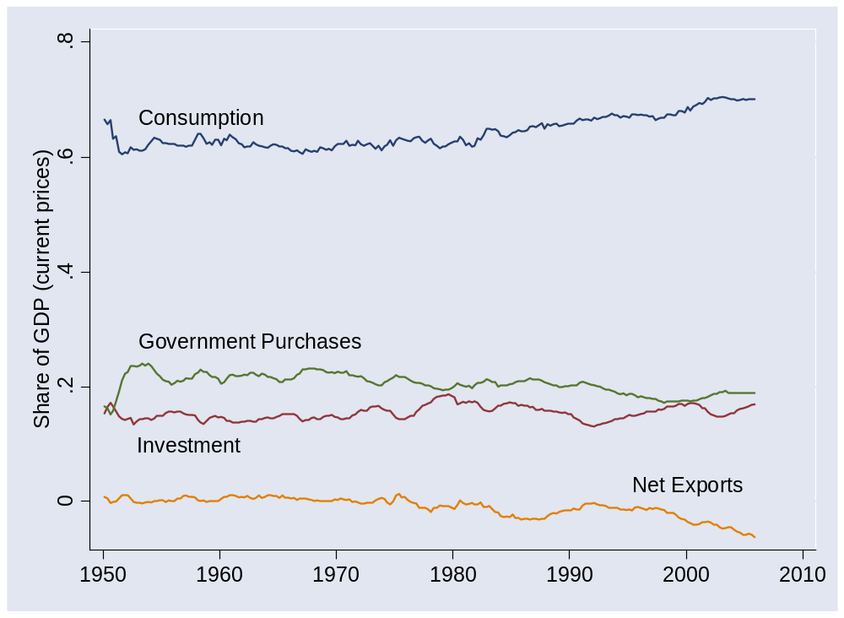
Flows of goods

Slide 62
Flows of assets (streamlined version)
Allocate flows of assets:
Y – C – G = I + NX
S = I + NX
  I = (gross) investment (new plant and equipment)
  S = (gross) national saving (purchases of assets)
  NX = net purchases of foreign assets
Why are these “flows of assets”?

Slide 63
Flows of assets (streamlined version)
Households+ Govt
S
Financial Markets
I
Firms
NX
Rest-of-World

Slide 64
Flows of assets
Allocate flows of assets:
(Y–C–T) + (T– G) = I + NX
S_{p} + S_{g} = I + NX
  T = taxes net of transfers paid by households to govt
Beware: many measures of saving
  Sometimes we subtract depreciation from both S and I (“net”)
  Useful for confusing amateurs
Later in the course
  We’ll include income and transfers with foreign countries and replace NX with the “current account”

Slide 65
Flows of assets
Households
S_{p}
Financial Markets
I
Firms
Government
S_{g}
NX
Rest-of-World

Slide 66
Do Americans save too little?
Notes:
Write down the list

Slide 67
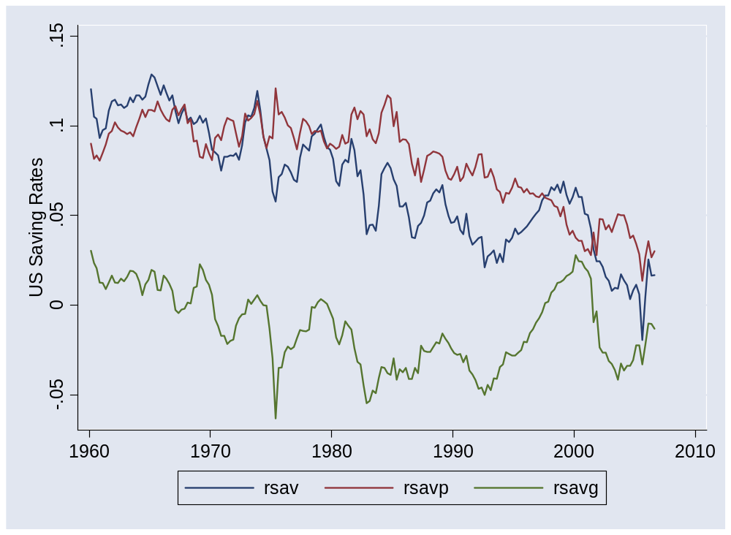
US saving rates
Source: US NIPA.
Notes:
Capital flowing “into” US

Slide 68
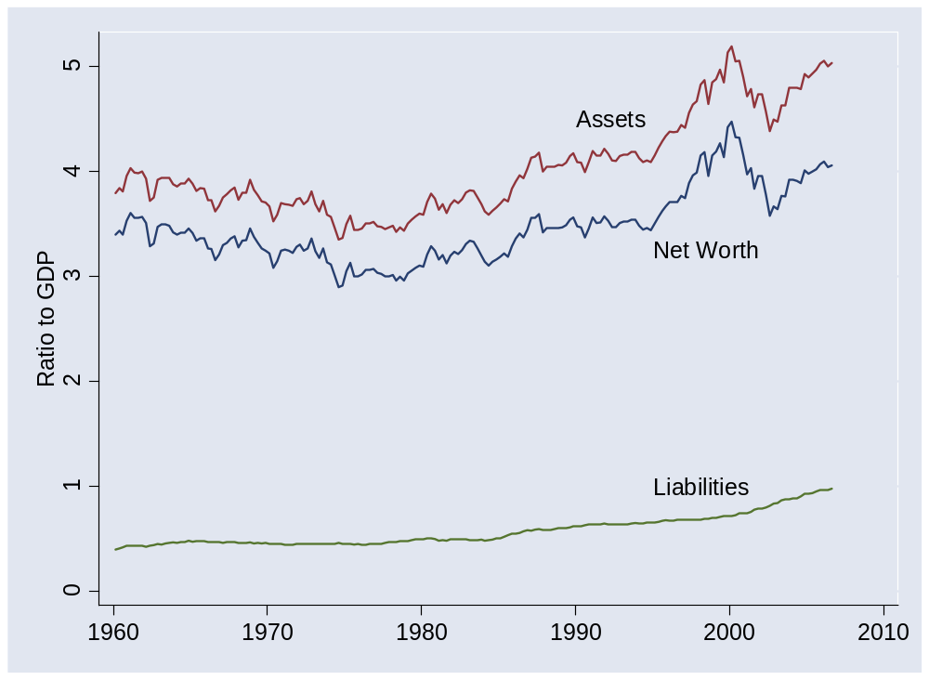
US net worth
Source: US, Federal Reserve, Flow of Funds Accounts.
Notes:
Capital flowing “into” US

Slide 69
Saving and net worth
How can net worth be high if saving is low?
Notes:
Write down the list

Slide 70
What’s coming up

Slide 71
Tomorrow (Wed Jan 30)
GDP release
  Fourth quarter advanced estimate
  Released at 8:30 am
  What do we expect?
  Impact on interest rates and equity prices?
  http://bea.gov/bea/newsrel/gdpnewsrelease.htm
FOMC meeting
  Statement released at 2:15 pm
  What do we expect?
  http://www.federalreserve.gov/FOMC/

Slide 72
Group Project #1
Due before next class
  Submit by 9am via Blackboard
Based on this class
Stop by if you have questions
Don’t panic
Get started!
Notes:
Questions?

Slide 73
International students
Please come to the next class ready to speak briefly about your country [aim for <1 minute]
  What has it done to encourage economic growth?
  What else do you think it should do?
  Email me answers by Monday noon
  Thank you!

Slide 74
National accounts: summary
Production
GDP
Income
Labor, Capital
Expenditures
C,I,G,NX
Think about setting up income statements for each sector: households + govt, firms, ROW
Financial Flows
S = I + NX

Slide 75
What have we learned?

Slide 76
Takeaways
Economic data are like sausages
GDP: output, income, economic performance
Separating prices and quantities is tricky: we do our best
Flows of goods and assets
  Goods: Y = C + I + G + NX
  Assets: S = I + NX
Get to work: Group Project #1 due next week

