Slide 1

The Global Economy
Capital and labor markets
© NYU Stern School of Business

Slide 2
Regulation
Is government regulation of capital and labor markets good or bad for economic performance?
Give examples – from any country you like.
Notes:
Rule of thumb: capital good, labor bad
Share/pair/square

Slide 3
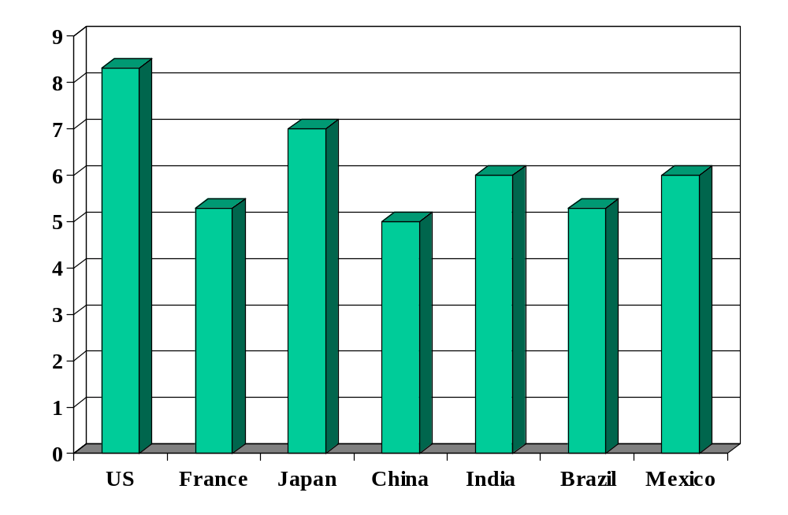
Investor protection (index)
Source: World Bank, Ding Business.

Slide 4
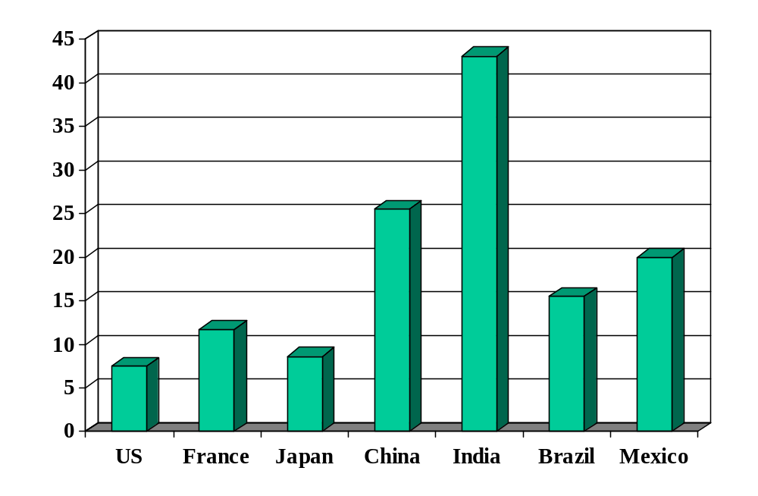
Cost of enforcing contracts (% of debt)
Source: World Bank, Doing Business.

Slide 5
What’s going on in France?
Claim: difference in economic performance between France and US is largely the result of labor laws
May even explain low employment rates of recent immigrants and the 2005 riots in the “banlieues”
  Gary Becker: “Generous minimum wages and other rigidities of the French labor market caused unemployment rates that have remained stubbornly high since the early 1990's. Immigrants, youths, and other new entrants into the labor market have been hurt the most.”
  Link
Plausible or not?

Slide 6
Plan of attack
Regulation ✓
What’s going on in France? ✓
Where we’ve been, where we’re headed
Stories and pictures
France and US
Labor market institutions (several parts)
France revisited

Slide 7
Where we’ve been
Good institutions
  Rule of law
  Property rights
  Open competitive markets

Slide 8
Where we’re headed
Long-Run Performance
Production, Saving & Investment, Productivity, Institutions, Capital & Labor Markets, International Trade
First half:
Short-Run Performance
Inflation, Business Cycle Indicators, Monetary Policy, Taxes & Deficits, Exchange Rates, Capital Flows, Emerging Market Crises
Second half:

Slide 9
Labor markets in France
Christopher Caldwell, Financial Times, Feb 2005:
  In early 2000, when the French unemployment rate was 9.6%, Martine Aubry, the Socialist labour minister, shepherded into law a bill that capped the work-week of most employees at 35 hours. She called it “a necessity for job creation.” Today, the unemployment rate stands at 9.9% … and French labour participation is rock-bottom among developed countries.

Slide 10
Labor markets in France
The Economist, Feb 1 07:
  These days a new hazard is blocking the French capital's pavements: smokers fleeing the country's new anti-tobacco law. The country's strict working-time rules, though, add a particular French twist: should smoking breaks be counted as part of the 35-hour week?

Slide 11
Labor markets in France
Financial Times, Feb 12 07:
  Presidential candidate Segolene Royal laid out her economic vision, which includes: increase the minimum wage, merge state-owned electricity and gas utilities, scrap laws that make it easier for small companies to hire and fire employees; demand that the European Central Bank focus on economic growth.

Slide 12
Labor markets in France
The Economist, Feb 1 07:
  France’s centre-right presidential candidate Nicolas Sarkozy took his campaign to London, calling it “one of the biggest French cities.” London is thought to have at least 300,000 French citizens – and voters – some of whom left “in desperation,” said Sarkozy. He called on them to help revive France’s “blocked society.” Journalists noted that France’s unemployment rate is 8.6%, compared with 5.5% in Britain, and has not dipped below 8% for nearly 25 years.

Slide 13
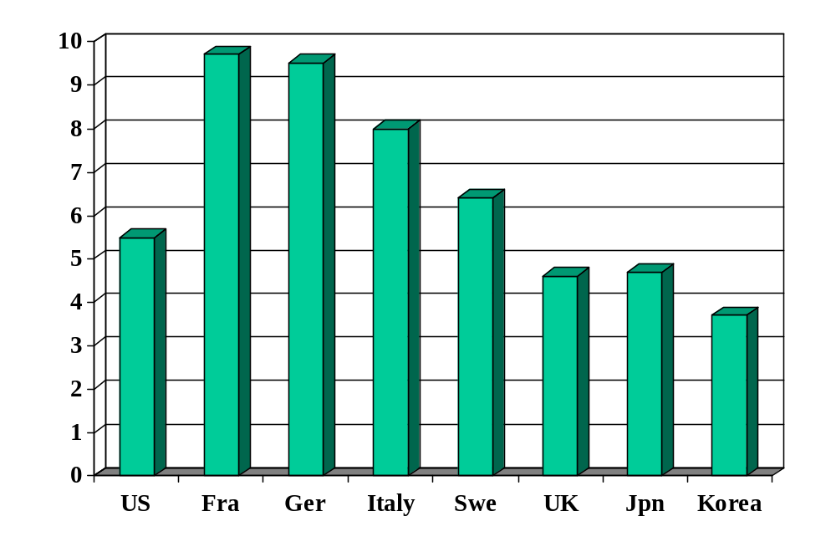
Unemployment rate (% of labor force)
Source: OECD, Employment Outlook; standardized rates intended to be comparable across countries.

Slide 14
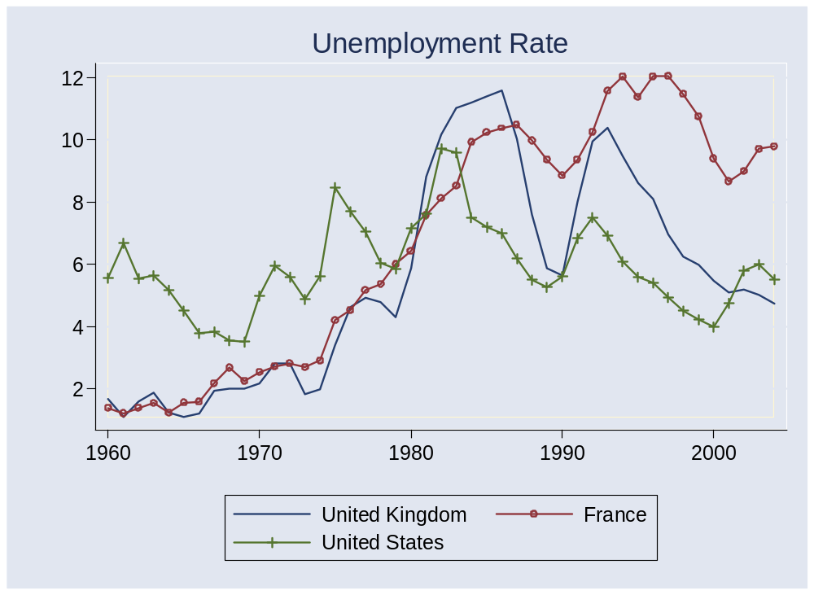
Unemployment rates
Source: OECD, Main Economic Indicators.

Slide 15
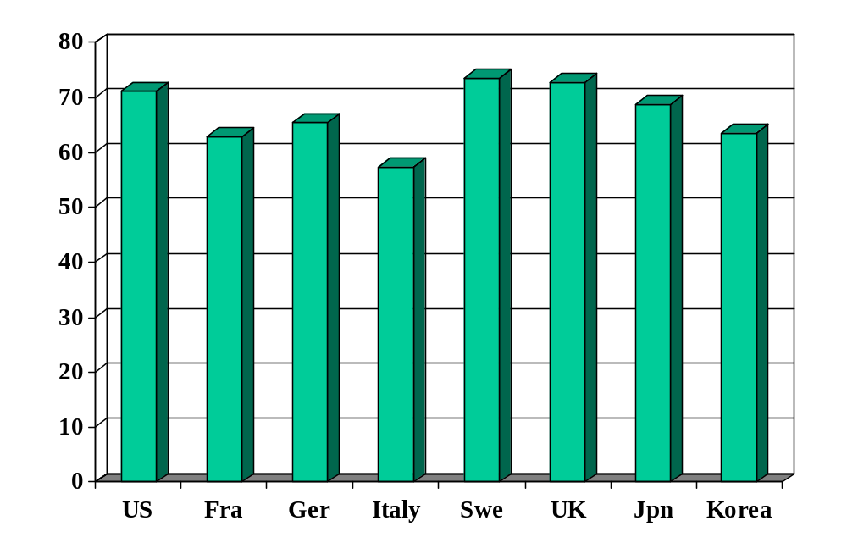
Employment rate (% of 15-64)
Source: OECD, Employment Outlook.

Slide 16
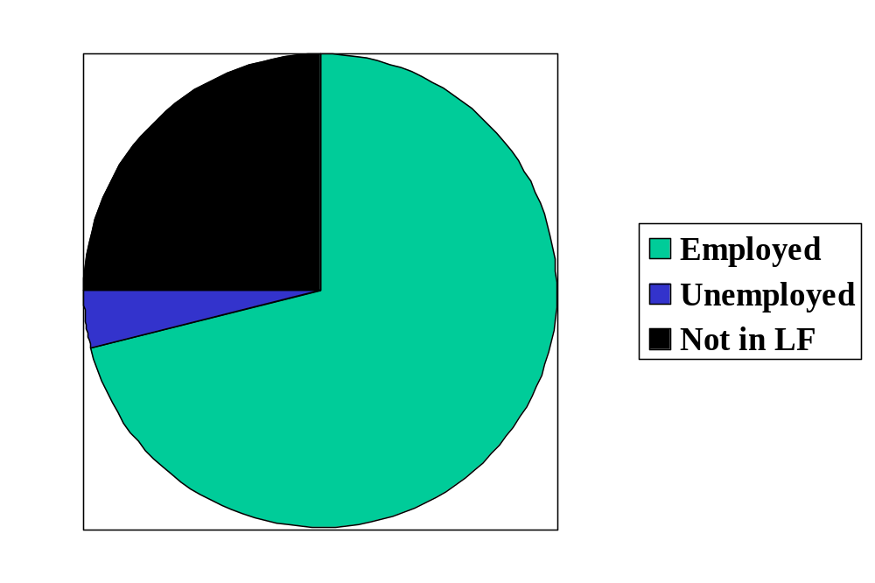
Labor market status in the US
Source: OECD, Employment Outlook, 2006. Numbers are percentages of the population 15-64.
Notes:
Draw this on board, show what universe and pieces are

Slide 17
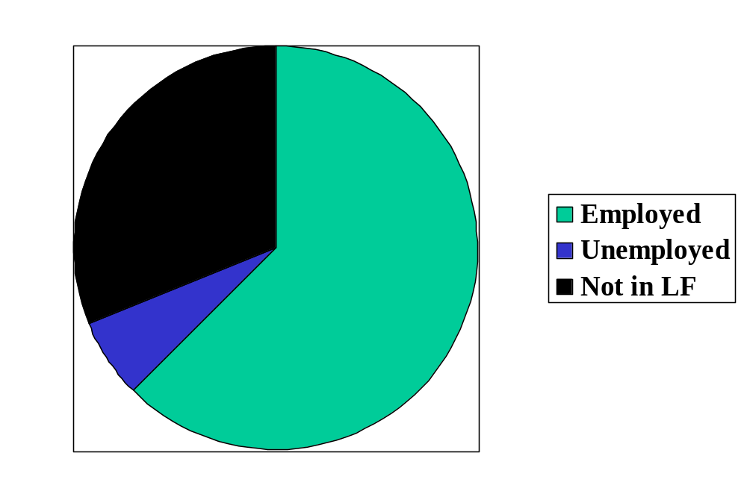
Labor market status in France
Source: OECD, Employment Outlook, 2006. Numbers are percentages of the population 15-64.

Slide 18
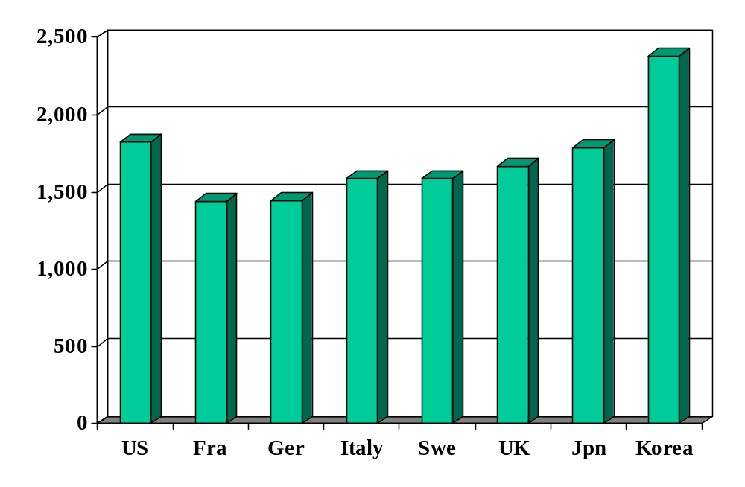
Hours worked (per person per year)
Source: OECD, Employment Outlook.

Slide 19
France and US
 | Y/POP | L/POP | h
US | 34,875 | 0.514 | 1806
France | 25,664 | 0.451 | 1532
Ratio | 1.36 | 1.14 | 1.18
Log of ratio (%) | 30.7 | 13.1 | 16.5
Source: Penn World Tables, version 6.2, and OECD, Employment Outlook.

Slide 20
France and US
 | Y/POP | Y/L | Y/hL
US | 34,875 | 67,865 | 37.58
France | 25,664 | 56,909 | 37.12
Ratio | 1.36 | 1.19 | 1.012
Log of ratio (%) | 30.7 | 17.6 | 1.1
Source: Penn World Tables, version 6.2, and OECD, Employment Outlook.

Slide 21
France and US
Why such large differences in employment, unemployment, and hours worked?

Slide 22
Labor market institutions
Employment “protection” laws
Industrial relations / trade unions
Minimum wages
Rigidity of hours, hiring and firing

Slide 23
Employment protection laws (EPL)
What are they?
  Laws that govern employment contracts
Examples
  Duration of contract
  Overtime compensation
  Layoffs
  Dismissals

Slide 24
Portugal v New Zealand
Fixed-term contracts
PRT Fixed term contracts allowed only in special situations (such as seasonal activity)
NZL Fixed term contracts are unrestricted, with no maximum duration period

Slide 25
Portugal v New Zealand
Overtime
PRT Mandatory premium for overtime work ranges from 50% to 75%, additional restrictions on night work, and there are 24 days of paid leave per year
NZL No required premium for overtime work, no restrictions on night work, and the minimum paid leave is 15 days per year

Slide 26
Portugal v New Zealand
Dismissal
PRT Has a list of fair grounds for termination and stringent procedural limitations on dismissals, such as mandatory notification of the government and priority rules for re-employment of redundant workers.
NZL Allows “contracts at will,” which can be terminated with notice without cause
Source: Botero, Djankov, La Porta, Lopez-de-Silanes, Shleifer, 2003

Slide 27
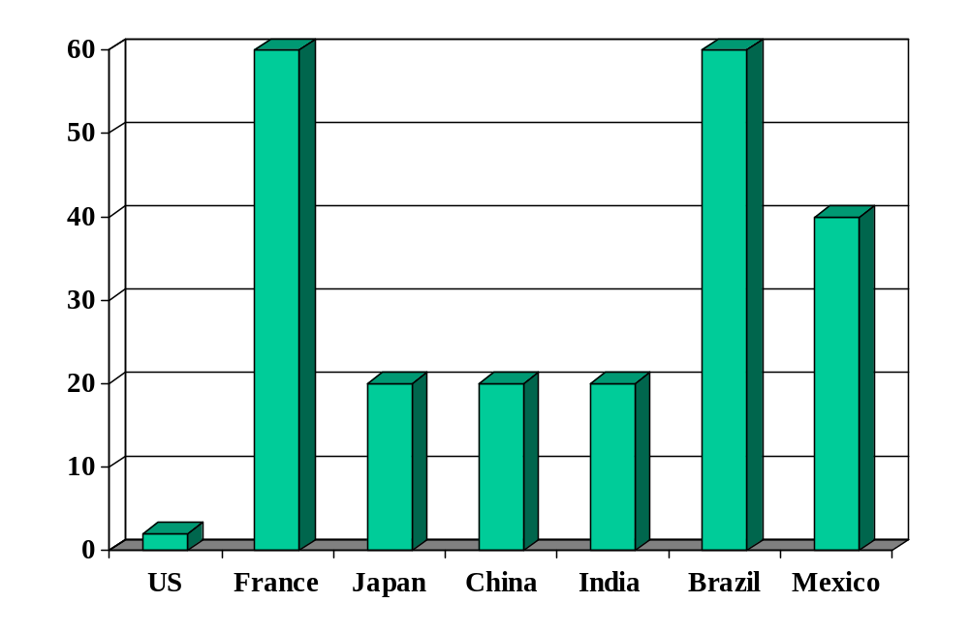
Rigidity of hours (index)
Source: World Bank, Ding Business.

Slide 28
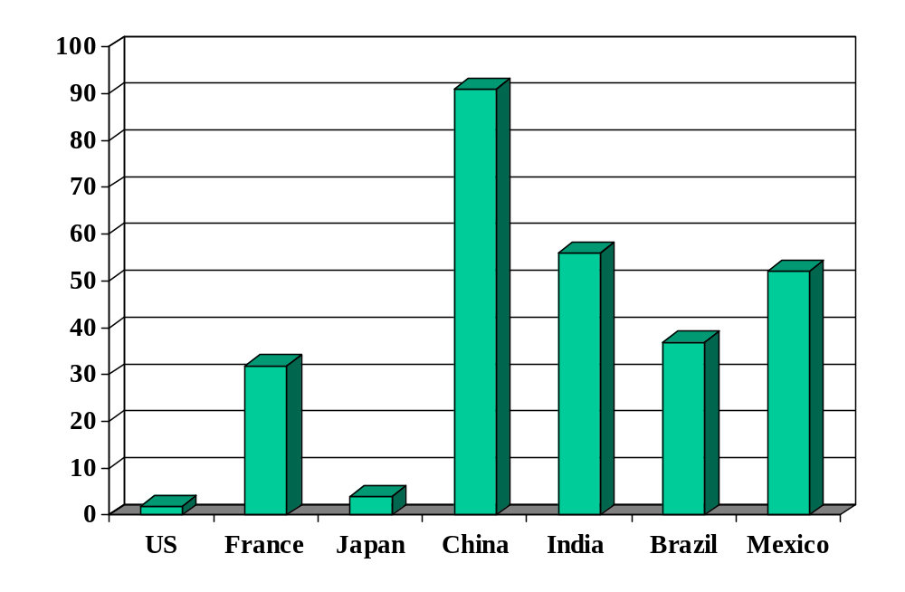
Firing costs (weeks of wages)
Source: World Bank, Ding Business.

Slide 29
Industrial relations laws
What are they?
  Laws that govern collective bargaining, enforcement of collective agreements, and the organization of trade unions
Examples:
  Employers’ duty to bargain with unions
  Extension of collective contracts to third parties
  Right to strike
  Right of unions to appoint company directors

Slide 30
Portugal v New Zealand
Collective bargaining
PRT Employers have a legal duty to bargain with unions, collective agreements are extended to third parties by law, workers councils are mandatory, and employer lockouts are prohibited.
NZL Employers have no legal obligation to bargain with unions, collective agreements are not legally extended, labor participation in management is not required by law, and employer lockouts are allowed.
Source: Botero, Djankov, La Porta, Lopez-de-Silanes, Shleifer, 2003

Slide 31
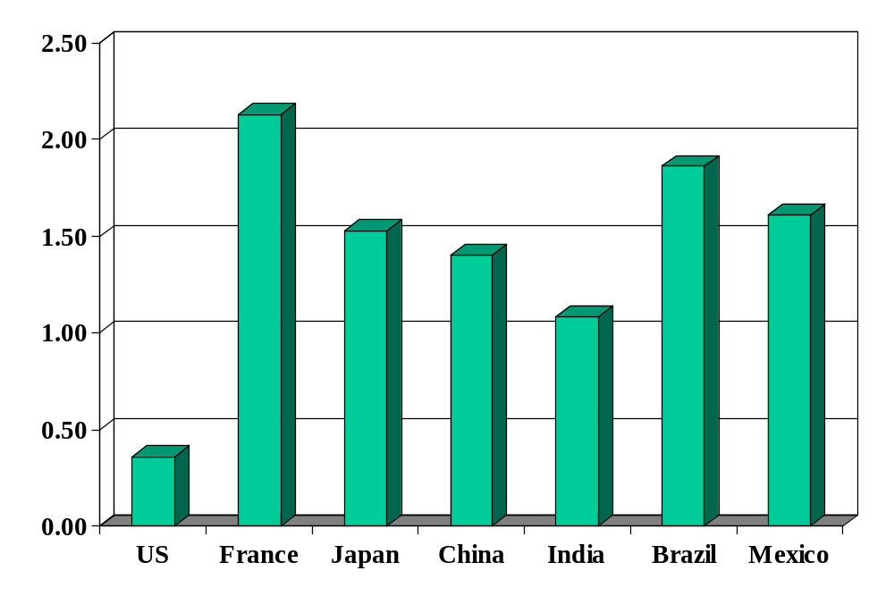
Union rights (index)
Source: Botero, Djankov, La Porta, Lopez-de-Silanes, Shleifer, Regulation of Labor.

Slide 32
Minimum wage
Good or bad? For whom?

Slide 33
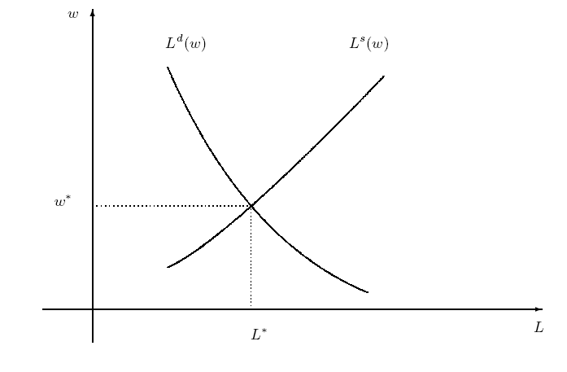
Labor market

Slide 34
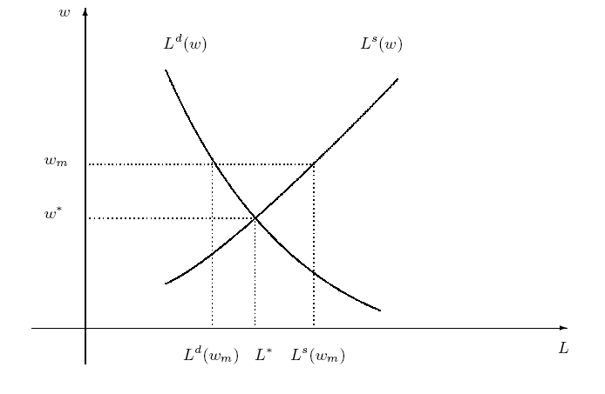
Labor market with min wage
Are we better off?
Who’s “we”?
Notes:
Is this a big deal in the US? Elsewhere?

Slide 35
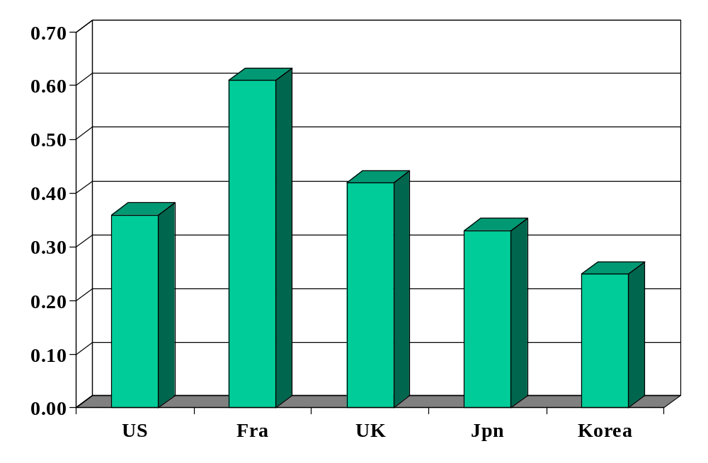
Minimum wage (ratio to median wage)
Source: OECD, employment database.

Slide 36
France revisited
Why are employment and hours lower than in US?
Would you build a plant there? Locate a bank?

Slide 37
What have we learned?

Slide 38
Takeaways
Fact: Countries differ widely in labor market institutions (laws and regulations)
Fact: Labor market indicators/outcomes also differ
  Employment rate, unemployment rate, hours worked
These differences are
  Probably related
  A fact of life if you’re running a business

Slide 39
The Global Economy
Dynamics and volatility
© NYU Stern School of Business
Notes:
World is volatile

Slide 40
The “stimulus package”
From Mankiw’s blog:
  The NY Times reports: “[A]dministration officials are counting on a lift this summer from the $168 billion economic stimulus package that Congress passed last week. ... [They] predicted that the stimulus package would create an additional 500,000 jobs this year.”
  Mankiw’s comment: “In other words, each job created adds $336,000 to the national debt.”
Is the stimulus package good or bad? Why?
Notes:
Summary: they stopped messing up

Slide 41
Mo Ibrahim
Telecoms engineer and entrepreneur
Built African mobile network
Supports improved governance in Africa
  “Nothing, simply nothing, is more important for Africa than good governance.”
  Ibrahim Index of African Governance intended to expose poor governance.
  Ibrahim Prize awarded to leader who rules fairly and turns power over to a successor.
FT interview, Feb 16 08
Good ideas?

Slide 42
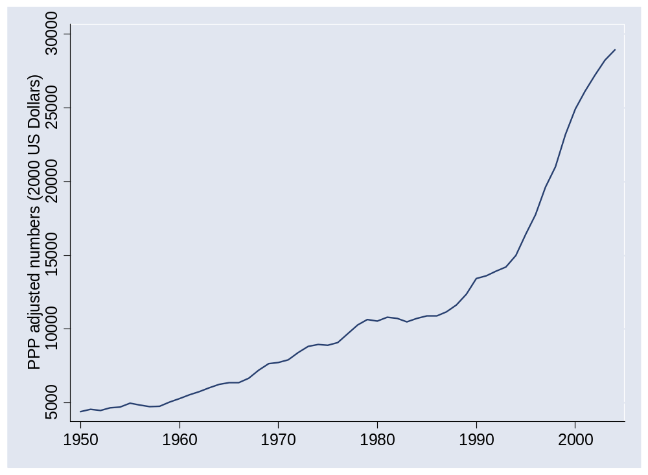
What happened in Ireland?

Slide 43
What happened in Ireland?
At the request of Helvecio Borges Guimaraes
Why did growth accelerate in early 1990s?

Slide 44
What happened in Ireland?
 | Y/L | K/L | A
1950 | 10,227 | 21,074 | 370
1993 | 36,640 | 86,685 | 828
2003 | 65,925 | 131,131 | 1,298
Contribution 1950-93 | 2.97 | 1.10 | 1.87
Contribution 1993-2003 | 5.87 | 1.38 | 4.49

Slide 45
What happened in Ireland?
EU membership, aid recipient
Fiscal discipline (>1987)
  Government hiring frozen
  Personal and corporate tax rates slashed
Attractive terms for foreign firms
  Lowest corporate tax rates in OECD
Peaceful labor relations
Notes:
Summary: they stopped messing up

Slide 46
Plan of attack
Mo Ibrahim, stimulus, Ireland ✓
Volatility: quotes and pictures
Labor market volatility (“transitions”/“flows”)
Volatility and labor market flexibility
What have we learned?
What’s coming up

Slide 47
Marx and Engels
Communist Manifesto (1848):
  Everlasting uncertainty and agitation distinguish the bourgeois epoch from all earlier ones. All fixed, fast frozen relations, with their train of ancient and venerable prejudices and opinions, are swept away, all new-formed ones become antiquated before they can ossify. All that is solid melts into air, all that is holy is profaned, and man is at last compelled to face with sober senses his real condition of life and his relations with his kind.
  All old-established national industries have been destroyed or are daily being destroyed. They are dislodged by new industries, whose introduction becomes a life and death question for all civilized nations.
Notes:
http://www.marxist.net/marx/index.html

Slide 48
Joseph Schumpeter
Capitalism, Socialism and Democracy (1942):
  The fundamental impulse that sets and keeps the capitalist engine in motion comes from the new consumers, goods, the new methods of production or transportation, the new markets, the new forms of industrial organization that capitalist enterprise creates. This process of Creative Destruction is the essential fact about capitalism.
  In capitalist reality, competition … strikes not at the margins of the profits and the outputs of the existing firms but at their foundations and their very lives.

Slide 49
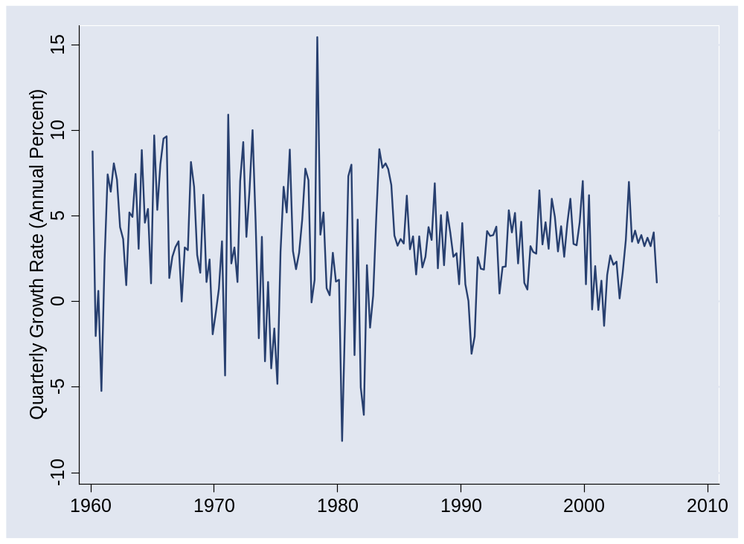
Macro volatility (US GDP growth)
Notes:
Does this seem right to you? Is the world less volatile?

Slide 50
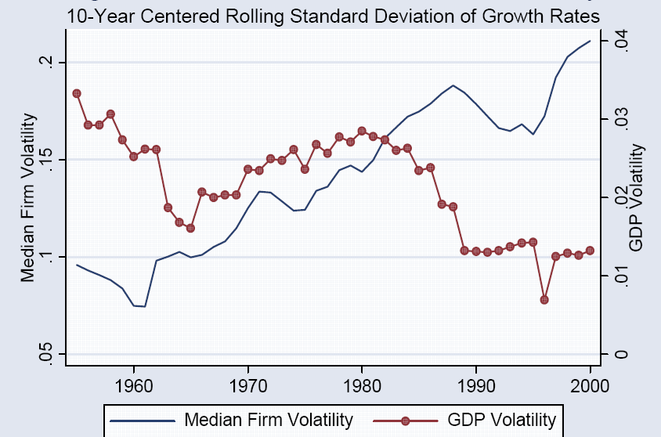
Macro and micro volatility
Source: Comin and Philippon, NBER Macro Annual, 2006.

Slide 51
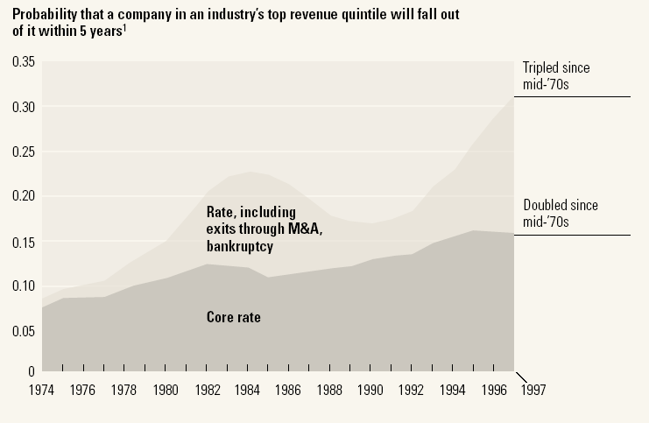
Firm volatility
Source: McKinsey Quarterly, “Extreme competition,” 2005.

Slide 52
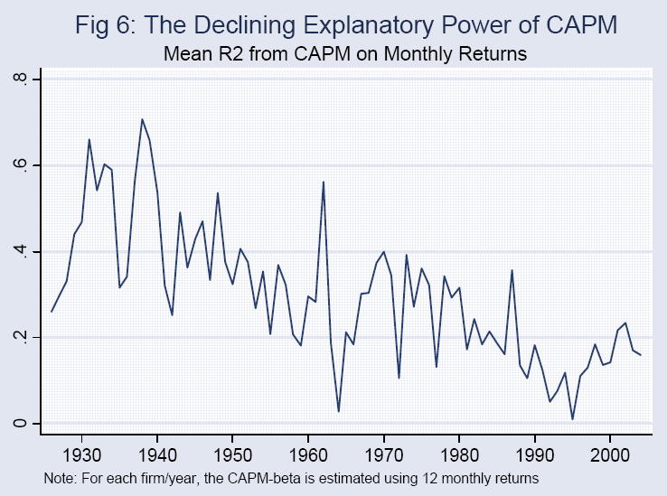
Stock volatility
Source: Comin and Philippon; see also Morck, Yeung, Yu, JFE, 2000.

Slide 53
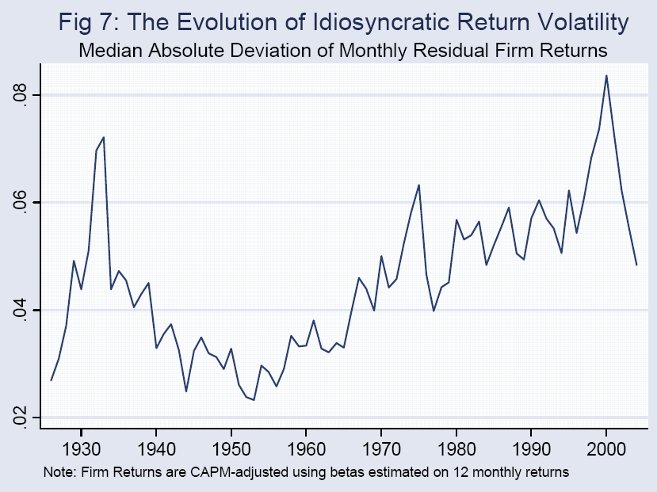
Stock volatility
Source: Comin and Philippon; see also Morck, Yeung, Yu, JFE, 2000.

Slide 54
Why?
Why more micro volatility? Good or bad?

Slide 55
Labor market volatility
We measure people changing jobs in a variety of ways

Slide 56
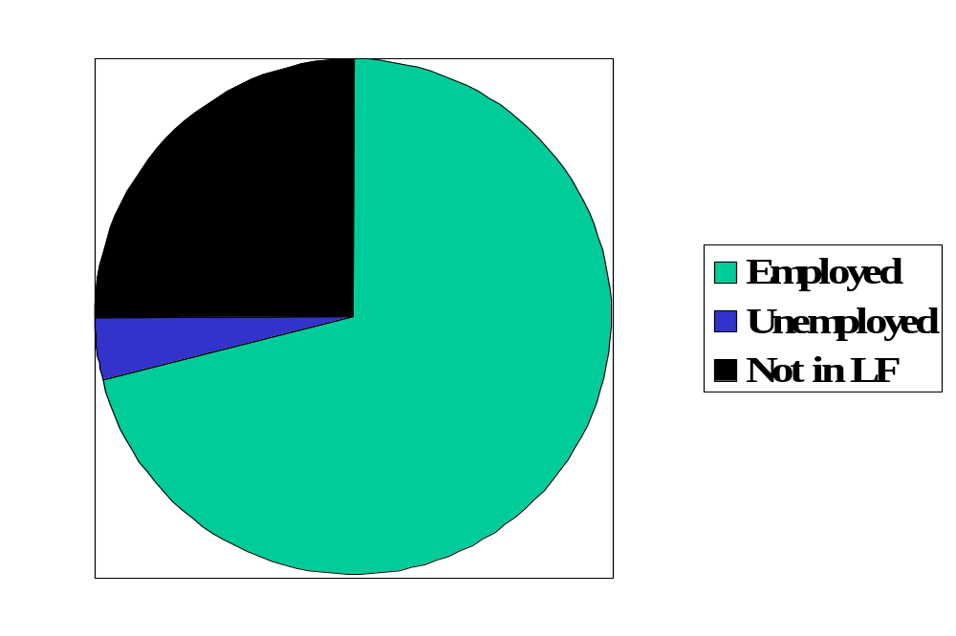
Reminder: labor market status (US)
Source: OECD, Employment Outlook, 2006. Numbers are percentages of the population 15-64.
Notes:
Draw this on board, show what universe and pieces are

Slide 57
Labor market “flows” (“transitions”)
Transitions
  How many people change “status” from month to month?
Aggregate measures of turnover
  Accessions: number of workers taking new jobs, whether their previous status was employed, unemployed, or not in labor force
  Separations: number of workers leaving current jobs, whether they become employed, unemployed, or leave labor force
Bottom line: enormous turnover

Slide 58
Labor market flows (avg, 1993-2005)
Monthly!
Percentages apply to “source” of flow
2.6% “job-to-job”
Employment
122.0m
1.3%
4.8%
28.3%
2.7%
2.4%
Unemployment
6.2m
Out of labor force
59.3m
23.3%
Source: US data, monthly, reported in Davis, Faberman, and Haltiwanger, “Flow approach,” 2005.

Slide 59
Labor market flows in US and EU
 |  | Workers and Jobs
Country | EPL | Accessions | Separations | Reallocation
Denmark | 1.8 | 29.0 | 29.0 | 58.0
France | 2.8 | 28.9 | 30.7 | 59.6
Germany | 2.5 | 31.6 | 30.4 | 62.0
Italy | 2.5 | 34.5 | 33.6 | 68.1
Sweden | 2.6 | 16.8 | 17.8 | 34.6
UK | 1.2 | 37.2 | 37.6 | 74.8
USA | 0.7 | 45.2 | 46.0 | 91.2
Source: OECD, Employment Report, 1994; numbers are annual percentages of labor force.
Notes:
What do you see?

Slide 60
Sources of micro volatility
Products come and go
Industries come and go
Good or bad?
What does this mean for capital? Labor?
Were the Luddites right?

Slide 61
Micro volatility and labor markets
What happens when you mix
  employment protection
  and micro volatility?

Slide 62

Ljunqvist and Sargent
Volatile Economy
+
Inflexible Labor Market

Slide 63
What have we learned?

Slide 64
Takeaways
Modern economies are volatile
Flexible markets improve aggregate performance …
…but individual firms and workers must deal with the uncertainty

Slide 65
What’s coming up
Global Business Conference
  Friday in Kimmel
  Perfect for Final Group Project ideas!
Group Project #4 not due for 2 weeks
Read mini-cases before next week’s class

Slide 66
Extra slides

Slide 67
Labor markets in Germany
Financial Times, Feb 13 06:
  Diether Klingelnberg knows what’s holding the German economy back: there is no incentive for (mid-sized) firms like his to hire new workers. Demand is good, we have more than enough orders, but without greater labor flexibility and predictability of social security and healthcare costs, companies are increasingly likely to move production abroad.

Slide 68
Labor markets in Hong Kong
Financial Times, February 2005:
  People routinely work Saturday mornings, have long work weeks (50-55 hours)
  Pressure on unskilled workers as jobs move to China
  Proposal: minimum wage, cap on hours
  Advocates: min wage would reduce unemployment by making work more attractive

Slide 69
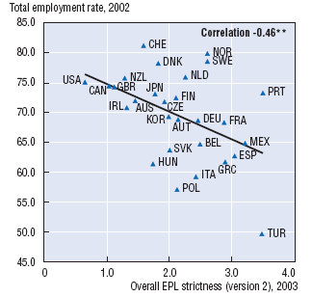
Protection and employment
Source: OECD, Employment Outlook, 2004.

Slide 70
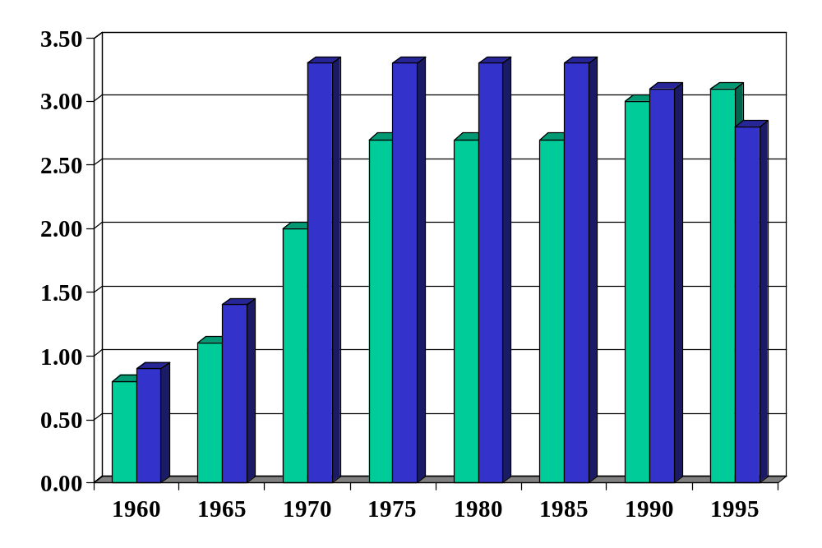
Employment protection in Europe
Green = FRA
Blue = DEU
Source: Blanchard and Wolfers.
Notes:
http://bpp.wharton.upenn.edu/jwolfers/research.shtml

Slide 71
Labor market indicators (“outcomes”)
Employment rate = employed/(working-age) population
Labor force = employed + unemployed
Unemployment rate = unemployed/labor force
Participation rate = labor force/working-age population
Inactivity rate = out of labor force/working-age population
Hours worked = average hours worked of employed people

Slide 72
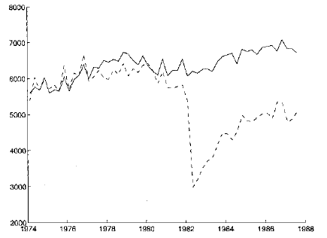
Displaced workers
Average quarterly earnings of “stayers” and “separators”
“stayers”
“separators”
Source: Ljungqvist and Sargent, JPE, 1999; adapted from Jacobson et al, AER, 1993.

Slide 73
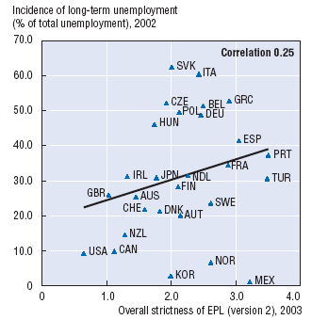
Protection and unemployment
Source: OECD, Employment Outlook, 2004.

Slide 74
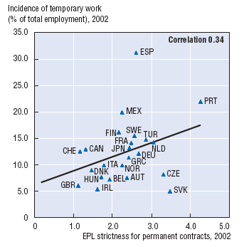
Protection and temporary work
Source: OECD, Employment Outlook, 2004.

Slide 75
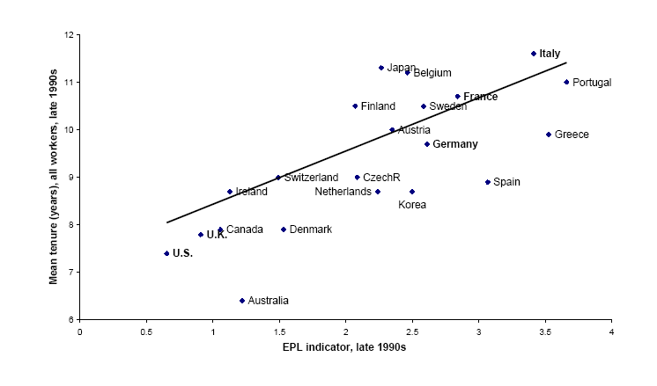
Employment protection and tenure
Source: Bertola, 2001.

Slide 76
Employment protection and tenure
Source: Bertola, 2001.

Slide 77
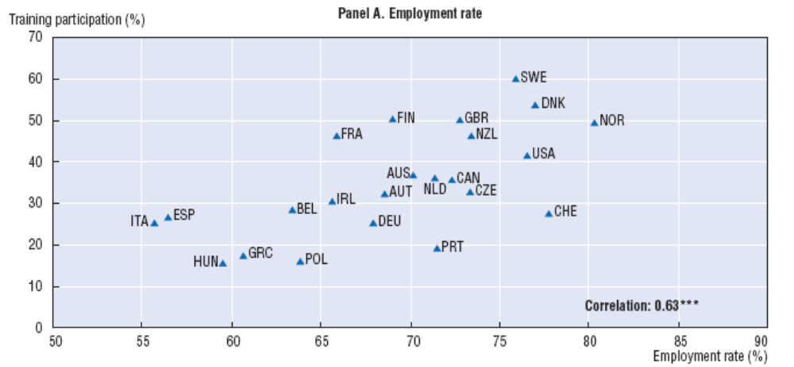
Training and employment
Source: OECD, Employment Outlook, 2004.

Slide 78
Labor markets in the US
The Economist, Jan 18 07:
  NESTLED among the wooded Blue Ridge mountains in Virginia's far south-west, Galax is a town of bluegrass music, barbecue and hardscrabble living. Globalization has hit hard. Last year … three big [furniture] factories closed their doors within months.
  For some, the future looks bleak. At 59, Paul Rotan sees little chance of finding another job with health insurance. But other, mainly younger, workers are already better off.
  [This is the way trade and innovation work.] Displaced workers should find new jobs, but their wages will probably fall. Although the country overall gains handsomely, these people are often worse off.
Link

