Slide 1

The Global Economy
Monetary Policy Objectives
© NYU Stern School of Business
Notes:
Board: GP5, Greenspan,
Open IE, get Nasdaq chart
Mon policy: rates down 300bps with inflation rising
Generally mysterious?

Slide 2
Reminders
Seating
  Please join your classmates: avoid the back row and far right section.
Participation
  We have some experts in the class, which is great, but it’s helpful to all if the non-experts ask questions, too.

Slide 3
Group Project #5
What’s your forecast for employment growth?
What indicators did you use?

Slide 4
Plan of attack
Group Project #5 ✓
Where we’re headed
Quotes and picture(s)
Aggregate supply and demand
Greenspan mini-case

Slide 5
Where we’re headed
Long-Run Performance
Production, Saving & Investment, Productivity, Institutions, Capital & Labor Markets, International Trade
First half:
Short-Run Performance
Inflation, Economic Indicators, Aggregate Supply & Demand, Monetary Policy, Taxes & Deficits, Exchange Rates, Capital Flows, Emerging Market Crises
Second half:

Slide 6
Milton Friedman
“Stone money,” in Money Mischief

Slide 7
David Ricardo
Proposals for a secure currency, 1816:
  The introduction of precious metals may with truth be considered one of the most important steps towards the improvement of commerce; but it is no less true that, with the advance of knowledge and science, it would be another improvement to banish them altogether [in favor of paper money].

Slide 8
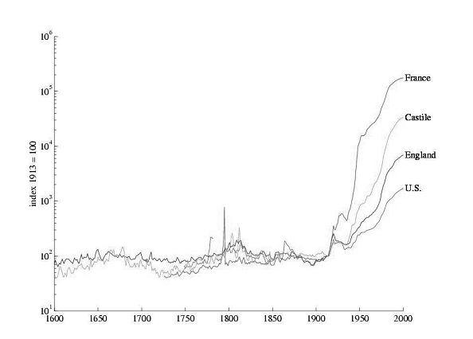
Prices through history

Slide 9
Federal Reserve
Federal Reserve Act
  The Federal Reserve System and the Federal Open Market Committee should seek “to promote effectively the goals of maximum employment, stable prices, and moderate long-term interest rates.”

Slide 10
ECB
ECB = European Central Bank
Treaty establishing the European Community:
  The primary objective of [monetary policy] shall be to maintain price stability.
  Without prejudice to the objective of price stability, the ECB shall support the general economic policies in the Community with a view to contributing to the achievement of … a high level of employment and sustainable and non-inflationary growth.

Slide 11
Banco Central de Argentina
BCRA Act (2003):
  The Argentine Central Bank is a National State self-governed institution, whose primary and fundamental mission is to preserve the value of the Argentine currency.

Slide 12
Ben Bernanke
Testimony to Congress, November 2005:
  Middle-income living standards, and poverty for that matter, are best addressed through employment growth. By maintaining low inflation and low expectations of inflation, you can create new employment.

Slide 13
Aggregate supply and demand
Reminder
  Aggregate demand concerns purchases of goods
  Aggregate supply concern production of goods

Slide 14
Aggregate supply and demand
What are our goals?
  Low inflation
  Output near “potential output” Y* [invisible hand again]

Slide 15
Aggregate supply and demand
What’s coming
  How should we respond to demand shocks?
  How should we respond to supply shocks?

Slide 16
Aggregate supply and demand
P
AS*
AS
Is this good or bad?
A
AD
Y

Slide 17
Aggregate supply and demand
What happens when we increase the money supply?

Slide 18
Aggregate supply and demand
P
AS*
AS
Is this good or bad?
B
A
AD
AD'
Y

Slide 19
Aggregate supply and demand
What’s an example of an adverse demand shock?
What is its impact?
How should we respond?

Slide 20
Aggregate supply and demand
P
AS*
AS
What should policy do?
A
B
AD'
AD
Y

Slide 21
Aggregate supply and demand
What’s an example of an adverse supply shock?
What is its impact?
How should we respond?

Slide 22
Aggregate supply and demand
P
AS*
AS
B
What should policy do?
A
AD
Y

Slide 23
Aggregate supply and demand
How should we respond to demand shocks?
How should we respond to supply shocks?
How can we tell them apart?

Slide 24
Greenspan mini-case
Indicators of GDP growth?
Indicators of inflation?
Are we facing supply or demand shocks?
What should we do?

Slide 25
Greenspan mini-case
Notes:
AS/AD diagram

Slide 26
Takeaways
Goals of monetary policy
  Resist demand shocks
  Accommodate supply shocks
Real-time policy
  How do you tell the difference?

Slide 27
After the break
Be prepared to comment on where interest rates come from

Slide 28
The Global Economy
Monetary Policy and Interest Rates
© NYU Stern School of Business
Notes:
Where do interest rates come from?
Are they too low, too high, or just right now?

Slide 29
Where do interest rates come from?
Notes:
Sex education for bond traders

Slide 30
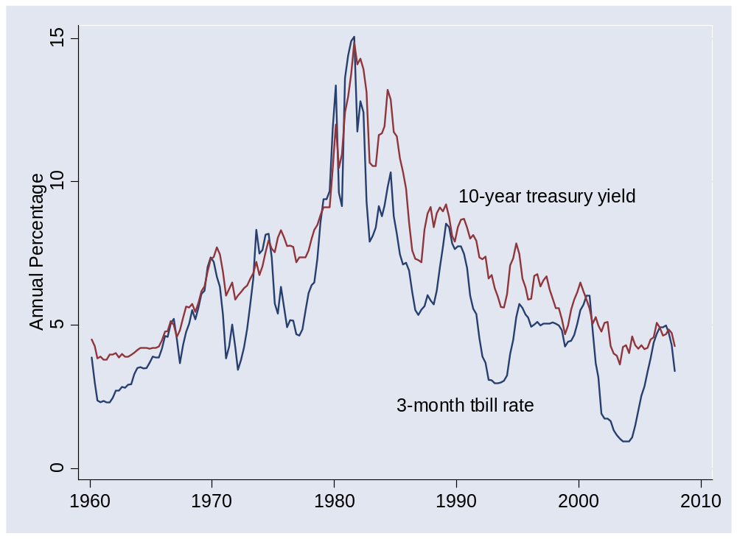
Where do interest rates come from?

Slide 31
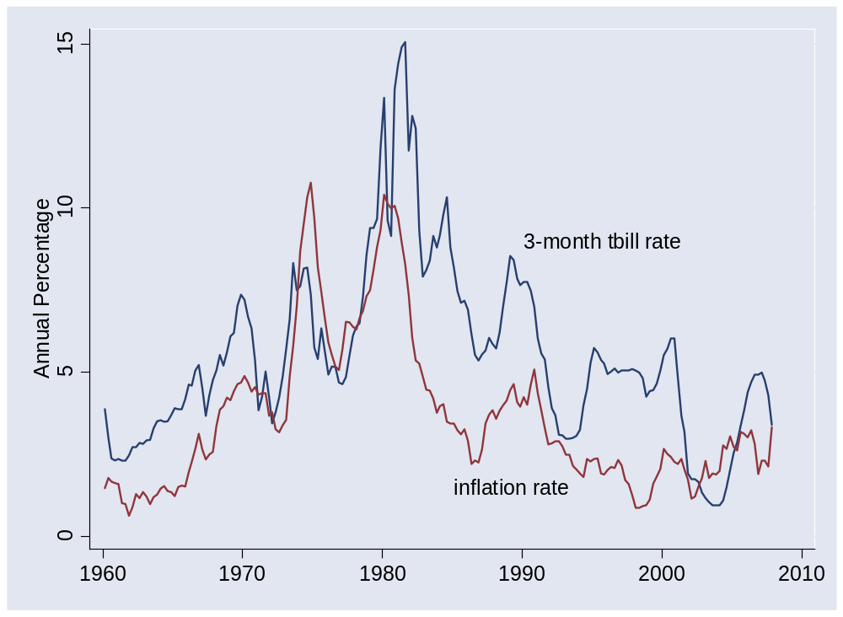
Where do interest rates come from?

Slide 32
Where do interest rates come from?
Inflation & Growth
Interest Rates
Monetary Policy

Slide 33
Plan of attack
Where do interest rates come from? ✓
Bond traders guide: the Taylor rule
Where do interest rates come from?
What’s going on now?
What have we learned?
Group Project #6

Slide 34
Taylor rule
Bond traders guide to monetary policy
  Inflation up ⇨ raise short rate
  GDP growth up ⇨ raise short rate
How?
Why is a “rule” valuable?

Slide 35
Taylor rule
Rule for setting short-term interest rate
i = r* + π + a₁(π –π*) + a₂(y–y*)
  i = short term interest rate (fed funds rate)
  r* = “equilibrium” real interest rate [2%?]
  π = inflation rate
  π* = target inflation [2%?]
  y = log of real GDP [or yoy growth rate]
  y* = log of “potential” real GDP [or “potential” growth]
  a₁, a₂ = (positive) parameters [1/2?]

Slide 36
Taylor rule
What does it suggest now?
i = r* + π + 0.5 (π –π*) + 0.5 (y–y*)

Slide 37
Taylor rule
What does a bond trader expect if
  Inflation rises 1%?
  Growth rises 1%?
Optional:
  How should long rates respond?

Slide 38
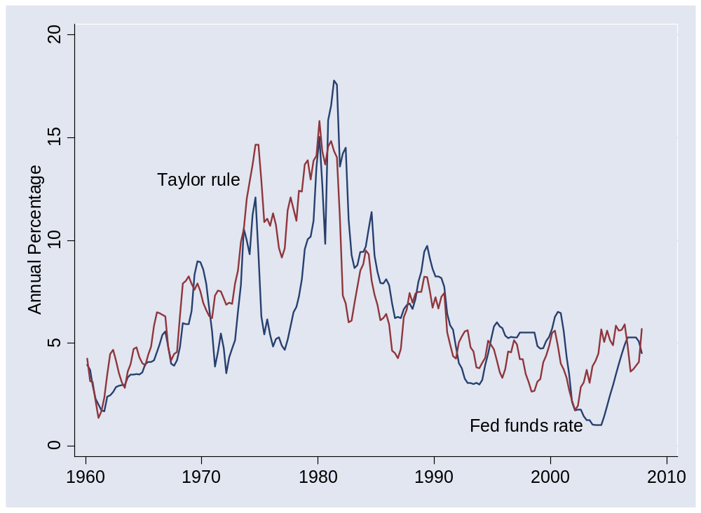
Taylor rule
What’s going on here?
Here?

Slide 39
Taylor rule
How does interest rate respond to
  Positive demand shock? [what changes?]
  Positive supply shock? [what changes?]

Slide 40
Taylor rule
Bond traders’ guide to monetary policy
How do short rates respond to news about
  Inflation?
  Output or employment?
  Central bank announcements?
Long rates?

Slide 41
Where do interest rates come from?
Inflation & Growth
Interest Rates
Monetary Policy

Slide 42
What’s going on now?
What’s the Fed up to?
Why are we below the Taylor rule?

Slide 43
What’s going on now?
Martin Wolfe, Financial Times, Mar 31 08:
  Remember March 14: it was the day free-market capitalism died. For three decades we have moved toward market-driven financial systems. By rescuing Bear Stearns, the Fed declared this era over. Deregulation has reached its limits.

Slide 44
What have we learned?

Slide 45
Takeaways
Most central banks focus on short-term interest rates
  Increase in rate corresponds to fall in money supply
Predictable policy good for the economy
Taylor rule ties interest rate to inflation and output
  Policy is predictable
  Strong output growth and high inflation trigger increases in interest rate

Slide 46
Group Project #6
Note links in online version
Aim for a professional business document
  Options: report or slides, whatever you prefer
Guideline: no more than 5 pages or 10 slides
Do not do any of your own statistical analysis!
Come see me if you have questions

