Slide 1

The Global Economy
Trade Theory
© NYU Stern School of Business
Notes:
Start quickly – full class
Samuelson: nontrivial result
Nobel laureate Paul Samuelson (1969) was once challenged by the mathematician Stanislaw Ulam to "name me one proposition in all of the social sciences which is both true and non-trivial." It was several years later than he thought of the correct response: comparative advantage. "That it is logically true need not be argued before a mathematician; that is is not trivial is attested by the thousands of important and intelligent men who have never been able to grasp the doctrine for themselves or to believe it after it was explained to them."
http://www.wto.org/english/res_e/reser_e/cadv_e.htm

Slide 2
Are markets moral?
Examples in which markets work well, poorly
Do markets encourage lying, cheating, and stealing?
Do markets contribute to global prosperity?
Are markets moral?

Slide 3
Plan of attack
Are markets moral? ✓
Where we’ve been, where we’re headed
Pictures and quotations
The logic of markets (“invisible hand”)
The logic of international trade
Does Trade = Productivity?
Was NAFTA good for Mexico?

Slide 4
Where we’ve been
Group Project #3: graded by Neely, answers posted

Slide 5
Where we’re headed
Long-Run Performance
Production, Saving & Investment, Productivity, Institutions, Capital & Labor Markets, International Trade
First half:
Short-Run Performance
Inflation, Business Cycle Indicators, Monetary Policy, Taxes & Deficits, Exchange Rates, Capital Flows, Emerging Market Crises
Second half:

Slide 6
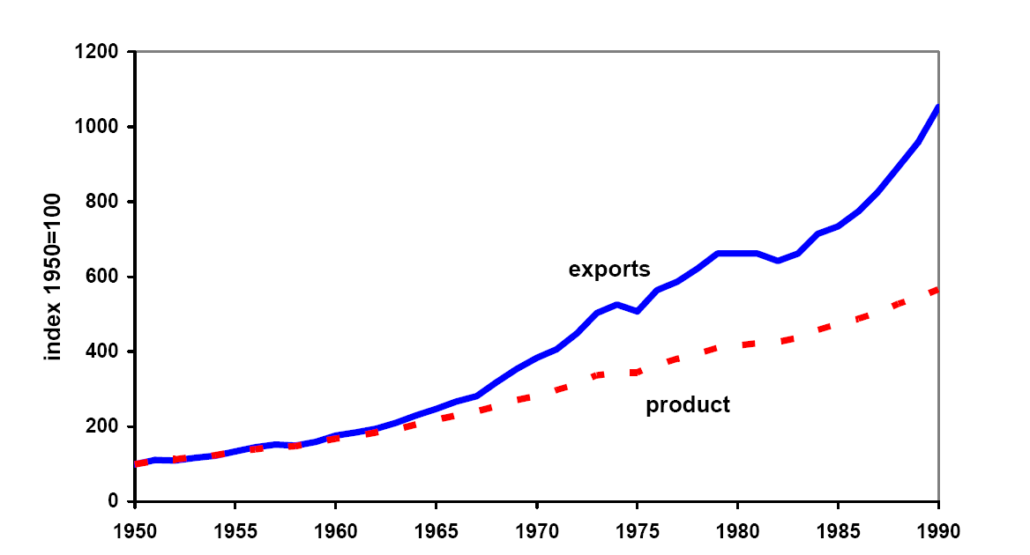
World trade and output since 1950
Source: Kehoe and Boergoing.
Notes:
What do you see here? Why?

Slide 7
Ernesto Zedillo
Former president of Mexico:
  Half of the world’s population lives on less than $2 a day. I say to you, with all conviction, that a vital part of the solution consists of promoting more globalization. More international trade, more investment flowing across countries, more knowledge diffused internationally among communities and individuals … will do much to defeat the evil of poverty during this new century.

Slide 8
Lou Dobbs
Television host and critic of “exporting jobs”
  The shipment of American jobs to cheap foreign labor markets threatens not only millions of workers and their families, but also the American way of life. Corporate raiders are breaking down our borders in search of the lowest-price labor available anywhere in the world. For the first time in history, corporations are laying off Americans from well-paying jobs and replacing them with low-paid foreign workers. … Corporate America isn’t doing all this alone: Big business and Washington are in cahoots, trading our nation's livelihood for short-term gain.
Notes:
From blurb for his book, Exporting America.

Slide 9
Global Trade Watch
Anti-globalization group on NAFTA:
  The data are in and they clearly show the damage NAFTA has wrought for millions of people in the US, Mexico, and Canada. As we predicted: a race-to-the-bottom in wages, destruction of hundreds of thousands of good US jobs, undermining of democratic control of domestic policy-making, and threats to health, environmental and food safety standards. … Millions of campesinos throughout Mexico have lost a significant source of income and left their small corn farms.

Slide 10
Bill Gross
PIMCO’s Investment Outlook, Nov 04:
  It’s really quite simple you know. Asia has hollowed out our manufacturing base and is now making inroads into services. … We can’t really educate or innovate ourselves out of this. 250 million Americans sitting around thinking up ways for the rest of the world to support us is not my idea of a real world outcome.

Slide 11
Dave Barry
Q: You are a large US car maker. You have been losing sales to Japanese producers, whose cars tend to be extremely well made. You should:
  Have Congress restrict Japanese imports
  Have Congress allow you to kidnap consumers’ children unless they buy your cars.
  Remind everyone about Pearl Harbor.
A: These are all pretty good.
Source: Dave Barry, Claw Your Way to the Top.

Slide 12
Take a breath
How should we think about international trade?
Is it different from other economic activity?

Slide 13
The logic of markets
Adam Smith, Wealth of Nations (1776)
  By pursuing his own interest, [an individual] is led by an invisible hand to promote the interest of the society more effectively than when he really intends to promote it. I have never known much good done by those who affected to trade for the public good. It is an affectation…. (paraphrase)
  Logic: if two people voluntary exchange products, it suggests that both find it in their interest. It’s “win-win.” Economic activity is a positive sum game.

Slide 14
The logic of markets
First theorem of welfare economics
  Under certain conditions, competitive markets produce a good allocation of resources.
  This follows from mathematical logic, not opinion
What conditions?
  Clearly defined property rights
What do we mean by a “good allocation”?
  No one can be made better off without someone else being made worse off (“pareto optimal”)

Slide 15
The logic of international trade
Adam Smith, Wealth of Nations
  All political writers since the time of Charles II had been prophesying “that in a few years we would be reduced to an absolute state of poverty” [by international trade], but “we find ourselves far richer than before.”
  All commerce that is carried on betwixt any two countries must necessarily be advantageous to both. The very intention of commerce is to exchange your own commodities for others which you think will be more convenient for you. … The goods which the English merchants want to import from France are certainly more valuable to them than what they give for them.
Notes:
http://www.econlib.org/library/Smith/smWN.html

Slide 16
Ricardo’s model of trade
Why a model?
  Simpler than the real world
  Which allows us to see exactly what’s going on
Ricardo’s insight (1817)
  Trade based on relative productivity
  Produce the good at which you’re relatively more productive, import the others
  Both countries benefit!
We’ll run through this quickly, but you’ll have to consult the notes to follow the mechanics
Notes:
http://www.econlib.org/library/Smith/smWN.html

Slide 17
Ricardo: setup
Two countries (US, Mexico), two goods (apples, bananas), one input (labor)
  Our production function: Y = AL (no K)
Productivities A (output from one unit of labor):
 | Apples | Bananas | Labor
US | 20 | 10 | 100
Mexico | 5 | 5 | 100
Notes:
What would Americans say? Mexicans? Wages and productivity…

Slide 18
Ricardo: consumption possibilities

Slide 19
Ricardo: consumption possibilities
Mexico
Compare: TFP, trade
b
500
Shown for: q = p_{b}/p_{a} > 1
500
a
Notes:
Talk about this in class, show that opportunities expand with trade
For extra work: do the US case…
In a sense, we’re done…

Slide 20
Ricardo: details
We’ll compare free trade (no tariffs) with no trade (prohibitive tariffs = no international markets)
  Extreme, but makes the point
Utility is a composite of the two goods:
u(a,b) = a^{0.75} b^{0.25}
  Translation: consumers spend 75% of income on apples, 25% on bananas
Producers maximize profit
Competitive markets

Slide 21
Ricardo: numbers
 | Free Trade | No Trade
 | US
Price of apples (p_{a}) | 0.05 | 0.05 dollars
Price of bananas (p_{b}) | 0.0667 | 0.10 dollars
Wage (w) | 1 | 1 dollar
Consumption of apples (a) | 1500 | 1500
Consumption of bananas (b) | 375 | 250
Utility (u) | 1061 | 958
 | Mexico
Price of apples (p_{a}) | 0.05 | 0.2 pesos
Price of bananas (p_{b}) | 0.0667 | 0.2 pesos
Wage (w) | 0.3333 | 1 peso
Consumption of apples (a) | 500 | 375
Consumption of bananas (b) | 125 | 125
Utility (u) | 354 | 285
Notes:
Note change in relative prices:
No trade: US q = 2, Mex q = 1
Free trade: q = 4/3 in both cases (in between)
Pick a number and show where it comes from
Comment on shift in production
Contrast consumption baskets in Mexico (draw on previous diagram)

Slide 22
Ricardo: mechanics
What are profits of Mexican banana producers?
What are profits of Mexican apple producers?
What does Mexico produce?
American apple and banana producers?
What is the Mexican wage?
What is the American wage?

Slide 23
Ricardo: impact of trade
Aggregate consumption up in both countries
Production changes:
  US shifted to apples
  Mexico shifted to bananas
  No change in labor (“jobs”) by assumption
Trade shows up as increase in productivity
  Real GDP = consumption at world prices
  GDP rises in both countries
  Y = AL: rise in Y shows up as rise in A

Slide 24
Ricardo: summary
Mexican consumers are better off
  Consumption possibilities set is strictly larger
Mexican production is more efficient
  Shift production to bananas, at which it is relatively more productive than the US
Similar arguments for the US, too
  Both sides benefit

Slide 25
Was NAFTA good for Mexico?
Mexican auto manufacturing is booming
  Many old factories shut down, new ones opened aimed at full North American market
Mexican garment manufacturing booming
  Clothes made with US cloth, shipped back to US
  Rules of origin work against Asian textiles
Mexican corn farmers wiped out
  Corn is US comparative advantage
  Many small farmers displaced

Slide 26
Trade and productivity
Free trade works like an increase in TFP
Are they the same?

Slide 27
Automobile TFP
Consider new technology for making cars:
  Technology breakthrough reduces labor requirement per car
  Thousands thrown out of work
Is this a good thing for the economy as a whole?

Slide 28
Automobile TFP
Consider new technology for making cars:
  We grow soybeans in Iowa
  Ship them to Japan, where they are “transformed” into cars
  Thousands thrown out of work
Is this a good thing for the economy as a whole?

Slide 29
Take a break
Be prepared to discussed “UPS” and “Dumping” mini-cases

Slide 30
The Global Economy
Trade Reality
© NYU Stern School of Business

Slide 31
Plan of attack
Trade and wages
Fallacies
Chinese dumping
UPS in Mexico
What have we learned?
What’s coming up

Slide 32
Trade and wages
Are Mexican workers undercutting American workers? [Or Chinese, Indian…]
Can Mexican workers compete with Americans? [Or Chinese, Indian…]

Slide 33
Trade and wages in Ricardo’s model
In the “free trade” equilibrium
  Why are Mexican wages lower?
  What if Mexican wages increased?
US wage (w₁) | 1
Mexican wage (w₂) | 1/3
Apple price (p_{a}) | 0.05
Banana price (p_{b}) | 0.0667

Slide 34
Fallacy #1
Trade costs us jobs
Why a fallacy?
  Trade is about what the jobs are, not how many
  What they’re really saying: “I lost my job, and I’m mad”
  In most countries, trade is a small factor in job creation and destruction [in US, replace “small” with “tiny”]

Slide 35
Fallacy #2
Our tariffs are good for us
Why a fallacy?
  Higher prices for consumers
  Inefficient production
  Note: true even if other countries have tariffs

Slide 36
Argentina in the 1930s
Export-oriented agriculture
  Wheat
  Beef (refrigerated and canned)
  Major markets: US and UK
During the Depression, both the US and UK raised tariffs on Argentine beef to protect their own farmers
Argentina responded with its own protection of manufactures
First step in 60-year decline in performance
Notes:
Argentina: think Canada in the Southern hemisphere
This isn’t all due to trade!

Slide 37
Voluntary export restraints
In 1980s, US “persuaded” Japanese carmakers to limit exports to US
Similar to a tariff, but
  “Voluntary” (hence ok with trade law)
  US got no revenue (Japanese carmakers did)
Limits on numbers benefited Japanese:
  Reduced competition among them in US (profits up)
  Instigated increase in quality
What were we thinking of?

Slide 38
Fallacy #3
We should subsidize local producers to help them compete with foreign producers
Why a fallacy?
  Costs us money
  Encourages inefficient production

Slide 39
Agriculture
Farmers are subsidized in all developed countries:
Country | Subsidy per Farmer
Norway | $33,000
Switzerland | $32,000
Japan | $26,000
US | $21,000
EU | $17,000
And: health and safety regulations keep out imports
Local milk in Norway?
Notes:
Data: The Economist, “From bad to worse,” May 5, 2001

Slide 40
Brazil v US
Brazil filed suit against US cotton subsidies
  US agreed to $1.6b cap on subsidies in 1995
  Current subsidies >$2b
  WTO ruled in 2004 that these subsidies violate trade rules
If Brazil wins:
  Is this good for Brazil?
  Bad for the US?

Slide 41
Fallacy #4
Free trade creates trade deficits
Why a fallacy?
  My deficit is someone else’s surplus: can’t cause deficits for everyone
  Trade deficits are about international financial flows [more later]

Slide 42
Fallacy #5
Outsourcing costs us jobs
Why a fallacy?
  No different from trade in goods: it’s an issue of which jobs, not how many.
  Countries should do jobs at which they have comparative advantage
  Krugman’s example
Notes:
Goldman Sachs: you hire the Indian, or they do.

Slide 43
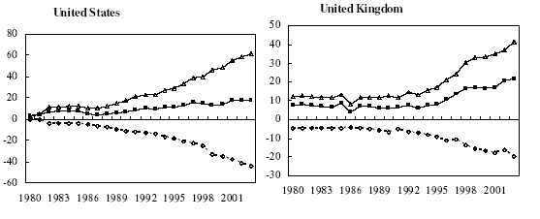
Outsourcing: business services
Billions of dollars: Δ = in, o = out, ■ = net

Slide 44
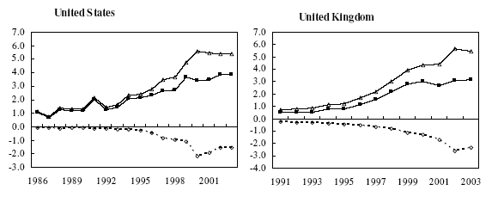
Outsourcing: IT services
Billions of dollars: Δ = in, o = out, ■ = net
Source: Amiti and Wei, NBER 10808.

Slide 45
Fallacy #6
High wages hurt competitiveness
Why a fallacy?
  Competitiveness depends on relation between wage and productivity
  If wages reflect productivity, a sign of competitive strength

Slide 46
Why protection?
High-performance “institutions” include
  Rule of law
  Property rights
  Competitive markets – for capital, labor, and products
What political process leads to good institutions?
  Democratic leaders often protect supporters from competition
  Dictators often protect friends
Trade adds:
  Protect us from “unfair” foreign competition (remember: foreigners don’t vote)

Slide 47
Examples

Slide 48
Chinese dumping
What is “dumping”?
How could dumping suits affect your business?
What should you do?

Slide 49
Chinese dumping
US firms file dumping suit against Chinese manufacturers
  Legitimate complaint or strategic attack on competitors?
US industry divided
  Retailers fight suit, favor low prices
Chinese firms hire US lawyers
  They’re the winners! (the lawyers, that is)
Some producers head elsewhere
  Vietnam, Brazil, etc

Slide 50
UPS in Mexico
What are Dadoo’s problems?
How do they affect his costs?
What should he do?

Slide 51
UPS in Mexico
UPS enters Mexico to take part in NAFTA boom
Mexicans protect local truckers
UPS asks US government for help
US drags feet when Teamsters protest Mexican truckers entering US
Mexico drags own feet in return
10+ years later nothing has changed

Slide 52
What have we learned?

Slide 53
Takeaways
Globalization is a fact of life
There is clear logic for markets and trade
  Consumers benefit from lower prices
  Production more efficient
Political opposition also a fact
Trade reality
  International business remains a challenge

Slide 54
What’s coming up
We’ve finished “long-run country performance”
Midterm in 2 weeks
Review next week + start of “short-term performance”
Group Project #4 reviews labor markets and trade

Slide 55
Extra slides

Slide 56
The logic of international trade
Adam Smith, Wealth of Nations
  What is prudence in the conduct of every private family, can scarce be folly in that of a great kingdom. If a foreign country can supply us with a commodity cheaper than we ourselves can make it, better buy it of them with some part of the produce of our own industry, employed in a way in which we have some advantage. The general industry of the country, being always in proportion to the capital which employs it, will not therby be diminished... but only left to find out the way in which it can be employed with the greatest advantage.
Notes:
http://www.wto.org/english/res_e/reser_e/cadv_e.htm

Slide 57
The logic of international trade
Paul Samuelson, when asked for an example of a proposition from the social sciences that was true but not trivial, mentioned comparative advantage:
  That it is logically true need not be argued before a mathematician; that it is not trivial is attested by the thousands of important and intelligent men who have never been able to grasp the doctrine for themselves or to believe it after it was explained to them.
Notes:
http://www.wto.org/english/res_e/reser_e/cadv_e.htm

Slide 58
Ricardo revisited
Two countries (US, Mexico), two goods (apples, bananas), one input (labor)
  Our production function: Y = AL (no K)
Productivities A (output from one unit of labor):
 | Apples | Bananas | Labor
US (country 1) | α₁ = 20 | β₁ = 10 | 100
Mexico (country 2) | α₂ = 5 | β₂ = 5 | 100

Slide 59
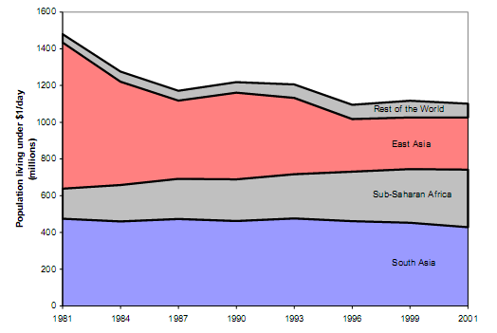
Global poverty
Source: World Bank, How Have the World's Poorest Fared Since the Early 1980s?
Notes:
How many believe it?

Slide 60
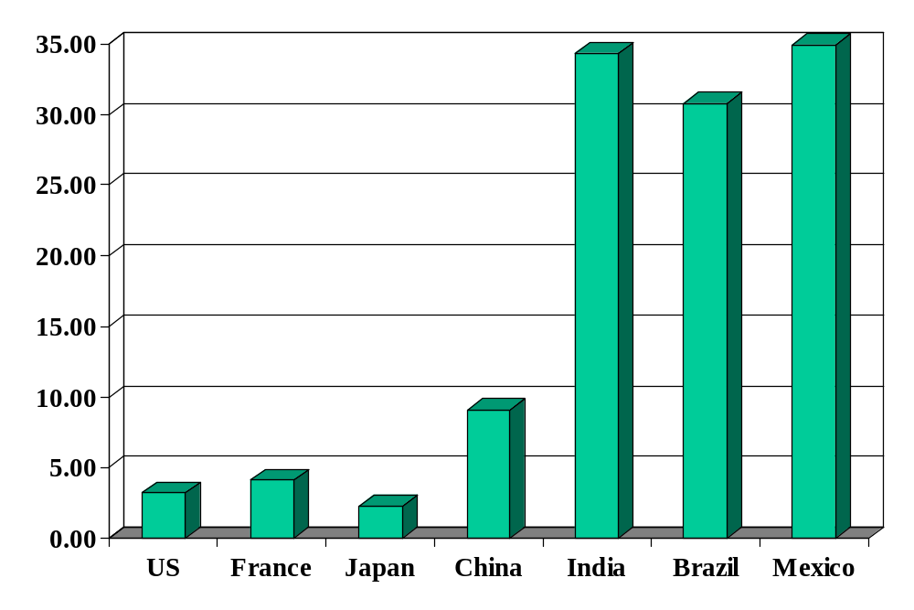
Average tariffs (non-agriculture)
Source: World Trade Organization, World Trade Report, 2004.

Slide 61
The challenge of good government
Madison again (Federalist Papers 51):
  The great difficulty [of good government] lies in this: you must first enable the government to control the governed; and in the next place oblige it to control itself.
Czech joke (circa 1968):
  The difference between capitalism and socialism? Under capitalism, Man oppresses Man. Under socialism it’s exactly the opposite.

