Slide 1
Deleveraging, Global Recession and Challenges for Financial Markets
Global Economy – Prof. Backus
Richard Berner
Chief U.S. Economist
Co-Head, Global Economics
March 24, 2009
For important disclosures, refer to the Disclosure Section

Slide 2
Key Themes
Global Recession or Something Worse?
Deleveraging Not Over
Sea Change in Consumer Behavior
Seeking Financial Stability
Sequencing Critical For Markets
Asset-Liability Mismatches

Slide 3
Global forecast at a glance

Slide 4
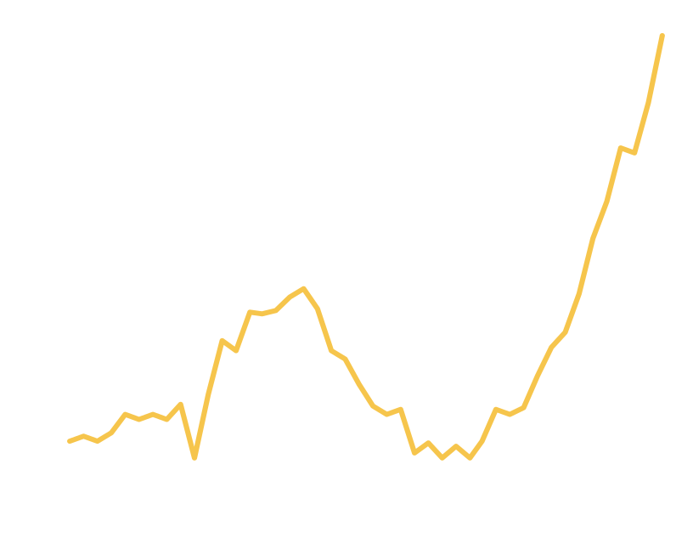
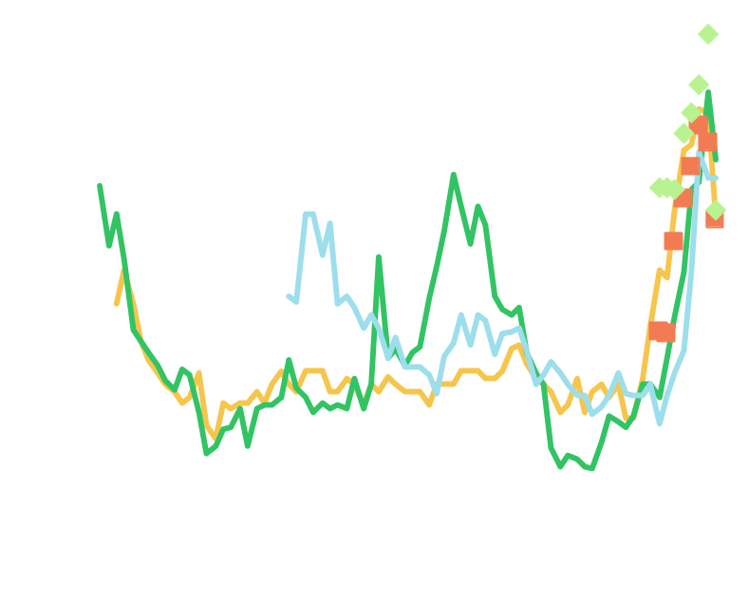
Losses + Deleveraging = Credit Crunch
Subprime-related losses have tightened lending and restricted credit. This will continue to worsen until losses turn down
Subprime Delinquencies Haven’t Peaked
Fewer Banks Tightening Lending Standards
(Net % of Institutions
Reporting a Tightening)
%
Mortgage
C&I
Credit Cards
Prime Mortgages
Subprime Mortgages
Source: Mortgage Bankers Association (data through 4Q08)
Source: Federal Reserve, Senior Loan Officer Survey.
Latest data point is 1Q09.

Slide 5
US Expected Cumulative Loss Summary:
Large Cap Banks, Total Banking Industry
As of 3Q08; in $ bil.
Total Financial
System – Est.
Cum. Loss ($ bil.)
Cumulative Loss
Assumptions
Total Bank – Est.
Cum. Loss ($ bil.)
Liquid-ation
Liquid-ation
Liquid-ation
Loans
Base
Bear
Base
Bear
Base
Bear
Subprime First Lien
Alt-A First Lien
Conventional First Lien
Neg Am First Lien
Other First Lien (Jumbo)
25%
15%
1%
25%
3%
30%
20%
2%
30%
4%
45%
30%
5%
40%
7%
28
15
7
45
6
34
20
11
54
7
51
29
36
71
15
203
105
62
70
45
243
140
94
84
53
365
211
312
111
105
1st Lien Mortgage
8%
9%
15%
101
125
202
485
613
1,103
Subprime Second Lien
Prime Second Lien
40%
15%
50%
20%
60%
30%
33
103
41
137
50
206
48
149
60
199
72
298
2nd Lien Mortgage
18%
23%
33%
136
179
256
197
259
370
Card
Other Consumer
8%
10%
10%
12%
12%
14%
30
62
38
75
45
87
78
160
98
192
117
224
Consumer Credit
9%
11%
13%
92
112
132
238
290
341
C&I Lending
5%
6%
7%
81
97
113
160
193
225
Resi Construction
Other Construction
Other CRE
35%
10%
6%
60%
11%
8%
70%
12%
10%
46
42
73
79
47
97
92
51
122
108
99
171
185
109
228
216
119
285
Total CRE
9%
13%
15%
161
223
264
378
522
620
Total Cum. Losses
7%
9%
13%
571
736
968
1,459
1,876
2,660
Source: Morgan Stanley Research

Slide 6

Global Writedowns vs. Capital Injections: A Timeline
Billions of US$
Source: Bloomberg, page WDCI<GO>. These data includes banks, GSE’s and insurance companies.
Note: Announced writedowns and recapitalizations are as of March 1.

Slide 7
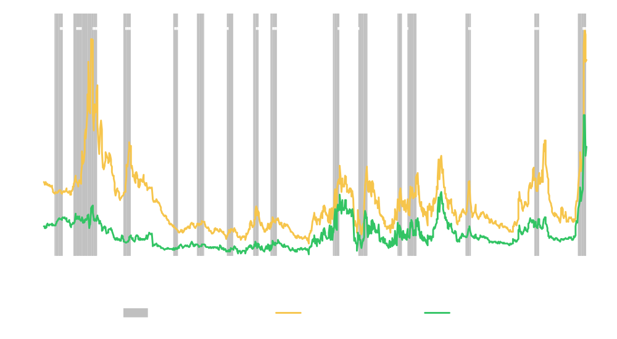
Credit Destruction Context
Credit spreads are wider than Great Depression levels
Source: Morgan Stanley, NBER, Moody’s, Yield Book

Slide 8
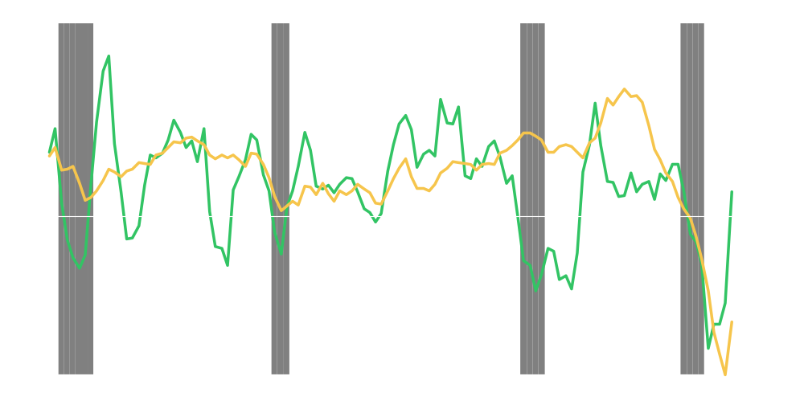
Unprecedented Household Wealth Destruction
US House Price Index, year-over-year percent change (right scale)
Stock Price Index: Wilshire 5000, year-over-year percent change (left scale)
Source: Federal Housing Finance Agency, Wall Street Journal, Morgan Stanley Research Estimates

Slide 9
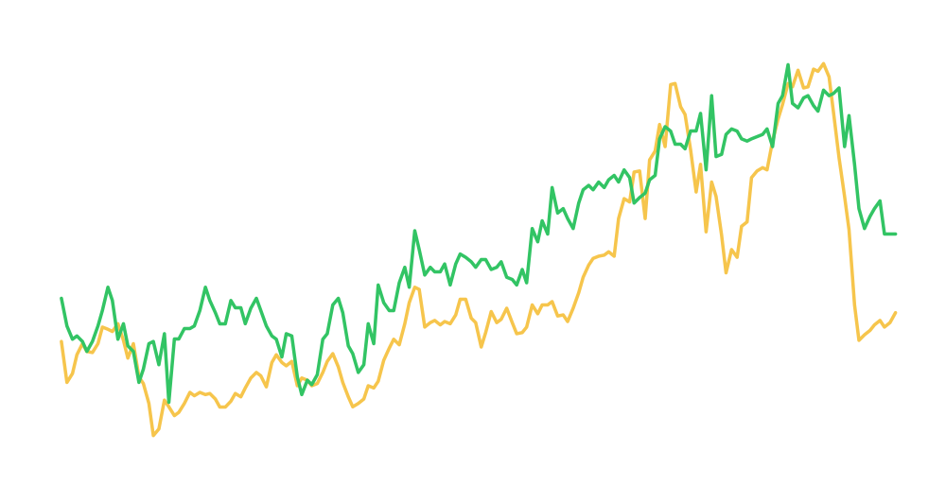
Consumers Return to Saving
Personal saving rate (right scale, inverted)
Net worth as a percent of disposable income (left scale)
Source: Federal Reserve Board, Bureau of Economic Analysis, Morgan Stanley Research Estimates

Slide 10
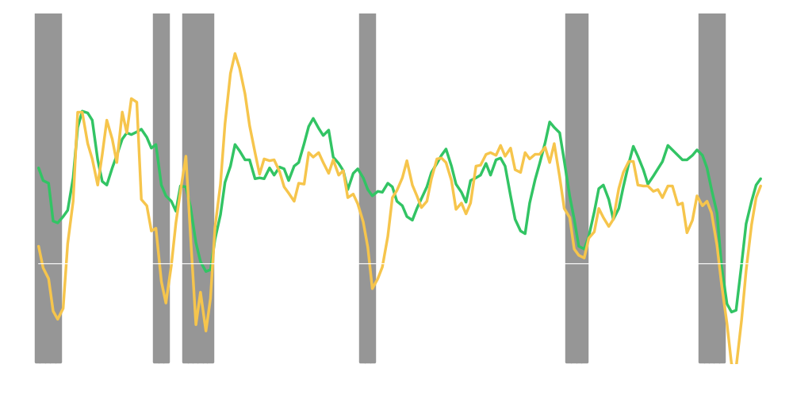
Global Recession Feeds Back to US
Real GDP (year-over-year percent change)
Non-US
US
Source: Macroeconomic Advisers, Bureau of Economic Analysis, Morgan Stanley Research Estimates

Slide 11
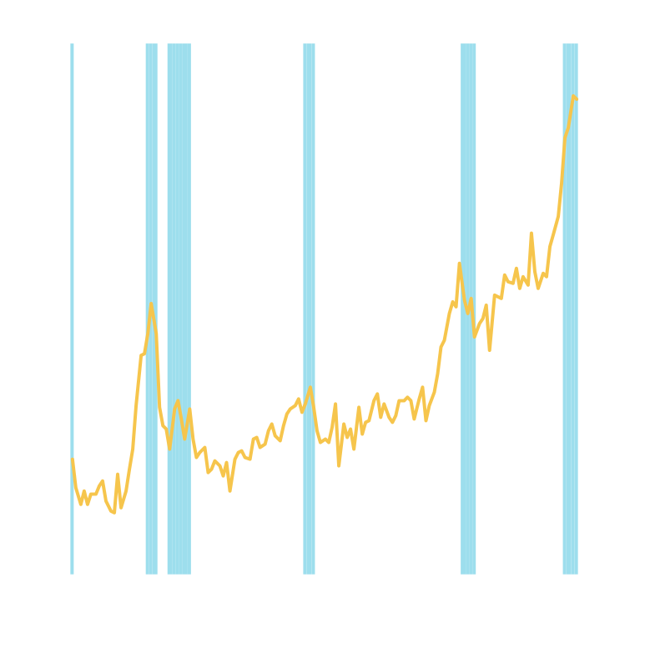
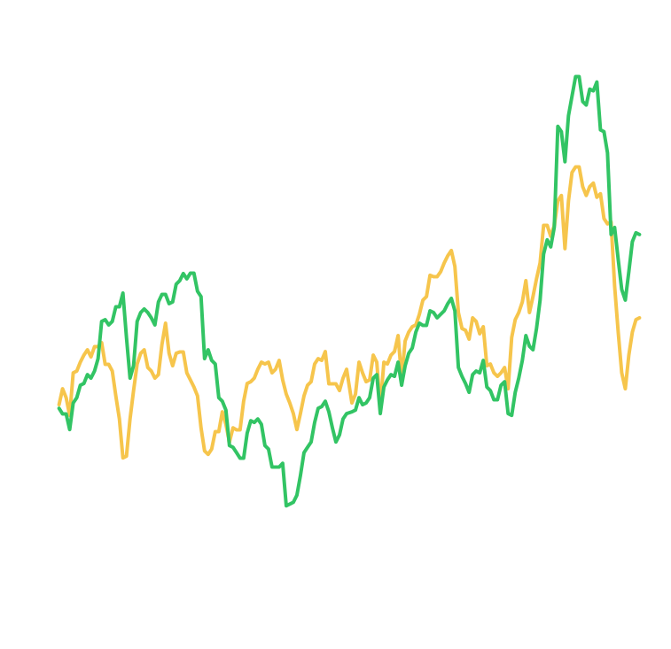
Global Recession Intensifies the Margin Squeeze
The Growing Importance of U.S. Affiliates’ Earnings
Profit Margins: Under Pressure⁽¹⁾
After-Tax Corporate Profits With IVA and CCAdj as
a Percentage of Corporate GDP
Foreign Share of U.S. Corporate Profits (Percent)
After-Tax Corporate Profits as a Percentage
of Corporate GDP
Source: Bureau of Economic Analysis
Source: Bureau of Economic Analysis, Morgan Stanley Research
(1) 1Q09 – 4Q10 values are Morgan Stanley estimates.

Slide 12
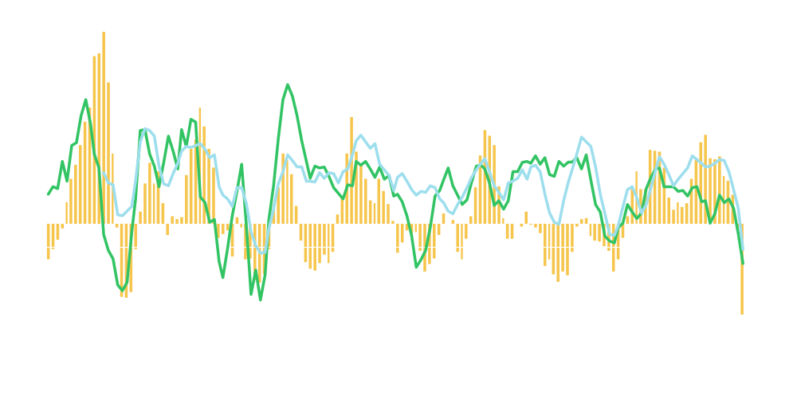
Slipping Global Growth Weakens Commodity Prices
Y-o-Y % Change
U.S. Real GDP
(left scale)
36-Country Real Foreign GDP Index
(left scale)
KR-CRB Spot Commodity Price Index, Raw Industrials
(right scale)
Source: Bureau of Economic Analysis, Commodity Research Bureau, Macroeconomic Advisers

Slide 13
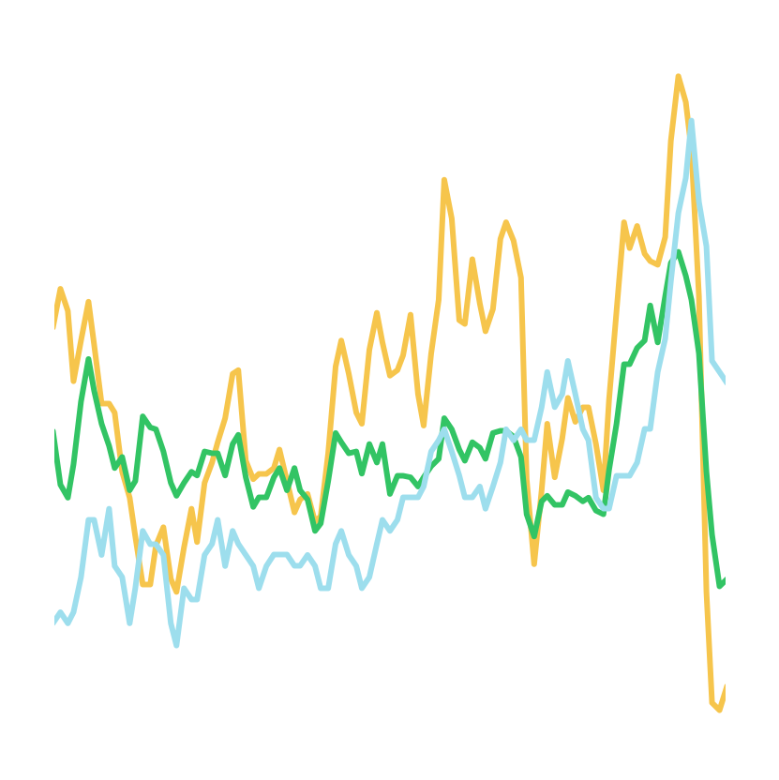
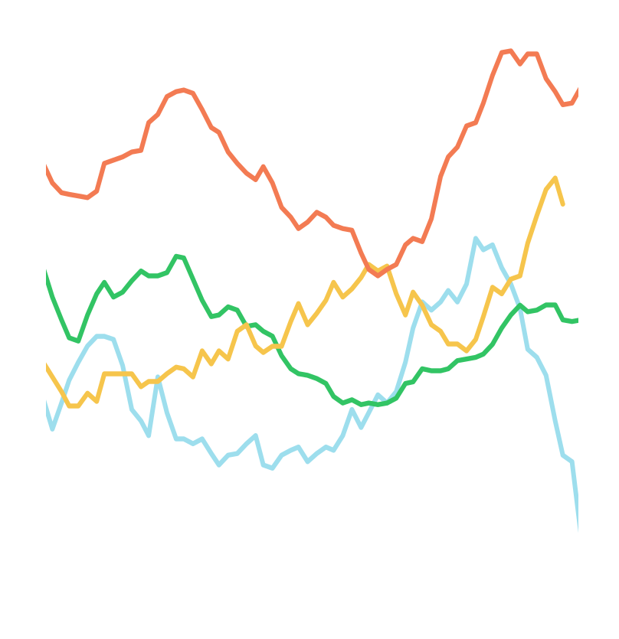
The Coming Global Deflation Scare
Advanced Economies
BRICs
%
%
Russia
U.K.
India
Brazil
Euro Area
U.S.
China
Source: Haver Analytics
Source: Haver Analytics

Slide 14
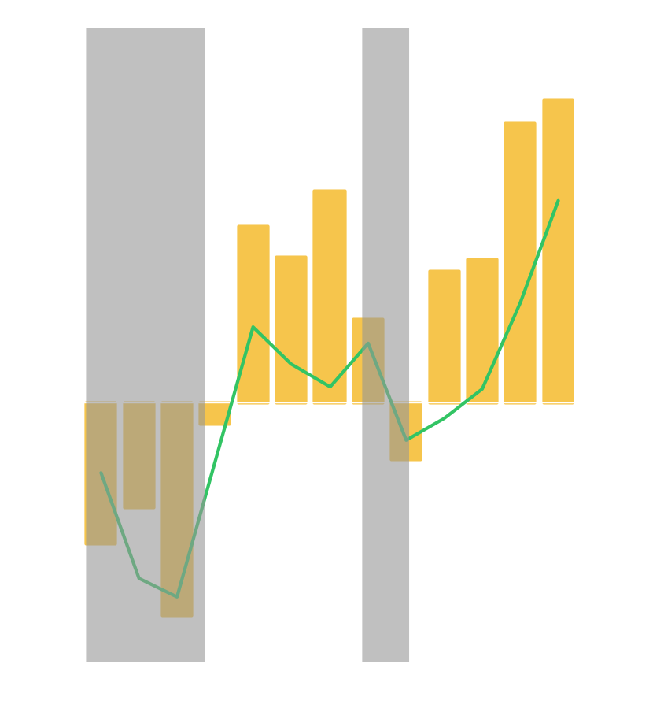
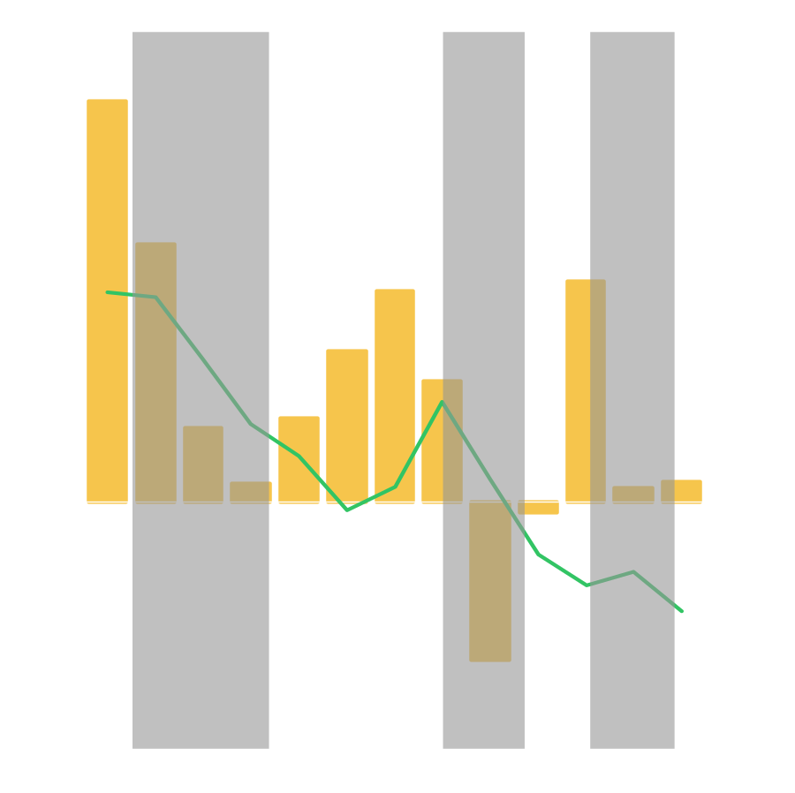
Lessons from the Great Depression and from Japan
United States
Annual % Change
Japan
Annual % Change
Real GDP
Real GDP
Household Final Consumption Expenditure Price Index
Personal Consumption Expenditures: Chain Price Index
Source: Bureau of Economic Analysis
Source: OECD

Slide 15
Learning from US and Japanese Policy Mistakes
US in the Depression
Excessively tight monetary policy, starting in 1928
Excessively tight fiscal policy
Protectionism (Smoot-Hawley)
Japan in the “Lost Decade”
Slow NPL writedowns
Slow bank recapitalization
Timid easing of monetary policy
Fiscal policy: Bridges to nowhere

Slide 16
Fed, Treasury Initiatives for Financial Stability
Not your father’s monetary policy
Backstops and facilities needed:
Stabilize financial system
Foreclosure mitigation
Facilities to restart securitization
Quantitative easing extensions:
Buy longer-term securities
Commit to keep rates low, conditional on inflation
Monetize fiscal stimulus

Slide 17
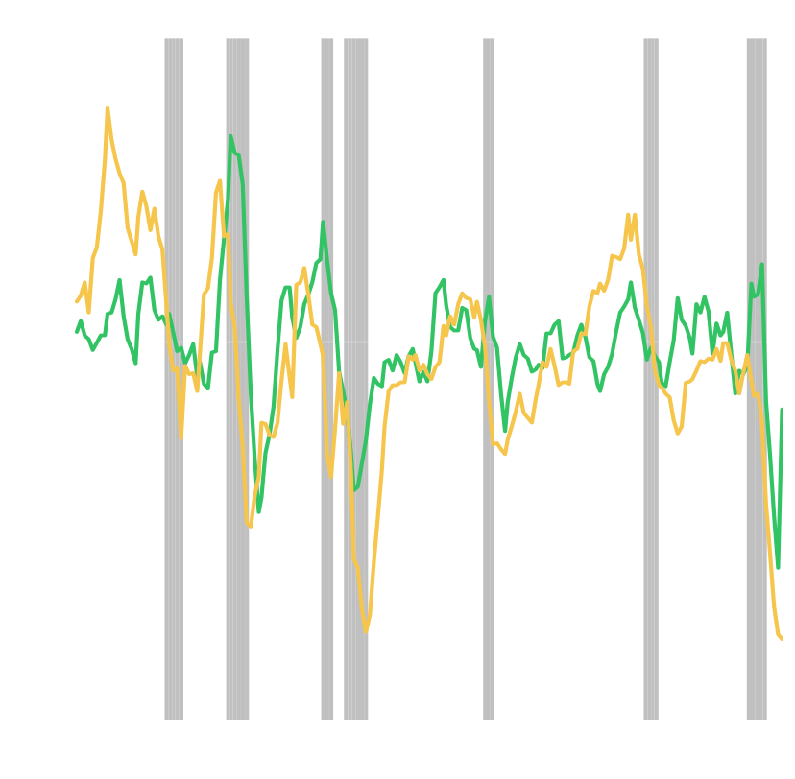
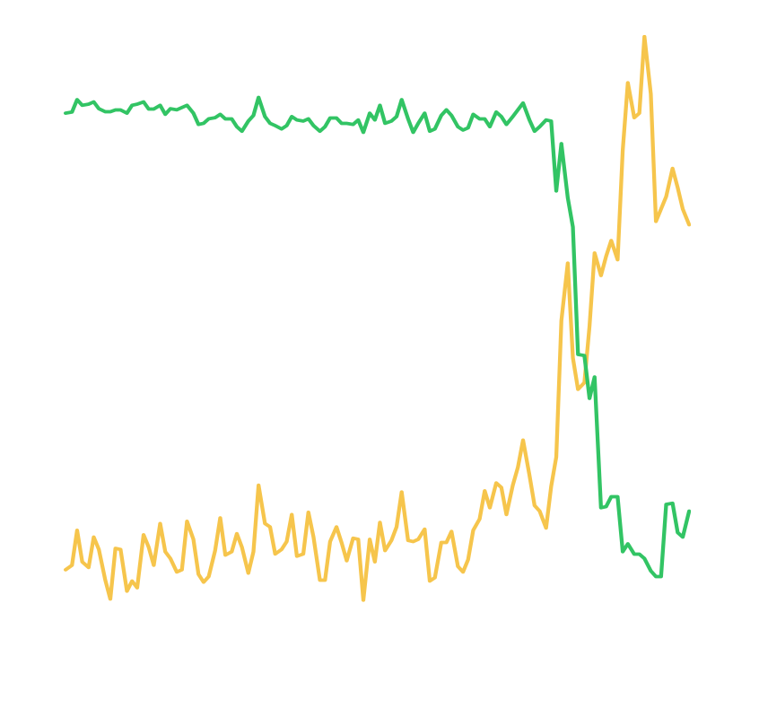
Quantitative Easing Will Avert Deflation
%
Change in Inflation
Money Multiplier (right scale)
M1 (year-over-year percent change, left scale)
Output Gap
Source: Bureau of Economic Analysis, Congressional Budget Office
Note: Output gap is the ratio of real GDP to its potential.
Change in inflation is the 4-quarter change in the inflation rate measured by the personal consumption expenditures chain price index.
Source: Federal Reserve Board
Note: Money multiplier is the ratio of M1 to the monetary base.

Slide 18
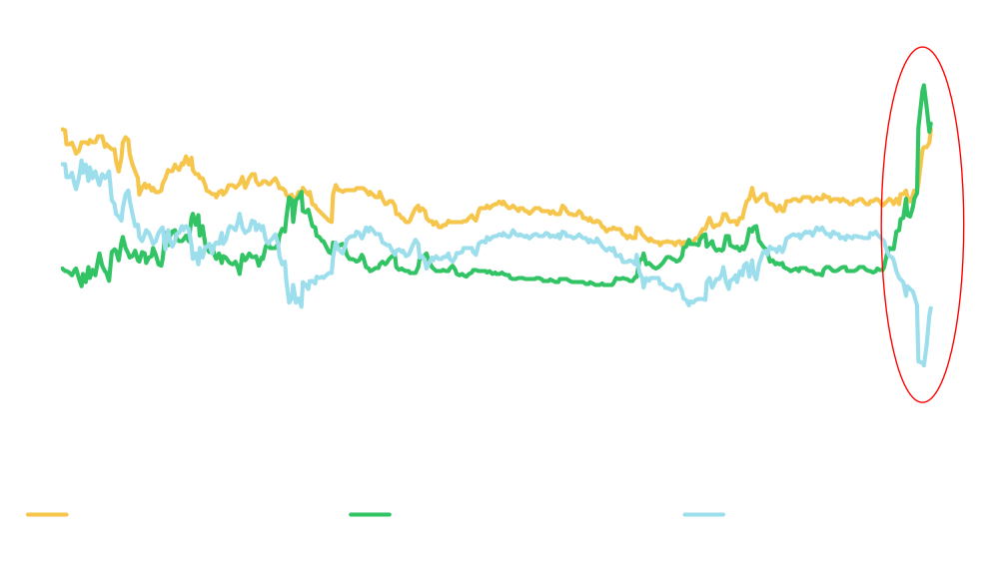
Sequencing: Funding and Credit Must Improve First
Credit needs to stabilize before equities can find a floor. Sequencing matters
Comparative Risk Premia – Credit Pain Means Stocks Aren’t Cheap
(%)
Source: Morgan Stanley, the Yield Book, Factset

Slide 19
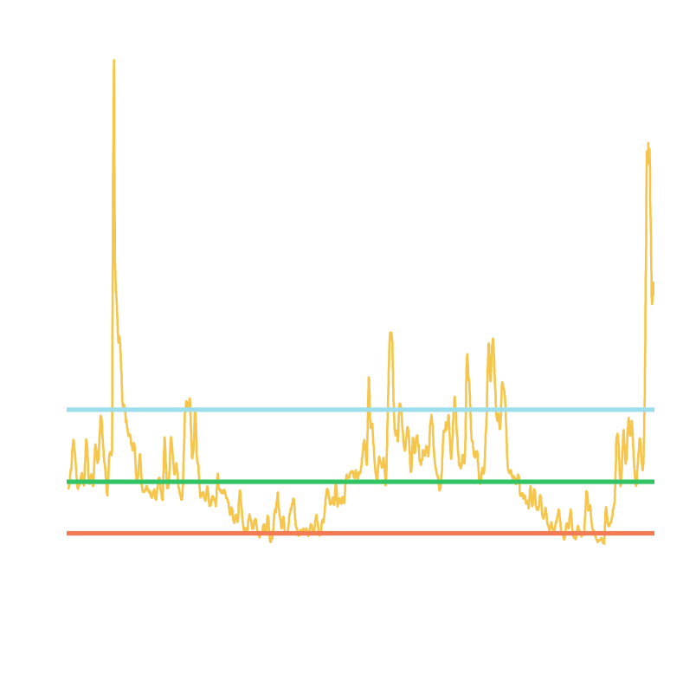
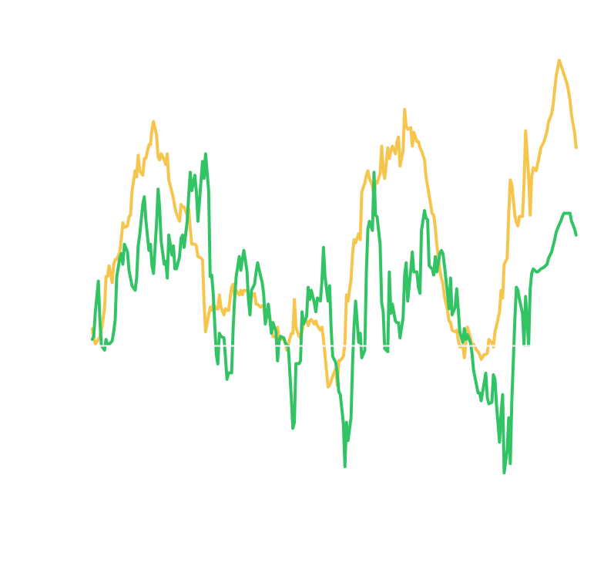
High Volatility, Steep Yield Curves to Persist for Now
Higher Volatility Here to Stay
Curve Will Begin to Flatten Next Year ⁽¹⁾
(bps)
VIX (20-Day Moving Average)
Median
10-Year / 2-Year Treasury Spread
Ave+1SD
Ave-1SD
2-Year Treasury / Fed Funds Spread
Source: CBOE
Source: Federal Reserve, Morgan Stanley Research
(1) April 2009 – December 2010 are Morgan Stanley estimates.

Slide 20
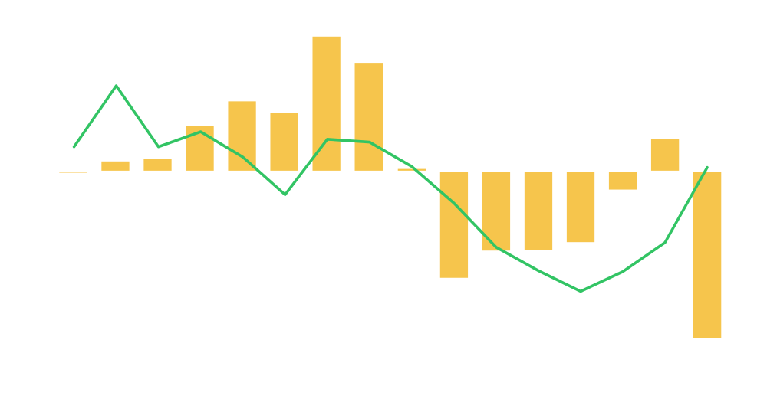
DB Pension Plan Net Asset Value and Discount Rates:
S&P 500 1993–2008E
Billions of dollars
%
Discount Rate (right scale)
NAV (left scale)
Note: 2008E assumes actual return on plan assets (-27%), the AA bond yield and no funding.
Source: Company reports

Slide 21
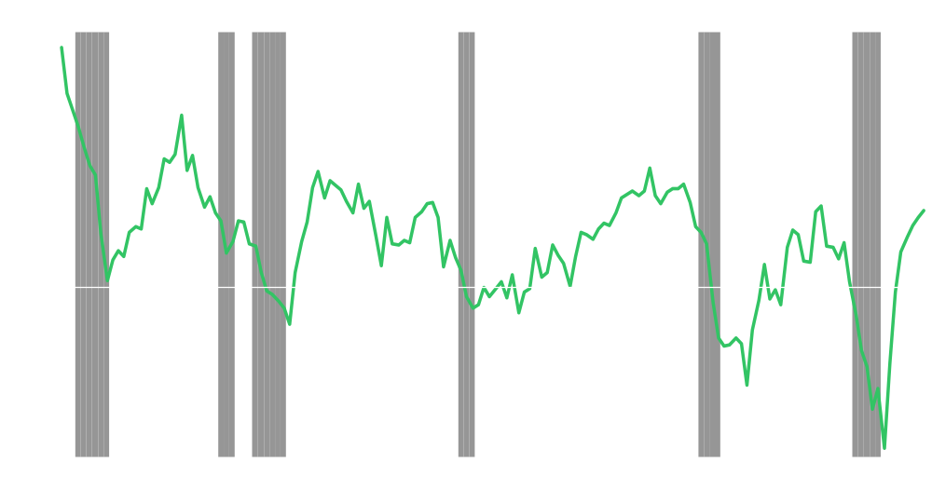
State and Local Budgets: A Boost from Stimulus
Percent of GDP
State and Local Government Deficit or Surplus
Source: Bureau of Economic Analysis

Slide 22
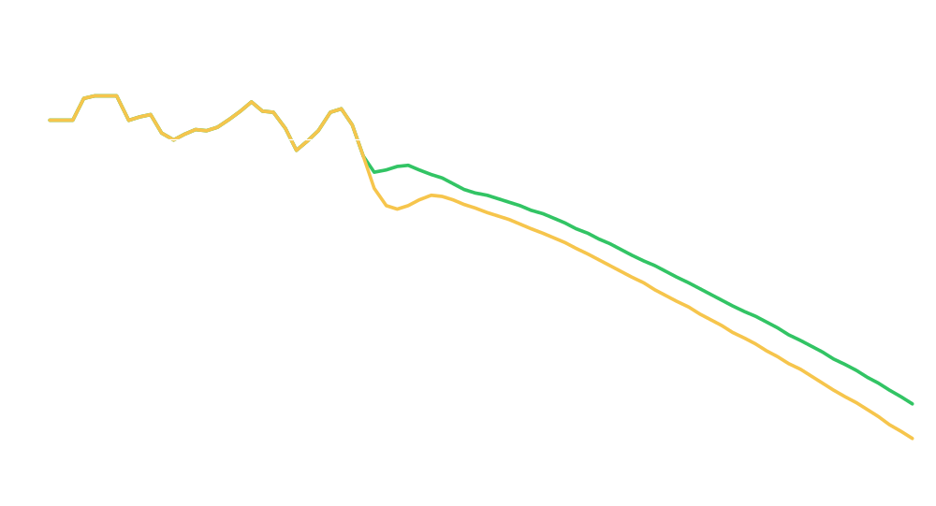
The State and Local Fiscal Timebomb
Operating surplus/deficit as percentage of GDP
Nov. 2008 GAO report
Jan. 2009 update
Note: Historical data from National Income and Product Accounts. Historical data from 1980 – 2007. GAO projections from 2008 – 2057 using many CBO projections and assumptions, particularly for the next 10 years.
Source: US Government Accountability Office, “Update of State and Local Government Fiscal Pressures” (GAO-09-320R, January 26, 2009).

Slide 23
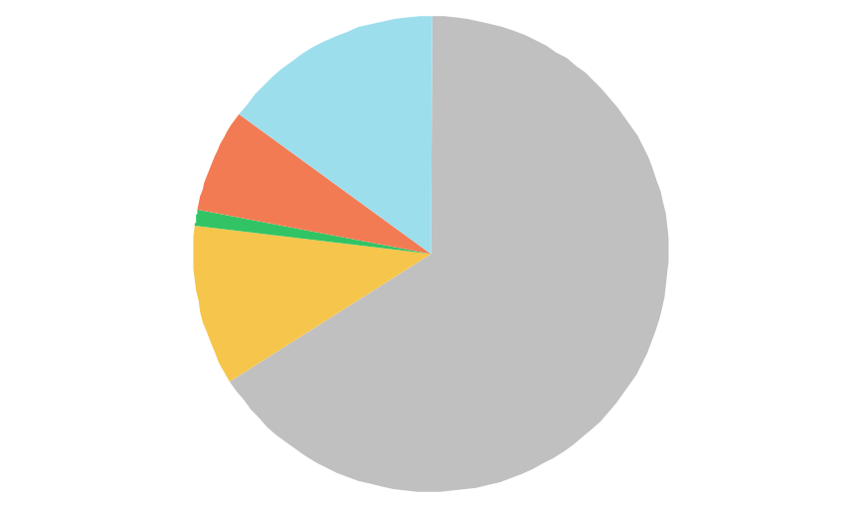
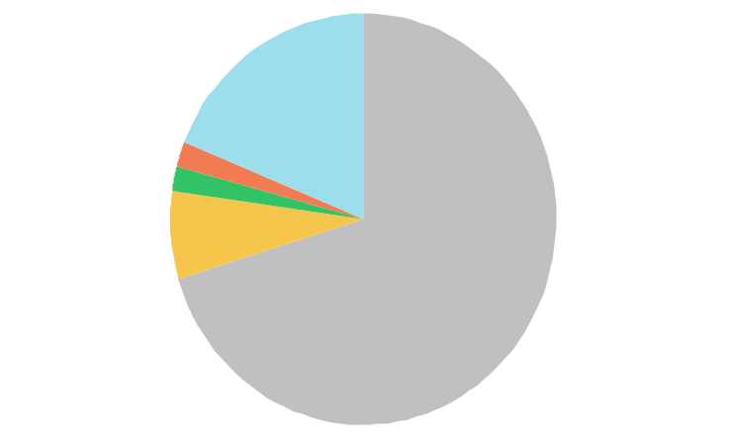
Comparing Compensation Structures
State & Local Government Workers
Total Compensation: $38.26/hour
Private Industry Workers
Total Compensation: $26.76/hour
Other compensation, 15%
Other compensation, 19%
Defined benefit plans, 7%
Defined benefit plans, 2%
Defined contribution plans, 1%
Defined contribution plans, 2%
Health Insurance, 11%
Health Insurance, 7%
Wages and salaries, 71%
Wages and salaries, 66%
Note: Employer Costs for Employee Compensation (ECEC), Tables 3 (State and Local Government Workers) and 5 (Private Industry Workers)
Source: Bureau of Labor Statistics

Slide 24
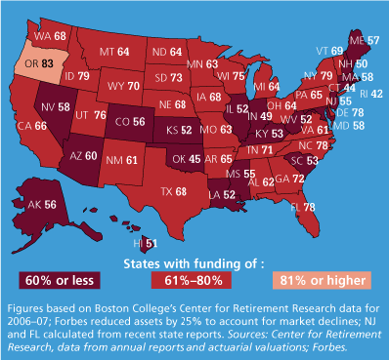
State and Local Pensions: Funding Status
Source: “Perilous State,” Forbes Magazine (February 16, 2009)

Slide 25
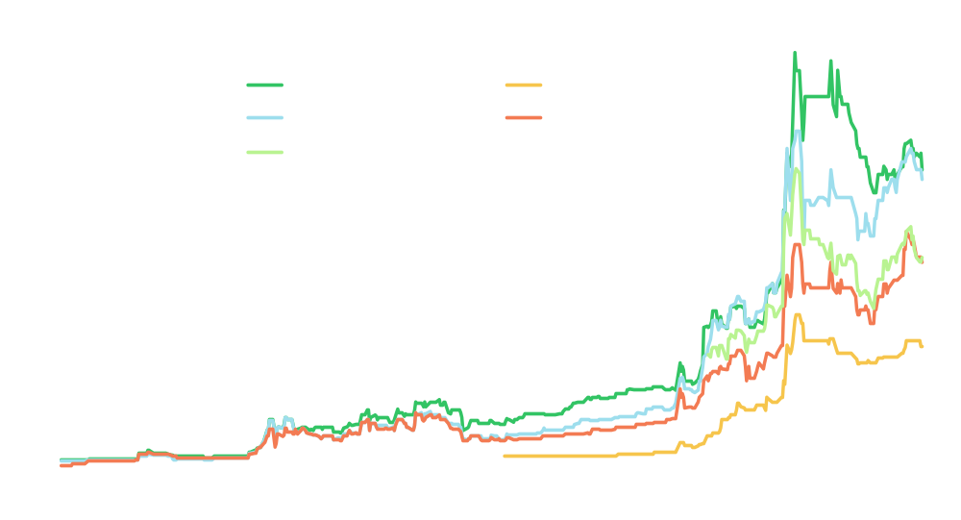
Concern about S&L Creditworthiness Rising
10-Year CDS Spreads
Note: Data as of February 20, 2009
Source: Morgan Stanley

Slide 26
Asset Allocation Under Stress: Diversified Portfolio
US Equity
US Bonds
International Equity
Emerging Market Equity
REITs
30%
25%
25%
10%
10%
Monthly
1993-2007
Quarterly
1993-2007
Theoretical
Equity Volatility
16.50
13.76
15.08
Volatility
Volatility/Equity
Correlation
11.83
0.72
0.91
9.54
0.69
0.91
10.50
0.70
0.92
Beta
Beta Volatility
Alpha Volatility
0.65
10.74
4.96
0.63
8.70
3.78
0.64
9.70
4.17
Real Return
Real Beta Return
Real Alpha Return
6.50
5.24
1.26
7.29
5.26
2.03
7.42
5.33
2.09
Note: “Portfolio D” refers to a hypothetical diversified portfolio.
Source: Morgan Stanley Research (see: “Portfolio Strategy: Diversification Performance: Under Stress (2008) and Over the Long Term (93-07),” Anthony Bova and Martin Leibowitz, November 10, 2008)

Slide 27
Diversified and 60-40 Portfolios: YTD October 31, 2008
D
B
USE Volatility = 22.14
Volatility
20.32
14.19
Volatility/Equity
Correlation
0.92
0.97
0.64
0.99
Beta
Beta Volatility
Alpha Volatility
0.89
19.79
4.10
0.64
14.12
0.96
USE Real Return = -30.69
Real Return
Real Beta Return
Real Alpha Return
-29.30
-27.63
-1.67
-21.51
-20.17
-1.34
Note: “Portfolio D” refers to a hypothetical diversified portfolio. “Portfolio B” refers to a portfolio composed of 60% US equity and 40% US bonds.
Source: Morgan Stanley Research (see: “Portfolio Strategy: Diversification Performance: Under Stress (2008) and Over the Long Term (93-07),” Anthony Bova and Martin Leibowitz, November 10, 2008)

Slide 28
Asset Class Characteristics: YTD October 2008
Correlations
Theoretical
1993-2007
YTD 2008
US Bonds
International Equity
Emerging Mkt Equity
REITs
0.18
0.92
0.75
0.55
-0.11
0.80
0.60
0.34
0.51
0.92
0.84
0.87
Volatility/Equity Volatility
Theoretical
1993-2007
YTD 2008
US Bonds
International Equity
Emerging Mkt Equity
REITs
0.45
1.18
1.70
0.88
0.28
1.07
1.74
1.01
0.19
1.22
1.71
1.67
Betas
Theoretical
1993-2007
YTD 2008
US Bonds
International Equity
Emerging Mkt Equity
REITs
0.14
0.77
0.76
0.48
-0.03
0.86
1.04
0.34
0.09
1.13
1.45
1.45
Source: Morgan Stanley Research (see: “Portfolio Strategy: Diversification Performance: Under Stress (2008) and Over the Long Term (93-07),” Anthony Bova and Martin Leibowitz, November 10, 2008)

Slide 29
Disclosure Section
The information and opinions in Morgan Stanley Research were prepared by Morgan Stanley & Co. Incorporated, and/or Morgan Stanley C.T.V.M. S.A. and their affiliates (collectively, "Morgan Stanley").
For important disclosures, stock price charts and rating histories regarding companies that are the subject of this report, please see the Morgan Stanley Research Disclosure Website at www.morganstanley.com/researchdisclosures, or contact your investment representative or Morgan Stanley Research at 1585 Broadway, (Attention: Equity Research Management), New York, NY, 10036 USA.
Global Research Conflict Management Policy
Morgan Stanley Research observes our conflict management policy, available at www.morganstanley.com/institutional/research/conflictpolicies.
Important Disclosures
Morgan Stanley Research does not provide individually tailored investment advice. It has been prepared without regard to the circumstances and objectives of those who receive it. Morgan Stanley recommends that investors independently evaluate particular investments and strategies, and encourages them to seek a financial adviser's advice. The appropriateness of an investment or strategy will depend on an investor's circumstances and objectives. Morgan Stanley Research is not an offer to buy or sell any security or to participate in any trading strategy. The value of and income from your investments may vary because of changes in interest rates or foreign exchange rates, securities prices or market indexes, operational or financial conditions of companies or other factors. Past performance is not necessarily a guide to future performance. Estimates of future performance are based on assumptions that may not be realized.
With the exception of information regarding Morgan Stanley, research prepared by Morgan Stanley Research personnel is based on public information. Morgan Stanley makes every effort to use reliable, comprehensive information, but we do not represent that it is accurate or complete. We have no obligation to tell you when opinions or information in Morgan Stanley Research change apart from when we intend to discontinue research coverage of a company. Facts and views in Morgan Stanley Research have not been reviewed by, and may not reflect information known to, professionals in other Morgan Stanley business areas, including investment banking personnel.
To our readers in Taiwan: Morgan Stanley Research is distributed by Morgan Stanley Taiwan Limited; it may not be distributed to or quoted or used by the public media without the express written consent of Morgan Stanley. To our readers in Hong Kong: Information is distributed in Hong Kong by and on behalf of, and is attributable to, Morgan Stanley Asia Limited as part of its regulated activities in Hong Kong; if you have any queries concerning it, contact our Hong Kong sales representatives.

Slide 30
Other Disclosures
Morgan Stanley Research is disseminated in Japan by Morgan Stanley Japan Securities Co., Ltd.; in Canada by Morgan Stanley Canada Limited, which has approved of and takes responsibility for its contents in Canada; in Germany by Morgan Stanley Bank AG, Frankfurt am Main, regulated by Bundesanstalt fuer Finanzdienstleistungsaufsicht (BaFin);in Spain by Morgan Stanley, S.V., S.A., a Morgan Stanley group company, supervised by the Spanish Securities Markets Commission(CNMV), which states that it is written and distributed in accordance with rules of conduct for financial research under Spanish regulations; in the US by Morgan Stanley & Co. Incorporated, which accepts responsibility for its contents. Morgan Stanley & Co. International plc, authorized and regulated by Financial Services Authority, disseminates in the UK research it has prepared, and approves solely for purposes of section 21 of the Financial Services and Markets Act 2000, research prepared by any affiliates. Private UK investors should obtain the advice of their Morgan Stanley & Co. International plc representative about the investments concerned. In Australia, Morgan Stanley Research and any access to it is intended only for "wholesale clients" within the meaning of the Australian Corporations Act. RMB Morgan Stanley (Proprietary) Limited is a member of the JSE Limited and regulated by the Financial Services Board in South Africa. RMB Morgan Stanley (Proprietary) Limited is a joint venture owned equally by Morgan Stanley International Holdings Inc. and RMB Investment Advisory (Proprietary) Limited, which is wholly owned by FirstRand Limited.
Trademarks and service marks in Morgan Stanley Research are their owners' property. Third-party data providers make no warranties or representations of the accuracy, completeness, or timeliness of their data and shall not have liability for any damages relating to such data. The Global Industry Classification Standard (GICS) was developed by and is the exclusive property of MSCI and S&P. Morgan Stanley bases projections, opinions, forecasts and trading strategies regarding the MSCI Country Index Series solely on public information. MSCI has not reviewed, approved or endorsed these projections, opinions, forecasts and trading strategies. Morgan Stanley has no influence on or control over MSCI's index compilation decisions. Morgan Stanley Research or portions of it may not be reprinted, sold or redistributed without the written consent of Morgan Stanley. Morgan Stanley research is disseminated and available primarily electronically, and, in some cases, in printed form. Additional information on recommended securities/instruments is available on request.
The information in Morgan Stanley Research is being communicated by Morgan Stanley & Co. International plc (DIFC Branch), regulated by the Dubai Financial Services Authority (the DFSA), and is directed at wholesale customers only, as defined by the DFSA. This research will only be made available to a wholesale customer who we are satisfied meets the regulatory criteria to be a client.
The information in Morgan Stanley Research is being communicated by Morgan Stanley & Co. International plc (QFC Branch), regulated by the Qatar Financial Centre Regulatory Authority (the QFCRA), and is directed at business customers and market counterparties only and is not intended for Retail Customers as defined by the QFCRA.
As required by the Capital Markets Board of Turkey, investment information, comments and recommendations stated here, are not within the scope of investment advisory activity. Investment advisory service is provided in accordance with a contract of engagement on investment advisory concluded between brokerage houses, portfolio management companies, non-deposit banks and clients. Comments and recommendations stated here rely on the individual opinions of the ones providing these comments and recommendations. These opinions may not fit to your financial status, risk and return preferences. For this reason, to make an investment decision by relying solely to this information stated here may not bring about outcomes that fit your expectations.

Slide 31
The Americas 1585 Broadway New York, NY 10036-8293 United States Tel: +1 (1) 212 761 4000 | Europe 20 Bank Street, Canary Wharf London E14 4AD United Kingdom Tel: +44 (0)20 7 425 8000 | Japan 4-20-3 Ebisu, Shibuya-ku Tokyo 150-6008 Japan Tel: +81 (0)3 5424 5000 | Asia/Pacific 1 Austin Road West Kowloon Hong Kong Tel: +852 2848 5200
© 2009 Morgan Stanley

