Slide 1

March 24, 2009
Exploiting the Gap Between Fundamental Reality and Market Perception
NYU – Stern School of Business
Tobias M. Levkovich
Managing Director, Chief U.S. Equity Strategist
tobias.levkovich@citi.com
(212) 816-1623
Lorraine Schmitt, Associate (212) 816-1657
Dan Kaskawits, Associate (212) 816-8515
See Appendix for Analyst Certification and Important Disclosures
Citi Investment Research is a division of Citigroup Global Markets Inc. (the "Firm"), which does and seeks to do business with companies covered in its research reports. As a result, investors should be aware that the Firm may have a conflict of interest that could affect the objectivity of this report. Investors should consider this report as only a single factor in making their investment decision. Non-US research analysts who have prepared this report are not registered/qualified as research analysts with the NYSE and/or NASD. Such research analysts may not be associated persons of the member organization and therefore may not be subject to the NYSE Rule 472 and NASD Rule 2711 restrictions on communications with a subject company, public appearances and trading securities held by a research analyst account.
Customers of the Firm in the United States can receive independent third-party research on the company or companies covered in this report, at no cost to them, where such research is available. Customers can access this independent research at http://www.smithbarney.com (for retail clients) or http://www.citigroupgeo.com (for institutional clients) or can call (866) 836-9542 to request a copy of this research.
Published March 9, 2009

Slide 2
The Outlook
Price Targets
S&P 500 EPS Estimates
Index | 2007A | 2008A | 2009E¹
S&P 500 | 1,468 | 903 | 1,000
DJIA | 13,265 | 8,776 | 9,500
 | 2008E | 2009E | 2010E
S&P 500 Operating EPS Estimate | $66.60 | $51.00 | $54.00
Year-over-Year Change | -21.1% | -23.4% | 5.9%
¹2009 S&P 500 and DJIA targets established on 10/06/08 and updated on 11/21/08.
Source: Citi Investment Research Economics and Analysis
Financial Sector Asset Write Downs ($Impact on S&P 500 EPS)
2007 = $9.00 2008 = $23.00 2009 = $11.00

Slide 3
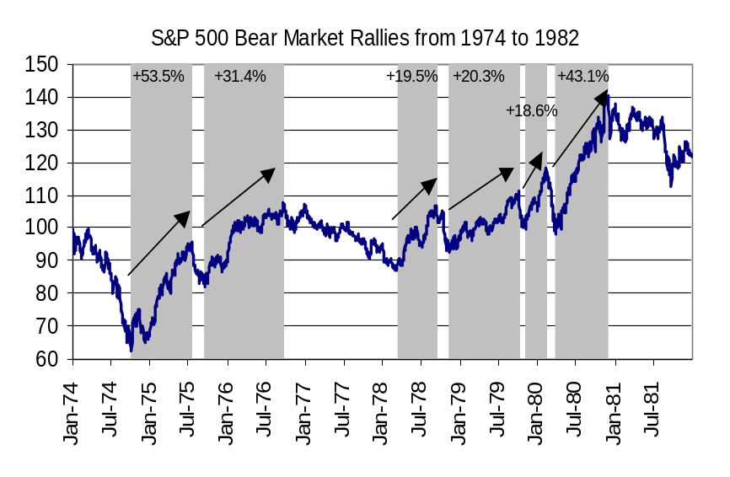
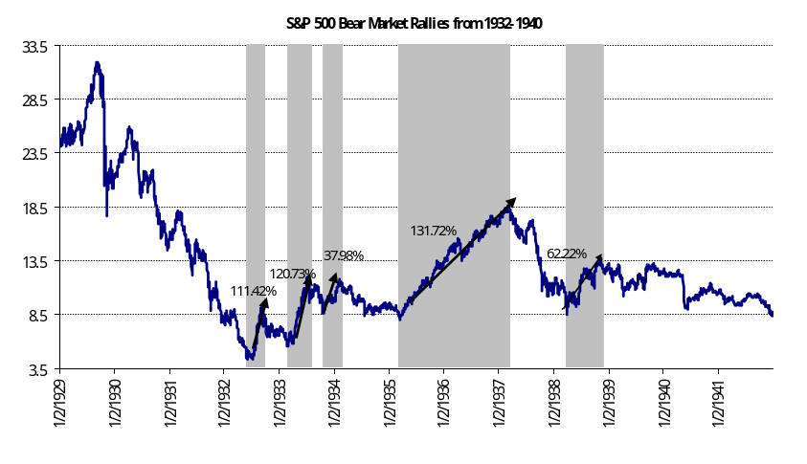
Meaningful Trading Rallies Are Plausible
S&P 500 Trading Rallies 1974-1982
S&P 500 Trading Rallies 1932-1940
Source: Global Financial Database and CIR - U.S. Equity Strategy
Source: Global Financial Database and CIR - U.S. Equity Strategy
Within these trading ranges, powerful trading rallies do occur; the six trading rallies from 1974-1982 averaged 32% versus trend-line appreciation of 9.4%.
Annual stock market total returns may be in the 7% area over the next several years, although we anticipate the continuation of significant trading variability around the trend line.
Within these trading ranges, powerful trading rallies do occur; the five trading rallies from 1932-1940 averaged 92.8% versus a CAGR of 19.4%.

Slide 4
Constructive View on Equities Driven By:
Depressed Investor Sentiment
Attractive Valuation
Declining Volatility
Lowered Earnings Expectations

Slide 5
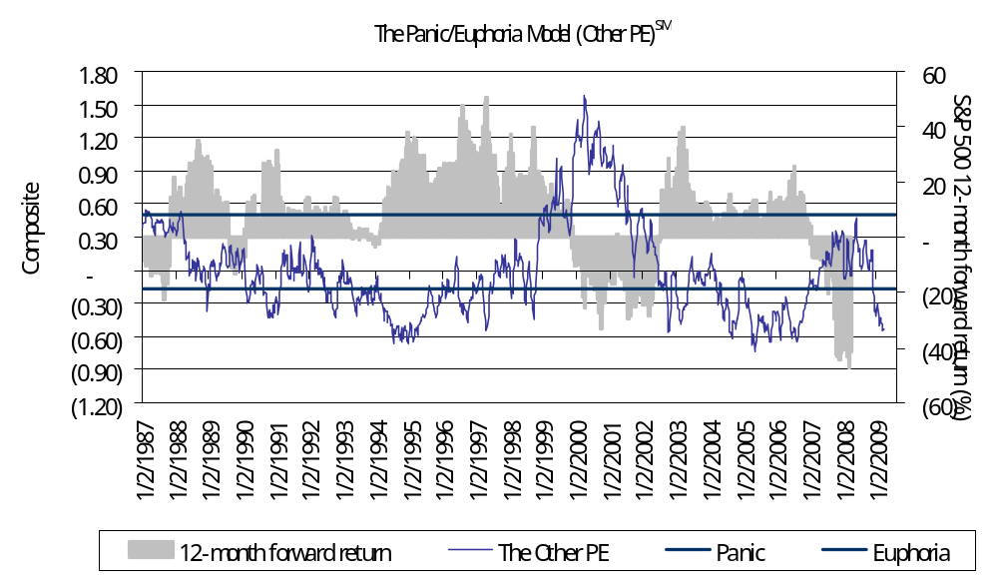
Sentiment
The Panic/Euphoria ModelSM
Source: Citi Investment Research - U.S. Equity Strategy
Back in “panic.”
Components: NYSE short interest ratio, margin debt, Nasdaq daily volume as % of NYSE volume, a composite average of Investors Intelligence and the American Association of Individual Investors bullishness data, retail money funds, the put/call ratio, CRB futures index, gasoline prices and the short interest ratio between public and member firms.
Money flows in 2008 were worse than 2002’s flight.

Slide 6
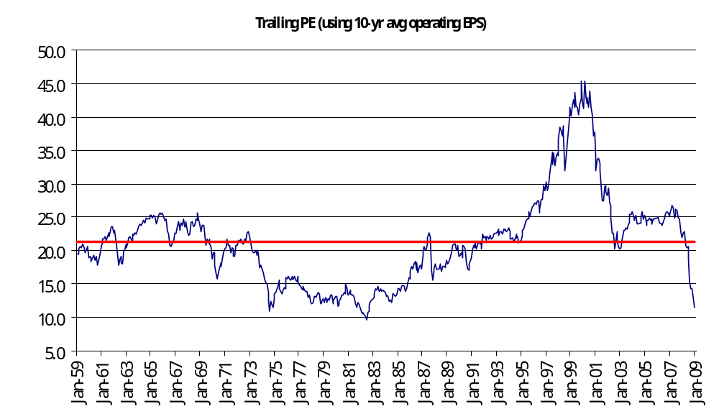
Valuation
Normalized P/E
Source: Citi Investment Research - U.S. Equity Strategy

Slide 7
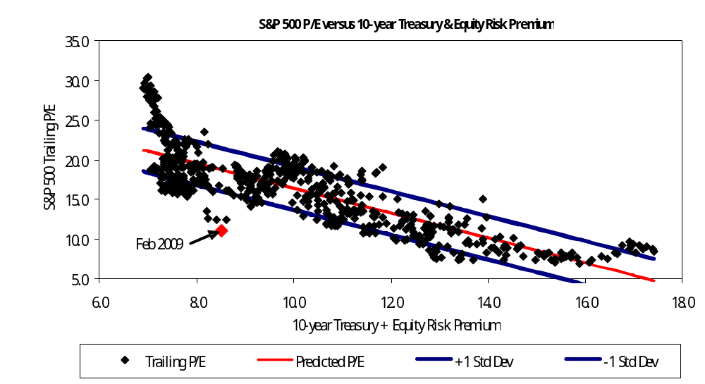
Valuation
P/Es, Interest Rates & Risk Premium Analysis
Source: Citi Investment Research - U.S. Equity Strategy

Slide 8
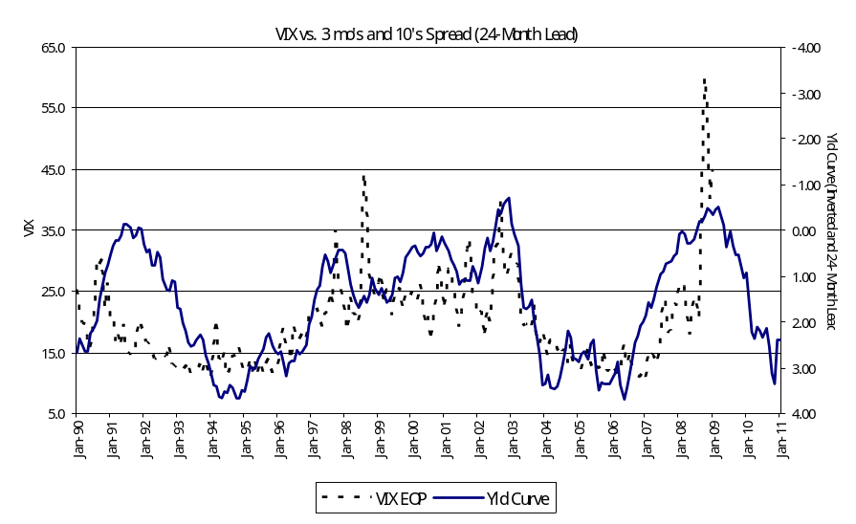
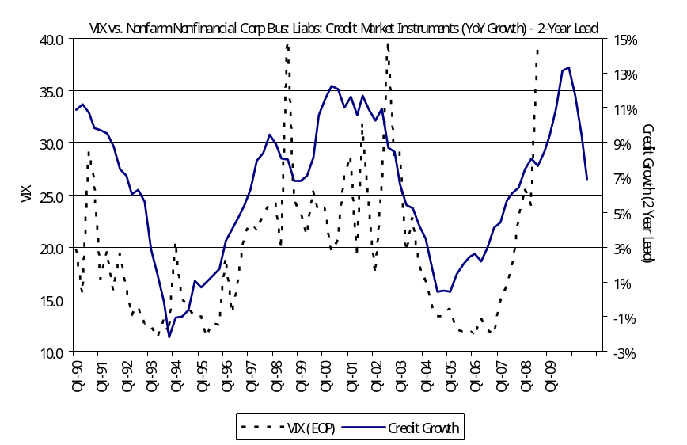
Likely Decline in Volatility
VIX vs. Yield Curve – 24 Month Lead
VIX vs. Corporate Credit Growth – 24 Month Lead
Source: Haver Analytics and Citi US Equity Strategy
Source: Haver Analytics and Citi US Equity Strategy

Slide 9
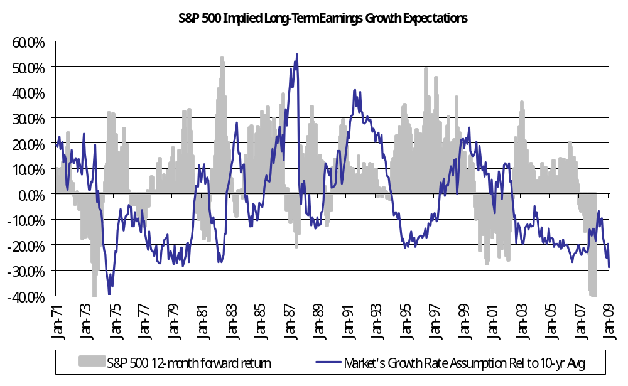
Earnings
Market Value Reflecting Implied EPS Growth
Source: Haver Analytics and Citi - U.S. Equity Strategy

Slide 10
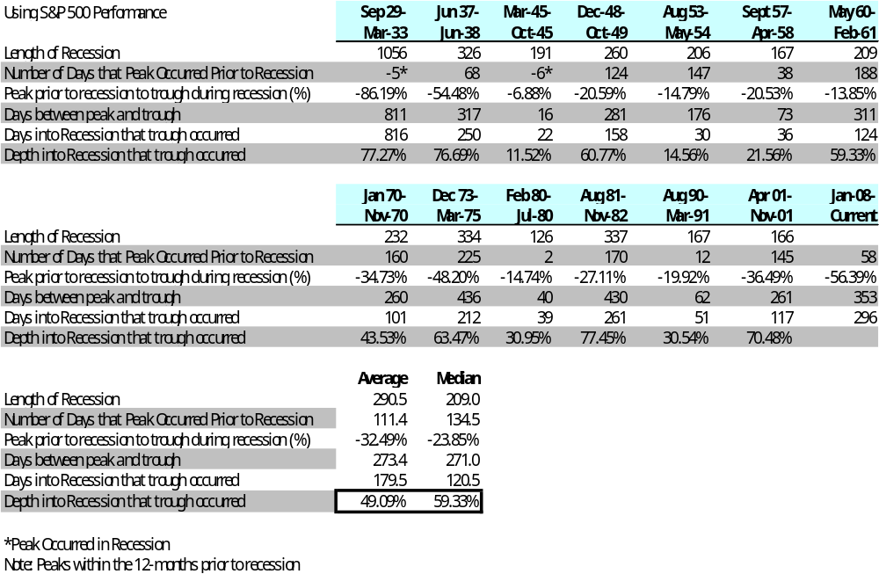
Recession Study
Stock Market Performance Around Recessions
Source: Global Financial Database, Haver, and Citi Investment Research – US Equity Strategy
Significant downside risk when recessions ensue.

Slide 11
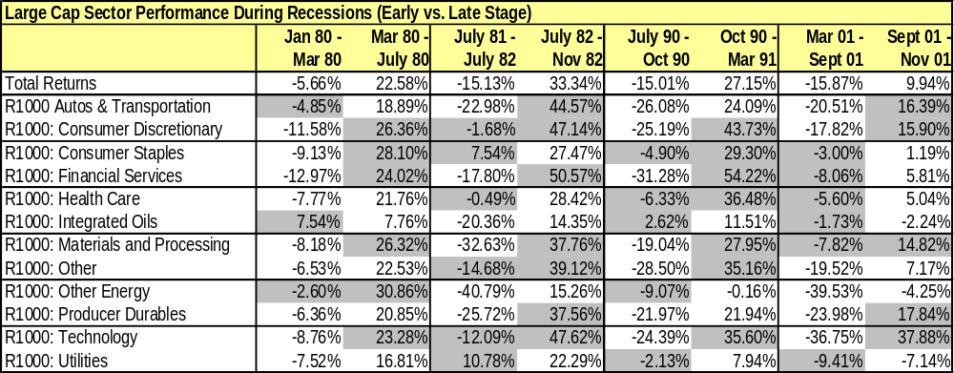
Recession Study
Stock Market Performance Around Recessions
Source: Russell and CIR – Small & Mid Cap Strategy
Financial Services, Tech, Materials, and Consumer Discretionary tend to do well during the second half of recessions.

Slide 12
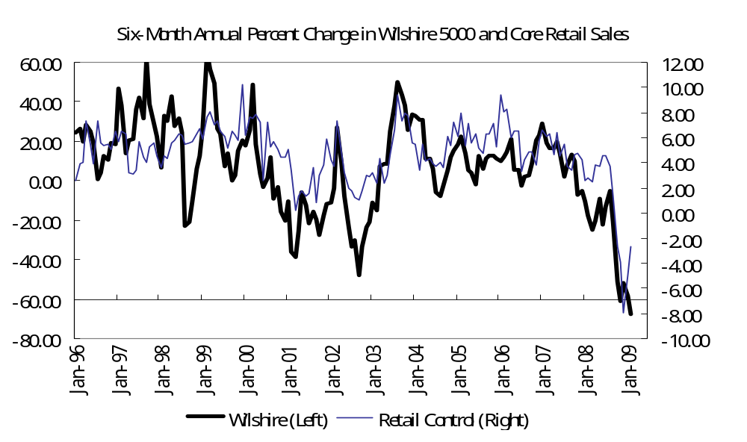
Stocks Drive Spending, Not Homes
Core Retail Sales and Wilshire 5000
The top quintile of American income earners account for roughly 40% of consumer spending and far more of discretionary spending.
Looks like consumers dramatically “underspent” their real estate riches, but equity market levels appear to have meaningful impact on the “mass affluent” spenders.
Source: Citi Economics & Market Analysis

Slide 13
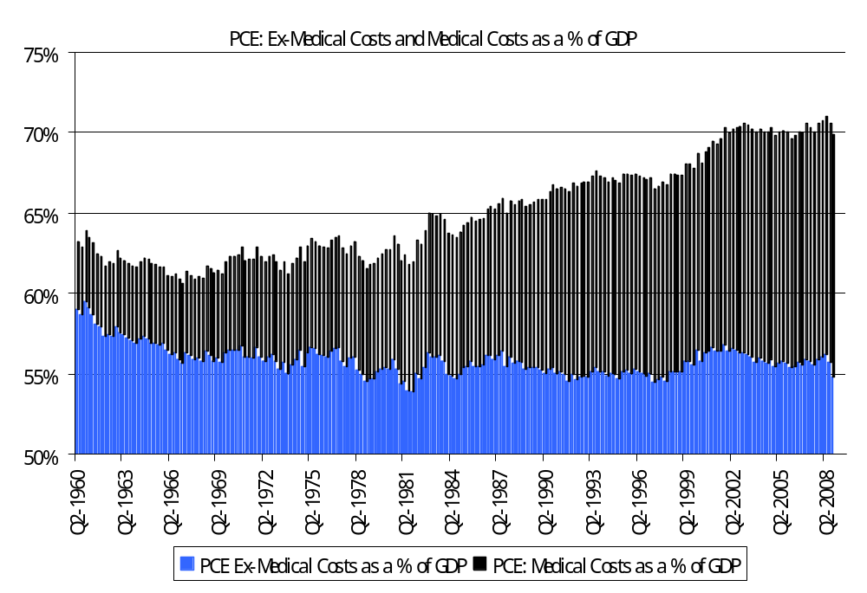
Consumer Myths
Consumer Spending: Medical Costs as a % of GDP vs. Ex-Medical Costs
Source: Citi Economics & Market Analysis

Slide 14
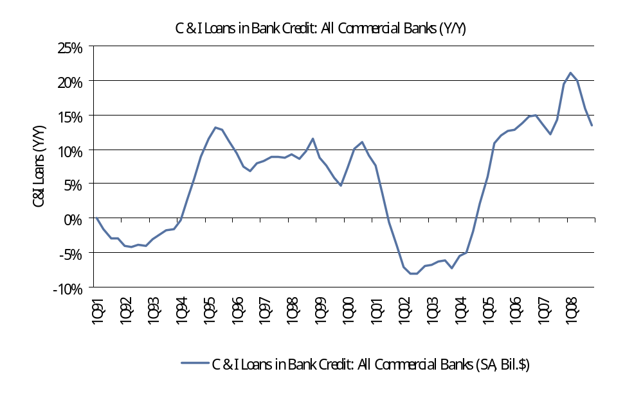
C&I Loan Activity
C&I Loans Outstanding
Source: Haver Analytics and CIR – US Equity Strategy

Slide 15
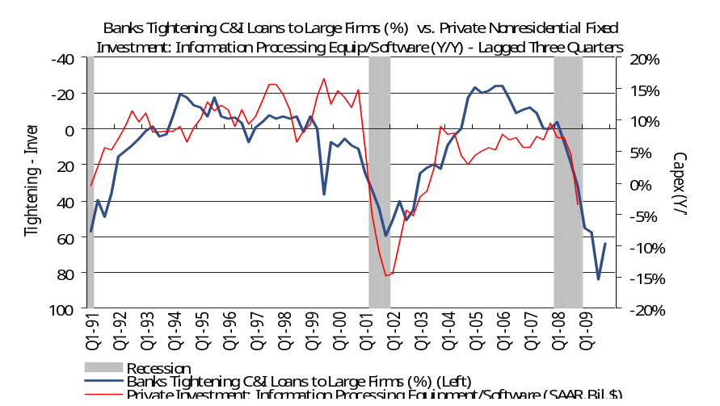
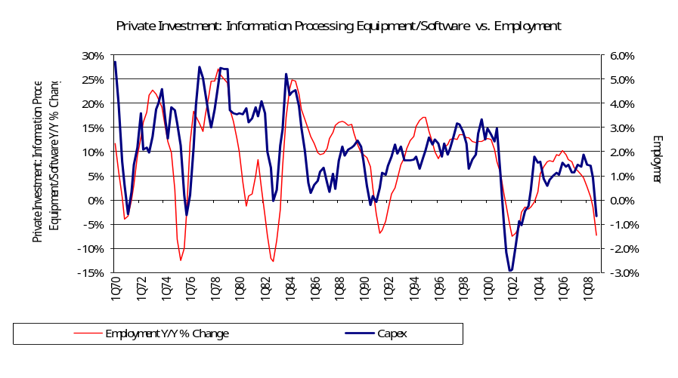
Tech Capex
Credit Standards and Tech Capex
Tech Capex and Jobs
Source: Haver Analytics, and CIR – U.S. Equity Strategy
Source: Haver Analytics, and CIR – U.S. Equity Strategy
Tighter bank loan tightening standards would be a negative for technology capex.
Job growth has a tight relationship with tech capex trends.

Slide 16
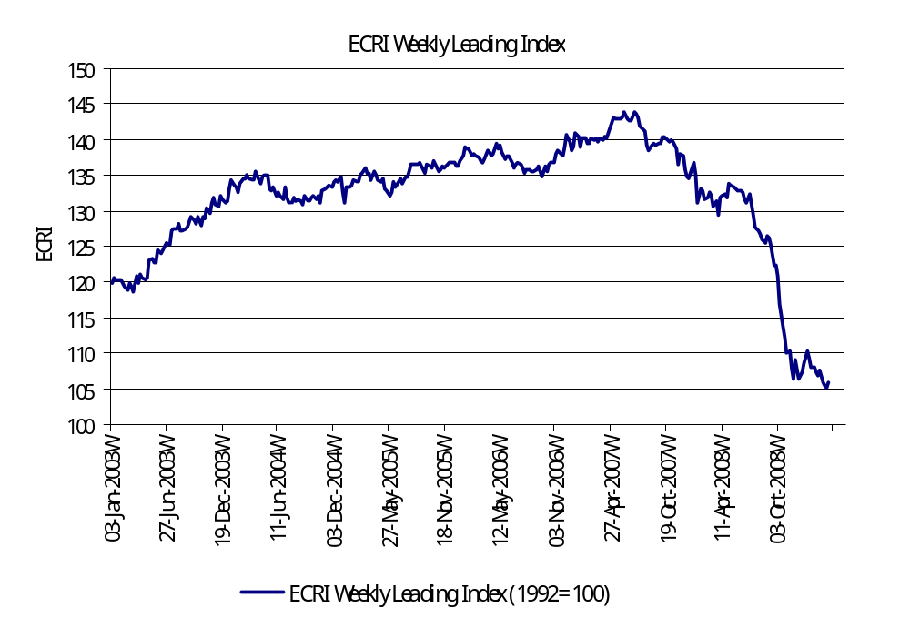
ECRI Leading Indicator
ECRI Weekly Leading Index
Source: Haver Analytics and CIR – US Equity Strategy

Slide 17
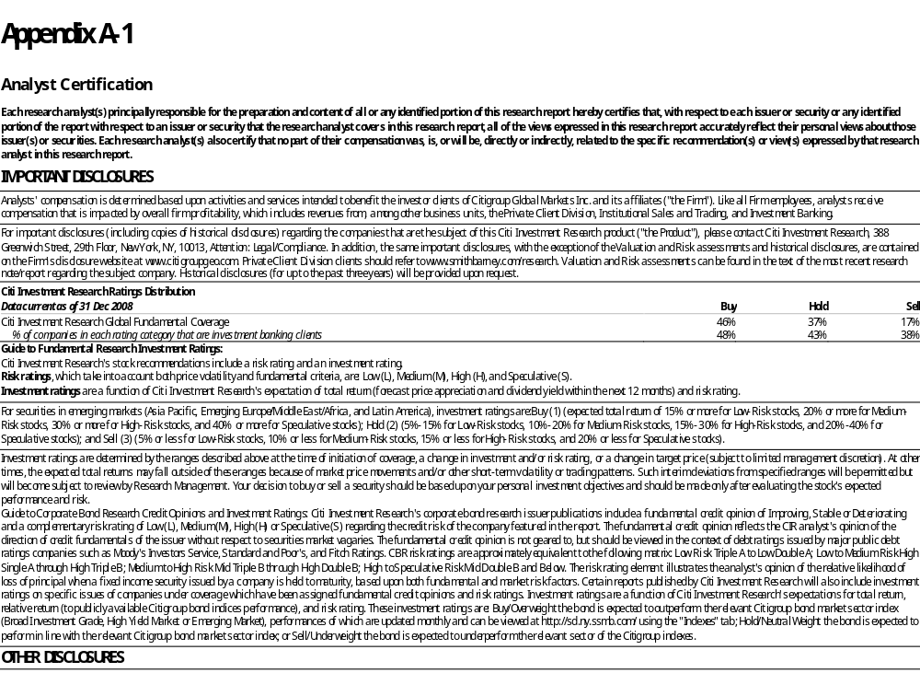

Slide 18
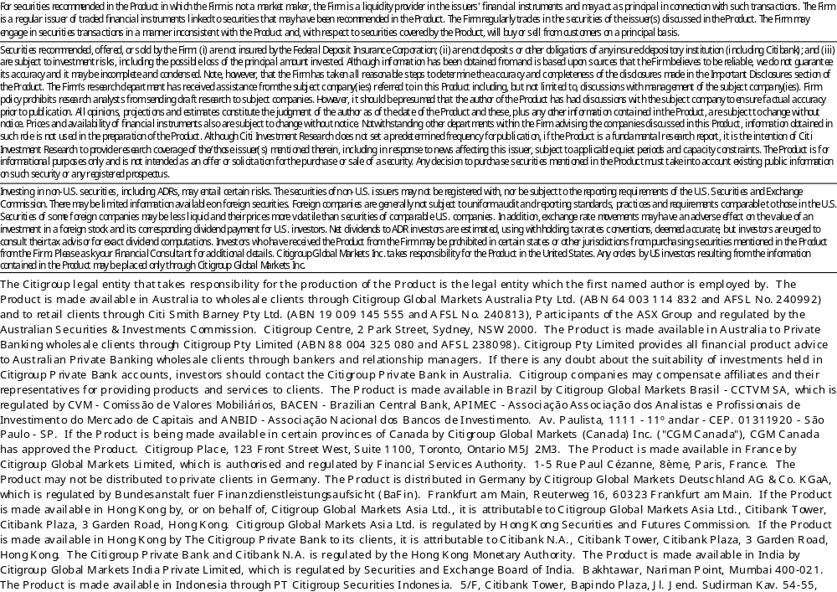

Slide 19
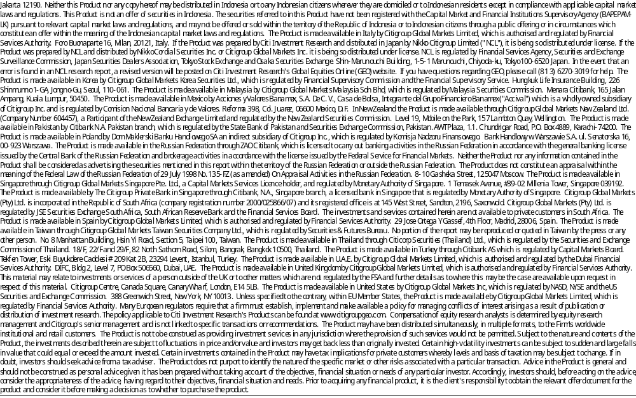

Slide 20
