Slide 1

The Global Economy
International Capital Flows
© NYU Stern School of Business
Notes:
Open spreadsheet
History of international capital flows
25 years ago lots of flows, but
From Rich to poor
mostly debt
Some to govts
Our concern was would they pay us back
Compare:
Mexico open to equity claims
China too
Governments less involved
Our concern is that they’re buying us!
Two issues today
US borrowing: why? Is it bad?
SWFs: why? Are they bad?

Slide 2
Group Project #7
Challenges of India’s tax system
Fiscal situation (debt and deficits)
Signs of trouble?

Slide 3
Questions
Money moves around the world in seconds
  Why does it move from one country to another?
  Is that a good thing?

Slide 4
Plan of attack
Group Project #7 ✓
Questions ✓
Where we’re headed
Capital flows
Balance of payments
Net foreign asset (NFA) dynamics
Is the US in trouble?

Slide 5
Where we’re headed
Govt Deficit
print money
Govt Debt
Trade Deficit
Inflation & FX
fear of default
Bank Failures
Crisis

Slide 6
Capital flows
What are they?
Where do they come from?
What do they tell us?

Slide 7
Capital flows
Industries
  Industry A (software): growing fast
  Industry B (steel): not growing
  Where will capital markets direct funds?
  Is that a good thing?

Slide 8
Capital flows
Governments
  Suppose one chooses to spend more than current tax revenue
  How would it finance its deficit?
  Would capital markets support this?
  Is that a good thing?

Slide 9
Capital flows
Countries
  When might capital flow from one country to another?
  Would capital markets support this?
  Is that a good thing?

Slide 10
Balance of payments
These are almost the same
  Trade balance (“merchandise”)
  Net exports (+ services)
  Current account balance (+ net income flows, incl interest)
Call me if you ever need to know the difference

Slide 11
Balance of payments
How is a current account deficit financed?
  “Inflow” of capital from abroad
  Equivalently: sell assets to rest-of-world (“borrow”)
  We say the current account is mirrored by an equal and opposite “capital and financial account”
  That’s why we say balance of payments

Slide 12
Balance of payments
BOP = CA + Capital/Financial Flows = 0
Country 1
CA < 0
Goods
Country 2
CA > 0
Capital flow
If Country 2 runs a current account surplus:
There is a capital “outflow” for Country 2, “inflow” for Country 1.
Notes:
Say: NX = CA
Plus: focus on goods

Slide 13
Balance of payments
What does a capital inflow finance?
Remember:
S = Y – C – G = I + NX
Does it matter?
[NB: we’re ignoring the difference between CA and NX here, and that’s ok – keeps things simple without missing the point.]

Slide 14
Balance of payments
Lawson doctrine
  Capital inflows ok if they finance private investment and consumption
  Not if they finance government deficits

Slide 15
Net foreign assets
International capital markets
  Countries own claims on each other
  Net position (net foreign assets or NFA):
  NFA = Claims on Foreign Countries – Foreign Claims on Us
Borrowers and lenders
  If NFA>0, country is net creditor (lender)
  If NFA<0, country is net debtor (borrower)
Two terms for the same thing
  Net foreign assets (NFA)
  Net international investment position (Net IIP)

Slide 16
US IIP (2007, USD, billions)
Category | Assets | Liabilities
Direct investment | 3333 | 2423
Portfolio investment | 7048 | 10,298
Other | 6982 | 7361
Reserves | 277 | –
Total | 17,640 | 20,082
Net IIP (=NFA) | –2,442
Source: IMF, International Financial Statistics.

Slide 17
China IIP (2007, USD, billions)
Category | Assets | Liabilities
Direct investment | 108 | 1266
Portfolio investment | 239 | 742
Other | 406 | 381
Reserves | 1535 | –
Total | 2,288 | 1,535
Net IIP (=NFA) | +753
Source: IMF, International Financial Statistics.

Slide 18
NFA dynamics
What does a current account or trade deficit mean?
Is it bad?

Slide 19
NFA dynamics
Current account deficits
  Decrease NFA
  Decrease net interest receipts
Analogy with firms
  Which firms raise the most money in capital markets?
  Is this a good analogy?

Slide 20
NFA dynamics
NFA dynamics
  Quick look at NFA/Y: how fast is it growing, and why?
  Missing: equity claims, asset revaluations…
Changes in NFA:
NFA_{t} = NFA_{t-1} + CA_{t} + Net Asset Revaluations
NFA_{t} ≈ (1+i)NFA_{t-1} + NX_{t}
Comments
  NX is like the primary deficit from fiscal policy [and CA the total deficit]
  Different if claims are equity or foreign-denominated
Reminder: CA includes interest payments!

Slide 21
NFA dynamics
NFA and Y
NFA_{t} = (1+i) NFA_{t-1} + NX_{t}
Y_{t} = (1+g) Y_{t-1}
Change in NFA/Y
NFA_{t}/Y_{t} = [(1+i)/(1+g)] (NFA_{t-1}/Y_{t-1}) + NX_{t}/Y_{t}
Typically i>g
  Negative NFA will tend to get worse on its own
  Eventually debt service overwhelms the economy [i NFA]
  Something must change – but what?

Slide 22
NFA dynamics: US
Current numbers
  NFA/Y = –20% (rough guess)
  NX/Y = –4% (EIU forecast)
  i = 0%
  g = – 1% (–2+1)
How is NFA/Y changing? Why?

Slide 23
Is the US in trouble?
Choose one:
  This US current account and trade deficit is a sign of serious trouble
  The US current account deficit is not a big deal
  Both of the above
  None of the above

Slide 24
Warren Buffett
Annual letter to shareholders, 2006:
  As time passes, and as claims against us grow, we own less and less of what we produce. ... Should we continue to run current account deficits comparable to those now prevailing, ... our US ‘family’ will be delivering [a substantial fraction of] its annual output to the rest of the world simply as tribute for the overindulgences of the past.

Slide 25
Stephen Roach
Morgan Stanley Global Economic Forum:
  Lacking in domestic saving, America must import foreign saving ... to keep growing at acceptable rates. And so America must then run massive and ever-widening current account deficits to attract that foreign capital. ... America now requires an average of $2.9 billion of capital inflows each and every business day to keep the magic going.

Slide 26
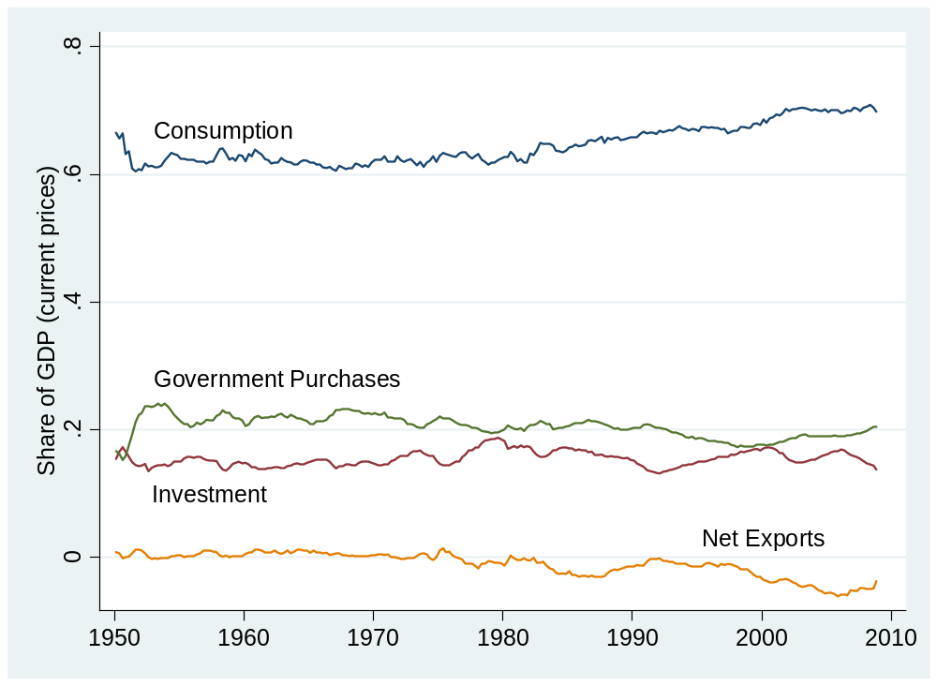
US flows
Source: BEA.

Slide 27
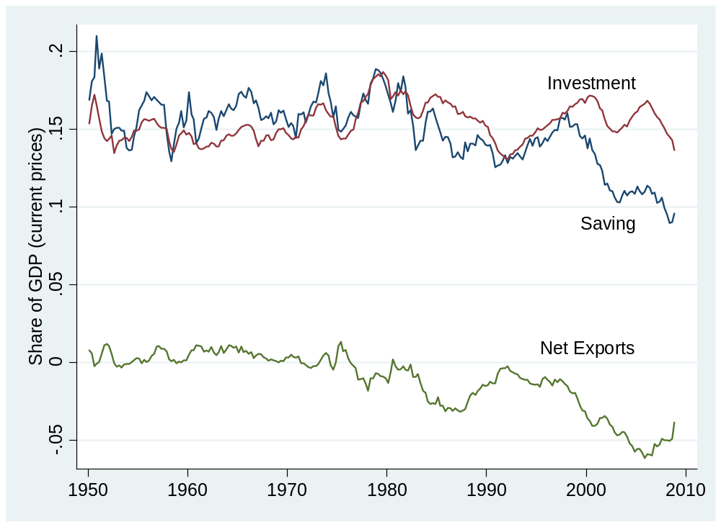
US flows
Source: BEA.

Slide 28
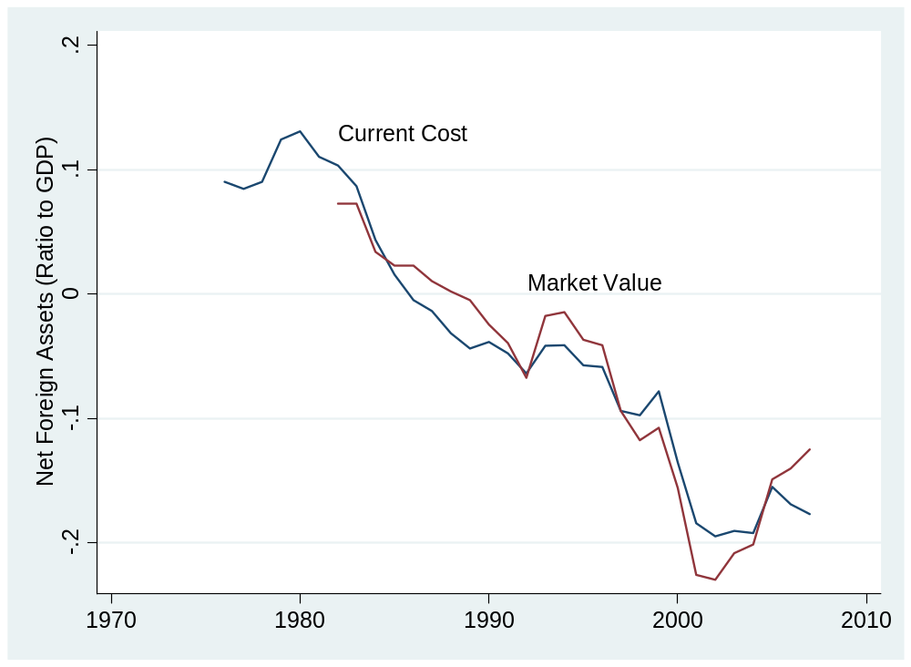
US net foreign assets
Source: BEA.

Slide 29
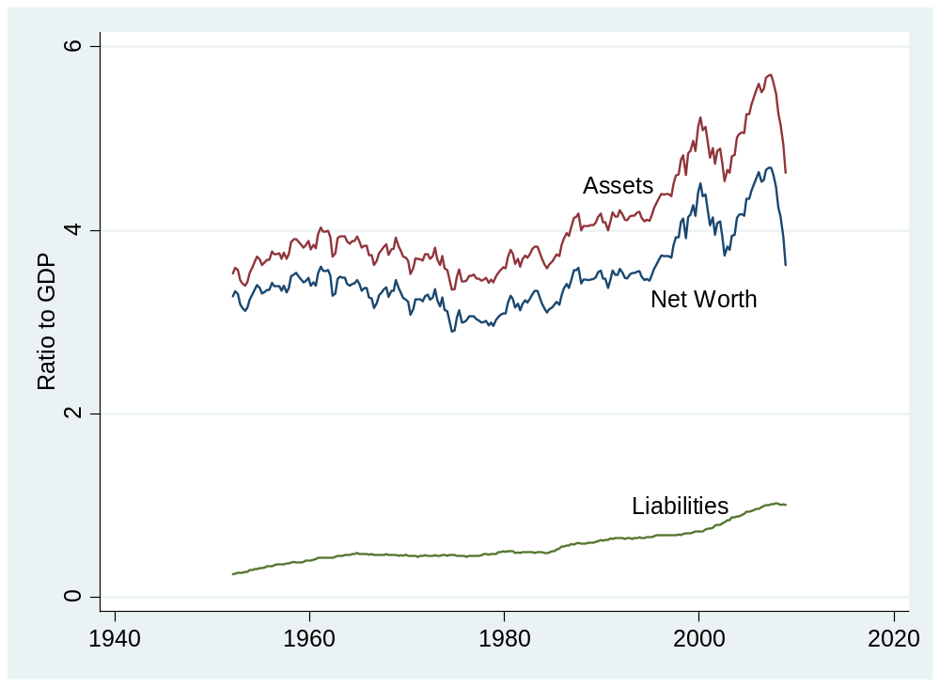
US household net worth
Source: Federal Reserve, Flow of Funds.

Slide 30
Is the US in trouble?
Choose one:
  We’re in trouble
  We’re fine
  Both of the above

Slide 31
Is the US in trouble?
Facts
  Notable trade and current account deficits
  Consumption has risen as fraction of GDP, saving has fallen
  Net foreign asset position negative
  But small relative to household net worth
My take
  Yes, but not because of the trade deficit
  Numbers not big enough to matter – yet!

Slide 32
Takeaways
Trade/current-account deficits equal capital inflows
  This is accounting, not theory
They reflect either high investment or low saving
Are deficit countries bad bets?
  It depends: on how the money is used, for example

Slide 33
After the break
Be prepared to speculate about signs that a country could be in trouble soon

Slide 34
The Global Economy
(Emerging Market?) Crises
© NYU Stern School of Business

Slide 35
LABA party
Thursday 10pm - Duvet

Slide 36
Signs of trouble
What would you look at to detect trouble early?

Slide 37
Signs of trouble
Fiscal indicators
  Government debt more than 50% of GDP ?
  Deficit more than 5% of GDP?
  Signs that deficit is a long-term issue? [pensions, healthcare, banks…]

Slide 38
Signs of trouble
Exchange rate
  Fixed or “managed”?
  Real exchange rate overvalued? [more than 30% above PPP or 20% above 3-year average]
  Reserves less than 3 months imports?

Slide 39
Signs of trouble
Capital inflows
  Foreign debt more than 50% of GDP?
  Capital inflows more than 5% of GDP?
  Public or private? [Lawson]
  Debt or equity? [debt is riskier]
  Short-term or long-term? [short is riskier]
  Denominated in foreign currency? [riskier]

Slide 40
Signs of trouble
Banking system
  Signs of weakness?
  Cause or effect?

Slide 41
Signs of trouble
Politics and institutions
  Could the government decide to default?
  Are “institutions” weak?

Slide 42
Signs of trouble
Govt Deficit
print money
Govt Debt
Trade Deficit
Inflation & FX
fear of default
Bank Failures
Crisis

Slide 43
Signs of trouble checklist
Government debt and deficits
Exchange rate and reserves
Current account and net foreign assets
Banking system
Politics and institutions

Slide 44
Plan of attack
Signs of trouble ✓
Volatility and crises
Mexico, Asia, China, Italy, Turkey
“Free markets” revisited

Slide 45
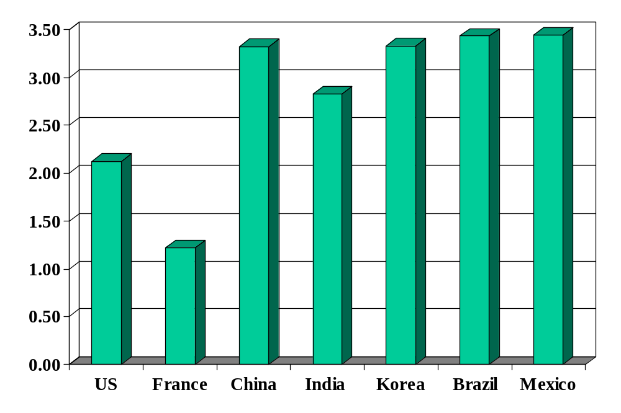
Volatility (std dev of annual growth rate %)
Source: World Bank, World Development Indicators, GDP per capita, 1975-2005.

Slide 46
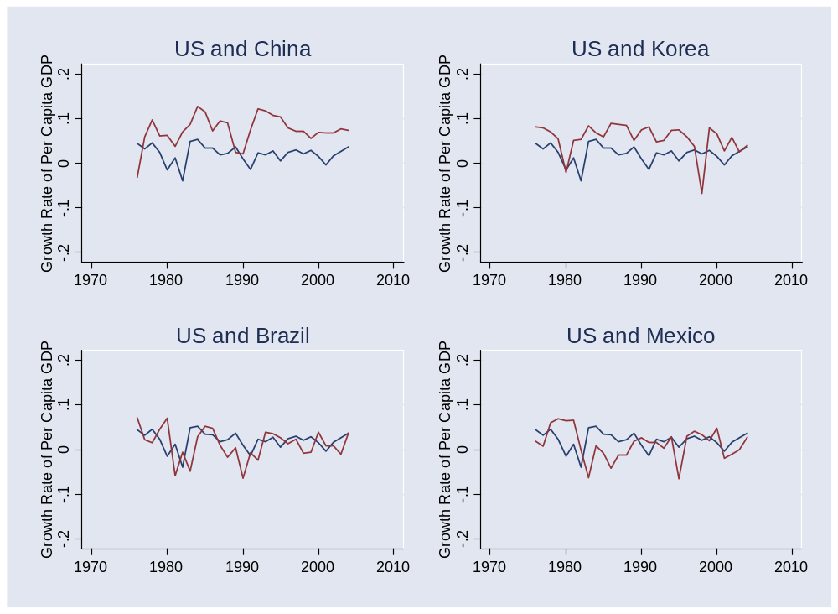
Volatility
Source: World Bank, World Development Indicators, GDP per capita, 1975-2005. Blue=US.

Slide 47
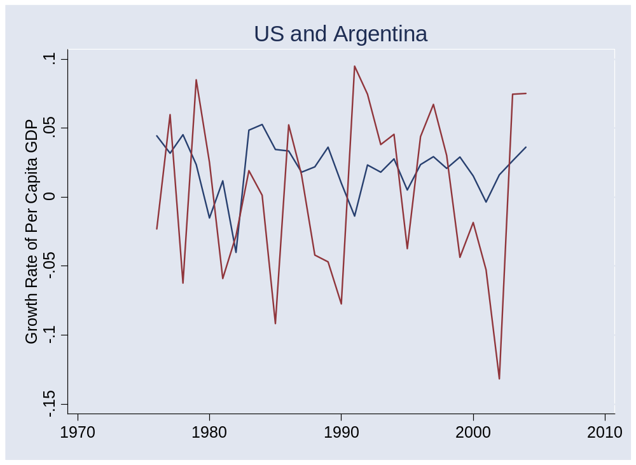
Volatility
Source: World Bank, World Development Indicators, GDP per capita, 1975-2005.

Slide 48
Crises (a fact of life)
Australia 1891-93 (“Barings crisis”)
  GDP fell 18%
United States 1907-08
  GDP fell 10%
Mexico 1994-95:
  GDP fell 9%, peso fell almost 50%
Korea 1997-98
  GDP fell 9%, won fell 30%
Argentina 1999-2002
  GDP fell 20%, peso fell 65%
Many others

Slide 49
Mexico 1994-95
High growth in early 1990s
Economic liberalization and NAFTA (1994)
Modest government debt [27%] and deficit [1%]
Exchange rate was “managed”
Higher inflation than US led to “real appreciation” [what does this mean?]
Current account deficit about 7% of GDP
Net foreign borrower [NFA/Y ≈ –29%]
Political turmoil during 1994 election campaign [Chiapas, Colosio, …]

Slide 50
Mexico 1994-95
Checklist
  Government debt and deficits
  Exchange rate and reserves
  Current account and net foreign assets
  Banking system
  Politics and institutions
Does it look risky to you? Would you have taken your money out of the country?

Slide 51
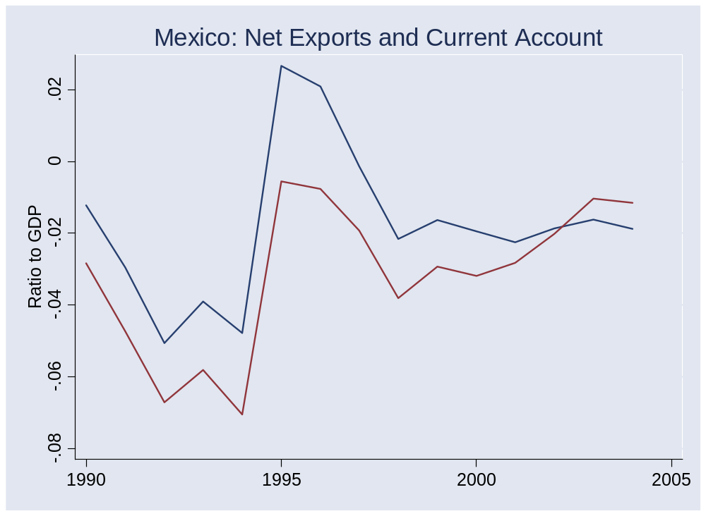
Mexico 1994-95
Source: IMF, International Financial Statistics.

Slide 52
Mexico 1994-95
More
  Government borrowed short-term, in dollars
  Many firms also borrowed in dollars [why?]
  Low reserves (not known at the time)
  Banks turned out to be in serious trouble

Slide 53
Asian crisis
Crisis hit many Asian countries in 1997
Overall picture
  Modest government debt, no deficits
  Exchange rates fixed or managed
  Reserves modest
  Banks had serious bad loan problems
  Banks and firms borrowed short-term in foreign currency
  Countries with weakest institutions had worst crises

Slide 54
China
Checklist
  Government debt and deficits (16%, 3.7%)
  Exchange rate and reserves (managed, >$1tr)
  Current account and net foreign assets (6%, 23%)
  Banking system (stable – EIU)
  Politics and institutions
Does it look risky to you? Would you take your money out of the country?

Slide 55
Italy
Checklist
  Government debt and deficits (108%, 4.9%)
  Exchange rate and reserves (EMS)
  Current account and net foreign assets (–3%, –8%)
  Banking system (better than US)
  Politics and institutions
Does it look risky to you? Would you take your money out of the country?

Slide 56
Turkey
Checklist
  Government debt and deficits (42%, 4.2%)
  Exchange rate and reserves (down sharply , 73b USD)
  Current account and net foreign assets (–5%, –20%)
  Banking system (stable – EIU)
  Politics and institutions (“tensions high” – EIU)
Does it look risky to you? Would you take your money out of the country?

Slide 57
Turkey
EIU Country Risk Service, Mar 09:
  The public debt/GDP ratio is now expected to rise for the first time since 2001. Turkey's large external financing needs also leave it vulnerable in the current climate of risk aversion. Global markets triggered massive falls in the value of the lira between September 2008 and March 2009.

Slide 58
Turkey
Why different from Italy?

Slide 59
Free markets revisited
Money moves around the world in seconds
  Is that a good thing?

Slide 60
Takeaways
Developing countries are volatile
Signs of trouble
  Checklist starts with government debt and deficits
Rich countries are different
  More stable politics and institutions

Slide 61
Next week
First half: review
Second half: in-depth look at Hungary a year ago
  Mini-case to be posted over the weekend
  Excellent practice for final exam

Slide 62
Mexico IIP (2006, USD, billions)
Category | Assets | Liabilities
Direct investment | 31 | 236
Portfolio investment | 7 | 254
Other | 51 | 80
Reserves | 76 | –
Total | 165 | 570
Net IIP | –405
Source: IMF, International Financial Statistics.

Slide 63
Japan IIP (2006, USD, billions)
Category | Assets | Liabilities
Direct investment | 450 | 108
Portfolio investment | 2343 | 1763
Other | 1004 | 1013
Reserves | 895 | –
Total | 4692 | 2884
Net IIP | 1808
Source: IMF, International Financial Statistics.

