Slide 1

The Global Economy
Business Cycle Indicators
© NYU Stern School of Business
Notes:
Open spreadsheet, Bloomberg calendar
Why do we look at all these things?

Slide 2
Bloomberg calendar
Why do we look at this stuff?
http://www.bloomberg.com/markets/ecalendar/index.html

Slide 3
Plan of attack
Bloomberg calendar ✓
Business cycle overview
Pictures
Forecasting
Good indicators (the “cross-correlation function”)
Forecasting revisited
What have we learned?

Slide 4
Business cycle overview
Current Conditions
Indicators
Theory: AS & AD
Monetary Policy
Statistical Analysis
Future Conditions

Slide 5
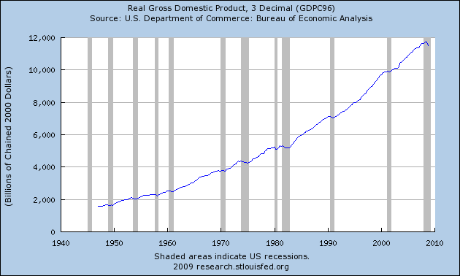
US GDP
Source: BEA via FRED.

Slide 6
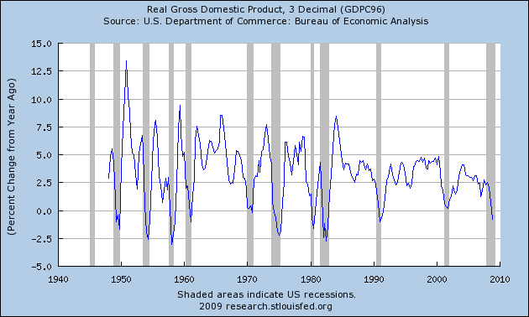
US GDP growth (year-on-year)
Source: BEA via FRED.

Slide 7
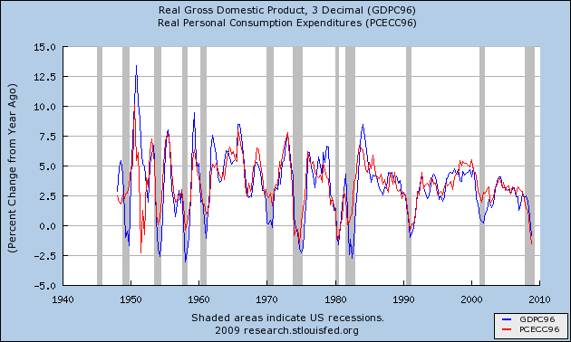
Components of US GDP growth
Source: BEA via FRED.

Slide 8
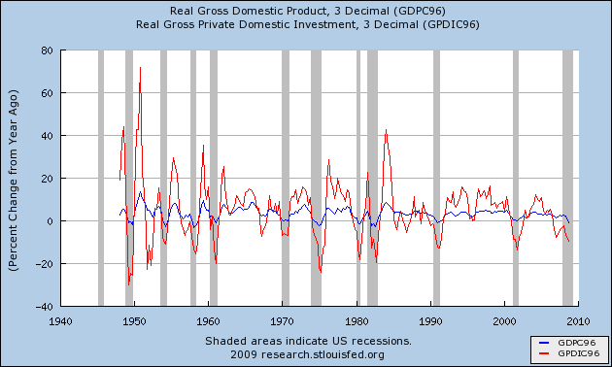
Components of US GDP growth
Source: BEA via FRED.

Slide 9
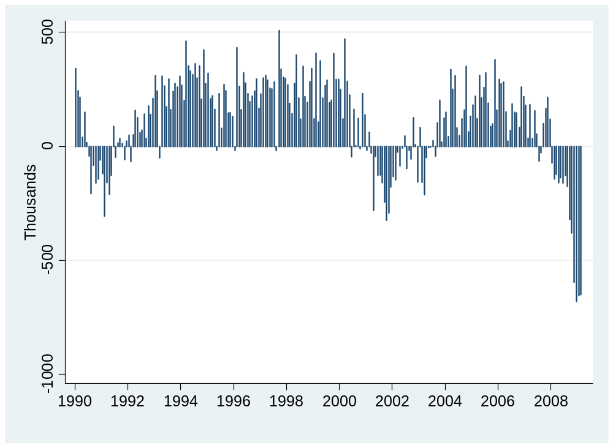
Employment (month-to-month change)
Source: BLS.

Slide 10
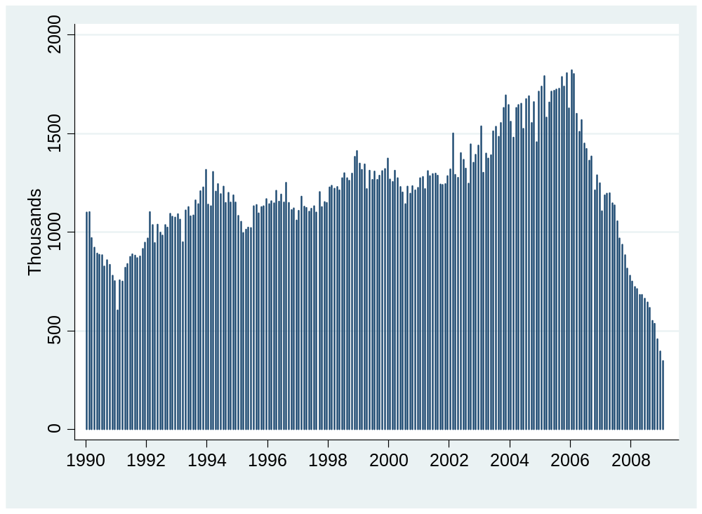
Housing starts
Source: Census.

Slide 11
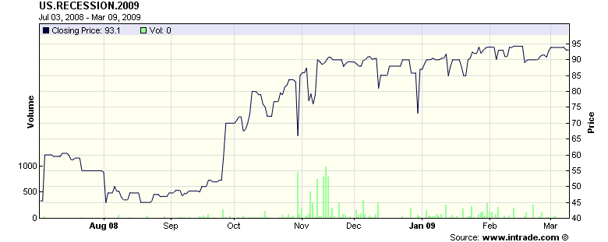
Recession futures
Probability recession in 2009 (2 qtrs negative growth)
Source: Intrade.com.

Slide 12
Forecasting
Can we forecast future economic conditions?
  Use information about the past & present to predict the future
Basic idea: use patterns in the data
  In the past, “this” was followed by “that”

Slide 13
Forecasting: example
Example: growth in industrial production (“IP”)
γ_{t,t+k} = log(IP_{t+k}/IP_{t})/k = k-period growth rate in IP
Why? How?

Slide 14
Forecasting: regressions
Reminder: we’re forecasting
γ_{t,t+k} = log(IP_{t+k}/IP_{t})/k = k-period growth rate in IP
[set k=12 months?]
Estimate the regression
γ_{t,t+k} = a + b x_{t} + residual
x_{t} is an “indicator” of your choice
Standard software produces estimates of a and b
Note timing!!

Slide 15
Forecasting: fancy regressions
Basic regression
γ_{t,t+k} = a + b x_{t} + residual
  γ_{t,t+k} is what we’re trying to forecast
  x_{t} is an “indicator” of your choice
Variations
  Use more than one x
  Add lags of x
  Add lags of γ
  Whatever works!

Slide 16
Forecasting: forecasts
Recall: we’ve estimated a and b in
γ_{t,t+k} = a + b x_{t} + residual
Calculate predicted future growth rate
γ_{t,t+k} = a + b x_{t}
  x_{t} = value now (t) of indicator x
  γ_{t,t+k} = predicted growth from now (t) to the future (t+k)
Make sure you understand the timing

Slide 17
Identifying good indicators
What would you suggest? Why?

Slide 18
Identifying good indicators
How do you find good indicators?
  Forecasting requires indicators that lead what you’re forecasting
  Ask friends, read reports, look at “cross-correlation function”

Slide 19
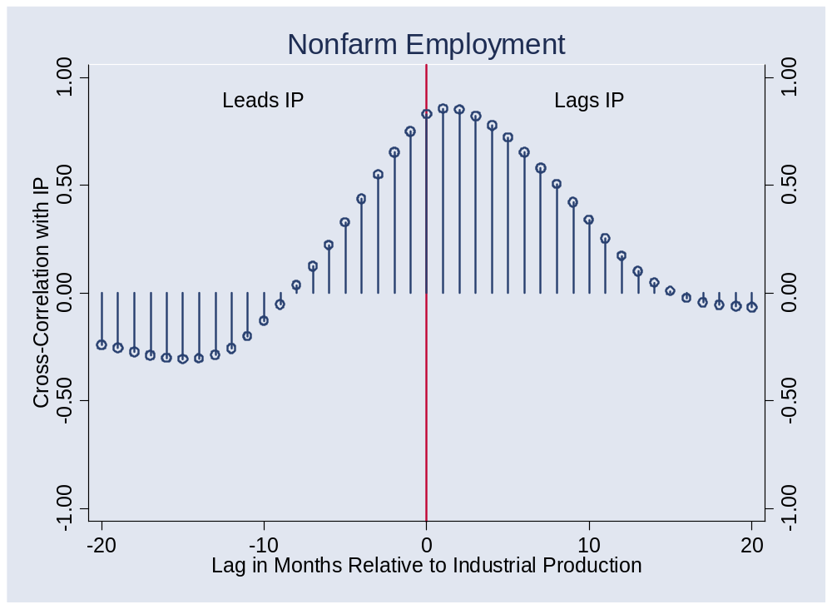
Identifying good indicators
Correlations for Random Indicator X

Slide 20
Identifying good indicators
Cross-correlation function (“ccf”)
  Correlations between two variables at different times
ccf(k) = Corr(x_{t},y_{t-k})
[plot this against k]
  If k<0: x leads y [or y lags x]
  If k>0: x lags y [or y leads x]

Slide 21
Identifying good indicators
Pictures: plot ccf(k) v k
  y = IP growth
  x = indicator
  Does indicator lead or lag IP growth?

Slide 22
Identifying good indicators
Mechanics of ccf calculations: see spreadsheet

Slide 23
Does employment lead or lag?
What is this dot?

Slide 24
Computing cross-correlations
Date | x(t) | y(t)
1 | 2.43 | 8.47
2 | 1.19 | 2.29
3 | 0.13 | 7.36
4 | 0.56 | 6.39
5 | 0.38 | 6.02
6 | 0.96 | 0.22
7 | 1.87 | 3.60
Reminder:
ccf(k) = corr[x(t),y(t-k)]
For k = 0:
ccf(0) = corr[x(t),y(t)]
Use data marked
Red for x
Blue for y

Slide 25
Computing cross-correlations
Date | x(t) | y(t)
1 | 2.43 | 8.47
2 | 1.19 | 2.29
3 | 0.13 | 7.36
4 | 0.56 | 6.39
5 | 0.38 | 6.02
6 | 0.96 | 0.22
7 | 1.87 | 3.60
Reminder:
ccf(k) = corr[x(t),y(t-k)]
For k = +1:
ccf(1) = corr[x(t),y(t-1)]
Means: x lags y
Use data marked
Red for x
Blue for y

Slide 26
Computing cross-correlations
Date | x(t) | y(t)
1 | 2.43 | 8.47
2 | 1.19 | 2.29
3 | 0.13 | 7.36
4 | 0.56 | 6.39
5 | 0.38 | 6.02
6 | 0.96 | 0.22
7 | 1.87 | 3.60
Reminder:
ccf(k) = corr[x(t),y(t-k)]
For k = –1:
ccf(-1) = corr[x(t),y(t+1)]
Means: y lags x
Use data marked
Red for x
Blue for y

Slide 27
Does employment lead or lag?

Slide 28
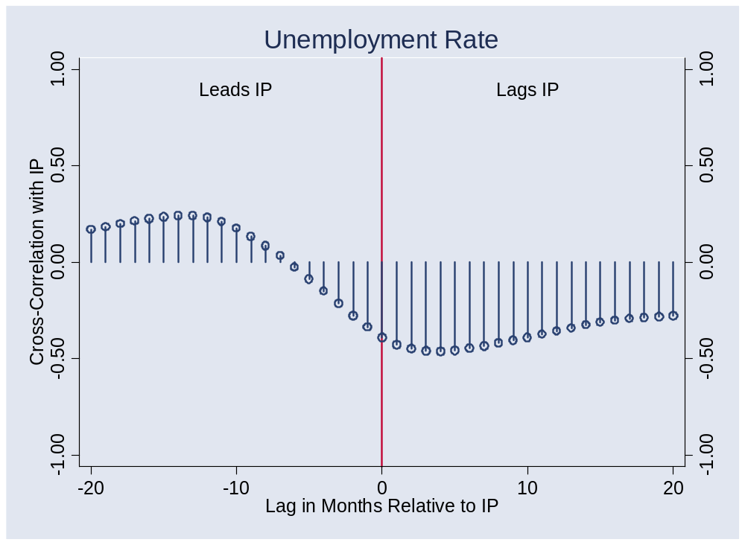
Unemployment?

Slide 29
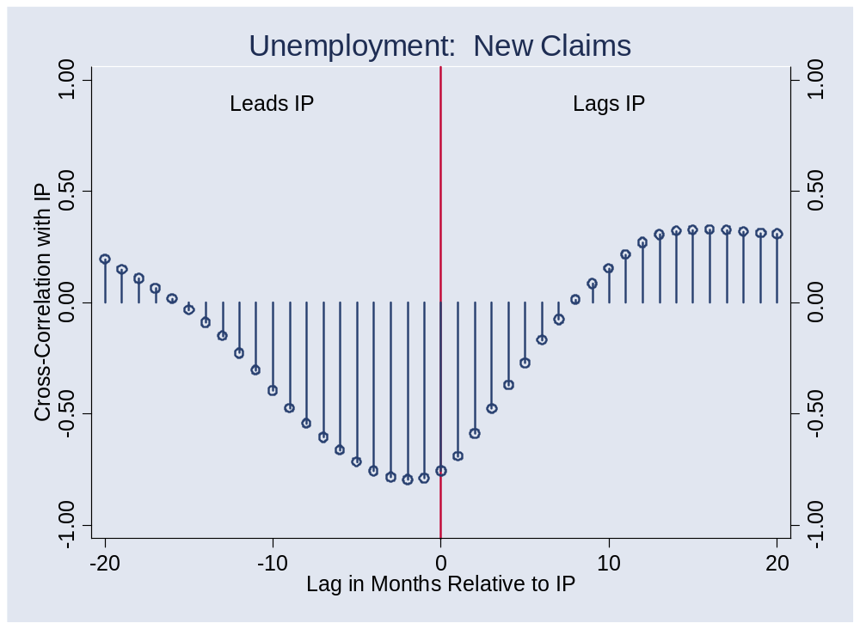
New claims for un ins?

Slide 30
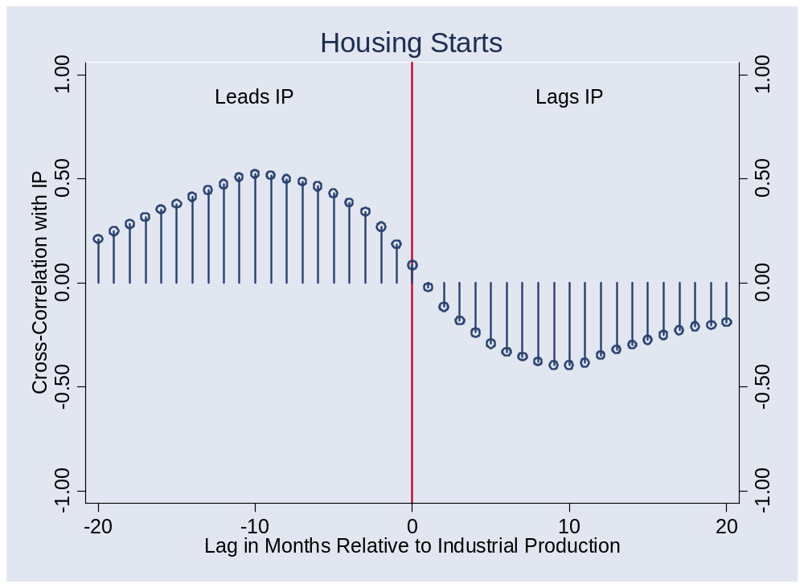
Housing starts?

Slide 31
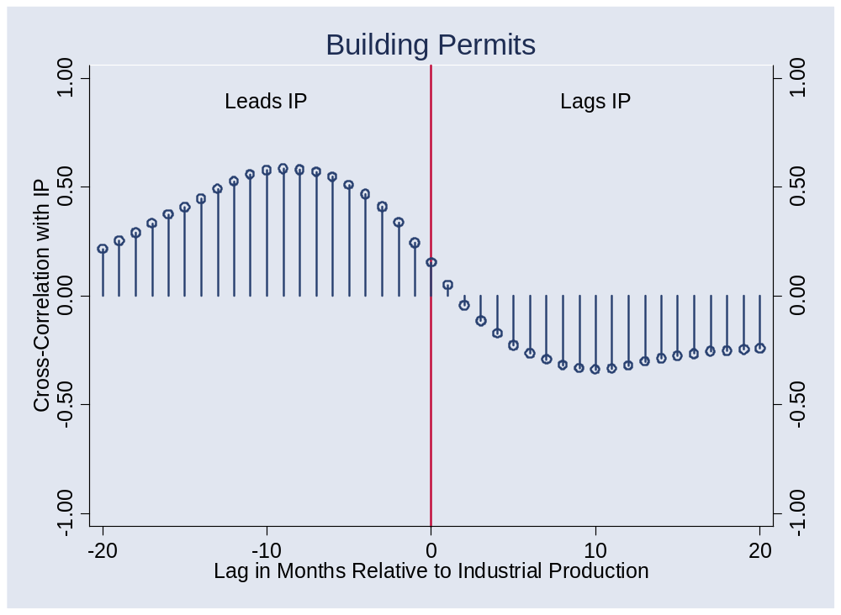
Building permits?

Slide 32
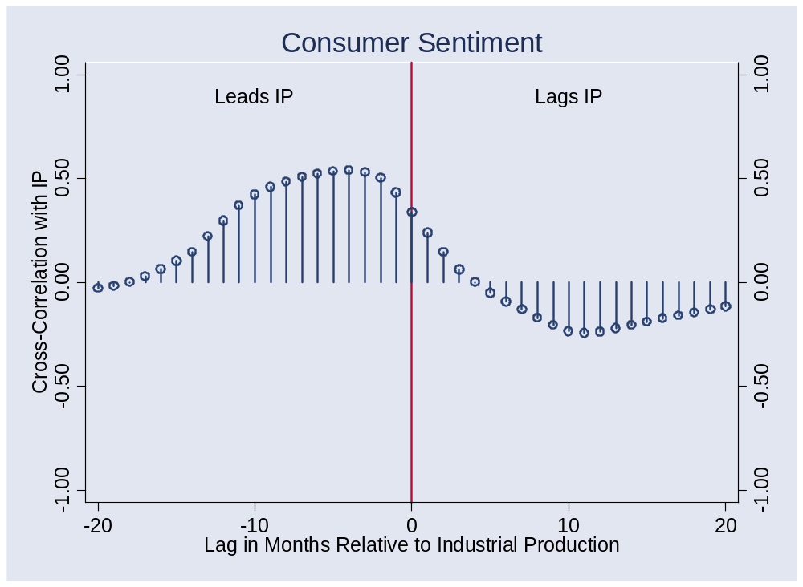
Consumer sentiment?

Slide 33
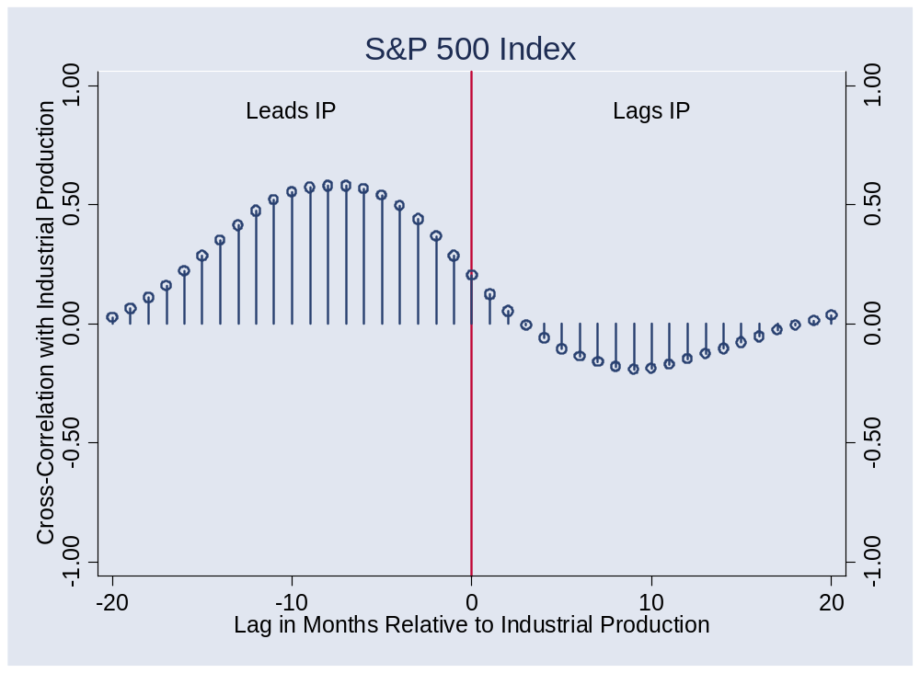
S&P 500 index?
Notes:
Pick a point: what is this?

Slide 34
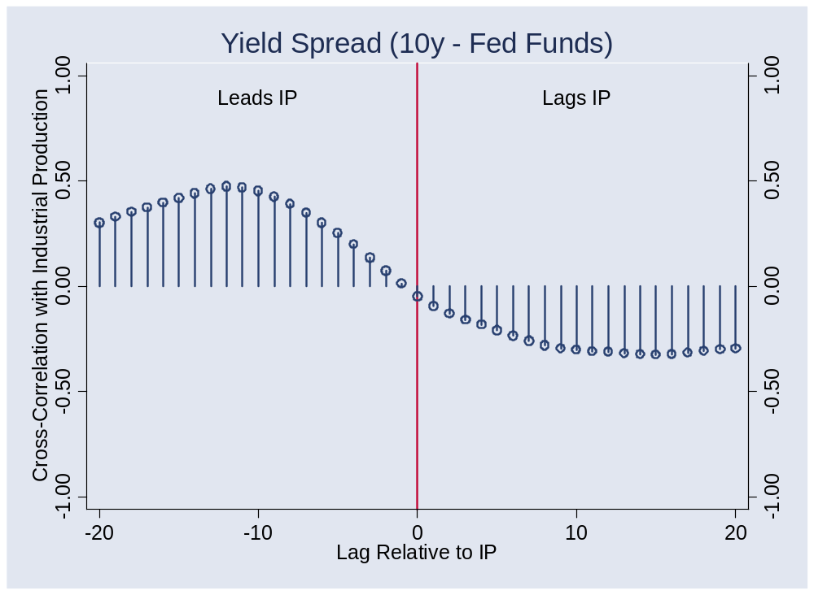
Yield spread?

Slide 35
Forecasting flow chart
Identify good indicators
  Use cross-correlation function, ask friends, whatever works
Transform them if appropriate
  Do you use the level? Growth rate? Change?
Put them in a regression
  Tells you relation between indicator and variable being forecast
  How long a sample do you use? [1985]
Use the regression coefficients and current value of indicator to construct forecast

Slide 36
How well do we do?
Forecasts have content
  Typical R² > 0, < 0.50
  Most of what happens is not predicted
Therefore: have a contingency plan

Slide 37
What have we learned?

Slide 38
Takeaways
Good indicators tell us something about the future
Even the best forecasts leave lots of uncertainty
Useful tools:
  Regressions
  Cross-correlation function

Slide 39
Enjoy the break
See you in a couple weeks

