Slide 1

The Global Economy
Aggregate Supply and Demand
© NYU Stern School of Business
Notes:
Welcome back!

Slide 2
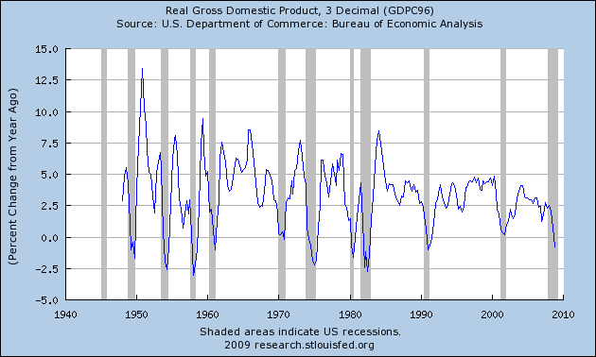
US GDP growth (year-on-year)
Source: BEA via FRED.

Slide 3
Question of the day
Where do business cycles come from?

Slide 4
Follow-up questions
Does the stimulus package increase GDP?
Does increase in productivity raise GDP?
Does increase in money supply raise output?
Does increase in saving raise or lower GDP?
Do high oil prices generate inflation?
Is the financial crisis a change in supply or demand?
Should monetary policy focus on inflation or output? [next time]
More than we need!

Slide 5
Plan of attack
Questions ✓
Where we’re headed
Aggregate supply and demand
Answers
What have we learned?
Group Project #5

Slide 6
Where we’re headed
Current Conditions
Indicators
Theory: AS & AD
Monetary Policy
Statistical Analysis
Future Conditions

Slide 7
Aggregate supply and demand
P
AS
AD
Y

Slide 8
Aggregate supply and demand
Adapt supply and demand to whole economy
Axes
  P is price level
  Y is real GDP
Curves
  Supply focuses on production of goods
  Demand focuses on purchase of goods
Why do they look like this?

Slide 9
Aggregate supply 1
Classical version [“long run”]
Production function
  Y = A K^{α} L^{1-α}
At any point in time
  A is given [but may change over time]
  K is given [but may change over time]
  L reflects “equilibrium” in labor market
  Y must therefore be “given” [and AS vertical]

Slide 10
Aggregate supply 1
P
AS*
Y

Slide 11
Aggregate supply 2
Keynesian version [“short run”]
Production function
  Y = A K^{α} L^{1-α}
At any point in time
  A, K given
  Nominal wage “sticky”
  Increase in P reduces real wage, so firms hire more people
  More L implies more Y ⇨ AS curve slopes upward
Wage eventually adjusts, bringing us back to AS*

Slide 12
Aggregate supply 2
P
AS*
AS
Y

Slide 13
Aggregate supply
What happens if we
  Change A or K?
  Change price of oil?
Note: typically both AS and AS* shift

Slide 14
Aggregate demand
Basic version
  Quantity theory generates inverse relation betw P and Y
  M V = P Y
  M/P = Y/V
  Given M and V, an increase in P results in lower Y
Sophisticated version
  Demand for money declines with nominal interest i
  M/P = L(i),Y
  Increase in P can decrease Y directly, or indirectly through an increase in i, which lowers demand for interest-sensitive products (housing, durable goods)

Slide 15
Aggregate demand
P
AD
Y

Slide 16
Aggregate demand
What happens if we
  Change M?
  Change G?
  Change consumption or investment demand (“optimism”?)

Slide 17
Aggregate supply and demand
P
AS*
AS
AD
Y

Slide 18
Equilibrium
P
AS*
AS
A
B
AD
Y

Slide 19
Equilibrium
Start at A [“short-run equilibrium”]
  Where AS and AD cross
Move toward B [“long-run equilibrium”]
  Why? Because wages adjust, shifting AS down
  This goes on until AS crosses AS* at B

Slide 20
Answers
AS/AD is a tool
Goal: keep things simple
Sort issues into AS and AD bins

Slide 21
Fiscal stimulus
Example: increase G
Does this shift AS or AD?
Does it raise or lower Y? P?

Slide 22
Fiscal stimulus
P
AS*
AS
A
B
AD
Y

Slide 23
Fiscal stimulus
Example: increase G
Does this raise or lower Y? P?
Impact of decrease in “demand”
  AD shifts right/up
  Short-run impact: prices up, output up
  Long-run impact? (Depends where you start)

Slide 24
Higher productivity
Example: IT revolution
Does this shift AS or AD?
Does it raise or lower Y? P?

Slide 25
Higher productivity
P
AS*
AS
AD
Y

Slide 26
Higher productivity
Example: IT revolution
Does this raise or lower Y? P?
Impact of increase in “supply”
  AS shifts right/down
  Short-run impact: prices down, output up
  Long-run impact: ditto

Slide 27
More money
Example: central bank increases M
Does this shift AS or AD?
Does it raise or lower Y? P?

Slide 28
More money
P
AS*
AS
AD
Y

Slide 29
More money
Example: central bank increases M
Does this raise or lower Y? P?
Impact of increase in “demand”
  AD shifts right/up
  Short-run impact: prices up, output up
  Long-run impact? Prices up, output unchanged [this should remind you of quant theory]
Milton Friedman: Is inflation “always and everywhere a monetary phenomenon”?

Slide 30
Higher oil prices
Example: oil prices spike up
Does this shift AS or AD?
Does it raise or lower Y? P?

Slide 31
Higher oil prices
P
AS*
AS
AD
Y

Slide 32
Higher oil prices
Example: oil prices spike up
Does this raise or lower Y? P?
Impact of decrease in “supply”
  AS shifts left/up
  Short-run impact: prices up, output down
  Long-run impact: ditto

Slide 33
Higher saving
Example: consumer confidence falls
Does this shift AS or AD?
Does it raise or lower Y? P?

Slide 34
Higher saving
P
AS*
AS
AD
Y

Slide 35
Higher saving
Example: consumer confidence falls
Does this raise or lower Y? P?
Impact of decrease in “demand”
  AD shifts left/down
  Short-run impact: prices down, output down
  Long-run impact? [this should remind you of quant theory]

Slide 36
Financial crisis
Is this a shift in supply or demand?

Slide 37
Inflation and growth
Would you expect to see high growth associated with high inflation? Why or why not?

Slide 38
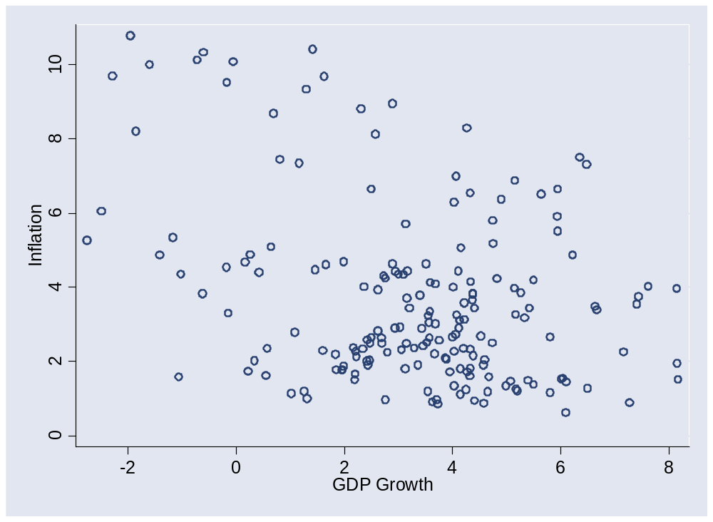
Inflation and growth

Slide 39
What have we learned?

Slide 40
Takeaways
Aggregate supply (producers/sellers) and demand (buyers) is the analyst standard
In practice, the challenge is to know whether conditions reflect supply or demand

Slide 41
Group Project #5
Goal: forecast US employment
  Number 1 Wall Street indicator
Data sources
  Indicators spreadsheet: see Blackboard link
  St Louis Fed’s “FRED” database
Statistical work is tricky
  See “forecasting” sheet of indicators spreadsheet
  Or use Minitab template
  Get started soon
Come see me if you have questions

Slide 42
Group Project #5
The document should look professional
  Valuable skill, worth practicing now
  Guide included in updated version of project (Blackboard)
  Samples available here
  More practice coming

Slide 43
Group Project #5
Reminder: we count the best 5 of 7
You can skip two if you want

Slide 44
After the break
Tobias Levkovich
  Managing director and Chief US Equity Strategist for Citi Investment Research and member of Citi’s Investment Strategy Committee. Prior to assuming his current role, Tobias spent 13 years analyzing the engineering, construction, and machinery industries and has been recognized repeatedly by Institutional Investor, The Wall Street Journal, and Reuters.
  Tobias began his career with LF Rothschild & Co. He holds a bachelor’s in commerce from Concordia University in Montreal and attended Boston University’s Graduate School of Management. He remains a huge fan of the Montreal Canadiens and Team Canada.

Slide 45
After the break
Richard Berner, Morgan Stanley, Chief US economist, Co-head of global economics
Career highlights
  PhD in economics, University of Pennsylvania
  Federal Reserve, Economist
  Salomon Brothers, Chief US Economist
  Morgan Stanley, London
  Mellon Bank, Chief Economist and Executive Vice President

