Slide 1

The Global Economy
Aggregate Supply and Demand
© NYU Stern School of Business
Notes:
Open: Bloomberg calendar

Slide 2
Questions
Does saving raise or lower GDP?
Do high oil prices generate inflation?
Does the stimulus package increase GDP?
Is the financial crisis a change in supply or demand?
Should monetary policy focus on inflation or output? [next time]

Slide 3
Plan of attack
Questions ✓
Where we’re headed
Aggregate supply and demand
Answers
What have we learned?
Group Project #5

Slide 4
Business cycle overview
Current Conditions
Indicators
Theory: AS & AD
Monetary Policy
Statistical Analysis
Future Conditions

Slide 5
Aggregate supply and demand
P
AS
AD
Y

Slide 6
Aggregate supply and demand
Adapt supply and demand to whole economy
Axes
  P is price level
  Y is real GDP
Curves
  Supply focuses on production of goods
  Demand focuses on purchase of goods
Why do they look like this?

Slide 7
Aggregate supply 1
Classical version [“long run”]
Production function
  Y = A K^{α} L^{1-α}
At any point in time
  A is given [but may change over time]
  K is given [but may change over time]
  L reflects “equilibrium” in labor market
  Y must therefore be “given” [and AS vertical]

Slide 8
Aggregate supply 1
P
AS*
Y

Slide 9
Aggregate supply 2
Keynesian version [“short run”]
Production function
  Y = A K^{α} L^{1-α}
At any point in time
  A, K given
  Nominal wage “sticky”
  Increase in P reduces real wage, so firms hire more people
  More L implies more Y ⇨ AS curve slopes upward
Wage eventually adjusts, bringing us back to AS*

Slide 10
Aggregate supply 2
P
AS*
AS
Y

Slide 11
Aggregate supply
What happens if we
  Change A or K?
  Change price of oil?
  Change “sticky” wage?
Note: typically both AS and AS* shift

Slide 12
Aggregate demand
Basic version
  Quantity theory generates inverse relation betw P and Y
  M V = P Y
  M/P = Y/V
  Given M, an increase in P results in lower Y
Sophisticated version
  Demand for money declines with nominal interest i
  M/P = L(i,Y)
  Increase in P can decrease Y directly, or indirectly through an increase in i, which lowers demand for interest-sensitive products (housing, durable goods)

Slide 13
Aggregate demand
P
AD
Y

Slide 14
Aggregate demand
What happens if we
  Change M?
  Change G?
  Change consumption or investment demand (“optimism”?)

Slide 15
Aggregate supply and demand
P
AS*
AS
AD
Y

Slide 16
Equilibrium
P
AS*
AS
A
B
AD
Y

Slide 17
Equilibrium
Start at A [“short-run equilibrium”]
  Where AS and AD cross
Move toward B [“long-run equilibrium”]
  Why? Because wages adjust, shifting AS down
  This goes on until AS crosses AS* at B

Slide 18
Higher saving
Example: consumer confidence falls
Does this raise or lower Y? P?

Slide 19
Higher saving
Example: consumer confidence falls
Does this raise or lower Y? P?
Impact of decrease in “demand”
  AD shifts left/down
  Short-run impact: prices down, output down
  Long-run impact? [this should remind you of quant theory]

Slide 20
Higher inflation
Where is this coming from? What is the impact?

Slide 21
Higher inflation
Where is this coming from? What is the impact?
Impact of higher energy prices
  Like a fall in A [why?]
  AS shifts left/up
  Short-run impact: prices up, output down
  Long-run impact?

Slide 22
Inflation and growth
Would you expect to see high growth associated with high inflation? Why or why not?

Slide 23
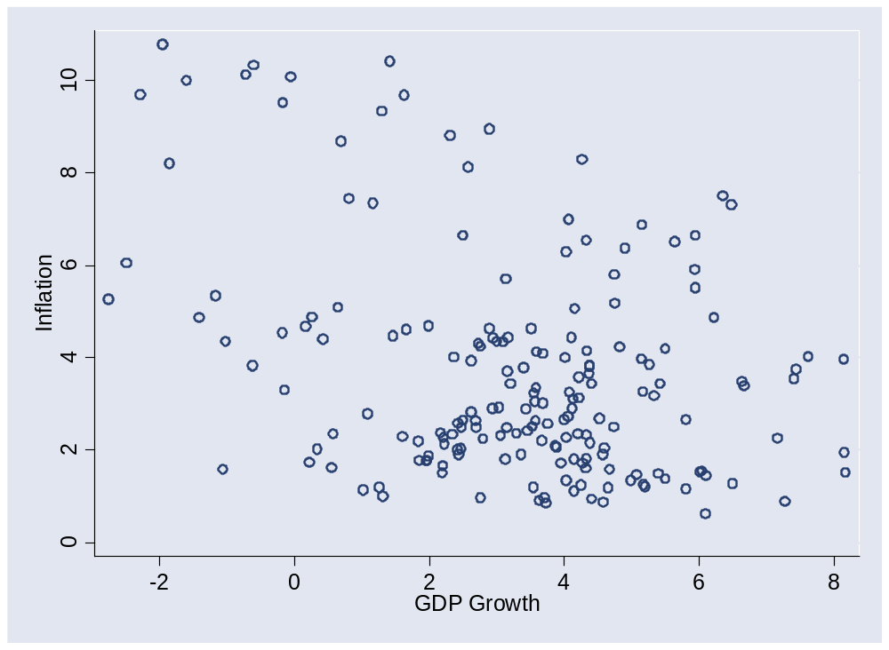
Inflation and growth

Slide 24
Milton Friedman
Is inflation “always and everywhere a monetary phenomenon”?

Slide 25
Monetary policy
Should it focus on inflation or growth?

Slide 26
What have we learned?

Slide 27
Takeaways
Aggregate supply and demand is the analyst standard
In practice, the challenge is to know whether high output reflects supply or demand factors

Slide 28
Group Project #5
Goal: forecast US employment growth
  Number 1 Wall Street indicator
Data sources
  Indicators spreadsheet: see Blackboard link
  St Louis Fed’s “FRED” database
Statistical work is tricky
  See “forecasting” sheet of indicators spreadsheet
  Or use Minitab template
  Get started soon
Come see me if you have questions

Slide 29
Group Project #5
The document should look professional
  Valuable skill, worth practicing now
  Guide included in updated version of project (Blackboard)
  Samples available here
  More practice coming

Slide 30
Group Project #5
Reminder: we count the best 5 of 7
You can skip two if you want

Slide 31
Richard Berner
PhD in economics, University of Pennsylvania
Currently
  Morgan Stanley, Co-head, Global Economics
Past positions
  Federal Reserve, Economist
  Salomon Brothers, Chief US Economist
  Morgan Stanley, London
  Mellon Bank, Chief Economist and Executive Vice President

Slide 32
After the break
Tobias Levkovich
  Managing director and Chief U.S. Equity Strategist for Citi Investment Research and member of Citi’s Investment Strategy Committee. Prior to assuming his current role, Tobias spent 13 years analyzing the engineering, construction, and machinery industries and has been recognized repeatedly by Institutional Investor, The Wall Street Journal, and Reuters.
  Tobias began his career with L.F. Rothschild & Co. He holds a bachelor’s in commerce from Concordia University in Montreal and attended Boston University’s Graduate School of Management. He remains a huge fan of the Montreal Canadiens and Team Canada.

Slide 33
Midterm
NB: these are last year’s numbers, to be updated
Guide to grades
  90 and up [35%]: A/A–
  65-89 [62%]: B+/B/B–
  Below 65 [3%]: think about what went wrong
  Come see me if you have questions
Statistics
  High: 100
  Median: 85
  Mean: 84

