Slide 1

The Global Economy
Principles of Tax Policy
© NYU Stern School of Business
Notes:
Many of the recent disasters/crises stemmed from fiscal policy mistakes

Slide 2
Definition
Fiscal policy: government expenses and revenues

Slide 3
Questions
What should governments spend money on?
How should they finance it?
How would you change US [other country] policy?

Slide 4
Plan of attack
Questions ✓
Quotes and pictures
What should governments do?
Principles of tax policy
Mankiw’s taxes
What have we learned?

Slide 5
France
The Economist, Survey France, Oct 26 06:
  An employer who pays a worker twice the minimum wage, or €2,400 a month, has to shell out nearly half as much again to the state in social-security contributions; the employee, for his part, has to hand over 22% of his pay in social-security contributions, on top of income tax. A French pay slip typically runs to over 40 itemised lines.
Notes:
http://online.wsj.com/article/SB117500805386350446-email.html?

Slide 6
Slovakia
Ivan Miklos, Deputy Prime Minister of Slovakia, Financial Times:
  I am convinced that the reforms of new EU member states could serve as inspiration for the older member states as well. One such reform is the flat tax. … We now have one of the simplest, most transparent tax systems in the world. … And our tax revenues have not decreased at all, partly because the reform eliminated most of the incentives and opportunities for tax avoidance. The new system has been particularly popular with German companies.
Notes:
March 23 2005 p 15

Slide 7
India
EIU, Country Commerce Report:
  Corporate tax rates have come down in recent years to fairly reasonable levels, in keeping with the government’s aim to widen the tax base and ensure greater compliance. But the underground economy, with its untaxed transactions and incomes, remains large.
  The system remains complicated, however, and is the subject of frequent litigation.

Slide 8
US
Mehir Desai, “Taxing foreign profits”:
  The United States operates a mishmash of a [corporate tax] system that taxes worldwide income, provides partial relief for foreign taxes paid, and imposes those taxes only upon repatriation. … The ability to defer US taxation until profits are repatriated is often framed as providing an incentive to ship jobs overseas. The current worldwide system is often derided as making American firms uncompetitive relative to their foreign competition. So, there are easy ways to take political potshots at the current system from both sides.

Slide 9
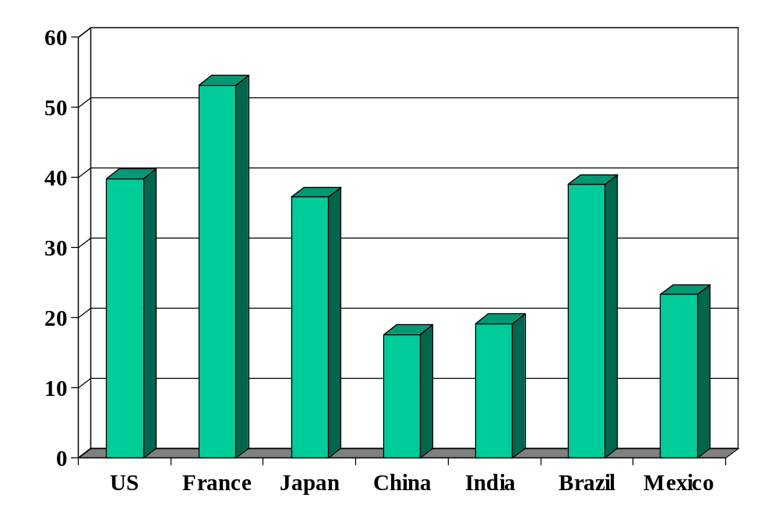
Government spending (% of GDP)
Source: OECD fiscal database, EIU country data.
Notes:
OECD countries: 2009 numbers, Economic Outlook, Annex Table 25.
China, India, Brazil, Mexico: EIU

Slide 10
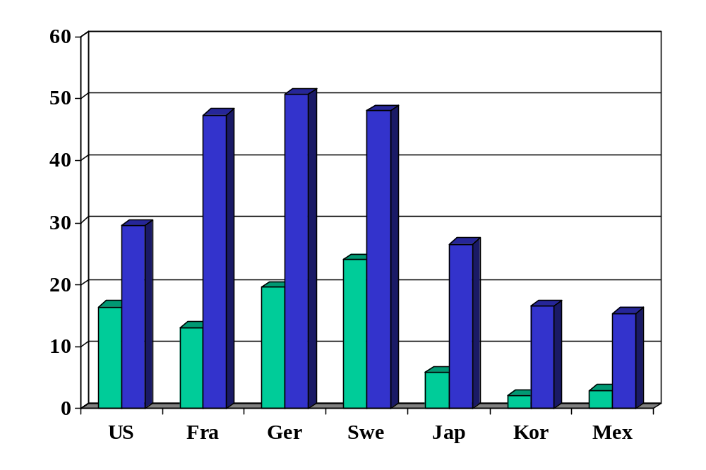
Personal tax rates (%, at average wage)
Source: OECD tax database. Green=direct tax. Blue=total incl soc ins payments by employee/er.

Slide 11
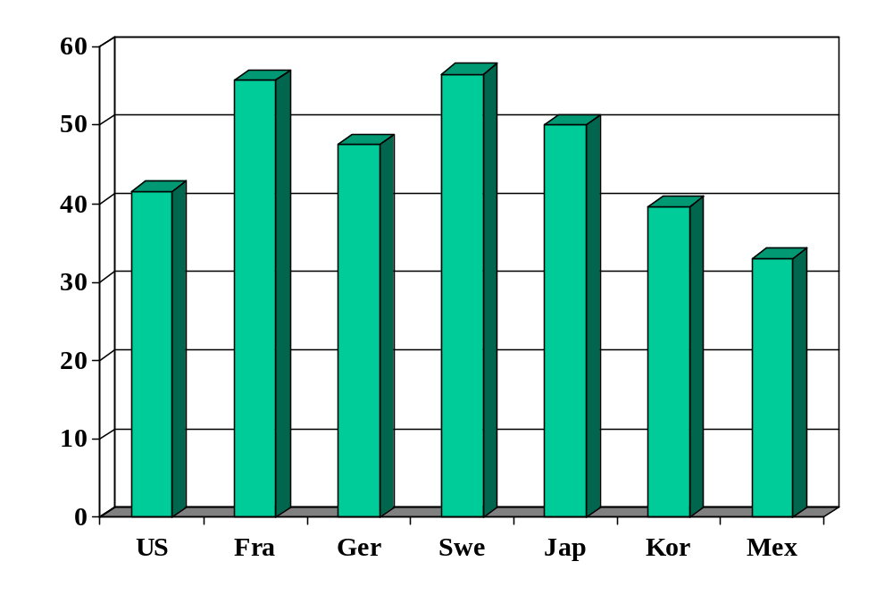
Top personal tax rates (%)
Source: OECD tax database.

Slide 12
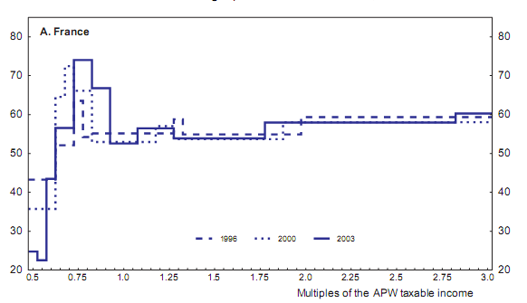
French marginal tax rates by income
Source: OECD working paper 439, “The French tax system.”

Slide 13
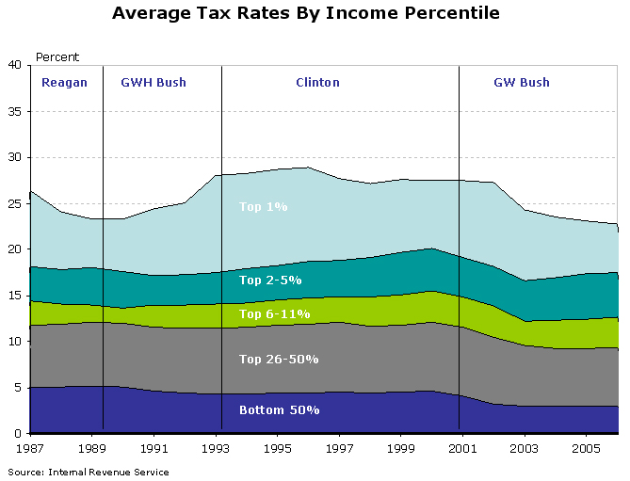
US average tax rates by income
Source: Macroblog, Aug 24 08.

Slide 14
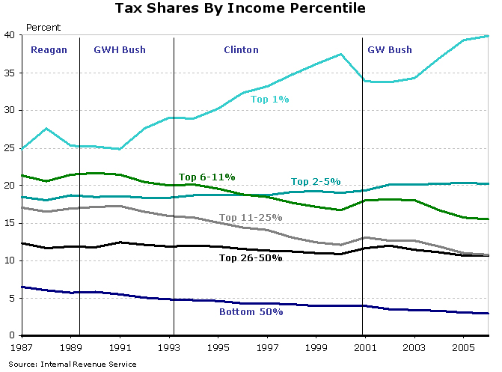
US tax shares by income
Source: Macroblog, Aug 24 08.

Slide 15
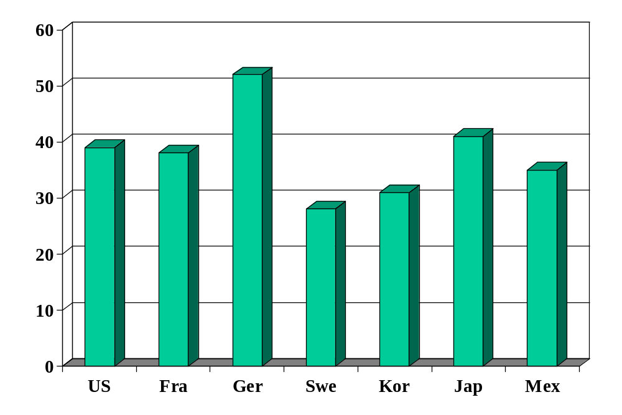
Corporate tax rates (official rate, %)
Source: KPMG Tax Survey.

Slide 16
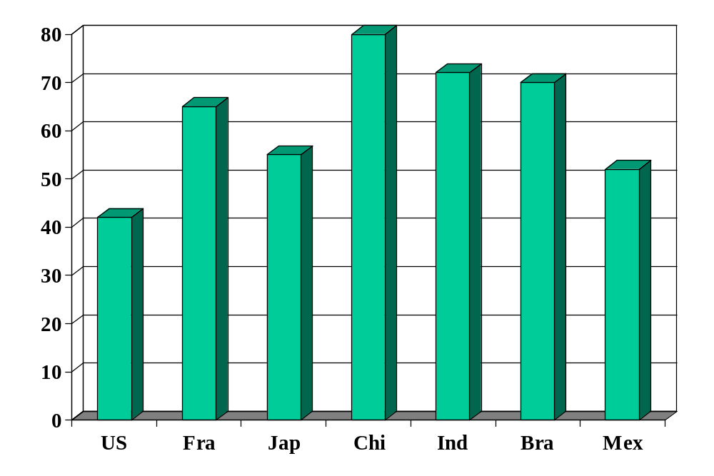
Business taxes (all taxes, % of profits)
Source: Doing Business.

Slide 17
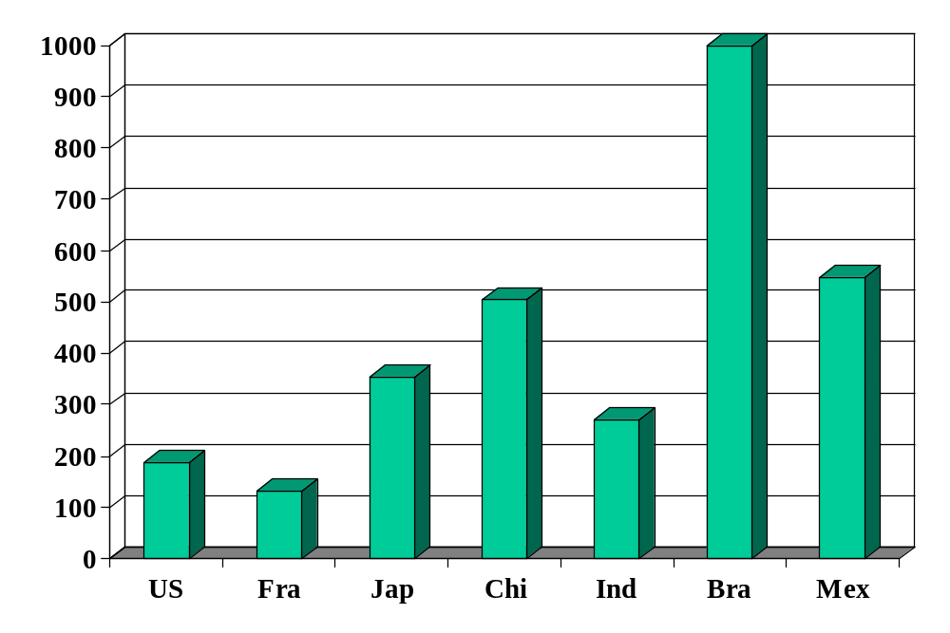
Complexity of business taxes (hours)
Source: Doing Business.

Slide 18
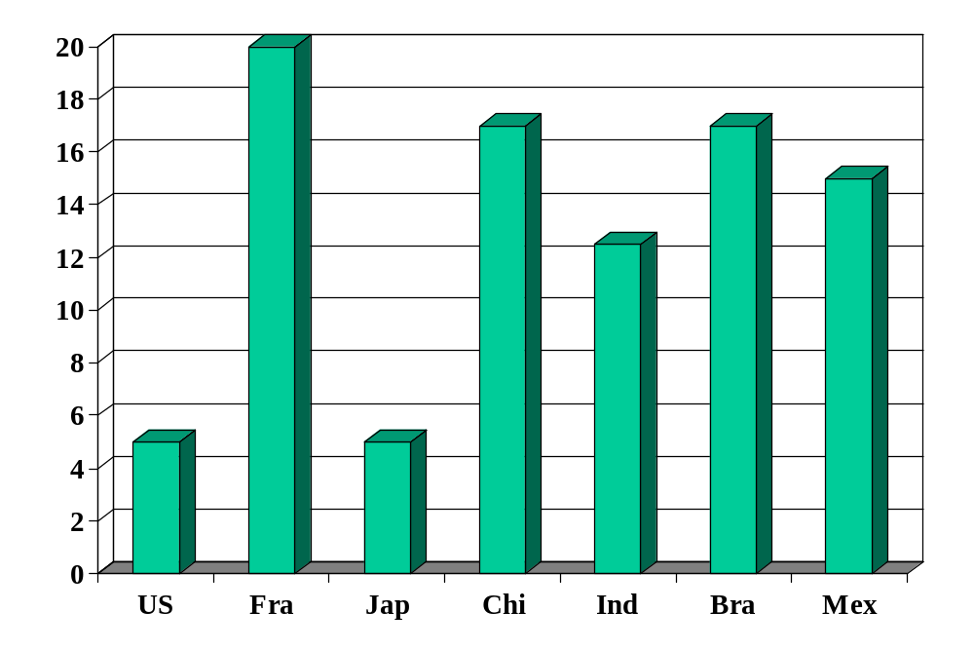
Value added tax (%)
Source: Doing Business.
Notes:
http://www.deloitte.com/dtt/article/0,1002,cid%253D5028,00.html

Slide 19
What should governments do?
Spending? Next.
Taxes? After that.

Slide 20
What should governments do?
Traditional arguments about spending
Provide public goods
  Non-excludable: hard to keep people from consuming ii [national defense, personal security, clean air]
  Non-rival: my consumption does not affect your consumption [national defense, etc]
Insurance and redistribution
  Protect the unfortunate and unlucky [disability, major medical issues, …]
Claim: hard to provide these services privately [is it?]

Slide 21

What should governments do?
Libertarian Reluctantly Calls Fire Department
April 21, 2004 | Issue 40•16
CHEYENNE, WY—After attempting to contain a living-room blaze started by a cigarette, card-carrying Libertarian Trent Jacobs reluctantly called the Cheyenne Fire Department Monday. “Although the community would do better to rely on an efficient, free-market fire-fighting service, the fact is that expensive, unnecessary public fire departments do exist,” Jacobs said. “Also, my house was burning down.” Jacobs did not offer to pay firefighters for their service.
© Copyright 2006, Onion, Inc. All rights reserved.
The Onion is not intended for readers under 18 years of age.

Slide 22
What should governments do?
How should they finance spending?
Is there a down side to high tax rates?

Slide 23
Tax principles
Principle #1: Taxes must finance spending
  High government spending requires high taxes
  More on this later today
Principle #2: Apply low rates to a broad base
  Exceptions implicitly raise taxes for others

Slide 24
Tax principles
Principle #2: Apply low rates to a broad base
Why?
  Taxes “distort” economic decisions
  High taxes distort more
Our logic
  Tax two markets equally
  Tax one market twice as much
  Which is better? [the first one]

Slide 25
Taxes and loss of surplus
P
consumer
surplus
S
P*
producer surplus
D
Q*
Q

Slide 26
Taxes and loss of surplus
P
“Deadweight loss”
S'
consumer
surplus
S
P_{c}
t
P*
tax revenue
P_{f}
producer surplus
D
Q'
Q*
Q

Slide 27
Taxes and loss of surplus
P
S''
S'
S
2t
t
D
Q

Slide 28
Tax principles
Applications of Principle #2
Should we
  Make food and clothing exempt from tax?
  Internet sales?
  Medical care?

Slide 29
Tax principles
Where are the largest disincentives of US tax system?

Slide 30
Mankiw’s taxes
If he earns an extra dollar, saves and invests it, and gives the proceeds to his kids in 35 years, how much do they get?
Inputs
  Income tax rate: 35%
  Return on investment: 10%
  Corporate tax rate: 25%
  Dividend and capital gains rate: 15%
  Estate tax rate: 15%
Answers: $28 with no taxes, $1.85 with given tax rates
What are his incentives to work and save?
Link
Notes:
http://gregmankiw.blogspot.com/2008/10/blog-post.html
http://macroblog.typepad.com/macroblog/2008/11/saving-and-taxe.html

Slide 31
What have we learned?

Slide 32
Takeaways
Countries differ in government spending and taxation
Taxes change incentives to work and save/invest
Good systems have low rates on large base

Slide 33
The Global Economy
Government Deficits
© NYU Stern School of Business
Notes:
Open spreadsheet

Slide 34
Question
If you invest in government bonds of Country X, how could you lose money?

Slide 35
Plan of attack
Question ✓
Where we’re headed
Pictures and quotes
Ingredients of government budgets
Government debt dynamics
Fiscal policy in Germany/Brazil/Peru/US
What have we learned?

Slide 36
Where we’re headed
Long-term country performance ✓
Business cycles ✓
Emerging market crises

Slide 37
Where we’re headed
Govt Deficit
print money
Govt Debt
Trade Deficit
Inflation & FX
fear of default
Bank Failures
Crisis

Slide 38
Where we’re headed
Govt Deficit
print money
Govt Debt
Trade Deficit
Inflation & FX
fear of default
Bank Failures
Crisis

Slide 39
Government spending (% of GDP)
Source: OECD fiscal database, EIU country data.
Notes:
OECD countries: 2009 numbers, Economic Outlook, Annex Table 25.
China, India, Brazil, Mexico: EIU

Slide 40
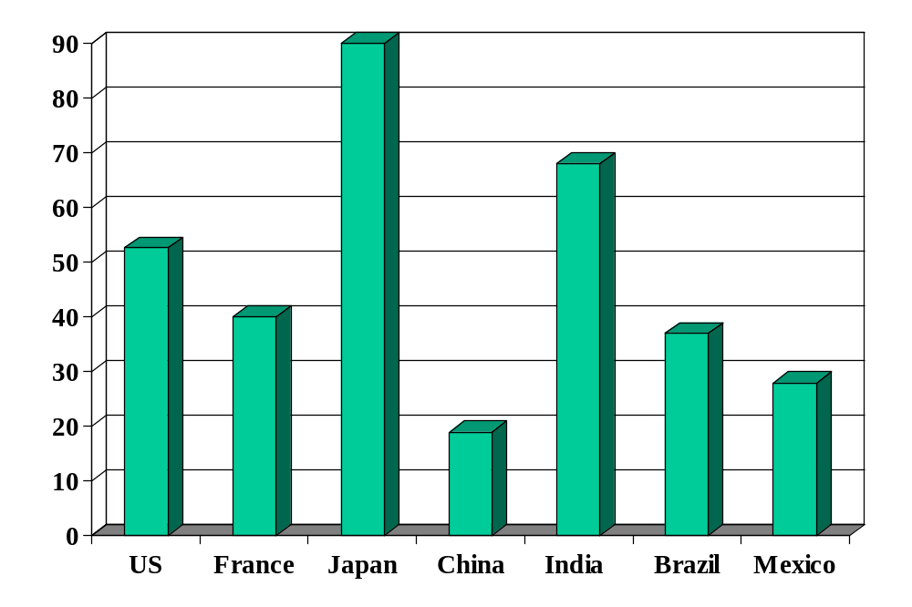
Government debt (net, % of GDP)
Source: Economist Intelligence Unit Country Data and OECD Economic Outlook.
Notes:
Net debt from OECD

Slide 41
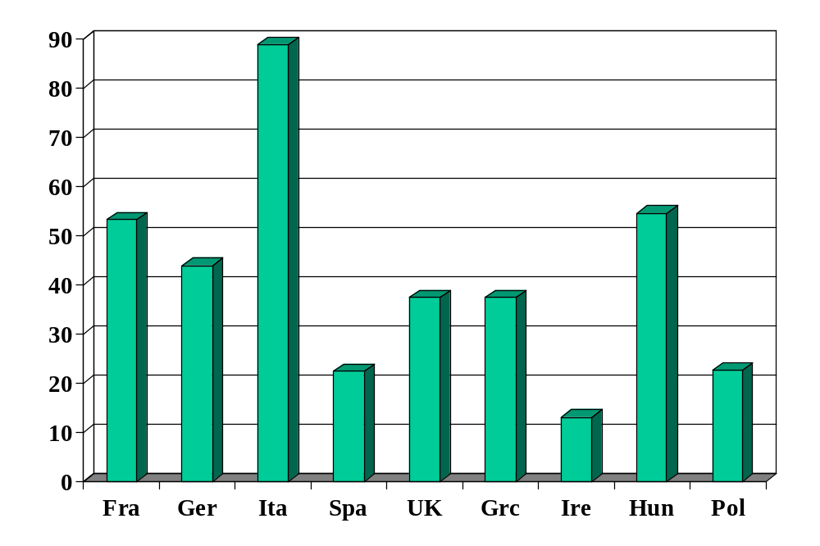
Government debt in EU (net, % of GDP)
Source: OECD Economic Outlook.
Notes:
Net debt from OECD

Slide 42
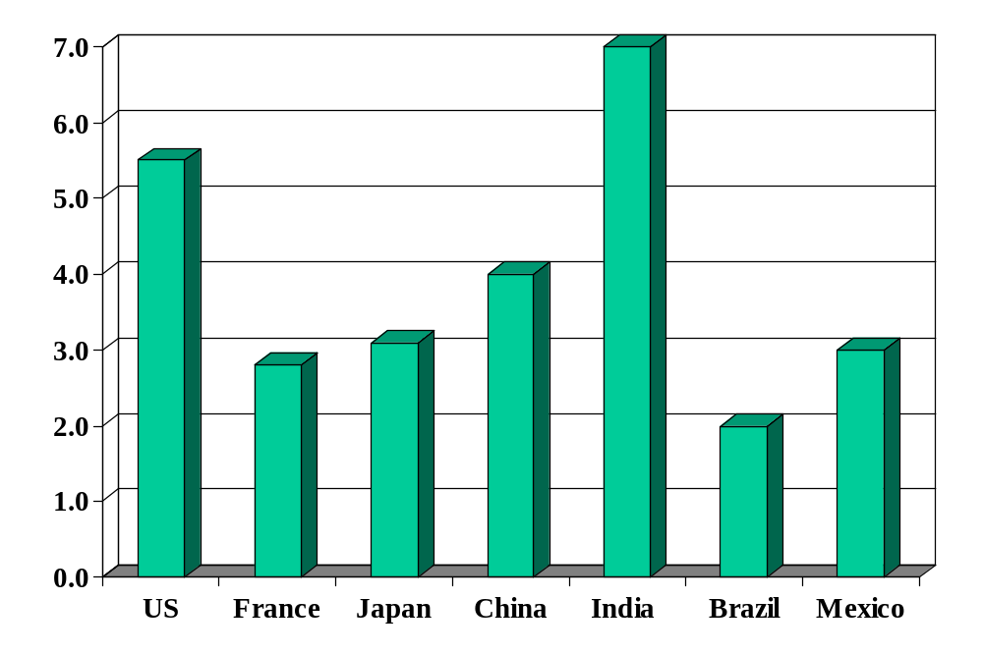
Government deficits (% of GDP)
Source: OECD Economic Outlook.

Slide 43
Alexander Hamilton
Second Report on Public Credit, 1795:
  Every system of Public Credit must assume as a fundamental principle that it will possess ability to pay the debt which it contracts. … With the creation of debt should be incorporated the means of extinguishment.

Slide 44
Angela Merkel
Financial Times, March 28 09:
  The German chancellor will warn leaders of the world's largest economies against pumping too much money into reviving global growth, saying that such action would create an unsustainable recovery. She rejected renewed calls to spend more public money in Germany as part of a co-ordinated stimulus plan.

Slide 45
Clive Crook
Financial Times, April 6 09:
  The Obama administration’s budget left a persistent deficit of roughly 3-4% of GDP. This has nothing to do with stimulus: the gap is there 10 years out and beyond, long after the economy is assumed to recover. The gap reflects underlying pressures on public spending. … Congress’s tweaks point toward even bigger deficits.

Slide 46
Ingredients of government budgets
Government budget:
G_{t} + V_{t} + i_{t} B_{t-1} = T_{t} + B_{t} – B_{t-1}
Ingredients:
  G = government purchases of goods and services
  V = transfer payments from government to households
  G + V = government spending
  T = tax revenue
  G + V – T = primary deficit (excl interest)
  B = government debt (“bonds”)
  i = (nominal) interest rate paid on debt
  iB = interest payments on debt

Slide 47
Ingredients in the US (billions of USD)
2008
Revenue |  | 4120
 | Tax revenue | 2849
 | Social insurance contributions | 996
Expenses |  | 4721
 | Goods, services, and employee comp | 2386
 | Social insurance payments | 1874
 | Interest on debt | 410
Surplus |  | -841
Sources: BEA. Numbers might not add: some small categories have been omitted.

Slide 48
Ingredients in Germany (% of GDP)
2005!
Revenue |  | 43.4
 | Tax revenue | 22.1
 | Social security revenue | 17.7
Expenses |  | 46.8
 | Goods, services, and employee comp | 11.7
 | Social security | 26.6
 | Interest on debt | 2.8
Surplus |  | -3.3
Sources: EIU Country Profile. Numbers might not add: some small categories have been omitted.

Slide 49
Fiscal policy in Germany in 2005
High debt: ~68% of GDP
  Reflects, in part, high cost of reunification
High spending
  Large pension obligations, aging population
High taxes
  Labor: esp high taxes on singles (52%) and two-income families (45%)
  Corporations: highest rate in OECD (39%)
How would this affect you if you were a
  German manufacturer deciding where to locate factory?
  Internationally mobile German worker?
Sources: OECD report.

Slide 50
Fiscal policy in Germany
What would you recommend?
Sources: OECD report.

Slide 51
Fiscal policy in Germany
Update
Budget balanced (primary surplus)
  Increased VAT from 16% to 19%
  Dropped corporate rate
  Capped some social programs
  Growth generated more revenue
Sources: OECD report.

Slide 52
Government debt dynamics
Principle #1: taxes must finance spending
  You need to pay for what you spend
Analogy: credit card
  Allows you to shift payments in time, not avoid them
  Higher debt leads to higher interest payments, which requires higher future cash flow to finance (and so on)
Government deficits and debt
  Deficits concern timing, not whether we pay for government spending
  Eventually accumulated debt must be repaid

Slide 53
Government debt dynamics
Government budget:
G_{t} + V_{t} + i_{t} B_{t-1} = T_{t} + B_{t} – B_{t-1}
Ingredients:
  G = government purchases of goods and services
  V = transfer payments from government to households
  G + V = government spending
  T = tax revenue
  D = G + V – T = primary deficit (excl interest)
  B = government debt (“bonds”)
  i = (nominal) interest rate on debt
  iB = interest payments

Slide 54
Government debt dynamics
Three versions of the same equation
D_{t} + iB_{t-1} = B_{t} – B_{t-1} (1) finance deficit with debt
B_{t} = (1+i)B_{t-1} + D_{t} (2) debt dynamics (backward)
B_{t-1} = B_{t}/(1+i) – D_{t}/(1+i) (3) debt dynamics (forward)
Bottom line
  Deficits must be financed (Principle #1)

Slide 55
Government debt dynamics
Current debt equals
B_{t-1} = B_{t}/(1+i) – D_{t}/(1+i) [version (3)]
= B_{t+1}/(1+i)² – [D_{t}/(1+i) + D_{t+1}/(1+i)²]
= …
= B_{t+n-1}/(1+i)^{n} – [D_{t}/(1+i) + D_{t+1}/(1+i)² + … + D_{t+n-1}/(1+i)^{n}]
Debt = present value of future primary surpluses
Comments
  Debt must be financed by future (primary) surpluses
  Assumes: B_{t+n-1}/(1+i)^{n} → 0 [weaker condition than B_{t+n} → 0]
  Or we could default!

Slide 56
Government debt dynamics
How much debt is too much?

Slide 57
Government debt dynamics
Issue:
  How does ratio of debt to GDP change?
  Both measured at current prices (“nominal”)
Growth of (nominal) debt [budget version (2)]
B_{t} = (1+i)B_{t-1} + D_{t}
Growth of (nominal) GDP
Y_{t} = (1+g)Y_{t-1}
Growth of debt to GDP ratio
B_{t}/Y_{t} = [(1+i)/(1+g)] (B_{t-1}/Y_{t-1}) + D_{t}/Y_{t}

Slide 58
Government debt dynamics
Reminder
B_{t}/Y_{t} = [(1+i)/(1+g)] (B_{t-1}/Y_{t-1}) + D_{t}/Y_{t}
“Natural” growth rates
  Debt: (1+i) [nominal]
  GDP: (1+g) [nominal]
  Ratio of debt to GDP: (1+i)/(1+g)

Slide 59
Government debt dynamics
Reminder
B_{t}/Y_{t} = [(1+i)/(1+g)] (B_{t-1}/Y_{t-1}) + D_{t}/Y_{t}
What could go wrong? [“wrong” = sharp rise in B/Y]

Slide 60
Fiscal policy in Germany
Germany in 2009 (Dec 08 estimates)
  B/Y = 64.4%
  D/Y = +2.3%
  iB/Y = 3.4%
  i = 5%
  g = 0% (inflation + real growth)
How does B/Y change?
Would you increase stimulus [Merkel]?
Sources: EIU Country Report, 2008 estimates.

Slide 61
Fiscal policy in Brazil
High debt for a developing country: ~40% of GDP
  Debt service high because interest rate is high
Major spending issues
  High spending for a developing country
  Generous pensions to civil servants (spending ~8% of GDP)
  Similar obligations to private-sector pensions
How would this affect you if you were a
  Brazilian worker about to retire?
  Young Brazilian worker?
  European food retailer deciding where to expand?

Slide 62
Fiscal policy in Brazil (% of GDP)
2009
Primary balance (non-interest) | 2.6
Interest on debt | 4.5
Total budget balance | –1.9
Public debt (last period) | 37.0
Is debt increasing or decreasing?
Sources: EIU Country Report, 2008 estimates.

Slide 63
Fiscal policy in Brazil
Brazil today
  B/Y = 37%
  D/Y = –2.6% [surplus!]
  i = 12% [what is this?]
  g = 3% (– 1.5+4.5)
How does B/Y change?

Slide 64
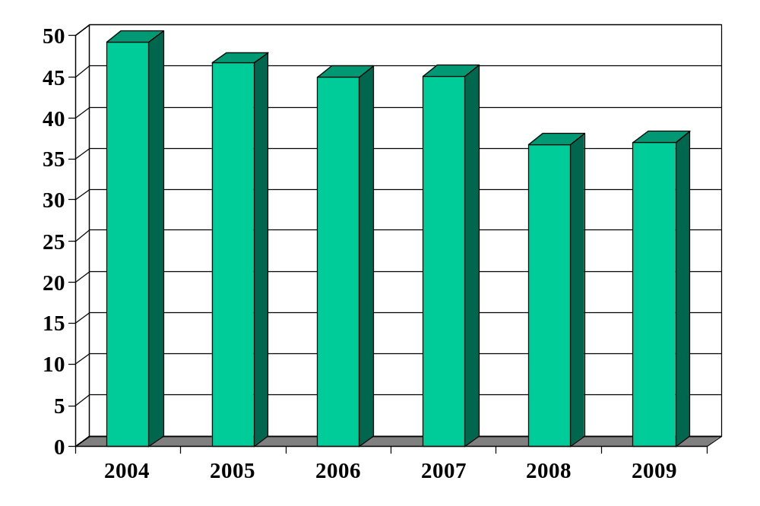
Brazilian debt (% of GDP)
Source: EIU Country Report.

Slide 65
Fiscal policy in Brazil
Bill Lewis, McKinsey (The Power of Prosperity):
  High government spending for developing country (~40%)
  Magnified by interest on past debt (at high rates)
  Requires high taxes
  Large underground economy survives by avoiding taxes
  Major impediment to TFP: official businesses more efficient, but higher tax burden limits their growth
  Therefore: fiscal discipline is a central issue for growth

Slide 66
Fiscal policy in Peru (% of GDP)
From MBA2 Jaime Pease:
2008
Primary balance (non-interest) | 1.4
Interest on debt | –2.0
Total budget balance | –0.6
Public debt (last period) | 27.3
Sources: Fitch report..

Slide 67
Fiscal policy in Peru
Peru today
  B/Y = 27%
  D/Y = –1.4%
  i = 7.5%
  g = 8.0% (5.6+2.4)
How does B/Y change?

Slide 68
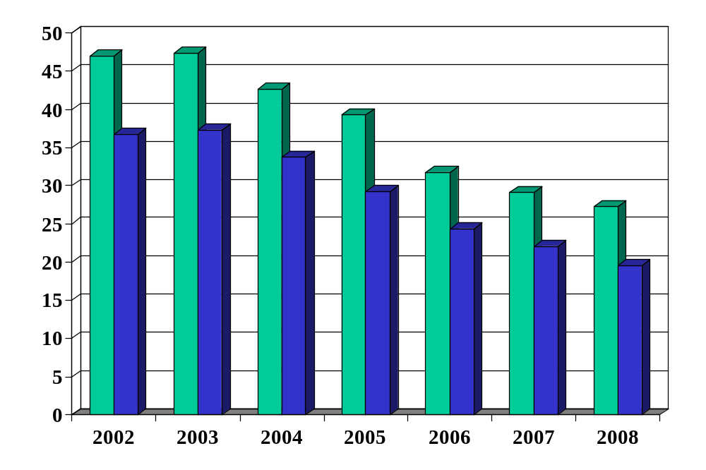
Peruvian debt (% of GDP)
Source: Fitch report. Green = total debt, Blue = foreign debt.

Slide 69
Fiscal policy in the US
Is the US in trouble? Why or why not?

Slide 70
Fiscal policy in the US (% of GDP)
2009
Primary balance (non-interest) | –12.4
Interest on debt | 1.3
Total budget balance | –13.7
Public debt (last period) | 38.7
Is debt increasing or decreasing?
Sources: EIU Country Report, 2008 estimates.

Slide 71
Fiscal policy in the US
US in 2009
  B/Y = 38.7%
  D/Y = –12.4%
  i = 3.4%
  g = –2.2% (–3.0+0.8)
How does B/Y change?
Source: CBO.

Slide 72
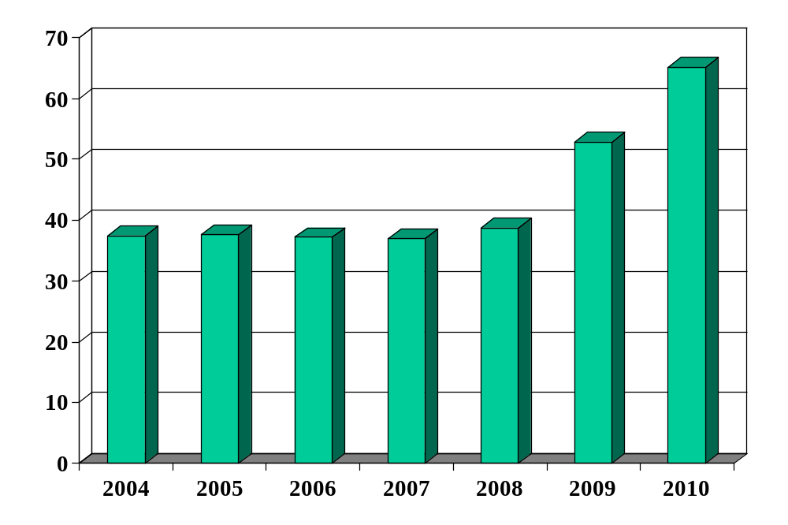
US debt (% of GDP)
Source: EIU Country Report.

Slide 73
Fiscal policy in the US
What are the budget issues?

Slide 74
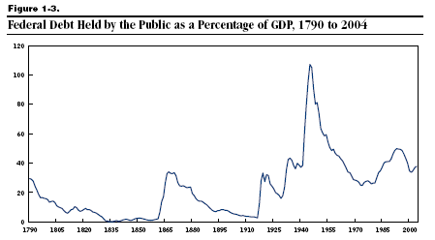
US debt (% of GDP)
Source: Congressional Budget Office.

Slide 75
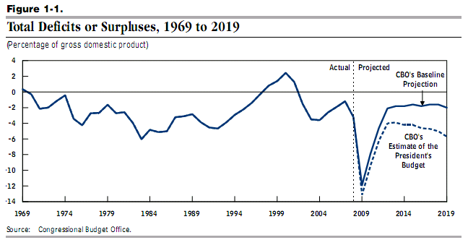
US budget deficits (% of GDP)
Source: Congressional Budget Office.

Slide 76
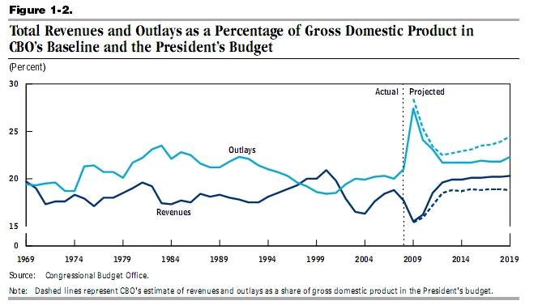
US revenue and expenses (% of GDP)
Source: Congressional Budget Office.

Slide 77
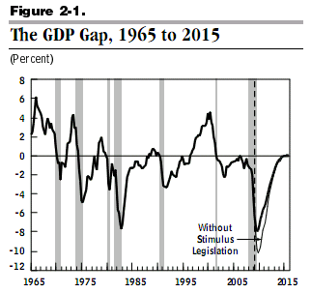
US GDP growth & stimulus
Source: Congressional Budget Office.

Slide 78
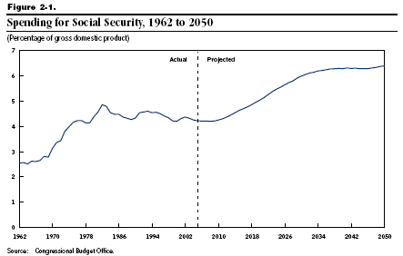
US social security (% of GDP)

Slide 79
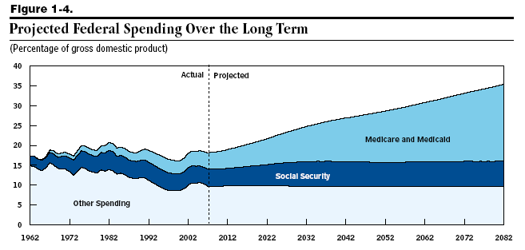
US medicare/medicaid (% of GDP)
Source: Congressional Budget Office.

Slide 80
What have we learned?

Slide 81
Takeaways
Government deficits must be financed
  By issuing debt today
  And by running (primary) surpluses in the future
Debt grows unless you run (primary) surpluses
US deficits
  The biggest issues are not the current deficit, but projected future deficits implied by social security and medicare-medicaid payments

Slide 82
Group Project #6
Note links in online version
Aim for a professional business document
  Options: report or slides, whatever you prefer
Guideline: no more than 5 pages or 10 slides
Do not do any of your own statistical analysis!
Option: focus on current use of balance sheet (“quantitative easing”) rather than Taylor rule
Come see me if you have questions

