Slide 1

The Global Economy
Production
© NYU Stern School of Business
Notes:
Intro
Move around, ask new people
Open IE with Bb, Gapminder (just in case)
Ask students for comments on countries: why successes?
Hand signals
Two hands = important point
Point up = louder
Faster, Timeout

Slide 2
Country reports
International students
  What has your country done to encourage economic growth?
  What else do you think it should do?
Others
  Feel free to comment
Notes:
15 minutes total
Consolidate at the end: what have we learned?

Slide 3
Plan of attack
Country reports ✓
Reminders
About the course
World history [exec summary]
Theory: the production function
  Capital and labor inputs
  Productivity (the infamous “TFP”)
High wages: good or bad?

Slide 4
Reminder: participation
Goal: 100% participation
Don’t panic – if you’re not comfortable, say so
Contributions to discussion board count
Be brief
Once you’ve made a comment, others get priority
Use your nameplate
Hand signals
Notes:
Aim for 100% participation – 40% last week.

Slide 5
Reminder: if you have questions
And we don’t have time to answer them in class
  Novices: What are we talking about?
  Experts: Some P2C2E
Let’s meet
  In my office
  Here between sessions
  Over lunch on Wednesdays
  Over a beer on Thursday nights
  If you’re interested, let me know and we’ll set it up

Slide 6
Reminder: slides
Available online Monday

Slide 7
Reminder: GDP
GDP: Gross Domestic Production
  Total value of production in a given geographic area
Nominal GDP
  GDP at current prices
  Changes over time from both quantities and prices
Real GDP (today’s focus)
  GDP at constant prices (eg, 2000 US dollars)
  Impact of price changes taken out
GDP price deflator
  = Nominal GDP / Real GDP

Slide 8
About the course
First half: Long-run performance
  Why is GDP per capita lower in Brazil than Japan?
  Why are China and India growing so rapidly?
  What are the business opportunities and challenges?
Second half: short-run performance
  Business cycles (short-term fluctuations)
  Emerging market crises (disasters)

Slide 9
About the course
Long run performance summary
  High GDP per capita comes from high productivity
  Productivity usually follows from good “institutions”
  Good institutions = effective property rights and open competitive markets
Supply and demand context
  We’ll focus (for now) on supply: how output is produced
  We’ll look at demand later
Notes:
15 minutes total
Consolidate at the end: what have we learned?

Slide 10
About the course
Typically a class session contains
  One idea
  Question or issue
  Theoretical tool
  Example or application
  Summary
Notes:
15 minutes total
Consolidate at the end: what have we learned?

Slide 11
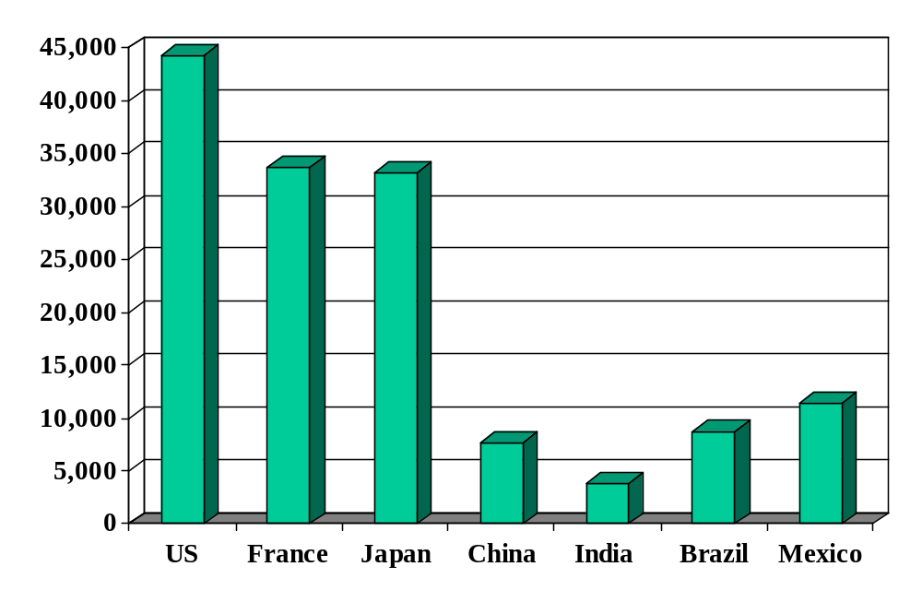
GDP per capita (2006, US dollars, PPP adj)
Why?
How did we get here?
Source: World Bank, World Development Indicators.
Notes:
Set up the class: why such large differences? Where did they come from?

Slide 12
About today’s class
GDP
Capital & Labor
Productivity
Political Process
“Institutions”

Slide 13
World history
Statistic | Year 0 | 1000 | 1820 | 1998
Population (millions) | 231 | 268 | 1,041 | 5,908
GDP Per Capita | 444 | 435 | 667 | 5,709
Life expectancy | 24 | 24 | 26 | 66
Source: Maddison, Millennial Perspective, OECD, 2001, Tables 1-2, 1-5a.
Notes:
Prior to 1500 or so: life was “poor, nasty, brutish, and short” (Thomas Hobbes, Leviathan, 1651)
Draw pix on board
Temporary ups and downs from natural disasters, war…

Slide 14
GDP per capita (1990 US$)
Region | Year 0 | 1000 | 1820 | 1998
Western Europe | 450 | 400 | 1,232 | 17,921
Western offshoots | 400 | 400 | 1,201 | 26,146
Japan | 400 | 425 | 669 | 20,413
Latin America | 400 | 400 | 665 | 5,795
E Europe + “USSR” | 400 | 400 | 667 | 4,354
Asia (excl Japan) | 450 | 450 | 575 | 2,936
Africa | 425 | 416 | 418 | 1,368
World Average | 444 | 435 | 667 | 5,709
Source: Maddison, Millennial Perspective, OECD, 2001, Table 1-2.
Notes:
Offshoots = US + Canada + Australia + NZ
Note: Some grew, others didn’t. But it’s not true that growth by some was associated with shrinkage by others.

Slide 15
World history
One-minute history of the world
Why Western Europe?
Why not China, India, Arab world?
What will the future bring?

Slide 16
Catch your breath
Why large differences in GDP per capita?
What do they mean for someone running a business?
What do they mean for Bono or Bill Gates?
Notes:
Stretch….

Slide 17
Production function
How are things produced?
What are the inputs? The outputs?
Production function
  A theoretical concept to organize our thoughts

Slide 18
Production function: picture
GDP
Capital & Labor
Productivity

Slide 19
Production function: math
Idea: relate output to inputs
Mathematical version:
Y = A F(K,L)
= A K^{α} L^{1-α} (“Cobb-Douglas”)
Definitions:
  K = quantity of physical capital used in production (plant and equipment)
  L = quantity of labor used in production
  A = total factor productivity (everything else)
  α = 1/3 (take my word for it)

Slide 20
Production function: properties
More inputs lead to more output
  Positive marginal products of capital and labor
Diminishing marginal products
  If we increase one input, each increase leads to less additional output
Constant returns to scale
  If we double both inputs, we double output
Notes:
Write out MPL …

Slide 21
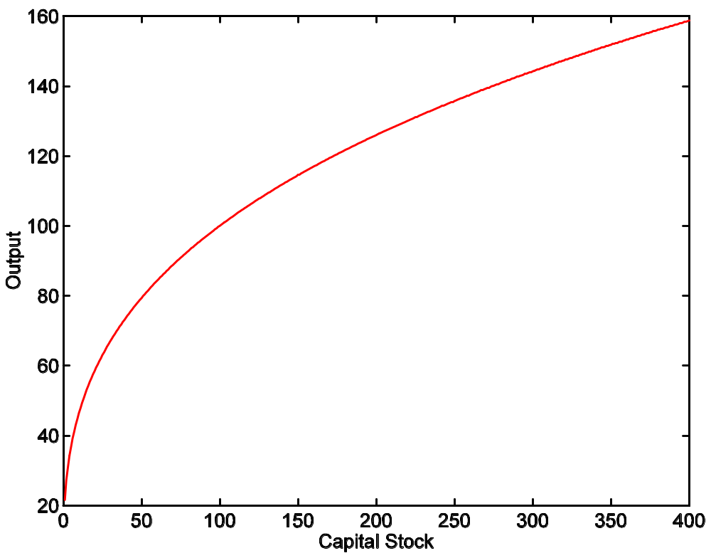
Production function: properties
A = 1
L = 100
α = 1/3

Slide 22
Capital
Meaning: physical capital used in production (plant and equipment)
Why does it change?
  Depreciation/destruction
  New investment (“capex”)
Mathematical version:
K_{t+1} = K_{t} – δ_{t}K_{t} + I_{t}
= (1 – δ_{t})K_{t} + I_{t}
Adjustments for quality?

Slide 23
Capital measurement
Option #1: direct surveys of plant and equipment
Option #2: perpetual inventory method
  Pick an initial value K₀ (survey?)
  Pick a depreciation rate (or measure depreciation directly)
  Measure K like this:
K_{t+1} = (1 – δ_{t})K_{t} + I_{t}
In practice, #2 is the norm:
  Get I from NIPA
  Set δ = 0.06 [ballpark number]
  Example: K₂₀₀₄ = 100, δ = 0.06, I = 12 → K₂₀₀₅ = 106

Slide 24
Labor
Meaning: units of labor used in production (labor input)
Why does it change?
  Population growth
  Policy, many other reasons

Slide 25
Labor measurement
Basic measure: L = number of workers (employment)
  Government surveys of employers and people
Adjustments for quality? Hours?
  Skill: education? other? [H = “human capital”]
  Hours: often not available [h = hours]
  Leads to an “augmented production function”:
Y = A F(K,hHL) = A K^{α} (hHL)^{1-α}

Slide 26
Labor
Demographics on Gapminder
  Check: birth rates, life expectancy, …

Slide 27
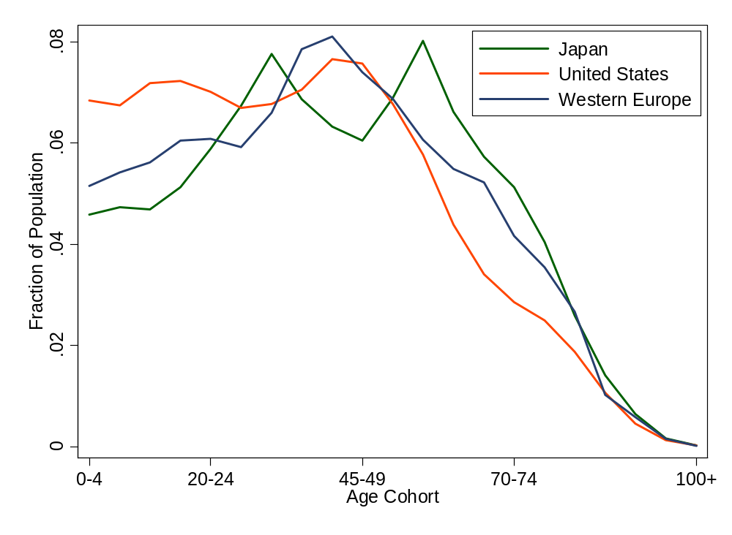
Age distribution
Source: UN Population Information Network.

Slide 28
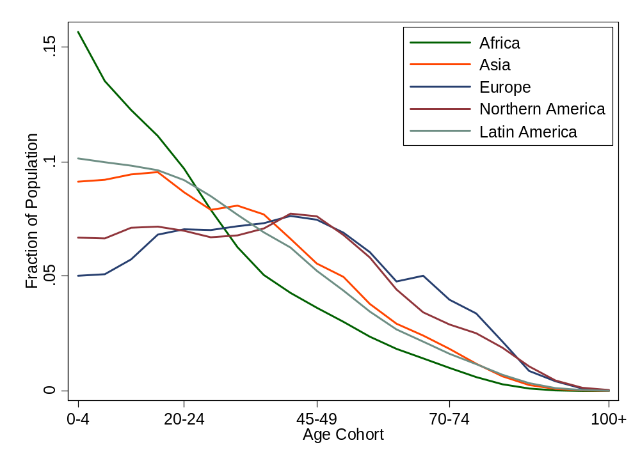
Age distribution
Source: UN Population Information Network.

Slide 29
Productivity
The last component of the production function is “A”
  Y = A F(K,L) = A K^{α} L^{1-α}
“Total Factor Productivity” or TFP
Why this mouthful?

Slide 30
Productivity
Simple labor productivity
  Average product of labor: Y/L = A (K/L)^{α}
Marginal product of labor
  Differentiate with respect to L:
  ∂Y/∂L = A K^{α} (1-α) L^{-α} = (1-α) A (K/L)^{α}
Our number:
  Total Factor Productivity: Y = A F(K,L) = A K^{α} L^{1-α}

Slide 31
Measuring TFP
We “measure” it indirectly
Solve the production function for A:
  Y = A K^{α} L^{1-α}
  A = Y/[K^{α} L^{1-α}] = (Y/L)/(K/L)^{α}
Example (US): Y/L = 33, K/L = 65:
A = 33/65^{1/3} = 8.21
Comments
  Any mistakes will be absorbed in A
  Solow: “a measure of our ignorance”

Slide 32
Production function summary
Remember: Y = A F(K,L)
What changes in this equation if
  A firm builds a new factory?
  The US reinstitutes a mandatory retirement age of 65
  Nintendo designs and produces a superior Wii?
  Workers shift from agriculture to industry in Viet Nam?
  France makes employment more attractive to employers?
  Dubai makes a massive infrastructure investments?
  Venture capital fund identifies good unfunded projects?
  Alaska builds a bridge to nowhere?

Slide 33
High wages
Good or bad? (For whom?)

Slide 34
Takeaways
The production function links output to inputs and productivity:
Y = A K^{α} L^{1-α}
Capital input (K)
  Plant and equipment, a consequence of investment (I)
Labor input (L)
  Population growth, age distribution, participation
  Could add skill (H) or hours per person (h)
TFP (A) is everything else
  can be inferred from data on output and inputs

Slide 35
After the break
Be prepared to discuss
  Problem 3 of Group Project #1

Slide 36
GDP per capita revisited
GDP per worker
    Y/L = A (K/L)^{α}
Where does GDP per capita come from?
    Y/POP = (L/POP) (Y/L)
    = (L/POP) A (K/L)^{α}
Reasons for high GDP per capita:
  More work: L/POP
  More productivity: A
  More capital: K/L
  Not present but could be added: skill H or hours worked h

Slide 37
Share of world GDP (%)
Region | 1000 | 1820 | 1950 | 1998
Western Europe | 8.7 | 23.6 | 26.3 | 20.6
Western offshoots | 0.7 | 1.9 | 30.6 | 25.1
Japan | 2.7 | 3.0 | 3.0 | 7.7
Latin America | 3.9 | 2.0 | 7.9 | 8.7
E Europe + “USSR” | 4.6 | 8.8 | 13.1 | 5.3
Asia (excl Japan) | 67.6 | 56.2 | 15.5 | 29.5
Africa | 11.8 | 4.5 | 3.6 | 3.1
World | 100.0 | 100.0 | 100.0 | 100.0
Source: Maddison, Millennial Perspective, OECD, 2001, Table 3-1c.
Notes:
Offshoots = US + Canada + Australia + NZ

Slide 38
The Global Economy
Capital Accumulation
© NYU Stern School of Business
Notes:
Start gapminder: growth v GDP per capita
Start spreadsheet (Solow)
Use China and India as the examples. Is s a big deal?

Slide 39
Plan of attack
Group Projects
Where we’ve been, where we’re headed
The Solow model
  How important are saving and investment?
  India
Does China invest too much?
What’s coming up

Slide 40
Group Project #2
Treat as the business problem it claims to be
Result should be professional business document
Looks toward the next class
Does not use what we’ve done in class – but I think you’ll find it interesting
Use the materials suggested
See or email me if you have questions
Notes:
Questions?

Slide 41
Group Project #2
Builds useful career skills: business judgment and communication
5-page limit intended to force you to prioritize
Some other projects develop same skills
Notes:
Questions?

Slide 42
Group Project #1
Designed to apply the concepts covered in notes
Answers will be posted shortly
Notes:
Questions?

Slide 43
Group Project #1
Problem 3
  Why difference in net exports?
  Why difference in saving/investment rates?
Notes:
Foreshadows this class

Slide 44
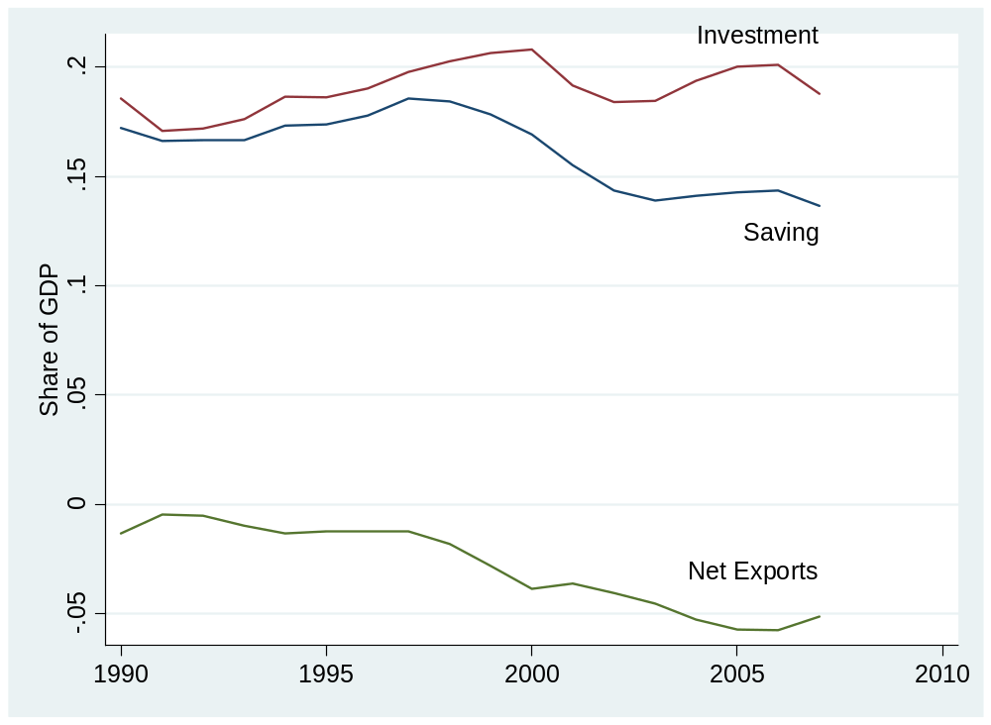
Group Project #1 (US)

Slide 45
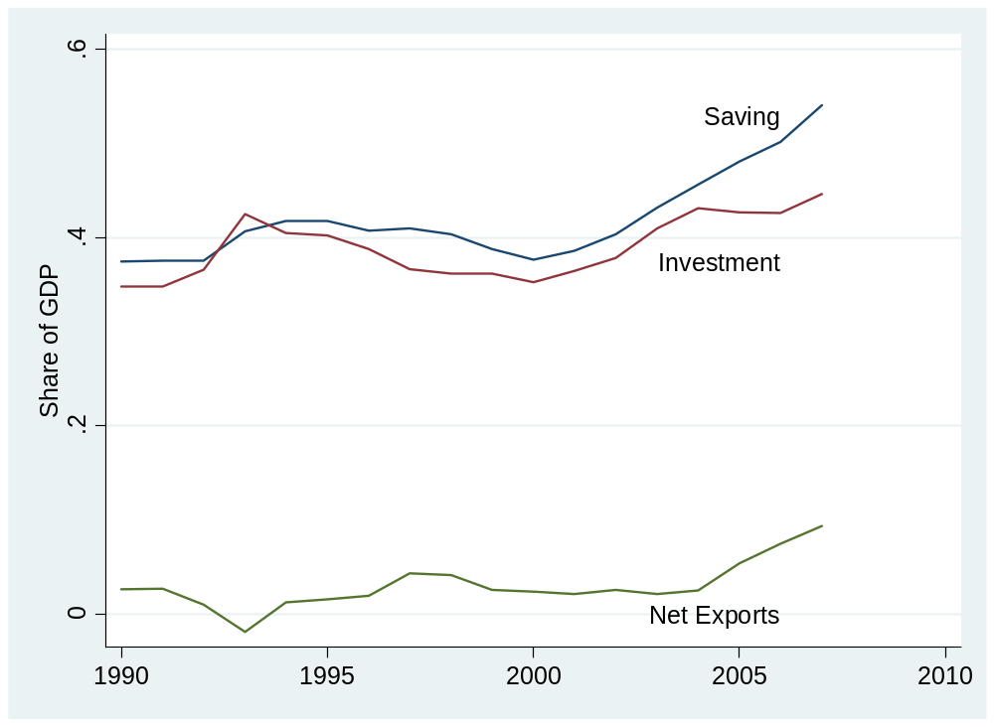
Group Project #1 (China)

Slide 46
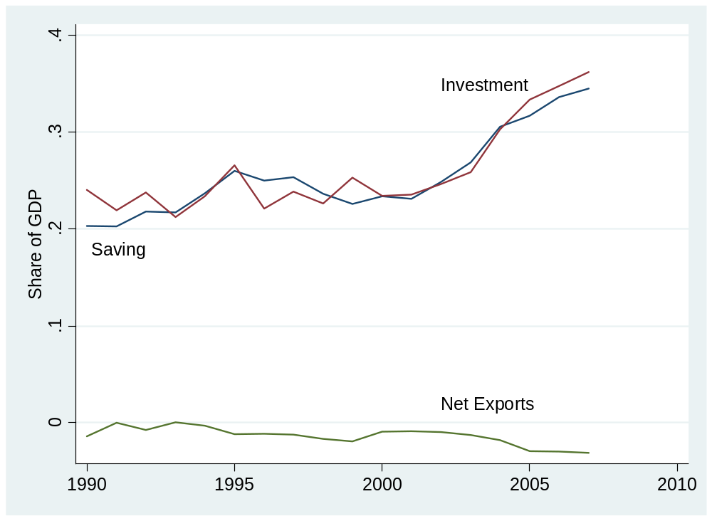
Group Project #1 (India)

Slide 47
Where we’ve been
Production function
Y = A K^{α} L^{1-α}
  Y is GDP
  A is “total factor productivity” or TFP
  K is capital (plant and equipment)
  L is number of workers (or perhaps a more refined measure of the “labor input”)
All measurable, either directly (Y,K,L) or indirectly (A)

Slide 48
Where we’re headed
GDP
Capital & Labor
Productivity
Political Process
“Institutions”

Slide 49
Where we’re headed
How important are saving and investment to growth?
Notes:
Solow stories

Slide 50
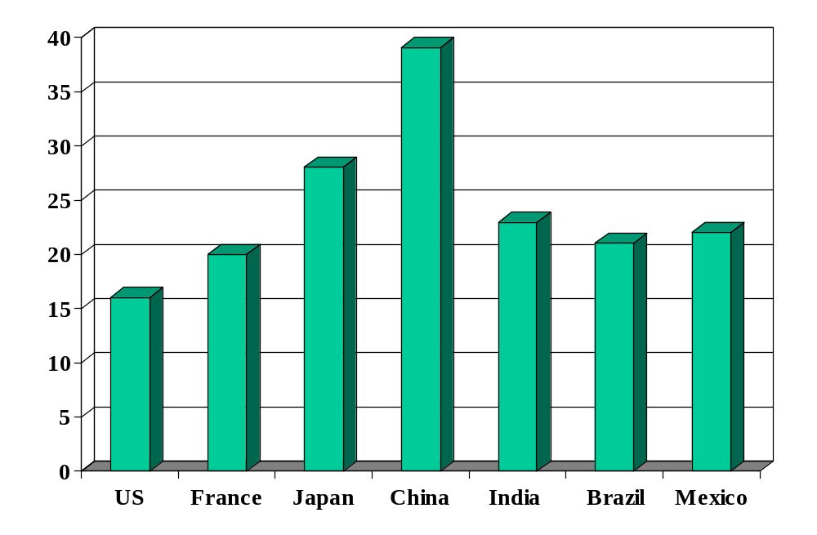
Investment rates (% of GDP)
Source: International Financial Statistics, averages for 1990-present.

Slide 51
Solow model
Quantitative tool for thinking about growth
Used to extrapolate current trends in a sensible way
  How large will China and India be in 2050?
Focus on saving and investment
Conclusion: adding capital can’t produce high growth on its own
  Diminishing returns to capital in production function
Don’t sweat the details

Slide 52
Solow model: overview
Production function:
Y = A K^{α} L^{1-α}
Flow identity:
I = S
Saving:
S = sY
Capital stock:
ΔK = I – δK
Notes:
Write on board, look at spreadsheet

Slide 53
Solow model: overview
Dynamic structure works like this
K_{t+1} depends on K_{t}
Use this to generate path of K
Y follows, since it depends on K
Notes:
Write on board, look at spreadsheet

Slide 54
Solow model: India
Inputs:
  GDP in 2003: 3139b (2000 USD)
  Capital: 3683b
  Labor force: 467m
  TFP: compute from above
  Saving and investment rate: 0.20
  Depreciation rate: 0.06
  Labor force growth: 0.00 (for comparison purposes)
  TFP growth: 0.05

Slide 55
Solow model: India
Comparisons
  No labor or TFP growth
  Higher saving/investment rate [how large an impact?]
  Higher TFP growth [how large an impact?]

Slide 56
Solow model: India
Estimated GDP | GDP
2003 | 3,139
2050: no-growth benchmark | 5,030
2050: higher saving (+5%) | 5,591
2050: TFP growth (2%) | 17,188
2050: TFP growth (+1%) | 31,851
Notes:
US in 2050: 27 trillion (ballpark)

Slide 57
India
Is relative shortage of capital important?

Slide 58
Does China save/invest too much?
How would we judge that?
What investment rate is needed to maintain K/Y?
  K and Y grow at rate g
  Given depreciation, how must investment rate vary with g?
Numbers
  Target: K/Y = 2 (typical number)
  Set δ = 0.06 (ditto)
  Compare: g = 0.03 and g = 0.08
In words: a fast-growing country needs a high investment rate just to keep up

Slide 59
What have we learned today?

Slide 60
Takeaways
Solow model
  Growth comes from saving-financed increases in capital
  Conclusion: capital can’t be the key to growth
  Value: tool for exploring future growth of emerging economies
What are we missing?
  TFP growth

Slide 61
What’s coming up
Read notes before next class
  Content is both important and demanding
  Major input to midterm exam
  You’ll be lost if you don’t

