Slide 1

The Global Economy
Sources of Growth
© NYU Stern School of Business
Notes:
Business (+ life) is a combination of quant and qualitative – the trick is to integrate them.
Open spreadsheet for calculations
Why are some countries richer than others? Why do some grow faster than others?
How do the business conditions vary?
US, Africa, China…

Slide 2
Fiscal stimulus
Fiscal means: government taxes and spending
Stimulus means: lower taxes, higher spending
What would a good stimulus bill look like?

Slide 3
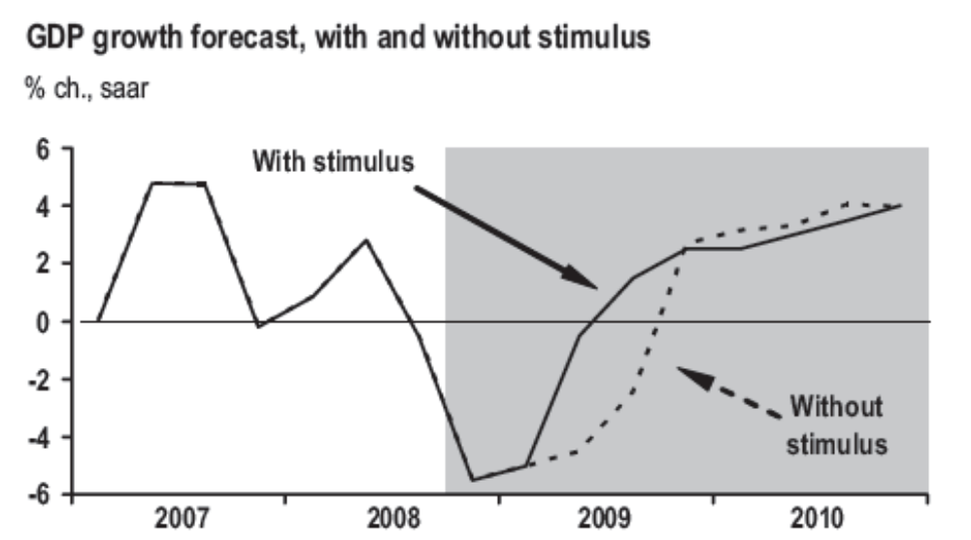
Fiscal stimulus
JP Morgan Chase, Jan 30 09:

Slide 4
Prices and wages
Which is better, high or low?
Notes:
Buy low, sell high

Slide 5
Plan of attack
Stimulus, wages and prices ✓
Where we’re headed
Pictures
Growth accounting
  A tool for quantifying sources of growth
What’s happening in France, China, etc

Slide 6
Where we’re headed
GDP
Capital & Labor
Productivity
Political Process
“Institutions”

Slide 7
Pictures
100+ year perspective
“1990 US dollars, PPP adjusted”
What’s going on?

Slide 8
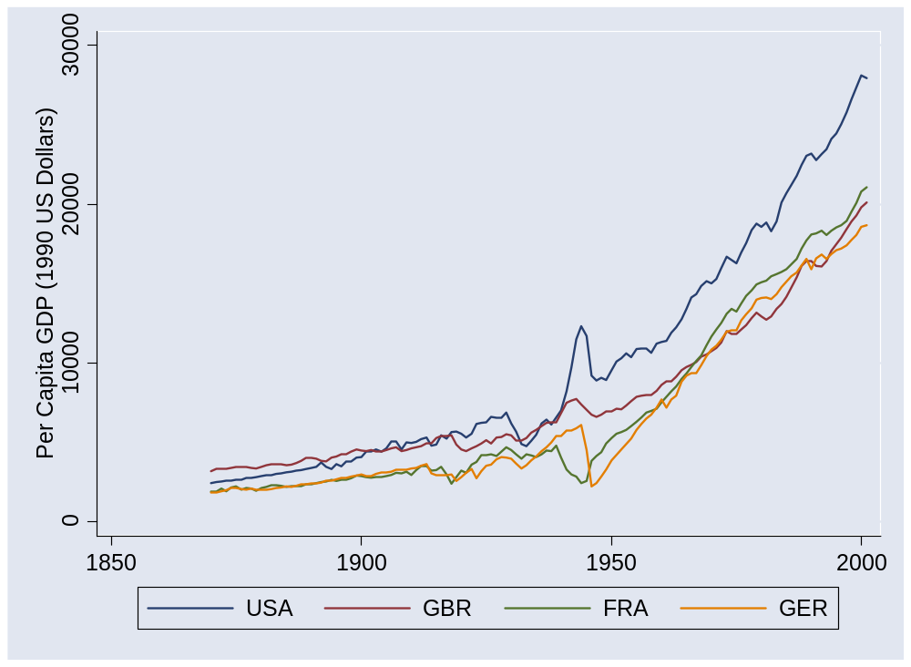
US and Europe
Source: Maddison, Historical Statistics, OECD.

Slide 9
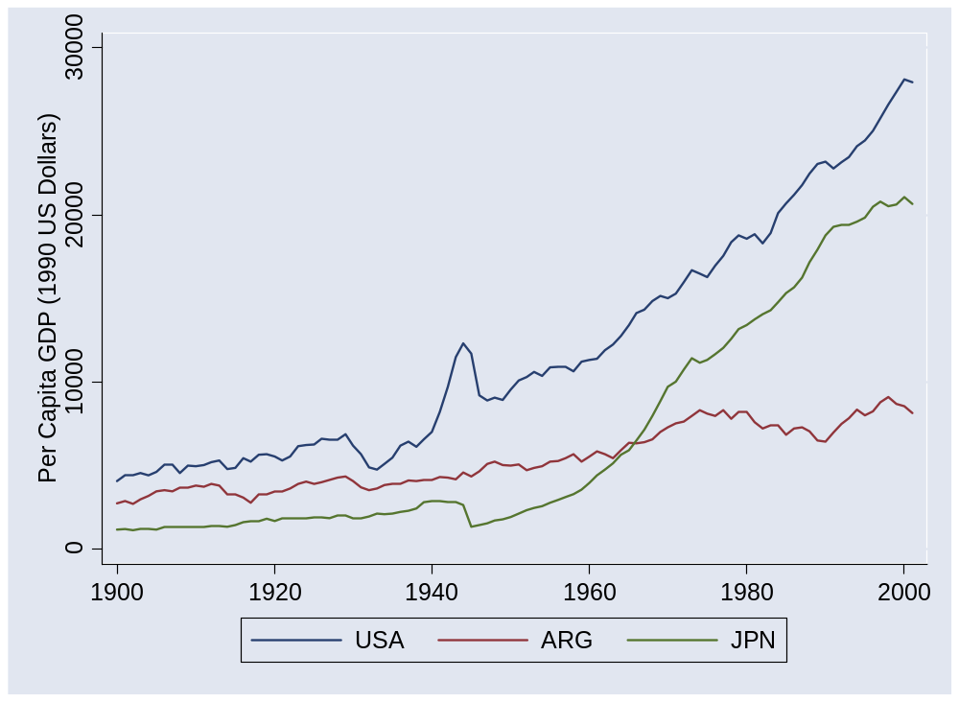
Argentina and Japan
Source: Maddison, Historical Statistics, OECD.

Slide 10
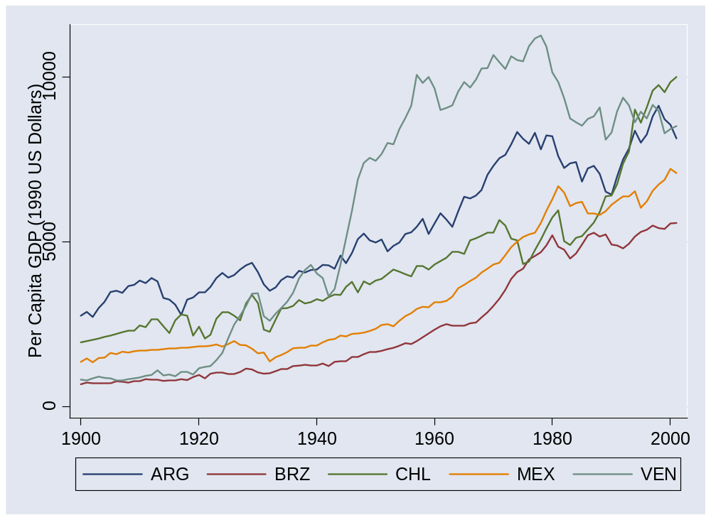
Latin America
Source: Maddison, Historical Statistics, OECD.

Slide 11
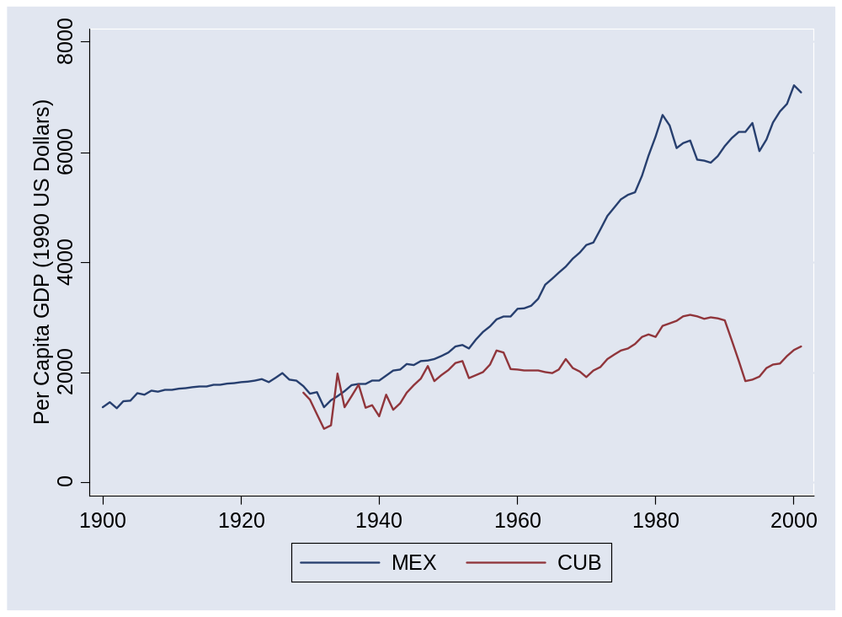
Mexico and Cuba
Source: Maddison, Historical Statistics, OECD.

Slide 12
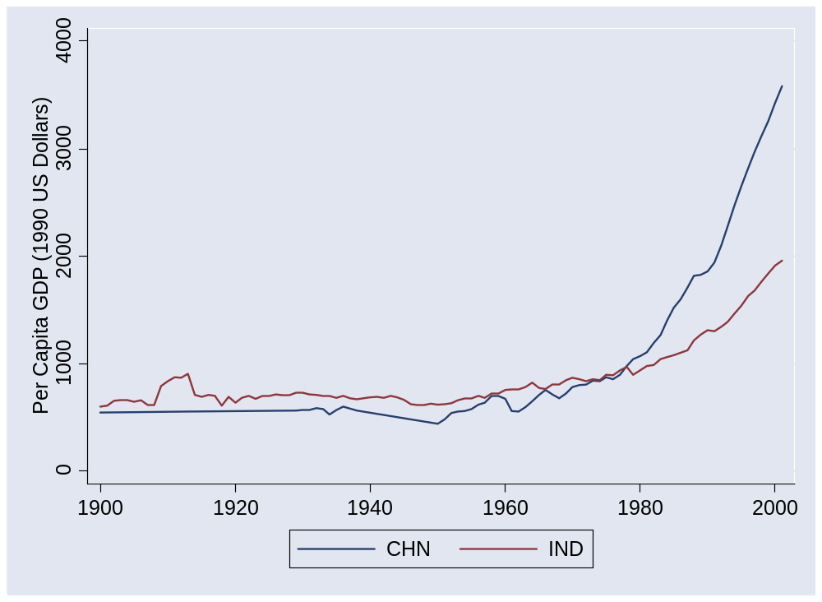
China and India
Source: Maddison, Historical Statistics, OECD.

Slide 13
Pictures
50+ year perspective
What’s going on?

Slide 14
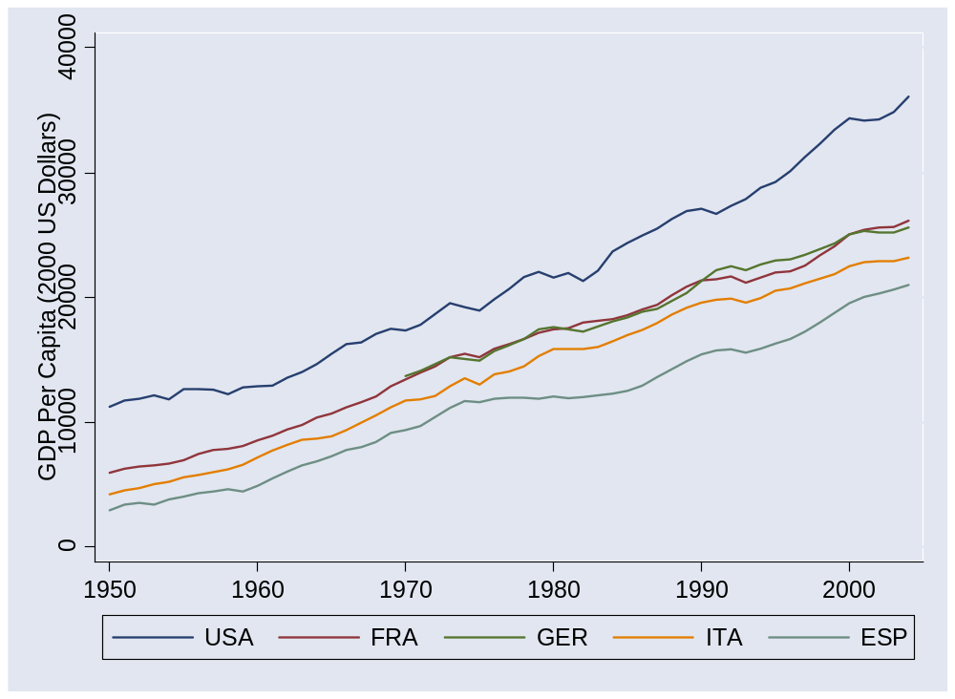
Europe (post 1950)
Source: Penn World Tables, version 6.2.

Slide 15
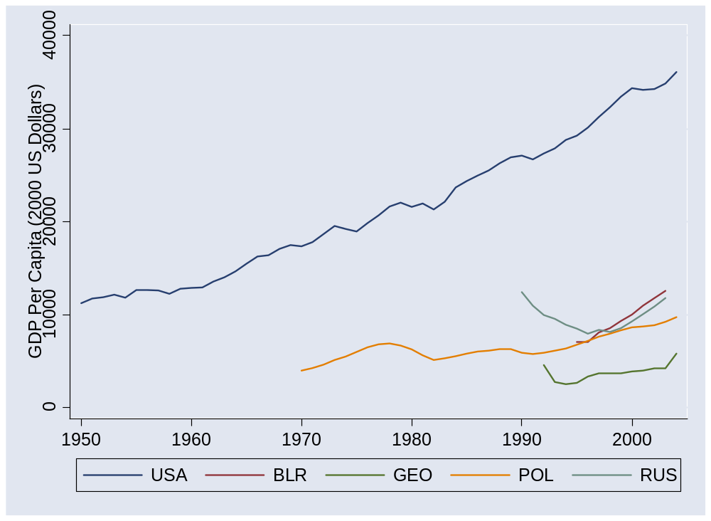
Former Soviet bloc
Source: Penn World Tables, version 6.2.

Slide 16
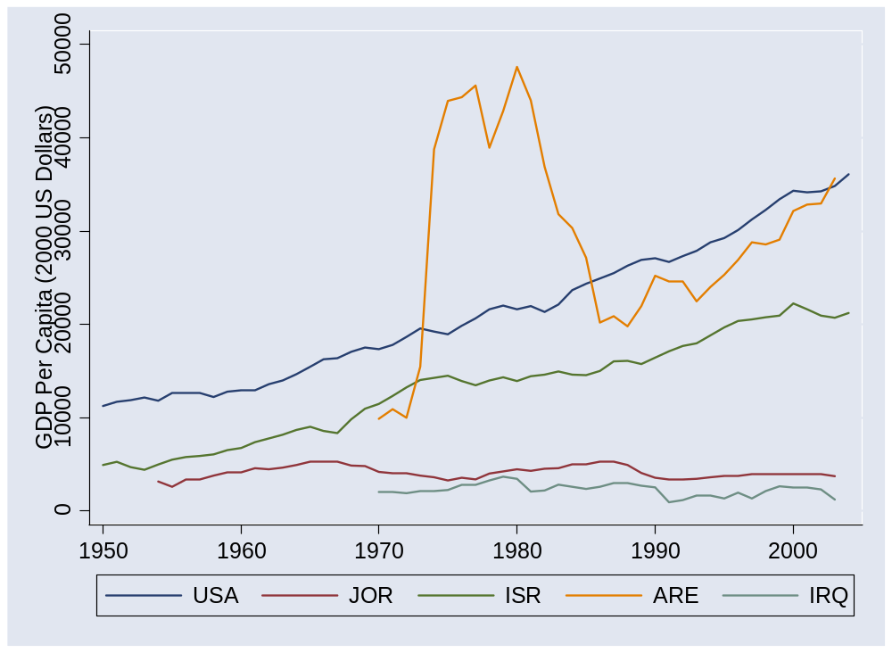
Middle East
Source: Penn World Tables, version 6.2.

Slide 17
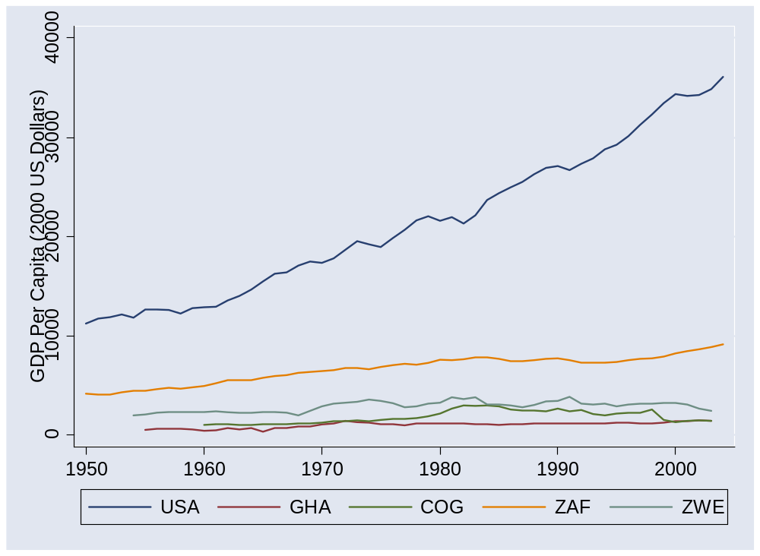
Africa 1
Source: Penn World Tables, version 6.2.

Slide 18
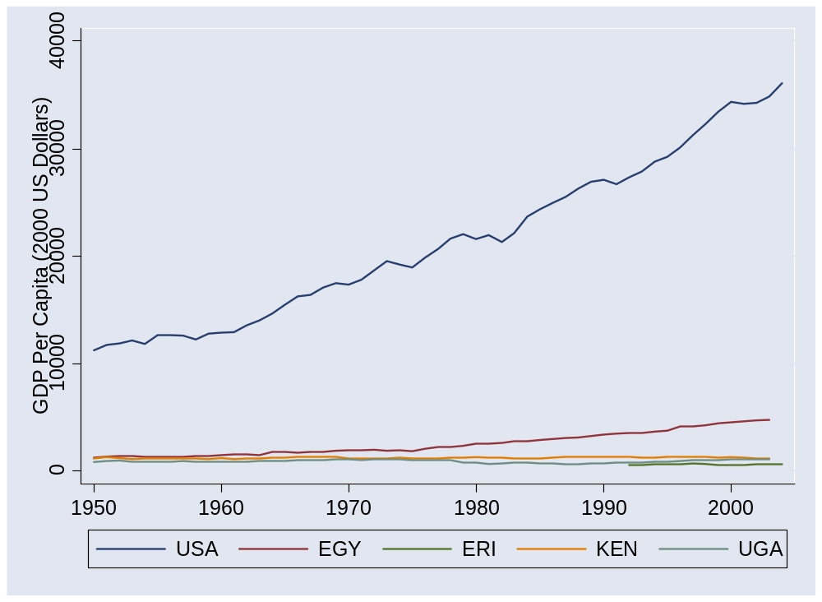
Africa 2
Source: Penn World Tables, version 6.2.

Slide 19
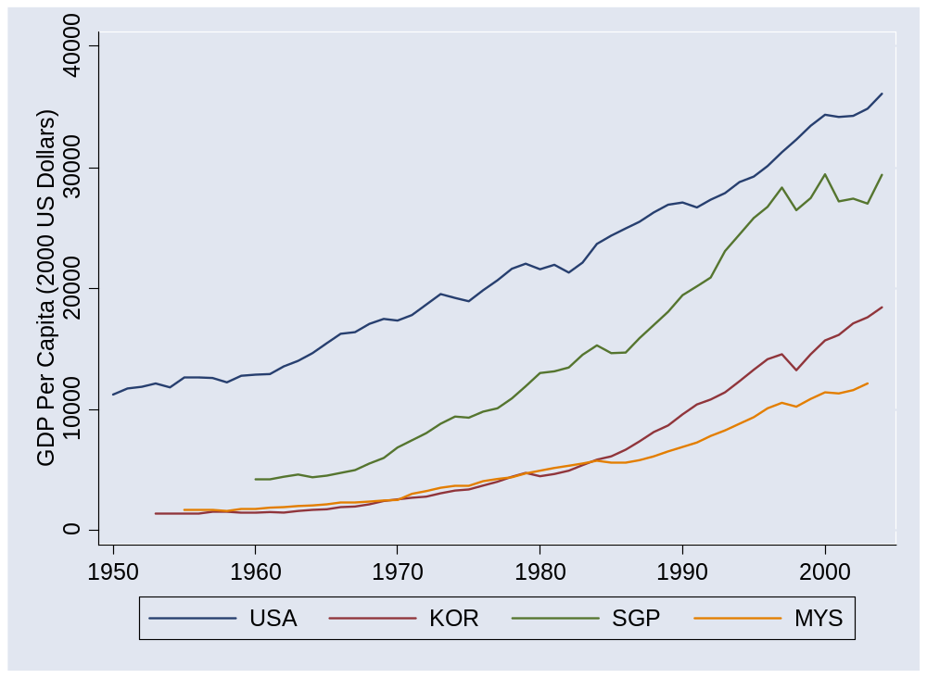
Asia 1
Source: Penn World Tables, version 6.2.

Slide 20
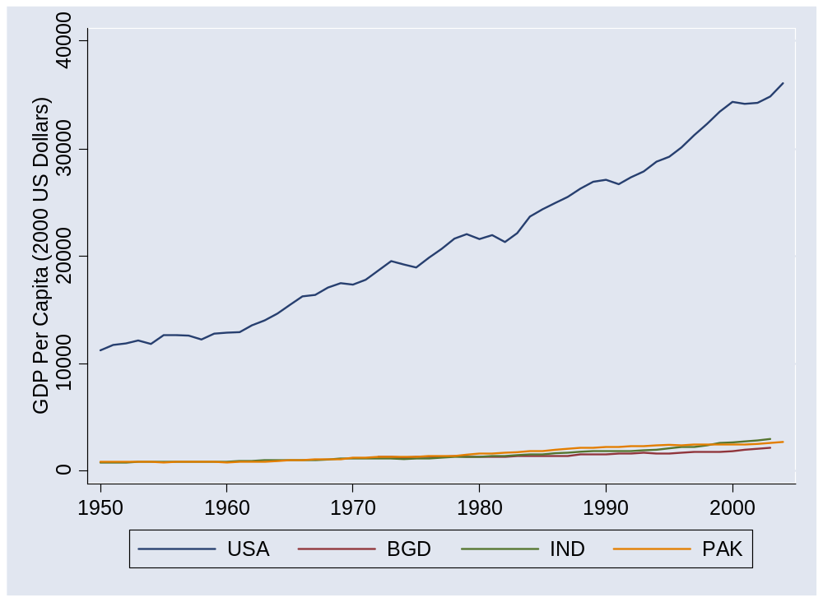
Asia 2
Source: Penn World Tables, version 6.2.

Slide 21
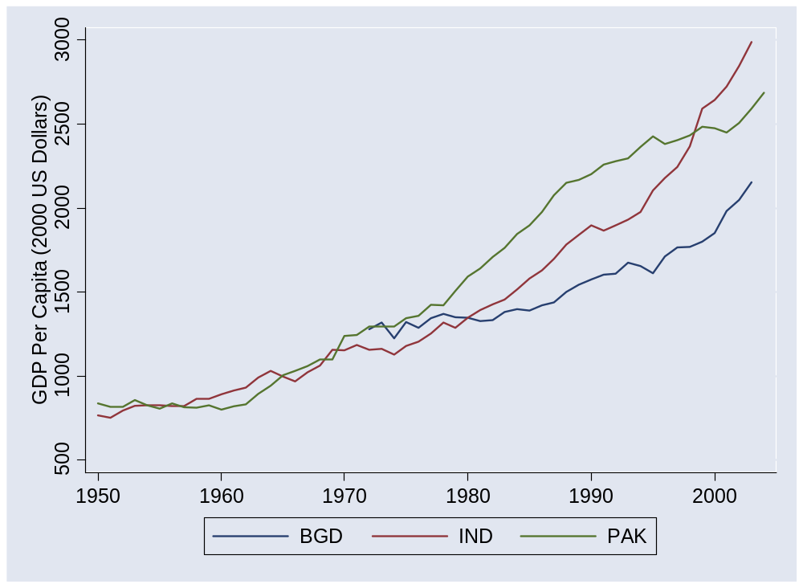
Asia 2 (without USA)
Source: Penn World Tables, version 6.2.

Slide 22
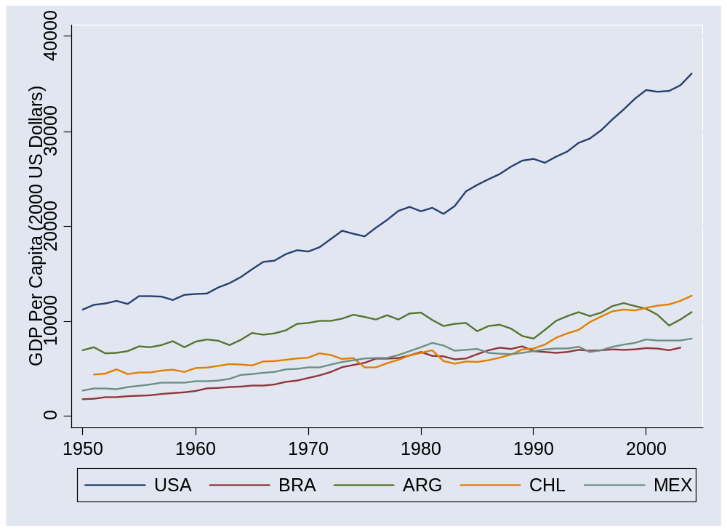
Latin America
Source: Penn World Tables, version 6.2.

Slide 23
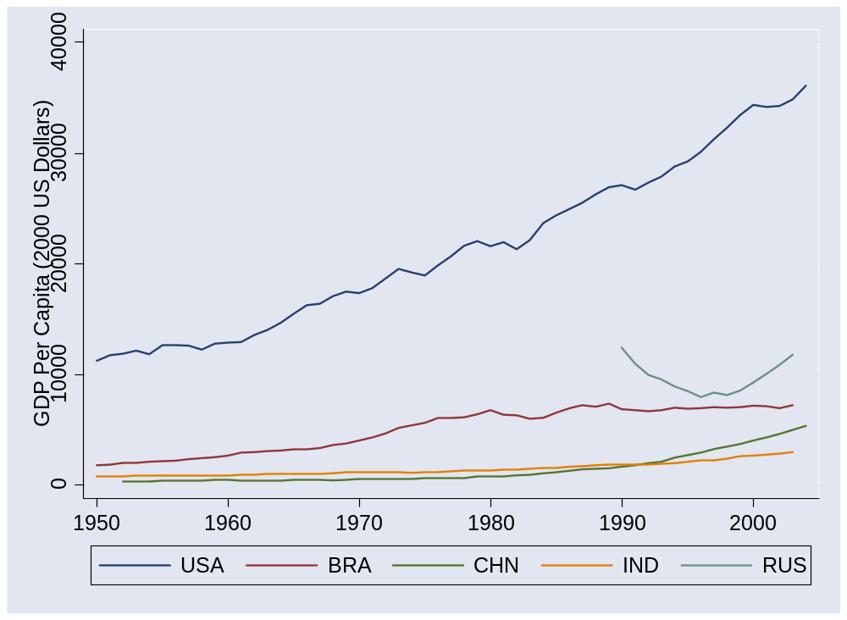
BRICs
Source: Penn World Tables, version 6.2.

Slide 24
Catch your breath
Where do these differences come from?
What do they say about the business environment?

Slide 25
Our plan
Use production function to study countries
Then move on from there

Slide 26
GDP per capita and per worker
GDP per worker
    Y = A K^{α} L^{1– α}
    Y/L = A (K/L)^{α}
GDP per capita
    Y/POP = (L/POP) (Y/L)
    = (L/POP) A (K/L)^{α}
Reasons for high GDP per capita:
  More work: L/POP
  More productivity: A
  More capital: K/L

Slide 27
Accounting for GDP
Where does output per worker come from?
Production function
Y = A K^{α} L^{1-α}
Y/L = A (K/L)^{α}
Comparison of two countries
(Y/L)₁/(Y/L)₂ = (A₁/A₂) [(K/L)₁/(K/L)₂]^{α}
Bottom line: a clue to economic performance

Slide 28
Computing growth rates
Traditional growth rate
(1+g)^{n} = x_{t+n}/x_{t}
Continuously-compounded growth rate
e^{nγ} = x_{t+n}/x_{t}
Computing the growth rate
γ = log(x_{t+n}/x_{t})/n
See
  “Math review”
  “Sources of growth”
My advice:
Just memorize this.

Slide 29
Accounting for growth
Where does growth in output per worker come from?
Production function
Y = A K^{α} L^{1-α}
Y/L = A (K/L)^{α}
In terms of growth rates
γ_{Y/L} = γ_{A} + α γ_{K/L}
[γ_{x} means “growth rate of X”]
γ_{K/L} is growth rate of K/L
α γ_{K/L} is “contribution to growth”
Bottom line: a clue to where growth comes from

Slide 30
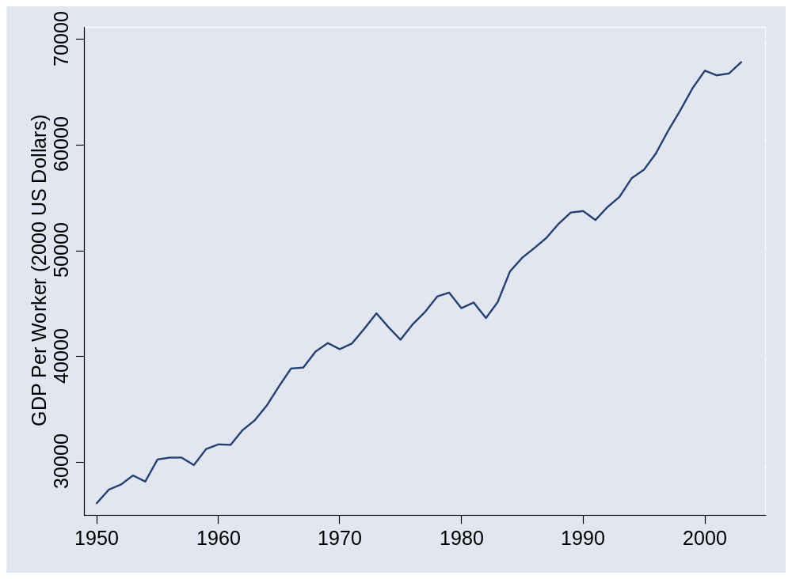
What happened in the US?
Source: Penn World Tables, version 6.2.

Slide 31
What happened in the US?
 | Y/L | K/L | A
1950 | 26,130 | 57,394 | 677
2003 | 67,865 | 177,008 | 1209
Growth rate (annual %) | 1.80 | 2.13 | 1.09
Contribution to growth | 1.80 | 0.71 | 1.09
Make sure you can calculate every number in italics

Slide 32
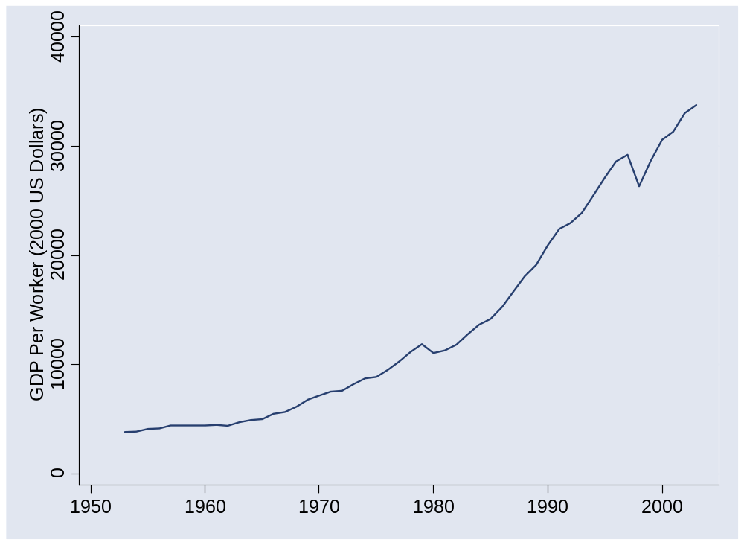
What happened in Korea?
Source: Penn World Tables, version 6.2.

Slide 33
What happened in Korea?
 | Y/L | K/L | A
1953 | 3,817 | 4,289 | 235
2003 | 33,784 | 113,720 | 697
Growth rate (annual %) | 4.36 | 6.56 | 2.18
Contribution to growth | 4.36 | 2.19 | 2.18

Slide 34
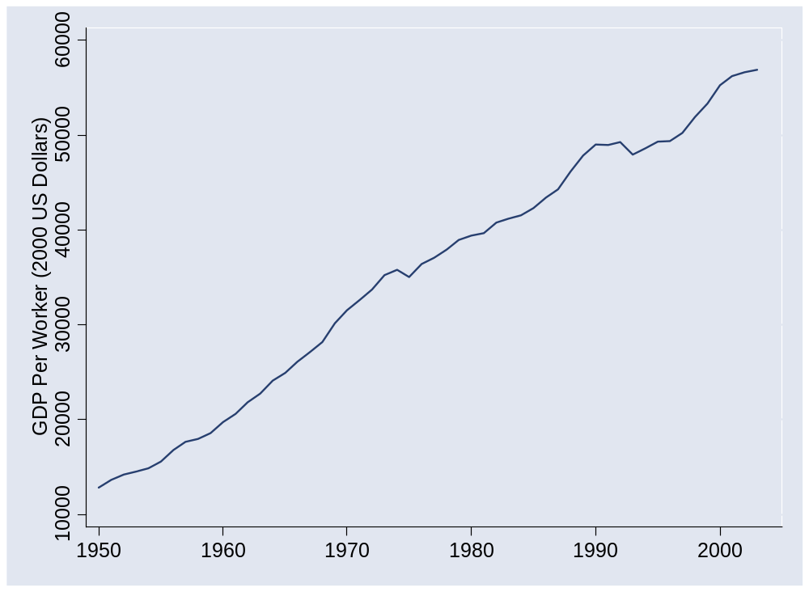
What happened in France?
Source: Penn World Tables, version 6.2.

Slide 35
What happened in France?
 | Y/L | K/L | A
1950 | 12,838 | 24,009 | 445
1973 | 35,236 | 82,298 | 810
2003 | 56,909 | 166,636 | 1,034
Contribution 1950-73 | 4.39 | 1.79 | 2.60
Contribution 1973-2003 | 1.60 | 0.79 | 0.81

Slide 36
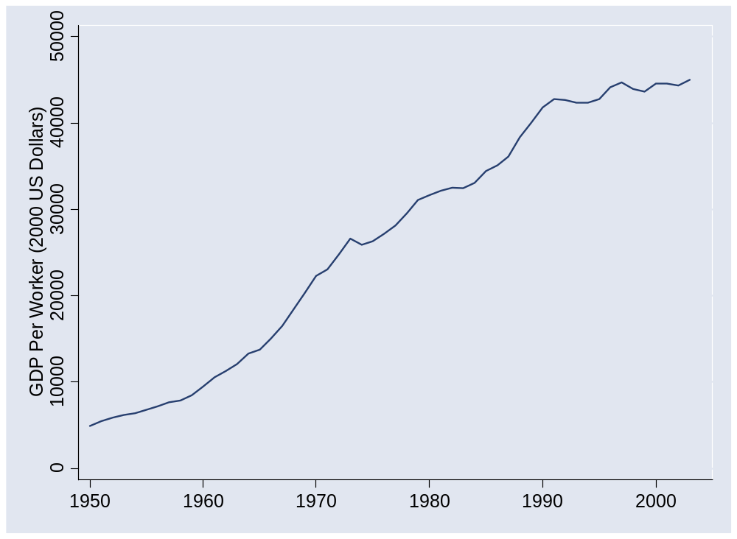
What happened in Japan?
Source: Penn World Tables, version 6.2.

Slide 37
What happened in Japan?
 | Y/L | K/L | A
1950 | 4,936 | 5,104 | 287
1973 | 26,642 | 61,119 | 676
1990 | 41,810 | 133,656 | 818
2003 | 45,030 | 180,284 | 797
Contribution 1950-73 | 7.33 | 3.60 | 3.73
Contribution 1973-90 | 2.65 | 1.53 | 1.12
Contribution 1990-2003 | 0.57 | 0.77 | (0.20)

Slide 38
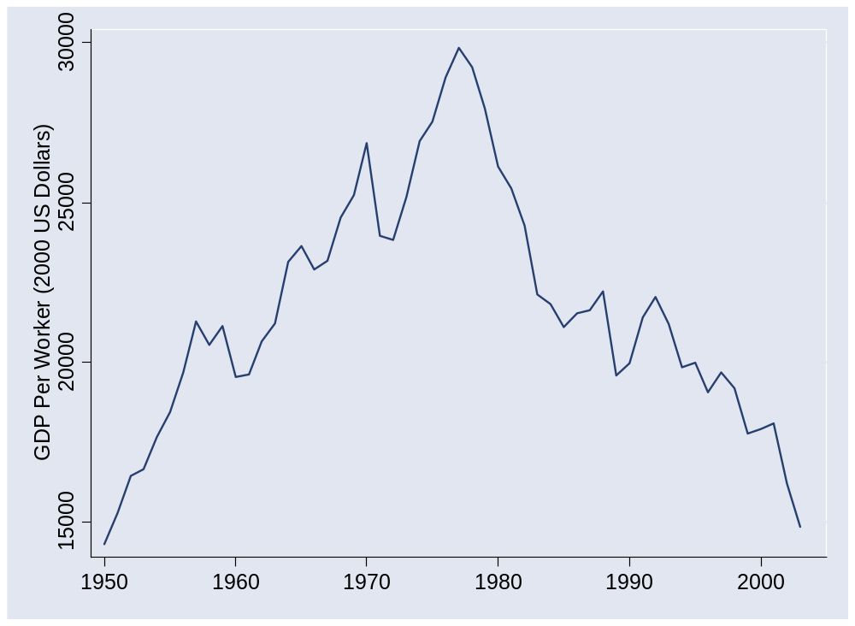
What happened in Venezuela?
Source: Penn World Tables, version 6.2.

Slide 39
What happened in Venezuela?
 | Y/L | K/L | A
1950 | 14,311 | 34,658 | 439
1977 | 29,853 | 81,303 | 689
2003 | 14,848 | 44,990 | 418
Contribution 1950-77 | 2.72 | 1.05 | 1.67
Contribution 1977-2003 | (2.69) | (0.76) | (1.92)

Slide 40
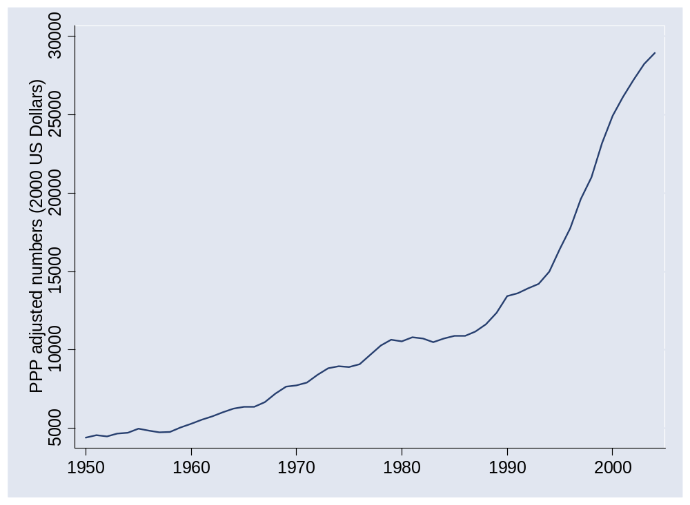
What happened in Ireland?

Slide 41
What happened in Ireland?
Why did growth accelerate in early 1990s?

Slide 42
What happened in Ireland?
 | Y/L | K/L | A
1950 | 10,227 | 21,074 | 370
1993 | 36,640 | 86,685 | 828
2003 | 65,925 | 131,131 | 1,298
Contribution 1950-93 | 2.97 | 1.10 | 1.87
Contribution 1993-2003 | 5.87 | 1.38 | 4.49

Slide 43
What happened in Ireland?
EU membership, aid recipient
Fiscal discipline (>1987)
  Government hiring frozen
  Personal and corporate tax rates slashed
  Government budget balanced
Peaceful labor relations
Attractive terms for foreign firms
  Lowest corporate tax rates in OECD
Notes:
Summary: they stopped messing up

Slide 44
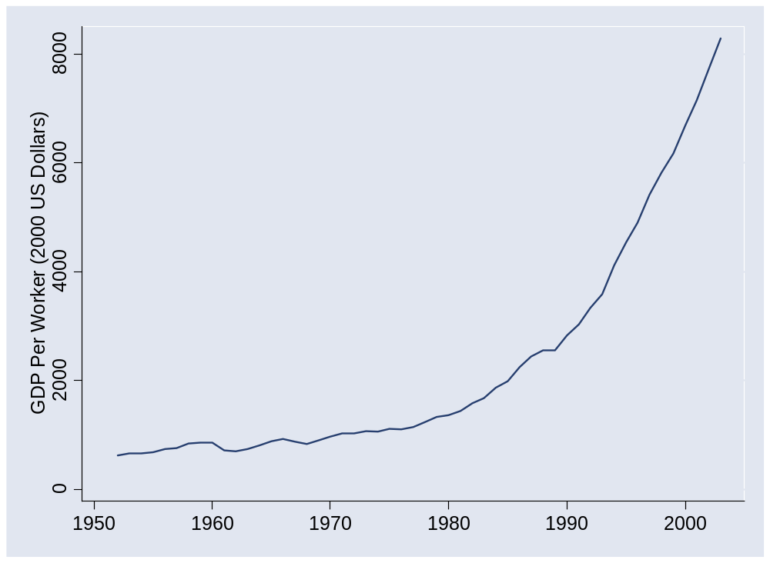
What happened in China?
Source: Penn World Tables, version 6.2.

Slide 45
What happened in China?
 | Y/L | K/L | A
1952 | 620 | 942 | 63
1978 | 1,234 | 3,070 | 85
2003 | 8,284 | 18,015 | 316
Contribution 1952-78 | 2.64 | 1.52 | 1.13
Contribution 1978-2003 | 7.62 | 2.36 | 5.26

Slide 46
What happened in China?
EIU, Country Finance Report:
  China’s financial sector is large but immature, with significant structural weaknesses. The quantity of household savings has risen significantly in recent years, as declining social welfare programs have encouraged increased saving for retirement, healthcare and education of children. Risk-management techniques and the quality of bank lending have improved. However, the dominance of state-owned banks (the five large banks dominate the sector) suggests that savings are not used efficiently. Pressure from local governments means that lending decisions are still occasionally driven by political factors.
Notes:
Summary: they stopped messing up

Slide 47
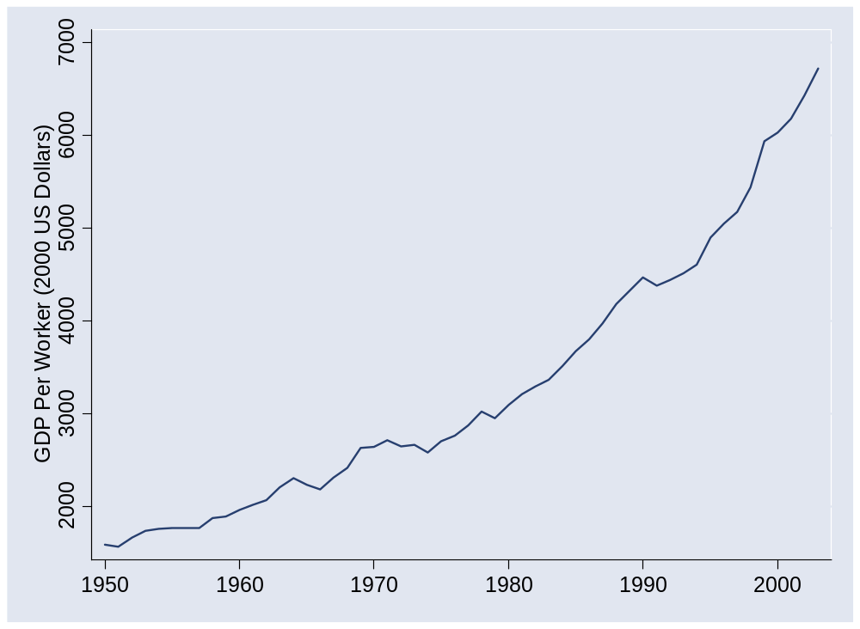
What happened in India?
Source: Penn World Tables, version 6.2.

Slide 48
What happened in India?
 | Y/L | K/L | A
1950 | 1,585 | 990 | 159
1980 | 3,094 | 3,714 | 200
2003 | 6,725 | 7,892 | 338
Contribution 1950-80 | 2.23 | 1.47 | 0.76
Contribution 1980-2003 | 3.38 | 1.09 | 2.28

Slide 49
What happened in India?
EIU, Country Finance Report:
  India is a difficult operating environment for foreign companies. Most economic activities are girded with restrictions, public services and infrastructure are poor, and the government continues to impede the free flow of capital across its borders. Tax rates are relatively high and the tax system is complicated.
Source: EIU Country Report.

Slide 50
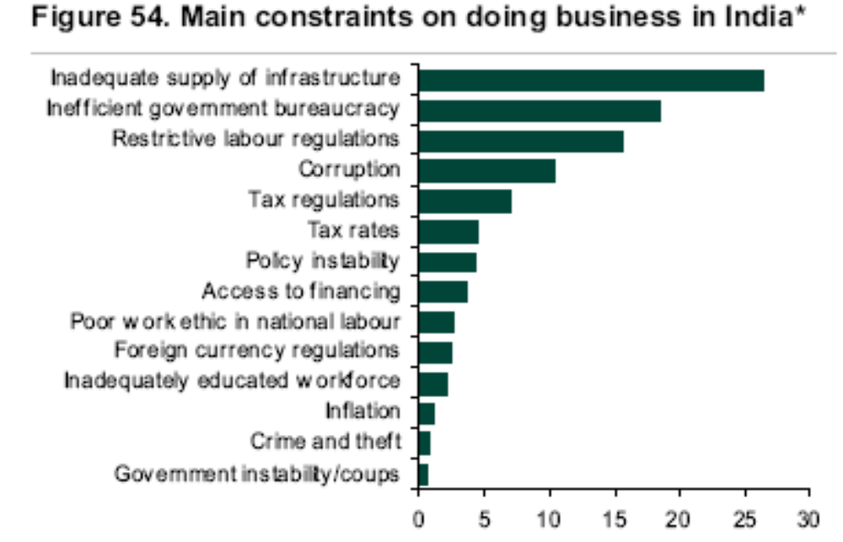
What happened in India?
Source: Lehman report, using data from World Economic Forum.

Slide 51
What happened in [country]?
Do your own calculations for any country you like
  Data online (link)
  Or through Blackboard (linked to this class)

Slide 52
Takeaways
Growth accounting quantifies sources of GDP growth
TFP important in most cases
But… where does TFP come from? [more on this next]

Slide 53
After the break
Be prepared to speak about Group Project #2

Slide 54
The Global Economy
“Institutions”
© NYU Stern School of Business
Notes:
Start Gapminder
Overview:
GP #3
Spiel:
Modern society is a miracle – that hundreds of millions of people could interact and have things (more or less) work
All of this shows up in TFP
Where does it come from?
Not just math/science/tech
Bigger issue: Why aren’t people stealing from each other?
Some examples: Pirates (North), borrowing/lending game….
What do we need?
Security / Rule of Law
Property rights
Competition

Slide 55
What are “institutions”?
“Social mechanisms” that facilitate economic activity
… through higher productivity (“TFP”)
Like what?

Slide 56
Group Project #2

Slide 57
Plan of attack
What are “institutions”? ✓
Group Project #2 ✓
Where we’re headed
Ocean shipping and other examples
Governance
What have we learned?

Slide 58
Where we’re headed
GDP
Capital & Labor
Productivity
Political Process
“Institutions”

Slide 59
Where does TFP come from?

Slide 60
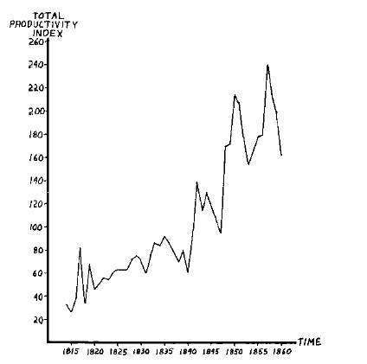
TFP in ocean shipping, 1600-1850
Source: Douglas North, 1993 Nobel prize
Why?

Slide 61
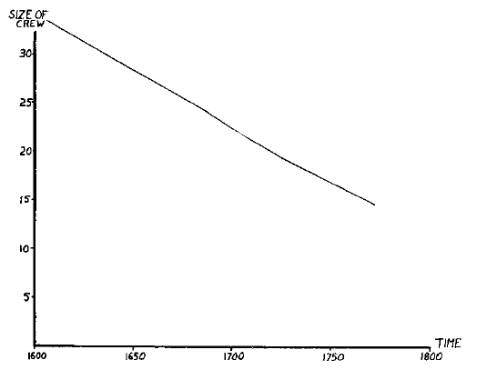
TFP in ocean shipping

Slide 62
TFP in ocean shipping
What does this suggest about TFP in general?
Notes:
Comment: TFP is a social phenomenon

Slide 63
The capital markets game
Parameters:
  Lender offers 100 to borrower for one year
  Lender’s cost of funds is 5%, charges 10%, the competitive risk-adjusted rate
  Borrower has project that generates 100 + 15
  If you default, you use up 50 (lawyers etc)
  Note: the deal generates value (115 – 105 = 10)
  What happens?

Slide 64
The capital markets game
Don’t lend
Payoffs = (0,0)
L
(+5,+5)
Repay
Lend
B
0
X
Default
(–105,+65)
What’s the outcome? What can we do about it?
Notes:
Note: economic activity creates value

Slide 65
The capital markets game
Note: creditor rights help borrowers!
  Making it easy to default simply kills off loan market, which hurts borrowers as well as lenders
  Result: positive NPV projects not funded, TFP lower than it could be
Evidence:
  States/countries with stronger creditor rights have more lending, lower rates
  Countries with strong creditor rights have more advanced financial systems and higher GDP per capita

Slide 66
The capital markets game
What does this suggest about institutions in general?

Slide 67
Institutions: categories
Rule of law
Clearly defined property rights
Open competitive markets (not “free”)

Slide 68
What is this?
Kidnap for ransom?

Slide 69
What is this?
Clear title to real estate?

Slide 70
What is this?
Ability to collect a debt?

Slide 71
What is this?
Monopoly franchise granted by government?

Slide 72
What is this?
Argentina then
  Facing inflation over 1000%, the government announced in 1991 that citizens could use either dollars or local currency and pegged the peso to the dollar. A decade later, the government converted all dollar assets into pesos (“pesification”) and devalued by 75%.

Slide 73
What is this?
Argentina now (WSJ, Oct 28 08):
  Argentina's government pressed forward with its controversial plan to nationalize private pension funds. … [President] Mrs. Kirchner said her move to seize the private funds is designed to protect contributors from alleged mismanagement amid the global market crisis.

Slide 74
What is this?
Bernie Madoff’s Ponzi scheme?
Satyam’s accounting fraud?
Tainted milk?
Pirated CDs and DVDs?
Dow Chemical’s purchase of Rohm & Haas?

Slide 75
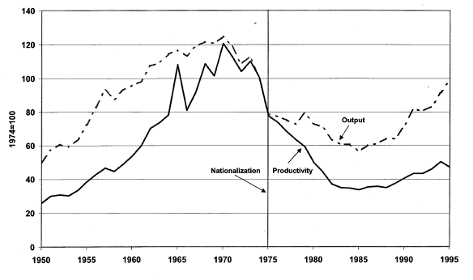
What is this?
Petroleum productivity in Venezuela
Light line is production, solid line is TFP.
Source: Schmitz and others.

Slide 76
What is this?
From Parkinson’s Law, published 1957, p 8:
Year | Ships | Men in Navy | Dock-workers | Dock officials | Naval Admin
1914 | 62 | 146,000 | 57,000 | 3249 | 2000
1928 | 20 | 100,000 | 62,439 | 4558 | 3569
What happened to productivity? Why?

Slide 77
What is this?
Indicator | US | France | Ratio
GDP | 6,297b | 1,296b | 5:1
Biomedical researchers | 77,000 | 12,000 | 6:1
Public research funding | 15.8b | 1.8b | 9:1
Industry research funding | 18.6b | 2.8b | 7:1
Biotech patents | 13,982 | 1051 | 13:1
Biotech startups | 1,100 | 40 | 27:1
Publicly-traded biotechs | 315 | 5 | 63:1
Recombinant proteins | 97 | 0 | ∞:1
Source: Gittelman, 2003.

Slide 78
What is this?
Robert Barro, Determinants of Economic Growth:
  [Paraphrase] One cannot conclude from the evidence that democracy is a critical element of economic growth.
Notes:
http://graphs.gapminder.org/world/#$majorMode=chart$is;shi=t;ly=2003;lb=f;il=t;fs=11;al=30;stl=t;st=t;nsl=t;se=t$wst;tts=C$ts;sp=6;ti=2007$zpv;v=0$inc_x;mmid=XCOORDS;iid=phAwcNAVuyj1jiMAkmq1iMg;by=ind$inc_y;mmid=YCOORDS;iid=p7mVTH_9OzWHQ2J6f54LXXA;by=ind$inc_s;uniValue=8.21;iid=phAwcNAVuyj0XOoBL_n5tAQ;by=ind$inc_c;uniValue=255;gid=CATID0;by=grp$map_x;scale=log;dataMin=194;dataMax=96846$map_y;scale=lin;dataMin=-10;dataMax=10$map_s;sma=49;smi=2.65$cd;bd=0$inds=

Slide 79
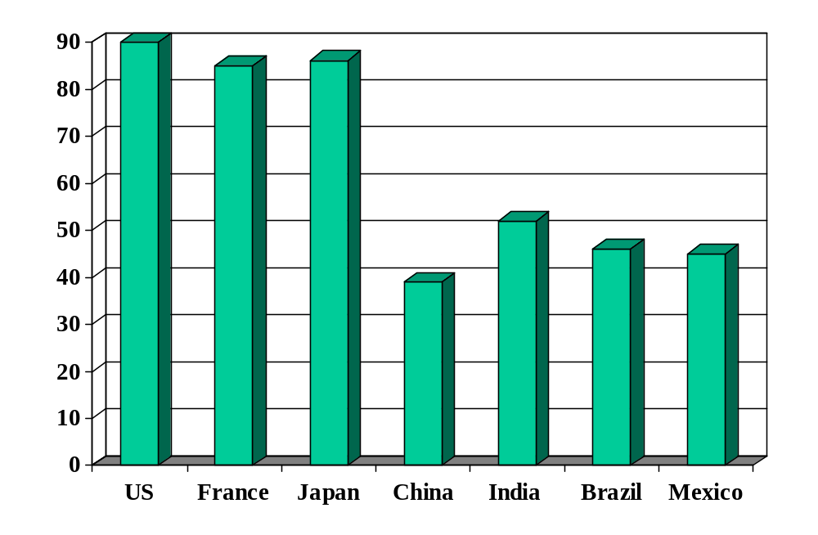
Rule of law (index)
Source: World Bank, Governance Indicators.

Slide 80
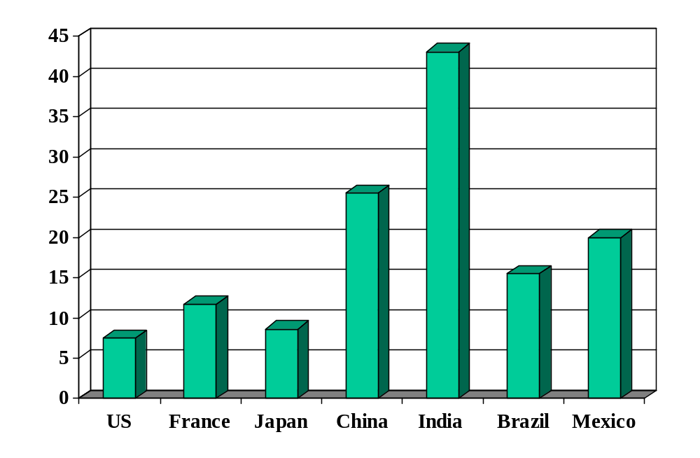
Cost of enforcing contracts (% of debt)
Source: World Bank, Doing Business.

Slide 81
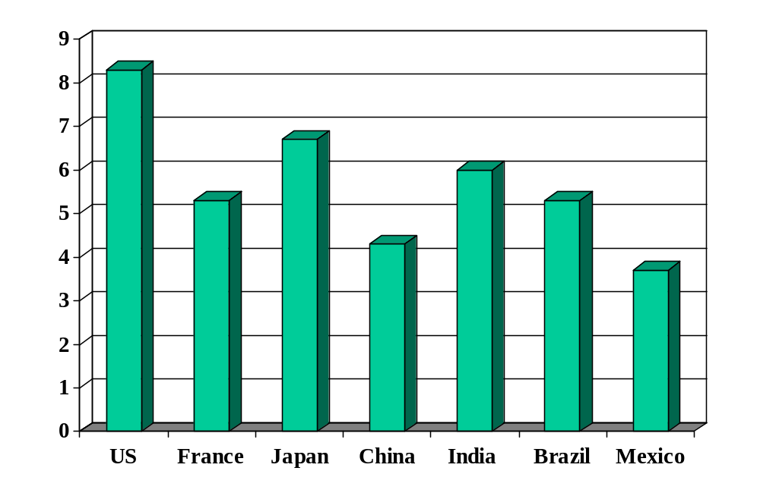
Investor protection (index)
Source: World Bank, Doing Business.

Slide 82
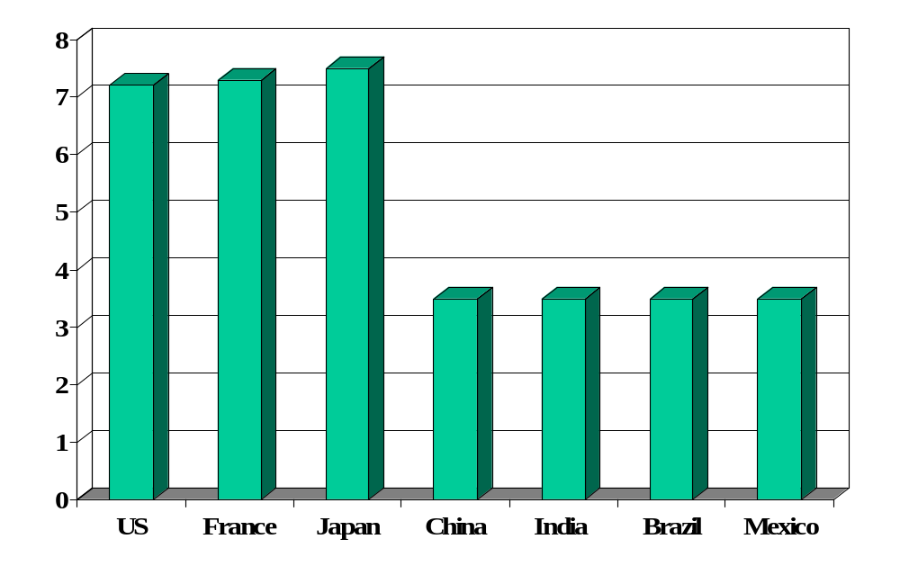
Absence of corruption (perceptions index)
Source: Transparency International.

Slide 83
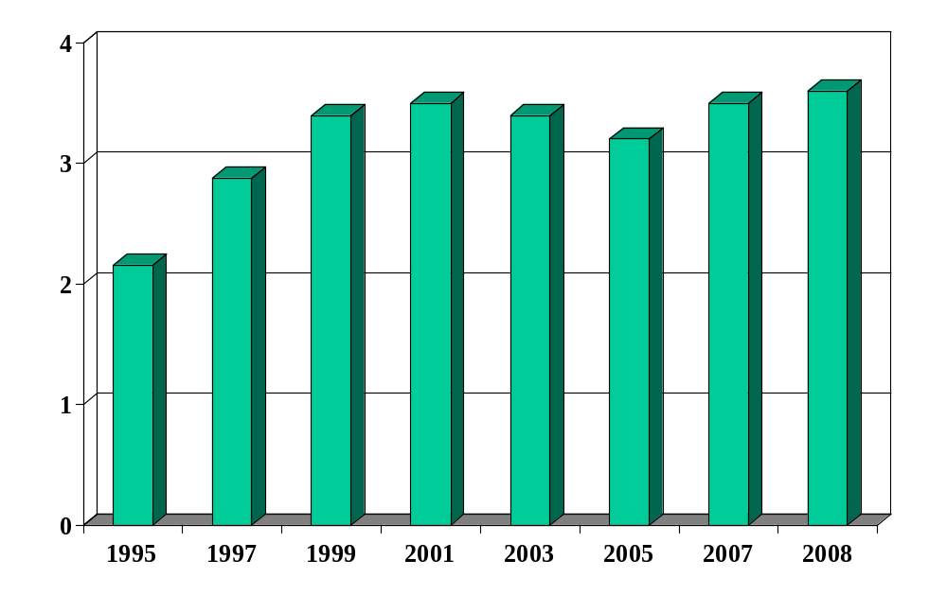
Absence of corruption in China
Source: Transparency International.

Slide 84
We started with
GDP
Capital & Labor
Productivity

Slide 85
Now we have
GDP
Capital & Labor
Productivity
“Institutions”

Slide 86
Governance
Bill Easterly, WSJ, Mar 23 07:
  Africa's poverty is well covered in the media, since it features such economists as Angelina Jolie, Madonna, Bono and Brad Pitt. But even Bill Gates, at an appearance at the World Economic Forum in Davos, expressed indifference to Africa's stagnant GDP, since “you can’t eat GDP.” Mr. Gates apparently missed the economics class that listed the components of GDP, such as food.
  African governments are not the only ones that are bad, but they have ranked low for decades on most international comparisons of corruption, state failure, red tape, lawlessness and dictatorship.
Notes:
Cold calls: share, pair?

Slide 87
Governance
Mo Ibrahim, telecoms engineer and entrepreneur
Built African mobile network
Supports improved governance in Africa
  “Nothing, simply nothing, is more important for Africa than good governance.”
  Ibrahim Index of African Governance intended to expose poor governance.
  Ibrahim Prize awarded to leader who rules fairly and turns power over to a successor.
FT interview, Feb 16 08
Good ideas?

Slide 88
Governance
James Madison, Federalist Papers 51 (1788):
  If men were angels, no government would be necessary. If angels were to govern men, neither external nor internal controls on government would be necessary. In framing a government which is to be administered by men over men, the great difficulty lies in this: you must first enable the government to control the governed; and in the next place oblige it to control itself.

Slide 89
And finally
GDP
Capital & Labor
Productivity
Political Process
“Institutions”

Slide 90
The challenge of good government
Czech joke (circa 1968):
  The difference between capitalism and socialism? Under capitalism, Man oppresses Man. Under socialism it’s exactly the opposite.

Slide 91
What have we learned?

Slide 92
Takeaways
Productivity (TFP) reflects “institutions” that facilitate economic activity
  Rule of law
  Property rights
  Open competitive markets
Measures of institutional quality are useful inputs to business decisions.
Good institutions follow from good governance.

Slide 93
What’s coming up
Group Project #3
  Application of the tools developed earlier today
  Good practice for the midterm
  Read notes again: “Sources of Economic Growth”

Slide 94
Extra slides
We don’t have time for these slides, but I don’t have the heart to delete them. If you find any of them interesting, feel free to ask questions next class.

Slide 95
China’s conundrum
Review of Winchester in Economist Jun 5 08:
  The Chinese began printing 600 years before Gutenberg. They built the first chain drive 700 years before the Europeans. And they made use of a magnetic compass at least a century before anyone else. So why, in the middle of the 15th century, did this advanced civilisation suddenly cease its spectacular progress?
  Suggestions: the stultifying pursuit of bureaucratic rank in the Middle Kingdom and the absence of a mercantile class to foster competition and self-improvement; the sheer size of China compared with the smaller states of Europe whose fierce rivalries fostered technological competition; its totalitarianism.

Slide 96
Islamic world
Question:
  Islamic countries around the Mediterranean in the middle ages were more advanced than Europe. Why has economic performance been worse?

Slide 97
“Washington consensus”
Fiscal discipline
Direct public spending toward pro-growth, pro-poor services such as education, health, and infrastructure investment
Broad tax base, low tax rates
Market-determined interest rates
Competitive exchange rates
Open trade in goods
Open trade in assets, incl inward direct investment
Privatize state enterprises
Abolish regulations that restrict competition
Legal security for property rights
Source: Wikipedia, http://en.wikipedia.org/wiki/Washington_Consensus

Slide 98
Property rights
Hernando de Soto, Mystery of Capital:
  My summary: the absence of clear property rights is a major problem in many developing countries. This hits small businesses hardest, since lack of clear claim to (say) real estate makes it difficult for them to finance new or expanding businesses. An earlier book emphasized red tape: it would take a small business months to get the approvals needed to operate legally in Peru.
Notes:
http://www.pbs.org/wgbh/commandingheights/lo/story/ch_menu_03.html
Ch 19, 2:00

Slide 99
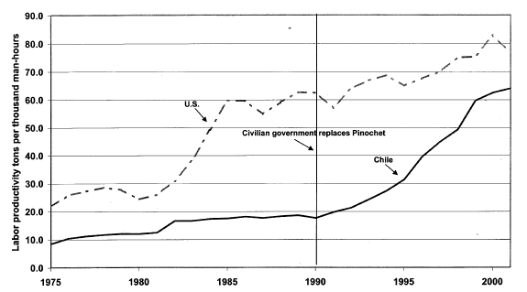
What is this?
Copper productivity in US and Chile
Light line is production, solid line is TFP.
Source: Schmitz and others.

Slide 100
Evidence
Good economic performance is associated with good institutions
How do we know this?
  Regressions: relate performance (growth and level of GDP per capita) to measures of institutional quality
  Micro studies
Causality?

Slide 101
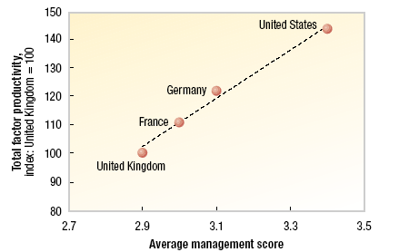
What is this?
McKinsey study:
Notes:
Good mgt = lean manuf, hire the best, reward performance

Slide 102
Immigration
Are Mexican workers more productive in the US?
Why immigration?

