Slide 1

The Global Economy
Midterm Review
© NYU Stern School of Business
Notes:
Review to consolidate learning
Long-term bus relationship: what do you look for?
Big picture “checklist,” but we’ll work through the components
Your job: ask a question if there’s anything you don’t follow

Slide 2
Where we’ve been
GDP
Capital & Labor
Productivity
Political Process
“Institutions”

Slide 3
Plan of attack
Where we’ve been ✓
About the midterm
Review of topics

Slide 4
About the midterm
Same format and content as practice exam
You can use one page of notes: std size, both sides
Bring a calculator that does “logs” and “exponents”
Wireless devices prohibited
Covers long-run performance only
Some questions will be quantitative
Anything from the notes, slides, or projects is fair game, but the exam is not an attempt to stump you with obscure issues

Slide 5
About the midterm
Recommended study plan
  Skim “checklist” to get big picture
  Review course materials: slides, notes, projects
  Draft one-page “cheat sheet”
  Work through practice exams
  Review topics you have difficulty with
  Keep a list of terms and concepts you don’t understand
  Stop by or email if you have questions

Slide 6
About the “cheat sheet”
For each topic, you should ask yourself:
  What are the big picture takeaways?
  What are the quantitative tools?

Slide 7
Measuring performance
Big picture
  Q: Why do we care about National Income and Product Accounts? A: They’re the basic data on country performance.
  Q: Does GDP measure performance? A: There are other things we might care about, but most of them are closely related to GDP.
Tools:
  Price indexes and price deflators are used to measure inflation and to separate real quantities from changes in average prices.
  Identities connect expenditure components and financial flows
Relevance
  Common indicators of performance and market size

Slide 8
Measuring performance
Production
GDP
Income
Labor, Capital
Expenditures
C,I,G,NX
Financial Flows
S = I + NX

Slide 9
Measuring performance
GDP
  Gross domestic product
  Gross of depreciation [ie, includes depreciation]
  Equals: sum of value-added for all production units
  Equals: payments to capital and labor by the same units
  Almost equals: income

Slide 10
Measuring performance
Real (quantities) and nominal (values)
  Not so easy to separate changes in nominal GDP into price and quantity components: we do our best.
  GDP and components measured at current market prices and constant prices: What’s the difference?
  Cross-country comparisons often done at constant international prices: Why do we call this PPP adjusted?

Slide 11
Measuring performance
Recall:
Y = C + I + G + NX
What does this mean?
We commonly take ratios to Y
  Often express everything at current prices [why?]
  Eg, NX/Y
Saving
  Has many definitions [be forewarned!]
  We use: S = Y – C – G [“gross” “national” saving]
  And sometimes: S = S_{p} + S_{g} [S_{p} = Y – C – T, S_{g} = T – G]

Slide 12
Measuring performance
Recall:
S = I + NX
What does this mean?
If S (domestic source of new funds) ≠ I (domestic use of new funds), where does the difference go?
  In the US?
  In China?
It is better to give or receive?

Slide 13
Production function
Big picture
  Q: Where does GDP come from? A: Inputs of capital and labor, total factor productivity
Tools
  The production function:
  Y = A K^{α} (hHL)^{1-α}
  Y/L = A (K/L)^{α} (hH)^{1-α}
  Y/POP = (L/POP) A (K/L)^{α} (hH)^{1-α}
Relevance
  Fundamental to country analysis. (Why is per capita GDP higher in the US than Argentina?)

Slide 14
Production function
Function
  Y/L = A (K/L)^{α} [for example]
India, 2000
  Y/L = 6216
  K/L = 6413
What is A?
  A = (Y/L)/(K/L)^{α} = ??
  “Whatever’s left”

Slide 15
Production function
What changes if
  A firm builds a new factory?
  France makes employment more attractive to firms?
  India invests in infrastructure?
  Dubai overbuilds?
  Students learn a lot in their Global Economy course?
  The US imports more cotton from Brazil and Africa?
  [put your own example here]?

Slide 16
Solow model
Big picture
  Q: Can saving and capital formation lead to continuing growth? A: No, diminishing returns to capital limits the impact, so saving-based growth will eventually stop
Tools
  Dynamics: connects “t” to “t+1”
Relevance
  Basic tool for studying economic dynamics. (How large will India’s economy be in 20 years?)
  Superior to extrapolating trends: builds in information on the economy, clarifies assumptions.

Slide 17
Solow model
How important is a high saving rate to India’s economic growth?
Is low saving a central issue for the US economy?

Slide 18
Growth accounting
Big picture
  Q: Why do some countries grow faster than others? A: It depends, but often the most important factor is TFP.
Tools
  Continuously-compounded growth rates:
  γ_{x} = log(x_{t+n}/x_{t})/n [“log” = “LN” in Excel]
  Growth accounting
  γ_{Y/L} = γ_{A} + α γ_{K/L} + (1–α) (γ_{H} +γ_{h})
Relevance
  Basic tool for country analysis. (Why have China and India grown so fast? Why has growth slowed in Japan?)

Slide 19
Growth accounting for China
 | Y/L | K/L | A
1952 | 620 | 942 | 63
1978 | 1,234 | 3,070 | 85
2003 | 8,284 | 18,015 | 316
Contribution 1952-78 | 2.64 | 1.52 | 1.13
Contribution 1978-2003 | 7.62 | 2.36 | 5.26
You should be able to compute all the numbers in italics

Slide 20
Growth accounting
How does a high saving rate show up?
Why is TFP growth so important?
  Would its absence worry you?
Where does TFP come from?

Slide 21
Institutions
Big picture
  Q: Where does TFP come from? A: Much of it is tied to “institutions”
Tools
  Measures of institutional quality
Relevance
  The institutional environment is probably the most important factor in decisions to produce or invest in a country. (Is an Argentine winery a good bet?)

Slide 22
Institutions
High-performance institutions
  Rule of law
  Property rights
  Competitive markets for products, capital, and labor

Slide 23
Institutions
The infamous “Washington consensus”: Good for business? Good for growth?
  Fiscal discipline
  Direct public spending toward pro-growth, pro-poor services such as education, health, and infrastructure investment
  Broad tax base, low tax rates
  Market-determined interest rates
  Competitive exchange rates
  Open trade in goods
  Open trade in assets, incl inward direct investment
  Privatize state enterprises
  Abolish regulations that restrict competition
  Legal security for property rights
Source: Wikipedia, http://en.wikipedia.org/wiki/Washington_Consensus

Slide 24
Labor markets
Big picture
  Q: Why do employment and unemployment rates differ so much across countries? A: Largely because local labor laws differ.
Tools
  Participation, employment, unemployment rates
  Measures of “employment protection” and flexibility
Relevance
  Labor laws can be a major source of difficulty when doing business abroad. If you’re American, you’d make a big mistake thinking other countries are like the US. (Should Toyota open a plant in France?)

Slide 25
International trade
Big picture
  Q: Who are the winners and losers from trade? A: On average, people in all countries gain, but it is nevertheless politically appealing to protect local workers and businesses from foreign competition.
Tools
  Ricardo’s model of trade is based on comparative advantage: consumers get products from cheapest source, production is more efficient.
Relevance
  If you’re operating in a foreign country, you can expect local competitors to use the political process against you. (UPS in Mexico, Chinese furniture makers in the US)

Slide 26
International trade
Trade is like TFP
Wages
  Why do wages differ across countries?
  Are high-wage countries uncompetitive?
  Would you expect trade to increase or reduce differences?
What is dumping? Why is it illegal?

Slide 27
Long-run “big picture”
GDP
Capital & Labor
Productivity
Political Process
“Institutions”

Slide 28
The challenge of good government
Madison (Federalist Papers 51):
  The great difficulty [of good government] lies in this: you must first enable the government to control the governed; and in the next place oblige it to control itself.
Mo Ibrahim, telecoms engineer and entrepreneur
  Nothing, simply nothing, is more important for Africa than good governance.
Czech joke (circa 1968):
  The difference between capitalism and socialism? Under capitalism, Man oppresses Man. Under socialism it’s exactly the opposite.

Slide 29
Practice midterm
Questions and answers posted
Come see me if you have questions

Slide 30
After the break
Be prepared to discuss
  Group Project #4 (questions 2 and 3)
  Zimbabwe

Slide 31
Beach and airplane reading
Andrea Camilleri, The terra-cotta dog. Delightful series about a Sicilian detective.
Alan Furst, Dark star. Great spy novel about Europe prior to World War II.
Carl Hiaasen, Tourist season. Florida-based mystery, loaded with dark humor.
Carol O'Connell, Dead famous. Her Mallory series has an intriguing protagonist of questionable (a)morality.
Richard Russo, Straight man. If you're not laughing out loud in 5 pages, I'll buy the book from you.
James Church, Corpse in the Koryo. Another good mystery set in an exotic location – in this case, North Korea.

Slide 32
Global economy nonfiction
Andres Oppenheimer, Bordering on chaos. US journalist reports on Mexico in the 1990s. Good read, good insights.
Norman Cantor, In the wake of the plague. How the black plague killed one-third of the people in Europe, but led to huge improvements in property rights. Short!
Peter Hessler, Oracle bones. Best book I’ve read on China.
William Dalrymple, City of Djinns. Well-written book about the author’s year in Dehli, a combination of personal experiences and history.
William Easterly, The elusive quest for growth. Great stories about the developing world from the director of NYU’s Africana Center.
Ryszard Kapuscinski, Imperium. Fascinating take on the Soviet Union from a Polish journalist. Old, but worth reading.

Slide 33
The Global Economy
Inflation
© NYU Stern School of Business
Notes:
Indicators
Arg note
High inflation: has anyone lived through one? What was it like?

Slide 34
Group Project #4
Question 2: Would you locate a plant in Brazil, Poland, or Singapore? Why?
Question 3: Why didn’t NAFTA generate better performance in Mexico?

Slide 35
Plan of attack
Group Project #4 ✓
Pictures and quotes
Quantity theory of money
Zimbabwe
Money supply mechanics
What have we learned?

Slide 36
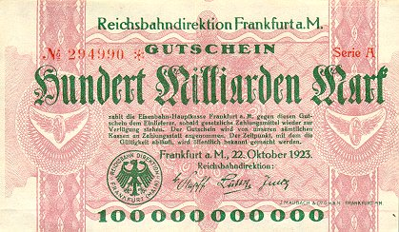
German currency
October 1923: 20 USD = 1 billion DM
Notes:
http://www.zum.de/whkmla/region/germany/turm2023.html

Slide 37
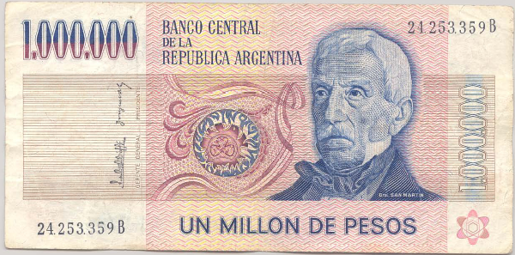
Argentine currency
This note dates from 1980s. What’s it worth now? Why?

Slide 38
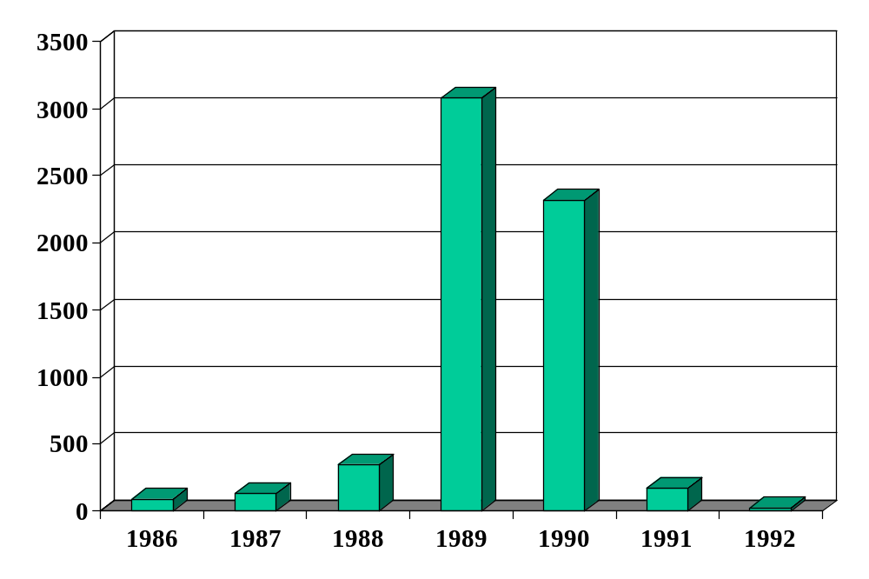
Inflation in Argentina (annual %)
Source: EIU database.

Slide 39
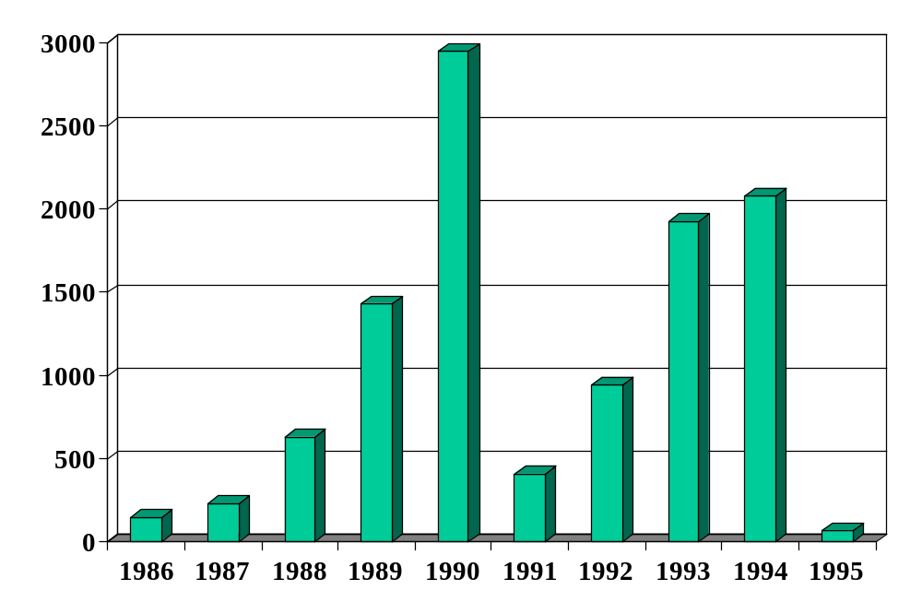
Inflation in Brazil (annual %)
Source: EIU database.

Slide 40
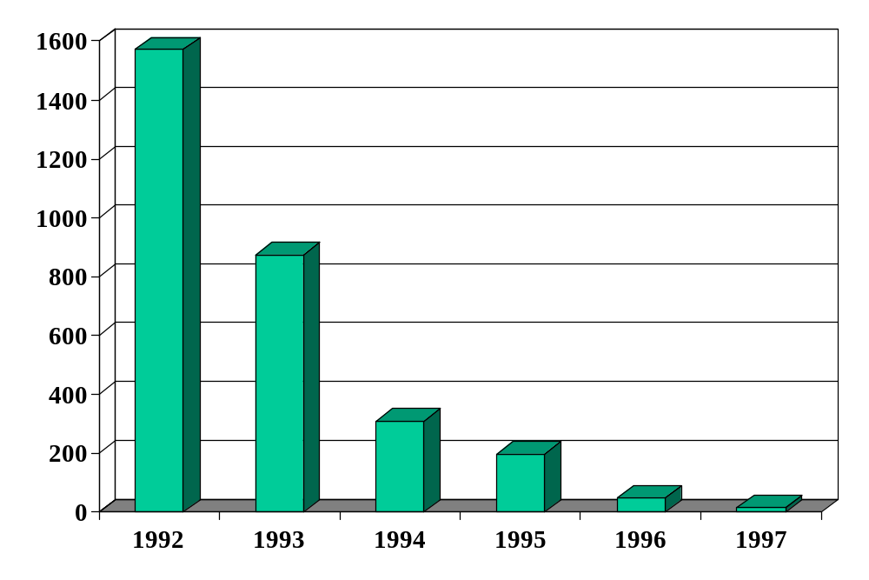
Inflation in Russia (annual %)
Source: EIU database.

Slide 41
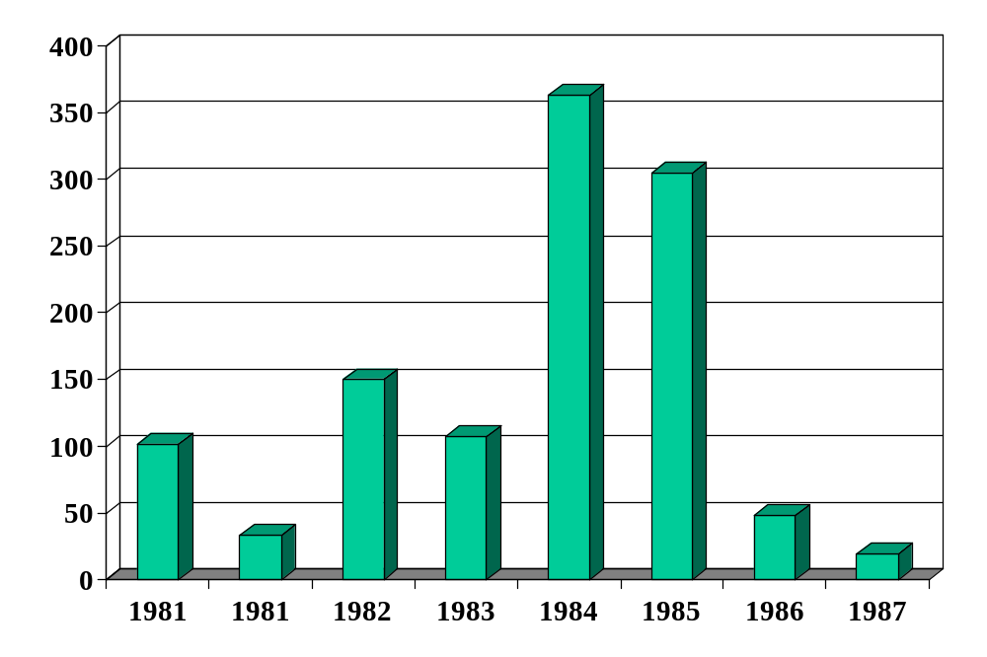
Inflation in Israel (annual %)
Source: EIU database.

Slide 42
Israel in the 1980s
American Rabbi visiting Israel:
  During Israel’s hyperinflation, the name of the game was to part with currency as quickly as possible. I had a invested some money with an Israeli mortgage bank, which gave me the option of receiving a secondary mortgage at a 5% fixed annual interest rate. When my wife and I purchased a condominium in 1981, interest rates on mortgages were 39%, so we took the secondary mortgage. Fixed rate mortgage payments became laughably easy to make as inflation shot up to 800% a year, because salaries more or less kept pace with inflation, a typical phenomenon in high inflation economies. The coup de grace came when I received a notice canceling my mortgage, because the cost of record-keeping had become more than the value of our monthly payment.
Link

Slide 43
Quantity theory
Milton Friedman, 1976 Nobel Laureate:
  “Inflation is always and everywhere a monetary phenomenon. To control inflation, you need to control the money supply.”
Is he right?

Slide 44
Quantity theory
Money
Growth
Inflation

Slide 45
Quantity theory
One equation (technology for transactions)
M V = P Y
  M = stock of money in circulation (currency)
  V = velocity (how often a unit of currency is used in a year)
In growth rates
γ_{M} + γ_{V} = γ_{P} + γ_{Y}
  γ_{M} = growth of money supply (think: currency in circulation)
  γ_{V} = growth of velocity
  γ_{P} = growth of price level (inflation rate)
  γ_{Y} = growth of real GDP

Slide 46
Quantity theory
Two hypotheses
  V is constant (γ_{V} = 0)
  Y not affected by changes in M [we’ll use this later]
One conclusion
  Money growth causes inflation
γ_{P} = γ_{M} – γ_{Y}

Slide 47
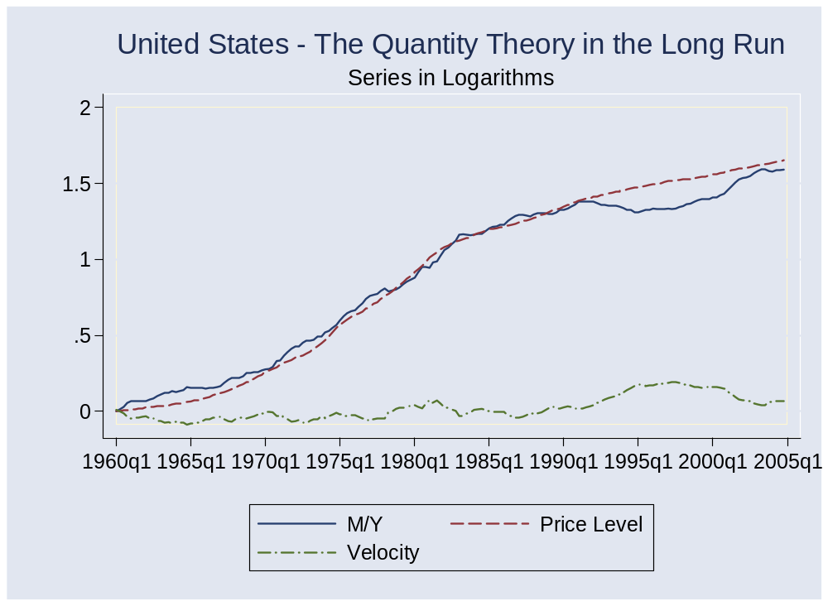
Quantity theory: long-run evidence

Slide 48
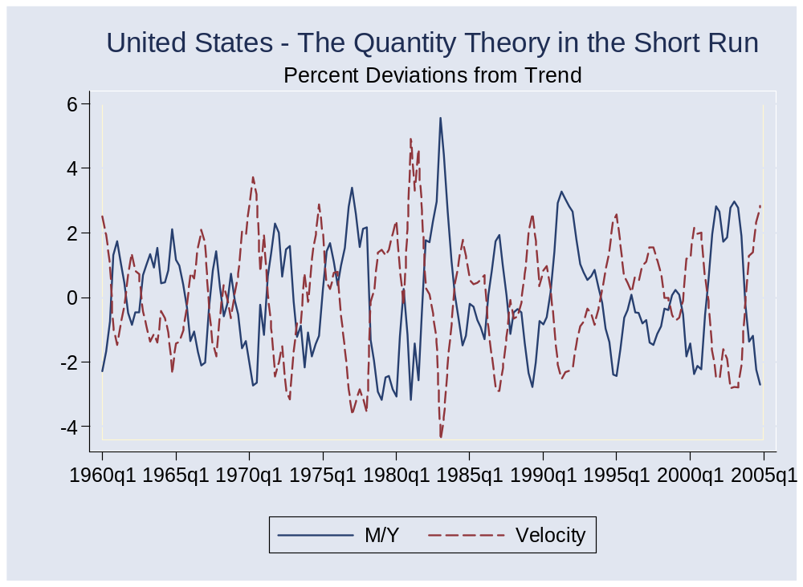
Quantity theory: short-run evidence

Slide 49
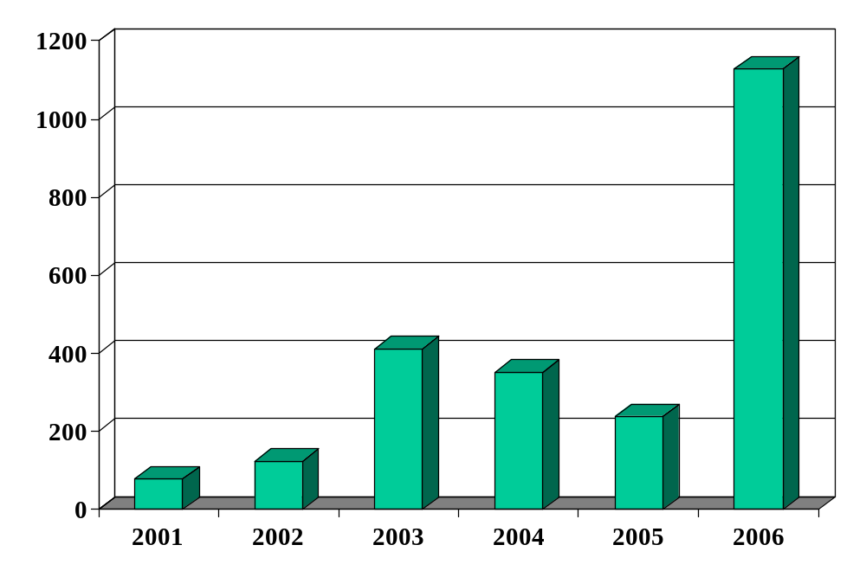
Zimbabwe (inflation rate)
Source: EIU database.

Slide 50
Zimbabwe
Dec 06: inflation over 1000 percent
Feb 07: inflation ruled “illegal”
Oct 08: inflation over 200 million percent (!)
Jan 09: transactions allowed in foreign currencies
  Soldiers and teachers to be paid in USD
Feb 09: 12 zeros knocked off currency

Slide 51
Zimbabwe
What’s going on? Outline a chain of connections that generates inflation as the outcome.
Notes:
Warning: you’re not prepared, but we’re going to give it a try anyway

Slide 52
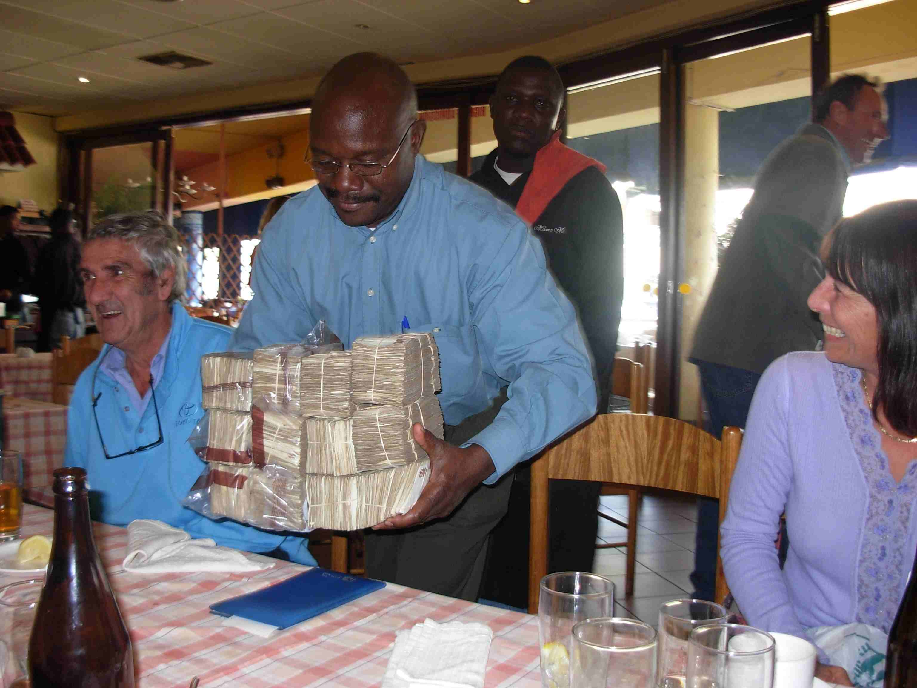
Zimbabwe: buying lunch

Slide 53
Money supply mechanics
How the central bank manages the money supply
Look at balance sheets for
  Treasury
  Central bank
  Private agents (households and firms)
Discuss
  Open market purchase of bonds
  Why do private agents accept the money?
  Zimbabwe revisited

Slide 54
Money supply mechanics
Treasury
Assets |  | Liabilities
 |  | Bonds | 200
Where does treasury debt come from?
How does central bank increase money supply?
Why do households go along?
Central bank
Assets |  | Liabilities
Bonds | 20 | Money | 20
Households and firms
Assets |  | Liabilities
Money | 20
Bonds | 180

Slide 55
Money supply mechanics
What happened in Zimbabwe?

Slide 56
Quantity theory amended
Political
Instability
Fiscal
Deficit
Money
Growth
Inflation

Slide 57
What have we learned?

Slide 58
Takeaways
Inflation comes from money growth
In big inflations, money growth typically comes from fiscal deficits …
… and fiscal deficits reflect political chaos
But: modest inflation is another story – more later

Slide 59
Extra slides

Slide 60
Real and nominal interest rates
Connection:
i = r + π
  i = nominal interest rate (what we usually see quoted)
  r = real interest rate (rate on basket of goods)
  π = expected inflation [why “expected”?]
Comment
  Movements in i reflect both r and π
  Which is more important? [It depends!]

Slide 61
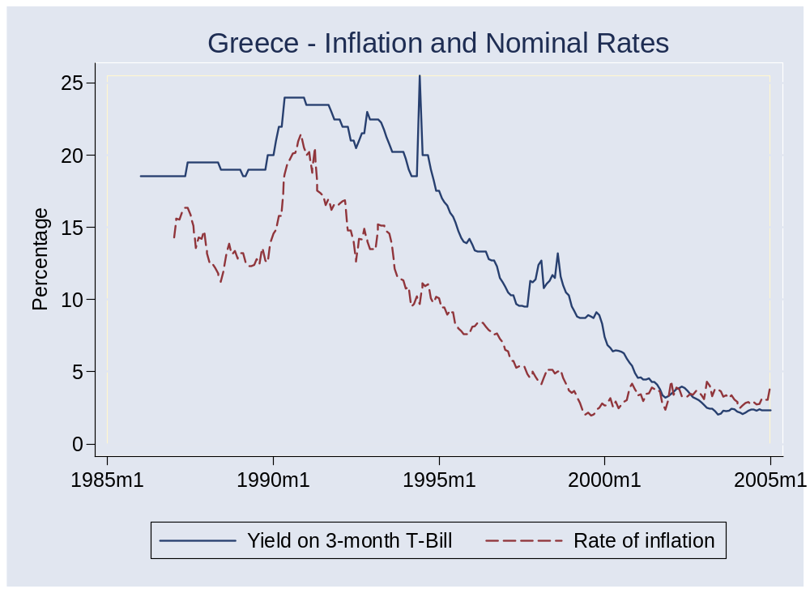
Interest rates and inflation

