Slide 1

The Global Economy
© NYU Stern School of Business
Notes:
Bring to class: Economist
Start Blackboard
Ditto GapMinder
Open Bloomberg calendar
On board: pickup binder, start at 8:35, do not sit on side or back, two names for cold calls
Conventions:
Point up = louder
Welcome to Global Economy
Goal: learn about the world, using economics as our tool
Gapminder: share-pair
US economy: share-pair-square

Slide 2
The Global Economy
© NYU Stern School of Business

Slide 3
The Global Economy
© NYU Stern School of Business

Slide 4
Gapminder
  http://graphs.gapminder.org/world/
Notes:
Growth vs GDP per capita
What do you see?
Cold calls

Slide 5
About participation
Broad-based participation part of class design
  Demands discipline from both of us with 100 students
“Volunteers” intended to keep you involved
  Don’t panic
  Ask for help if you need it

Slide 6
About participation
If you’re stuck, here are some foolproof comments:
  It depends
  Fact of life
  P2C2E
  [Of course, each is better if you explain why]
  Or ask: What the heck are we talking about?

Slide 7
About participation
We’ll use class to work through issues together
  Share your thoughts
  I’ll share mine
  Don’t be insulted if we disagree
  Extra credit if you prove me wrong

Slide 8
Plan of attack
Gapminder ✓
Prospects for the US
Crisis fact and fiction
About the course

Slide 9
Prospects for the US economy
How bad?

Slide 10
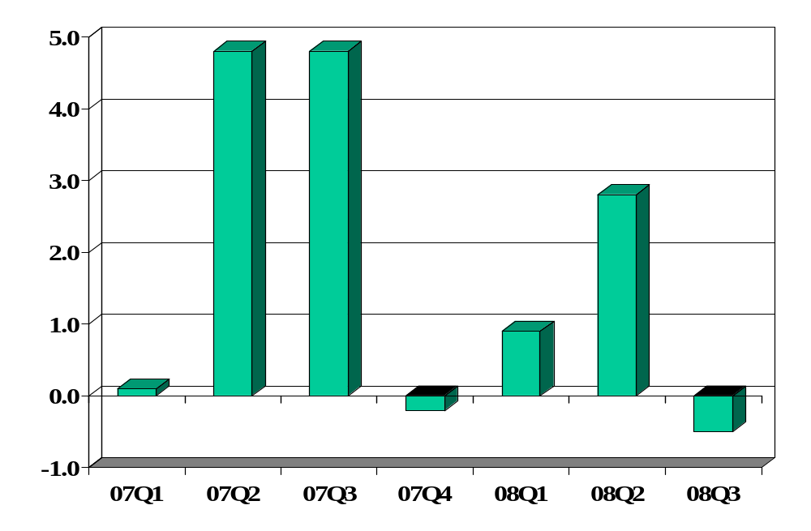
US GDP growth (annual rate, %)
What is this?
Source: US Bureau of Economic Analysis.

Slide 11
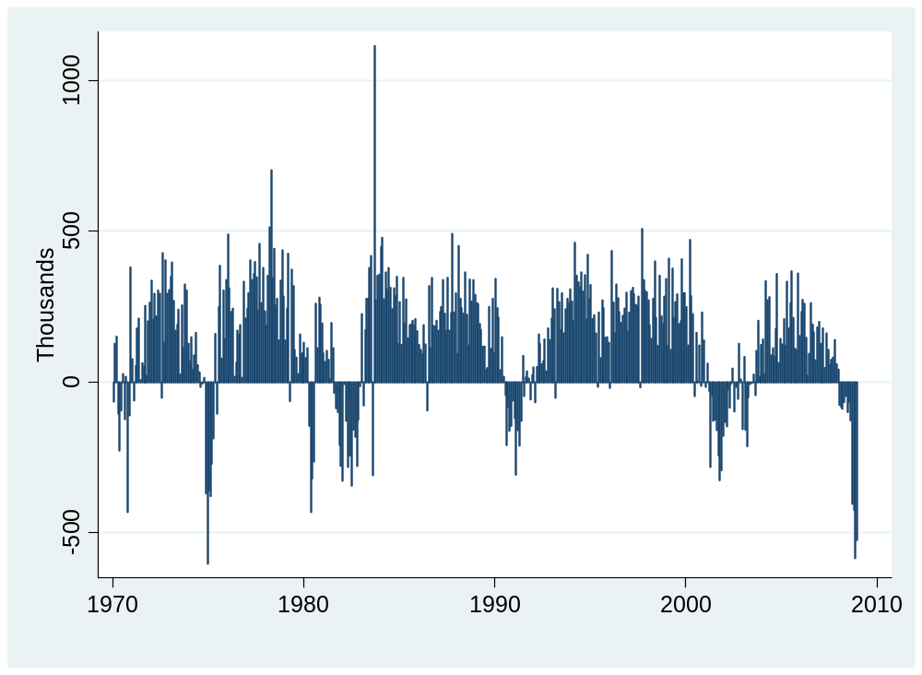
Employment (nonfarm payroll, change)
Source: BLS via FRED.

Slide 12
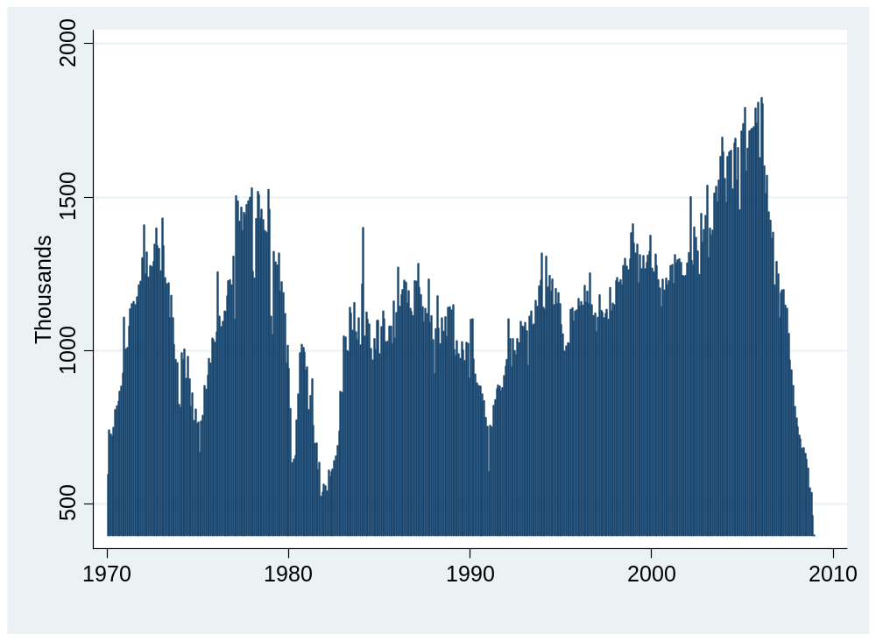
Housing starts
Source: Census via FRED.

Slide 13
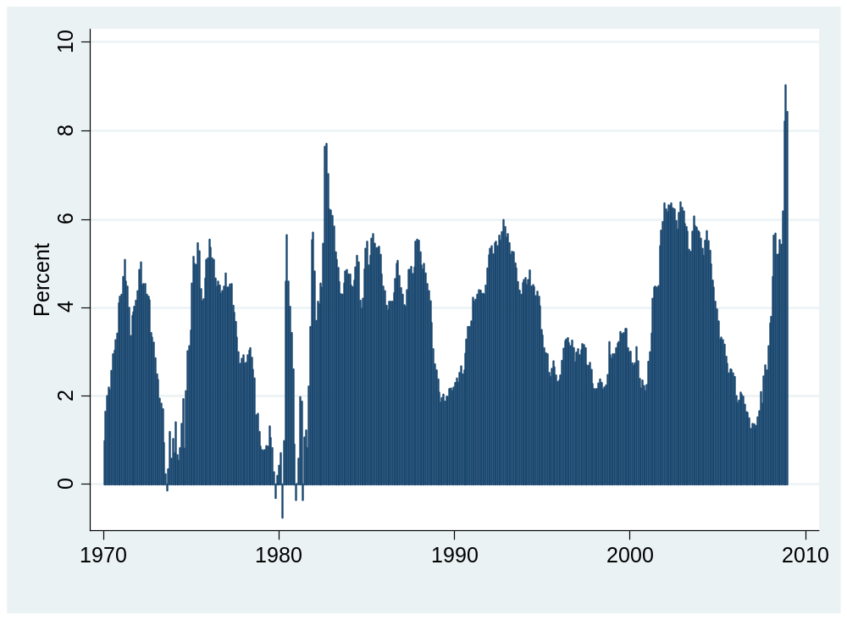
Corporate bond spread (Baa – treas)
Source: Federal Reserve via FRED.

Slide 14
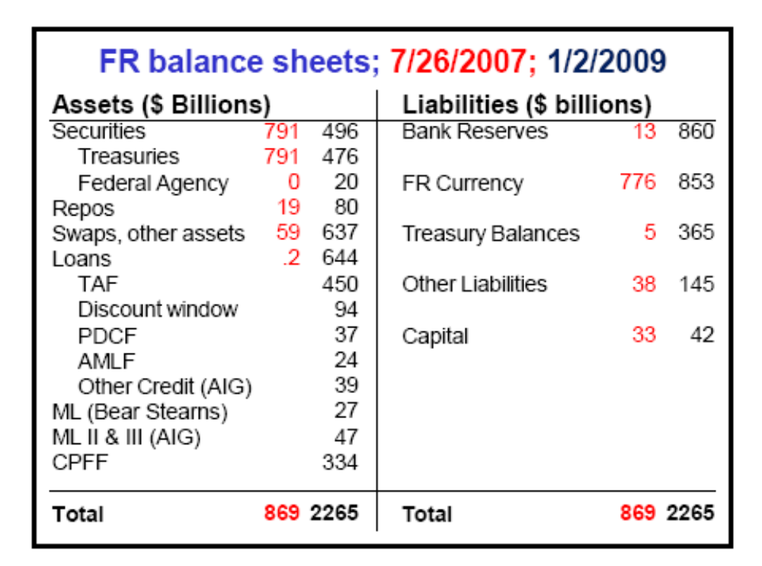
Fed policy
Source: Rudebusch, SF Fed.

Slide 15
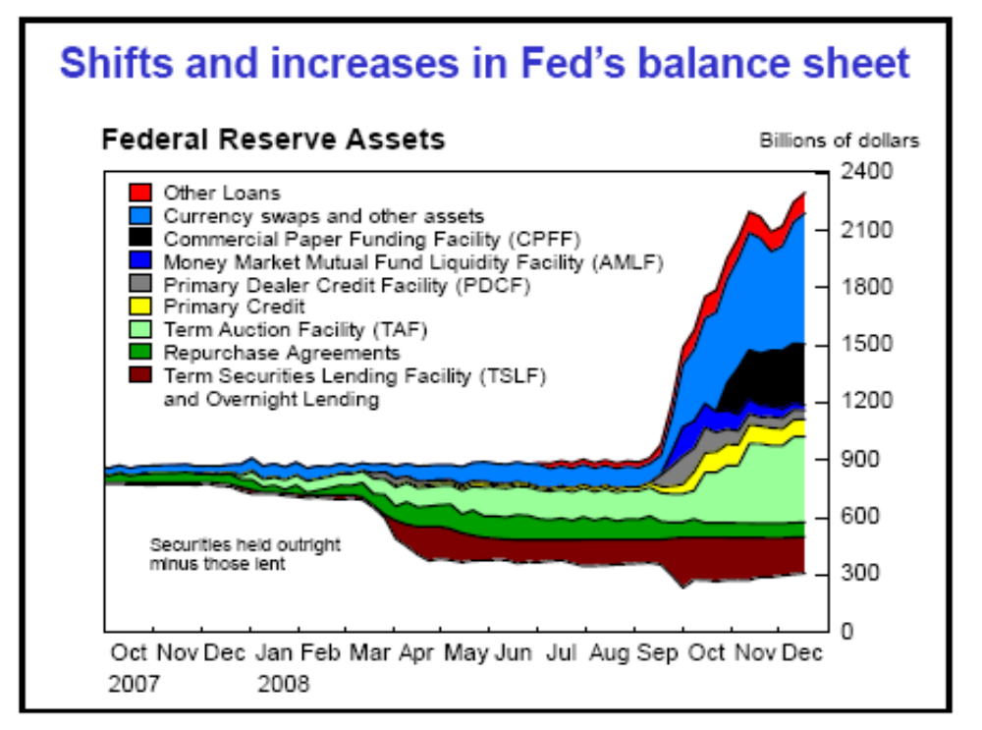
Fed policy
Source: Rudebusch, SF Fed.

Slide 16
US prospects
Robert Mellman, JP Morgan Chase, Jan 16 09:
  Incoming reports remain bleak: 2.7% decline in December retail sales, 2.3% monthly fall in December manufacturing output, and 3.3% slump in November export volumes. With more complete source data in hand, real GDP growth for 4Q08 is adding up to –5.5% (annual rate). We have revised downward our 1Q09 real GDP forecast from –3% to –5%.

Slide 17
US prospects
Lewis Alexander, Citi, Jan 23 09:
  The outlook for the global economy continues to deteriorate. Incoming data have, almost uniformly, surprised on the down side.
  Financial conditions remain central. Credit markets have improved since December. The Fed is committed to unconventional policies. The US appears set to implement aggressive fiscal policies.

Slide 18
US prospects
Richard Berner, MS, Jan 22 09:
  A US recession is likely. Deflation scare and downturn will keep the Fed’s ZIRP/quantitative easing in play through 2009. Significant fiscal stimulus, likely by early spring 2009, and a mechanism to clean up balance sheets should limit the recession downside and help promote a modest recovery in 2010.

Slide 19
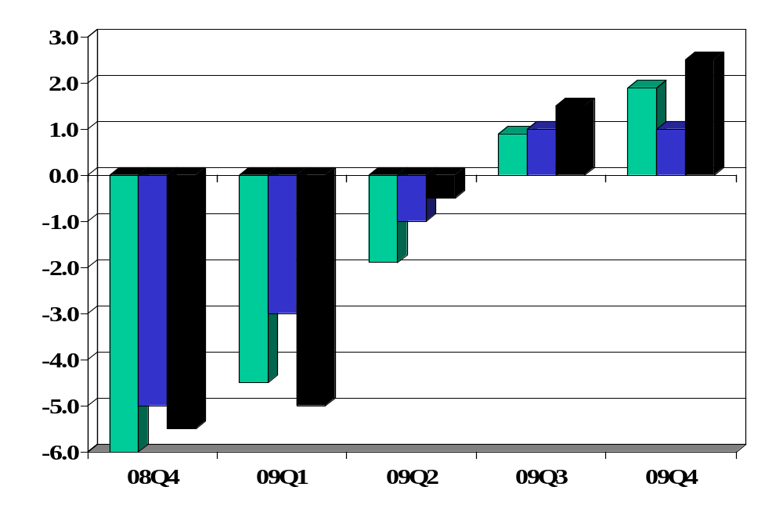
US growth forecasts (C, GS, JPM)
Source: Company reports (Citi, GS, JPM).

Slide 20
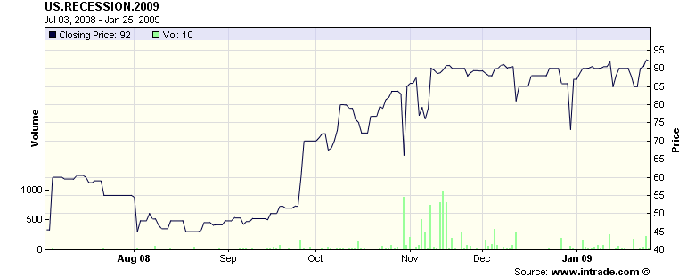
Recession?
Probability of recession in 2009 (2Q neg growth, final)
Source: Intrade.com.

Slide 21
Financial crisis fact and fiction
How the game works
  I make a statement
  You tell us whether it’s fact or fiction – and why
  If you’re stuck, pass or make something up

Slide 22
Financial crisis fact and fiction
No one saw this coming
We need to bail out the banks
Housing is the issue, we need to address it directly
We’re in for a long recession

Slide 23
Financial crisis fact and fiction
No one saw this coming
We need to bail out the banks
Housing is the issue, we need to address it directly
We’re in for a long recession

Slide 24
About the course
Read the syllabus – please!

Slide 25
About the course
Mixture of quantitative and qualitative
  Neither is enough on its own
  Just like business
  All of our quantitative tools are used in business

Slide 26
About the course
My biggest challenge
  Diversity of student backgrounds
My goal
  Keep things as simple as possible – but not simpler!
Our enemy
  P2C2E
Notes:
Questions?

Slide 27
About you
Target audience:
  Know some economics, want to know more, willing to work
Experts: if you’ve taken many economics courses
  You’re welcome to join us, but you’re not the target audience
Non-experts: if you’re completely new to economics
  You’re welcome to join us, but expect to work hard
Notes:
Questions?

Slide 28
About me
Grew up in Pittsburgh
PhD in Economics, Yale, 1981
Research interests:
  International capital markets
  Fixed income and currency derivatives
  Emerging markets
Other interests:
  Paul (17) and Melanie (14)
  Pittsburgh sports teams
  Basketball, biking, books, beer
Notes:
Questions?

Slide 29
About class notes
Theoretical background to class discussion
Executive summaries: more concise than a textbook
Custom designed for this course
Read them – preferably before class
Notes:
Questions?

Slide 30
About class notes
One view
  “The notes explained the concepts clearly and were easy to follow.”
Another
  “The notes were dense and difficult to follow.”
Notes:
Questions?

Slide 31
About the textbook
Optional
Most students prefer not to use one
But if you have little or no background in economics, you might buy
  Mankiw, Macroeconomics [concise, well-written]
Blackboard lists chapters for current edition, but older editions are similar and cheaper (Amazon, eBay)
  Editions 5 and 6 are effectively the same
Order now so you’ll have it
Notes:
Questions?

Slide 32
About slides
Catalyst for discussion: not intended to be read on their own
More than we need: don’t panic if we skip some
Available by mid-afternoon the day before class
Subject to modification without notice

Slide 33
About grades
Participation | 10%
Group Projects (best 5 of 7) | 30%
Midterm | 30%
Final | 30%

Slide 34
About participation
Comments and articles posted on Blackboard
Comments in class
Use your name plate so we know who you are

Slide 35
About participation
Keep it short
  20 seconds or less
Keep it simple
  I will duck complex questions to protect non-experts
If your question is too complex for class, we can meet
  Here between sessions from 12:45 to 1:15
  Over lunch on Wednesdays
  At the Half Pint at 6:15 on Thursdays [Backup: Stoned Crow]
  All by prior arrangement: let me know if you’re interested

Slide 36
About group projects
Essential part of the class experience
I’ll tell you what’s coming the week before
Some are demanding, so plan ahead
Notes:
Questions?

Slide 37
About groups
Preset groups designed to have international diversity
You can change them if you like
  Unlimited marriage and divorce
  Can contain members from both sections
  No more than five
Make sure all names are listed on projects

Slide 38
About the room
Please don’t sit in the section to my right
Or in the back row

Slide 39
About laptops
Please turn them off

Slide 40
About the TFs
Jonathan Hill
  From: England
  Concentrations: finance
  Career plans: quantitative asset management
  Personal interests: soccer, sailing, American football
Rebecca Solow
  From: Iowa City
  Concentrations: finance and strategy, joint Wagner
  Career plans: banking
  Personal interests: theater, sailing
Notes:
Questions?

Slide 41
About help
If you get stuck, come see me
Or email me – I check email frequently
Or see either of the TFs
Notes:
Questions?

Slide 42
About Blackboard
Notes:
Show all pages
Overview
Sessions
Discussion
Resources

Slide 43
About feedback
If you have ideas, comments, questions, whatever:
  Come see me
  Send an email
  Speak to one of the TFs
  Send an anonymous email to me
  … whatever you like

Slide 44
About 9:00 am
Painful for all of us
Suggestion: aim for 8:50, bring coffee and paper, look for an interesting article for us to discuss

Slide 45
Takeaways
Read the syllabus
Come to class prepared
Expect to participate
Have some fun

Slide 46
The Global Economy
Measuring Macroeconomic Performance
© NYU Stern School of Business
Notes:
Open Bloomberg calendar
Set fast pace: lots to do
Notes + this session + GP1
Open spreadsheet for price indexes

Slide 47
Question of the day
We’ll see lots of statements like:
  “Per Capita GDP in 2000 prices is 30% higher in the US than France”
What on earth are we talking about?

Slide 48

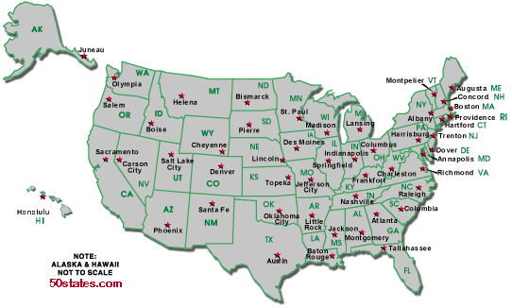
US and France
Per capita GDP: $40k
Per capita GDP: $29k
Avg weekly hours: 35
Avg weekly hours: 29

Slide 49
Plan of attack
Pictures
Measuring country performance:
  GDP
  Prices and quantities
  Flows of goods and assets (“identities”)
Do Americans save too little?
What’s coming up

Slide 50
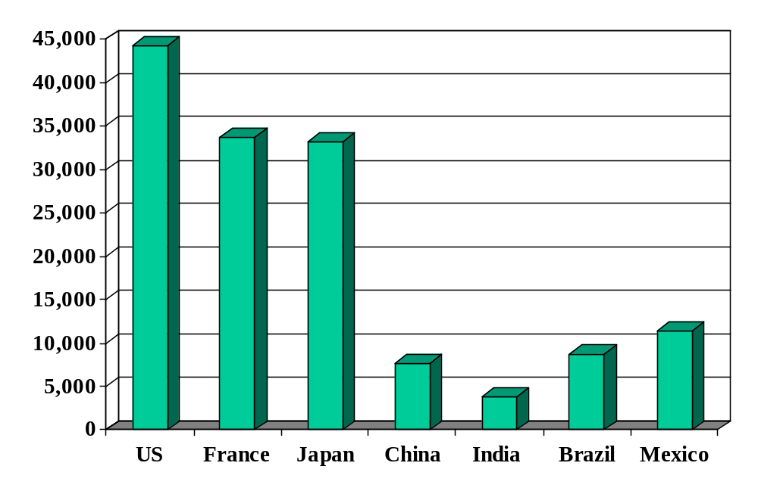
GDP per capita (2006, US dollars, PPP adj)
Source: World Bank, World Development Indicators.
Notes:
What are we talking about?

Slide 51
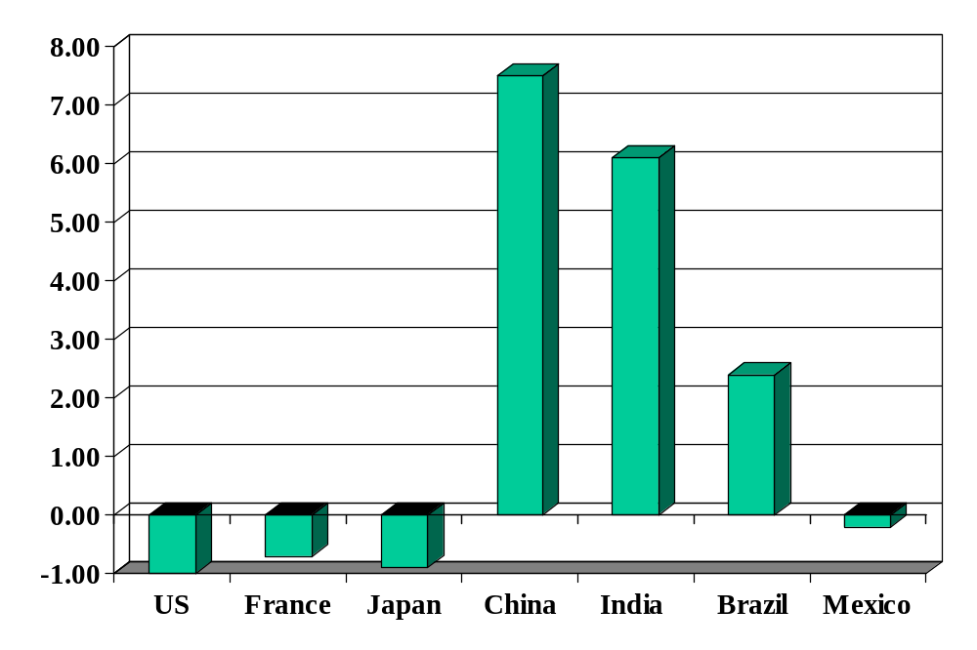
GDP growth (real, forecast for 2009, %)
Source: The Economist.

Slide 52
GDP
GDP = Gross Domestic Product
  As value added [NYU Stern]
  As income [my salary]
  As final sales [your tuition payment]

Slide 53
GDP overview
GDP = Gross Domestic Product
Total value of production in an economy (“output”)
  Sum value-added by all production units
  Equals: sales minus material costs
  Equals: payments to labor and capital (owners)
  Equals (almost): income
  Equals: sales of final good (last stage of value chain)
Why gross?
  All of these numbers include depreciation

Slide 54
GDP as value added
Example:
  Farmer produces wheat, sells it for 100
  Miller buys wheat, produces flour, sells it for 175
  Baker buys flour, makes bread, sells it for 300
What is value added for each producer?
What is GDP?
Who eats the wheat?

Slide 55
GDP as value added
Producer | Value Added | Final Sales
Farmer | 100 | 0
Miller | 75 | 0
Baker | 125 | 300
GDP (total) | 300 | 300

Slide 56
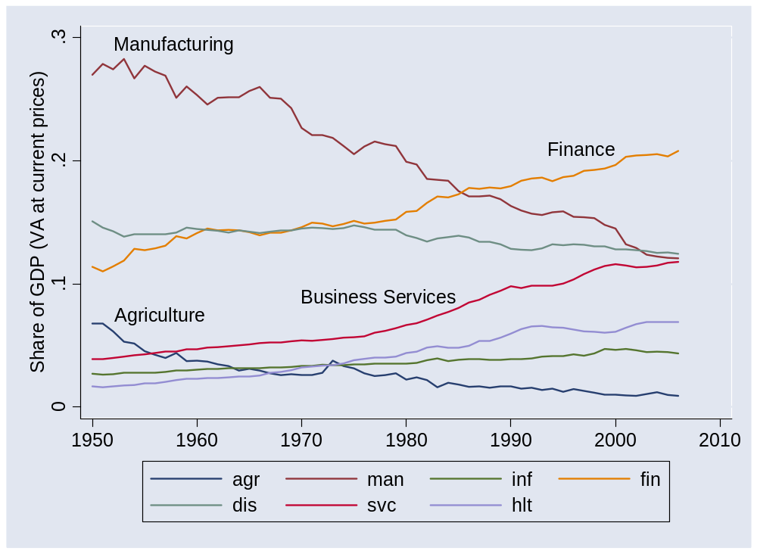
GDP by industry
Source: US NIPA.
Notes:
What does this mean? What does it tell us?

Slide 57
GDP as income
Recall: GDP = payments to labor and capital (“almost income”)
In income but not in GDP
  Capital gains
  Interest on government debt
  Net foreign income
In GDP but not in income
  Depreciation
Bottom line
  GDP ≈ income [“≈” means “almost equals”]
Notes:
Draw venn diagram?

Slide 58
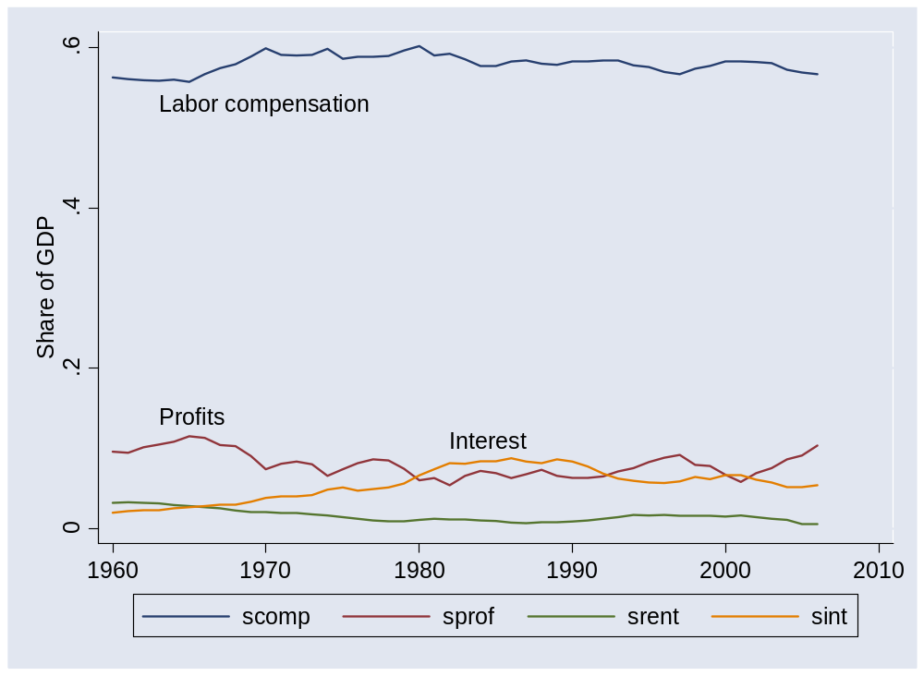
GDP by income component
Source: US NIPA.

Slide 59
GDP as final sales
Allocate GDP among purchasers of final goods:
Y = C + I + G + NX
  Y = GDP (“output”)
  C = sales to households (“consumption”)
  I = sales of capital goods to firms (“investment”)
  G = purchases of goods and services by government
  NX = net exports (exports minus imports)
  We call these: “expenditure components”
  Can be nominal (current prices) or real (base-year prices)

Slide 60
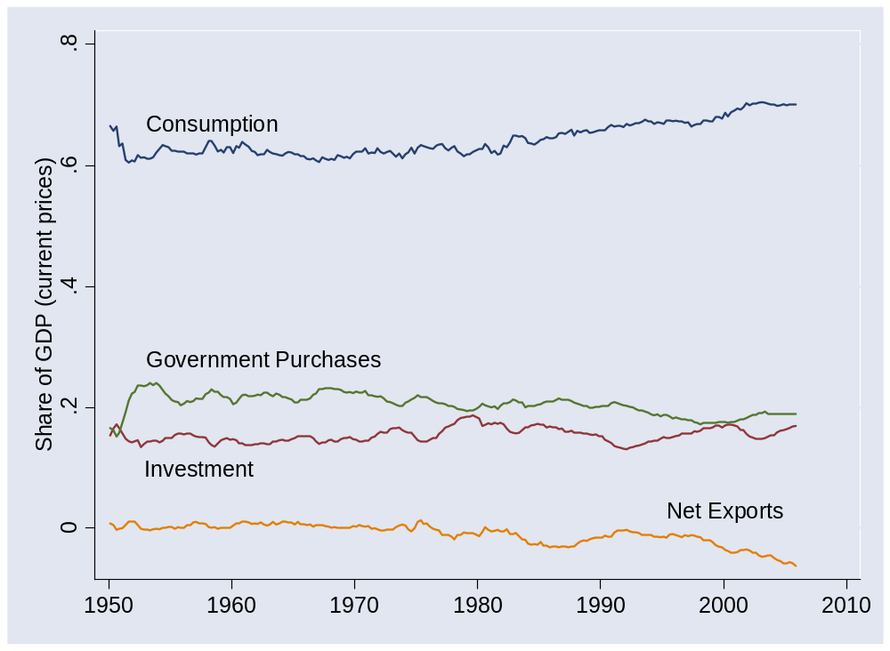
GDP by expenditure component
Source: US NIPA.

Slide 61
GDP: real and nominal
GDP measured at market prices
  At current prices: “nominal”
  At base-year prices: “real”
What is
  GDP at 2000 prices?
  GDP in 2005 US dollars?
  GDP in 2000 international prices?
  GDP in 2000 USD PPP adjusted?
More on this – now

Slide 62
Prices and quantities
Intel (say)
  Sales up 25% year-on-year
  How much is higher prices, how much greater quantities?
US economy: ditto
  GDP up 5% year-on-year
  How much is higher prices, how much more “stuff”?
What to remember
  Inflation is the “average” increase in prices
  “Real” GDP growth is the “average” increase in quantities
  “Averaging” is trickier than it looks
  Several natural approaches produce different answers
  So we muddle along and hope for the best

Slide 63
Prices and quantities
Approach 1 (“fixed weight/price”) (“Paasche”)
  Compute GDP at current prices (“nominal GDP”)
  Compute GDP at constant prices (eg, 1990) (“real GDP”)
  Compute price deflator = ratio of first to second
  Inflation is rate of change of deflator
Approach 2 (“fixed basket/quantity”) (“Laspeyres”)
  Compute GDP at current prices (“nominal GDP”)
  Compute price index as cost of a fixed “basket” of products
  Compute real quantity as ratio of nominal quantity to index
  Inflation is rate of change of index

Slide 64
Prices and quantities
Example:
 | Fish |  | Chips
Date | Price | Quantity | Price | Quantity
2004 | 0.50 | 10 | 0.25 | 10
2005 | 0.75 | 12 | 0.50 | 8
What’s “real” GDP growth? What’s the inflation rate?

Slide 65
Prices and quantities
Fixed weight method (“GDP deflator”):
Date | Nominal GDP | Real GDP | Price Deflator
2004 | 7.50 | 7.50 | 1.000
2005 | 13.00 | 8.00 | 1.625
Growth rate | 73.3% | 6.7% | 62.5%
Base year: 2004.
Numbers in italics can be computed from the others.
Notes:
Where does this [pick one] number come from?

Slide 66
Prices and quantities
Fixed weight method (“GDP deflator”):
Date | Nominal GDP | Real GDP | Price Deflator
2004 | 7.50 | 12.50 | 0.600
2005 | 13.00 | 13.00 | 1.000
Growth rate | 73.3% | 4.0% | 66.7%
Base year: 2005.

Slide 67
Prices and quantities
Fixed basket method (“CPI”):
Date | Price Index (2004 Basket) | Price Index (2005 Basket)
2004 | 7.50 | 8.00
2005 | 12.50 | 13.00
Growth rate | 66.7% | 62.5%

Slide 68
Prices and quantities
Other issues
  Substitution bias. As some products get cheaper relative to others, people naturally buy more of them, less of the others. This substitution into cheaper products is ignored in fixed-weight indexes like the CPI.
  Quality adjustment. Adjust price increases for changes in product quality.
Impact
  Both adjustments tend to reduce our estimate of inflation and increase our estimate of real growth.

Slide 69
Flow identities
Connect flows of goods to financial flows
  Households save: where does it go?
  Firms invest (“capex”): how is it financed?
  Governments run deficits: how are they financed?
Notes:
Expenditures: who we sell to
Financing: how are expenditures financed?

Slide 70
Flows of goods
Reminder: allocate GDP among purchasers of final goods:
Y = C + I + G + NX
  Y = GDP (“output”)
  C = sales to households (“consumption”)
  I = sales of capital goods to firms (“investment”)
  G = purchases of goods and services by government
  NX = net exports (exports minus imports)
  We call these: “expenditure components”
  Can be nominal (current prices) or real (base-year prices)

Slide 71
Flows of assets (streamlined version)
Allocate flows of assets:
Y – C – G = I + NX
S = I + NX
  I = (gross) investment (new plant and equipment)
  S = (gross) national saving (purchases of assets)
  NX = net purchases of foreign assets
Why are these “flows of assets”?

Slide 72
Flows of assets (streamlined version)
Households+ Govt
S
Financial Markets
I
Firms
NX
Rest-of-World

Slide 73
Flows of assets
Allocate flows of assets:
(Y–C–T) + (T– G) = I + NX
S_{p} + S_{g} = I + NX
  T = taxes net of transfers paid by households to govt
Beware: many measures of saving
  Sometimes we subtract depreciation from both S and I (“net”)
  Useful for confusing amateurs
Later in the course
  We’ll include income and transfers with foreign countries and replace NX with the “current account”

Slide 74
Flows of assets
Households
S_{p}
Financial Markets
I
Firms
Government
S_{g}
NX
Rest-of-World

Slide 75
National accounts summary
Production
GDP
Income
Labor, Capital
Expenditures
C,I,G,NX
Think about setting up income statements for each sector: households + govt, firms, ROW
Financial Flows
S = I + NX

Slide 76
Do Americans save too little?
Notes:
Write down the list

Slide 77
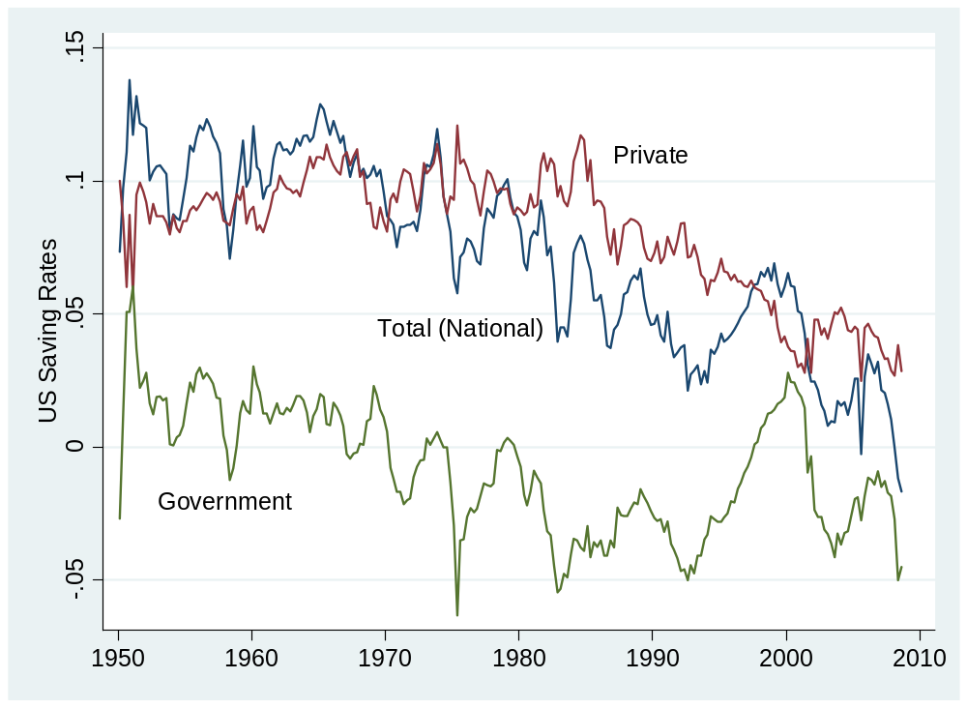
US saving rates
Source: US NIPA.

Slide 78
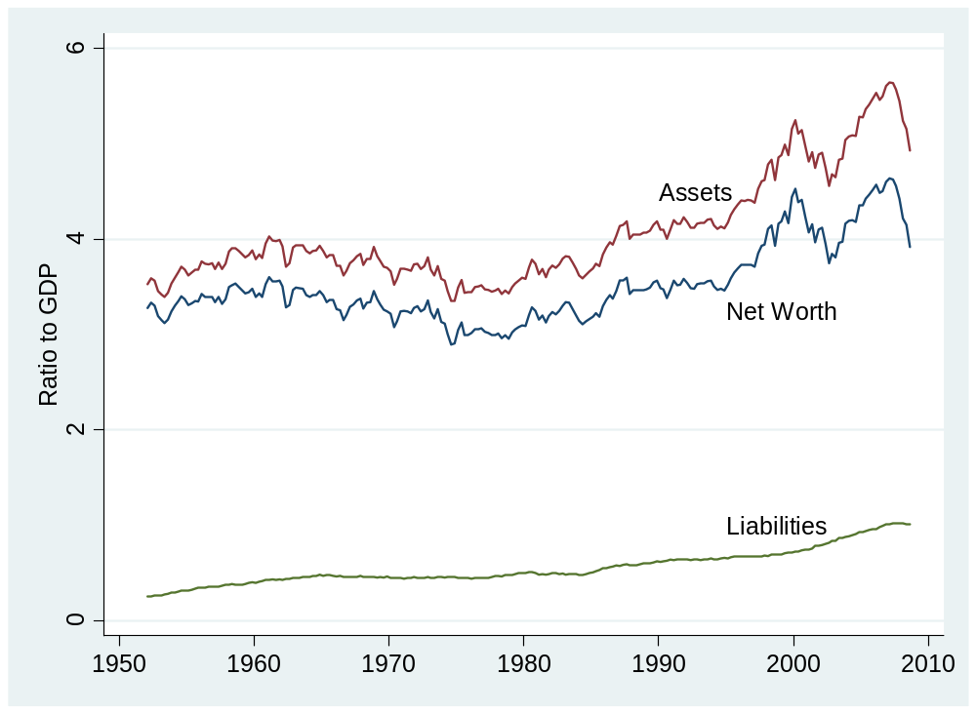
US net worth
Source: US, Federal Reserve, Flow of Funds Accounts.

Slide 79
Saving and net worth
How can net worth be high if saving is low?
Notes:
Write down the list

Slide 80
What’s coming up

Slide 81
Tomorrow
FOMC meeting tomorrow
  Statement released at 2:15 pm tomorrow
  What do we expect?
  http://www.federalreserve.gov/FOMC/
GDP release Friday
  Fourth quarter “advance” estimate
  Released at 8:30 am
  What do we expect?
  Impact on markets?
  http://bea.gov/bea/newsrel/gdpnewsrelease.htm

Slide 82
Group Project #1
Due before next class
  Submit by 9am via Blackboard
Based on this class + notes
Stop by if you have questions
Don’t panic
Get started!

Slide 83
International students
Write 100 words [maximum] about your country
  What has it done to encourage economic growth?
  What else do you think it should do?
  Post on Blackboard by Monday noon
  Thank you!

Slide 84
Chinese students
Let’s have lunch next Wed (Feb 4)
  Check in to arrange details
Indian students the following week?
Others any time after that

Slide 85
Takeaways
Economic data are like sausages
GDP ≈ output, income, economic performance
Separating prices and quantities is tricky: we do our best
Flows of goods and assets
  Goods: Y = C + I + G + NX
  Assets: S = I + NX
Get to work: Group Project #1 due next week

Slide 86

Steelers fans are everywhere
Source: http://anon.nasa-global.edgesuite.net/anon.nasa-global/ccvideos/steelers.asx

