Slide 1

The Global Economy
Labor markets
© NYU Stern School of Business
Notes:
Stories
Trading stocks in London

Slide 2
Regulation
Is government regulation good or bad for economic performance?
Give examples – from any country you like.
Notes:
Rule of thumb: capital good, labor bad
Share/pair/square

Slide 3
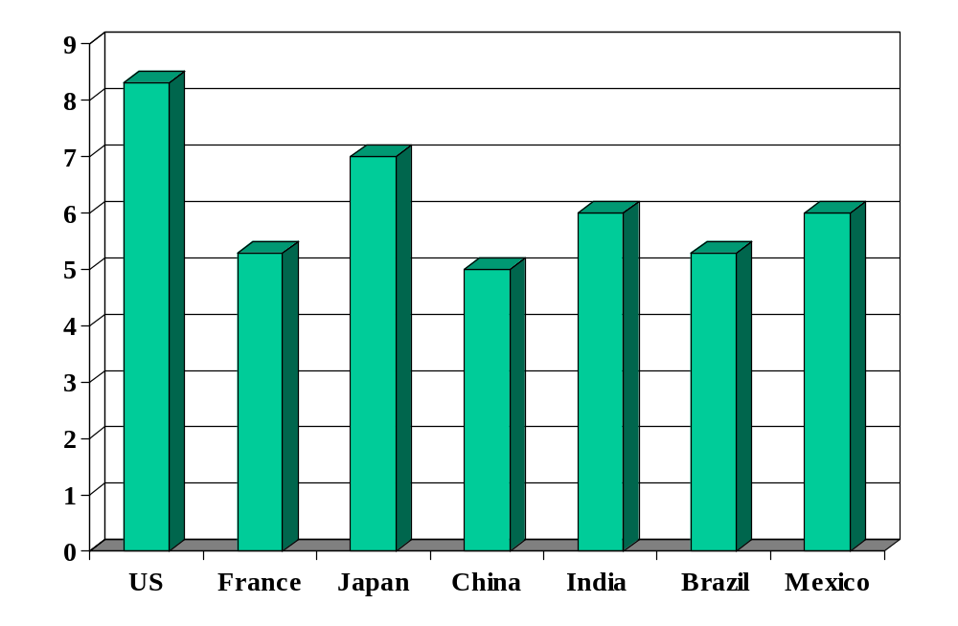
Investor protection (index)
Source: World Bank, Ding Business.

Slide 4
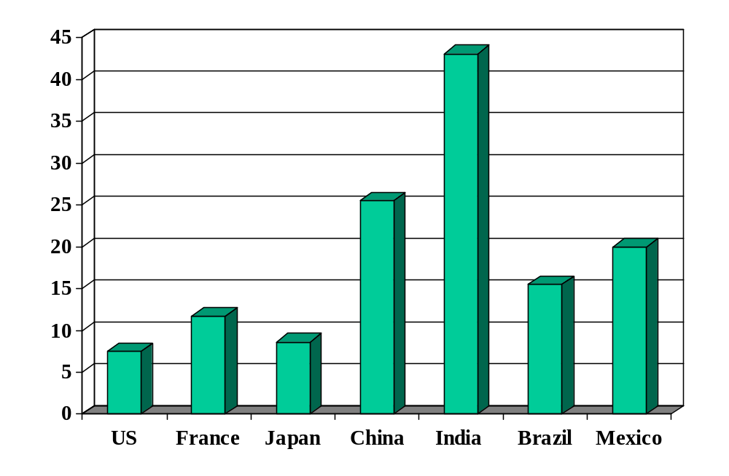
Cost of enforcing contracts (% of debt)
Source: World Bank, Doing Business.

Slide 5
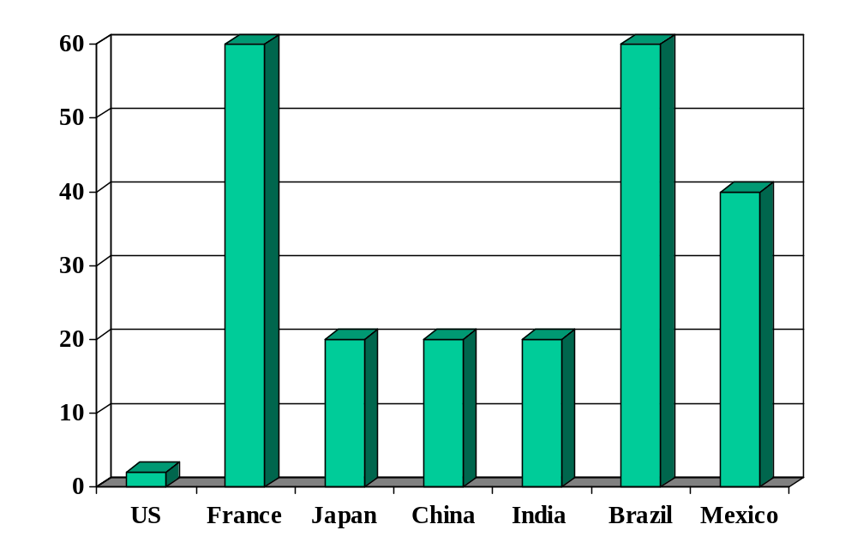
Rigidity of hours (index)
Source: World Bank, Ding Business.

Slide 6
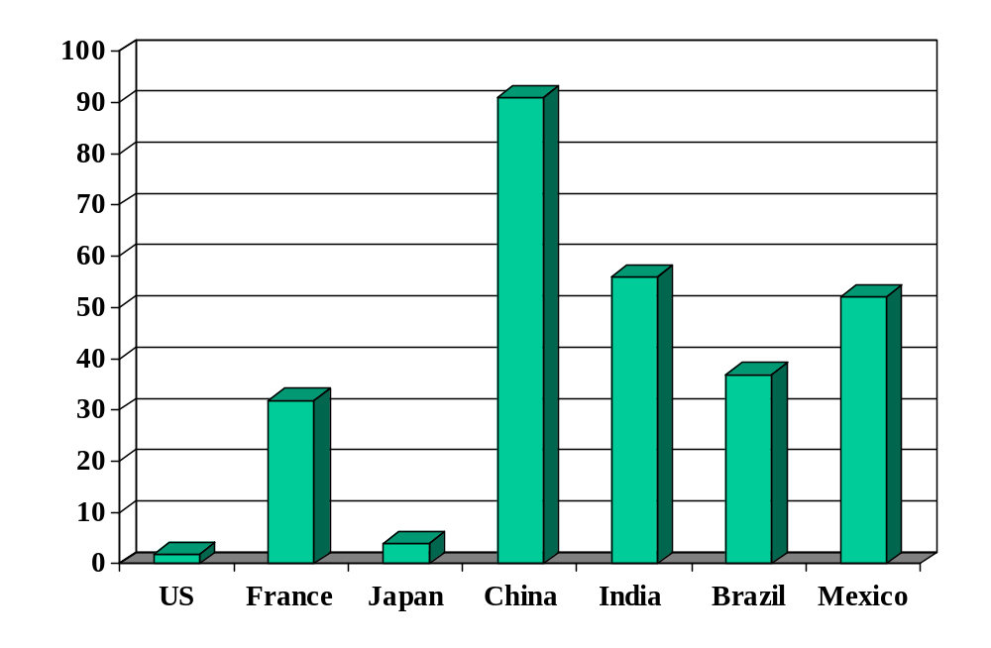
Firing costs (weeks of wages)
Source: World Bank, Ding Business.

Slide 7
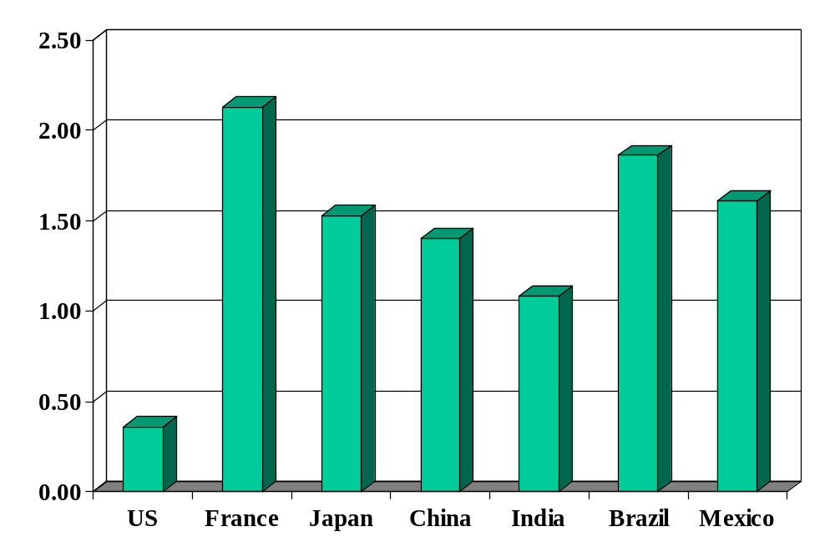
Union rights (index)
Source: Botero, Djankov, La Porta, Lopez-de-Silanes, Shleifer, Regulation of Labor.

Slide 8
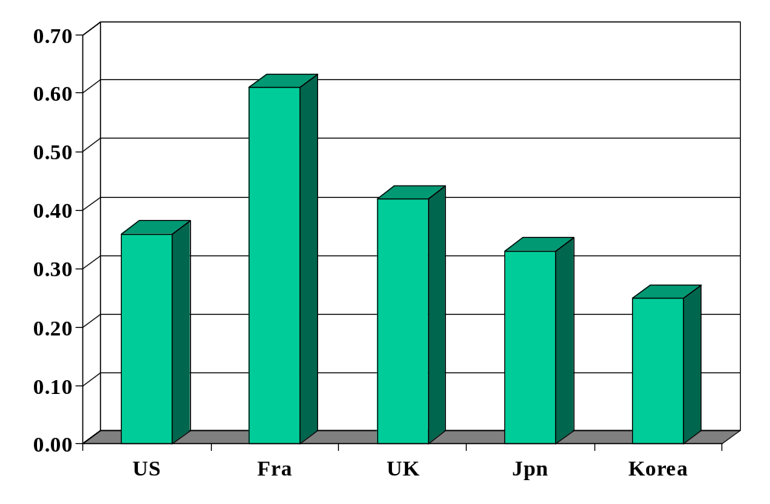
Minimum wage (ratio to median wage)
Source: OECD, employment database.

Slide 9
Plan of attack
Regulation ✓
Where we’ve been, where we’re headed
What’s going on in France?
France and US
Labor market institutions (several parts)
Denmark

Slide 10
Where we’ve been
Good institutions
  Rule of law
  Property rights
  Open competitive markets

Slide 11
Where we’re headed
GDP
Capital & Labor
Productivity
Political Process
“Institutions”

Slide 12
What’s going on in France?
Christopher Caldwell, Financial Times, Feb 05:
  In early 2000, when the French unemployment rate was 9.6%, Martine Aubry, the Socialist labour minister, shepherded into law a bill that capped the work-week of most employees at 35 hours. She called it “a necessity for job creation.” Today, the unemployment rate stands at 9.9% … and French labour participation is rock-bottom among developed countries.

Slide 13
What’s going on in France?
The Economist, Feb 1 07:
  Smokers are fleeing the country's new anti-tobacco law. The country's strict working-time rules, though, add a particular French twist: should smoking breaks be counted as part of the 35-hour week?

Slide 14
What’s going on in France?
Financial Times, Feb 12 07:
  Presidential candidate Segolene Royal laid out her economic vision: increase the minimum wage, scrap laws that make it easier for small companies to hire and fire employees.

Slide 15
What’s going on in France?
The Economist, Feb 1 07:
  France’s centre-right presidential candidate Nicolas Sarkozy took his campaign to London, calling it “one of the biggest French cities.” London is thought to have at least 300,000 French citizens – and voters – some of whom left “in desperation,” said Sarkozy. Journalists noted that France’s unemployment rate is 8.6%, compared with 5.5% in Britain, and has not dipped below 8% for nearly 25 years.

Slide 16
What’s going on in France?
How would you guess France and US compare?
  Employment (fraction of working-age population)
  Unemployment (fraction of labor force)
  Hours worked per employed person

Slide 17
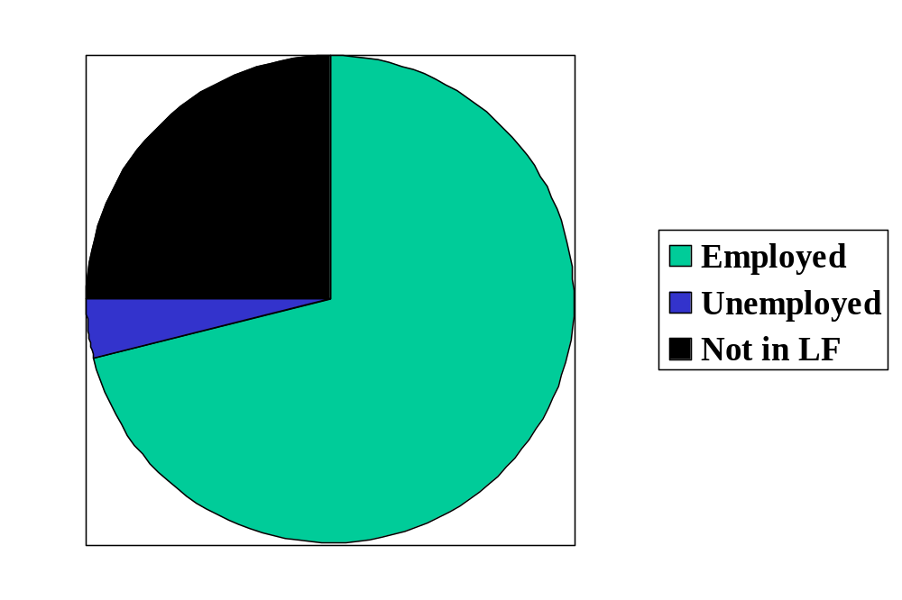
Labor market status in the US
Source: OECD, Employment Outlook, 2006. Numbers are percentages of the population 15-64.
Notes:
Draw this on board, show what universe and pieces are

Slide 18
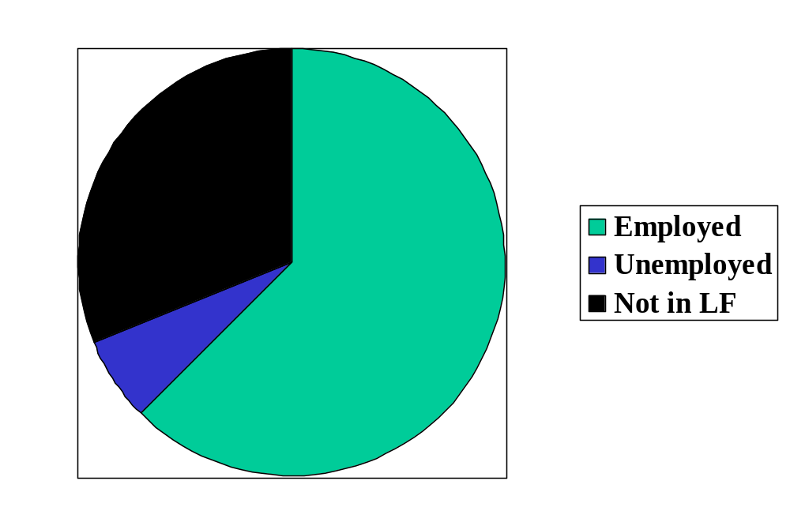
Labor market status in France
Source: OECD, Employment Outlook, 2006. Numbers are percentages of the population 15-64.

Slide 19
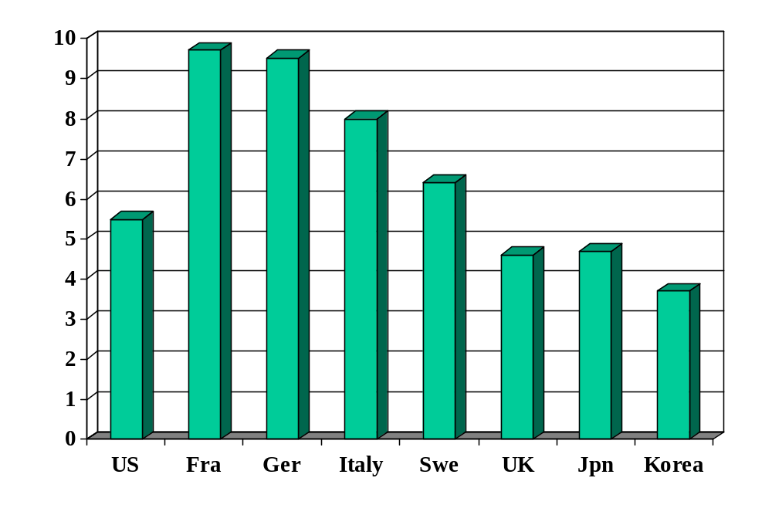
Unemployment rate (% of labor force)
Source: OECD, Employment Outlook; standardized rates intended to be comparable across countries.

Slide 20
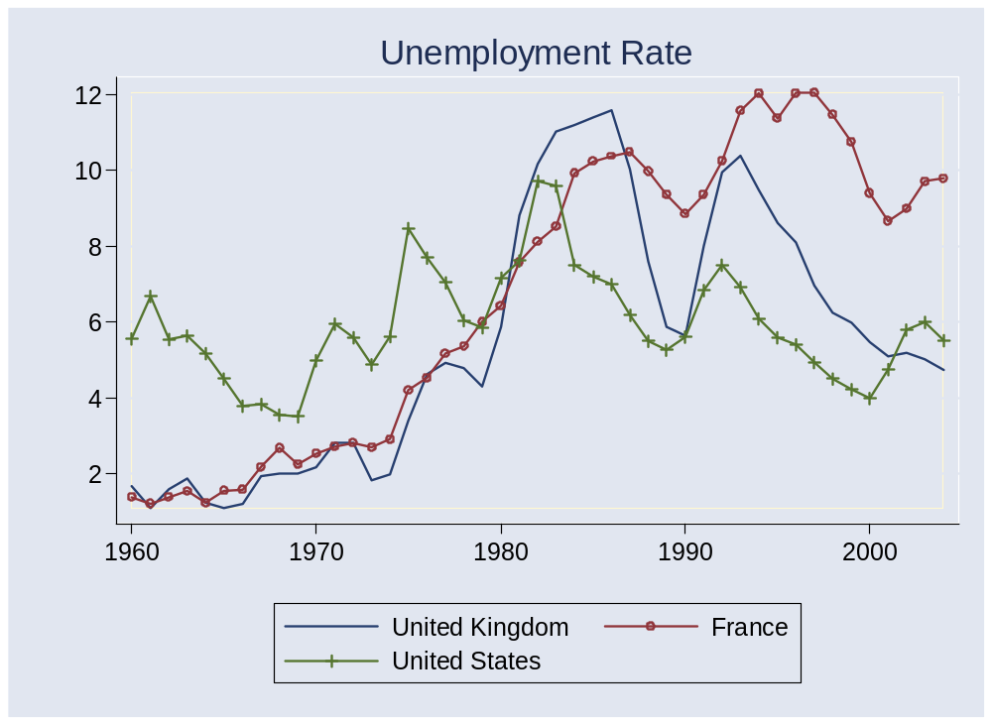
Unemployment rates
Source: OECD, Main Economic Indicators.

Slide 21
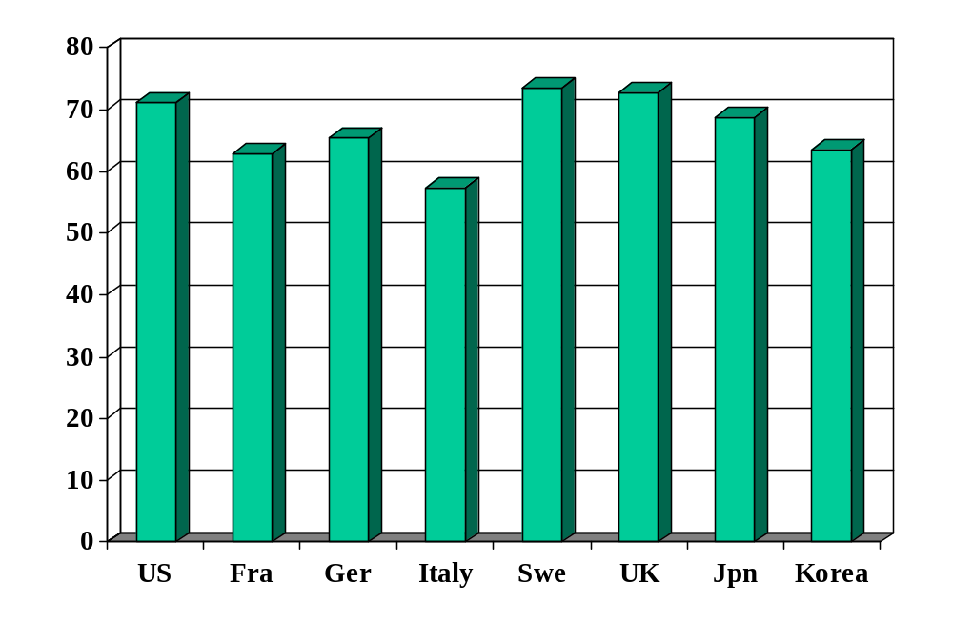
Employment rate (% of 15-64)
Source: OECD, Employment Outlook.

Slide 22
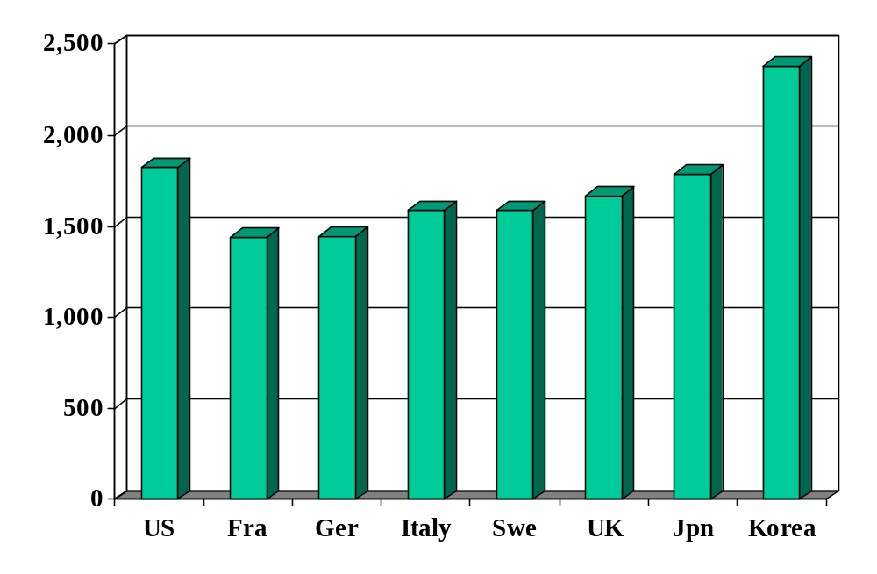
Hours worked (per person per year)
Source: OECD, Employment Outlook.

Slide 23
France and US
 | Y/POP | L/POP | h
US | 34,875 | 0.514 | 1806
France | 25,664 | 0.451 | 1532
Ratio | 1.36 | 1.14 | 1.18
Log of ratio (%) | 30.7 | 13.1 | 16.5
Source: Penn World Tables, version 6.2, and OECD, Employment Outlook.

Slide 24
France and US
 | Y/POP | Y/L | Y/hL
US | 34,875 | 67,865 | 37.58
France | 25,664 | 56,909 | 37.12
Ratio | 1.36 | 1.19 | 1.012
Log of ratio (%) | 30.7 | 17.6 | 1.1
Source: Penn World Tables, version 6.2, and OECD, Employment Outlook.

Slide 25
Labor market institutions
Employment “protection” laws
Industrial relations / trade unions
Minimum wages

Slide 26
Employment protection laws (EPL)
What are they?
  Laws that govern employment contracts
Examples
  Duration of contract
  Overtime compensation
  Layoffs
  Dismissals

Slide 27
Portugal v New Zealand
Fixed-term contracts
PRT Fixed term contracts allowed only in special situations (such as seasonal activity)
NZL Fixed term contracts are unrestricted, with no maximum duration period

Slide 28
Portugal v New Zealand
Overtime
PRT Mandatory premium for overtime work ranges from 50% to 75%, additional restrictions on night work, and there are 24 days of paid leave per year
NZL No required premium for overtime work, no restrictions on night work, and the minimum paid leave is 15 days per year

Slide 29
Portugal v New Zealand
Dismissal
PRT Has a list of fair grounds for termination and stringent procedural limitations on dismissals, such as mandatory notification of the government and priority rules for re-employment of redundant workers.
NZL Allows “contracts at will,” which can be terminated with notice without cause
Source: Botero, Djankov, La Porta, Lopez-de-Silanes, Shleifer, 2003

Slide 30
Industrial relations laws
What are they?
  Laws that govern collective bargaining, enforcement of collective agreements, and the organization of trade unions
Examples:
  Employers’ duty to bargain with unions
  Extension of collective contracts to third parties
  Right to strike
  Right of unions to appoint company directors

Slide 31
Portugal v New Zealand
Collective bargaining
PRT Employers have a legal duty to bargain with unions, collective agreements are extended to third parties by law, workers councils are mandatory, and employer lockouts are prohibited.
NZL Employers have no legal obligation to bargain with unions, collective agreements are not legally extended, labor participation in management is not required by law, and employer lockouts are allowed.
Source: Botero, Djankov, La Porta, Lopez-de-Silanes, Shleifer, 2003

Slide 32
Minimum wage
Good or bad? For whom?

Slide 33
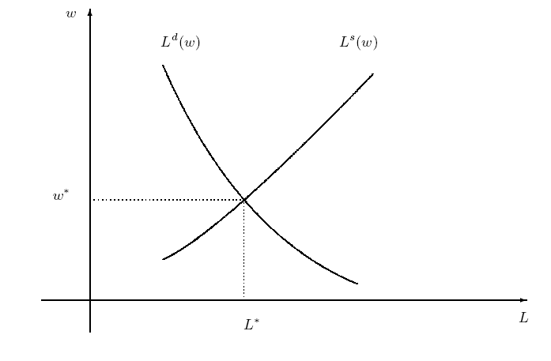
Labor market w/out min wage

Slide 34
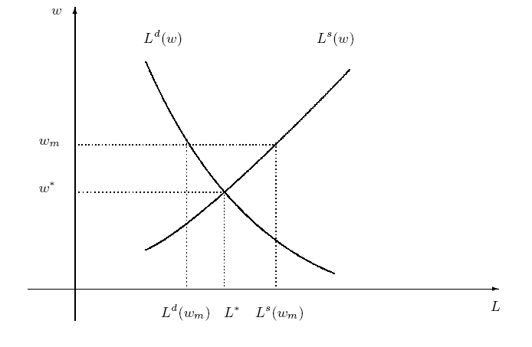
Labor market with min wage
Are we better off?
Who’s “we”?
Notes:
Is this a big deal in the US? Elsewhere?

Slide 35
France revisited
Why are employment and hours lower than in US?
Would you build a plant there? Locate a bank?

Slide 36
Denmark
Flexible labor market
Generous unemployment insurance and training
Result:
  Labor market flexible: indicators look like US
  Cost high: 2.7% of GDP [v 0.2% in US]

Slide 37
Takeaways
Fact: Countries differ widely in labor market institutions (laws and regulations)
Fact: Labor market indicators/outcomes also differ
  Employment rate, unemployment rate, hours worked
These differences are
  Probably related
  A fact of life if you’re running a business

Slide 38
After the break
Be prepared to speak about Group Project #3

Slide 39
The Global Economy
Volatility
© NYU Stern School of Business
Notes:
Intro: call me when we reach “equil”
World is volatile place
Gapminder: shares

Slide 40
Group Project #3
Problem #1
  How do Japan and Korea differ?
  Which looks more promising?
Problem #2
  How do Argentina and Chile differ?
  Which looks more promising?

Slide 41
Plan of attack
Group Project #3 ✓
Pictures and quotes
Labor market volatility (“transitions”/“flows”)
Volatility and labor market flexibility
What have we learned?
What’s coming up

Slide 42
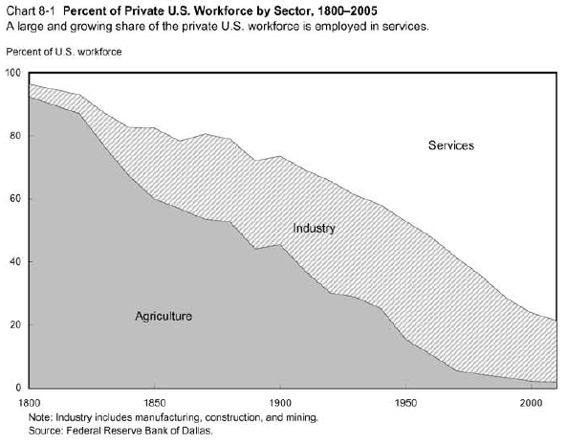
US output
Source: Dallas Fed.

Slide 43
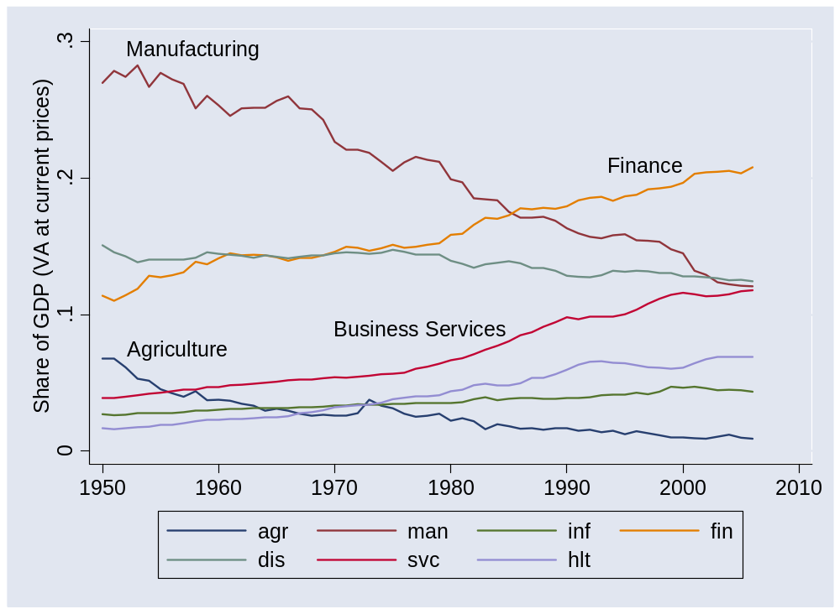
US output
Source: BEA.

Slide 44
US output
Millions of agricultural jobs lost
Millions of manufacturing jobs lost
Where did they go?

Slide 45
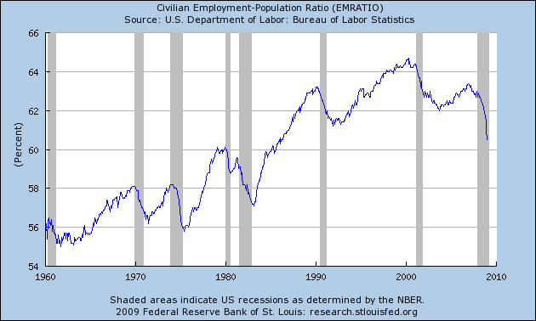
US employment
Source: FRED.

Slide 46
Country output
Gapminder

Slide 47
Marx and Engels
Communist Manifesto (1848):
  Everlasting uncertainty and agitation distinguish the bourgeois epoch from all earlier ones. All fixed, fast frozen relations, with their train of ancient and venerable prejudices and opinions, are swept away, all new-formed ones become antiquated before they can ossify. All that is solid melts into air, all that is holy is profaned, and man is at last compelled to face with sober senses his real condition of life and his relations with his kind.
  All old-established national industries have been destroyed or are daily being destroyed. They are dislodged by new industries, whose introduction becomes a life and death question for all civilized nations.
Notes:
http://www.marxist.net/marx/index.html

Slide 48
Joseph Schumpeter
Capitalism, Socialism and Democracy (1942):
  The fundamental impulse that sets and keeps the capitalist engine in motion comes from the new consumers, goods, the new methods of production or transportation, the new markets, the new forms of industrial organization that capitalist enterprise creates. This process of Creative Destruction is the essential fact about capitalism.
  In capitalist reality, competition … strikes not at the margins of the profits and the outputs of the existing firms but at their foundations and their very lives.

Slide 49
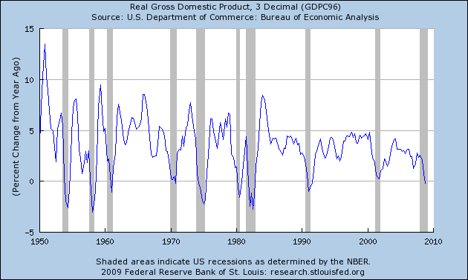
Macro volatility
Source: FRED.

Slide 50
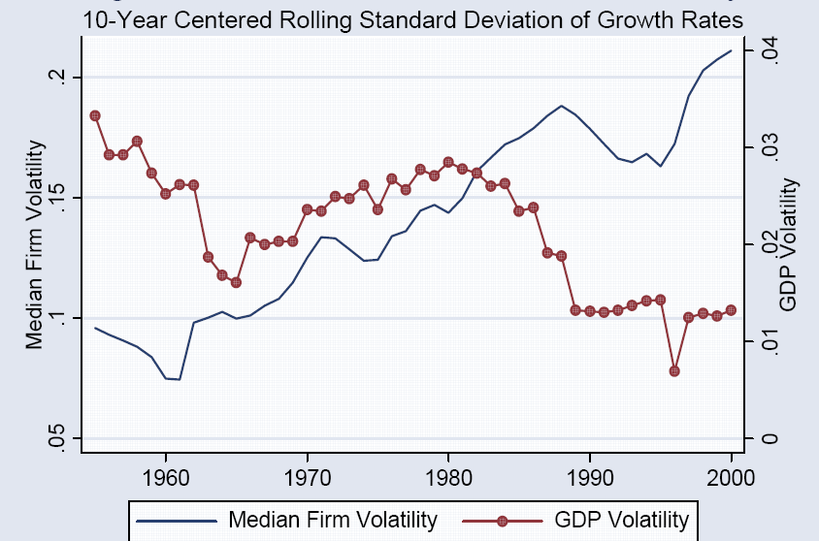
Macro and micro volatility
Source: Comin and Philippon, NBER Macro Annual, 2006.

Slide 51
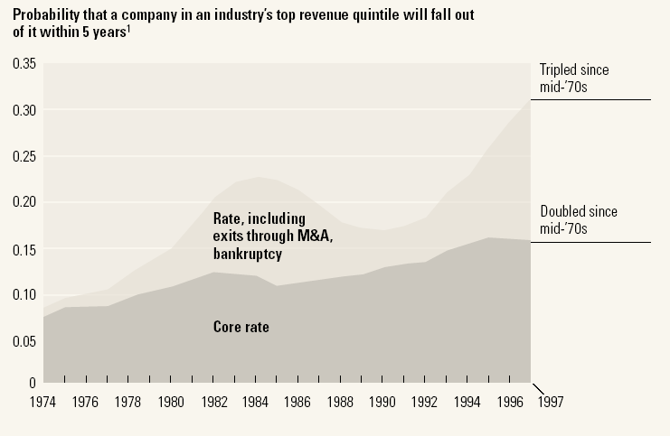
Firm volatility
Source: McKinsey Quarterly, “Extreme competition,” 2005.

Slide 52
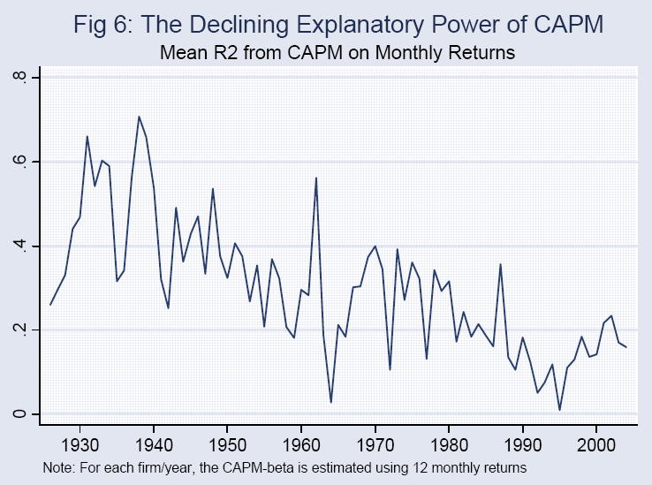
Stock volatility
Source: Comin and Philippon; see also Morck, Yeung, Yu, JFE, 2000.

Slide 53
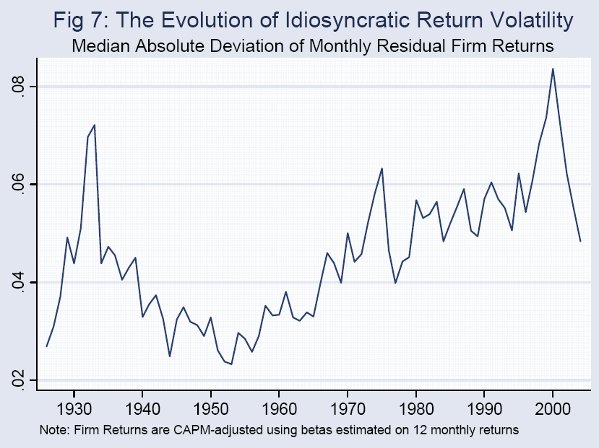
Stock volatility
Source: Comin and Philippon; see also Morck, Yeung, Yu, JFE, 2000.

Slide 54
Why?
Why more micro volatility? Good or bad?

Slide 55
Labor market volatility
We measure people changing jobs in a variety of ways

Slide 56
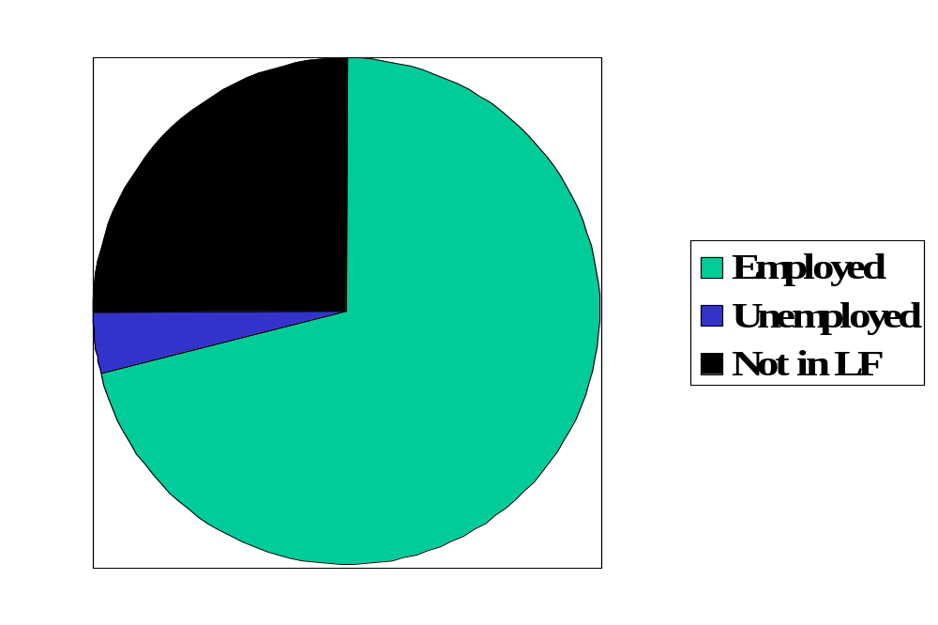
Reminder: labor market status (US)
Source: OECD, Employment Outlook, 2006. Numbers are percentages of the population 15-64.
Notes:
Draw this on board, show what universe and pieces are

Slide 57
Labor market “flows” (“transitions”)
Transitions
  How many people change “status” from month to month?
Aggregate measures of turnover
  Accessions: number of workers taking new jobs, whether their previous status was employed, unemployed, or not in labor force
  Separations: number of workers leaving current jobs, whether they become employed, unemployed, or leave labor force
Bottom line: enormous turnover

Slide 58
Labor market flows (avg, 1993-2005)
Monthly!
Percentages apply to “source” of flow
2.6% “job-to-job”
Employment
122.0m
1.3%
4.8%
28.3%
2.7%
2.4%
Unemployment
6.2m
Out of labor force
59.3m
23.3%
Source: US data, monthly, reported in Davis, Faberman, and Haltiwanger, “Flow approach,” 2005.

Slide 59
Labor market flows in US and EU
 |  | Workers and Jobs
Country | EPL | Accessions | Separations | Reallocation
Denmark | 1.8 | 29.0 | 29.0 | 58.0
France | 2.8 | 28.9 | 30.7 | 59.6
Germany | 2.5 | 31.6 | 30.4 | 62.0
Italy | 2.5 | 34.5 | 33.6 | 68.1
Sweden | 2.6 | 16.8 | 17.8 | 34.6
UK | 1.2 | 37.2 | 37.6 | 74.8
USA | 0.7 | 45.2 | 46.0 | 91.2
Source: OECD, Employment Report, 1994; numbers are annual percentages of labor force.
Notes:
What do you see?

Slide 60
Labor market flows
New York Times, Oct 9 05:
  The French government is also trying to make it easier for small companies to lay off workers. But that proposal provoked thousands of strikers to take to the streets... Mrs. Merkel floated a similar idea in Germany. … Some European experts say that French and German leaders are at least looking at the heart of the unemployment problem: that companies are not likely to hire more freely unless they can fire more freely. As economist Katinka Barysch put it, “the best place to lose your job is in a country where it's easiest to find a new job.”

Slide 61
Sources of micro volatility
Products come and go
Firms come and go
Industries come and go
Good or bad?
What does this mean for capital? Labor?

Slide 62
Micro volatility and labor markets
What happens when you mix
  employment rigidity
  and micro volatility?

Slide 63

Ljunqvist and Sargent
Volatile Economy
+
Inflexible Labor Market

Slide 64
What have we learned?

Slide 65
Takeaways
Modern economies are volatile
Flexible markets improve aggregate performance …
…but individual firms and workers must deal with the uncertainty

Slide 66
What’s coming up
Read mini-cases before next week’s class
AIMR conference on Friday
Group Project #4: not due for 2 weeks

Slide 67
Extra slides

Slide 68
Labor markets in Germany
Financial Times, Feb 13 06:
  Diether Klingelnberg knows what’s holding the German economy back: there is no incentive for (mid-sized) firms like his to hire new workers. Demand is good, we have more than enough orders, but without greater labor flexibility and predictability of social security and healthcare costs, companies are increasingly likely to move production abroad.

Slide 69
Labor markets in Hong Kong
Financial Times, February 2005:
  People routinely work Saturday mornings, have long work weeks (50-55 hours)
  Pressure on unskilled workers as jobs move to China
  Proposal: minimum wage, cap on hours
  Advocates: min wage would reduce unemployment by making work more attractive

Slide 70
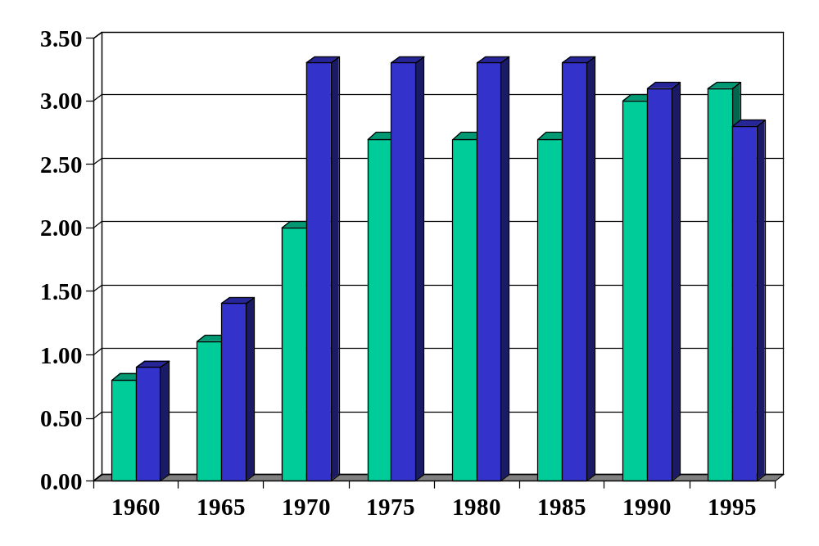
Employment protection in Europe
Green = FRA
Blue = DEU
Source: Blanchard and Wolfers.
Notes:
http://bpp.wharton.upenn.edu/jwolfers/research.shtml

Slide 71
Labor market indicators (“outcomes”)
Employment rate = employed/(working-age) population
Labor force = employed + unemployed
Unemployment rate = unemployed/labor force
Participation rate = labor force/working-age population
Inactivity rate = out of labor force/working-age population
Hours worked = average hours worked of employed people

Slide 72
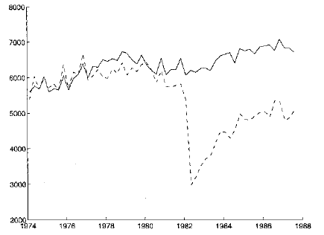
Displaced workers
Average quarterly earnings of “stayers” and “separators”
“stayers”
“separators”
Source: Ljungqvist and Sargent, JPE, 1999; adapted from Jacobson et al, AER, 1993.

Slide 73
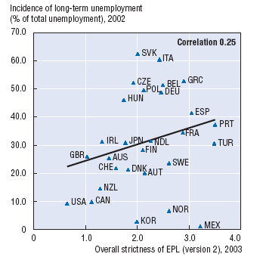
Protection and unemployment
Source: OECD, Employment Outlook, 2004.

Slide 74
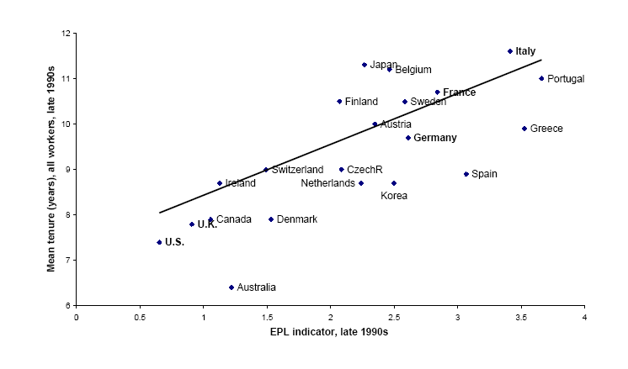
Employment protection and tenure
Source: Bertola, 2001.

Slide 75
Labor markets in the US
The Economist, Jan 18 07:
  NESTLED among the wooded Blue Ridge mountains in Virginia's far south-west, Galax is a town of bluegrass music, barbecue and hardscrabble living. Globalization has hit hard. Last year … three big [furniture] factories closed their doors within months.
  For some, the future looks bleak. At 59, Paul Rotan sees little chance of finding another job with health insurance. But other, mainly younger, workers are already better off.
  [This is the way trade and innovation work.] Displaced workers should find new jobs, but their wages will probably fall. Although the country overall gains handsomely, these people are often worse off.
Link

