Slide 1

The Global Economy
Emerging Market Crises
© NYU Stern School of Business

Slide 2
Turkey
Would you invest there?
Would you buy government debt? Private debt? Equity?
How would you decide?

Slide 3
Turkey
GDP growth (est 2008) | 3.7
Inflation (est 2008) | 8.2
Short-term interest rate | 13.0
Govt budget balance (% of GDP) | –2.9
Govt primary balance (% of GDP) | 4.9
Govt debt (% of GDP) | 57.1
Current account (USD b) | –39.4
Current account (% of GDP) | –7.4
Net foreign assets (% of GDP) | – 48.4
Reserves (USD b) | 74.4

Slide 4
Turkey
EIU Risk Service, February 2008:
  Turkey would be among the more vulnerable emerging markets to a reduction in risk appetite. The public debt burden remains high. However, improvements in the public finances reduce the risk of payment difficulties.

Slide 5
Turkey
Lehman report, December 2006:
  The crux of the problem is Turkey’s current account deficit, which is in turn driven by a collapse in the private savings rate. … In addition, we worry about the rising indebtedness of the corporate sector. Indeed, the rise in short-term external debt is one of the factors that pushed the score higher this time around. So, although we would not look for a financial crisis in Turkey, we have little doubt that the economy will remain vulnerable.

Slide 6
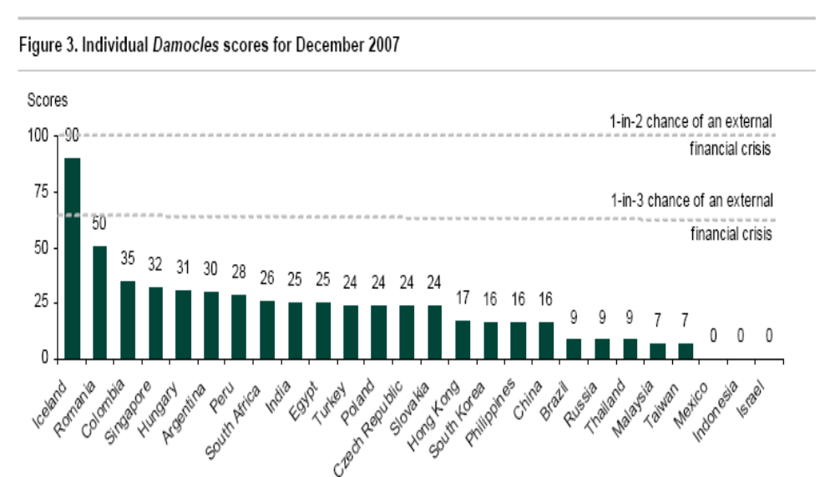
Turkey
Source: Lehman Brothers, Damocles, December 2007.

Slide 7
Plan of attack
Turkey ✓
Current account review
Volatility and crises
Mexico 1994-95
Orthodox theory of crises
Open questions
Takeaways

Slide 8
Current account review
Current account deficits lead to foreign liabilities
Viability for investors depends on what underlies it
  Worry if: deficit financed government or personal consumption (saving fell)
  Esp if it’s government debt and the political situation makes repayment politically difficult
  Don’t worry if: deficit financed new plant and equipment (investment rose) – esp if claims are equity
  Unless: the investment isn’t paying off
For later: Why might level of development matter?

Slide 9
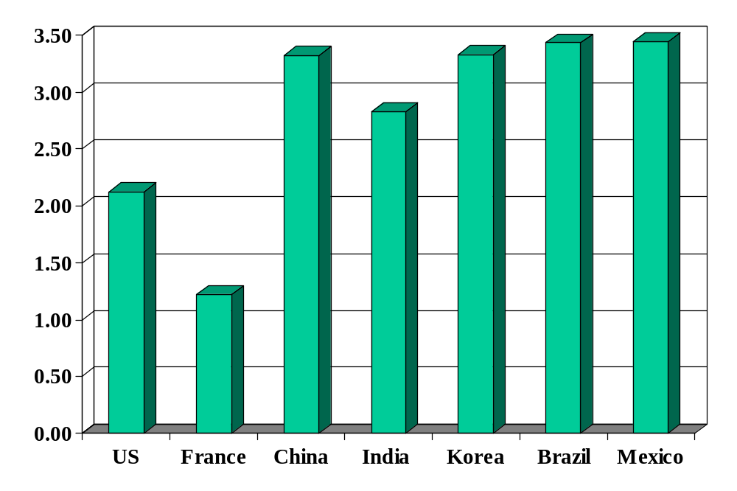
Volatility (std dev of annual growth rate %)
Source: World Bank, World Development Indicators, GDP per capita, 1975-2005.

Slide 10
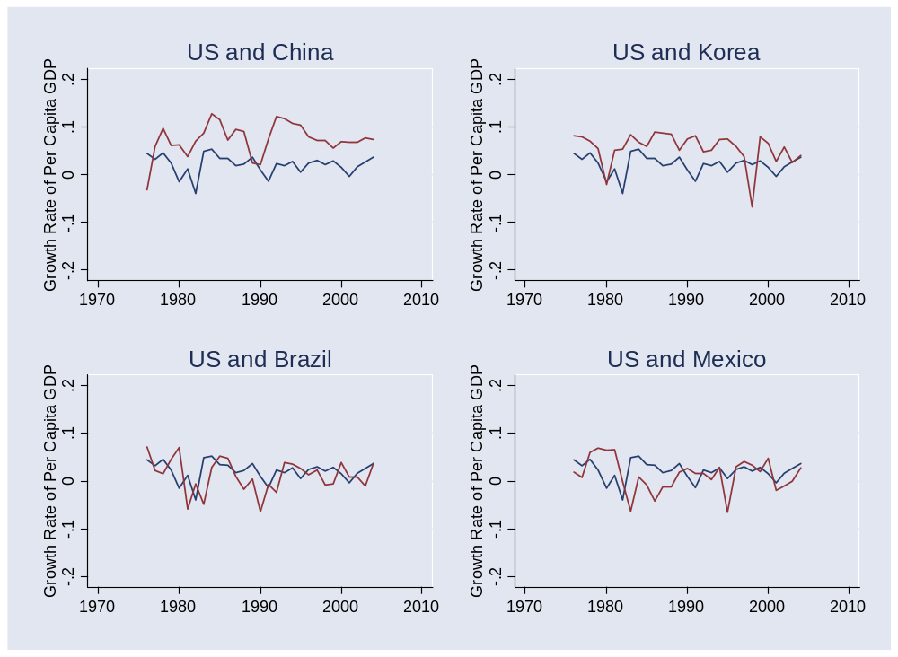
Volatility
Source: World Bank, World Development Indicators, GDP per capita, 1975-2005. Blue=US.

Slide 11
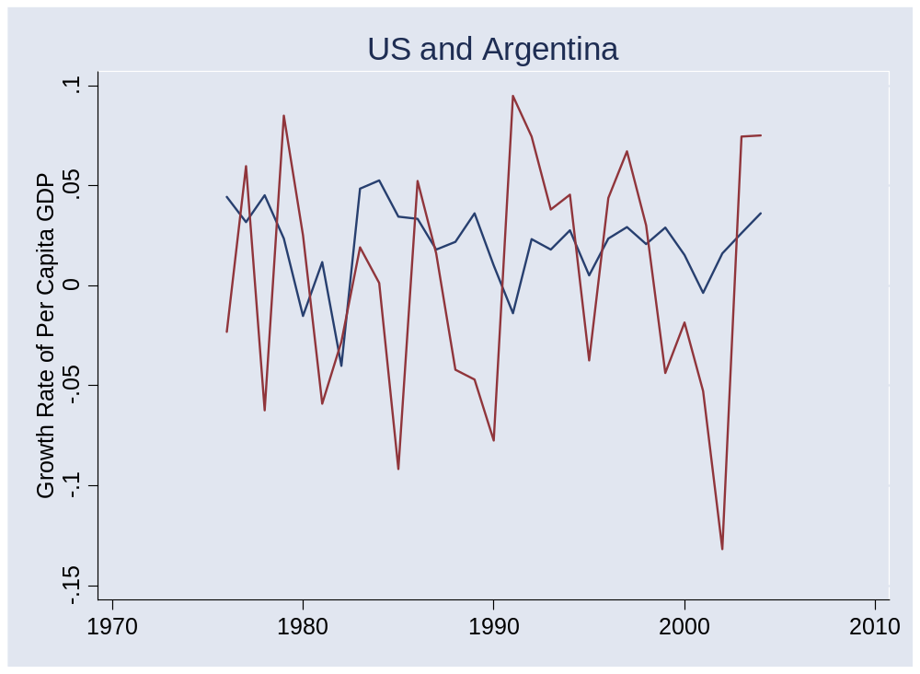
Volatility
Source: World Bank, World Development Indicators, GDP per capita, 1975-2005.

Slide 12
Crises
Australia 1891-93 (“Barings crisis”)
  GDP fell 18%
United States 1907-08
  GDP fell 10%
Mexico 1994-95:
  GDP fell 9%, peso fell almost 50%
Korea 1997-98
  GDP fell 9%, won fell 30%
Argentina 1999-2002
  GDP fell 20%, peso fell 65%

Slide 13
Iceland
5-6% growth in recent years
Investment boom (hydro, aluminum)
Trade deficit of >10% of GDP
Fiscal deficit of about 3% of GDP
Investors concerned, interest rates up

Slide 14
Iceland
Financial Times, Apr 07:
  Norway’s state pension fund has emerged as one of the biggest investors to profit from the turmoil in the Icelandic bond markets, according to derivatives traders. Traders estimated that the fund, which invests Norway's large oil revenues abroad and is one of the biggest pension funds in the world, had made a profit of nearly €3m from shorting, or betting on the decline of bonds in Icelandic banks.
Norwegian friend:
  In principle, I’d much rather take advantage of the Swedes.

Slide 15
Crises
Why?

Slide 16
Mexico 1994-95
Early 1990s were a high-growth period
Economic liberalization and NAFTA (1994)
Current account deficits about 7% of GDP [why?]
Exchange rate was “managed”
Higher inflation than US led to “real appreciation” [what does this mean?]
Modest government deficit
President Zedillo took office in early December
Banco de Mexico ran out of reserves, peso collapsed, economy sank

Slide 17
Mexico 1994-95
Could we have seen this coming?
What could Mexico have done?

Slide 18
“Orthodox” theory of crises
Fixed exchange rate
Government deficit leads to current account deficit
  Financed in part by issuing foreign debt
Investors question repayment
  When do you hit this point?
Investors stop buying debt (current account reverses!)
Central bank unable to support exchange rate
  FX reserves run out, currency collapses

Slide 19
“Orthodox” theory of crises
Does Mexico fit the pattern?
Turkey?

Slide 20
Open questions
Asian crisis of 1997: no sign of fiscal deficits, why did investors panic?
Could this happen in China?
Why do investors panic in emerging markets, when similar conditions in developed countries typically generate little reaction?
Are fixed exchange rates a curse?

Slide 21
Takeaways
Developing countries are volatile
Fundamental factor in crisis
  Investor concern over repayment
Key indicators
  Government budget, current account, reserves …
Why rich countries are different
  Better protection of investors
  Better capital structure (more equity, less debt)

Slide 22
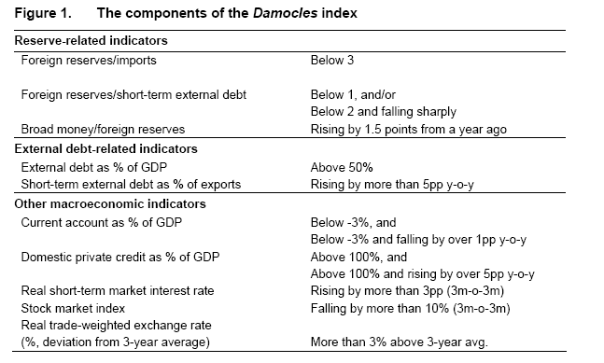
Lehman’s risk index
Source: Lehman Brothers, Damocles, December 2006.

Slide 23
The Global Economy
Final Review
© NYU Stern School of Business

Slide 24
Final group projects

Slide 25
Plan of attack
Final group projects ✓
Final exam
Where we’ve been
List of topics
Applications

Slide 26
About the final exam
Thursday, May 8, 11:15-1:15
  Morning class in KMC 2-60, afternoon class in 1-70.
Same format and content as practice exam
You can use one page of notes
Bring a calculator
Wireless devices prohibited
Covers second half only
Mixture of qualitative and quantitative
Anything from the notes, slides, or projects is fair game, but the exam is not an attempt to stump you with obscure issues

Slide 27
About the final
Recommended study plan
  Skim “checklist” to get big picture
  Review course materials slides, notes, projects
  Draft summary page
  Work through practice exam
  Review topics you have difficulty with
  Come see me if you have questions

Slide 28
About the “cheat sheet”
For each topic, I suggest you ask:
  What are the quantitative tools?
  What are the takeaways?

Slide 29
Where we’ve been
Long-Run Performance
Production, Saving & Investment, Productivity, Institutions, Capital & Labor Markets, International Trade
First half:
Short-Run Performance
Inflation, Economic Indicators, Aggregate Supply & Demand, Monetary Policy, Taxes & Deficits, Exchange Rates, Capital Flows, Emerging Market Crises
Second half:

Slide 30
Where we’ve been
Second half is collection of topics (see “checklist”)
Goal: coherent holistic view of risks
Example:
  What would you look at to assess the risks of short-term private investment in Turkey?

Slide 31
Inflation
Big picture
  Q: Where does high inflation come from?
  A: Money growth [<= fiscal deficits <= political uncertainty]
Tools
  Quantity theory ties inflation to money growth:
M V = P Y
γ_{P} = γ_{M} – γ_{Y} (V constant)
  Monetary mechanics: use central bank balance sheet to show how it changes the supply of money/currency
Relevance
  High inflation destroys bond values and makes day-to-day business difficult.

Slide 32
Business cycles
Big picture
  Economic activity is “stochastic” [random]
  But the randomness has patterns
  The patterns allow prediction
Tools
  Statistical analysis of macroeconomic data [“time series”]
  Cross-correlation function
  Regressions
Relevance
  Reminder: unpredictable things can happen to the economy, your business, and even your career

Slide 33
Business cycle properties
Cyclicality
  Most measures of economic activity move up/down with GDP
  We say they are procyclical if they go up/down with GDP does, countercyclical if the opposite
Volatility
  Volatility = standard deviation of (say) growth rate
  Consumption is less volatile than GDP, investment more
Leads and lags
  Employment lags GDP [what else?]
  Housing starts, term spread, stock market lead GDP [what else?]

Slide 34
Business cycle analysis
Big picture
  Q: Where do business cycles come from?
  A: Shocks to supply and demand.
Tools
  AS/AD framework: supply and demand affect output and prices
  Comment: shocks to supply and demand have different consequences
Relevance
  Standard tool of analysis for analysts and business press

Slide 35
Monetary policy
Big picture
  Q: How do central banks manage interest rates? [why “manage”?]
  A1: Offset demand shocks, accommodate supply shocks
  A2: Carefully, often approximated by Taylor rule.
Principles of good policy
  Stable prices, predictable policy, independent central bank?
Taylor rule approximates policy in many countries:
i = r* + π + a₁(π –π*) + a₂(y–y*)
Relevance
  Summarizes impact of GDP growth, inflation on interest rates
  Helps to identify unusual policy episodes

Slide 36
Aggregate supply and demand
Outline
  Short run eq
  Long run eq
  Demand shifts
  Supply shifts
  Objectives of policy
ECB policy question from 08 final

Slide 37
Fiscal policy
Big picture
  Q: How do taxes and deficits affect performance?
  A1: Taxes discourage some activities (working and saving?)
  A2: Deficits can indicate future problems, esp in emerging markets
Tools
  Principle: apply low rates to broad tax base [incentives]
  Deficits: you can’t run them forever
  Sustainability analysis: how is debt/GDP evolving?
Relevance
  Taxes central to many business decisions
  Deficits are a common indicator of trouble [what kind?]

Slide 38
Fiscal policy (kill this??)
Default?
Fiscal Deficit
Inflation
Trade Deficit
For each one:
What’s the link?
Indicators?
Exchange Rate

Slide 39
Exchange rates
Big picture
  Q: Where do exchange rates come from?
  A: Long run: prices/inflation. Short run: who knows?
Tools
  Purchasing power parity: prices of goods tend to equalize across countries
s P* = P
    OK over 5-10 years, irrelevant over 0-3 months
  Interest rate parity
    Currencies with high interest rate generally appreciate (increase in value) [why is this puzzling?]
  Other predictors: 50-50 bet is often the best you can do
Relevance
  Exchange rates central to international transactions
  If you can’t predict them, think about mitigating their impact

Slide 40
Exchange rate regimes
Big picture
  Q: How do fixed exchange rates work????
  A: ??
Tools
  ??Purchasing power parity: prices of goods tend to equalize across countries
s P* = P
    OK over 5-10 years, irrelevant over 0-3 months
  Interest rate parity
    Currencies with high interest rate generally appreciate (increase in value) [why is this puzzling?]
  Other predictors: 50-50 bet is often the best you can do
Relevance
  Exchange rates central to international transactions
  If you can’t predict them, think about mitigating their impact

Slide 41
Balance of payments
Big picture
  Q: Are trade and current account deficits signs of trouble?
  A2: For developing countries, maybe [esp if govt def too]
  A2: For developed countries, probably not.
Tools
  Balance of payments: net exports, trade balance, current account, capital and financial account, net foreign assets
  Current account deficit financed by inflow of capital
    Current account deficit = inflow of foreign funds
  Sustainability analysis: how is NFA/GDP evolving?
Relevance
  Current account is fundamental indicator – but of what?

Slide 42
Emerging market crises
Big picture
  Q: Why are developing countries more volatile, experiencing occasional crises?
  A: Often government and current account deficits. Also: Fact of life.
Theory
  Government deficits lead to increase in money growth, inflation, fall in exchange rate
  Asian crisis: no government deficits, so what happened?
  Political analysis inevitable here: how will political leaders deal with the situation?
Relevance
  Emerging markets: high risk – also high reward?

Slide 43
Country analysis
Run through a country
  Fiscal policy
  Current account
  Exchange rate
Romania question from 08 final

Slide 44
Automobile market analysis
What are the prospects for US car sales over the next 12 months?
  What are the major issues?
  What would you look at to learn more?
  What tools would you use?
  What’s the bottom line?

Slide 45
Equity market analysis
What industries should I target to exploit a possible economic recovery?
  What are the major issues?
  What would you look at to learn more?
  What tools would you use?
  What’s the bottom line?

Slide 46
Country analysis
What are the prospects for the Japanese economy over the next 5 years?
  What are the major issues?
  What would you look at to learn more?
  What tools would you use?
  What’s the bottom line?

Slide 47
Bond market analysis
What are the prospects for interest rates over the next 12 months?
  What are the major issues?
  What would you look at to learn more?
  What tools would you use?
  What’s the bottom line?

Slide 48
Emerging market analysis
What are the primary risks of opening a subsidiary in Brazil?
  What are the major issues?
  What would you look at to learn more?
  What tools would you use?
  What’s the bottom line?

Slide 49
Course recommendations 1
Economics
  International macroeconomic policy, Roubini (Fall)
  Advanced macroeconomics, Ljungqvist and Sargent (Fall)
  Developing financial institutions and markets, Sylla
  Game theory, Brandenburger (Spring).

Slide 50
Course recommendations 2
Quant tools
  Regression and multivariate analysis, Simonoff
  Forecasting time series, Hurvich or Deo
Other recommended courses
  Financial statement analysis, various
  Decision models, Juran
  Collaboration, conflict, and negotiation, various

Slide 51
Beach and airplane reading
Adam Hall, Quiller. Cold war spy novel moves at breakneck pace. Called Northlight in Britain.
Walter Mosley, Cinnamon kiss. LA noir from a master.
Ian Rankin, Resurrection man. Edinburgh noir. Wonderfully anti-social protagonist.
Brian Haig, . Light and funny??
Carol O’Connor, Find me. Most recent Mallory mystery, maybe the best one yet.

Slide 52
Global economy nonfiction
Andres Oppenheimer, Bordering on chaos: Mexico's roller-coaster journey toward prosperity. A page-turner – really.
Ron Chernow, Alexander Hamilton. Great story of one of the founders of the American economic and political system, esp its financial system.
William Lewis, The power of productivity. Studies of country performance by a McKinsey partner. A little slow, but the content is fascinating. Should be called: the power of competition.
Jonathan Spence, The search for modern China. China since 1400 by a leading China scholar.

Slide 53
Good luck
Best of luck on the exam
Enjoy your summer
Report back in the fall

