Slide 1

The Global Economy
Business Cycle Indicators
© NYU Stern School of Business
Notes:
Open spreadsheet, Bloomberg calendar
WSJ forecasts
Why do we look at all these things?

Slide 2
Bloomberg calendar
Why do we look at this stuff?
http://www.bloomberg.com/markets/ecalendar/index.html

Slide 3
Market guide
Indicators of current and future output
  Stocks up
  Interest rates up
Indicators of current and future inflation
?? Inventories

Slide 4
Add stuff on
Inventories
Job flows
New claims

Slide 5
Riddle
Why do economists add a digit after the decimal point to their forecasts?
To show they have a sense of humor.

Slide 6
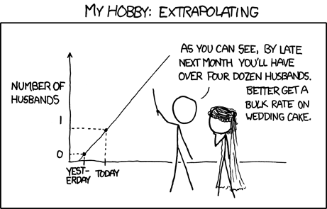
Plan of attack
Source: xkcd <http://xkcd.com/605/>

Slide 7
Plan of attack
Bloomberg calendar ✓
Business cycle overview
Pictures
Forecasting
Good indicators (the “cross-correlation function”)
Forecasting revisited
What have we learned?

Slide 8
Business cycle overview
Current Conditions
Indicators
Theory: AS & AD
Monetary Policy
Statistical Analysis
Future Conditions

Slide 9
Business cycle checklist ??
Macroeconomic conditions
  GDP growth, inflation, interest rates
Business cycle indicators
  Hints about future conditions
AS and AD
  Which is shifting?
Monetary policy
  How do we expect the central bank to respond?
  How will this affect interest rates? Inflation and GDP?

Slide 10
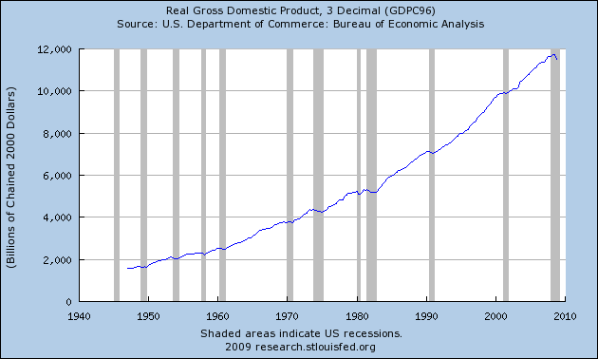
US GDP
Source: BEA via FRED.

Slide 11
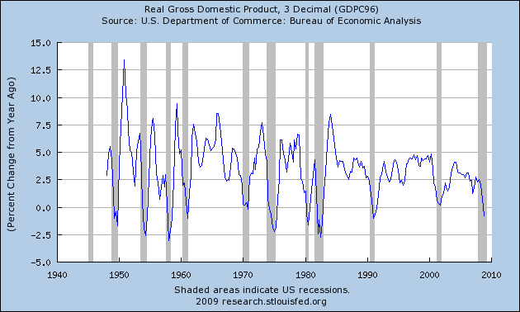
US GDP growth (year-on-year)
Source: BEA via FRED.

Slide 12
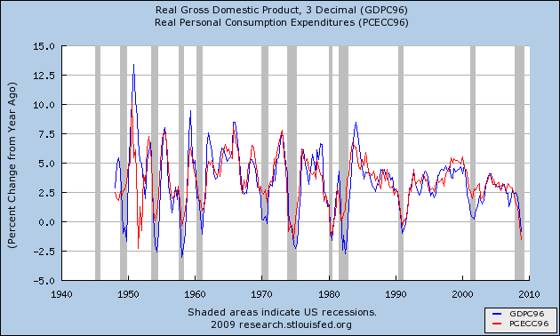
Components of US GDP growth
Source: BEA via FRED.

Slide 13
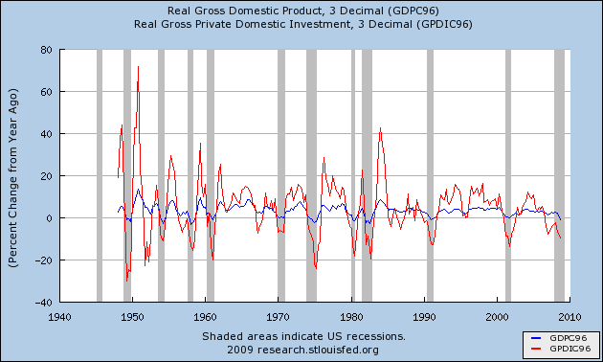
Components of US GDP growth
Source: BEA via FRED.

Slide 14
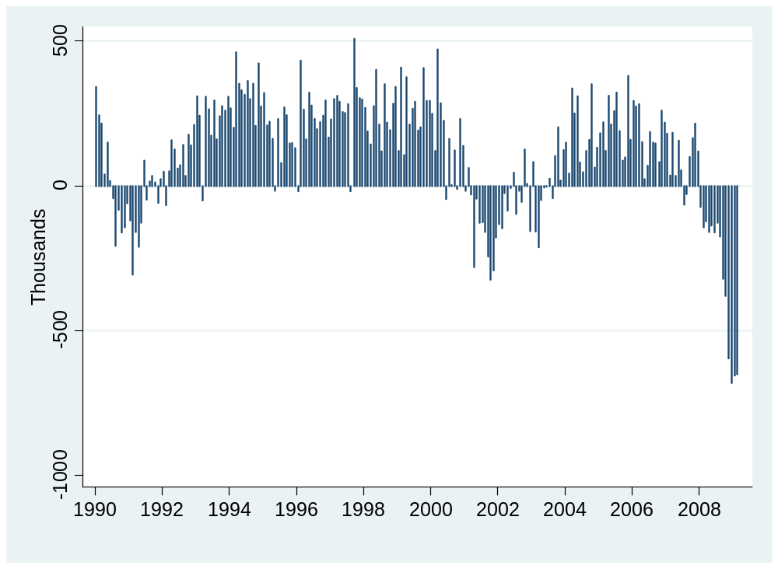
Employment (month-to-month change)
Source: BLS.

Slide 15
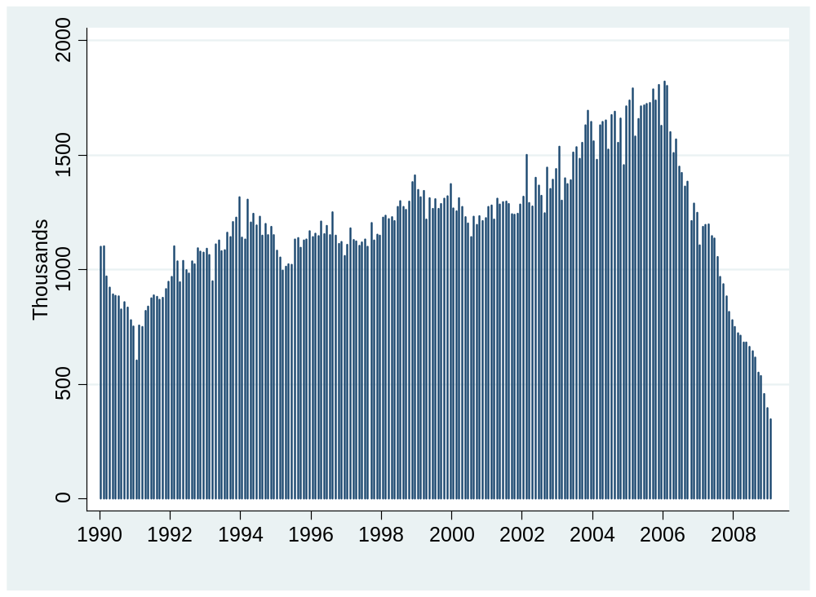
Housing starts
Source: Census.

Slide 16
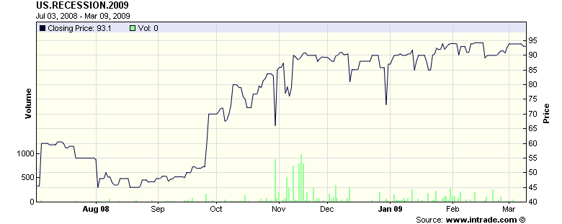
Recession futures
Probability recession in 2009 (2 qtrs negative growth)
Source: Intrade.com.

Slide 17
Forecasting
Can we forecast future economic conditions?
  Use information about the past & present to predict the future
Basic idea: use patterns in the data
  In the past, “this” was followed by “that”

Slide 18
Forecasting: example
Example: growth in industrial production (“IP”)
γ_{t,t+k} = log(IP_{t+k}/IP_{t})/k = k-period growth rate in IP
Why? How?

Slide 19
Forecasting: regressions
Reminder: we’re forecasting
γ_{t,t+k} = log(IP_{t+k}/IP_{t})/k = k-period growth rate in IP
[set k=12 months?]
Estimate the regression
γ_{t,t+k} = a + b x_{t} + residual
x_{t} is an “indicator” of your choice
Standard software produces estimates of a and b
Note timing!!

Slide 20
Forecasting: fancy regressions
Basic regression
γ_{t,t+k} = a + b x_{t} + residual
  γ_{t,t+k} is what we’re trying to forecast
  x_{t} is an “indicator” of your choice
Variations
  Use more than one x
  Add lags of x
  Add lags of γ
  Whatever works!

Slide 21
Forecasting: forecasts
Recall: we’ve estimated a and b in
γ_{t,t+k} = a + b x_{t} + residual
Calculate predicted future growth rate
γ_{t,t+k} = a + b x_{t}
  x_{t} = value now (t) of indicator x
  γ_{t,t+k} = predicted growth from now (t) to the future (t+k)
Make sure you understand the timing

Slide 22
Identifying good indicators
What would you suggest? Why?

Slide 23
Identifying good indicators
How do you find good indicators?
  Forecasting requires indicators that lead what you’re forecasting
  Ask friends, read reports, look at “cross-correlation function”

Slide 24
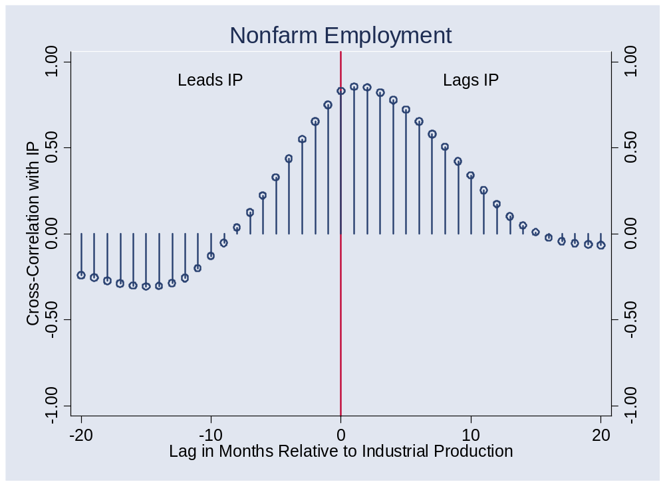
Identifying good indicators
Correlations for Random Indicator X

Slide 25
Identifying good indicators
Cross-correlation function (“ccf”)
  Correlations between two variables at different times
ccf(k) = Corr(x_{t},y_{t-k})
[plot this against k]
  If k<0: x leads y [or y lags x]
  If k>0: x lags y [or y leads x]

Slide 26
Identifying good indicators
Pictures: plot ccf(k) v k
  y = IP growth
  x = indicator
  Does indicator lead or lag IP growth?

Slide 27
Identifying good indicators
Mechanics of ccf calculations: see spreadsheet

Slide 28
Does employment lead or lag?
What is this dot?

Slide 29
Computing cross-correlations
Date | x(t) | y(t)
1 | 2.43 | 8.47
2 | 1.19 | 2.29
3 | 0.13 | 7.36
4 | 0.56 | 6.39
5 | 0.38 | 6.02
6 | 0.96 | 0.22
7 | 1.87 | 3.60
Reminder:
ccf(k) = corr[x(t),y(t-k)]
For k = 0:
ccf(0) = corr[x(t),y(t)]
Use data marked
Red for x
Blue for y

Slide 30
Computing cross-correlations
Date | x(t) | y(t)
1 | 2.43 | 8.47
2 | 1.19 | 2.29
3 | 0.13 | 7.36
4 | 0.56 | 6.39
5 | 0.38 | 6.02
6 | 0.96 | 0.22
7 | 1.87 | 3.60
Reminder:
ccf(k) = corr[x(t),y(t-k)]
For k = +1:
ccf(1) = corr[x(t),y(t-1)]
Means: x lags y
Use data marked
Red for x
Blue for y

Slide 31
Computing cross-correlations
Date | x(t) | y(t)
1 | 2.43 | 8.47
2 | 1.19 | 2.29
3 | 0.13 | 7.36
4 | 0.56 | 6.39
5 | 0.38 | 6.02
6 | 0.96 | 0.22
7 | 1.87 | 3.60
Reminder:
ccf(k) = corr[x(t),y(t-k)]
For k = –1:
ccf(-1) = corr[x(t),y(t+1)]
Means: y lags x
Use data marked
Red for x
Blue for y

Slide 32
Does employment lead or lag?

Slide 33
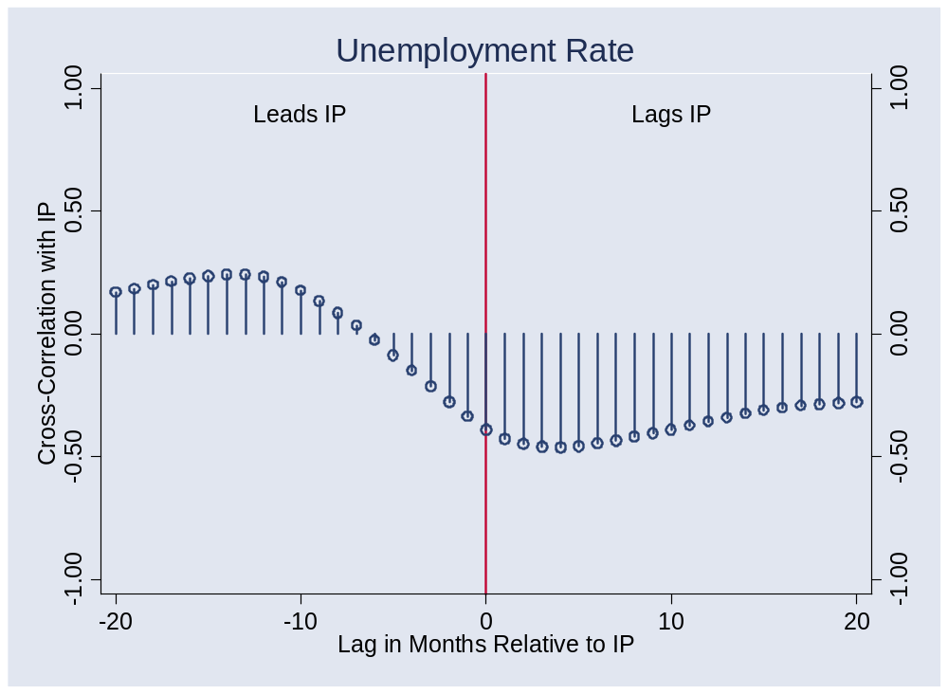
Unemployment?

Slide 34
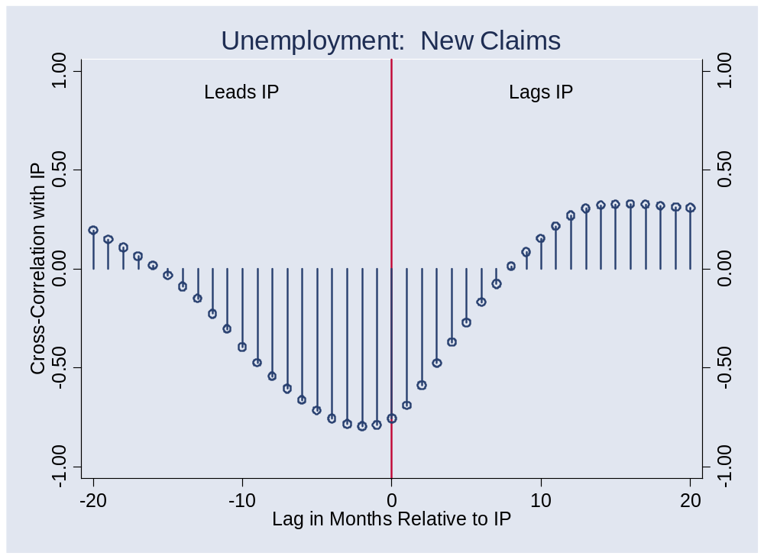
New claims for un ins?

Slide 35
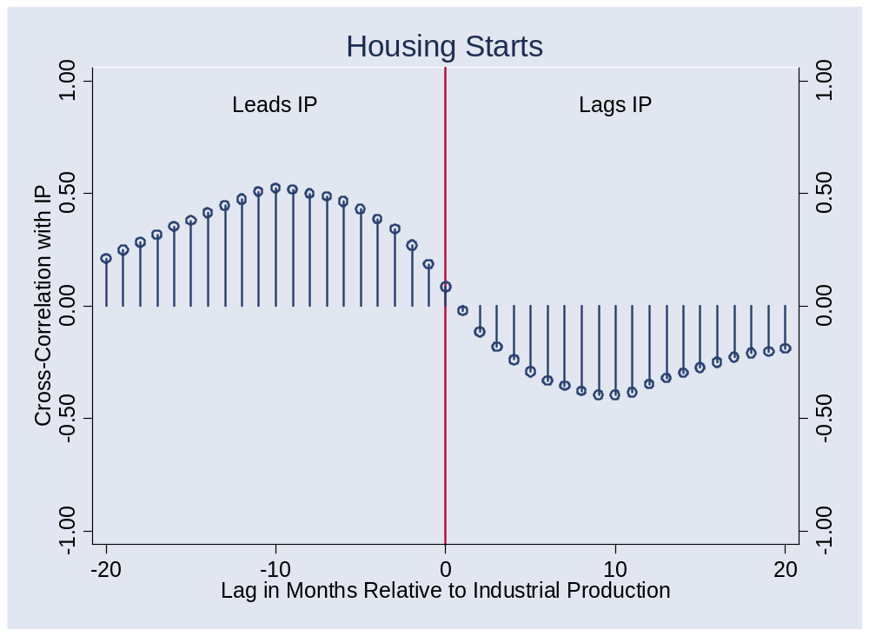
Housing starts?

Slide 36
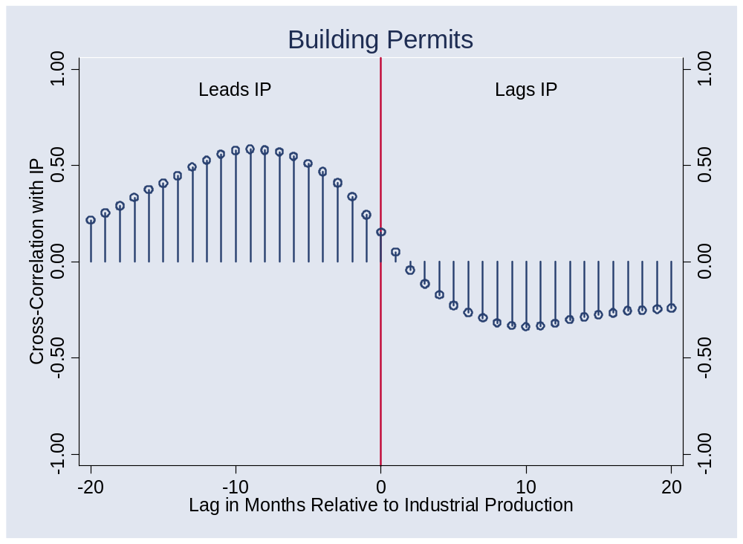
Building permits?

Slide 37
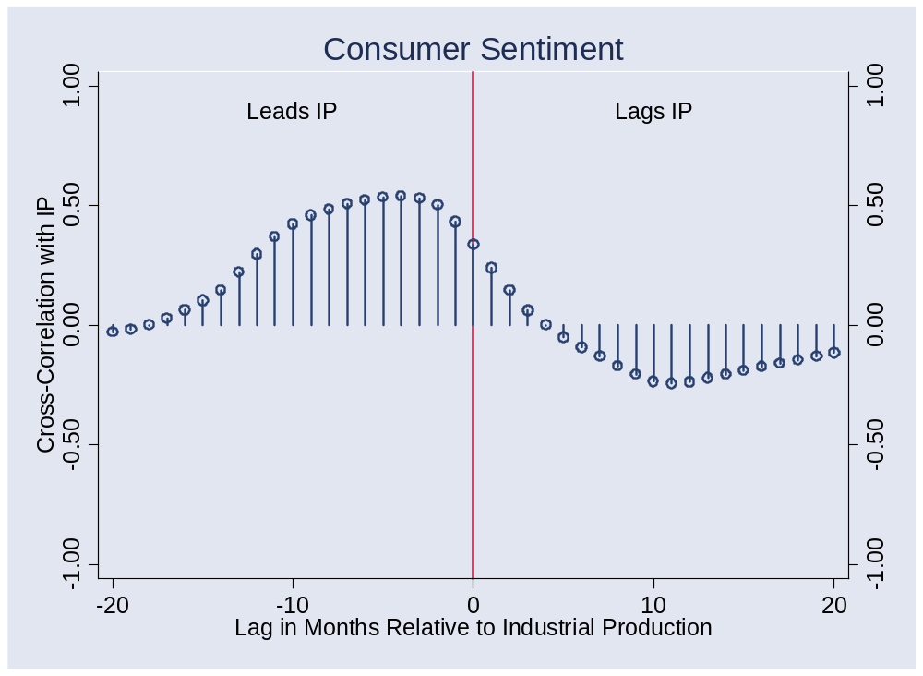
Consumer sentiment?

Slide 38
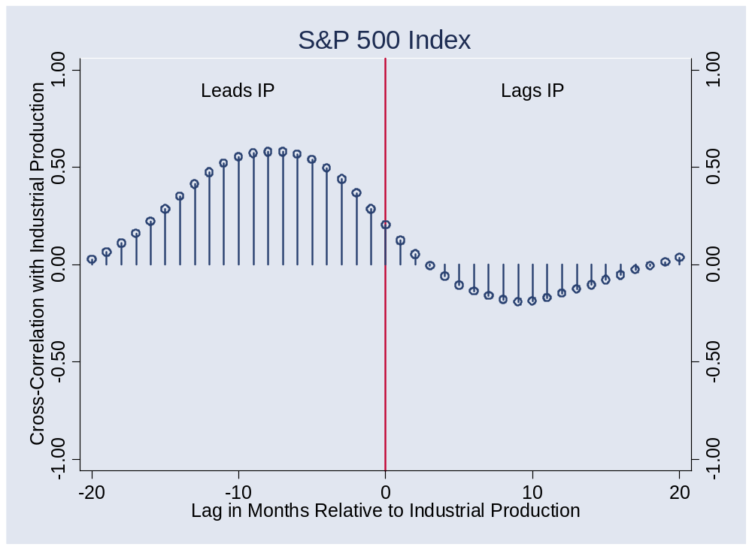
S&P 500 index?
Notes:
Pick a point: what is this?

Slide 39
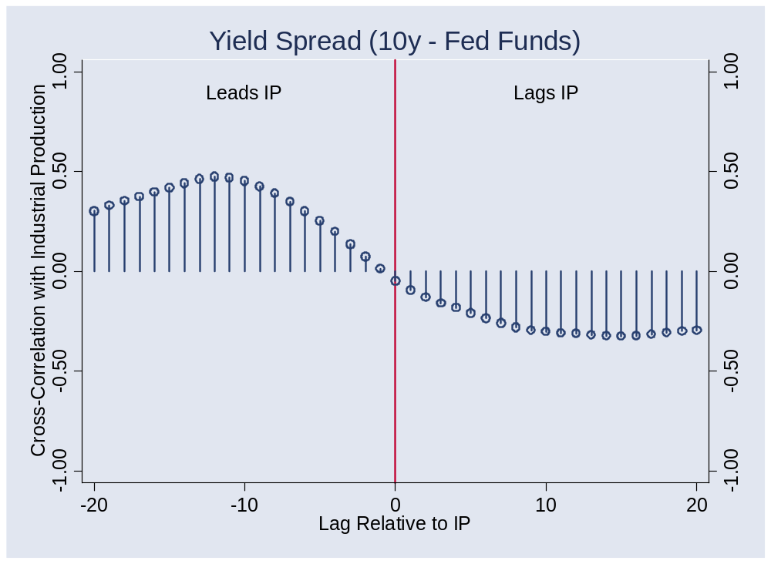
Yield spread?

Slide 40
Forecasting flow chart
Identify good indicators
  Use cross-correlation function, ask friends, whatever works
Transform them if appropriate
  Do you use the level? Growth rate? Change?
Put them in a regression
  Tells you relation between indicator and variable being forecast
  How long a sample do you use? [1985]
Use the regression coefficients and current value of indicator to construct forecast

Slide 41
How well do we do?
Forecasts have content
  Typical R² > 0, < 0.50
  Most of what happens is not predicted
Therefore: have a contingency plan

Slide 42
What have we learned?

Slide 43
Takeaways
Good indicators tell us something about the future
Even the best forecasts leave lots of uncertainty
Useful tools:
  Regressions
  Cross-correlation function

Slide 44
Enjoy the break
See you in a couple weeks

