Slide 1

The Global Economy
Business Cycle Indicators
© NYU Stern School of Business
Notes:
Open spreadsheet, Bloomberg calendar
WSJ forecasts
Why do we look at all these things?

Slide 2
The idea
Can we predict the future? Yes, a little: lots of “indicators” contain information about the current and future direction of the economy.
This is inherently a statistical exercise. There’s no limit to how sophisticated we can make this, but our goal is to keep things as simple as possible.
Notes:
Talk about information being central to business: WalMart, Google, …
Statistics

Slide 3
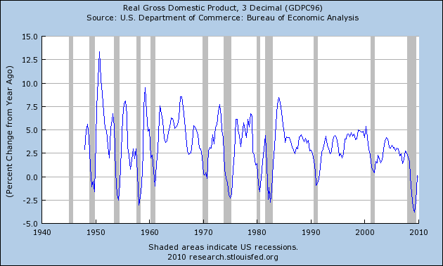
Where we’ve been
Source: FRED.
Notes:
Business cycles: fact of life

Slide 4
Where we’re headed
Current Conditions
Indicators
Theory: AS & AD
Monetary Policy
Statistical Analysis
Future Conditions

Slide 5
Plan of attack
The idea, where we’ve been, where we’re headed ✓
Business cycle indicators
Business cycle scorecard
Leads and lags (the “cross-correlation function”)
What have we learned?

Slide 6
Indicators
How does the economy look right now? In 6 months?
How do we know?

Slide 7
Indicator terminology
An indicator is procyclical if it moves up and down with GDP, countercyclical if it moves in the opposite direction
An indicator leads GDP if its ups and downs precede those in GDP, lags if its movements come after
We’ll use Industrial Production (IP) instead of GDP because it’s available monthly

Slide 8
Good indicators
Strongly correlated
Available quickly
Lead

Slide 9
Good indicators
Name some
What makes them good?
Bloomberg calendar
http://www.bloomberg.com/markets/ecalendar/index.html

Slide 10
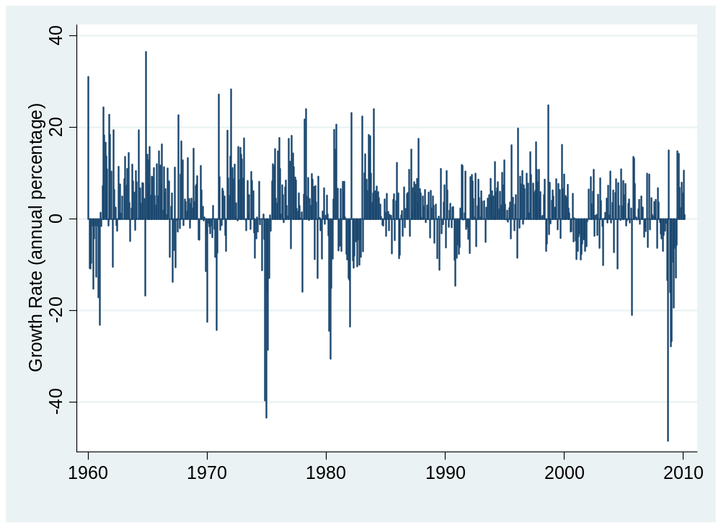
IP (month-to-month growth, annual %)
What do you see?
Source: Federal Reserve.

Slide 11
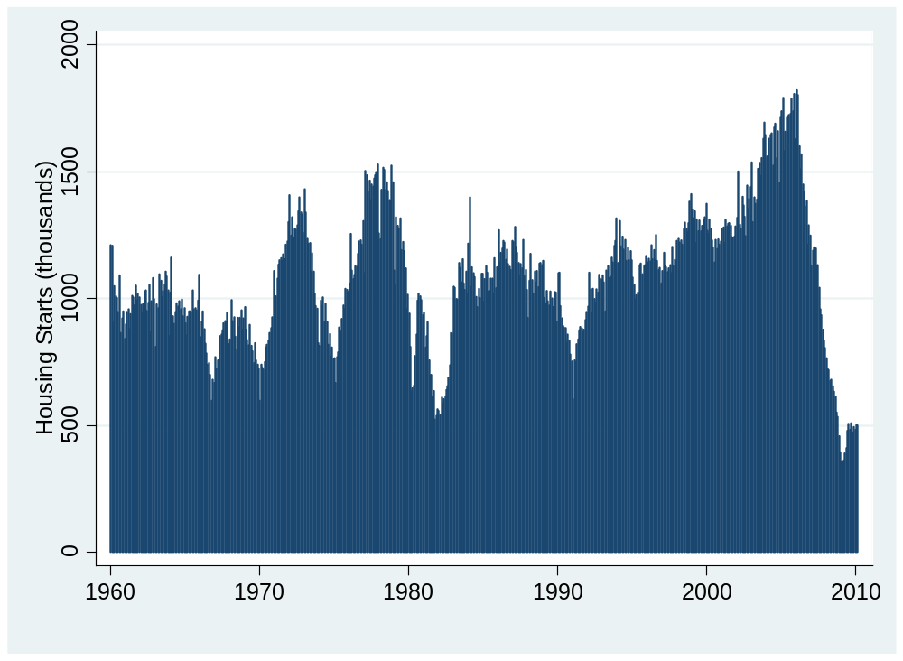
Housing starts
What do you see?
Source: Census.

Slide 12
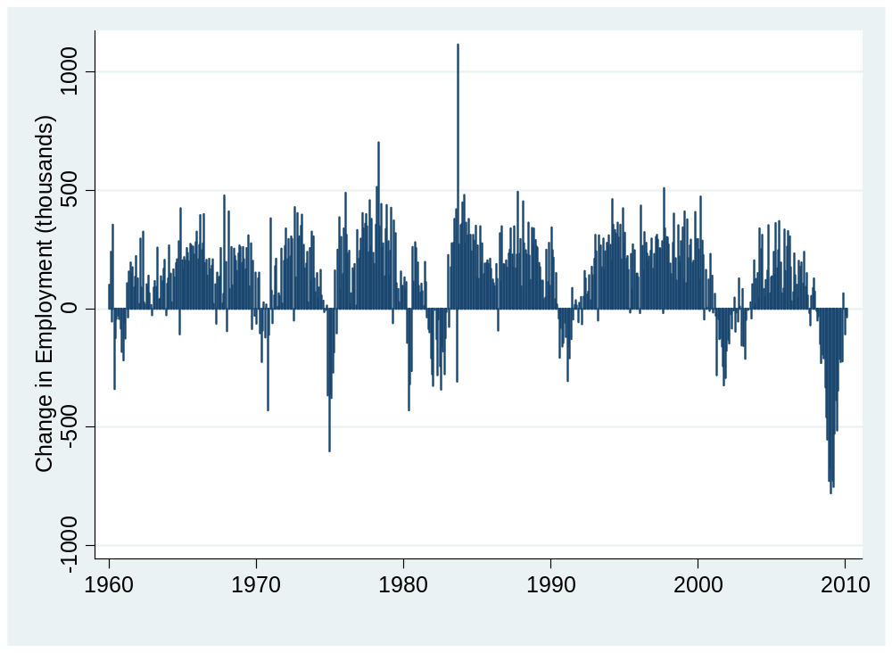
Employment (month-to-month change)
What do you see?
Source: BLS.

Slide 13
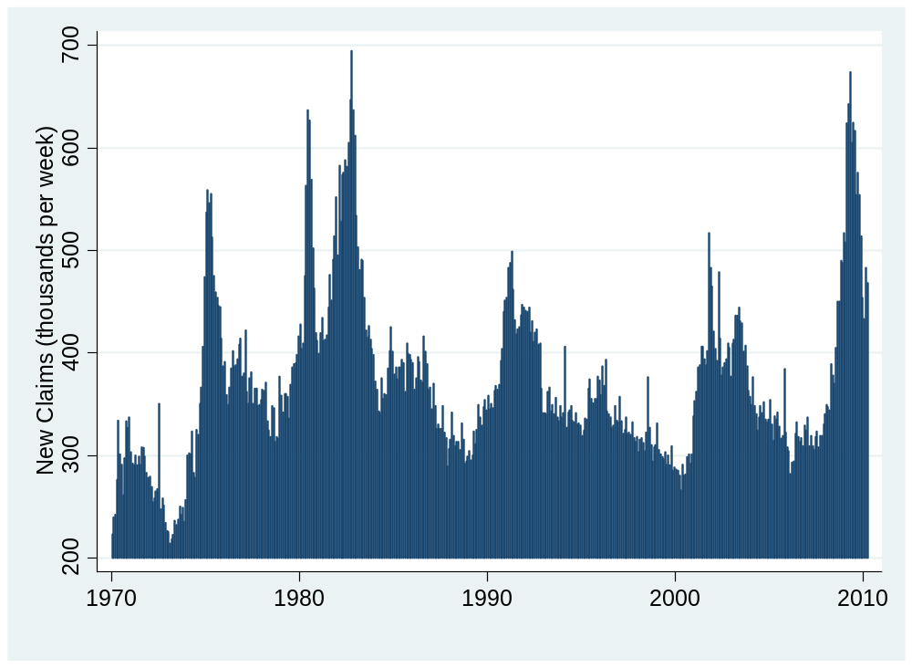
New claims for unemp insurance
What do you see?
Source: Census.

Slide 14
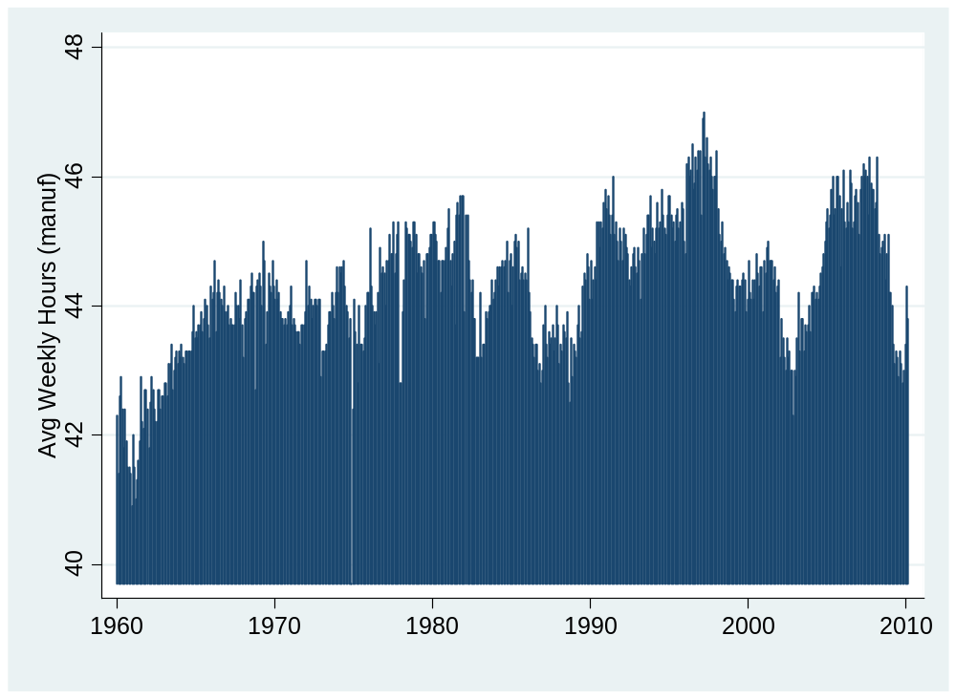
Avg weekly hours in manufacturing
What do you see?
Source: BLS.

Slide 15
Business cycle scorecard
For each indicator, draw three lines
  Mean
  Mean plus one std dev
  Mean minus one std dev
Breaks graph into four regions
Score them: very bad, bad, good, very good

Slide 16
Business cycle scorecard
Indicator | – – | – | + | + +
Industrial production
Housing starts
Employment
New claims
Avg weekly hours
Summary

Slide 17

IP (month-to-month growth, annual %)
Source: Federal Reserve.

Slide 18
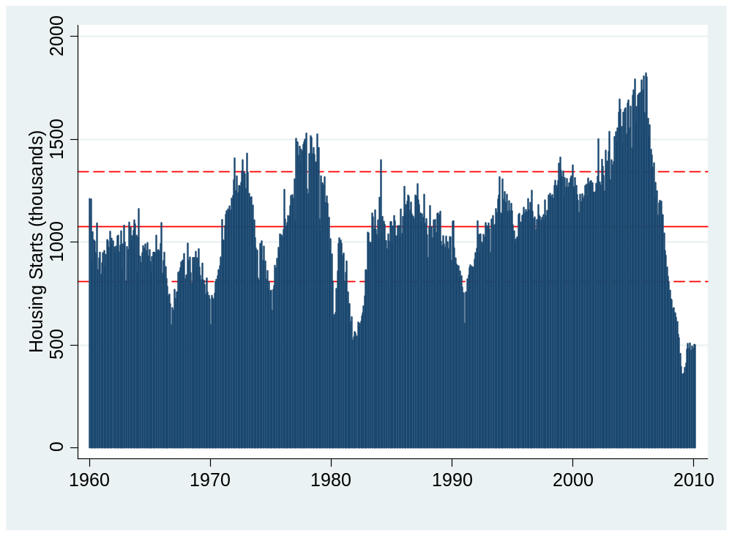
Housing starts
Source: Census.

Slide 19

Employment (month-to-month change)
Source: BLS.

Slide 20

New claims for unemp insurance
Source: Census.

Slide 21
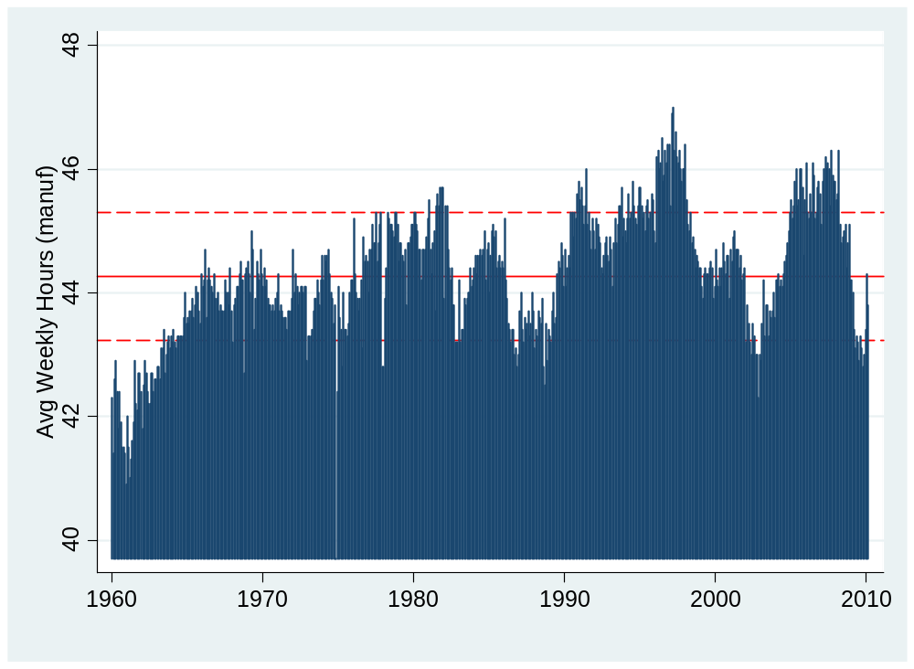
Avg weekly hours in manufacturing
Source: BLS.

Slide 22
Business cycle scorecard
Indicator | – – | – | + | + +
Industrial production
Housing starts
Employment
New claims
Avg weekly hours
Summary

Slide 23
Catch your breath
How do we forecast the future, as opposed to the present or past?
Leading indicators indicate future economic growth
How do we find them?
  Ask friends
  Read books
  Use the cross-correlation function [ccf]
Notes:
A good picture

Slide 24
Finding leading indicators
Useful tool: cross-correlation function (“ccf”)
Look at correlation between indicator x and variable y at different leads and lags
  Leading indicator: past x correlated with current or future y
Formal definition [don’t panic yet]
ccf(k) = Corr[x(t),y(t-k)]
[plot this against k]
  If k<0: x leads y [equivalently y lags x]
  If k>0: x lags y [equivalently y leads x]
Notes:
This is tricky, so we’ll go over three different ways

Slide 25
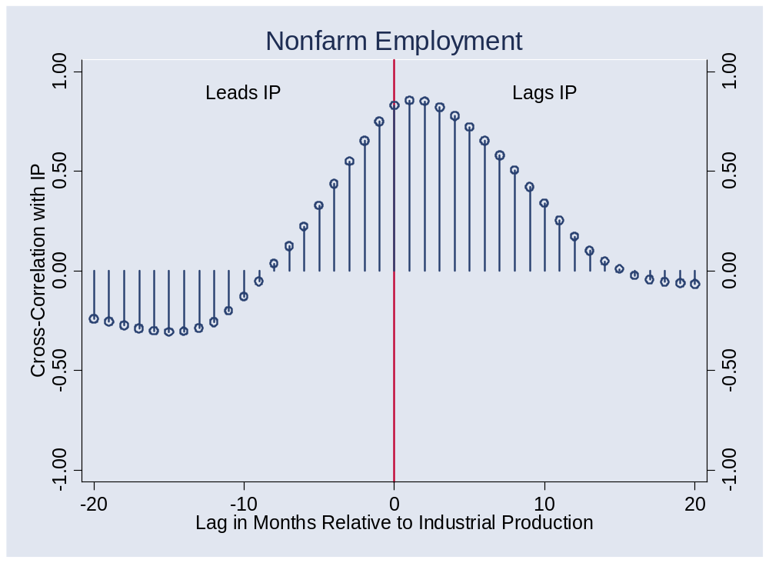
Finding leading indicators
Correlations for Random Indicator X
Notes:
Write on board
k
X comes before IP
X comes after IP
X same time

Slide 26
Finding leading indicators
Guide to figures: most variables are yoy growth rates, data from 1960 to present
Notes:
This is tricky, so we’ll go over three different ways

Slide 27
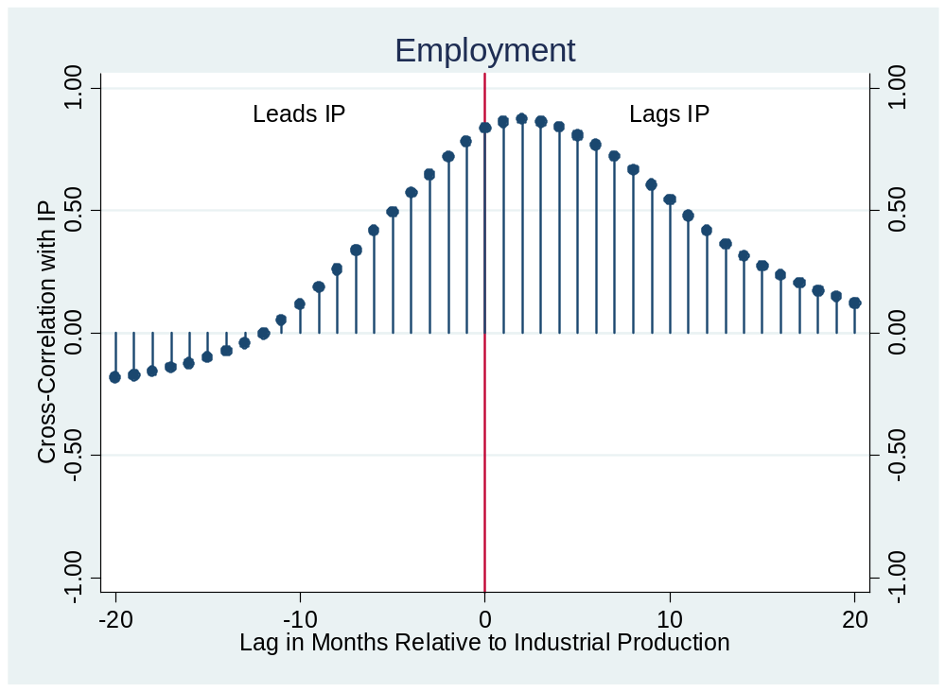
Does employment lead or lag?
Notes:
What is this dot?

Slide 28
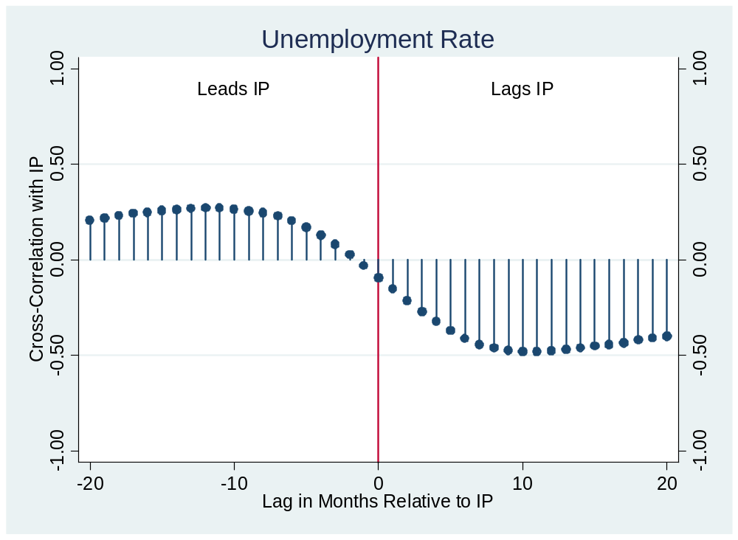
Unemployment?

Slide 29
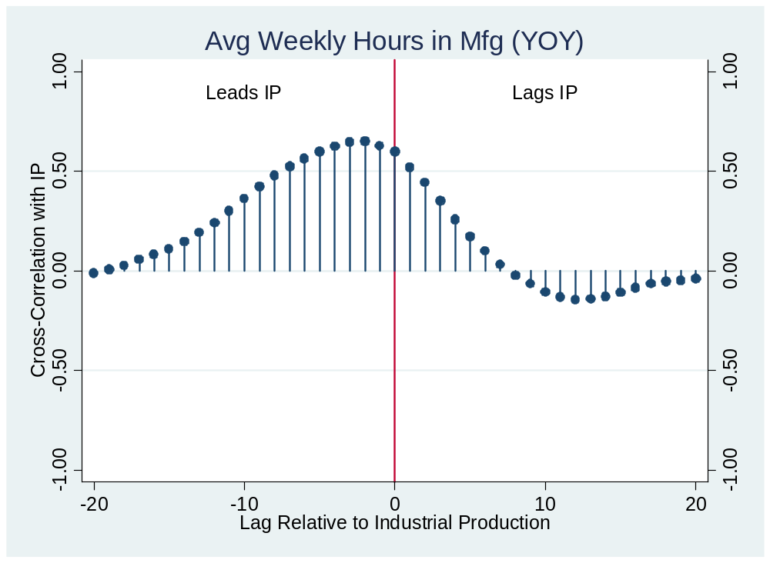
Average weekly hours?

Slide 30
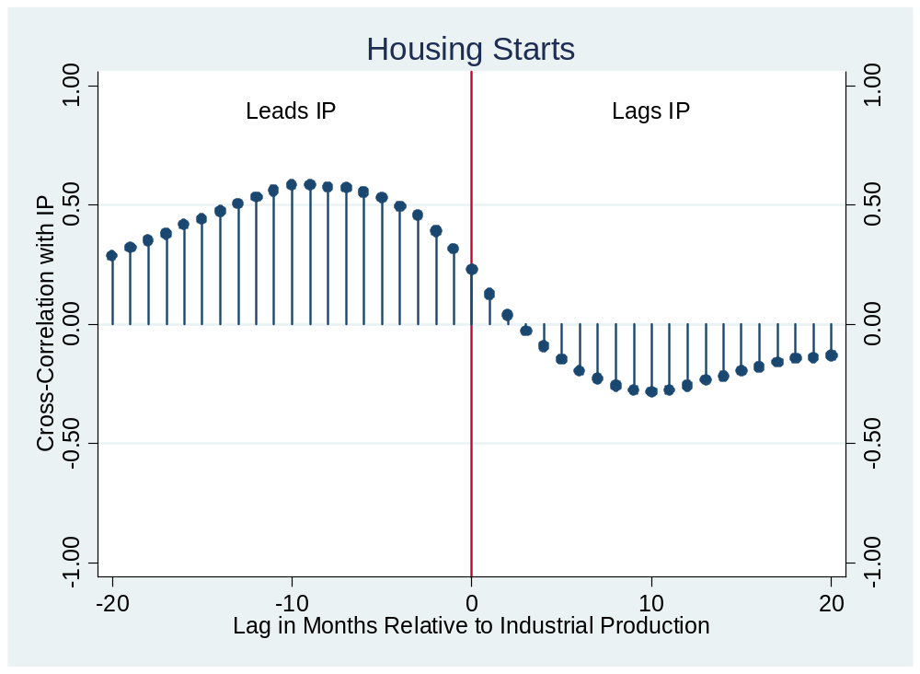
Housing starts?
Notes:
Both growth rates

Slide 31
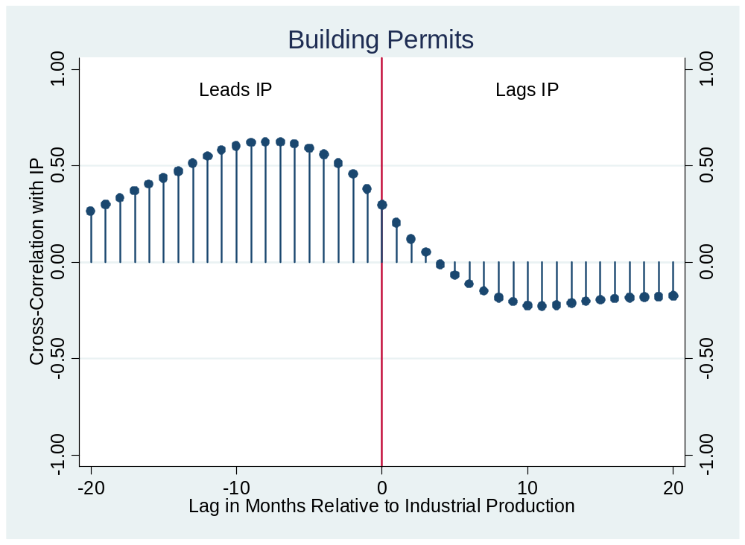
Building permits?

Slide 32
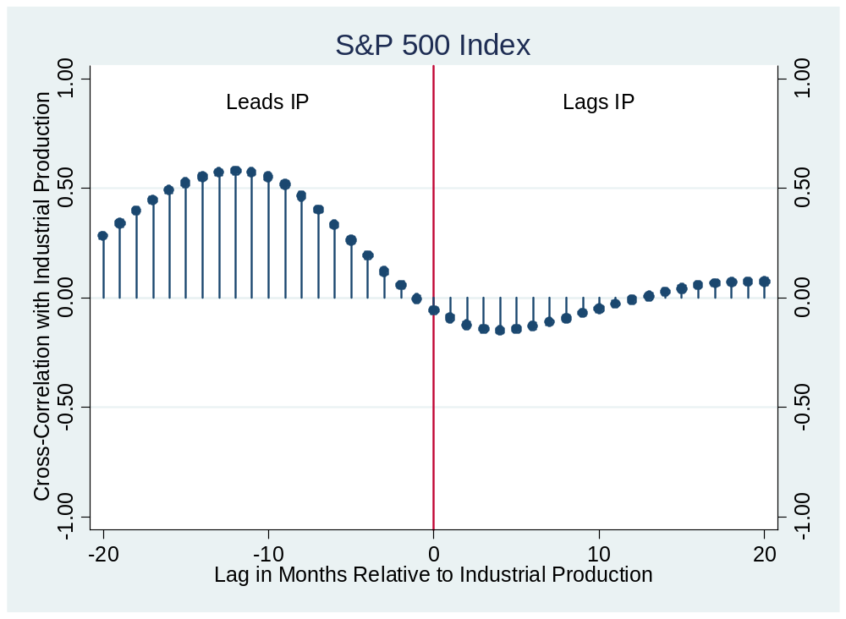
S&P 500 index?
Notes:
Pick a point: what is this?

Slide 33
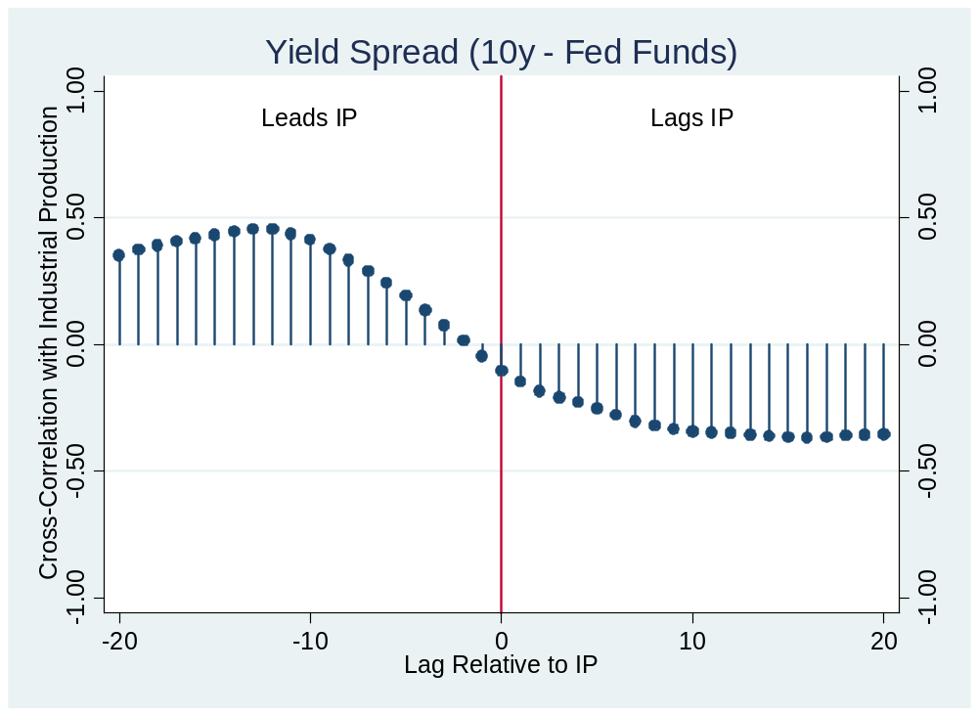
Yield spread?

Slide 34
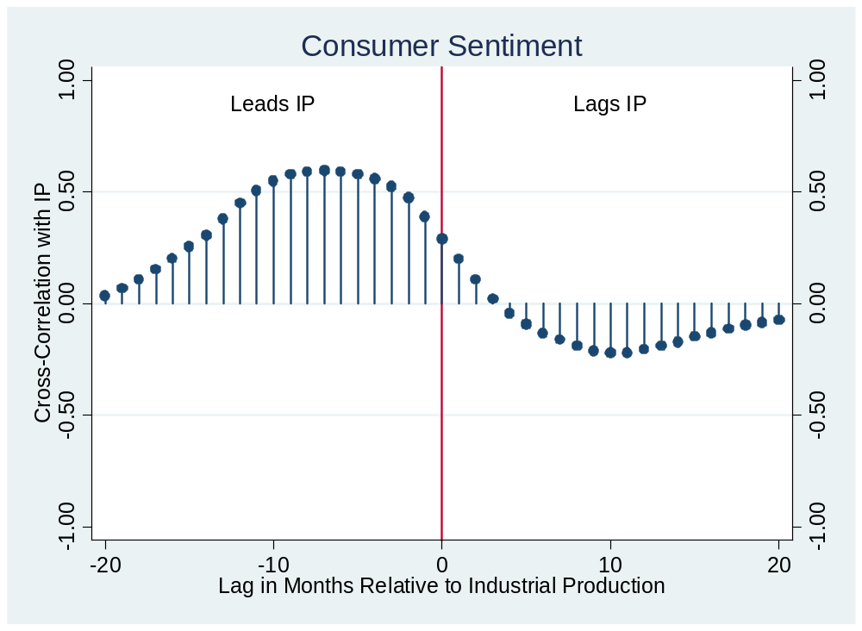
Consumer sentiment?

Slide 35
What have we missed?
Using regressions to generate forecasts
  Take a stats class
  Good for you no matter what your career plans
Market-based forecasts
  Futures markets in lots of things
  Market “aggregates” information
Notes:
A good picture

Slide 36
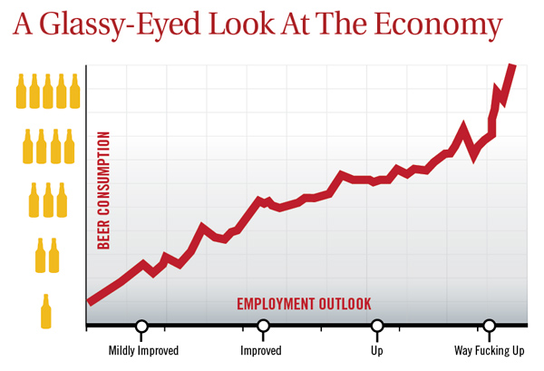
Unemployment outlook
“Nation's Unemployment Outlook Improves Drastically After Fifth Beer,” The Onion.
Notes:
http://www.theonion.com/articles/nations-unemployment-outlook-improves-drastically,2792/

Slide 37
What have we learned?

Slide 38
Takeaways
Good indicators tell us something about the future
Useful tools
  Business cycle scorecard
  Cross-correlation function

Slide 39
Computing cross-correlations
Date | x(t) | y(t)
1 | 2.43 | 8.47
2 | 1.19 | 2.29
3 | 0.13 | 7.36
4 | 0.56 | 6.39
5 | 0.38 | 6.02
6 | 0.96 | 0.22
7 | 1.87 | 3.60
Reminder:
ccf(k) = corr[x(t),y(t-k)]
For k = 0:
ccf(0) = corr[x(t),y(t)]
Use data marked
Red for x
Blue for y

Slide 40
Computing cross-correlations
Date | x(t) | y(t)
1 | 2.43 | 8.47
2 | 1.19 | 2.29
3 | 0.13 | 7.36
4 | 0.56 | 6.39
5 | 0.38 | 6.02
6 | 0.96 | 0.22
7 | 1.87 | 3.60
Reminder:
ccf(k) = corr[x(t),y(t-k)]
For k = +1:
ccf(1) = corr[x(t),y(t-1)]
Means: x lags y
Use data marked
Red for x
Blue for y

Slide 41
Computing cross-correlations
Date | x(t) | y(t)
1 | 2.43 | 8.47
2 | 1.19 | 2.29
3 | 0.13 | 7.36
4 | 0.56 | 6.39
5 | 0.38 | 6.02
6 | 0.96 | 0.22
7 | 1.87 | 3.60
Reminder:
ccf(k) = corr[x(t),y(t-k)]
For k = –1:
ccf(-1) = corr[x(t),y(t+1)]
Means: y lags x
Use data marked
Red for x
Blue for y

Slide 42
The Global Economy
Aggregate Supply and Demand
© NYU Stern School of Business
Notes:
Welcome back!

Slide 43
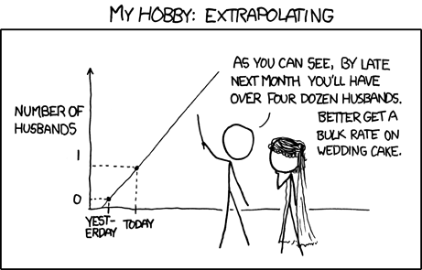
Extrapolating
Source: xkcd <http://xkcd.com/605/>

Slide 44
Group Project #5
Revised version on Blackboard
  Last bullet deleted
Goal: assess US economy
Standard data sources
  Indicators spreadsheet: see Blackboard link
  St Louis Fed’s “FRED” database
  Census
  Federal Reserve
Come see me if you have questions

Slide 45
Group Project #5
The document should look professional
  See discussion for Group Project #2
  If you’d prefer 10 slides to 5 pages, let me know

Slide 46
Group Project #5
Reminder: we count the best 5 of 7
You can skip this one if it’s not your kind of thing

Slide 47
Plan of attack
Group Project #5 ✓
The idea, where we’re headed
Aggregate supply and demand
Applications
What have we learned?

Slide 48
The idea
The basic framework for business cycle analysis is a variant of the supply and demand diagram. It’s widely used by bank analysts and business journalists.

Slide 49
Where we’re headed
Current Conditions
Indicators
Theory: AS & AD
Monetary Policy
Statistical Analysis
Future Conditions

Slide 50
Aggregate supply and demand
P
AS
AD
Y

Slide 51
Aggregate supply and demand
Adapt supply and demand diagram to whole economy
Axes
  P is price level
  Y is real GDP
  Usually interpreted as inflation and GDP growth
Curves
  Supply focuses on production of goods
  Demand focuses on purchase of goods
Why do they look like this?

Slide 52
Aggregate supply 1
Classical version [“long run”]
Production function
  Y = A K^{α} L^{1-α}
At any point in time
  A is given [but may change over time]
  K is given [but may change over time]
  L reflects “equilibrium” in labor market
  Y must therefore be “given” [and AS vertical]

Slide 53
Aggregate supply 1
P
AS*
Y

Slide 54
Aggregate supply 2
Keynesian version [“short run”]
Production function
  Y = A K^{α} L^{1-α}
At any point in time
  A, K given
  Nominal wage “sticky”
  Increase in P reduces real wage, so firms hire more people
  More L implies more Y ⇨ AS curve slopes upward
Wage eventually adjusts, bringing us back to AS*

Slide 55
Aggregate supply 2
P
AS*
AS
Y

Slide 56
Aggregate supply
What happens if we
  Change A or K?
  Change price of oil?
Note: typically both AS and AS* shift

Slide 57
Aggregate demand
Take this on faith
We’ll see next week
  Quantity theory generates inverse relation betw P and Y
  M V = P Y
  M/P = Y/V
  Given M and V, an increase in P results in lower Y
With more work, you can bring interest rates in

Slide 58
Aggregate demand
P
AD
Y

Slide 59
Aggregate demand
What happens if we
  Change M?
  Change G?
  Change consumption or investment demand (“optimism”?)

Slide 60
Aggregate supply and demand
P
AS*
AS
AD
Y

Slide 61
Equilibrium
P
AS*
AS
A
B
AD
Y

Slide 62
Equilibrium
Start at A [“short-run equilibrium”]
  Where AS and AD cross
Move toward B [“long-run equilibrium”]
  Where AS* and AD cross
  Why? Because wages adjust, shifting AS down
  This goes on until AS crosses AS* at B

Slide 63
Applications
Does the stimulus package increase GDP?
Does increase in money supply raise output?
Does increase in productivity raise GDP?
Does increase in saving raise or lower GDP?
Do high oil prices generate inflation?
Is the financial crisis a change in supply or demand?
Should monetary policy focus on inflation or output? [next time]

Slide 64
Fiscal stimulus
Example: increase G
Does this shift AS or AD?
Does it raise or lower Y? P?

Slide 65
Fiscal stimulus
P
AS*
AS
A
B
AD
Y

Slide 66
Fiscal stimulus summary
Example: increase G
Does this raise or lower Y? P?
Impact of decrease in “demand”
  AD shifts right/up
  Short-run impact: prices up, output up
  Long-run impact? (Depends where you start)

Slide 67
More money
Example: central bank increases M
Does this shift AS or AD?
Does it raise or lower Y? P?

Slide 68
More money
P
AS*
AS
AD
Y

Slide 69
More money summary
Example: central bank increases M
Does this raise or lower Y? P?
Impact of increase in “demand”
  AD shifts right/up
  Short-run impact: prices up, output up
  Long-run impact? Prices up, output unchanged [this should remind you of quant theory]
Milton Friedman: Is inflation “always and everywhere a monetary phenomenon”?

Slide 70
Higher productivity
Example: IT revolution
Does this shift AS or AD?
Does it raise or lower Y? P?

Slide 71
Higher productivity
P
AS*
AS
AD
Y

Slide 72
Higher productivity summary
Example: IT revolution
Does this raise or lower Y? P?
Impact of increase in “supply”
  AS shifts right/down
  Short-run impact: prices down, output up
  Long-run impact: ditto

Slide 73
Higher oil prices
Example: oil prices spike up
Does this shift AS or AD?
Does it raise or lower Y? P?

Slide 74
Higher oil prices
P
AS*
AS
AD
Y

Slide 75
Higher oil prices summary
Example: oil prices spike up
Does this raise or lower Y? P?
Impact of decrease in “supply”
  AS shifts left/up
  Short-run impact: prices up, output down
  Long-run impact: ditto

Slide 76
Higher saving
Example: consumer confidence falls
Does this shift AS or AD?
Does it raise or lower Y? P?

Slide 77
Higher saving
P
AS*
AS
AD
Y

Slide 78
Higher saving
Example: consumer confidence falls
Does this raise or lower Y? P?
Impact of decrease in “demand”
  AD shifts left/down
  Short-run impact: prices down, output down
  Long-run impact? [this should remind you of quant theory]

Slide 79
Financial crisis
Is this a shift in supply or demand?

Slide 80
Inflation and growth
Do you expect to see high growth associated with high inflation? Why or why not?
Put another way: do we see mostly shifts in supply or demand?

Slide 81
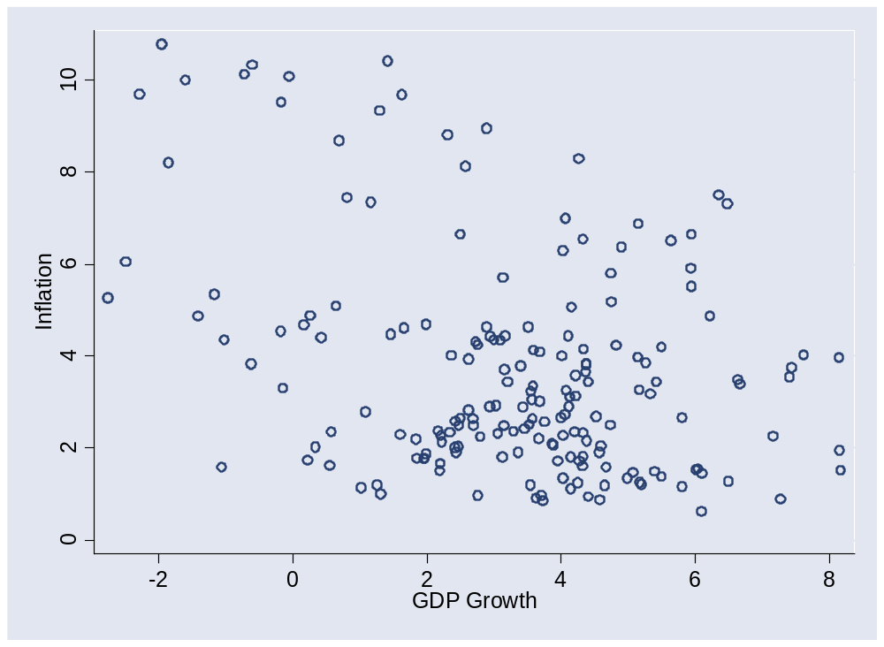
Inflation and growth

Slide 82
AS/AD summary
What they are
  Aggregate supply concerns production of goods
  Aggregate demand concerns purchases of goods
  Axes are P and Y, but we use inflation and growth
What shifts them
  What shifts AD?
  What shifts AS & AS*?
How to use them
  Short-run equilibrium: where AS and AD cross
  Long-run equilibrium: where AS* and AD cross

Slide 83
Takeaways
Aggregate supply (producers/sellers) and demand (buyers) is the analyst standard
In practice, the challenge is to know whether conditions reflect supply or demand

Slide 84
Special review session
Tuesday, April 6, 4:45-6:15 *** Note change ***
Location TBA: probably Amity Hall
Come with questions, comments, stories

Slide 85
Midterm summary
Max | 96
75th percentile | 89
65th percentile | 87
50th percentile (median) | 83
25th percentile | 79
Min | 58

Slide 86
Business cycle checklist
Macroeconomic conditions
  GDP growth, inflation, interest rates
Business cycle indicators
  Hints about future conditions
AS and AD
  Which is shifting?
Monetary policy
  How do we expect the central bank to respond?
  How will this affect interest rates? Inflation and GDP?

