Slide 1

The Global Economy
Government Debt & Deficits
© NYU Stern School of Business
Notes:
Open spreadsheet

Slide 2
Special review session, part 2
Today, 4:45-6:00
Location: Amity Hall, downstairs (80 West 3rd)
Come with questions, comments, stories

Slide 3
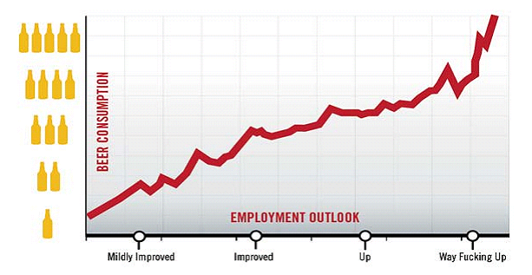
Employment outlook
Notes:
http://www.theonion.com/articles/nations-unemployment-outlook-improves-drastically,2792/

Slide 4
Where we’re headed
Govt Deficit
print money
Govt Debt
Trade Deficit
Inflation & FX
fear of default
Bank Failures
Crisis

Slide 5
Where we’re headed: checklist
Government debt and deficits
Exchange rate and reserves
Current account and net foreign assets
Banking system
Politics and institutions

Slide 6
The idea
Most governments issue debt. If they issue too much, investors become concerned about repayment.
How much is too much? It depends.
Notes:
Stories: Hamilton, Rothschilds

Slide 7
Plan of attack
Where we’re headed, the idea ✓
Quotes and pix
Ingredients of government budgets
Government debt dynamics
What’s missing?
[Greece and other examples along the way]

Slide 8
Alexander Hamilton
Second Report on Public Credit, 1795:
  Every system of Public Credit must assume as a fundamental principle that it will possess ability to pay the debt which it contracts. … With the creation of debt should be incorporated the means of extinguishment.

Slide 9
Clive Crook
Financial Times, April 6 09:
  The Obama administration’s budget left a persistent deficit of roughly 3-4% of GDP. This has nothing to do with stimulus: the gap is there 10 years out and beyond, long after the economy is assumed to recover. The gap reflects underlying pressures on public spending. … Congress’s tweaks point toward even bigger deficits.

Slide 10
Angela Merkel
Financial Times, March 28 09:
  The German chancellor will warn leaders of the world’s largest economies against pumping too much money into reviving global growth, saying that such action would create an unsustainable recovery. She rejected renewed calls to spend more public money in Germany as part of a co-ordinated stimulus plan.

Slide 11
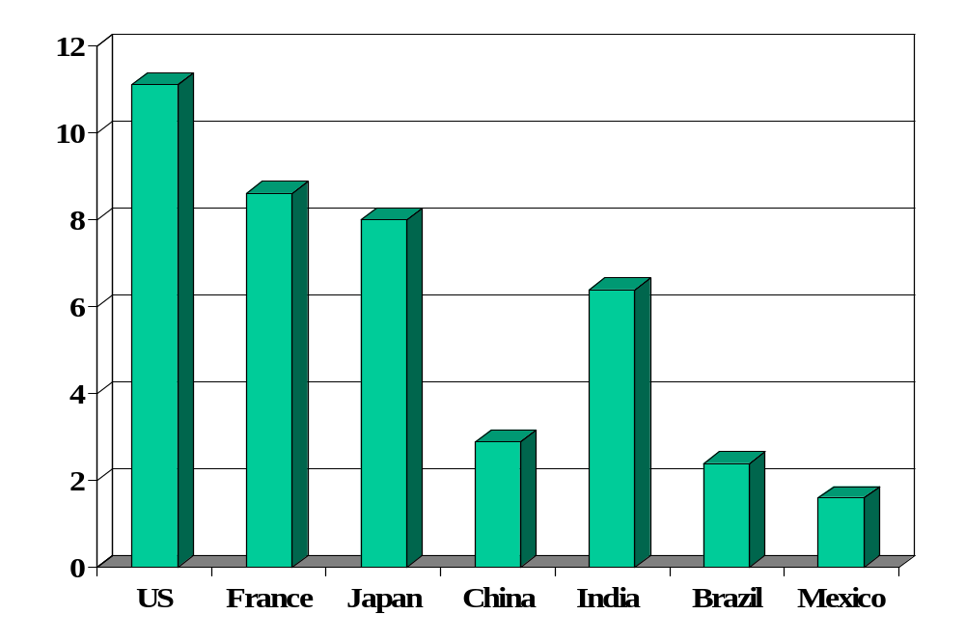
Government deficits (2010, % of GDP)
Source: Economist.
Notes:
http://www.oecd.org/dataoecd/5/51/2483816.xls

Slide 12
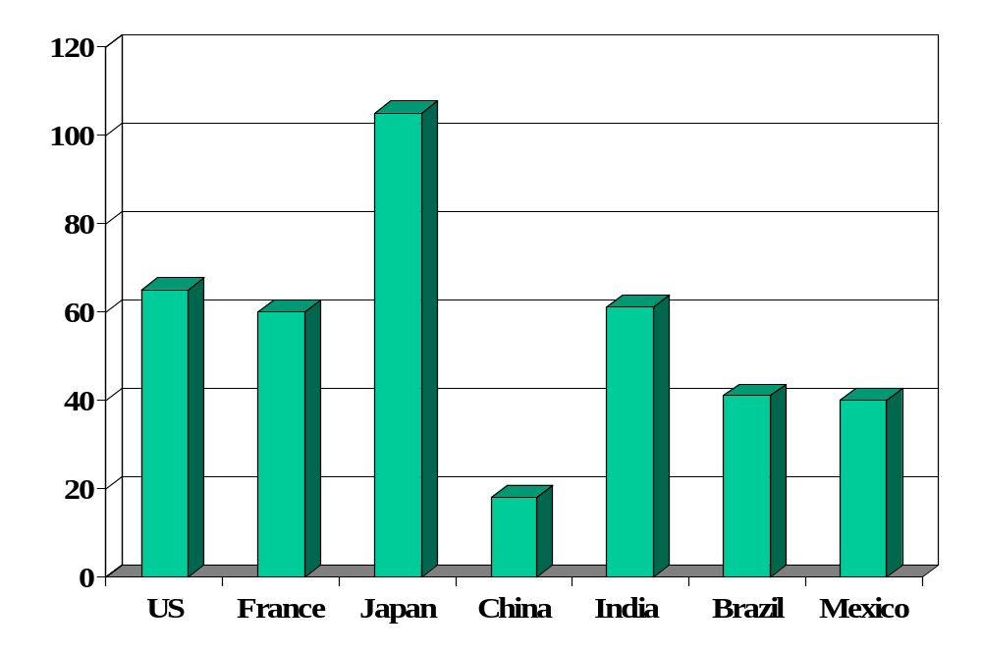
Government debt (% of GDP)
Source: OECD (net debt) and EIU Country Data (public sector debt).
Notes:
Net debt from OECD

Slide 13
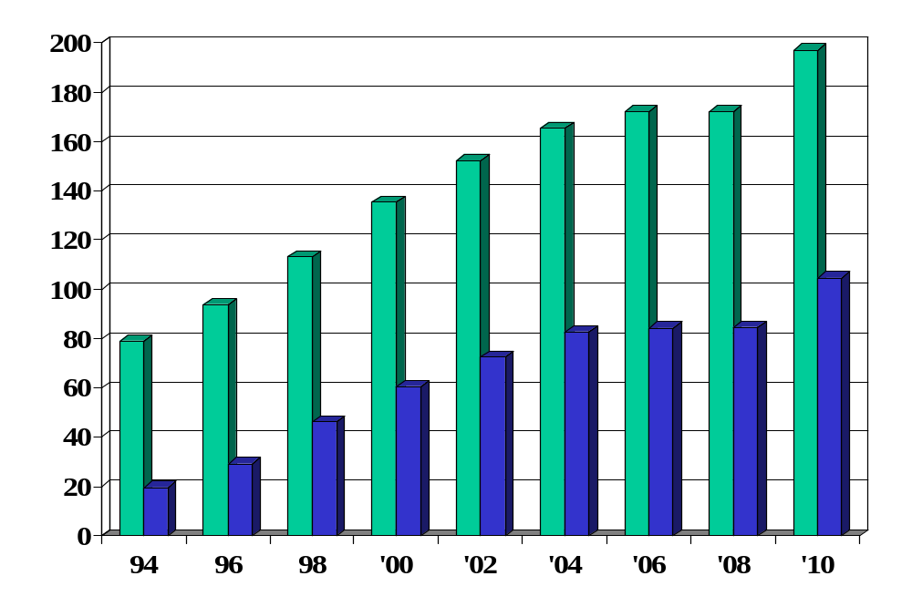
Japan: debt (% of GDP, green=gross, blue=net)
What happened here?
Source: OECD.
Notes:
http://www.oecd.org/dataoecd/5/51/2483816.xls

Slide 14
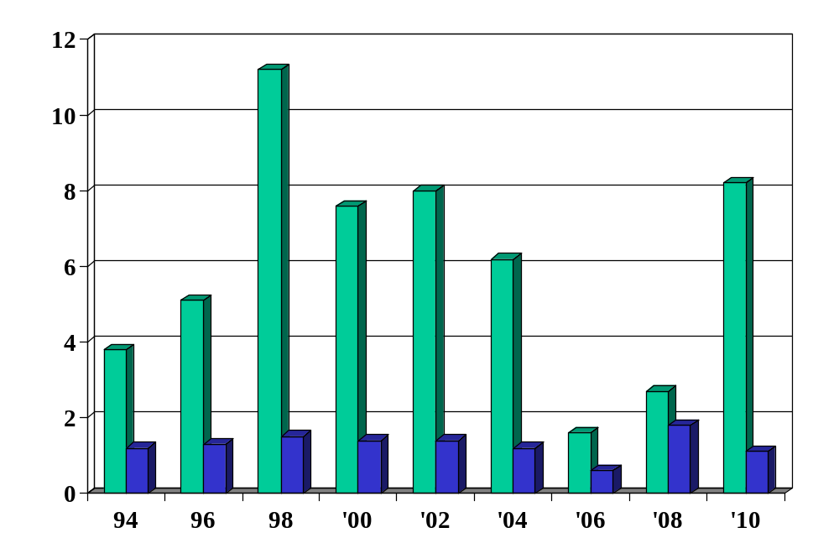
Japan: deficit (% of GDP, green=def, blue=int)
What happened here?
Source: OECD.
Notes:
http://www.oecd.org/dataoecd/5/51/2483816.xls

Slide 15
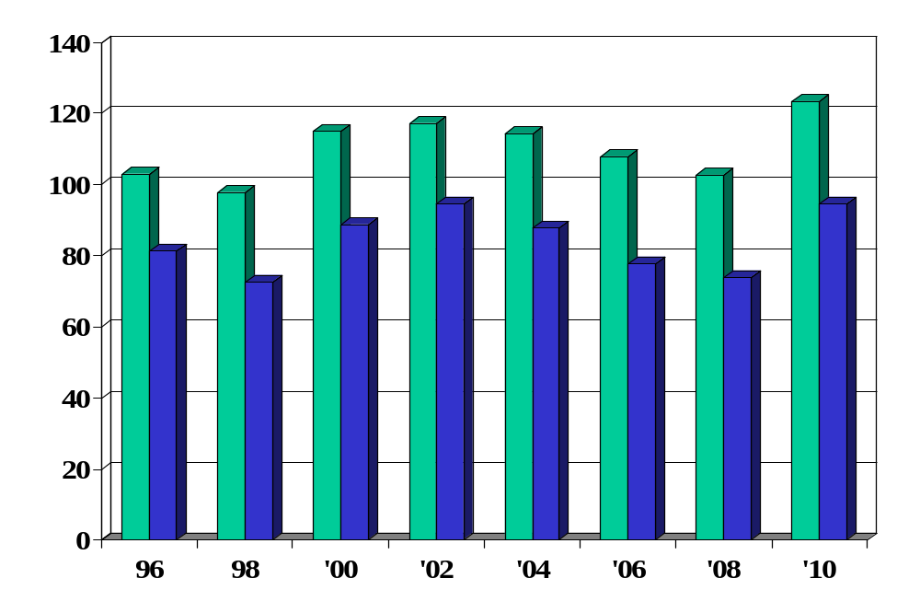
Greece: debt (% of GDP, green=gross, blue=net)
Source: OECD.
Notes:
http://www.oecd.org/dataoecd/5/51/2483816.xls

Slide 16
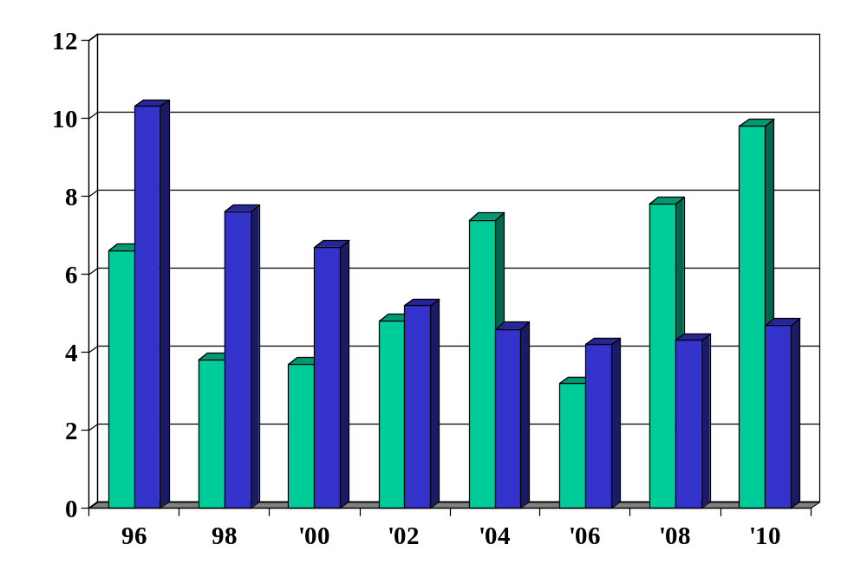
Greece: deficit (% of GDP, green=def, blue=int)
What happened here?
Source: OECD.
Notes:
http://www.oecd.org/dataoecd/5/51/2483816.xls

Slide 17
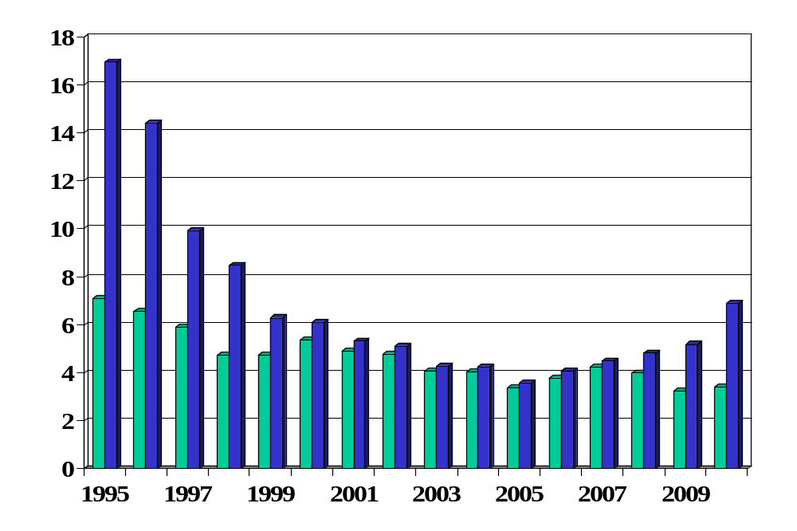
Greece: interest rates v Germany
What happened here?
Source: EIU Country Data (long bonds).
Notes:
Started Jan 1 99
Greece joined Jan 1 2001

Slide 18
Ingredients of government budgets
Government spending
G_{t} + V_{t} + i_{t} B_{t-1}
Government tax revenue
T_{t}
Government debt
B_{t}

Slide 19
Ingredients of government budgets
Government budget:
G_{t} + V_{t} + i_{t} B_{t-1} = T_{t} + B_{t} – B_{t-1}
Ingredients:
  G = government purchases of goods and services
  V = transfer payments from government to households
  G + V = government spending
  T = tax revenue
  G + V – T = primary deficit (excl interest)
  B = government debt (“bonds”)
  i = (nominal) interest rate paid on debt
  iB = interest payments on debt

Slide 20
Ingredients in the US (billions of USD)
2008
Revenue |  | 4120
 | Tax revenue | 2849
 | Social insurance contributions | 996
Expenses |  | 4721
 | Goods, services, and employee comp | 2386
 | Social insurance payments | 1874
 | Interest on debt | 410
Surplus |  | -841
Sources: BEA. Numbers might not add: some small categories have been omitted.

Slide 21
Ingredients in Germany (% of GDP)
2005!
Revenue |  | 43.4
 | Tax revenue | 22.1
 | Social security revenue | 17.7
Expenses |  | 46.8
 | Goods, services, and employee comp | 11.7
 | Social security | 26.6
 | Interest on debt | 2.8
Surplus |  | -3.3
Sources: EIU Country Profile. Numbers might not add: some small categories have been omitted.

Slide 22
Fiscal policy in Germany in 2005
High debt: ~68% of GDP
  Reflects, in part, high cost of reunification
High spending
  Large pension obligations, aging population, social programs
High taxes
  Labor: esp high taxes on singles (52%) and two-income families (45%)
  Corporations: highest rate in OECD (39%)
How would this affect you if you were a
  German manufacturer deciding where to locate factory?
  Internationally mobile German worker?
Sources: OECD report.

Slide 23
Fiscal policy in Germany in 2005
What would you recommend?
Sources: OECD report.

Slide 24
Fiscal policy in Germany
Update
Budget balanced (primary surplus)
  Increased VAT from 16% to 19%
  Dropped corporate rate
  Capped some social programs
  Growth generated more revenue
  Balanced budget restrictions being phased in
Sources: OECD report.

Slide 25
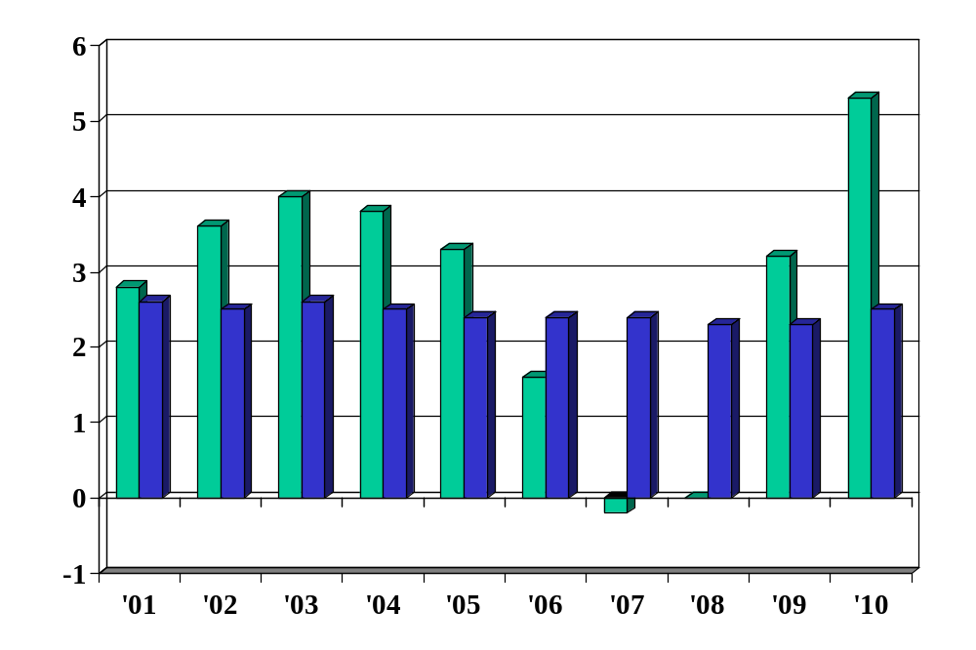
Germany: deficit (% of GDP, green=def, blue=int)
Source: OECD.
Notes:
http://www.oecd.org/dataoecd/5/51/2483816.xls

Slide 26
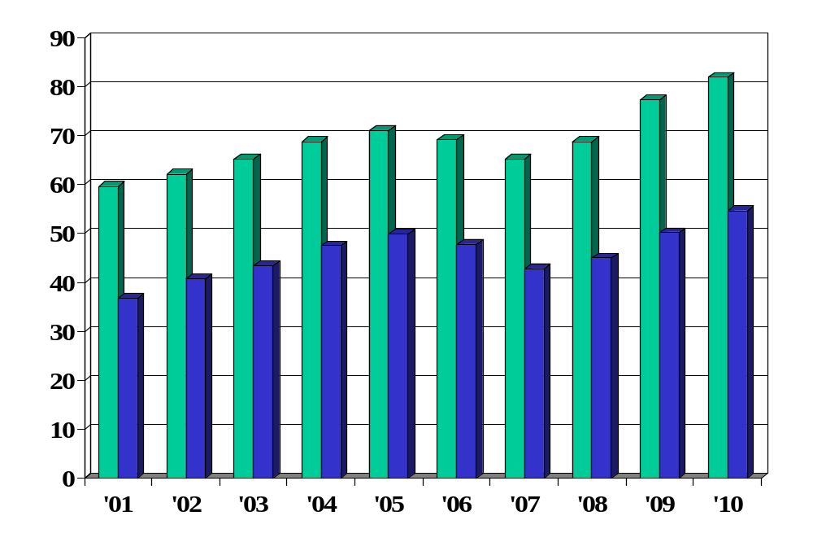
Germany: debt (% of GDP, green=gross, blue=net)
Source: OECD.
Notes:
http://www.oecd.org/dataoecd/5/51/2483816.xls

Slide 27
Government debt dynamics
Principle #1: taxes must finance spending
  You need to pay for what you spend
Analogy: credit card
  Allows you to shift payments in time, not avoid them
  Higher debt leads to higher interest payments, which requires higher future cash flow to finance (and so on)
Government deficits and debt
  Deficits concern timing, not whether we pay for government spending
  Eventually accumulated debt must be repaid – unless you default

Slide 28
Government debt dynamics
Government budget
G_{t} + V_{t} + i_{t} B_{t-1} = T_{t} + B_{t} – B_{t-1}
(G_{t} + V_{t} – T_{t}) + i_{t} B_{t-1} = B_{t} – B_{t-1}
Ingredients:
  D = G + V – T = primary deficit (excl interest)
  B = government debt (“bonds”)
  iB = interest payments

Slide 29
Government debt dynamics
Three versions of the same equation
D_{t} + iB_{t-1} = B_{t} – B_{t-1} (1) finance deficit with debt
B_{t} = (1+i)B_{t-1} + D_{t} (2) debt dynamics (backward)
B_{t-1} = B_{t}/(1+i) – D_{t}/(1+i) (3) debt dynamics (forward)
Bottom line
  Deficits must be financed (Principle #1)

Slide 30
Government debt dynamics
Current debt equals
B_{t-1} = B_{t}/(1+i) – D_{t}/(1+i) [version (3)]
= B_{t+1}/(1+i)² – [D_{t}/(1+i) + D_{t+1}/(1+i)²]
= …
= B_{t+n-1}/(1+i)^{n} – [D_{t}/(1+i) + D_{t+1}/(1+i)² + … + D_{t+n-1}/(1+i)^{n}]
Debt = present value of future primary surpluses
Comments
  Debt must be financed by future (primary) surpluses
  Assumes: B_{t+n-1}/(1+i)^{n} → 0 [weaker condition than B_{t+n} → 0]
  Or we could default!

Slide 31
Government debt dynamics
Issue:
  How does ratio of debt to GDP change?
  Both measured at current prices (“nominal”)
Growth of (nominal) debt [budget version (2)]
B_{t} = (1+i)B_{t-1} + D_{t}
Growth of (nominal) GDP
Y_{t} = (1+g)Y_{t-1}
Growth of debt to GDP ratio
B_{t}/Y_{t} = [(1+i)/(1+g)] (B_{t-1}/Y_{t-1}) + D_{t}/Y_{t}

Slide 32
Government debt dynamics
Reminder
B_{t}/Y_{t} = [(1+i)/(1+g)] (B_{t-1}/Y_{t-1}) + D_{t}/Y_{t}
“Natural” growth rates
  Debt: (1+i) [nominal]
  GDP: (1+g) [nominal]
  Ratio of debt to GDP: (1+i)/(1+g)
Fine print
  What interest rate? Whatever’s paid on government debt.
  What growth rate? Nominal, just like the interest rate.

Slide 33
Government debt dynamics
Reminder
B_{t}/Y_{t} = [(1+i)/(1+g)] (B_{t-1}/Y_{t-1}) + D_{t}/Y_{t}
What could go wrong? [“wrong” = sharp rise in B/Y]

Slide 34
Fiscal policy in Germany
Germany in 2009
  B/Y = 50%
  D/Y = +2.3%
  iB/Y = 3.4%
  i = 5% [what “i” should you use here?]
  g = 0% (inflation + real growth)
How does B/Y change?
Would you increase stimulus [Merkel]?
Sources: EIU Country Report.

Slide 35
Fiscal policy in Brazil
High debt for a developing country: ~40% of GDP
  Debt service high because interest rate is high
Major spending issues
  Large government for developing country
  Generous pensions to civil servants
  Similar obligations to private-sector pensions
How would this affect you if you were a
  Brazilian worker about to retire?
  Young Brazilian worker?
  European food retailer deciding where to expand?

Slide 36
Fiscal policy in Brazil (% of GDP)
2009
Primary balance (non-interest) | 2.6
Interest on debt | 4.5
Total budget balance | –1.9
Public debt (last period) | 37.0
Note different “sign convention”: deficits negative here
Sources: EIU Country Report.

Slide 37
Fiscal policy in Brazil
Brazil today
  B/Y = 41.6% [end of last year]
  D/Y = 2.8% [primary surplus!]
  i = 12% [what is this?]
  g = 10.8% (=5.3+5.5)
How does B/Y change?

Slide 38
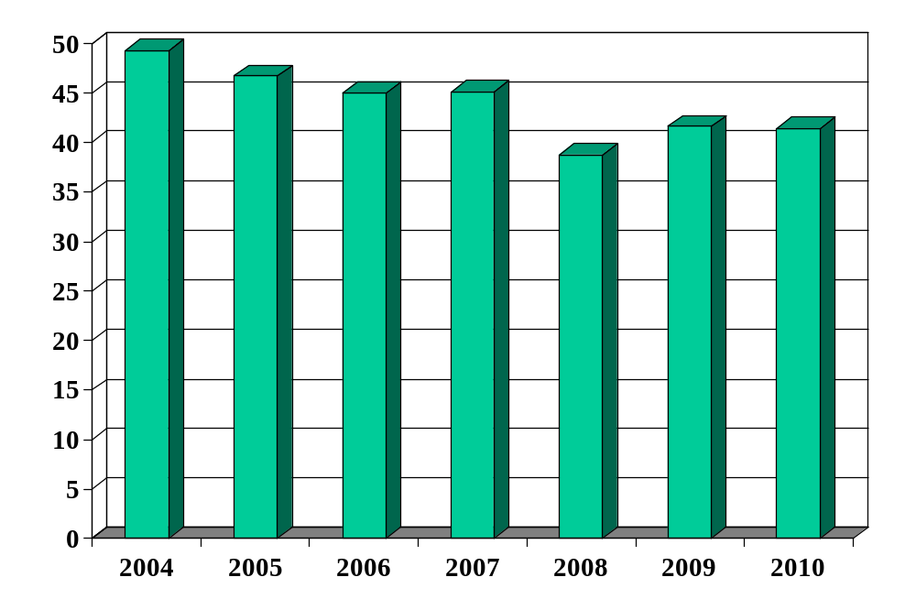
Brazilian debt (% of GDP)
Source: EIU Country Report.

Slide 39
Fiscal policy in Brazil
Bill Lewis, McKinsey (The Power of Prosperity):
  High government spending for developing country (~40%)
  Magnified by interest on past debt (at high rates)
  Requires high taxes
  Large underground economy survives by avoiding taxes
  Major impediment to TFP: official businesses more efficient, but higher tax burden limits their growth
  Therefore: fiscal discipline is a central issue for growth
  Changing in recent times?

Slide 40
Fiscal policy in Peru (% of GDP)
From MBA alum Jaime Pease:
2008
Primary balance (non-interest) | 1.4
Interest on debt | –2.0
Total budget balance | –0.6
Public debt (last period) | 27.3
Sources: Fitch report..

Slide 41
Fiscal policy in Peru
Peru in 2008
  B/Y = 27%
  D/Y = –1.4%
  i = 7.5%
  g = 8.0% (5.6+2.4)
How does B/Y change?

Slide 42
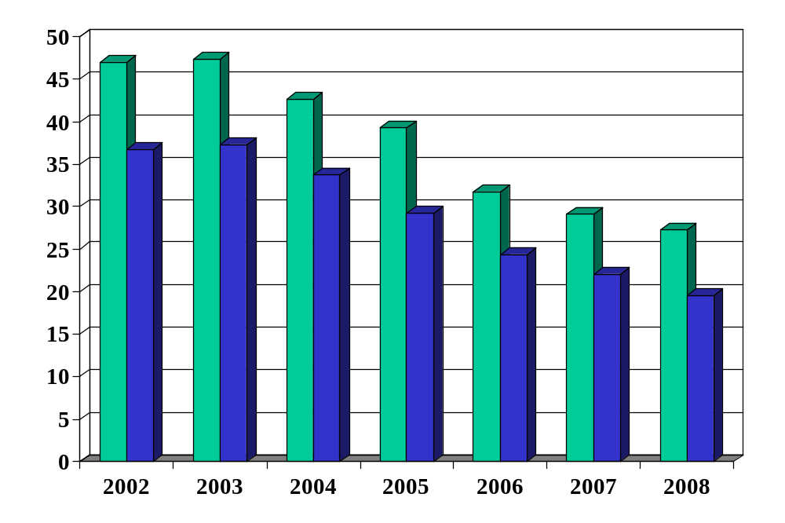
Peruvian debt (% of GDP)
Source: Fitch report. Green = total debt, Blue = foreign debt.

Slide 43
Fiscal policy in Greece
Euro Zone limits
  Deficit no greater than 3% of GDP
  Debt no greater than 60% of GDP
  Why?
  If this is the rule, how did Greece make it?
What went wrong?

Slide 44
Fiscal policy in the US
The subject of Group Project #7
See links in online version and posts on Blackboard (Discussion)

Slide 45
What’s missing?
Hidden liabilities and expenses
  Pension liabilities often ignored or understated
  Financial bailouts: they’re expensive when they happen
  Dodgy accounting and financial trickery
  Debt denominated in foreign currency
Hidden (potential) interest expense
  If investors panic, interest rate can rise quickly
Hidden revenue
  Growth not only increases the denominator in B/Y
  … it also generates higher tax revenue

Slide 46
What have we learned?
What are the signs of fiscal difficulty?

Slide 47
Takeaways
Fiscal policy analysis combines accounting and psychological analysis of politicians
Basic principle: government deficits must be financed
  By issuing debt today
  And by running (primary) surpluses in the future
If the latter seems unlikely, invest elsewhere
The cure for all ills: growth

Slide 48
After the break
Be prepared to discuss
  Group Project #6
  Pricing Heineken in the US

Slide 49
The Global Economy
Exchange Rates
© NYU Stern School of Business
Notes:
ERs central to most international transactions – and a source of vol
Invest in German/Brazilian/Chinese stock
Coke in Venezuela
Foreign student at Stern
ER central to each
Plan:
Exchange rate variations in (mostly) developed countries with flex ERs
Fixed ERs and how they work (EZ, etc)

Slide 50

LABA Summit this Friday

Slide 51
Group Project #6
How does the ECB work?
What is its mission?
How do you see EZ interest rates evolving?

Slide 52
Heineken USA
Euro was $1.44 at start of year
  What is it now?
  Where do you think it will be at year-end?
How does the change affect your business?
How would you respond?
Notes:
Now 1.35

Slide 53
The idea
Exchange rates….
… where sensible theories come to die
When inflation is high, currencies typically fall proportionately. When inflation is low, movements in exchange rates still vary, but in largely inexplicable ways.

Slide 54
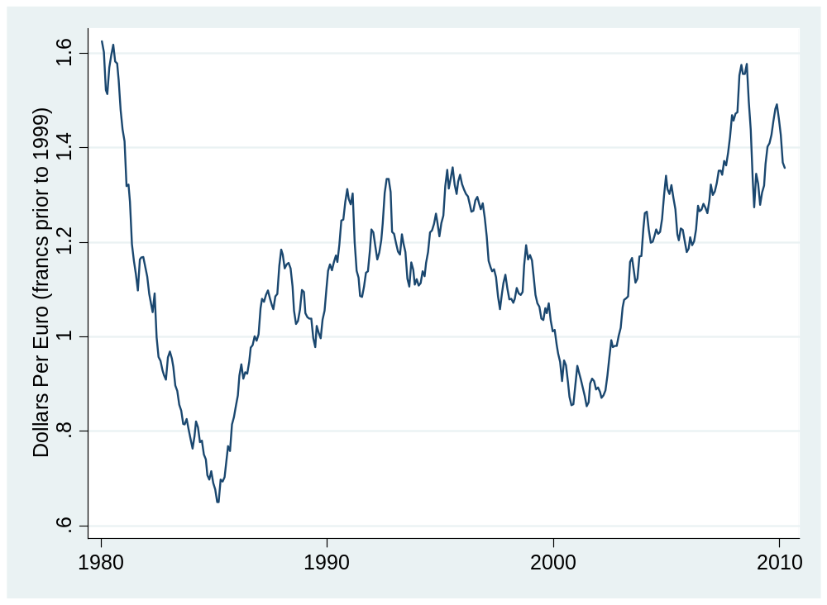
Dollars per euro (franc<1999)
Source: IMF or FRED.

Slide 55
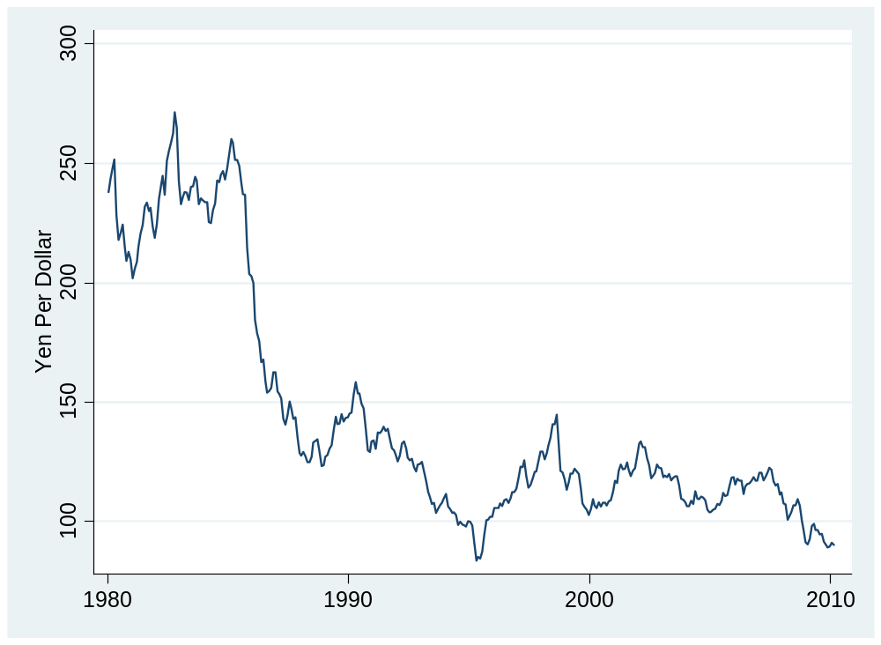
Yen per dollar
Source: IMF or FRED.

Slide 56
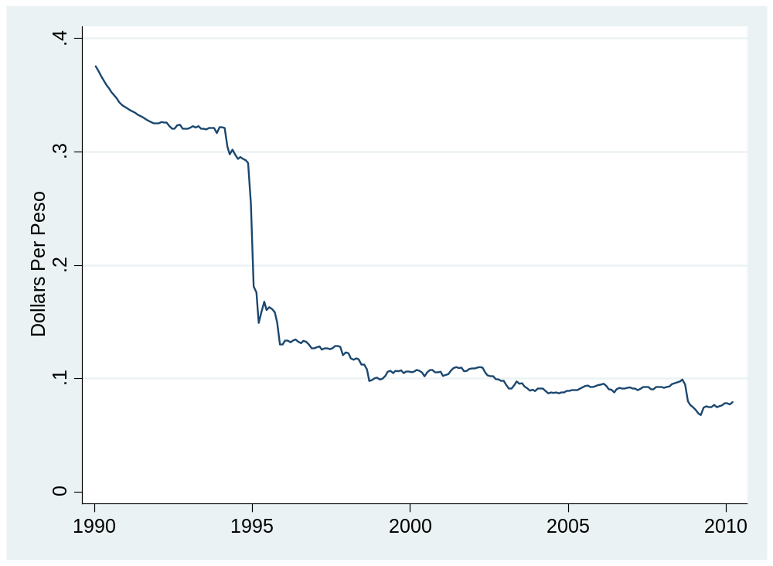
Dollars per peso
Source: IMF or FRED.

Slide 57
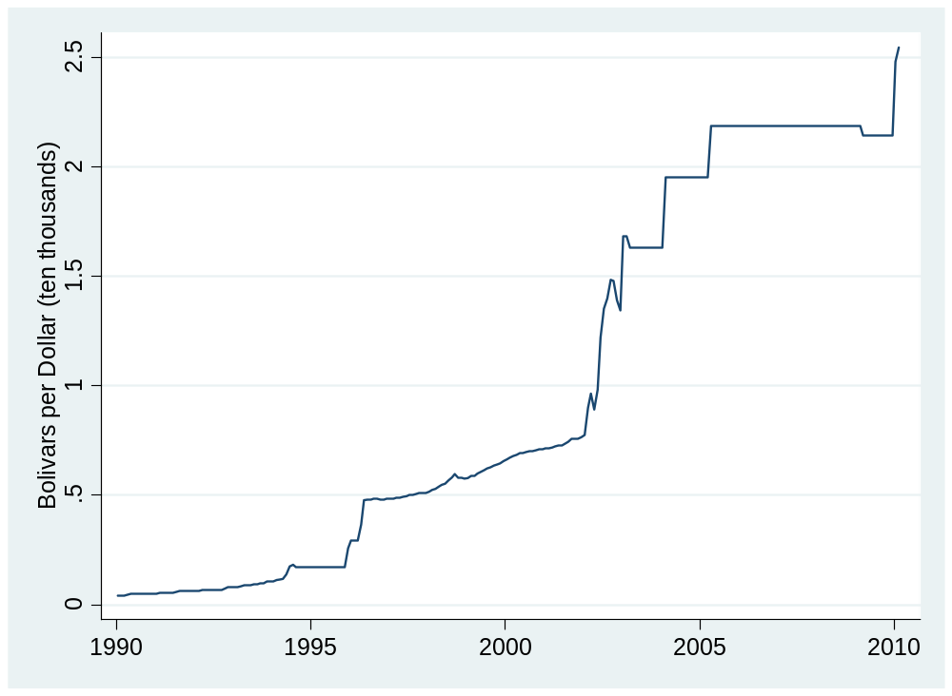
Bolivars per dollar
Source: IMF or FRED.

Slide 58
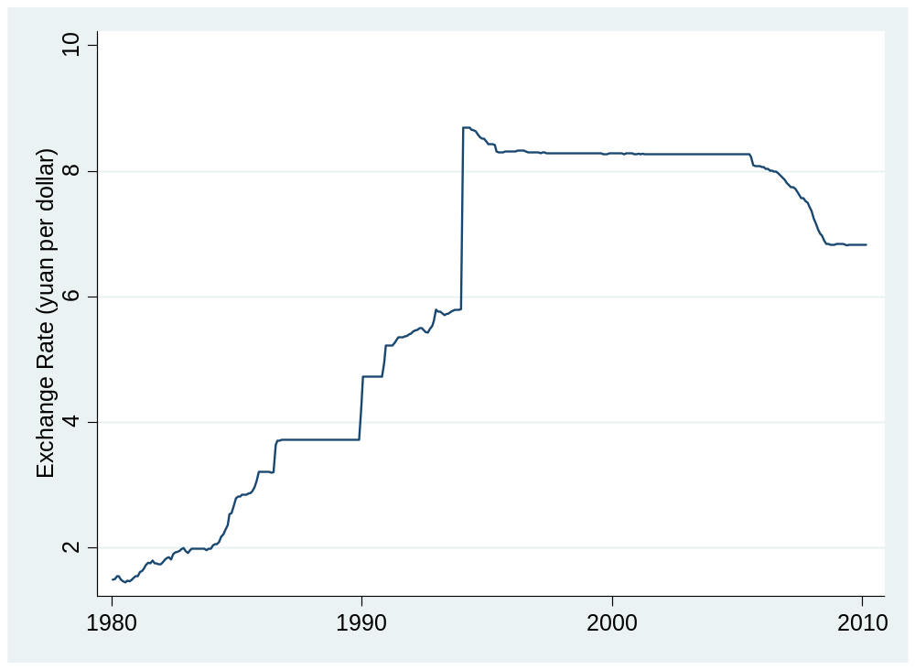
Yuan per dollar
Source: IMF or FRED.

Slide 59
Quotes
Alan Greenspan:
  Having endeavored to forecast exchange rates for more than half a century, I have understandably developed significant humility about my ability in this area, a sentiment that I suspect many in this room share.
Link

Slide 60
Quotes
Bill Gross, PIMCO, 2004:
  If you think writing about the fortunes of the stock market is tricky, try getting your arms around currencies.
Link

Slide 61
Quotes
Warren Buffett, Letter to Shareholders, 2005:
  Berkshire owned about $21.4 billion of foreign exchange contracts at yearend, spread among 12 currencies. As I mentioned last year, holdings of this kind are a decided change for us. But the evidence grows that our trade [deficit] will put unremitting pressure on the dollar for many years to come.
Positions closed two years later at a loss.

Slide 62
Quotes
Anonymous hedge fund manager:
  From time to time, the dollar's been very weak; from time to time, it's very strong. … Over the very very long term, currency processes tend to be fairly stable and mean-reverting. So the dollar's very weak today, but that's no reason to believe the dollar's going to be weak forever or that, because it's weak today, it's going to get dramatically weaker tomorrow. [But] it's amazing how many brilliant investors have gotten egg on their face trying to trade G-7 [currency] crosses.
Link

Slide 63
Quotes
Jean-Paul Villain, head of strategy, ADIA:
  We came to a very firm conclusion: we simply don’t know how to trade currencies.

Slide 64
Plan of attack
ECB, Heineken ✓
Pix and quotes ✓
Exchange rates and prices: the PPP “anchor”
Exchange rates and interest rates: the “carry trade”
What have we learned?

Slide 65
Exchange rates and prices
Theory: purchasing power parity
  Currency prices (foreign exchange rates) adjust to equate the prices (purchasing power) across countries. If the cost of living in high in country X, its currency should fall.
  Some people refer to this (and similar concepts) as long-rune equilibrium.
What we’ll find
  Poor short-term indicator, but common long-run “anchor”

Slide 66
Exchange rates and prices
Define
  P = domestic price (measured in domestic currency)
  P* = foreign price (measured in foreign currency)
  s = spot exchange rate (domestic currency price of one unit of foreign currency)
  NB: rise in s = fall in value of domestic currency
Comparing prices
  Expressed in the same units, the prices are P and sP*
  If they’re different, is there an arbitrage opportunity?

Slide 67
Exchange rates and prices
Country/Region | USD Price of Big Mac (Jan 2010)
US | 3.58
Euro Zone | 4.62
Norway | 6.82
Japan | 3.54
China | 1.83
Brazil | 3.45
Mexico | 2.50
Is dollar weak or strong? Expected to rise or fall?
Source: The Economist.

Slide 68
Exchange rates and prices
Look at “average” prices
  P = domestic price index (measured in domestic currency)
  P* = foreign price index (measured in foreign currency)
  s = spot exchange rate (domestic currency price of one unit of foreign currency)
Comparing prices
  Expressed in the same units, the prices are P and sP*
  If they’re different, is there an arbitrage opportunity?

Slide 69
Exchange rates and prices
Theory: exchange rate equates purchasing power
Two ways to express this:
P = sP* or s = P/P*
RER = sP*/P = 1
We say the (domestic) currency is
  Undervalued if s > P/P* (domestic goods cheap)
  Overvalued if s < P/P* (domestic goods expensive)

Slide 70
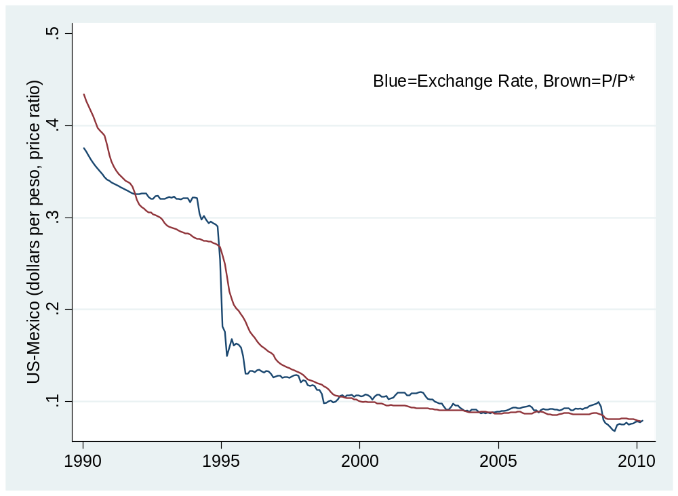
US/Mexico: s and P/P*
Source: IMF or FRED.

Slide 71
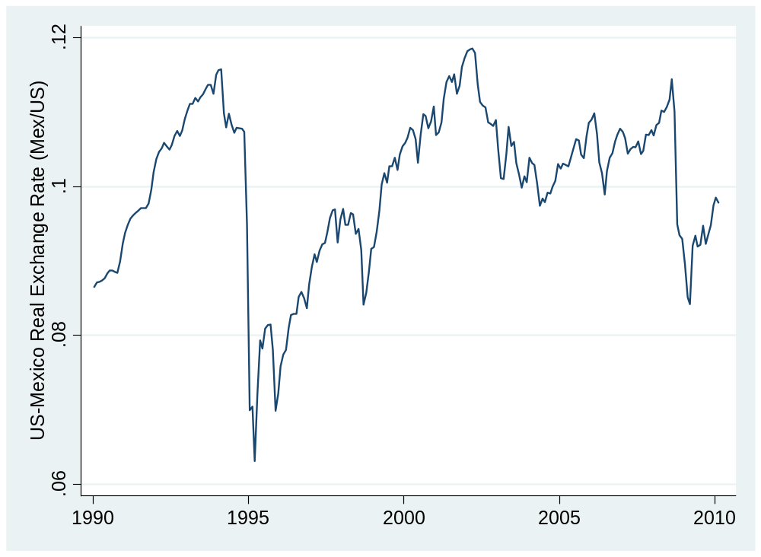
US/Mexico: real exchange rate
Source: IMF or FRED.

Slide 72
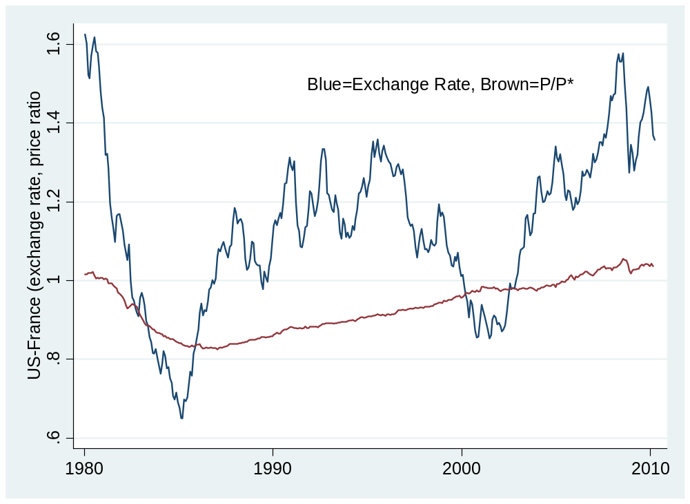
US/France: s and P/P*
Source: IMF or FRED.

Slide 73
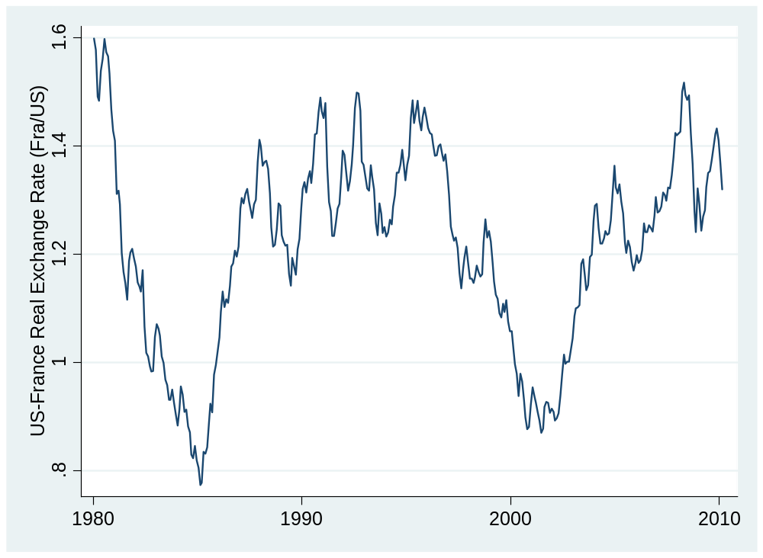
US/France: real exchange rate
Source: IMF or FRED.

Slide 74
Exchange rates and prices
Summary
Dollar v peso
  Large movements in P*/P reflected in opposite movements in s
  Still lots of movement in RER left
Dollar v euro/franc
  Little variation in P*/P
  Movements in s are therefore similar to those in sP*/P

Slide 75
PPP fail in Venezuela
From WSJ, Jan 17 10:
  President Hugo Chavez ordered Sunday the seizure of a French-owned retail chain on accusations that it raised prices after Venezuela devalued the currency by half. “Until when are we going to allow this to happen?” Mr. Chavez asked during his Sunday television program in reference to the alleged price increase by Almacenes Exito, headquartered in Colombia and controlled by French retailer Casino Guichard-Perrachon S.A.
Why is this dumb?
Links (1 | 2)

Slide 76
Exchange rates and interest rates

Slide 77
Exchange rates and interest rates
Uncovered interest rate parity
  If interest rates differ between two countries, expected depreciation equates expected returns expressed in a common currency
  Eg, if USD interest is 2% and EURO interest is 3%, a 1% appreciation of the dollar would make up the difference
What we’ll find
  High interest rate currencies tend to go up, not down

Slide 78
Exchange rates and interest rates
Country/Region | Money market rate
US | 0.22
Euro Zone | 0.64
Japan | 0.29
Australia | 4.55
China | 1.94
India | 3.97
Brazil | 8.65
Mexico | 4.43
Why are rates different? Where would you invest?
Source: The Economist.

Slide 79
Exchange rates and interest rates
Definitions
  i = money market interest rate on domestic currency
  i* = money market interest rate on foreign currency
  s = spot exchange rate (domestic currency price of one unit of foreign currency)
Returns measured in domestic currency
  Domestic return: i
  Foreign return: i* + (s_{t+1}– s_{t})/s_{t}
Uncovered interest parity
i = i* + E (s_{t+1}– s_{t})/s_{t}

Slide 80
Exchange rates and interest rates
The “carry trade”
  Long position in high interest rate currency
  Short position in low interest rate currency
  Carry: positive net interest rate
  Risk: that currency will depreciate
Which currencies would you go short in now? Long?

Slide 81
Exchange rates and interest rates
The “carry trade”
  Long position in high interest rate currency
  Short position in low interest rate currency
  Carry: positive net interest rate
  Risk: that currency will depreciate
Question: is risk worth it, on average?
If uncovered interest parity works
  Same average return either way

Slide 82
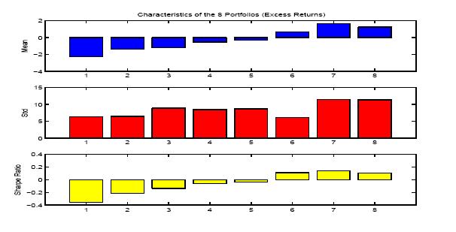
Exchange rates and interest rates
Portfolio strategy
  Rank currencies by short-term interest rate
  Sort into eight portfolios (low to high by rate)
  Compute excess returns (relative to dollar investments)
Source: Lustig and Verdelhan, NBER wp 11104.

Slide 83
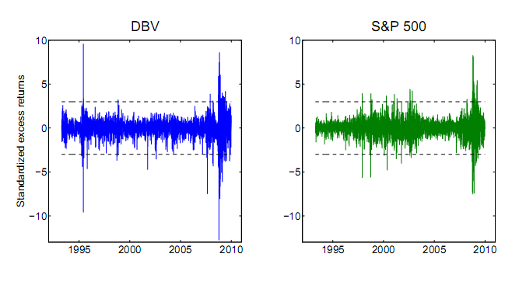
Exchange rates and interest rates
Risk in carry trade: Deutsche Bank Currency Harvest Fund (standardized daily excess returns v S&P 500)
Source: Chernov, discussion of Jurek.
Notes:
http://dbfunds.db.com/dbv/index.aspx

Slide 84
Exchange rates and interest rates
Bottom line
  On average, high interest rate currencies appreciate
  Opposite of uncovered interest parity [another theory gone to waste]
  Carry trade has positive average excess returns, also significant risk

Slide 85
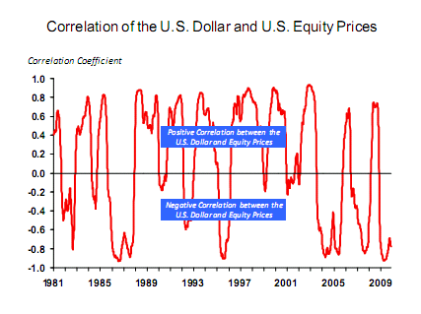
Exchange rates and equities
Source: Michael Rosenberg, Bloomberg. FXMI <go>

Slide 86
What have we learned?
What should we tell Heineken USA?
How should they manage currency risk?

Slide 87
Takeaways
Exchange rates are largely inexplicable in short run
  Significant source of business risk
Nevertheless
  PPP is useful a long-term anchor
  The carry trade works – on average

