Slide 1

The Global Economy
Exchange Rates
© NYU Stern School of Business
Notes:
ERs central to most international transactions – and a source of vol
Invest in German/Brazilian/Chinese stock
Coke in Venezuela
Foreign student at Stern
ER central to each
Plan:
Exchange rate variations in (mostly) developed countries with flex ERS
Fixed ERs and how they work (EZ, etc)

Slide 2
Overview
Exchange rates….
… where sensible theories come to die

Slide 3
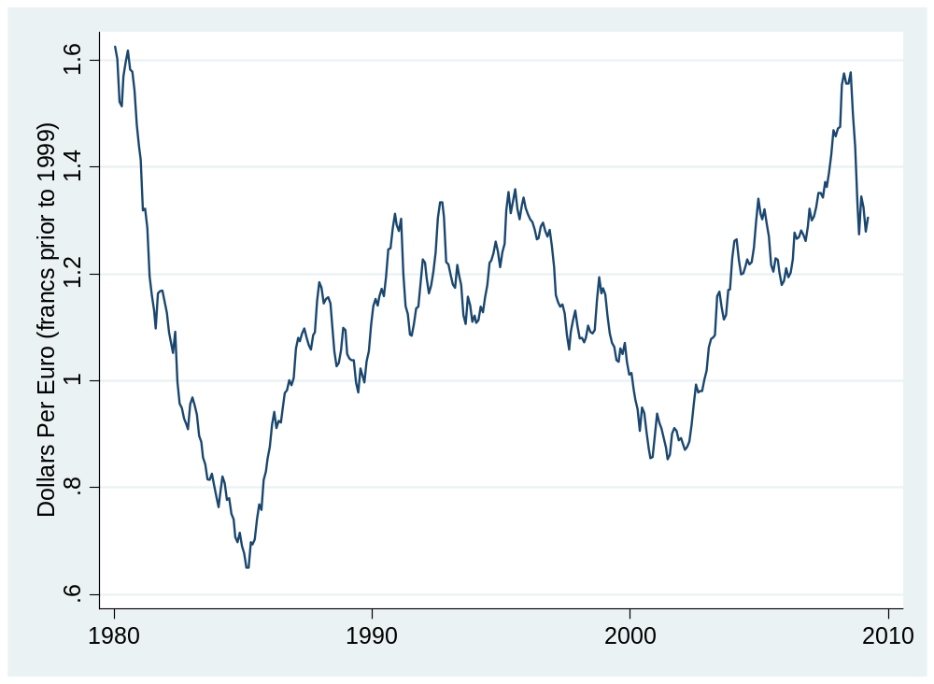
Dollars per euro (franc<1999)
Source: IMF or FRED.

Slide 4
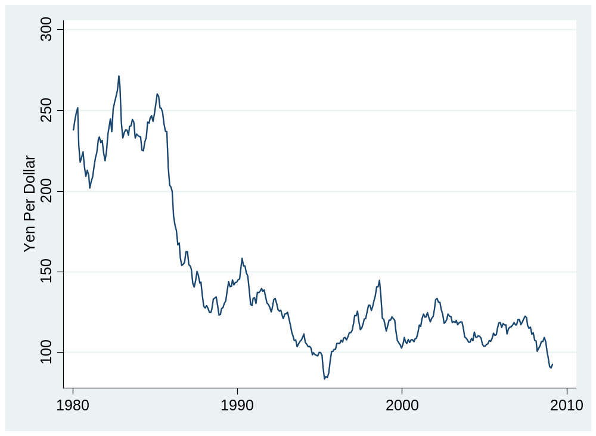
Yen per dollar
Source: IMF or FRED.

Slide 5
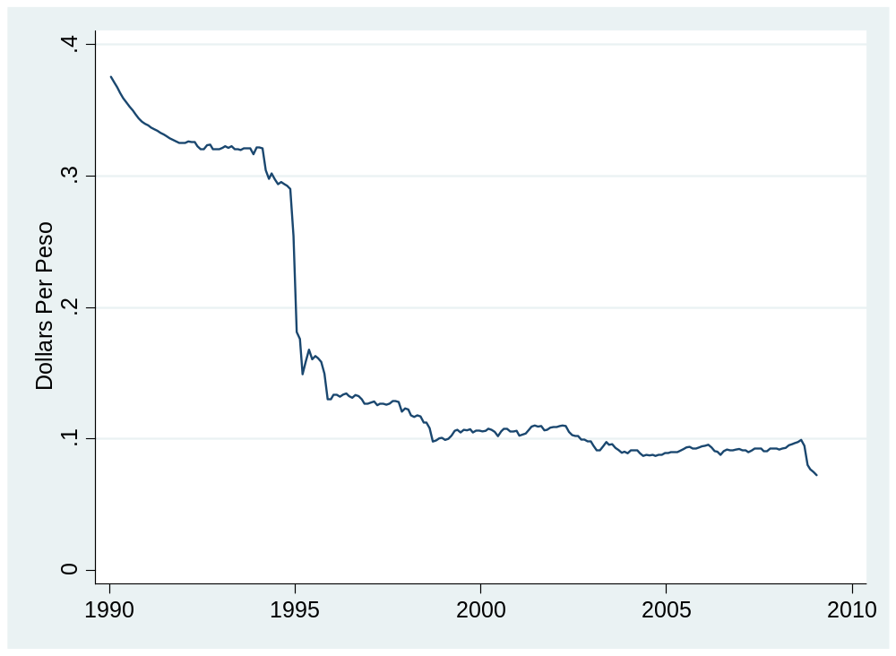
Dollars per peso
Source: IMF or FRED.

Slide 6
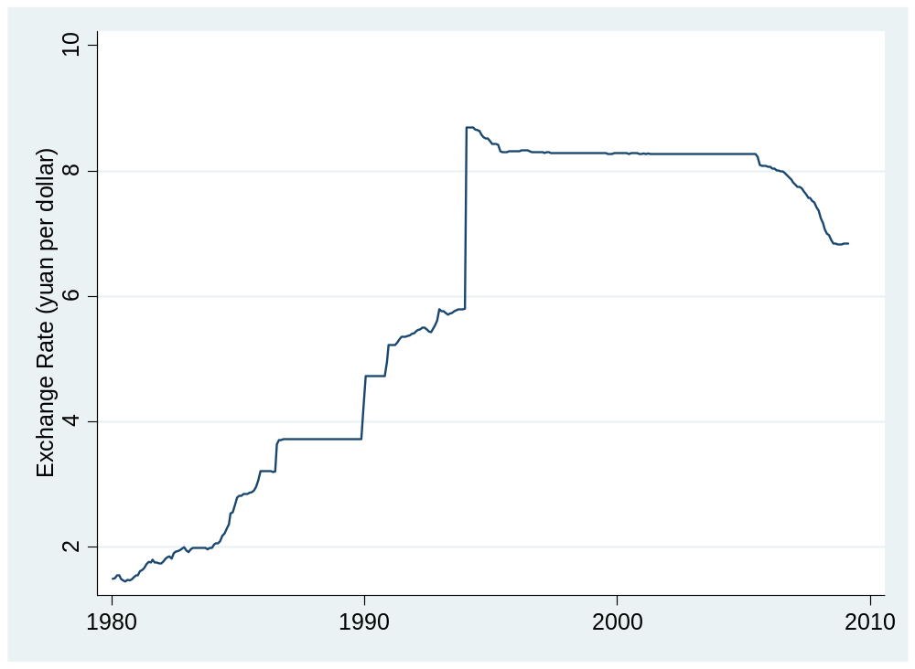
Renminbi per dollar
Source: IMF or FRED.

Slide 7
Quotes
Alan Greenspan:
  Having endeavored to forecast exchange rates for more than half a century, I have understandably developed significant humility about my ability in this area, a sentiment that I suspect many in this room share.
Link

Slide 8
Quotes
Bill Gross, PIMCO, 2004:
  If you think writing about the fortunes of the stock market is tricky, try getting your arms around currencies.
Link

Slide 9
Quotes
Warren Buffett, Letter to Shareholders, 2005:
  Berkshire owned about $21.4 billion of foreign exchange contracts at yearend, spread among 12 currencies. As I mentioned last year, holdings of this kind are a decided change for us. But the evidence grows that our trade [deficit] will put unremitting pressure on the dollar for many years to come.
Positions closed two years later at a loss.

Slide 10
Quotes
Anonymous hedge fund manager:
  From time to time, the dollar's been very weak; from time to time, it's very strong. … Over the very very long term, currency processes tend to be fairly stable and mean-reverting. So the dollar's very weak today, but that's no reason to believe the dollar's going to be weak forever or that, because it's weak today, it's going to get dramatically weaker tomorrow. [But] it's amazing how many brilliant investors have gotten so much egg on their face trying to trade the G-7 [currency] crosses.
Link

Slide 11
Plan of attack
Pictures and quotations ✓
Where we’re headed
Exchange rates and prices: the PPP “anchor”
Exchange rates and interest rates: the “carry trade”
What have we learned?

Slide 12
Where we’re headed
Govt Deficit
print money
Govt Debt
Trade Deficit
Inflation & FX
fear of default
Bank Failures
Crisis

Slide 13
Exchange rates and prices
Theory: purchasing power parity
  If prices are lower in the country X than country Y, the value of X’s currency will rise to reduce the difference.
What we’ll find
  Poor short-term indicator, but common long-run “anchor”

Slide 14
Exchange rates and prices
Define
  P = domestic price (measured in domestic currency)
  P* = foreign price (measured in foreign currency)
  s = spot exchange rate (domestic currency price of one unit of foreign currency)
  NB: rise in s = fall in value of domestic currency
Comparing prices
  Expressed in the same units, the prices are P and sP*
  If they’re different, is there an arbitrage opportunity?

Slide 15
Exchange rates and prices
Region | USD Price of Big Mac (Feb 09)
US | 3.54
Euro Zone | 4.38
Japan | 3.23
China | 1.83
Brazil | 3.45
Argentina | 3.30
Mexico | 2.30
Is dollar weak or strong? Expected to rise or fall?
Source: The Economist.

Slide 16
Exchange rates and prices
Look at “average” prices
  P = domestic price index (measured in domestic currency)
  P* = foreign price index (measured in foreign currency)
  s = spot exchange rate (domestic currency price of one unit of foreign currency)
Comparing prices
  Expressed in the same units, the prices are P and sP*
  If they’re different, is there an arbitrage opportunity?
  If they’re different, should we expect s to adjust?

Slide 17
Exchange rates and prices
Purchasing power parity
  Currency of the expensive country will fall in value
Definitions
  Nominal exchange rate: s
  Real exchange rate: RER = s P*/P
Literal version of PPP:
RER = 1 ⬄ sP* = P
Practical version: if RER >1 [and sP* > P], s will fall
Assessment: works eventually, but you need 5-10 years

Slide 18
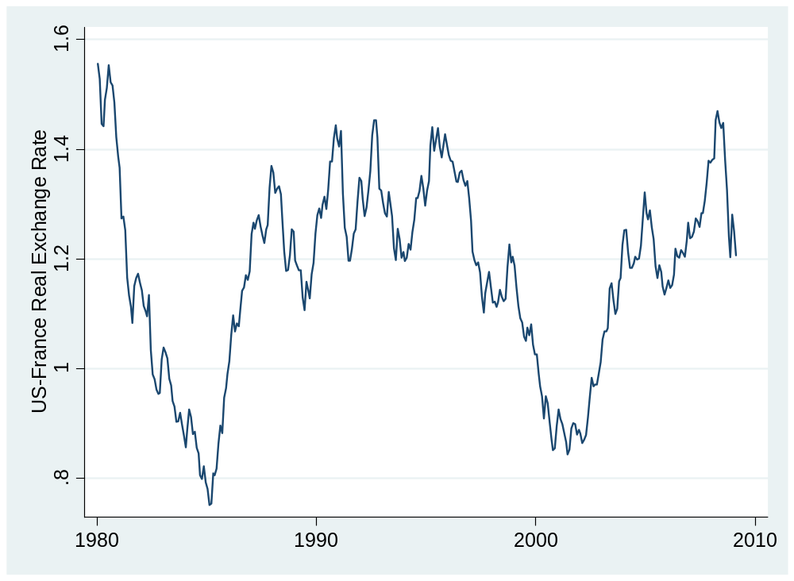
US/France real exchange rate
Source: IMF or FRED.

Slide 19
Dollars per euro (franc<1999)
Source: IMF or FRED.

Slide 20
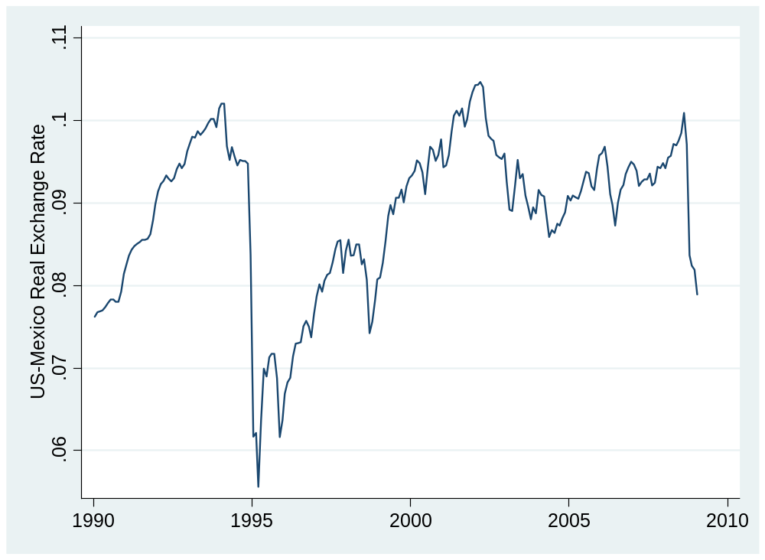
US/Mexico real exchange rate
Source: IMF or FRED.

Slide 21
Dollars per peso
Source: IMF or FRED.

Slide 22
Exchange rates and prices
Summary
Dollar v euro/franc
  Little variation in P*/P
  Movements in s are therefore similar to those in sP*/P
Dollar v peso
  Large movements in P*/P reflected in opposite movements in s
  Still lots of movement in RER left

Slide 23
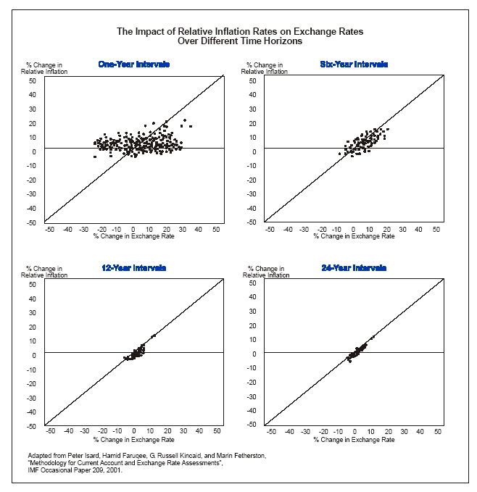
Exchange rates and prices
Source: Deutsche Bank guide.

Slide 24
Exchange rates and interest rates

Slide 25
Exchange rates and interest rates
Uncovered interest rate parity
  If interest rates differ between two countries, expected depreciation equates expected returns expressed in a common currency
  Eg, if USD interest is 2% and EURO interest is 3%, a 1% appreciation of the dollar would make up the difference
What we’ll find
  High interest rate currencies tend to go up, not down

Slide 26
Exchange rates and interest rates
Region | Money market rate
US | 0.50
Euro Zone | 1.50
Japan | 0.54
China | 1.22
India | 4.49
Brazil | 11.16
Mexico | 6.24
Why are rates different? Where would you invest?
Source: The Economist.

Slide 27
Exchange rates and interest rates
Definitions
  i = money market interest rate on domestic currency
  i* = money market interest rate on foreign currency
  s = spot exchange rate (domestic currency price of one unit of foreign currency)
Returns measured in domestic currency
  Domestic return: i
  Foreign return: i* + (s_{t+1}– s_{t})/s_{t}
Uncovered interest parity
i = i* + E (s_{t+1}– s_{t})/s_{t}

Slide 28
Exchange rates and interest rates
The “carry trade”
  Long position in high interest rate currency
  Short position in low interest rate currency
  Carry: positive net interest rate
  Risk: that currency will depreciate
Which currencies would you go short in now? Long?

Slide 29
Exchange rates and interest rates
The “carry trade”
  Long position in high interest rate currency
  Short position in low interest rate currency
  Carry: positive net interest rate
  Risk: that currency will depreciate
Question: is risk worth it, on average?
Uncovered interest parity answer: same return either way

Slide 30
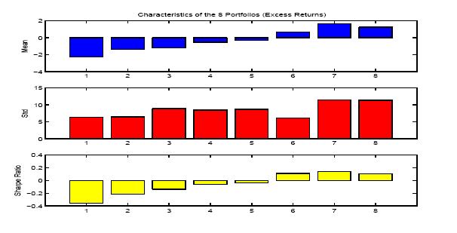
Exchange rates and interest rates
Portfolio strategy
  Rank currencies by short-term interest rate
  Sort into eight portfolios (low to high by rate)
  Compare excess returns in dollars
Source: Lustig and Verdelhan, NBER wp 11104.

Slide 31
Exchange rates and interest rates
Bottom line
  Currency changes do not compensate (on average) for interest differentials
  On average, high interest rate currencies appreciate
  Low R² (0.05 or so)
  Nevertheless: investments in high interest rate currencies have higher average returns (and some risk of currency fluctuations)

Slide 32
What have we learned?

Slide 33
Takeaways
Exchange rates remain largely inexplicable in short run
Nevertheless
  PPP is useful a long-term anchor
  The carry trade works – on average
FX volatility is a fact of life

Slide 34
After the break
Be prepared to discuss Group Project #6

Slide 35
The Global Economy
Fixed Exchange Rates
© NYU Stern School of Business
Notes:
And how they come unfixed!

Slide 36
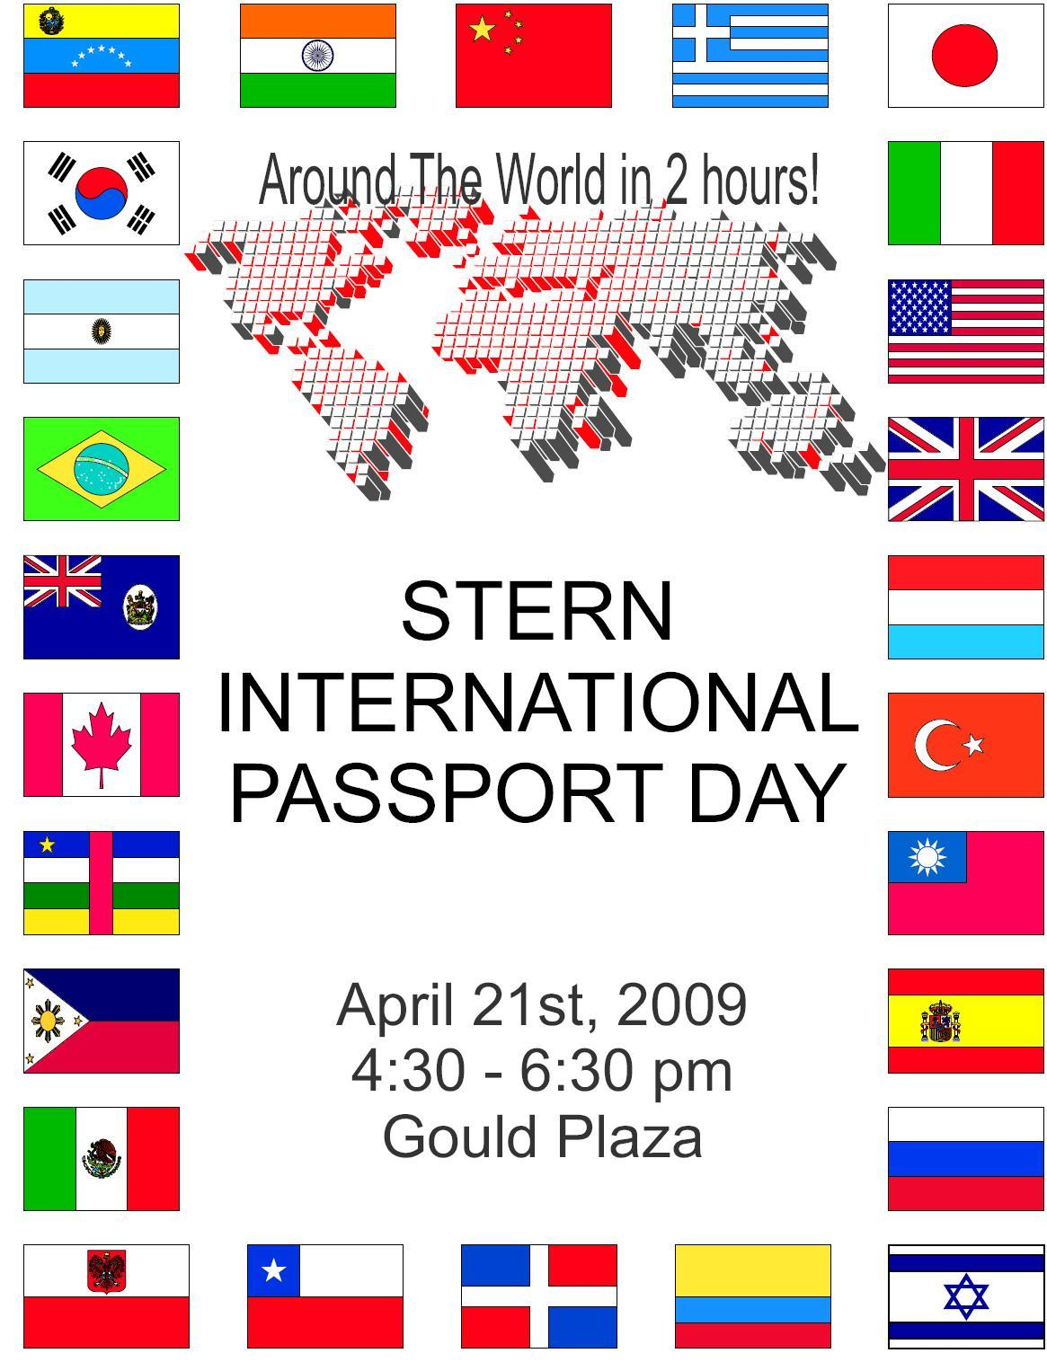
International passport day
Most attended event at Stern
26 countries represented
Food and Performances
FREE!!!!

Slide 37
Group Project #6
How does the ECB differ from the Federal Reserve?
How does ECB policy differ from Fed policy in general? Now?

Slide 38
Question
Is the Chinese renminbi “undervalued”?
  What does this mean?
  How might we tell?
Notes:
IMF paper: http://www.imf.org/external/pubs/ft/wp/2006/wp06220.pdf
PBOC balance sheet: http://www.pbc.gov.cn/diaochatongji/tongjishuju/gofile.asp?file=2004S2.htm

Slide 39
Plan of attack
Group Project #6 ✓
Question ✓
Exchange rate systems
China and Mexico
Reserve “mechanics”
China and Mexico again

Slide 40
Exchange rate systems
Convertibility
  We say a currency is convertible if people can trade it freely for foreign currency – and vice versa
Fixed and flexible exchange rates
  An exchange rate is flexible [or floating] if the market price is determined with little or no direct government intervention.
  An exchange rate is fixed [or pegged] if the central bank supports the official rate by buying or selling foreign currency
Examples?

Slide 41
China
Currency
  The government maintains what is referred to as a managed float of the renminbi, but which is in fact a peg to a basket of currencies.
  China continues to retain strict controls on its national currency and foreign currencies. The renminbi is convertible on the current account (that is, for trade, services and other similar payments) but remains non-convertible on the capital account (that is, for investments, borrowing and the like). It may not legally be used overseas.
Source: EIU, Country Finance Report.

Slide 42
Mexico
Currency
  Mexico has active currency and derivatives markets. Spot trading is done on the open market in Mexico, and transactions are closed at same-day, 24-hour and 48-hour periods.
  The central bank is itself a major currency trader. Mexico’s Exchange Rate Commission adheres to a free-floating exchange rate policy but, since October 2008, will actively intervene in the markets when the peso suffers a 2% or more depreciation in a 24 hour period.
Source: EIU, Country Finance Report.

Slide 43
Mexico
Financial inflows
  Substantial liberalization since 1996. Investments still limited to 49% in ﬁshing, shipping, publishing, telecommunications, and some ﬁnance. Some exemptions for subsidiaries from countries with Mexican trade agreements. Constitutional restrictions on real estate.
Financial outflows
  Capital moves freely across Mexican borders. State retirement saving plan invests primarily in high-grade local debt, but up to 10% can be foreign.
Source: EIU Country Finance Report.

Slide 44
Exchange rate systems
Common currency (Euro Zone, Panama)
Currency board (HK, Argentina < 00)
Fixed exchange rate (US < 71)
Crawling peg (Mexico < 95, China > 00)
Managed exchange rate (Brazil? Canada?)
Floating exchange rate (US?)
Increasing flexibility

Slide 45
Fixed exchange rates
How does central bank set the rate? [How is any price set? Think: EU’s CAP.]

Slide 46
Reserves
Holdings of foreign currency by central bank

Slide 47
Reminder: money supply mechanics
Treasury
Assets |  | Liabilities
 |  | Bonds | 200
Reminder
How does central bank increase money supply?
Decrease?
Central bank
Assets |  | Liabilities
Bonds | 20 | Money | 20
Households & firms (everyone else)
Assets |  | Liabilities
Money | 20
Bonds | 180

Slide 48
Reserve mechanics
Treasury
Assets |  | Liabilities
 |  | Bonds | 200
What are foreign exchange reserves?
How does bank maintain rate?
What if people buy foreign currency?
What if central bank runs out?
Central bank
Assets |  | Liabilities
Bonds | 10 | Money | 20
FX reserves | 10
Households & firms (everyone else)
Assets |  | Liabilities
Money | 20
FX | 50
Bonds | 190

Slide 49
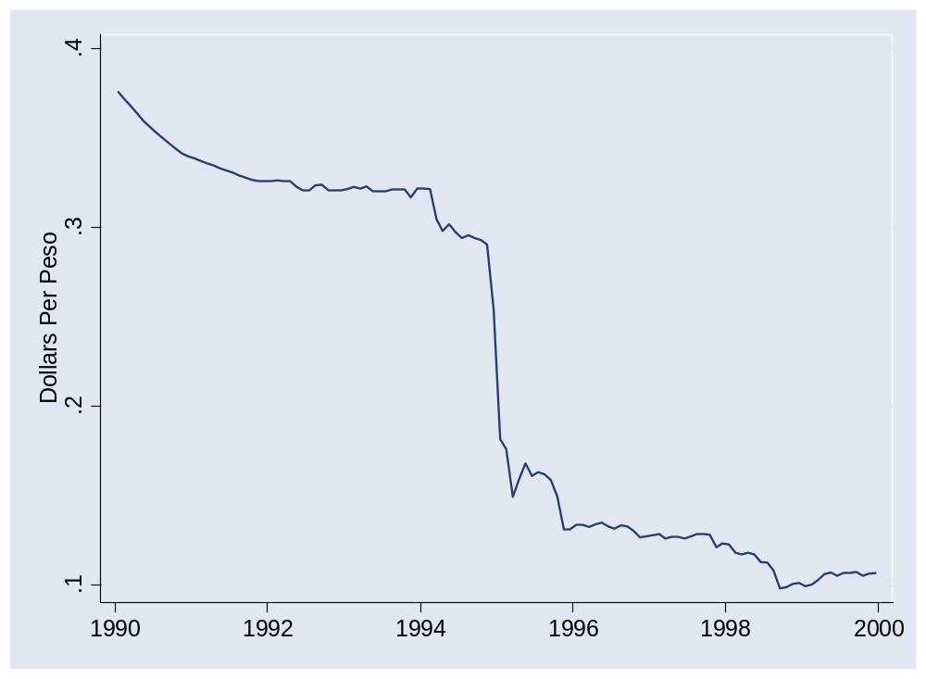
Mexico in 1994
What happened here?

Slide 50
Reserve mechanics
Treasury
Assets |  | Liabilities
 |  | Bonds | 200
What if people buy foreign currency?
Central bank
Assets |  | Liabilities
Bonds | 10 | Money | 20
FX reserves | 10
Households & firms (everyone else)
Assets |  | Liabilities
Money | 20
FX | 50
Bonds | 190

Slide 51
Reserve mechanics
Treasury
Assets |  | Liabilities
 |  | Bonds | 200
How does buying FX affect money supply?
How can we offset this impact?
We call this “sterilization”
Central bank
Assets |  | Liabilities
Bonds | 10 | Money | 20
FX reserves | 10
Households & firms (everyone else)
Assets |  | Liabilities
Money | 20
FX | 50
Bonds | 180

Slide 52
China
Could it run out of reserves?

Slide 53
Reserve mechanics
Treasury
Assets |  | Liabilities
 |  | Bonds | 200
What if PBOC
Buys FX
Sterilizes?
Are reserves “wealth”?
What is its major risk?
Central bank
Assets |  | Liabilities
Bonds | 10 | Money | 20
FX reserves | 10
Households & firms (everyone else)
Assets |  | Liabilities
Money | 20
FX | 50
Bonds | 180

Slide 54
China
Is the renminbi “undervalued”?
  What does this mean?
  How might we tell?
Notes:
IMF paper: http://www.imf.org/external/pubs/ft/wp/2006/wp06220.pdf
PBOC balance sheet: http://www.pbc.gov.cn/diaochatongji/tongjishuju/gofile.asp?file=2004S2.htm

Slide 55
Renminbi per dollar
Source: IMF or FRED.

Slide 56
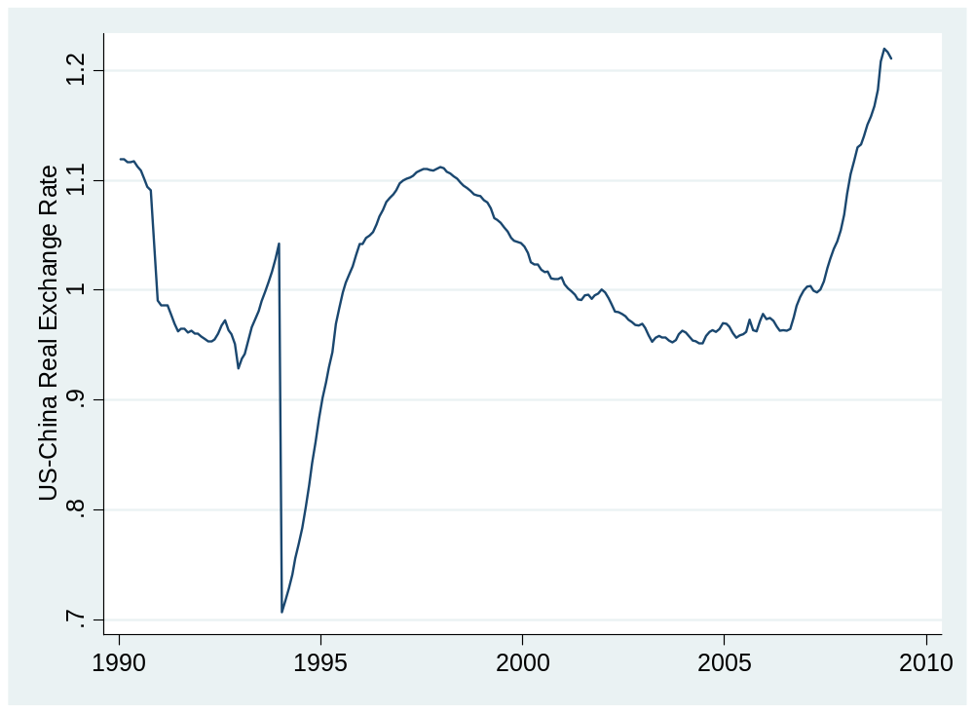
US/China real exchange rate
Source: IMF or FRED.

Slide 57
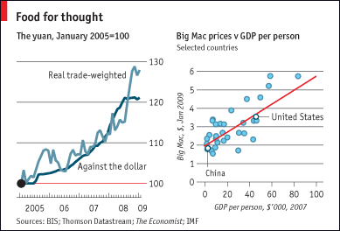
Chinese renminbi
The Economist Feb 5 09:
Source: The Economist, link.

Slide 58
China
Zhou Xiaochuan, PBOC governor, Mar 23 09:
  China's central bank chief proposed a sweeping overhaul of the global monetary system, outlining how the dollar could eventually be replaced as the world's main reserve currency by the Special Drawing Right (SDR).
Krugman
  China long dollars, needs an exit plan
Questions
  What the US interest in this?
  China’s?
Notes:
IMF paper: http://www.imf.org/external/pubs/ft/wp/2006/wp06220.pdf
PBOC balance sheet: http://www.pbc.gov.cn/diaochatongji/tongjishuju/gofile.asp?file=2004S2.htm

Slide 59
Takeaways
Fixed exchange rates require “support”
  Buy and sell at official price [limited by “reserves”]
  Or restrict “convertibility”
They also blow up on occasion

Slide 60
Heineken USA
Prospects for dollar/euro rate
Possibility of 10% move
How should you respond to strong euro?
Overall currency strategy

