Slide 1

The Global Economy
Fixed Exchange Rates
© NYU Stern School of Business
Notes:
Why do countries fix exchange rates?
Usually talk about disasters, today we’ll start with China

Slide 2
Is the RMB “undervalued”?
How can we tell?
What’s the answer?
Does Schumer have a complaint or is he just whining?

Slide 3
Recommended changes ??
Stick to line: It depends.
Flesh out Greece and Auz examples, show histories

Slide 4
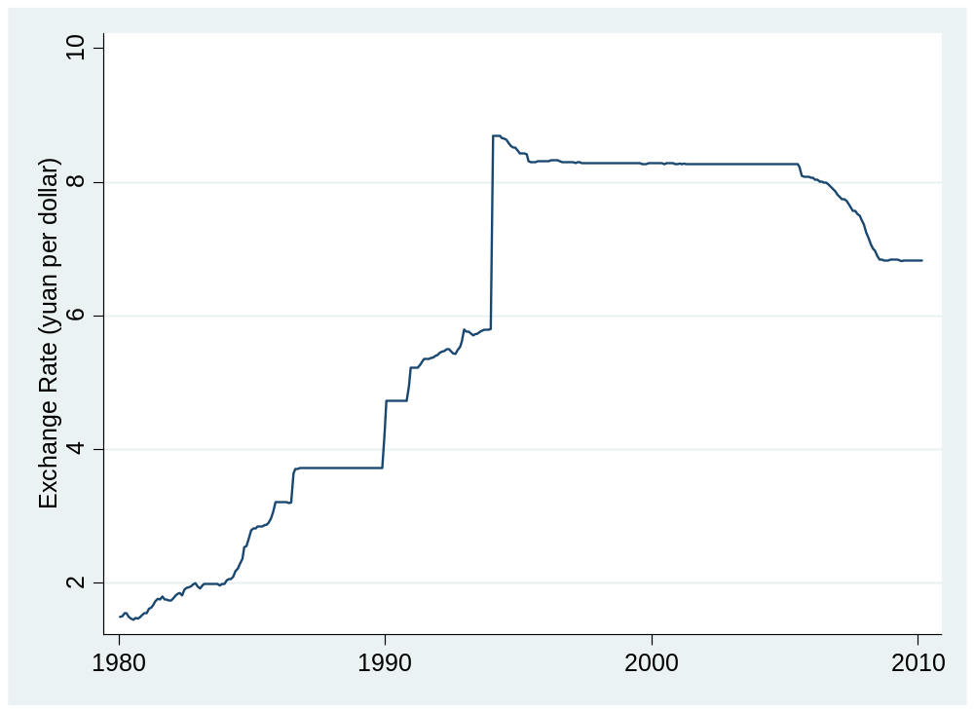
Is the RMB “undervalued”?
Source: IMF or FRED.

Slide 5
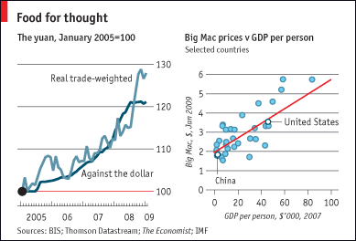
Is the RMB “undervalued”?
The Economist Feb 5 09:
Source: The Economist, link.

Slide 6
Is the RMB “undervalued”?
Modest undervaluation relative to PPP seems likely [but we see that in lots of countries]
Fixed rate, enormous reserves provoke questions
Politics?
If currency floats, will it rise or fall?

Slide 7
Stan Fischer
First Deputy Managing Director, International Monetary Fund, 2001:
  Each of the major international capital market-related crises since 1994—Mexico, in 1994, Thailand, Indonesia and Korea in 1997, Russia and Brazil in 1998, and Argentina and Turkey in 2000—has in some way involved a fixed or pegged exchange rate regime. At the same time, countries that did not have pegged rates—among them South Africa, Israel in 1998, Mexico in 1998, and Turkey in 1998—avoided crises of the type that afflicted emerging market countries with pegged rates.
Former Professor of Economics at MIT, currently governor of the Bank of Israel
Notes:
http://www.imf.org/external/np/speeches/2001/010601A.HTM

Slide 8
Plan of attack
RMB mini-case ✓
The idea
Exchange rate systems
China and Mexico
Reserve “mechanics”
China and Mexico again
Crisis indicators

Slide 9
The idea
Countries sometimes buy and sell foreign currencies to influence their exchange rates.
Open questions
  Why?
  Does it work?

Slide 10
Exchange rate systems
Convertibility
  We say a currency is convertible if people can trade it freely for foreign currency – and vice versa
Fixed and flexible exchange rates
  An exchange rate is flexible [or floating] if the market price is determined with little or no direct government intervention.
  An exchange rate is fixed [or pegged] if the central bank supports the official rate by buying or selling foreign currency
Examples?

Slide 11
China
Currency
  The government maintains what is referred to as a managed float of the renminbi, but which is in fact a peg to a basket of currencies.
  China continues to retain strict controls on its national currency and foreign currencies. The renminbi is convertible on the current account (that is, for trade and similar payments) but remains non-convertible on the capital account (that is, for investments, borrowing and the like). It may not legally be used overseas.
Source: EIU, Country Finance Report.

Slide 12
Mexico
Currency
  Mexico has active currency and derivatives markets. Spot trading is done on the open market in Mexico, and transactions are closed at same-day, 24-hour and 48-hour periods.
  The central bank is itself a major currency trader. Mexico’s Exchange Rate Commission adheres to a free-floating exchange rate policy but, since October 2008, will actively intervene in the markets when the peso suffers a 2% or more depreciation in a 24 hour period.
Source: EIU, Country Finance Report.

Slide 13
Mexico
Financial inflows
  Substantial liberalization since 1996. Investments still limited to 49% in ﬁshing, shipping, publishing, telecommunications, and some ﬁnance. Some exemptions for subsidiaries from countries with Mexican trade agreements. Constitutional restrictions on real estate.
Financial outflows
  Capital moves freely across Mexican borders. State retirement saving plan invests primarily in high-grade local debt, but up to 10% can be foreign.
Source: EIU Country Finance Report.

Slide 14
Exchange rate systems
Common currency (Euro Zone, Panama)
Currency board (HK, Argentina < 00)
Fixed exchange rate (US < 71)
Crawling peg (Mexico < 95, China > 05)
Managed exchange rate (Brazil? Canada?)
Floating exchange rate (US?)
Increasing flexibility

Slide 15
Fixed exchange rates
How does central bank set the rate? [How is any price set? Think: EU’s CAP.]

Slide 16
Reserves
Holdings of foreign currency by central bank

Slide 17
Reminder: money supply mechanics
Treasury
Assets |  | Liabilities
 |  | Bonds | 200
Reminder
How does central bank increase money supply?
Decrease?
Central bank
Assets |  | Liabilities
Bonds | 20 | Money | 20
Households & firms (everyone else)
Assets |  | Liabilities
Money | 20
Bonds | 180

Slide 18
Reserve mechanics
Treasury
Assets |  | Liabilities
 |  | Bonds | 200
What are foreign exchange reserves?
How does bank maintain rate?
What if people buy foreign currency?
What if central bank runs out?
Central bank
Assets |  | Liabilities
Bonds | 10 | Money | 20
FX reserves | 10
Households & firms (everyone else)
Assets |  | Liabilities
Money | 20
FX | 50
Bonds | 190

Slide 19
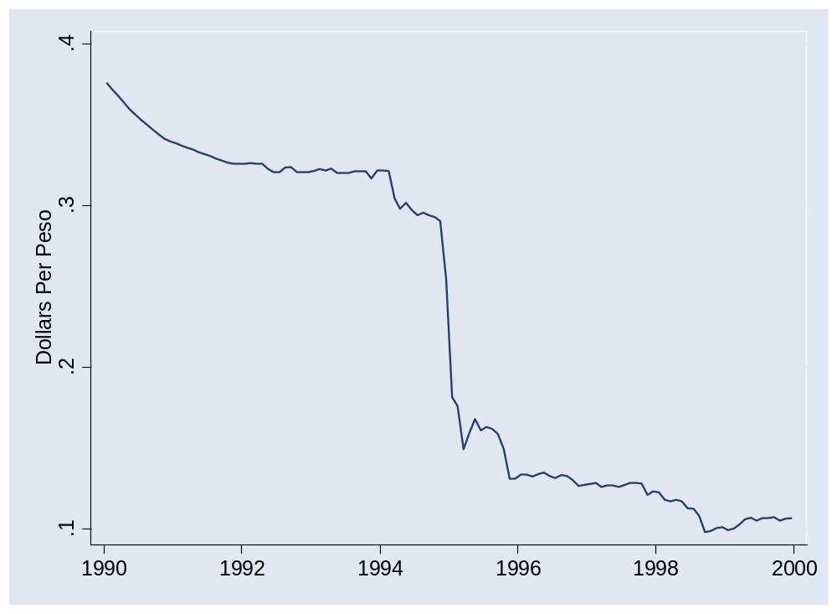
Mexico in 1994
What happened here?

Slide 20
Reserve mechanics
Treasury
Assets |  | Liabilities
 |  | Bonds | 200
Currency board: start with enough FX to cover the entire money supply
Why might this work?
Central bank
Assets |  | Liabilities
Bonds | 10 | Money | 20
FX reserves | 10
Households & firms (everyone else)
Assets |  | Liabilities
Money | 20
FX | 50
Bonds | 180

Slide 21
Reserve mechanics
Treasury
Assets |  | Liabilities
 |  | Bonds | 200
What if people buy foreign currency – what happens to reserves?
What happens to money supply?
How can we offset this impact? [“sterilization”]
Central bank
Assets |  | Liabilities
Bonds | 10 | Money | 20
FX reserves | 10
Households & firms (everyone else)
Assets |  | Liabilities
Money | 20
FX | 50
Bonds | 190

Slide 22
China
Could it run out of reserves?

Slide 23
Reserve mechanics
Treasury
Assets |  | Liabilities
 |  | Bonds | 200
What if people sell foreign currency to PBC?
And it sterilizes?
How does PBC finance this?
What risk is PBC exposed to?
Central bank
Assets |  | Liabilities
Bonds | 10 | Money | 20
FX reserves | 10
Households & firms (everyone else)
Assets |  | Liabilities
Money | 20
FX | 50
Bonds | 180

Slide 24
Crisis indicators
Add to our list
  Fixed exchange rate system
  Overvalued exchange rate
  Foreign exchange reserves

Slide 25
Takeaways
Fixed exchange rates require government support
  Buy and sell at official price [limited by “reserves”]
  Or restrict “convertibility”
Common transactions
  Intervention: purchases and sales of foreign currency
  Sterilization: open market purchase or sale to undo impact of intervention on money supply

Slide 26
After the break
Be prepared to discuss Group Project #7

Slide 27
China
Zhou Xiaochuan, PBC governor, Mar 23 09:
  China's central bank chief proposed a sweeping overhaul of the global monetary system, outlining how the dollar could eventually be replaced as the world's main reserve currency by the Special Drawing Right (SDR).
Krugman
  China long dollars, needs an exit plan
Questions
  What the US interest in this?
  China’s?
Notes:
IMF paper: http://www.imf.org/external/pubs/ft/wp/2006/wp06220.pdf
PBOC balance sheet: http://www.pbc.gov.cn/diaochatongji/tongjishuju/gofile.asp?file=2004S2.htm

Slide 28
The Global Economy
International Capital Flows
© NYU Stern School of Business
Notes:
Open spreadsheet
History of international capital flows
25 years ago lots of flows, but
From Rich to poor
mostly debt
Some to govts
Our concern was would they pay us back
Compare:
Mexico open to equity claims
China too
Governments less involved
Our concern is that they’re buying us!
Two issues today
US borrowing: why? Is it bad?
SWFs: why? Are they bad?

Slide 29
Group Project #7
Analysis: US budget issues
Investment recommendation: buy or sell US Treasuries?

Slide 30
The ideas
Trade and current account deficits reflect international capital inflows: foreign purchases of local assets.
Are deficits good or bad? It depends.

Slide 31
Larry Summers (vintage 2005)
Do you like this one?
  The most serious problem we have faced in the last fifty years is that of low national saving and resulting dependence on foreign capital. ... The current account deficit has widened sharply over the last four years ... to an unprecedented rate of 5% of net national product.
Or this one?
  Finance ministers of countries with significant current account deficits say: “We live in a country that capital is trying to get into. Would you rather live in a country that capital is trying to get out of?”

Slide 32
Martin Wolf
Financial Times, May 4 11:
  The view I have derived from the last three decades of experience is that it is almost an iron rule that, whenever countries run really large and sustained current account deficits (more than 5 per cent of GDP, or so), they end up in financial crisis. ... That is what happened to the Latin American countries in the debt crisis that erupted in 1982 and to the Asian countries in the crisis that erupted in 1997. It is also what happened in the current financial crisis, whose epicentre has been in countries that ran large current account deficits, notably, the US, Spain, UK and a number of countries in central and eastern Europe.

Slide 33
Where we’re headed
Govt Deficit
print money
Govt Debt
Trade Deficit
Inflation & FX
fear of default
Bank Failures
Crisis

Slide 34
Plan of attack
Group Project #7 ✓
The ideas, Larry Summers, where we’re headed ✓
Capital flows (how to think about them)
Balance of payments (how the data works)
Net foreign asset (NFA) dynamics
Greece again
Crisis indicators

Slide 35
Capital flows
What are they?
Where do they come from?
What do they tell us?

Slide 36
Capital flows
Industries
  Industry A (software): growing fast
  Industry B (steel): not growing
  Where will capital markets direct funds?
  Is that a good thing?

Slide 37
Capital flows
Governments
  Suppose one chooses to spend more than current tax revenue
  How would it finance its deficit?
  Would capital markets support this?
  Is that a good thing?

Slide 38
Capital flows
Individual
  ??? Win lottery
  Would capital markets support this?
  Is that a good thing?

Slide 39
Capital flows
Countries
  When might capital flow from one country to another?
  Would capital markets support this?
  Is that a good thing?

Slide 40
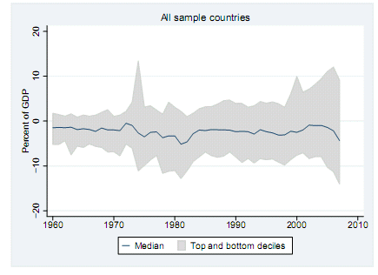
Capital flows
Notes:
http://www.imf.org/external/pubs/ft/wp/2009/wp09276.pdf

Slide 41
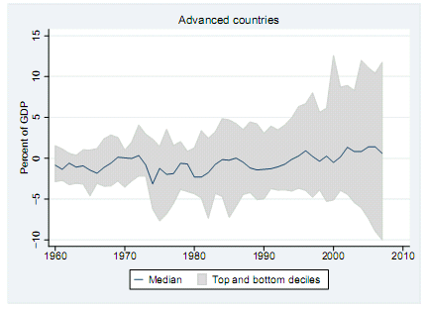
Capital flows
Notes:
http://www.imf.org/external/pubs/ft/wp/2009/wp09276.pdf

Slide 42
Balance of payments
These are almost the same
  Trade balance (“merchandise”)
  Net exports (+ services)
  Current account balance (+ net income flows, incl interest)
Call me if you ever need to know the difference

Slide 43
Balance of payments
How is a current account deficit financed?
  “Inflow” of capital from abroad
  Equivalently: sell assets to rest-of-world (“borrow”)
  We say the current account is mirrored by an equal and opposite “capital and financial account”
  That’s why we say balance of payments

Slide 44
Balance of payments
What does a capital inflow finance?
Remember:
S = Y – C – G = I + NX
[NB: we’re ignoring the difference between CA and NX here – keeps things simple without missing the point.]
Does it matter where the capital goes?

Slide 45
Balance of payments
BOP = CA + Capital/Financial Flows = 0
Country 1
CA > 0
Goods
Country 2
CA < 0
Capital
If Country 2 runs a current account deficit:
There is a capital “inflow” for Country 2, “outflow” for Country 1.
Notes:
Say: NX = CA
Plus: focus on goods

Slide 46
Balance of payments
Are trade and current account deficits bad? (Answer?)
Lawson doctrine
  Capital inflows ok if they finance private investment and consumption
  Not if they finance government deficits
Related equations
S = I + NX
S_{p} + S_{g} = I + NX
Trade deficit can finance: high I, low S_{p}, low S_{g}

Slide 47
Net foreign assets
International capital markets
  Countries own claims on each other
  Net position (net foreign assets or NFA):
  NFA = Claims on Foreign Countries – Foreign Claims on Us
Borrowers and lenders
  If NFA>0, country is net creditor (lender)
  If NFA<0, country is net debtor (borrower)
Two terms for the same thing
  Net foreign assets (NFA)
  Net international investment position (Net IIP)

Slide 48
US IIP (2007, USD, billions)
Category | Assets | Liabilities
Direct investment | 3333 | 2423
Portfolio investment | 7048 | 10,298
Other | 6982 | 7361
Reserves | 277 | –
Total | 17,640 | 20,082
Net IIP (=NFA) | –2,442
Source: IMF, International Financial Statistics.

Slide 49
China IIP (2007, USD, billions)
Category | Assets | Liabilities
Direct investment | 108 | 1266
Portfolio investment | 239 | 742
Other | 406 | 381
Reserves | 1535 | –
Total | 2,288 | 1,535
Net IIP (=NFA) | +753
Source: IMF, International Financial Statistics.

Slide 50
NFA dynamics
What does a current account or trade deficit mean?
Is it bad?

Slide 51
NFA dynamics
Current account deficits
  Decrease NFA
  Decrease net interest receipts
Analogy with firms
  Which firms raise the most money in capital markets?
  Is this a good analogy?

Slide 52
NFA dynamics
NFA dynamics
  Quick look at NFA/Y: how fast is it growing, and why?
  Missing: equity claims, asset revaluations…
Changes in NFA:
NFA_{t} = NFA_{t-1} + CA_{t} + Net Asset Revaluations
NFA_{t} ≈ (1+i)NFA_{t-1} + NX_{t}
Comments
  NX is like the primary deficit from fiscal policy [and CA the total deficit]
  Different if claims are equity or foreign-denominated
  Note different sign convention from government debt
Reminder: CA includes interest payments!

Slide 53
NFA dynamics
NFA and Y
NFA_{t} = (1+i) NFA_{t-1} + NX_{t}
Y_{t} = (1+g) Y_{t-1}
Change in NFA/Y
NFA_{t}/Y_{t} = [(1+i)/(1+g)] (NFA_{t-1}/Y_{t-1}) + NX_{t}/Y_{t}
Typically i>g
  Negative NFA will tend to get worse on its own
  Eventually debt service overwhelms the economy [i NFA]
  Something must change – but what?

Slide 54
NFA dynamics: Greece
Current numbers
  NFA/Y = –80% (crude estimate based on IMF data)
  NX/Y = –8.6% (EIU forecast)
  i = 6.5%
  g = – 1% (– 2.5+1.5)
How is NFA/Y changing? Why?

Slide 55
NFA dynamics: India
Current numbers
  NFA/Y = –15%
  NX/Y = –1% (EIU forecast)
  i = 8%
  g = 18.4% (7.7+10.7)
How is NFA/Y changing? Why?

Slide 56
NFA dynamics: Australia
Current numbers
  NFA/Y = –50%
  NX/Y = –3% (EIU forecast)
  i = 5%
  g = 5% (2.9+2.1)
How is NFA/Y changing? Why?

Slide 57
Australia IIP (2008, USD, billions)
Category | Assets | Liabilities
Direct investment | 196 | 271
Portfolio investment | 259 | 647
Other | 214 | 285
Reserves | 33 | –
Total | 703 | 1,202
Net IIP (=NFA) | –499
Source: IMF, International Financial Statistics.

Slide 58
NFA dynamics: US
Current numbers
  NFA/Y = –20% (approximate)
  NX/Y = –3% (EIU forecast)
  i = 3.8%
  g = 5.3% (3.1+2.2)
How is NFA/Y changing? Why?

Slide 59
Is the US in trouble?
Choose one:
  This US current account and trade deficit is a sign of serious trouble
  The US current account deficit is not a big deal
  Both of the above
  None of the above

Slide 60
Warren Buffett
Annual letter to shareholders, 2006:
  As time passes, and as claims against us grow, we own less and less of what we produce. ... Should we continue to run current account deficits comparable to those now prevailing, ... our US ‘family’ will be delivering [a substantial fraction of] its annual output to the rest of the world simply as tribute for the overindulgences of the past.

Slide 61
Stephen Roach
Morgan Stanley Global Economic Forum:
  Lacking in domestic saving, America must import foreign saving ... to keep growing at acceptable rates. And so America must then run massive and ever-widening current account deficits to attract that foreign capital. ... America now requires an average of $2.9 billion of capital inflows each and every business day to keep the magic going.

Slide 62
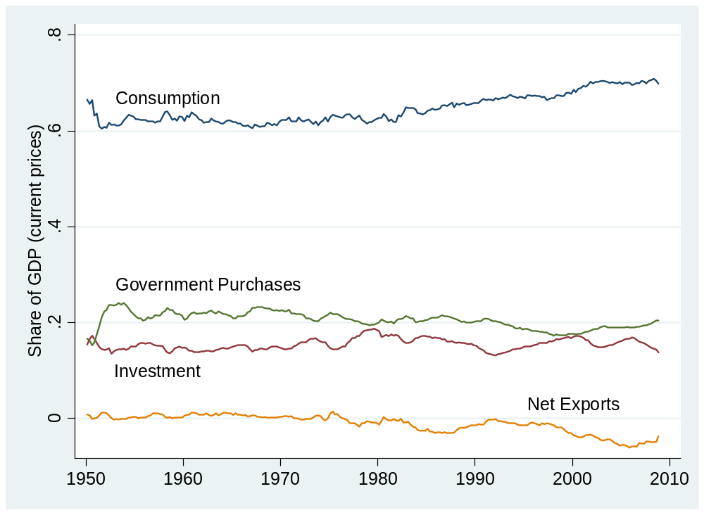
US flows
Source: BEA.

Slide 63
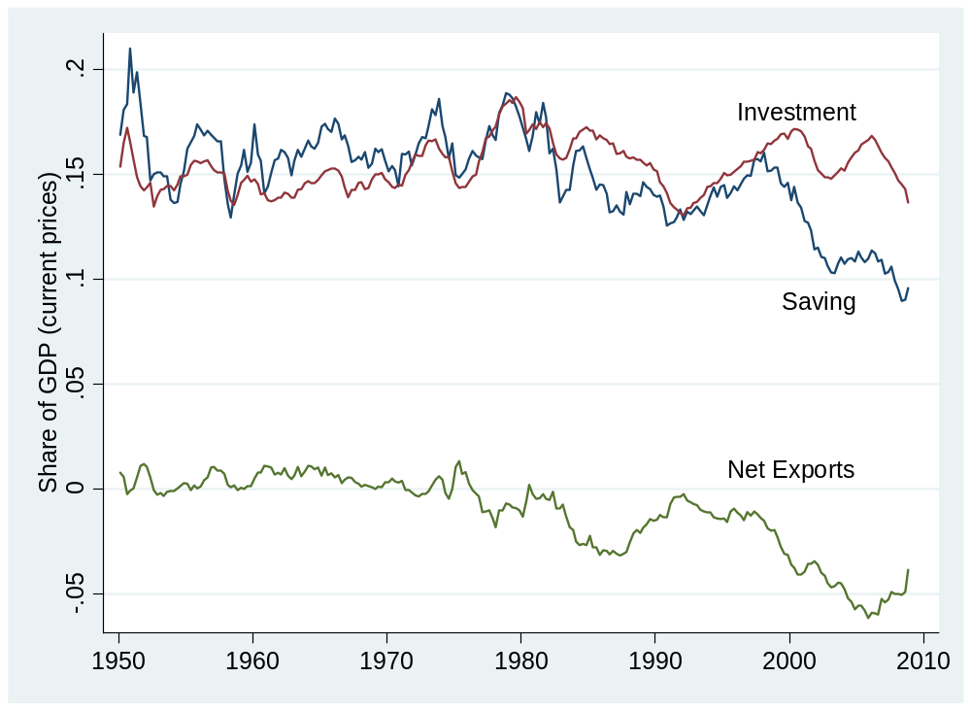
US flows
Source: BEA.

Slide 64
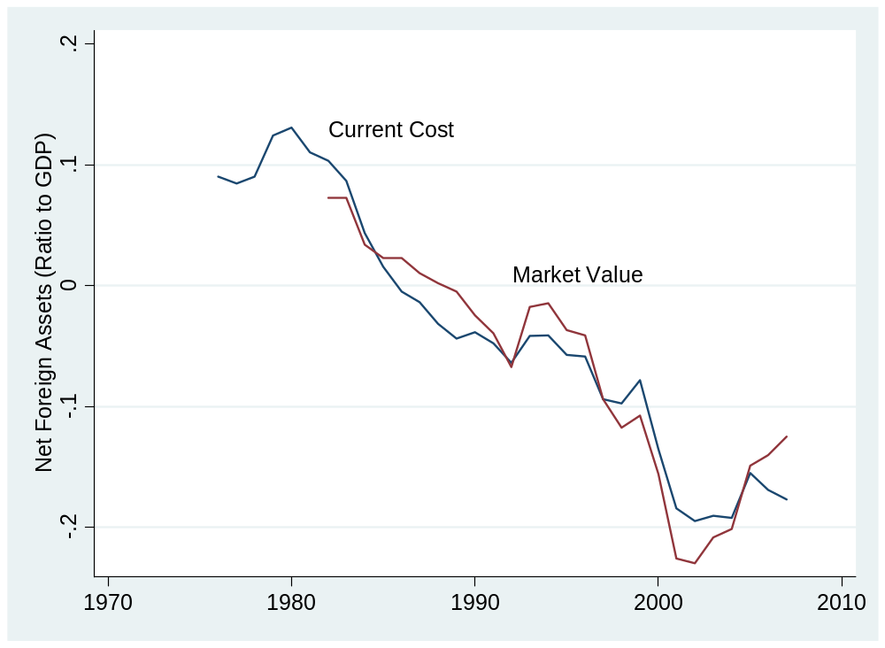
US net foreign assets
Source: BEA.

Slide 65
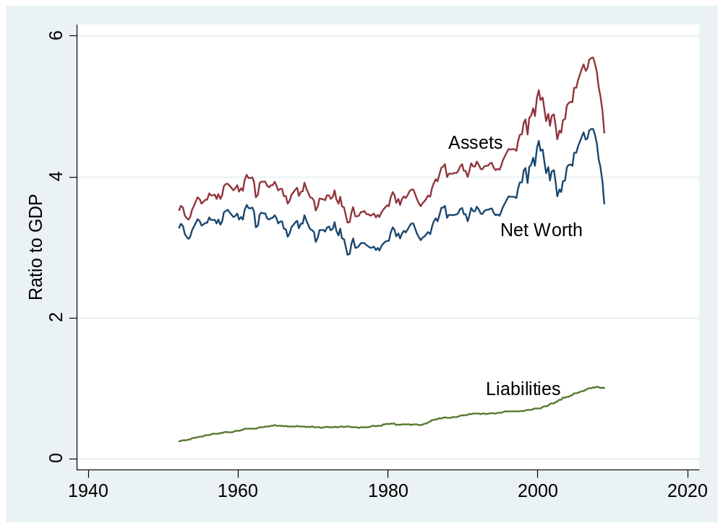
US household net worth
Source: Federal Reserve, Flow of Funds.

Slide 66
Is the US in trouble?
Choose one:
  We’re in trouble
  We’re fine
  Both of the above

Slide 67
Is the US in trouble?
Facts
  Notable trade and current account deficits
  Consumption has risen as fraction of GDP, saving has fallen
  Net foreign asset position negative
  But small relative to household net worth
My take
  Yes, but not because of the trade deficit
  Numbers not big enough to matter – yet!

Slide 68
Crisis indicators
Add to our list
  Trade and current account deficit
  Foreign debt
  Esp if debt not equity, government not private, foreign denominated

Slide 69
Takeaways
Trade/current-account deficits equal capital inflows
  This is accounting, not theory
They reflect either high investment or low saving
Are deficit countries bad bets?
  It depends: there’s greater risk if deficits finance consumption or government purchases or take the form of debt

